Slide 1
Topic 7:
Latches and Flip-flop

Slide 2
Introduction
Memory Elements
Pulse-Triggered Latch
  S-R Latch
  Gated S-R Latch
  Gated D Latch
Edge-Triggered Flip-flops
  S-R Flip-flop
  D Flip-flop
  J-K Flip-flop
  T Flip-flop
Asynchronous Inputs

Slide 3
Introduction
A sequential circuit consists of a feedback path, and employs some memory elements.
Combinational outputs
Memory outputs
Combinational logic
Memory elements
External inputs
Sequential circuit = Combinational logic + Memory Elements

Slide 4
Introduction
There are two types of sequential circuits:
  synchronous: outputs change only at specific time
  asynchronous: outputs change at any time
Multivibrator: a class of sequential circuits. They can be:
  bistable (2 stable states)
  monostable or one-shot (1 stable state)
  astable (no stable state)
Bistable logic devices: latches and flip-flops.
Latches and flip-flops differ in the method used for changing their state.

Slide 5
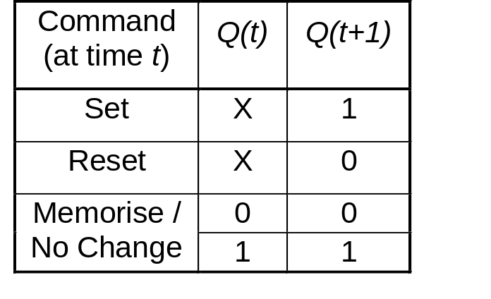
Memory Elements
Memory element: a device which can remember value indefinitely, or change value on command from its inputs.
Characteristic table:
Memory element
Q
command
stored value
Q(t): current state
Q(t+1) or Q⁺: next state

Slide 6
Memory Elements
Memory element with clock. Flip-flops are memory elements that change state on clock signals.
Clock is usually a square wave.
Memory element
Q
command
stored value
clock
Positive pulses
Positive edges
Negative edges

Slide 7
Memory Elements
Two types of triggering/activation:
  pulse-triggered
  edge-triggered
Pulse-triggered
  latches
  ON = 1, OFF = 0
Edge-triggered
  flip-flops
  positive edge-triggered (ON = from 0 to 1; OFF = other time)
  negative edge-triggered (ON = from 1 to 0; OFF = other time)

Slide 8
S-R Latch
Complementary outputs: Q and Q'.
When Q is HIGH, the latch is in SET state.
When Q is LOW, the latch is in RESET state.
For active-HIGH input S-R latch (also known as NOR gate latch),
R=HIGH (and S=LOW)  RESET state
S=HIGH (and R=LOW)  SET state
both inputs LOW  no change
both inputs HIGH  Q and Q' both LOW (invalid)!

Slide 9
S-R Latch
For active-LOW input S'-R' latch (also known as NAND gate latch),
R'=LOW (and S'=HIGH)  RESET state
S'=LOW (and R'=HIGH)  SET state
both inputs HIGH  no change
both inputs LOW  Q and Q' both HIGH (invalid)!
Drawback of S-R latch: invalid condition exists and must be avoided.

Slide 10
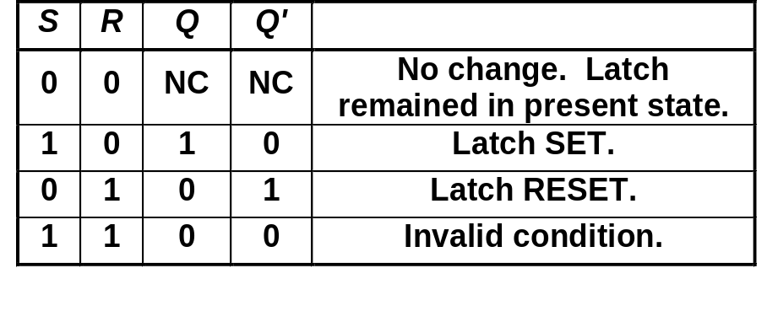
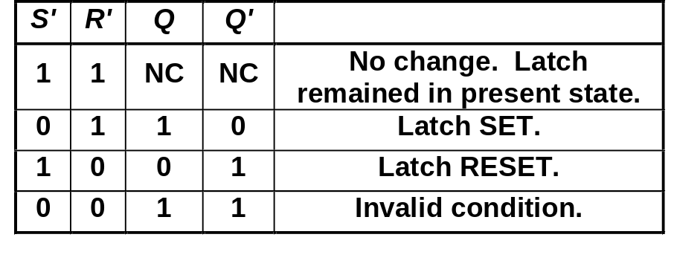
S-R Latch
Characteristics table for active-high input S-R latch:
Characteristics table for active-low input S'-R' latch:
S
R
Q
Q'
S
R
Q
Q'

Slide 11
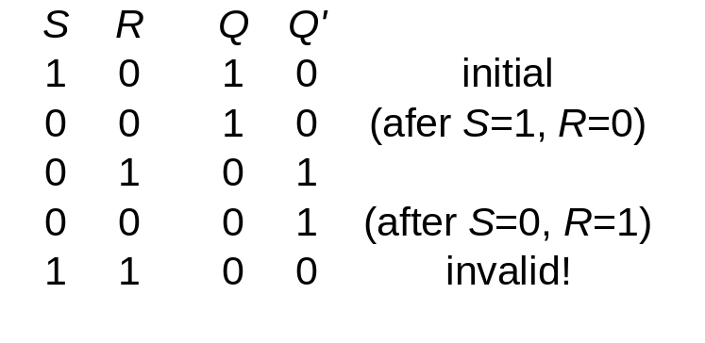
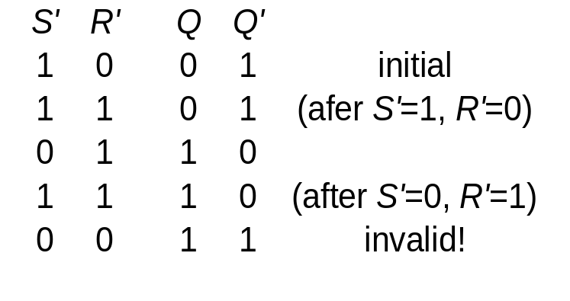
S-R Latch
Active-HIGH input S-R latch
Active-LOW input S’-R’ latch
1
0
1
0
0
R
1
1
0
0
Q
0
Q'
0
0
1
1
1
0
0
0
0
1
S
S'
Q
R'
Q'
S'
Q
R'
Q'

Slide 12
Gated S-R Latch
S-R latch + enable input (EN) and 2 NAND gates → gated S-R latch.
S
Q
S
EN
R
Q
Q'
EN
Q'
R

Slide 13
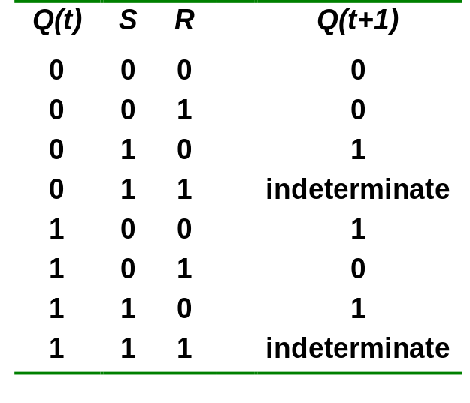
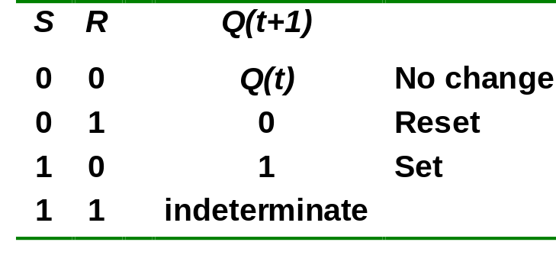
Gated S-R Latch
Outputs change (if necessary) only when EN is HIGH.
Under what condition does the invalid state occur?
Characteristic table:
EN=1
Q(t+1) = S + R'.Q
S.R = 0

Slide 14
Gated D Latch
Make R input equal to S' → gated D latch.
D latch eliminates the undesirable condition of invalid state in the S-R latch.
D
Q
D
EN
Q
Q'
EN
Q'

Slide 15
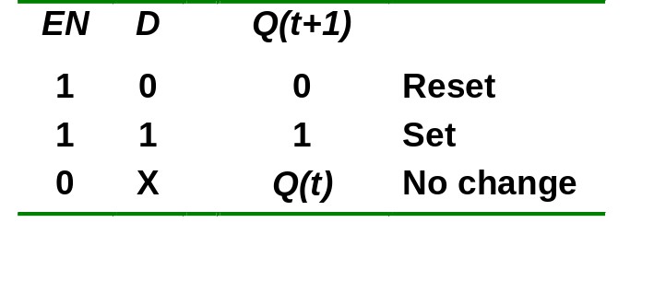
Gated D Latch
When EN is HIGH,
  D=HIGH → latch is SET
  D=LOW → latch is RESET
Hence when EN is HIGH, Q ‘follows’ the D (data) input.
Characteristic table:
When EN=1, Q(t+1) = D

Slide 16
Latch Circuits: Not Suitable
Latch circuits are not suitable in synchronous logic circuits.
When the enable signal is active, the excitation inputs are gated directly to the output Q. Thus, any change in the excitation input immediately causes a change in the latch output.
The problem is solved by using a special timing control signal called a clock to restrict the times at which the states of the memory elements may change.
This leads us to the edge-triggered memory elements called flip-flops.

Slide 17
Edge-Triggered Flip-flops
Flip-flops: synchronous bistable devices
Output changes state at a specified point on a triggering input called the clock.
Change state either at the positive edge (rising edge) or at the negative edge (falling edge) of the clock signal.
Clock signal
Positive edges
Negative edges

Slide 18
Edge-Triggered Flip-flops
S-R, D and J-K edge-triggered flip-flops. Note the “>” symbol at the clock input.
S
C
R
Q
Q'
D
C
Q
Q'
J
C
K
Q
Q'
Positive edge-triggered flip-flops
S
C
R
Q
Q'
D
C
Q
Q'
J
C
K
Q
Q'
Negative edge-triggered flip-flops

Slide 19
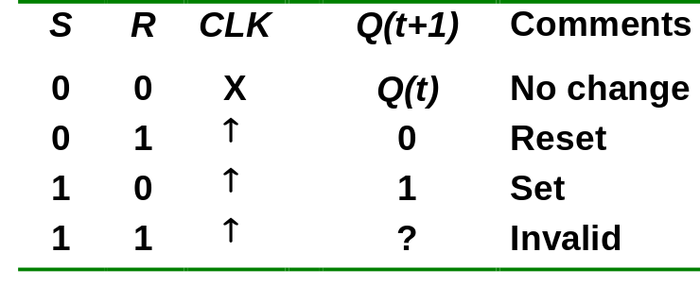
S-R Flip-flop
S-R flip-flop: on the triggering edge of the clock pulse,
  S=HIGH (and R=LOW)  SET state
  R=HIGH (and S=LOW)  RESET state
  both inputs LOW  no change
  both inputs HIGH  invalid
Characteristic table of positive edge-triggered S-R flip-flop:
X = irrelevant (“don’t care”)
↑ = clock transition LOW to HIGH

Slide 20
S-R Flip-flop
It comprises 3 parts:
  a basic NAND latch
  a pulse-steering circuit
  a pulse transition detector (or edge detector) circuit
The pulse transition detector detects a rising (or falling) edge and produces a very short-duration spike.

Slide 21
S-R Flip-flop
The pulse transition detector.
S
Q
Pulse transition detector
CLK
Q'
R
CLK'
CLK'
CLK
CLK*
CLK
CLK*
CLK
CLK
CLK'
CLK'
CLK*
CLK*
Positive-going transition
(rising edge)
Negative-going transition
(falling edge)

Slide 22
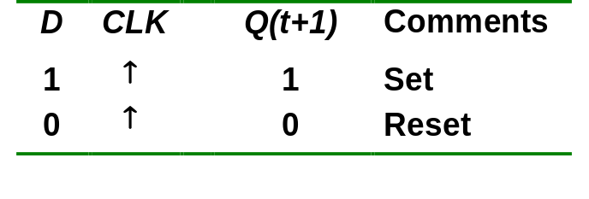
D Flip-flop
D flip-flop: single input D (data)
  D=HIGH  SET state
  D=LOW  RESET state
Q follows D at the clock edge.
Convert S-R flip-flop into a D flip-flop: add an inverter.
D
S
C
R
Q
Q'
CLK
↑ = clock transition LOW to HIGH
A positive edge-triggered D flip-flop formed with an S-R flip-flop.

Slide 23
D Flip-flop
Application: Parallel data transfer.
To transfer logic-circuit outputs X, Y, Z to flip-flops Q₁, Q₂ and Q₃ for storage.
D
CLK
Q
Q'
Q1 = X*
X
Combinational logic circuit
Y
D
CLK
Q
Q'
Q2 = Y*
Z
D
CLK
Q
Q'
Q3 = Z*
Transfer
* After occurrence of negative-going transition

Slide 24
J-K Flip-flop
J-K flip-flop: Q and Q' are fed back to the pulse-steering NAND gates.
No invalid state.
Include a toggle state.
  J=HIGH (and K=LOW)  SET state
  K=HIGH (and J=LOW)  RESET state
  both inputs LOW  no change
  both inputs HIGH  toggle

Slide 25
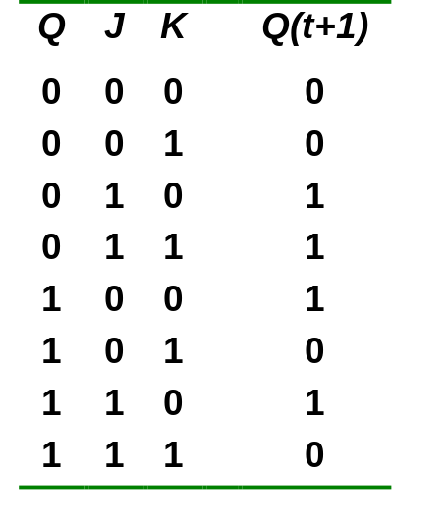
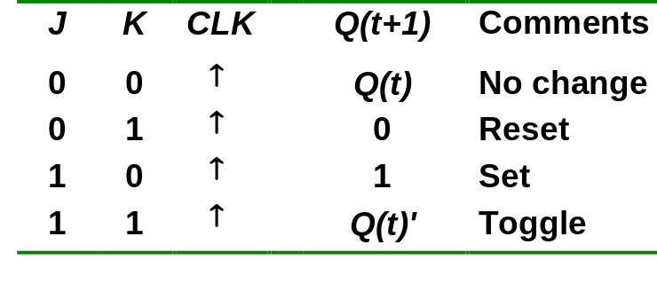
J-K Flip-flop
J-K flip-flop.
Characteristic table.
J
Q
Pulse transition detector
CLK
Q'
K
Q(t+1) = J.Q' + K'.Q

Slide 26
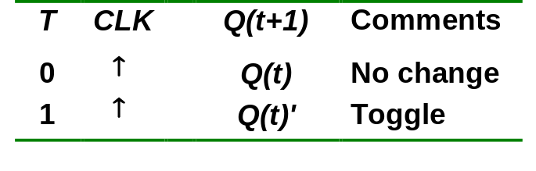
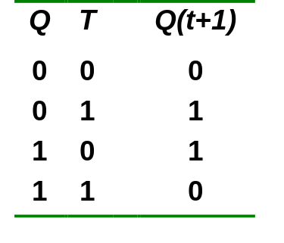
T Flip-flop
T flip-flop: single-input version of the J-K flip flop, formed by tying both inputs together.
Characteristic table.
T
T
Q
J
C
K
Q
Q'
Pulse transition detector
CLK
CLK
Q'
Q(t+1) = T.Q' + T'.Q

Slide 27
T Flip-flop
Application: Frequency division.
High
High
High
J
C
K
J
C
K
QA
J
C
K
QB
Q
CLK
CLK
CLK
CLK
Q
QA
QB
Divide clock frequency by 2.
Divide clock frequency by 4.

Slide 28
Asynchronous Inputs
S-R, D and J-K inputs are synchronous inputs, as data on these inputs are transferred to the flip-flop’s output only on the triggered edge of the clock pulse.
Asynchronous inputs affect the state of the flip-flop independent of the clock; example: preset (PRE) and clear (CLR) [or direct set (SD) and direct reset (RD)]
When PRE=HIGH, Q is immediately set to HIGH.
When CLR=HIGH, Q is immediately cleared to LOW.
Flip-flop in normal operation mode when both PRE and CLR are LOW.

Slide 29
Asynchronous Inputs
A J-K flip-flop with active-LOW preset and clear inputs.
PRE
PRE
J
Q
J
C
K
Q
Q'
Pulse transition detector
CLK
K
Q'
CLR
CLR
CLK
PRE
CLR
J = K = HIGH
Q
Preset
Toggle
Clear

Slide 30
Master-Slave Flip-flops
Another class is pulse-triggered master-slave which largely replaced by edge-triggered device.
Data entered at leading edge of the clock pulses, but the output does not reflect the input state until the trailing edge
Does not allow data to change while the clock pulse is active
Truth table operation same as for the edge-triggered JK flip-flop except the way it is clocked.
Compose of 2 sections: master section and slave section
  Master section – a gated latch
  Slave section – the same except it is clocked at an inverted clock pulse and is controlled by the output of master section

Slide 31
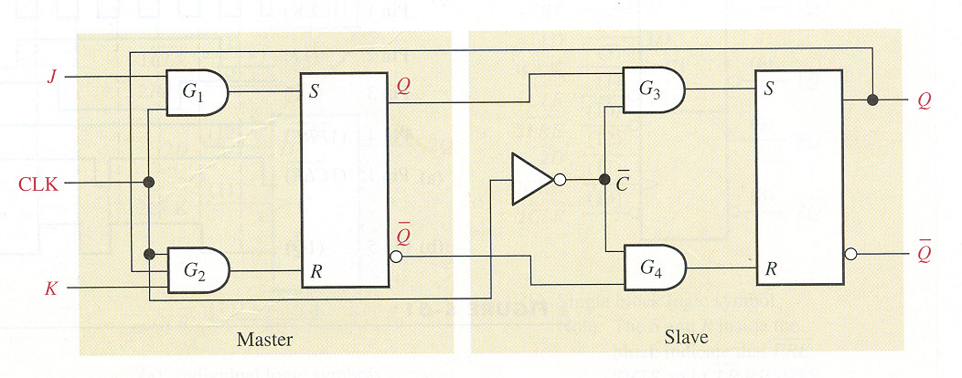
Master-Slave Flip-flops
  Master assume state determine by inputs JK at leading edge of clock pulse
  The state of master section transfer to slave section at trailing edge since the clock is inverted
  At trailing edge of clock pulse, the state of slaves appears on the Q and Q’ outputs
  The Q output is connected back to the input of G2 and Q’ to the input G1 to produce the toggle operation when J = K = 1

Slide 32
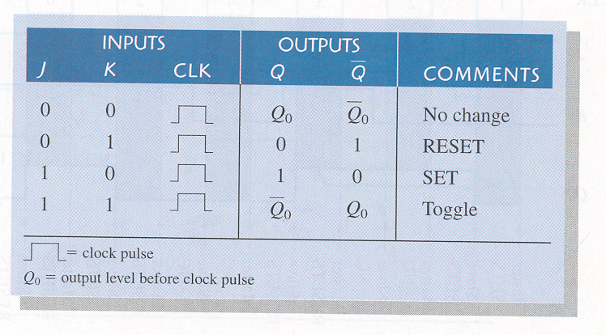
Master-Slave Flip-flops
Truth Table for master-slave JK flip-flops

Slide 33
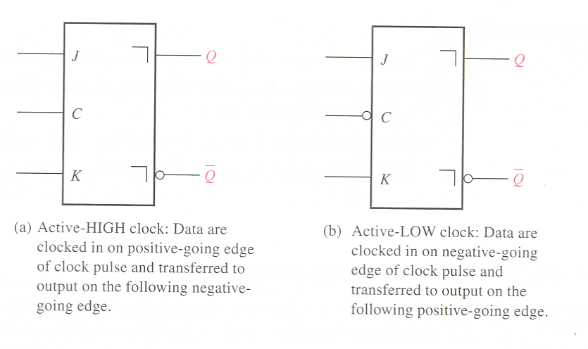
Master-Slave Flip-flops
Logic Symbols for master-slave JK flip-flops

