Slide 1
Topic 8:
Sequential Logic Counters

Slide 2
Counters
Introduction: Counters
Asynchronous (Ripple) Counters
Asynchronous Counters with MOD number < 2^{n}
Asynchronous Down Counters
Cascading Asynchronous Counters

Slide 3
Synchronous (Parallel) Counters
Up/Down Synchronous Counters
Designing Synchronous Counters
Decoding A Counter
Counters with Parallel Load

Slide 4
Introduction: Counters
Counters are circuits that cycle through a specified number of states.
Two types of counters:
  synchronous (parallel) counters
  asynchronous (ripple) counters
Ripple counters allow some flip-flop outputs to be used as a source of clock for other flip-flops.
Synchronous counters apply the same clock to all flip-flops.
Notes:
FF can be connected together to perform counting operations
The number of FF and the way they are connected together determine the number of states (called the modulus)
Two broad categoriesa; syn and sync according to the way they are clocked.
Classified by the type of sequence, number of states or the number of FF in the counter
- the clock input of an asynchronous counter is always connected only to the LSB FF

Slide 5
Asynchronous (Ripple) Counters
Asynchronous counters: the flip-flops do not change states at exactly the same time as they do not have a common clock pulse.
Also known as ripple counters, as the input clock pulse “ripples” through the counter – cumulative delay is a drawback.
n flip-flops → a MOD (modulus) 2^{n} counter. (Note: A MOD-x counter cycles through x states.)
Output of the last flip-flop (MSB) divides the input clock frequency by the MOD number of the counter, hence a counter is also a frequency divider.

Slide 6
Asynchronous (Ripple) Counters
Example: 2-bit ripple binary counter.
Output of one flip-flop is connected to the clock input of the next more-significant flip-flop.
HIGH
J
Q₀
J
Q₁
CLK
C
Q₀
C
K
K
FF0
FF1
CLK
1
2
3
4
Q₀
Timing diagram
00 → 01 → 10 → 11 → 00 ...
Q₀
0
1
0
1
0
Q₁
0
0
1
1
0
Notes:
The CLK is applied to input C of FFO only which is always the LSB
Theond FF is triggered by Q0’ of output FFO
FFO changes state at the positive going edge of each clock pulse
FF1 changes state when triggered by positive going transition of the QO’ output of FFO
Because the inherent propagation delay time through FF, a transition of the input clock pulse and the transistion of QO’ output of FFO can never occur exactly at the same time. Therefore the two FF are never simultaneously triggered, so the counter operation is asynchronous.
For simplicity the transition of QO, Q1 and CLK as shown as simultaneous.
CLK Q1 QO
Init 0 0
1 0 1
2 1 0
3 1 1
4 0 0
Since it goes through a binary sequence, this counter is called a binary counter

Slide 7
Asynchronous (Ripple) Counters
Example: 3-bit ripple binary counter.
HIGH
J
Q₀
J
Q₁
J
Q₂
CLK
C
Q₀
C
Q₁
C
K
K
K
FF0
FF1
FF2
CLK
1
2
3
4
5
6
7
8
Q₀
0
1
0
1
0
1
0
1
0
Q₁
0
0
1
1
0
0
1
1
0
Q₂
0
0
0
0
1
1
1
1
0
Recycles back to 0
Notes:
- Ripples
the effect of the input clock pulse is first “felt” by FFO. This effect cannot get to FF1 immediately because of the propagation delay theough FF0
Then there is the propagation delay through FF1 before FF2 can be triggered.
Thus the effect of an input clock pulse “ripples” through the counter, taking some time, due to propagation delays to reach the last FF

Slide 8
Asynchronous (Ripple) Counters
Propagation delays in an asynchronous (ripple-clocked) binary counter.
If the accumulated delay is greater than the clock pulse, some counter states may be misrepresented!
CLK
1
2
3
4
Q₀
Q₁
Q₂
t_{PHL} (CLK to Q₀)
t_{PHL} (CLK to Q₀)
t_{PLH}
(CLK to Q₀)
t_{PLH} (Q₀ to Q₁)
t_{PHL} (Q₀ to Q₁)
t_{PLH} (Q₁ to Q₂)
Notes:
Notice all counters change state on the leading edge of CLK 4
The ripple clocking effect is shown for the first 4 clock pulses with the propagation delays indicated
FF2 is not triggered until 2 delay times after the positive-going edge of the clock pulse, CLK 4 thus it takes 3 pro delay times for the effectof the clock pulse, CLK4 to ripple through the counter and change Q2 from LOW to HIGH
Major disadvantage because it limits the rate at which the counter can be clocked and creates decoding problem
The maximum cumulative delay must be less than the period of the clock waveform

Slide 9
Asynchronous (Ripple) Counters
Example: 4-bit ripple binary counter (negative-edge triggered).
HIGH
J
Q₀
J
Q₁
J
Q₂
J
Q₃
CLK
C
C
C
C
K
K
K
K
FF0
FF1
FF2
FF3
CLK
1
2
3
4
5
6
7
8
9
10
11
12
13
14
15
16
Q₀
Q₁
Q₂
Q₃

Slide 10
Asyn. Counters with MOD no. < 2^{n}
States may be skipped resulting in a truncated sequence.
Technique: force counter to recycle before going through all of the states in the binary sequence.
Example: Given the following circuit, determine the counting sequence (and hence the modulus no.)
C
B
A
Q
J
Q
J
Q
J
All J, K inputs are 1 (HIGH).
CLK
CLK
CLK
Q
K
Q
K
Q
K
CLR
CLR
CLR
B
C

Slide 11
Asyn. Counters with MOD no. < 2^{n}
Example (cont’d):
C
B
A
Q
J
Q
J
Q
J
All J, K inputs are 1 (HIGH).
CLK
CLK
CLK
Q
K
Q
K
Q
K
CLR
CLR
CLR
B
C
1
2
3
4
5
6
7
8
9
10
11
12
MOD-6 counter produced by clearing (a MOD-8 binary counter) when count of six (110) occurs.
Clock
A
B
C
NAND
Output
1
0

Slide 12
Asyn. Counters with MOD no. < 2^{n}
Example (cont’d): Counting sequence of circuit (in CBA order).
1
2
3
4
5
6
7
8
9
10
11
12
Clock
A
0
0
0
1
0
0
0
1
0
1
1
0
0
0
1
1
0
1
0
0
0
1
0
0
B
C
NAND
Output
1
0
111
000
Temporary state
001
Counter is a MOD-6 counter.
110
010
101
011
100

Slide 13
Asyn. Counters with MOD no. < 2^{n}
Exercise: How to construct an asynchronous MOD-5 counter? MOD-7 counter? MOD-12 counter?
Question: The following is a MOD-? counter?
F
E
D
C
B
A
Q
J
Q
J
Q
J
Q
J
Q
J
Q
J
Q
K
Q
K
Q
K
Q
K
Q
K
Q
K
CLR
CLR
CLR
CLR
CLR
CLR
C
D
E
F
All J = K = 1.

Slide 14
Asyn. Counters with MOD no. < 2^{n}
Decade counters (or BCD counters) are counters with 10 states (modulus-10) in their sequence. They are commonly used in daily life (e.g.: utility meters, odometers, etc.).
Design an asynchronous decade counter.
(A.C)'
HIGH
J
Q
D
J
Q
C
J
Q
B
J
Q
A
CLK
C
C
C
C
K
K
K
K
CLR
CLR
CLR
CLR

Slide 15
Asyn. Counters with MOD no. < 2^{n}
Asynchronous decade/BCD counter (cont’d).
HIGH
D
C
B
A
J
Q
J
Q
J
Q
J
Q
(A.C)'
CLK
C
C
C
C
K
K
K
K
CLR
CLR
CLR
CLR
1
2
3
4
5
6
7
8
9
10
11
Clock
D
0
0
0
0
1
0
0
0
0
1
0
0
1
1
0
0
0
0
1
0
1
0
1
0
0
1
1
0
1
1
1
0
0
0
0
1
1
0
0
1
0
0
0
0
C
B
A
NAND
output

Slide 16
Asynchronous Down Counters
So far we are dealing with up counters. Down counters, on the other hand, count downward from a maximum value to zero, and repeat.
Example: A 3-bit binary (MOD-2³) down counter.
1
J
Q₀
J
Q₁
J
Q₂
3-bit binary up counter
Q
Q
Q
Q
CLK
C
C
C
Q'
K
Q'
K
Q'
K
Q'
1
J
Q₀
J
Q₁
J
Q₂
3-bit binary down counter
Q
Q
Q
Q
CLK
C
C
C
Q'
Q'
Q'
K
Q'
K
K

Slide 17
Asynchronous Down Counters
Example: A 3-bit binary (MOD-8) down counter.
000
001
111
1
J
Q₀
J
Q₁
J
Q₂
010
110
Q
Q
Q
Q
CLK
C
C
C
Q'
Q'
Q'
K
Q'
K
K
011
101
100
CLK
1
2
3
4
5
6
7
8
Q₀
0
1
0
1
0
1
0
1
0
Q₁
0
1
1
0
0
1
1
0
0
Q₂
0
1
1
1
1
0
0
0
0

Slide 18
Cascading Asynchronous Counters
Larger asynchronous (ripple) counter can be constructed by cascading smaller ripple counters.
Connect last-stage output of one counter to the clock input of next counter so as to achieve higher-modulus operation.
Example: A modulus-32 ripple counter constructed from a modulus-4 counter and a modulus-8 counter.
Q₀
Q₁
Q₂
Q₃
Q₄
J
Q
J
J
J
J
Q
Q
Q
Q
Q
Q
CLK
C
C
C
C
C
Q'
Q'
Q'
Q'
K
K
K
Q'
K
Q'
K
Q'
Modulus-4 counter
Modulus-8 counter

Slide 19
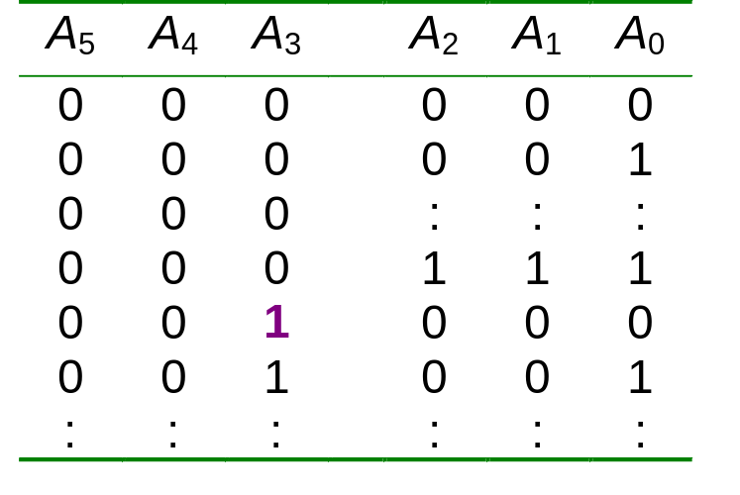
Cascading Asynchronous Counters
Example: A 6-bit binary counter (counts from 0 to 63) constructed from two 3-bit counters.
A₀ A₁ A₂
A₃ A₄ A₅
Count pulse
3-bit
binary counter
3-bit
binary counter

Slide 20
Cascading Asynchronous Counters
If counter is a not a binary counter, requires additional output.
Example: A modulus-100 counter using two decade counters.
freq/10
1
CTEN
Decade counter
CTEN
Decade counter
freq/100
TC
TC
CLK
C
Q₃ Q₂ Q₁ Q₀
C
Q₃ Q₂ Q₁ Q₀
freq
TC = 1 when counter recycles to 0000

Slide 21
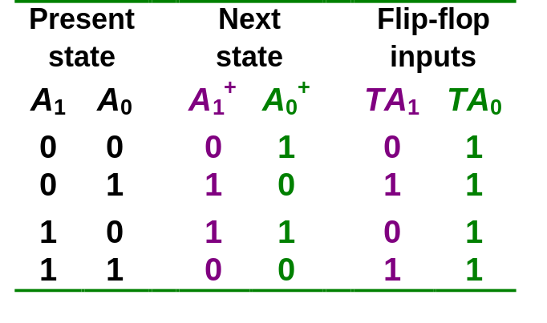
Synchronous (Parallel) Counters
Synchronous (parallel) counters: the flip-flops are clocked at the same time by a common clock pulse.
We can design these counters using the sequential logic design process.
Example: 2-bit synchronous binary counter (using T flip-flops, or JK flip-flops with identical J,K inputs).
00
01
11
10

Slide 22
Synchronous (Parallel) Counters
Example: 2-bit synchronous binary counter (using T flip-flops, or JK flip-flops with identical J,K inputs).
TA₁ = A₀
TA₀ = 1
1
J
A₀
J
A₁
Q
Q
Q
C
C
Q'
Q'
K
Q'
K
CLK

Slide 23
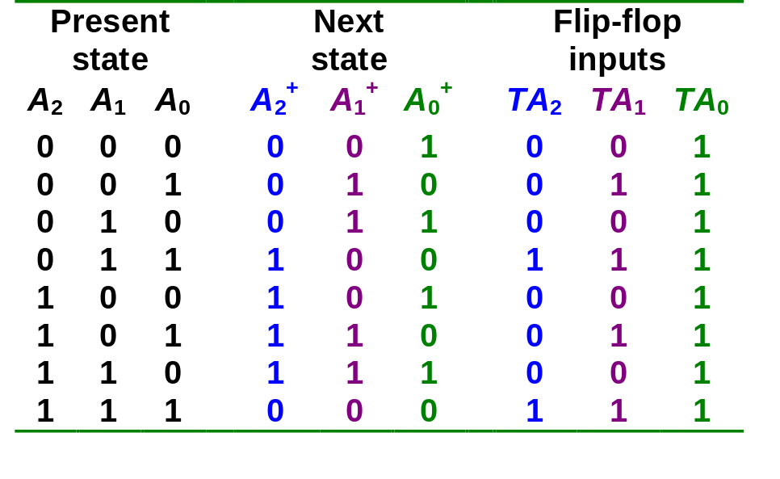
Synchronous (Parallel) Counters
Example: 3-bit synchronous binary counter (using T flip-flops, or JK flip-flops with identical J, K inputs).
A₁
A₁
A₁
1
1
1
1
1
1
1
A₂
1
A₂
1
1
A₂
1
1
1
1
A₀
A₀
A₀
TA₂ = A₁.A₀
TA₁ = A₀
TA₀ = 1

Slide 24
Synchronous (Parallel) Counters
Example: 3-bit synchronous binary counter (cont’d).
  TA₂ = A₁.A₀ TA₁ = A₀ TA₀ = 1
A₂
A₁
A₀
Q
Q
Q
J
K
J
K
J
K
CP
1

Slide 25
Synchronous (Parallel) Counters
Note that in a binary counter, the n^{th} bit (shown underlined) is always complemented whenever
  011…11 → 100…00
  or 111…11 → 000…00
Hence, X_{n} is complemented whenever X_{n-1}X_{n-2} ... X₁X₀ = 11…11.
As a result, if T flip-flops are used, then TX_{n} = X_{n-1} . X_{n-2} . ... . X₁ . X₀

Slide 26
Synchronous (Parallel) Counters
    Example: 4-bit synchronous binary counter.
      TA₃ = A₂ . A₁ . A₀
      TA₂ = A₁ . A₀
      TA₁ = A₀
      TA₀ = 1
1
A₁.A₀
A₂.A₁.A₀
J
A₀
J
A₁
J
A₂
J
A₃
Q
Q
Q
Q
Q
C
C
C
C
Q'
Q'
Q'
Q'
K
Q'
K
K
K
CLK

Slide 27
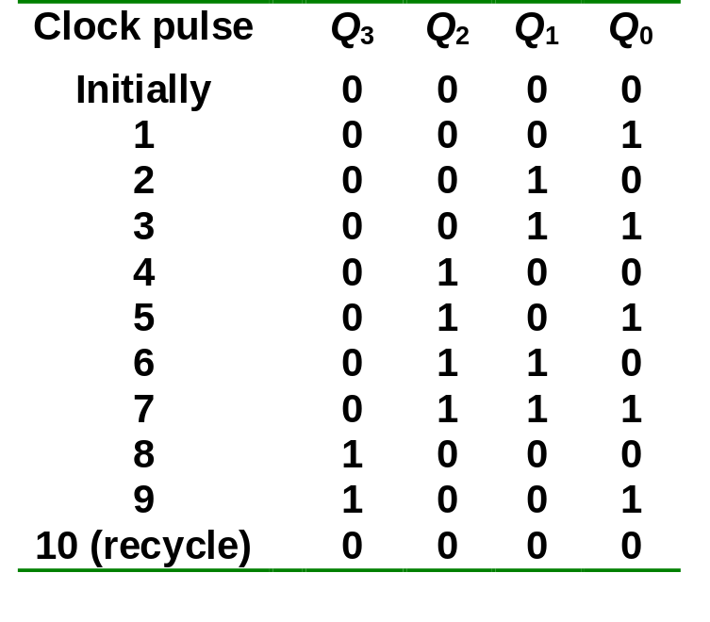
Synchronous (Parallel) Counters
Example: Synchronous decade/BCD counter.
T₀ = 1
T₁ = Q₃'.Q₀
T₂ = Q₁.Q₀
T₃ = Q₂.Q₁.Q₀ + Q₃.Q₀

Slide 28
Synchronous (Parallel) Counters
Example: Synchronous decade/BCD counter (cont’d).
T₀ = 1
T₁ = Q₃'.Q₀
T₂ = Q₁.Q₀
T₃ = Q₂.Q₁.Q₀ + Q₃.Q₀
Q₀
1
T
Q
T
Q₁
T
Q₂
T
Q₃
Q
Q
Q
Q
Q
Q
Q
C
C
C
C
Q'
Q'
Q'
Q'
Q'
Q'
Q'
Q'
CLK

Slide 29
Up/Down Synchronous Counters
Up/down synchronous counter: a bidirectional counter that is capable of counting either up or down.
An input (control) line Up/Down (or simply Up) specifies the direction of counting.
  Up/Down = 1 → Count upward
  Up/Down = 0 → Count downward

Slide 30
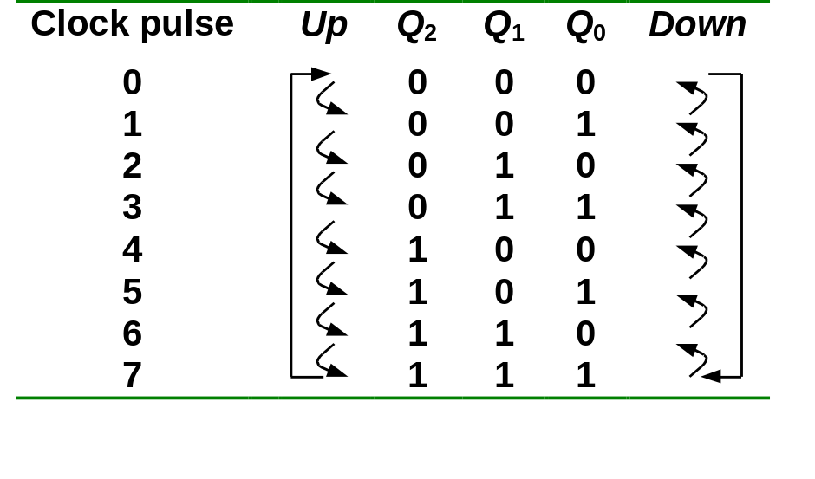
Up/Down Synchronous Counters
Example: A 3-bit up/down synchronous binary counter.
TQ₀ = 1
TQ₁ = (Q₀.Up) + (Q₀'.Up' )
TQ₂ = ( Q₀.Q₁.Up ) + (Q₀'. Q₁'. Up' )
Up counter
TQ₀ = 1
TQ₁ = Q₀
TQ₂ = Q₀.Q₁
Down counter
TQ₀ = 1
TQ₁ = Q₀’
TQ₂ = Q₀’.Q₁’

Slide 31
Up/Down Synchronous Counters
Example: A 3-bit up/down synchronous binary counter (cont’d).
TQ₀ = 1
TQ₁ = (Q₀.Up) + (Q₀'.Up' )
TQ₂ = ( Q₀.Q₁.Up ) + (Q₀'. Q₁'. Up' )
Q₀
Q₁
1
T
Q
T
T
Q₂
Q
Q
Q
Q
Q
Up
C
C
C
Q'
Q'
Q'
Q'
Q'
Q'
CLK

Slide 32
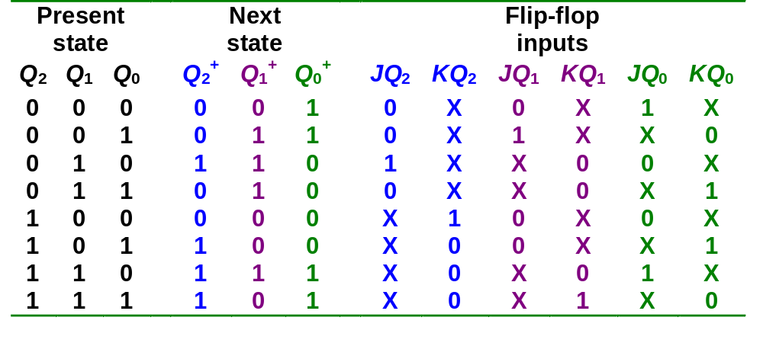
Designing Synchronous Counters
000
Covered in Lecture #12.
Example: A 3-bit Gray code counter (using JK flip-flops).
100
001
101
011
111
010
110

Slide 33
Designing Synchronous Counters
3-bit Gray code counter: flip-flop inputs.
Q₁Q₀
Q₁Q₀
Q₁Q₀
Q₂
Q₂
00 01 11 10
Q₂
00 01 11 10
00 01 11 10
0
1
1
0
1
1
X
X
0
1
1
X
X
X
X
X
X
X
X
X
X
1
JQ₂ = Q₁.Q₀'
JQ₁ = Q₂'.Q₀
JQ₀ = Q₂.Q₁ + Q₂'.Q₁'
= (Q₂ ⊕ Q₁)'
Q₁Q₀
Q₁Q₀
Q₁Q₀
Q₂
00 01 11 10
Q₂
00 01 11 10
Q₂
00 01 11 10
0
1
X
X
X
X
0
1
X
X
0
1
X
1
X
1
X
X
1
X
1
X
KQ₂ = Q₁'.Q₀'
KQ₁ = Q₂.Q₀
KQ₀ = Q₂.Q₁' + Q₂'.Q₁
= Q₂ ⊕ Q₁

Slide 34
Decoding A Counter
Decoding a counter involves determining which state in the sequence the counter is in.
Differentiate between active-HIGH and active-LOW decoding.
Active-HIGH decoding: output HIGH if the counter is in the state concerned.
Active-LOW decoding: output LOW if the counter is in the state concerned.

Slide 35
Decoding A Counter
Example: MOD-8 ripple counter (active-HIGH decoding).
0
1
2
3
4
5
6
7
8
9
10
Clock
A'
B'
C'
HIGH only on count of ABC = 000
A'
B'
C
HIGH only on count of ABC = 001
A'
B
C'
HIGH only on count of ABC = 010
.
.
.
A
B
C
HIGH only on count of ABC = 111

Slide 36
Decoding A Counter
Example: To detect that a MOD-8 counter is in state 0 (000) or state 1 (001).
A'
B'
C'
0
1
2
3
4
5
6
7
8
9
10
Clock
A'
B'
C
A'
B'
HIGH only on count of ABC = 000 or ABC = 001
Example: To detect that a MOD-8 counter is in the odd states (states 1, 3, 5 or 7), simply use C.
0
1
2
3
4
5
6
7
8
9
10
Clock
HIGH only on count of odd states
C

Slide 37
Counters with Parallel Load
Counters could be augmented with parallel load capability for the following purposes:
  To start at a different state
  To count a different sequence
  As more sophisticated register with increment/decrement functionality.

Slide 38
Counters with Parallel Load
Different ways of getting a MOD-6 counter:
A₄ A₃ A₂ A₁
A₄ A₃ A₂ A₁
Load
Count = 1
Clear = 1
CP
Clear
Count = 1
Load = 0
CP
I₄ I₃ I₂ I₁
I₄ I₃ I₂ I₁
Inputs = 0
Inputs have no effect
(a) Binary states 0,1,2,3,4,5.
(b) Binary states 0,1,2,3,4,5.
A₄ A₃ A₂ A₁
A₄ A₃ A₂ A₁
Carry-out
Count = 1
Clear = 1
CP
Count = 1
Clear = 1
CP
Load
Load
I₄ I₃ I₂ I₁
I₄ I₃ I₂ I₁
1 0 1 0
0 0 1 1
(c) Binary states 10,11,12,13,14,15.
(d) Binary states 3,4,5,6,7,8.

Slide 39
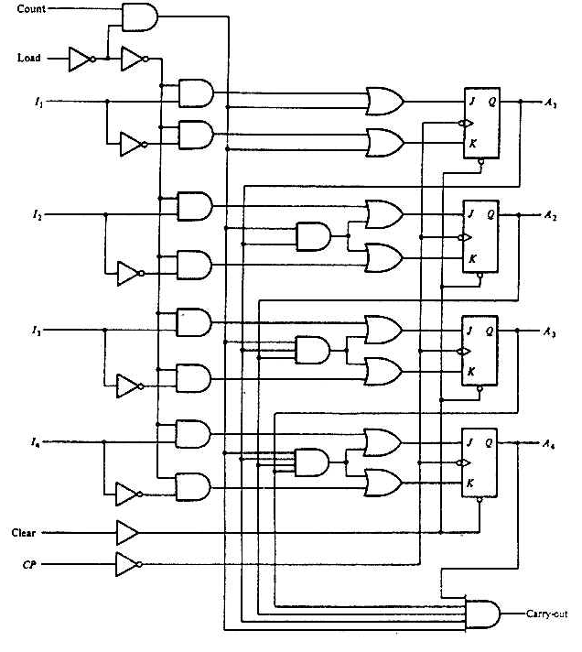
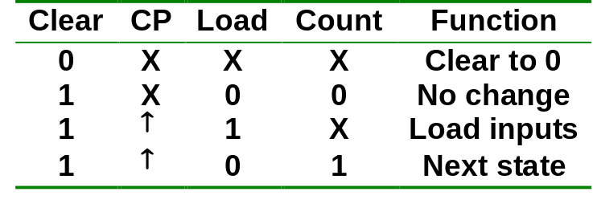
Counters with Parallel Load
4-bit counter with parallel load.

