Slide 1

Project Presentation on Let’sChat
Submitted to:-Ashima MEHTA
Name of the students:-Ravi Raj,Shubham Yadav,Rohit Yadav,Rakib Khan | Date: 12/08/2021
Branch & Semester : C.S.E-3 ,1 | Roll number of students:- 22131,22160,22145,22129

Slide 2
Contents
Project Overview
Project Description:
Server Description
Client Description
How server works
How client works
Server code
Client code

Slide 3
Project Overview
This project is built using the Core Java.
I have used java10 to compile and run this application.
I have used java.swing package for making GUI for this application.
I have used Java UIManager to change the look and feel of the java.swing GUI.
This project is created for chatting purpose.
Multiple users can connect to the server, which can handle all the connected users.
Single user can send the message like other chat applications, by select that particular user in the client list.
It is very simple and easy to use.

Slide 4
Project Description
This is an networking based project, created by using java networking concept, this is basically an client-server model based networking, to create this application I used the TCP/IP model of network protocol, to build the server I have used the multithreading also to handle the multiple clients at one time, Multithreading provides us to handle multiple processes at one time.
Packages used to build the UI interface:
-javax.swing package
-java.awt package
Packages used to build the client-Server model:
-java.net package
-java.io package
-java.util package

Slide 5
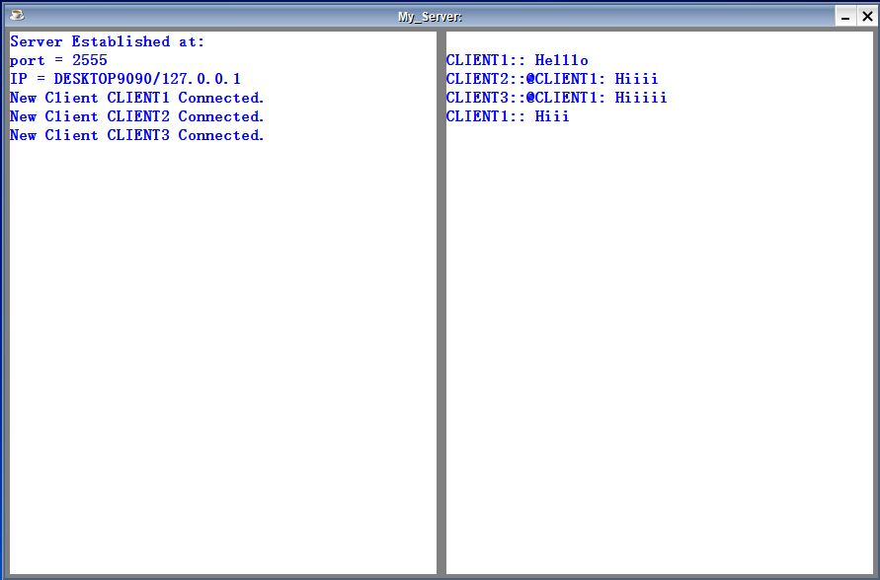
Server Description
To start this project first start the server as:
You don’t need to provide any information to the server.
When you start the server it’ll detect all the information automatically.
When you’ll start the server it shows the information which is detect from the computer system,
like port number and IP address and this details shows on server.

Slide 6
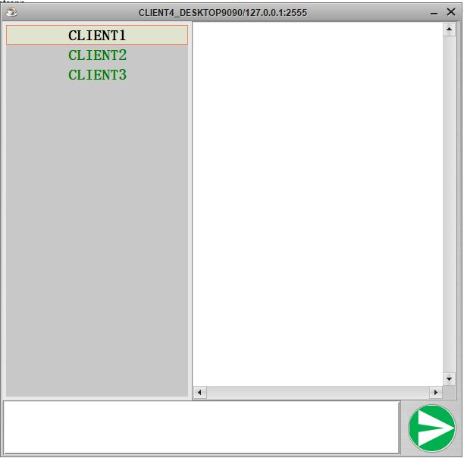
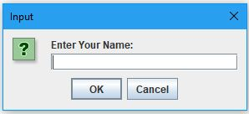
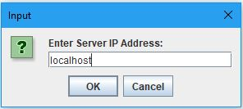
Client Description
When you’ll start the client application, first it’ll ask your name after it it’ll ask the IP address, at the IP address field you need to enter your server machine’s IP address, if you don’t know the server machine IP address then see it on server machine it will shows the IP address of that machine if you are run both client and server a in the same machine then you can enter the “localhost” in place of IP address.
After entered the details the client will open and you can chat with other clients.

Slide 7
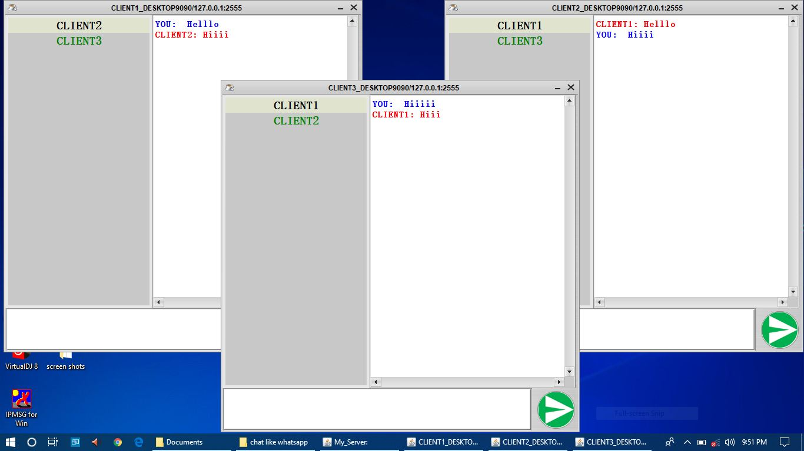

Slide 8
How Server Works?
The java.net.ServerSocket class represents a server socket.
It is constructed on a particular port. Then it calls accept() to listen for incoming connections. accept() blocks until a connection is detected.
Then accept() returns a java.net.Socket object you use to perform the actual communication with the client.
In this project the server runs on the port number 2555 which is generated by using the string hashcode() method, which converts a string into hashcode.
When server start it needs two thing IP of computer system which is detected automatically and port number which is given internally into the source code.
If you want to test the connection into the local system then you don’t need any network, if you want to run it on the multiple computer’s or laptops then connect your server machine a network connection.
Is doesn’t need any internet connection, it needs only a simple network connection without internet.
When server will started it is ready to connect with the clients.
Here server will two tasks first is waiting for clients and another is handle the connected clients.
Server will always on waiting for new clients.
The two classes java.io.DataInputStream and java.io.DataOutputStream are used to send and receive the messages to the server.

Slide 9
How Client Works?
The java.net.Socket class represents a (client) socket.
It is constructed on a particular port on which server is running.
In this project the client runs on the port number 2555 and IP address on which server is running.
When client start it needs two thing IP of server system on which server is running and user name, both are provided at run time, the port number is given internally in the source code.
If you want to test the connection into the local system then you don’t need any network, if you want to run it on the multiple computer’s or laptops then connect your computer to the server machine by using a wireless or wired network connection.
Is doesn’t need any internet connection, it needs only a simple network connection without internet.
When client start it needs two types of buffers for message transmission, one is input buffer for which we’re use the java.io.DataInputStream for reading or getting the messages from the server, another is output buffer for which we’re using the java.io.DataOutputStream for sending the messages to the server.

Slide 10
Server code
public void startServer() throws IOException, BindException
{
int port = “PK”.hashcode();
server = new ServerSocket(port);
serverinfo = "Server Established at:\nport = "+port+"\nIP = "+InetAddress.getLocalHost();
serverInfo.setText(serverinfo); //GUI
clientInfo.setText(clientinfo);//GUI
while(true)
{
clientCount++;
client = server.accept(); //Waiting state
ClientHandler thread = new ClientHandler(client, clientCount);
thread.start(); //Connected state
users.add(thread);// add in to HashMap
}
}

Slide 11
class ClientHandler extends Thread
{
Socket client = null;
DataInputStream inBuffer = null;
DataOutputStream outBuffer = null;
String name = null;
int clientNo;
public ClientHandler(Socket client, int id) throws IOException
{
this.client = client;
clientNo = id;
inBuffer = new DataInputStream(client.getInputStream());
outBuffer = new DataOutputStream(client.getOutputStream());
name = inBuffer.readUTF();
clientList.add(name);
serverinfo = "New Client "+name +" Connected.";
serverInfo.append("\n"+serverinfo);
broadCastToAll(serverinfo);
outBuffer.flush();
if(clientList.size()<2)
{
String data = ("Only you are online now.");
outBuffer.writeUTF(data);
}
else
{
String data = getOnlineUsers();
outBuffer.writeUTF(data);
}
}

Slide 12
public void sendMessage(String message) throws IOException
{
outBuffer.flush();
outBuffer.writeUTF(message);
}
@Override
public void run()
{
while(true)
{
try {
String message = inBuffer.readUTF();
clientinfo = name+"::"+message;
if(message.toUpperCase().equals("!GETONLINEUSERS")){
outBuffer.flush();
if(clientList.size()<2){
outBuffer.writeUTF(("Only you are online now."));
}
else{
outBuffer.writeUTF((getOnlineUsers()));
}
}
else if(message.contains("@")){
clientinfo = broadCastToOne(clientinfo);
}

Slide 13
else{
broadCastToAll(clientinfo);
}
clientInfo.append("\n"+clientinfo);
}
catch(SocketException e) {
serverinfo = "Connection closed by: Client__"+name+".";
serverInfo.append("\n"+serverinfo);
clientList.remove(name);
users.remove(this);
try {
broadCastToAll(serverinfo);
client.close();
} catch (IOException e1) {}
break;
}
catch (IOException e) {
e.printStackTrace();
}
}
}

Slide 14
Client code
public void run(String name) throws IOException
{
client = new Socket(ip, port);
setTitle(name+"_"+InetAddress.getLocalHost()+":"+port);
inBuffer = new DataInputStream(client.getInputStream());
outBuffer = new DataOutputStream(client.getOutputStream());
outBuffer.writeUTF(name);
while(true)
{
try
{
String str = inBuffer.readUTF();
info = (str);
setTextIntoField(info);
}catch(SocketException e) {
JOptionPane.showMessageDialog(this, "Server Has Stopped/Closed.");
break;
}
}
}

Slide 15
public void sendToOne(String name) throws IOException
{
outBuffer.flush();
String data = msg.getText();
data = "@"+name+": "+data;
outBuffer.writeUTF(data);
msg.setText("");
}
public void sendAll() throws IOException
{
outBuffer.flush();
String dt = msg.getText();
outBuffer.writeUTF(dt);
msg.setText("");
}

Slide 16

Have You Any Query

Slide 17

Thank you

