Slide 1
Multiway Search Trees
Prof. Ki-Hoon Lee
School of Computer and Information Engineering
Kwangwoon University

Slide 2
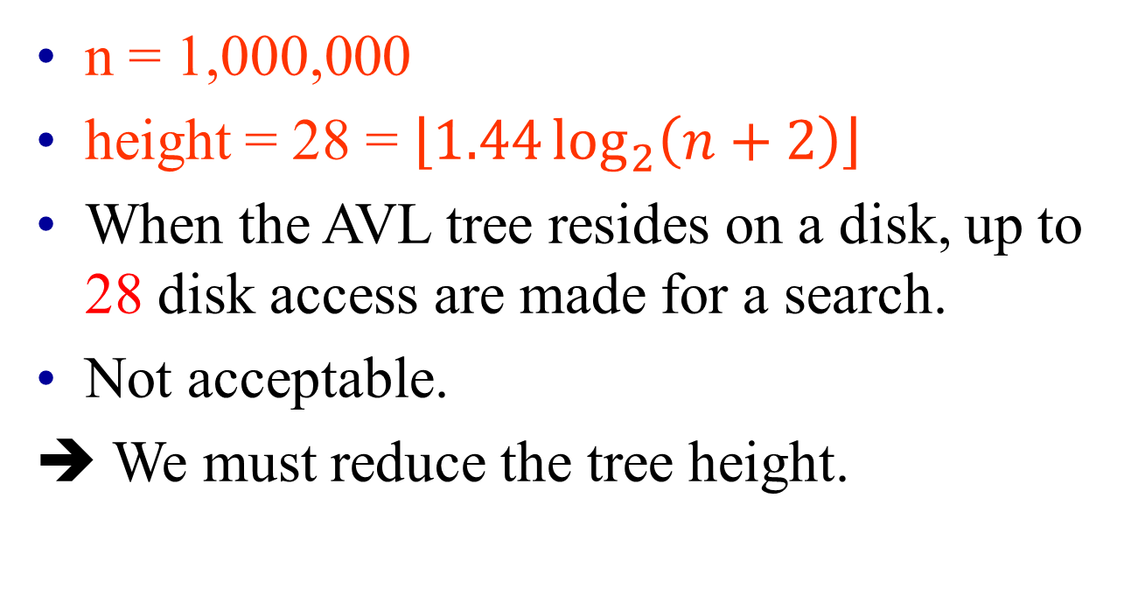
AVL Trees
n = 1,000,000
height = 28 = $\left\lfloor 1.44\log_{2}\left(n+2\right)\right\rfloor$
When the AVL tree resides on a disk, up to 28 disk access are made for a search.
Not acceptable.
➔ We must reduce the tree height.
Notes:
43 cache misses possible when searching memory resident AVL trees

Slide 3
m-Way Search Trees
Each node has up to m – 1 elements and m children.
m = 2 ➔ binary search tree.
10 30 35
k < 10
10 < k < 30
30 < k < 35
k > 35

Slide 4
Maximum # of Elements
Happens when all internal nodes are m-nodes.
Full degree m tree.
# of nodes = 1 + m + m² + m³ + … + m^{h-1}
= (m^{h} – 1)/(m – 1).
Each node has m – 1 elements.
So, # of elements = m^{h} – 1.

Slide 5
Capacity of m-Way Search Tree
Notes:
Natural extension of 2-3 and 2-3-4 trees would leave worst case at m=2.

Slide 6
Definition of m-Way Search Trees
An m-way search tree is either empty or satisfies the following properties:
The root has at most m subtrees and has the following structure:
n, A₀, (E₁, A₁), (E₂, A₂), …, (E_{n}, A_{n})
where the A_{i}, 0 ≤ i ≤ n < m, are pointers to subtrees, and the E_{i}, 0 ≤ i ≤ n < m, are elements. Each element E_{i} has a key E_{i}.K
E_{i}.K < E_{i+1}.K, 1 ≤ i < n
Let E₀.K = -∞ and E_{n+1}.K = ∞. All keys in the subtree A_{i} are greater than E_{i}.K and less than E_{i+1}.K, 0 ≤ i ≤ n
The subtrees A_{i}, 0 ≤ i ≤ n, are also m-way search trees

Slide 7
m-Way Search Trees
3, A₀, (10, A₁), (30, A₂), (35, A₃)
10 30 35
k < 10
10 < k < 30
30 < k < 35
k > 35

Slide 8
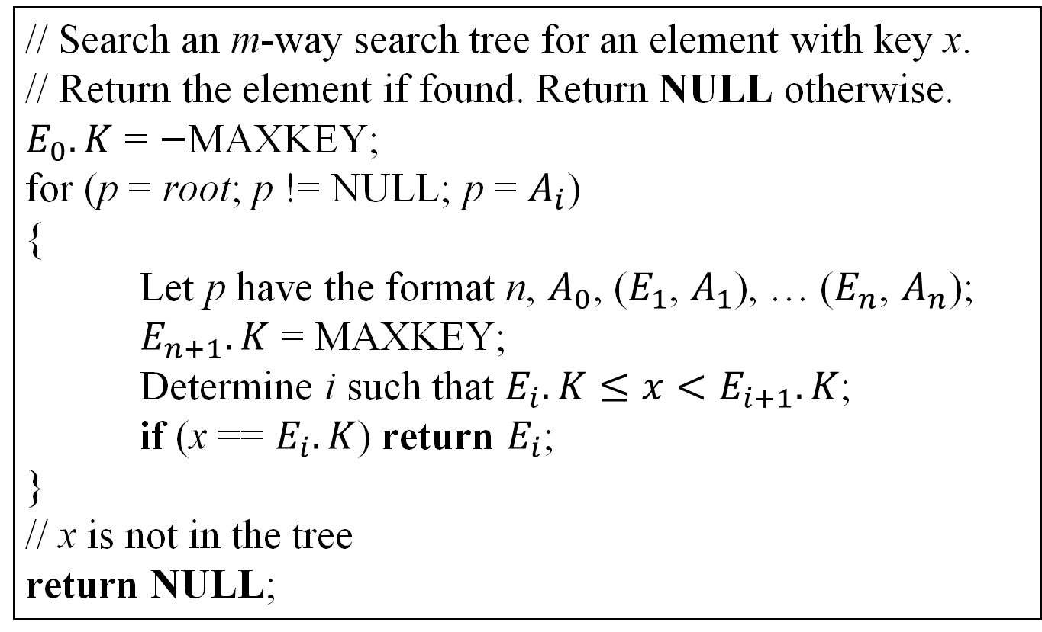
Searching an m-Way Search Trees
// Search an m-way search tree for an element with key x.
// Return the element if found. Return NULL otherwise.
$E_{0}.K$ = −MAXKEY;
for (p = root; p != NULL; p = $A_{i}$)
{
Let p have the format n, $A_{0}$, ($E_{1}$, $A_{1}$), … ($E_{n}$, $A_{n}$);
$E_{n+1}.K$ = MAXKEY;
Determine i such that $E_{i}.K≤x<E_{i+1}.K$;
if (x == $E_{i}.K$) return $E_{i}$;
}
// x is not in the tree
return NULL;

Slide 9
B-Trees
A balanced m-way search tree
In defining a B-tree, it is convenient to extend m-way search trees by the addition of external nodes
A
40
B
C
10
20
80
external node

Slide 10
B-Trees (cont.)
An external node represents a node that can be reached during a search only if the element being sought is not in the tree
The corresponding child pointer of the parent of each external node is set to NULL
Nodes that are not external nodes are called internal nodes
40
10
20
80
external node

Slide 11
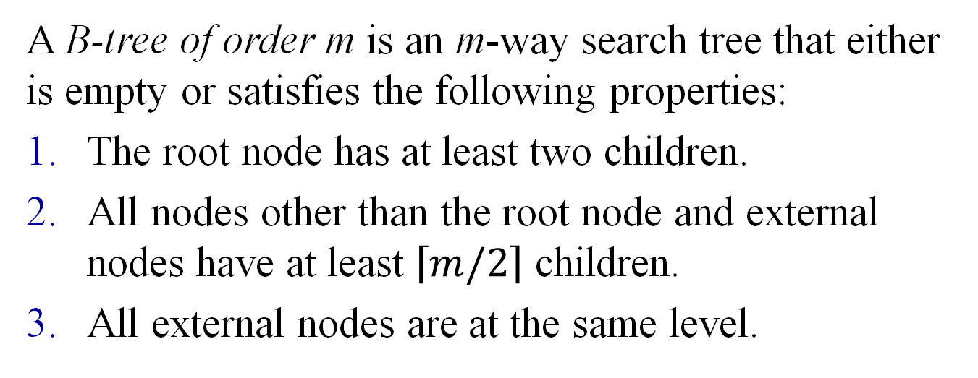
Definition of B-Tree
A B-tree of order m is an m-way search tree that either is empty or satisfies the following properties:
The root node has at least two children.
All nodes other than the root node and external nodes have at least $\left\lceil m/2\right\rceil$ children.
All external nodes are at the same level.

Slide 12
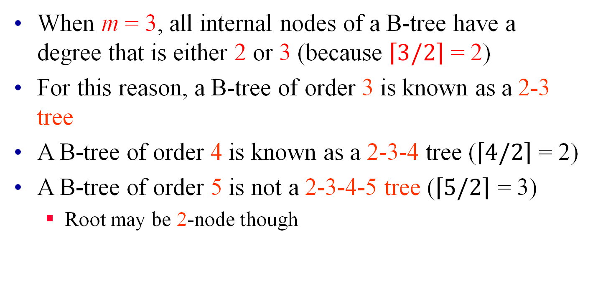
2-3 and 2-3-4 Trees
When m = 3, all internal nodes of a B-tree have a degree that is either 2 or 3 (because $\left\lceil 3/2\right\rceil$ = 2)
For this reason, a B-tree of order 3 is known as a 2-3 tree
A B-tree of order 4 is known as a 2-3-4 tree ($\left\lceil 4/2\right\rceil$ = 2)
A B-tree of order 5 is not a 2-3-4-5 tree ($\left\lceil 5/2\right\rceil$ = 3)
Root may be 2-node though

Slide 13
2-3 Tree (= B-tree of order 3)
A
40
B
C
10
20
80
< 2-3 tree >

Slide 14
2-3-4 Trees (= B-tree of order 4)
50
10
70
80
5
7
9
30
40
60
75
85
90
92
< 2-3-4 tree >

Slide 15
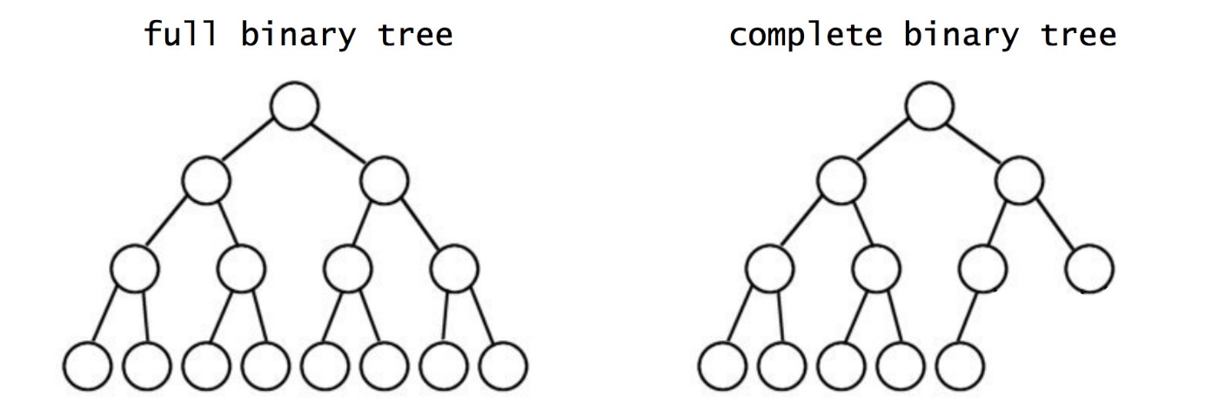
B-Trees of Order 2
All B-trees of order 2 are full binary trees
The root node has at least two children.
All nodes other than the root node and external nodes have at least one child.
All external nodes are at the same level.
➔ By 1 and 2, the tree is a binary tree, and by 3, the tree is a full binary tree.

Slide 16
Insertion into a B-Tree
Performing a search to determine the leaf node, p, into which the new key is to be inserted
If the insertion of the new key into p results in p having m keys, the node p is split.
This splitting process can propagate all the way up to the root
When the root splits, a new root with a single element is created, and the height of the B-tree increases by one
Otherwise, the new p is written to the disk, and the insertion is complete.

Slide 17
Insert (m = 3)
8
4
15 20
1 3
5 6
9
16 17
30 40
Insertion into a full leaf triggers bottom-up node splitting pass.
Notes:
2-3 Tree. Insert 10, no problem. Insert 18?

Slide 18
Insert (m = 3)
8
4
15 20
1 3
5 6
9
16 17
30 40
Insert an element with key = 2.
New element goes into a 3-node.

Slide 19
Insert into a Leaf 3-node
Insert the new key so that the 3 keys are in ascending order.
1 2 3
Split the overflowed node around the middle key.
2
1
3
Insert the middle key and a pointer to the new node into the parent.
Notes:
The code will do all 3 steps as one.

Slide 20
Insert (m = 3)
8
4
15 20
1 3
5 6
9
16 17
30 40
Insert an element with key = 2.

Slide 21
Insert (m = 3)
8
4
2
15 20
3
1
5 6
9
16 17
30 40
Insert an element with key = 2 plus a pointer into parent.

Slide 22
Insert (m = 3)
8
2 4
15 20
1
3
5 6
9
16 17
30 40
Now, insert an element with key = 18.

Slide 23
Insert into a Leaf 3-node
Insert the new key so that the 3 keys are in ascending order.
16 17 18
Split the overflowed node.
17
16
18
Insert the middle key and a pointer to the new node into the parent.

Slide 24
Insert (m = 3)
8
2 4
15 20
1
3
5 6
9
16 17
30 40
Insert an element with key = 18.

Slide 25
Insert (m = 3)
8
17
2 4
15 20
18
1
3
5 6
9
16
30 40
Insert an element with key = 17 plus a pointer into parent.

Slide 26
17
15 20
18
9
16
30 40
17
15 17 20
17
9
16
18
30 40
15
20
9
16
18
30 40

Slide 27
Insert (m = 3)
8
17
2 4
15
20
1
3
5 6
9
16
18
30 40
Insert an element with key = 17 plus a pointer into parent.

Slide 28
Insert (m = 3)
8 17
2 4
15
20
1
3
5 6
9
16
18
30 40
Now, insert an element with key = 7.

Slide 29
Insert (m = 3)
8 17
6
2 4
15
20
7
1
3
5
9
16
18
30 40
Insert an element with key = 6 plus a pointer into parent.

Slide 30
Insert (m = 3)
8 17
4
6
2
15
20
5
7
1
3
9
16
18
30 40
Insert an element with key = 4 plus a pointer into parent.

Slide 31
Insert (m = 3)
8
4
17
2
6
15
20
1
3
5
7
9
16
18
30 40
Insert an element with key = 8 plus a pointer into parent.
There is no parent. So, create a new root.

Slide 32
Insert (m = 3)
8
4
17
2
6
15
20
1
3
5
7
9
16
18
30 40
Height increases by 1.

Slide 33

Split an Overfull Node
$$To split the node, assume that following the insertion of the new element, p has the format$$
$$m, A_{0}, (E_{1}, A_{1}), …, (E_{\left\lceil m/2\right\rceil }, A_{\left\lceil m/2\right\rceil }), …, (E_{m}, A_{m}),$$
$$and E_{i}<E_{i+1}, 1≤i<m$$
17
15 17 20
9
16
18
30 40

Slide 34
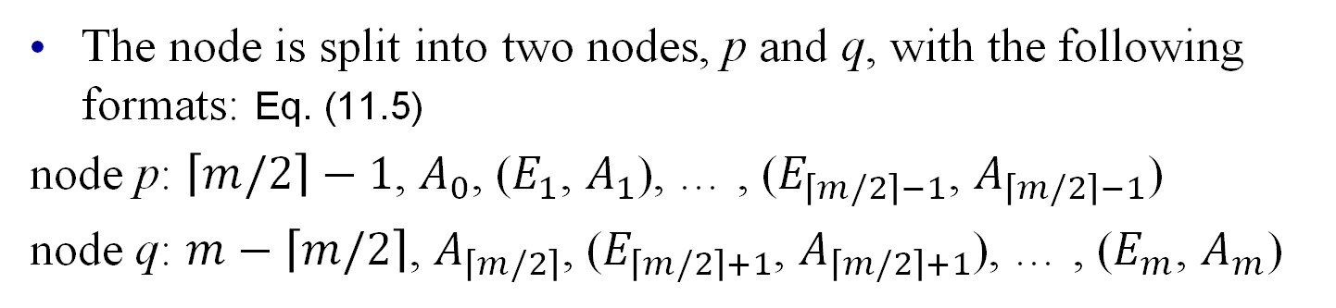
Split an Overfull Node (cont.)
The node is split into two nodes, p and q, with the following formats: Eq. (11.5)
node p: $\left\lceil m/2\right\rceil −1$, $A_{0}$, ($E_{1}$, $A_{1}$), … , ($E_{\left\lceil m/2\right\rceil −1}$, $A_{\left\lceil m/2\right\rceil −1}$)
node q: $m−\left\lceil m/2\right\rceil$, $A_{\left\lceil m/2\right\rceil }$, ($E_{\left\lceil m/2\right\rceil +1}$, $A_{\left\lceil m/2\right\rceil +1}$), … , ($E_{m}$, $A_{m}$)
17
17
15 17 20
15
20
9
16
18
30 40
9
16
18
30 40

Slide 35

Split an Overfull Node (cont.)
The remaining element, $E_{\left\lceil m/2\right\rceil }$, and a pointer to the new node, q, form a tuple ($E_{\left\lceil m/2\right\rceil }$, q). This is to be inserted into the parent of p.
17
15
20
9
16
18
30 40

Slide 36
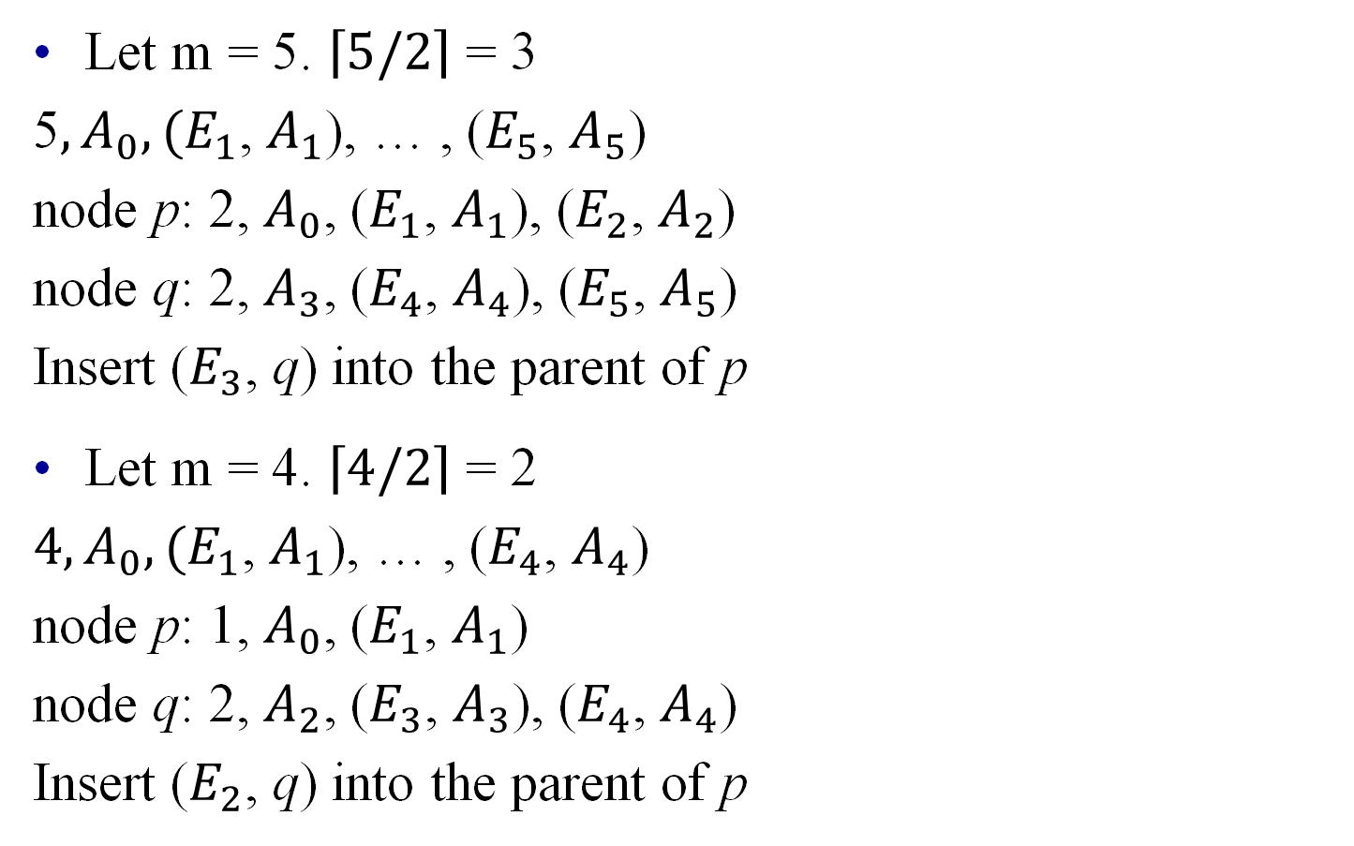
Split an Overfull Node (cont.)
Let m = 5. $\left\lceil 5/2\right\rceil$ = 3
5$, A_{0}, (E_{1}$, $A_{1}$), … , ($E_{5}$, $A_{5}$)
node p: 2, $A_{0}$, ($E_{1}$, $A_{1}$), ($E_{2}$, $A_{2}$)
node q: 2, $A_{3}$, ($E_{4}$, $A_{4}$), ($E_{5}$, $A_{5}$)
Insert ($E_{3}$, q) into the parent of p
Let m = 4. $\left\lceil 4/2\right\rceil$ = 2
$4, A_{0}, (E_{1}$, $A_{1}$), … , ($E_{4}$, $A_{4}$)
node p: 1, $A_{0}$, ($E_{1}$, $A_{1}$)
node q: 2, $A_{2}$, ($E_{3}$, $A_{3}$), ($E_{4}$, $A_{4}$)
Insert ($E_{2}$, q) into the parent of p

Slide 37
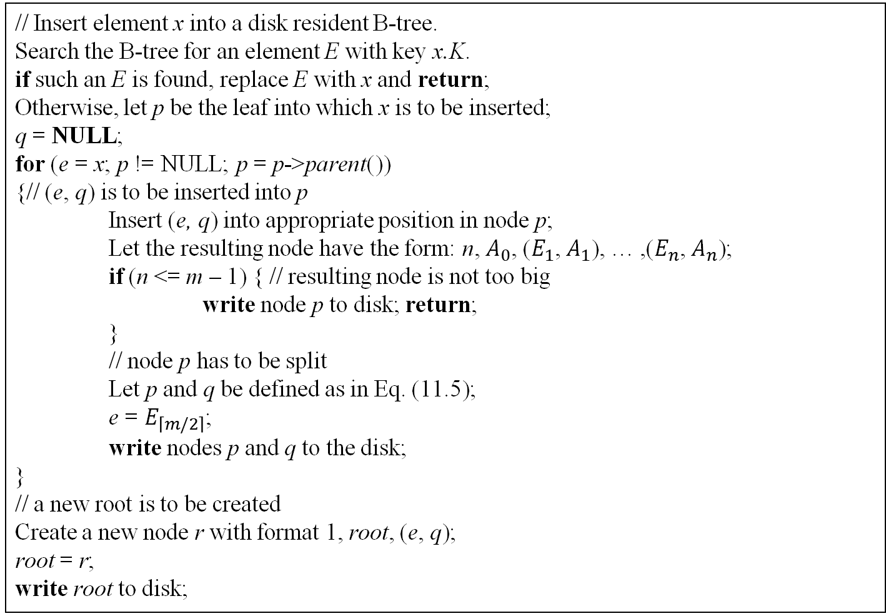
Insertion into a B-Tree
// Insert element x into a disk resident B-tree.
Search the B-tree for an element E with key x.K.
if such an E is found, replace E with x and return;
Otherwise, let p be the leaf into which x is to be inserted;
q = NULL;
for (e = x; p != NULL; p = p->parent())
{// (e, q) is to be inserted into p
Insert (e, q) into appropriate position in node p;
Let the resulting node have the form: n, $A_{0}$, ($E_{1}$, $A_{1}$), … ,($E_{n}$, $A_{n}$);
if (n <= m – 1) { // resulting node is not too big
write node p to disk; return;
}
// node p has to be split
Let p and q be defined as in Eq. (11.5);
e = $E_{\left\lceil m/2\right\rceil }$;
write nodes p and q to the disk;
}
// a new root is to be created
Create a new node r with format 1, root, (e, q);
root = r;
write root to disk;

Slide 38
B⁺-Tree
A B⁺-tree is a close cousin of the B-tree. The essential differences are:
In a B⁺-tree we have two types of nodes—index and data.
The index nodes of a B⁺-tree correspond to the internal nodes of a B-tree while the data nodes correspond to external nodes.
The index nodes store keys (not elements) and pointers and the data nodes store elements (together with their keys but no pointers).
The data nodes are linked together to form a doubly linked list.

Slide 39
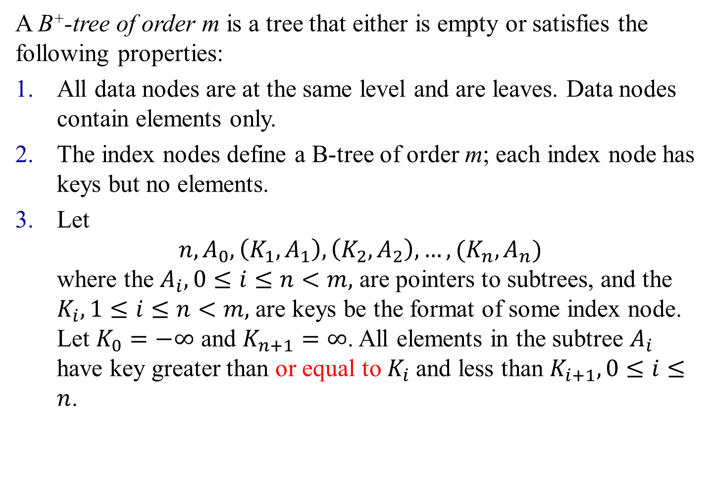
Definition of B⁺-Tree
$$A B+-tree of order m is a tree that either is empty or satisfies the following properties:$$
$$All data nodes are at the same level and are leaves. Data nodes contain elements only.$$
$$The index nodes define a B-tree of order m; each index node has keys but no elements.$$
$$Letn, A_{0}, \left(K_{1},A_{1}\right),\left(K_{2},A_{2}\right), …, (K_{n},A_{n})where the A_{i}, 0≤i≤n<m, are pointers to subtrees, and the K_{i}, 1≤i≤n<m, are keys be the format of some index node. Let K_{0}=−∞ and K_{n+1}=∞. All elements in the subtree A_{i} have key greater than or equal to K_{i} and less than K_{i+1}, 0≤i≤n.$$

Slide 40
Example B⁺-tree
9
5
16 30
1 3
5 6
9
16 17
30 40
index node
leaf/data node
Notes:
Yellow nodes (leaves) have elements; green nodes have keys and pointers. Green nodes are index nodes. Leaf capacity may be different from index-node capacity.

Slide 41
Searching a B⁺-tree
B⁺-trees support two types of searches—exact match and range
Range search
To search for all elements with keys in the range [A, B], we proceed as in an exact match search for the start, A, of the range
We march down (rightward) the doubly linked list of data nodes until we reach a data node that has an element whose key exceeds the end, B, of the search range (or until we reach the end of the list)

Slide 42
B⁺-tree—Search
9
5
16 30
1 3
5 6
9
16 17
30 40
key = 5
6 ≤ key ≤ 20
Notes:
Range search

Slide 43
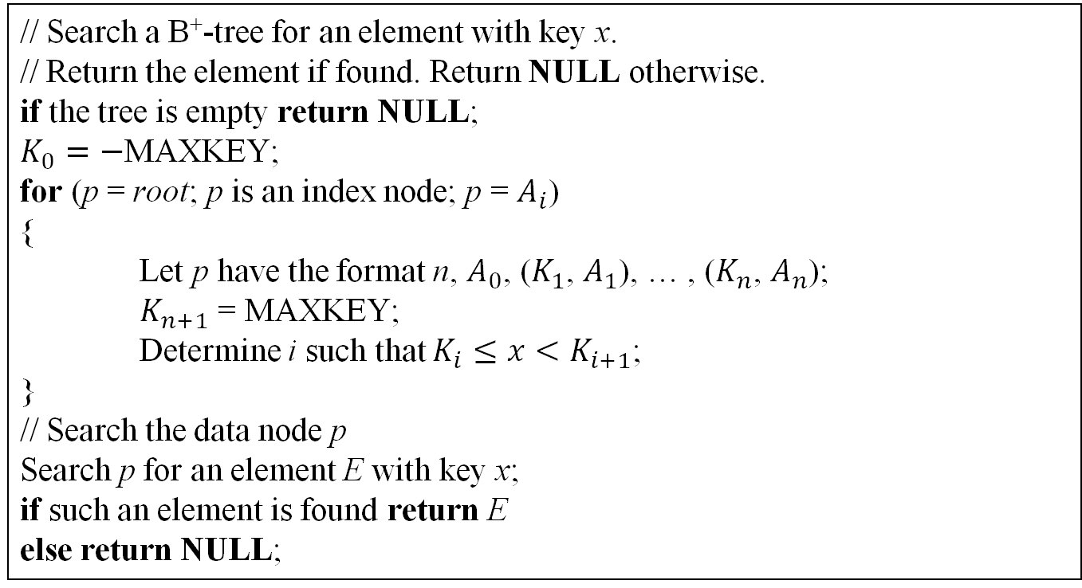
Searching a B⁺-tree (cont.)
// Search a B⁺-tree for an element with key x.
// Return the element if found. Return NULL otherwise.
if the tree is empty return NULL;
$K_{0}=−$MAXKEY;
for (p = root; p is an index node; p = $A_{i}$)
{
Let p have the format n, $A_{0}$, ($K_{1}$, $A_{1}$), … , ($K_{n}$, $A_{n}$);
$K_{n+1}$ = MAXKEY;
Determine i such that $K_{i}≤x<K_{i+1}$;
}
// Search the data node p
Search p for an element E with key x;
if such an element is found return E
else return NULL;

Slide 44
Insertion into a B⁺-tree
An important difference between inserting into a B-tree and inserting into a B⁺-tree is how we handle the splitting of a data node
When a data node becomes overfull, take the m elements (including the one being inserted) in sorted order.
Place the first half in the original node, and the rest in a new node.
Let the new node be q, and let k be the least key value in q. Insert (k, q) into the parent index node (if any) using the insertion procedure for a B-tree
The splitting of an index node is identical to the splitting of an internal node of a B-tree

Slide 45
B⁺-tree—Insert (m = 3)
9
5
16 30
1 3
5 6
9
16 17
30 40
Insert an element with key = 2.
New element goes into a 3-node.

Slide 46
Insert into a 3-node
Insert new key so that the keys are in ascending order.
1 2 3
Split into two nodes.
1
2 3
Insert smallest key in new node and pointer to this new node into parent.
2
1
2 3
Notes:
The code will do all 3 steps as one.

Slide 47
B⁺-tree—Insert (m = 3)
9
5
2
16 30
2 3
1
5 6
9
16 17
30 40
Insert an index entry 2 plus a pointer into parent.

Slide 48
B⁺-tree—Insert (m = 3)
9
2 5
16 30
1
2 3
5 6
9
16 17
30 40
Now, insert an element with key = 18.

Slide 49
B⁺-tree—Insert (m = 3)
9
17
2 5
16 30
17 18
1
2 3
5 6
9
16
30 40
Now, insert an element with key = 18.
Insert an index entry 17 plus a pointer into parent.
Notes:
Insertion of index entries works as for B-trees.

Slide 50
B⁺-tree—Insert (m = 3)
9
17
2 5
16
30
1
2 3
5 6
9
16
17 18
30 40
Now, insert an element with key = 18.
Insert an index entry 17 plus a pointer into parent.
Notes:
Insertion of index entries works as for B-trees.

Slide 51
B⁺-tree—Insert (m = 3)
9 17
2 5
16
30
1
2 3
5 6
9
16
17 18
30 40
Now, insert an element with key = 7.
Notes:
Yellow splits into 5 & 6,7. Index entry 6 is inserted into parent. Parent splits as in a 2-3 tree, grandparent splits, root splits and height increases by 1.

