Slide 1

Cheddar Tracker
Stock Portfolio Manager
by Yingtong Zhou
2023.12.12

Slide 2
Cheddar Tracker
Keep track of daily stock transactions and profits.
Dynamic Form to take user inputs
Inputs: stock symbol, shares, price per share, sell price, purchase date
Update and display entries automatically to the front end
Outputs: dynamic list displaying trades, trading details, total profit/loss

Slide 3
Outline
Intro to Android Studio
Demo Display
Highlights and Implementation
Problem Solving

Slide 4

Intro to Android Studio
MainActivity
OnCreate() -> Main()
setContentView(R.layout.activity_main);
findViewById(R.id.checkPortfolio);
setOnClickListener( onClick() )
Back-end Logic
Virtual Device
Emulator
Front-end Design
Notes:
new Intent的两个参数：
第一个Package context
当前ClassName.this
第二个Bundle options
要跳转的ClassName.class

Slide 5
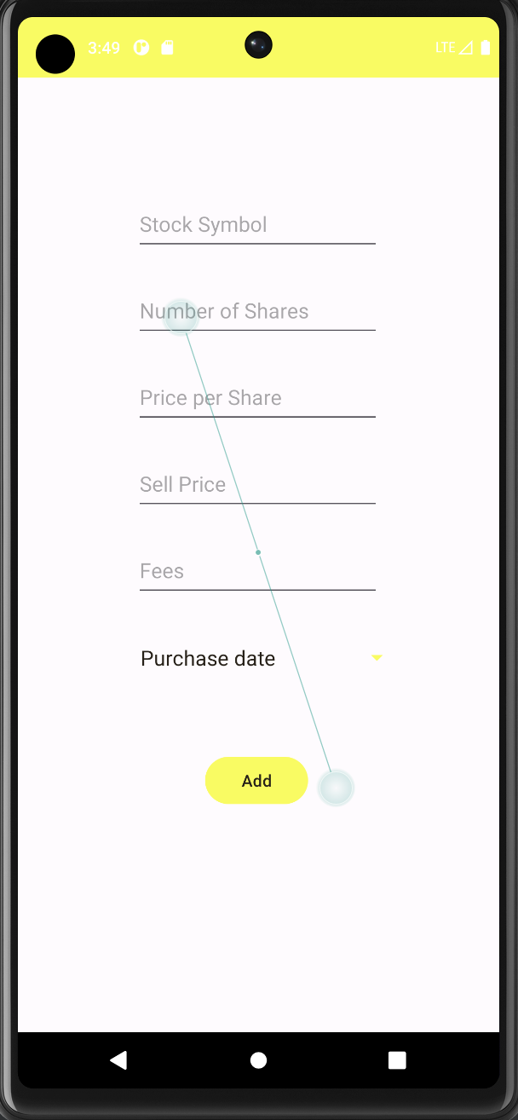
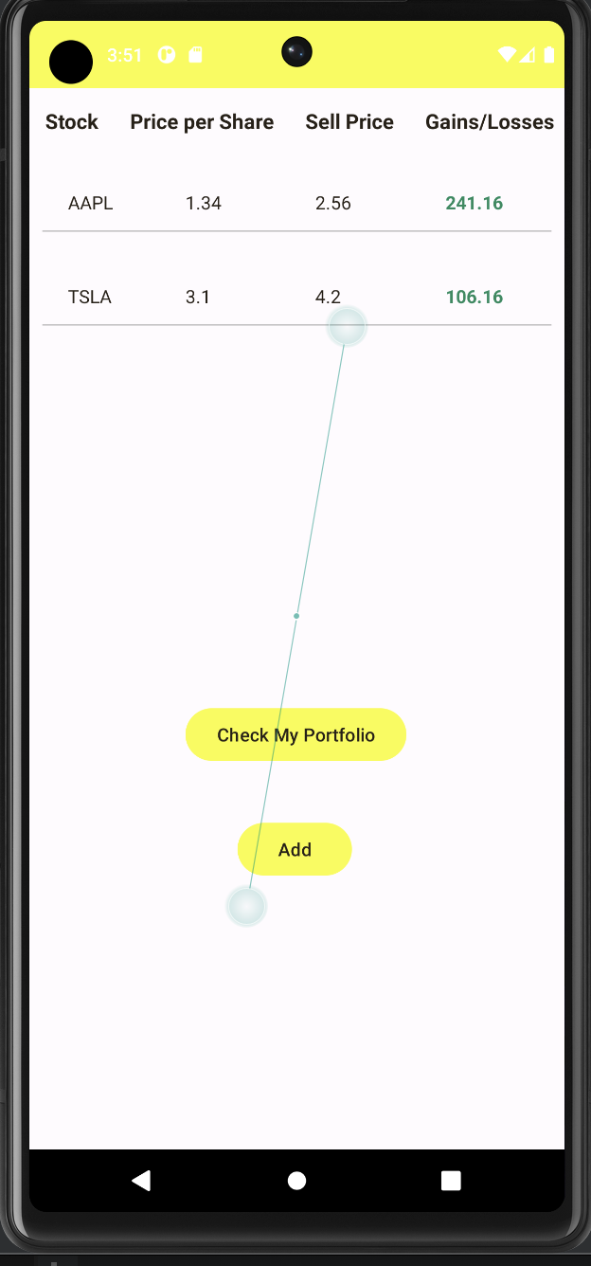
Highlights & Implementation
Dynamic Form
Add
Id (.xml)
Data structure (UserStockPosition)
Store
Write to file (MyApplication, FileManager)
Display
View Holder (RecyclerView)
Design layout and logic (StockAdapter)
Calculation (StockOperations)
Add
Display

Slide 6
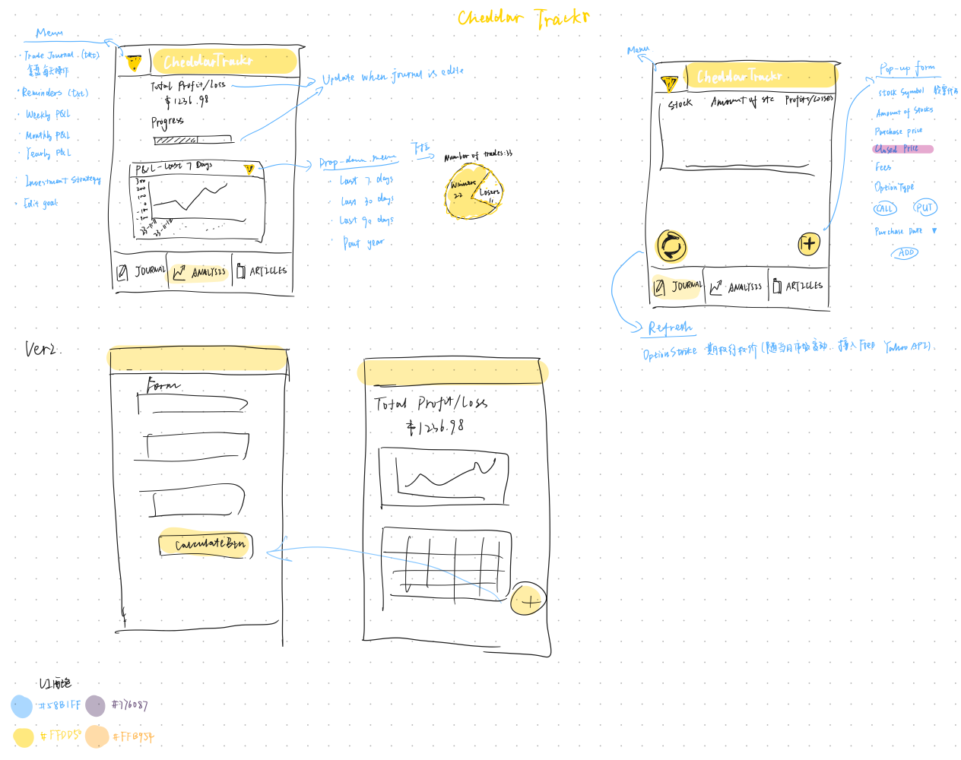
Highlights & Implementation
UI
Drawable
.xml
Visible & Invisible TextView
(empty_list)
TextView v.s. Toast

Slide 7
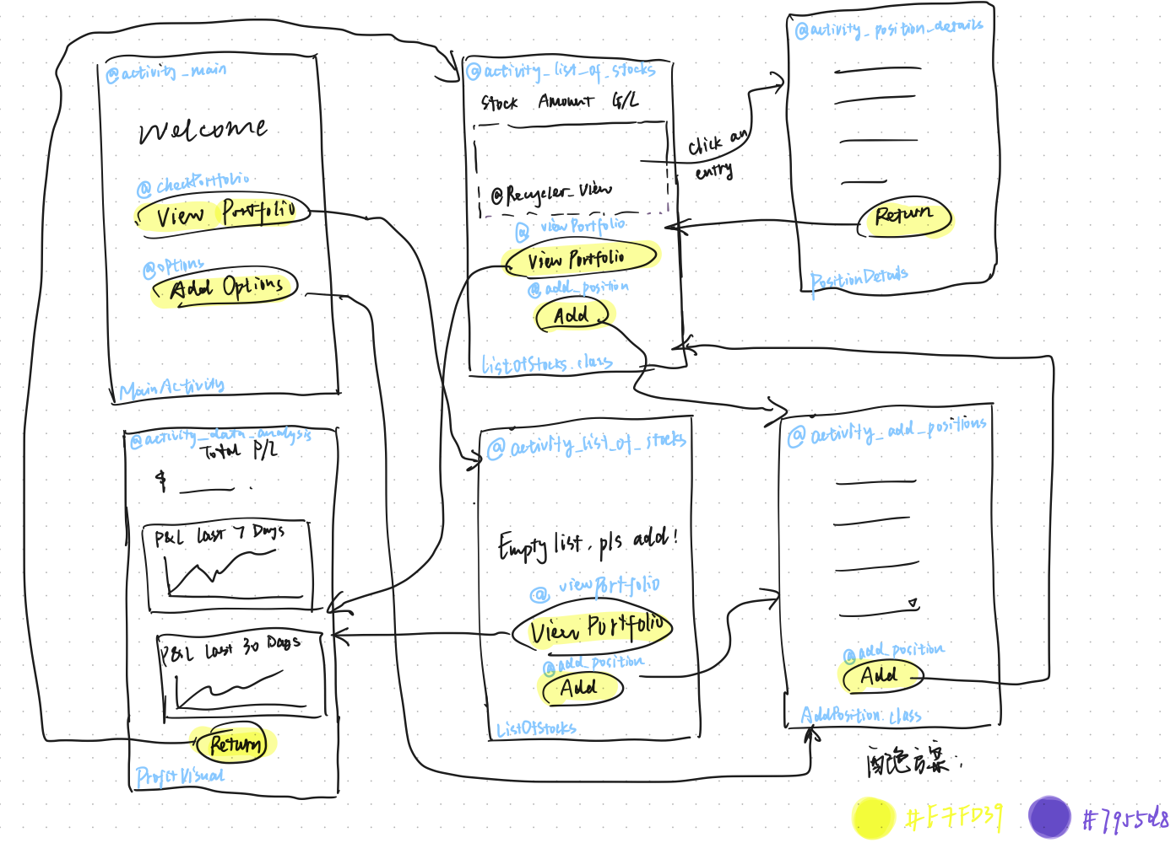

Slide 8
Problem #1. APP Forced Termination
Connect a button with activity
import androidx.appcompat.app.AppCompatActivity;
Class extends AppCompatActivity
setContentView(R.layout.activity_data_analysis);
Button returnButton = findViewById(R.id.return_button);
Put all logic inside OnCreate()
Declare the Activity in Manifest File
<activity android:name=".ListOfStocks"
android:exported="false"/>
Unable to find explicit activity class {com.example.cheddartracker/com.example.cheddartracker.AddPosition}; have you declared this activity in your AndroidManifest.xml?

Slide 9
Problem #2. No display on emulator
Locate the issue
Run another example file (not code issue; emulator)
Read LogCat (debug file log)
Search for solution
Solution
Upgrade SDK version (33 to 34) in gradle file
Downgrade AVD version (34 to 30) in SDK config
Compatibility is essential!

Slide 10
Advanced Features
Data Visualization
https://github.com/PhilJay/MPAndroidChart
Free API Integration
RapidAPI

Slide 11
MainActivity
StockAdapter
onCreate(Bundle):void
onCreate(Bundle):void

