Slide 1
Grid-based models applied to dimers of benzene derivatives: Force-Field and DFT calculations
Notes:
37

Slide 2
Structure
1. Theory
2. GOAT & ORCA results
3. Different grids
3.1. Benzene (bnz)
3.2 Hexafluorobenzene (hfb)
3.3 Bnz + Hfb
4. Conclusion
5. Outlook
2
Notes:
37

Slide 3
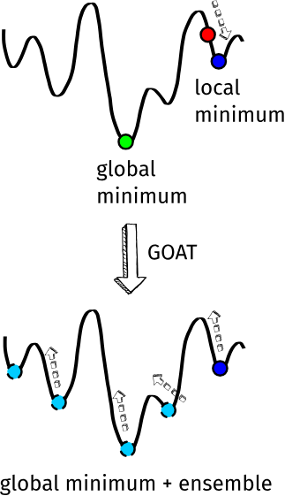
GOAT
Global Optimizer AlgoriThm
Local minimum
Uphill push (small random displacement)
Local optimization (downhill)
Reject if known or higher
In-/decrease E_kin
Repeat
several „workers“ parallel → efficient
Found conformers are new starting points
No guarantee for global minimum!
https://www.faccts.de/docs/orca/6.0/manual/contents/typical/GOAT.html
3
B. de Souza, Angew. Chem. Int. Ed. 2025, 64, e202500393.

Slide 4
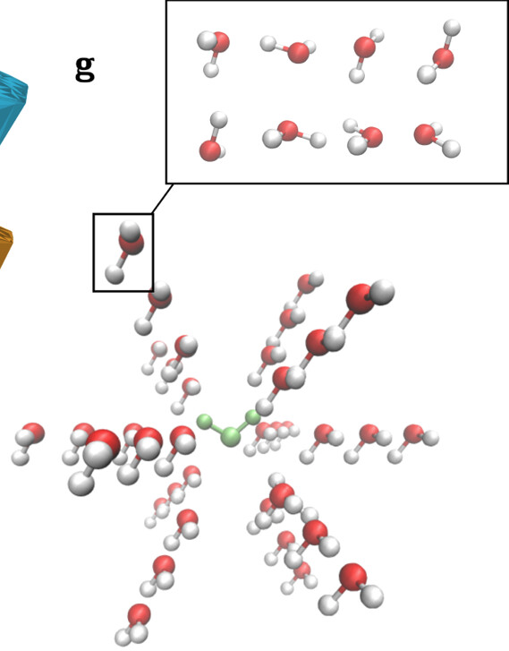
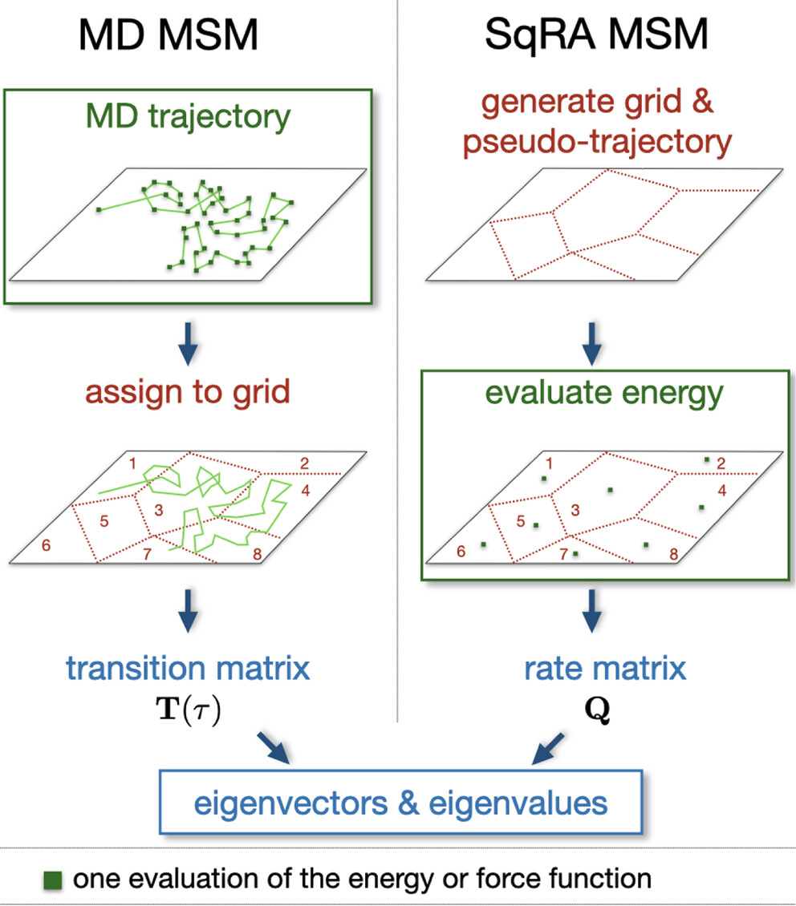
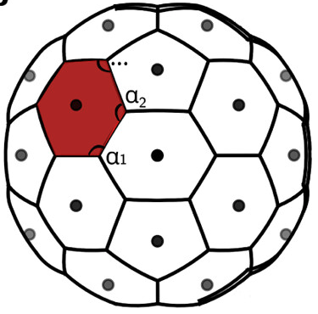
MolGri
Every energy is calculated once
→ DFT possible
Whole configurational space is explored
3
H. Zupan, B. G. Keller, Journal of Chemical Theory and Computation 2025, 21, 614-628.

Slide 5

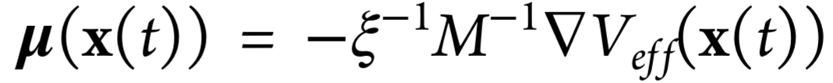
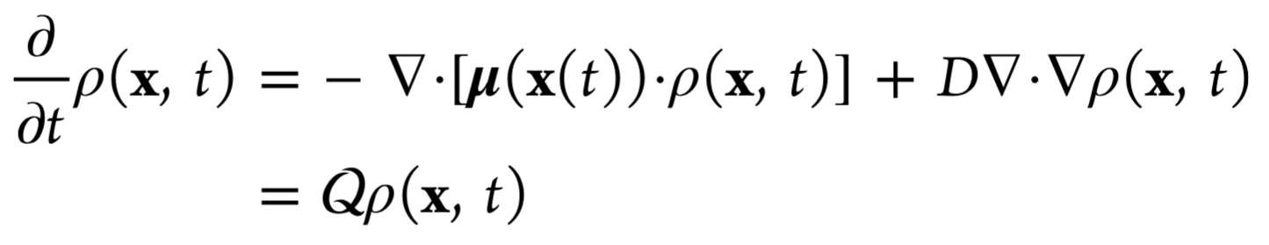
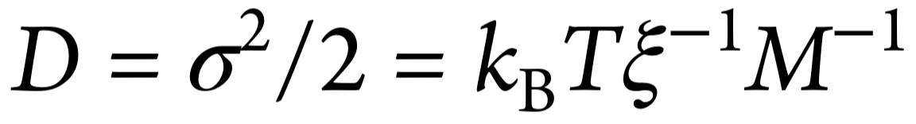
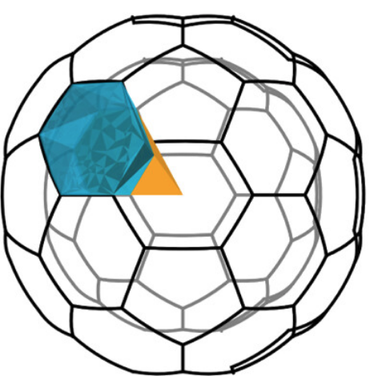
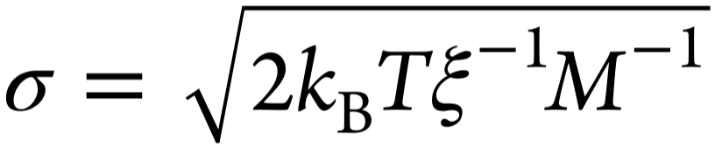
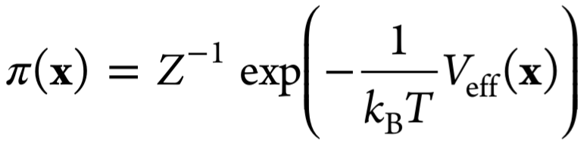
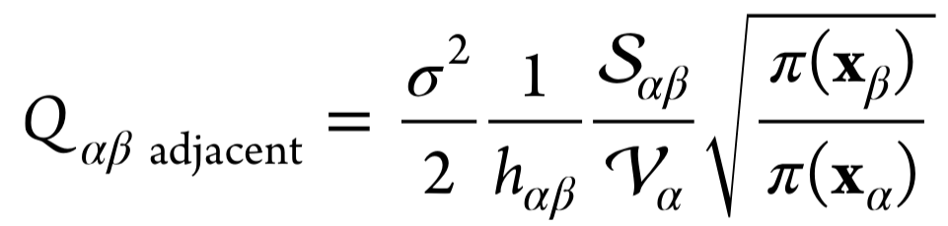
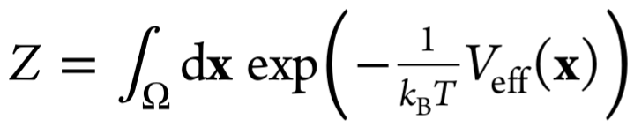
SQRA
Fokker-Planck equation:
Square Root Approximation:
: friction
probability density
drift vector
diffusion constant
Fokker-Planck operator
volatility
surface
rate matrix
stationary density
distance
volume
partition function:
5
H. Zupan, B. G. Keller, Journal of Chemical Theory and Computation 2025, 21, 614-628.

Slide 6
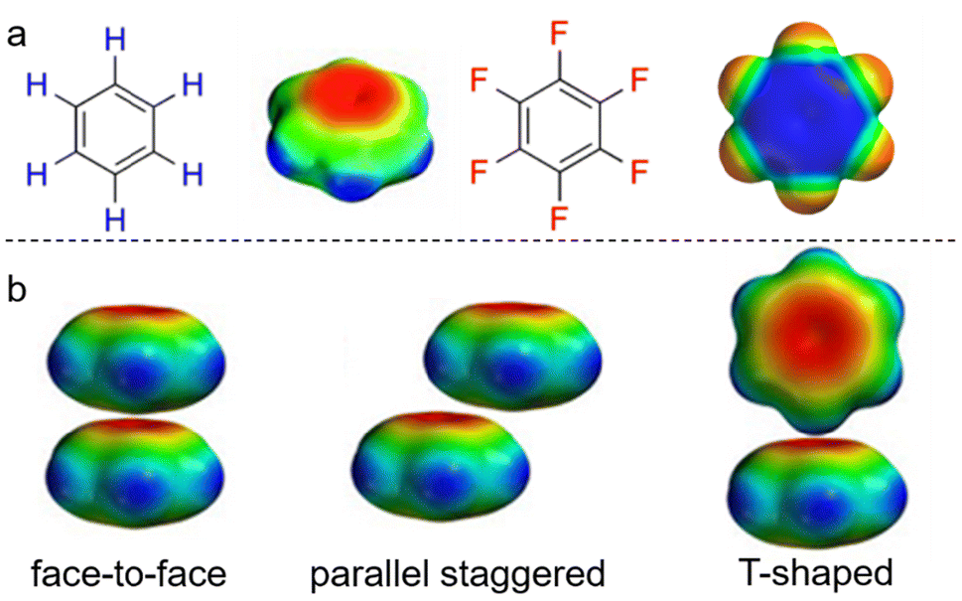
Benzene dimer
Parallel displaced and
t-shaped both very low in energy
No computational study for dimer of two hexafluorobenzenes, but neutron diffration studies: t-shaped
 | sandwich | parallel displaced | t-shaped
CCSD(T)/aug-cc-pVDZ* | 3.8 | 0.1 | 0.0
CCSD(T)/aug-cc-pVQZ* (est.) | 3.9 | 0.0 | 0.1
5
J. M. Steed, T. A. Dixon, W. Klemperer, J. Chem. Phys. 1979, 70, 4940–4946.
Q. Cheng, P. Xing, Nanoscale 2025, 17, 16056-16070.

Slide 7
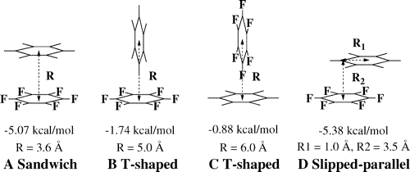
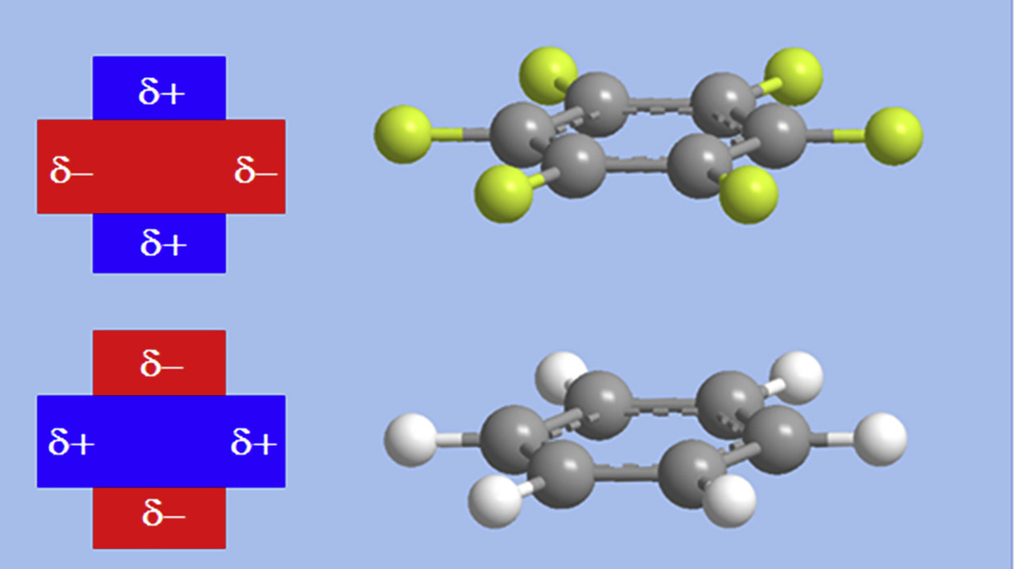
Benzene & Hexafluorobenzene dimer
Parallel displaced and sandwich are preferred
S. Mallick et al., iScience 2019, 22, 269-287.
S. Tsuzuki, T. Uchimaru, M. Mikami, J. Phys. Chem. A 2006, 110, 2027-2033.
 | sandwich | t-shaped | t-shaped | parallel displaced
MP2/aug-cc-pVTZ | 1.8 | 21.3 | 26.4 | 0.0
CCSD(T)/aug(d)-6-311G* (est.) | 1.3 | 15.2 | 18.8 | 0.0
5
K. Hiraoka, S. Mizuse, S. Yamabe, J. Phys. Chem. 1990, 94, 3689–3694.
Q. Cheng, P. Xing, Nanoscale 2025, 17, 16056-16070.

Slide 8
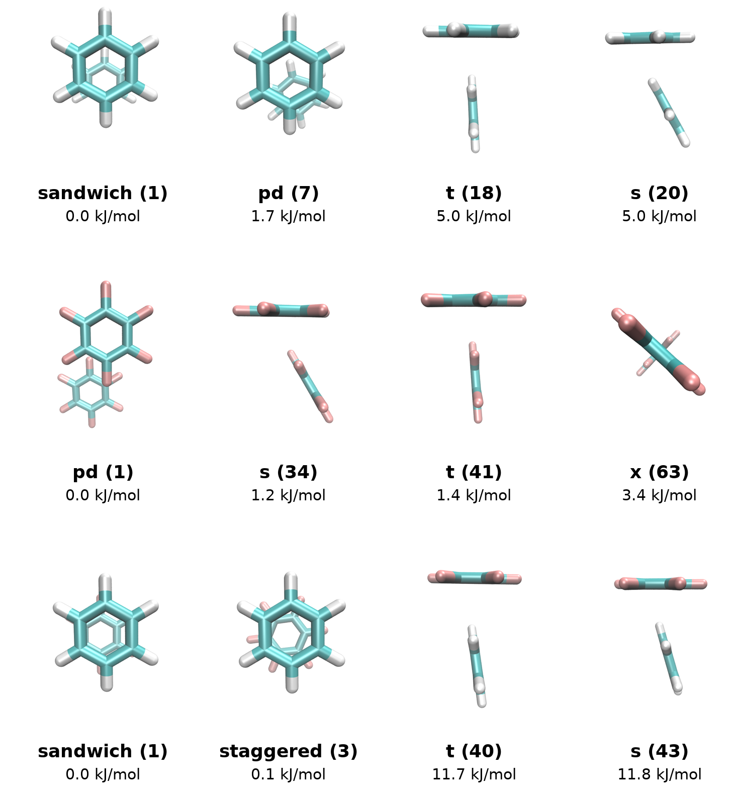
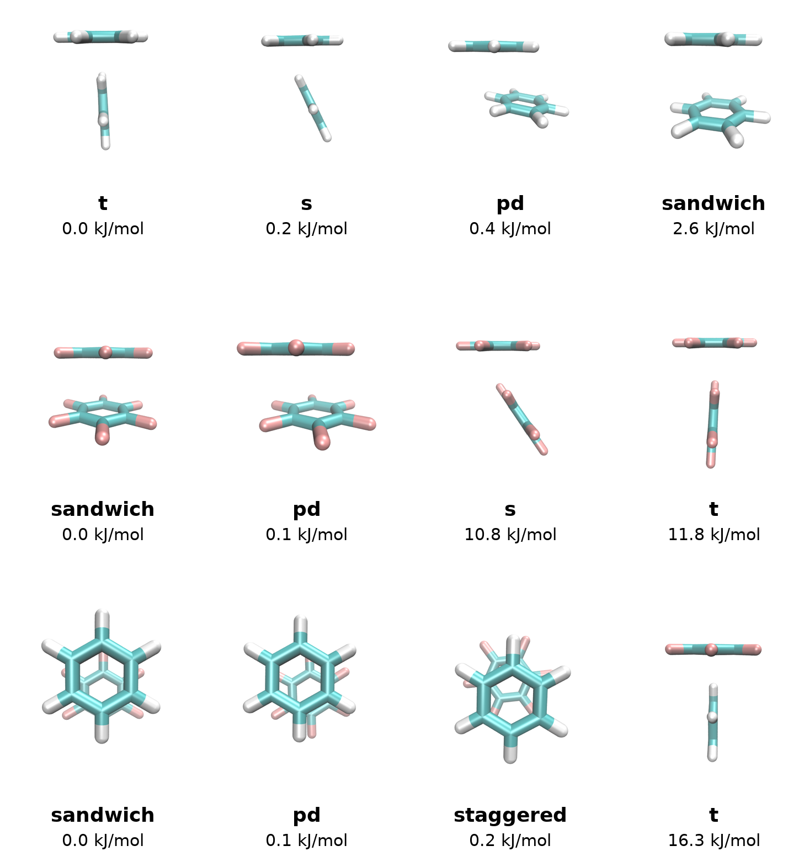
GOAT Results
ORCA Results
5
XTB ALPB(benzene)
PBE0 D3 DEF2-TZVP

Slide 9
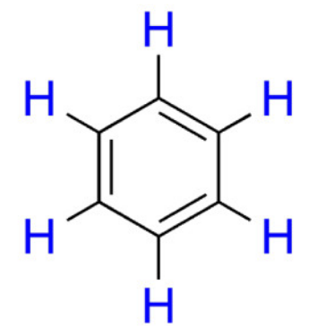
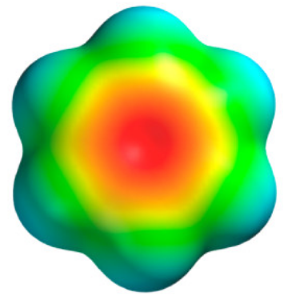
Benzene
5
C. J. Pace, J. Gao, Acc. Chem. Res. 2013, 46, 907-915.

Slide 10
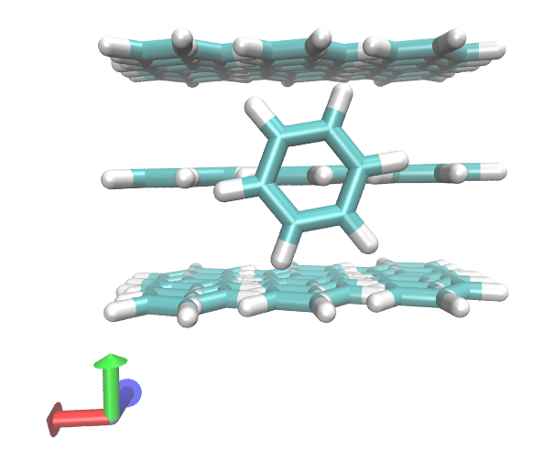
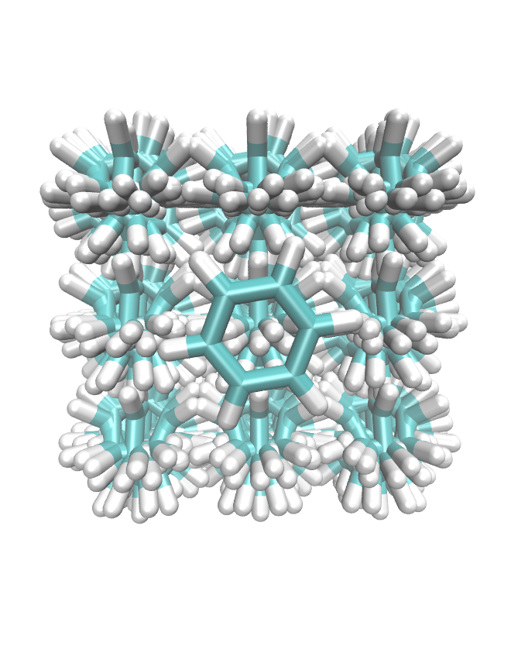
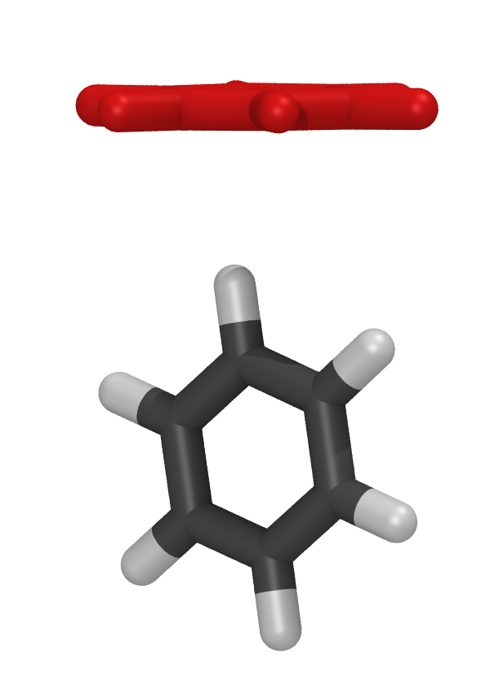
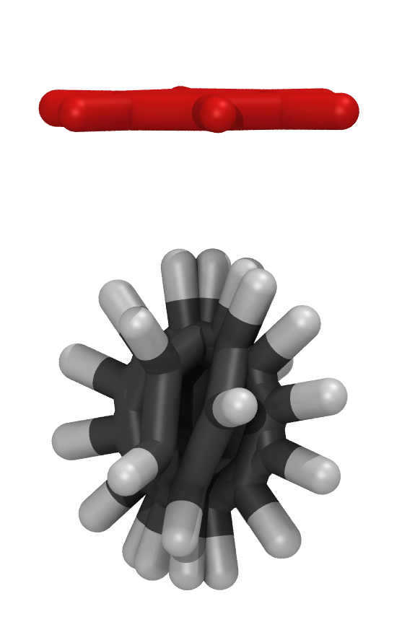
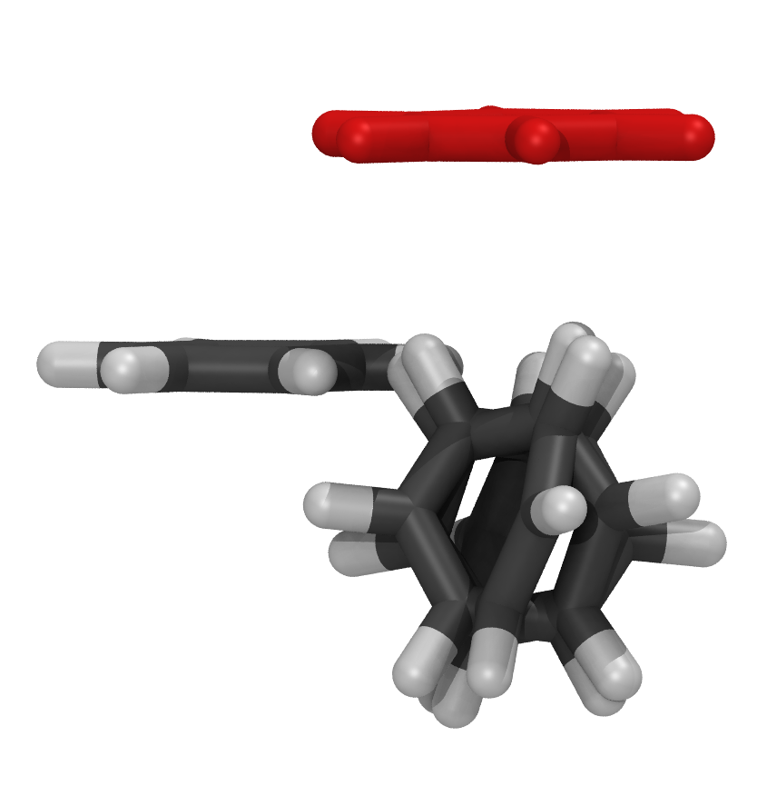
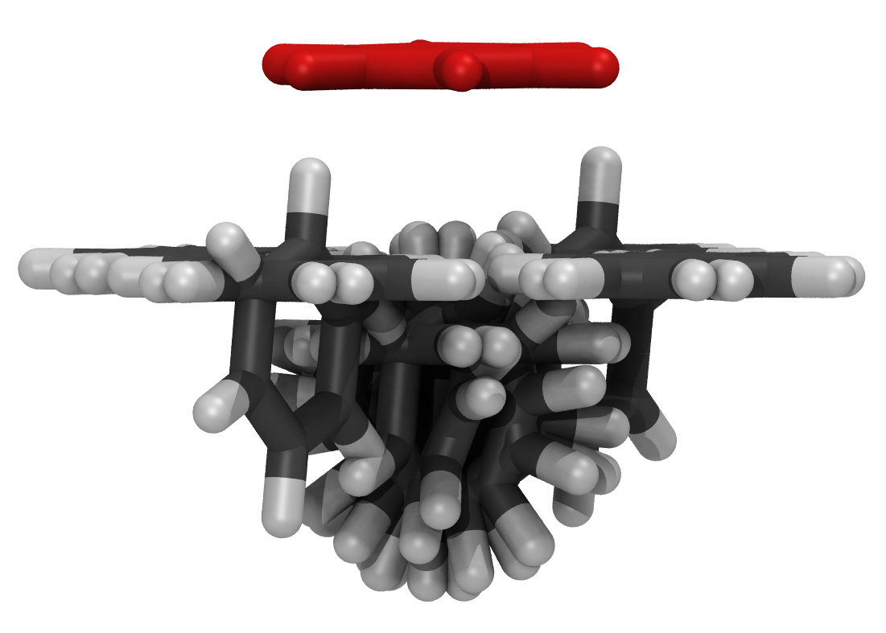
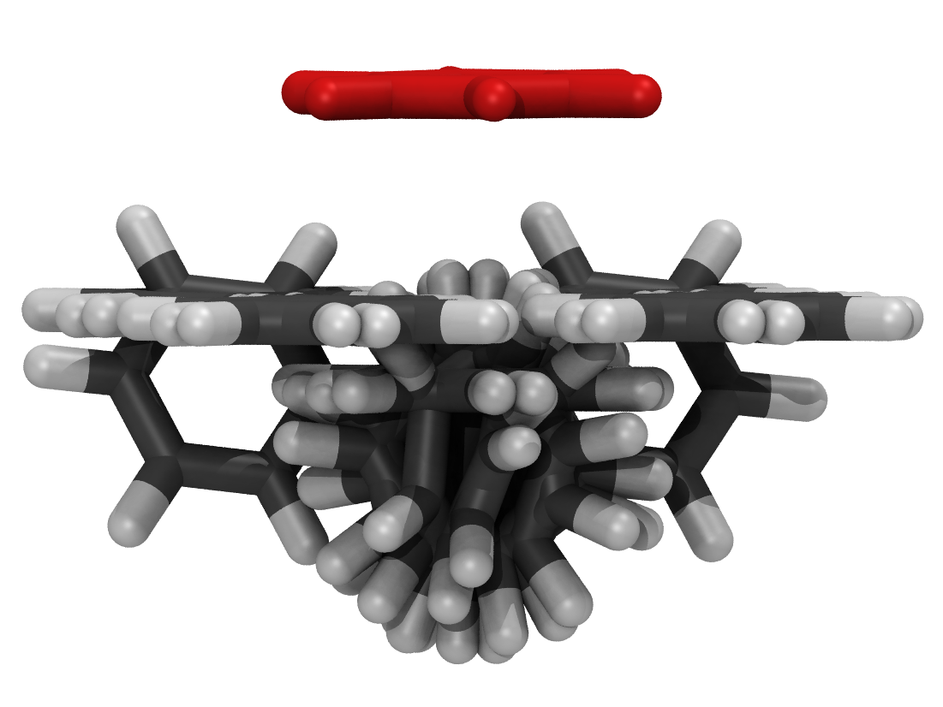
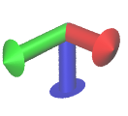
cart_10_3_3_3
Nrot
x
y
z
[ [-4,4,3], [-4,4,3], [3, 5, 3] ]
270 structures
DFT
FF
1
5
20
1
5
20
5
→ t-shaped/pd
5
Notes:
37

Slide 11
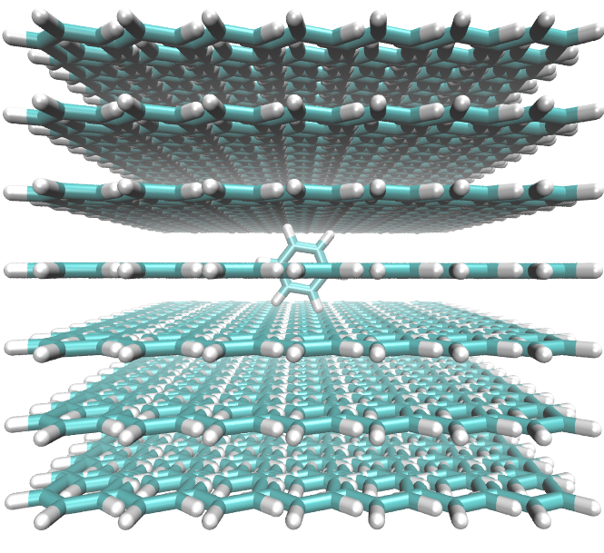
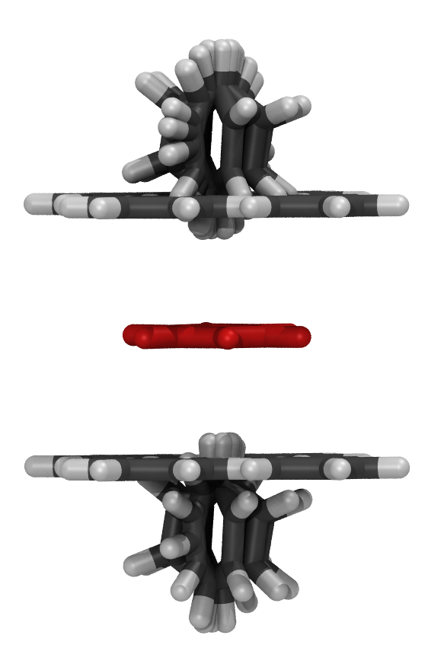
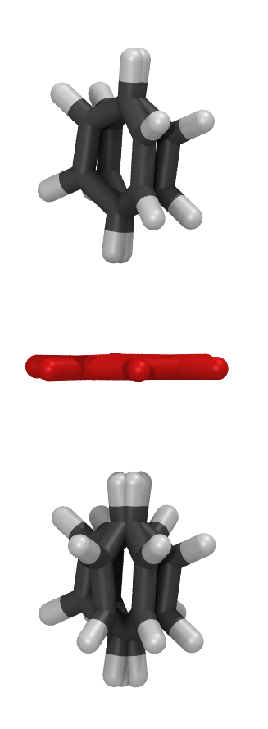
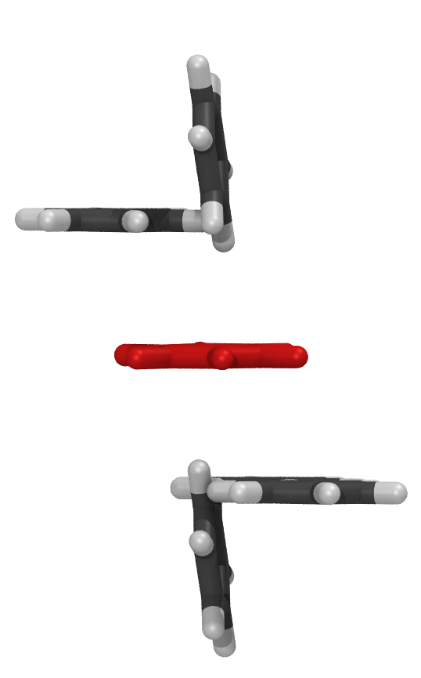
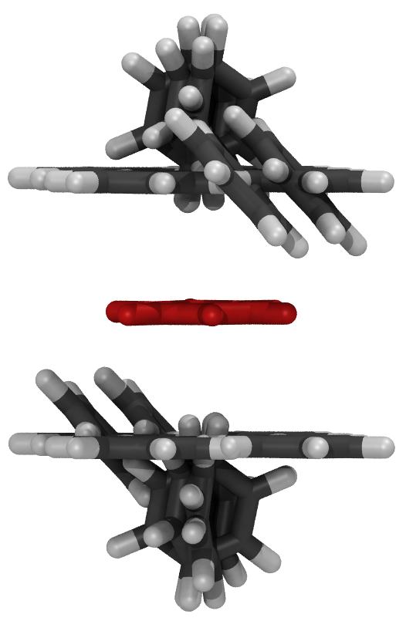
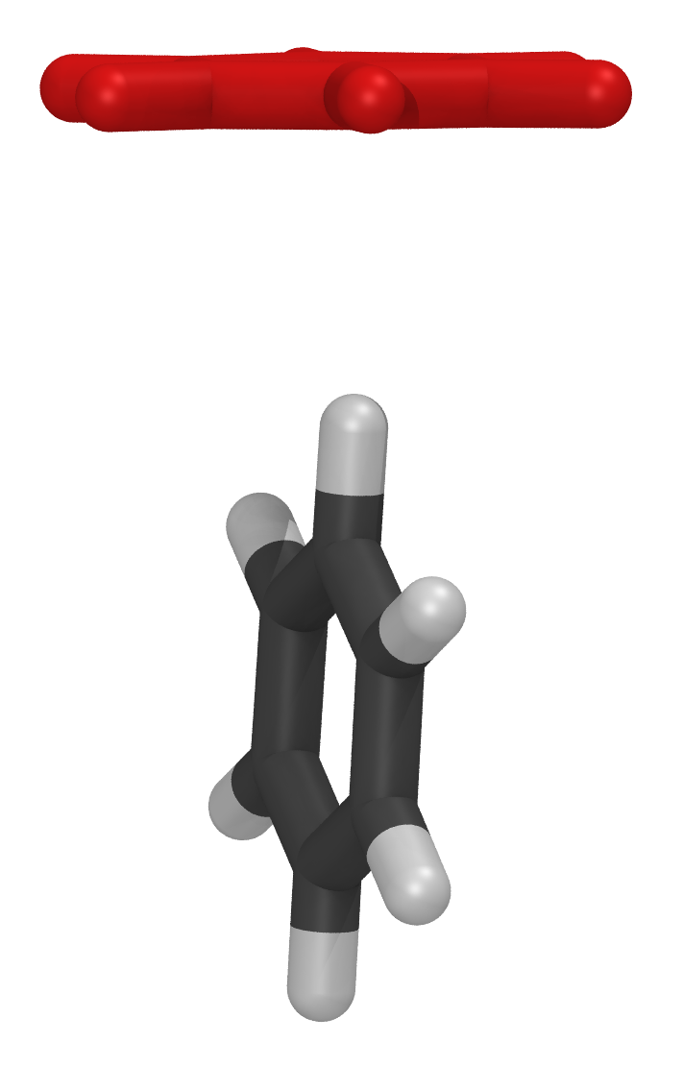
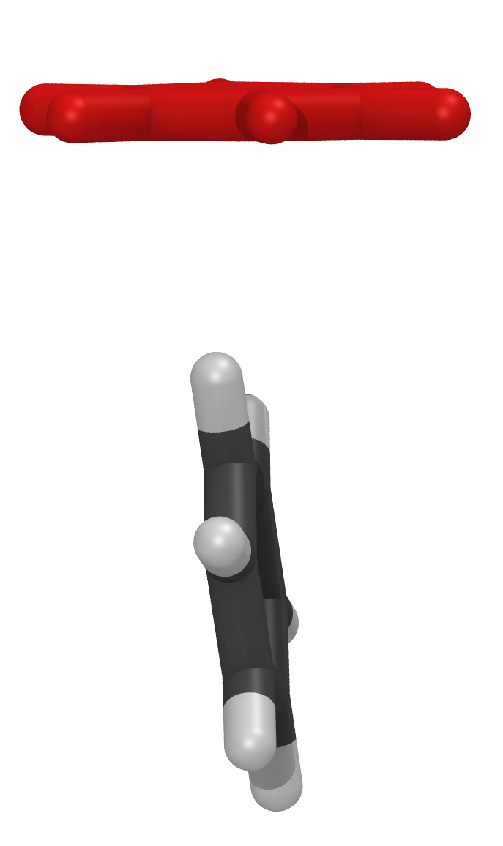
cart_50_7_7_11
[[-9, 9, 7], [-9, 9, 7], [-9, 9, 11]]
26 950 structures
DFT
FF
→ t-shaped/pd
5
Notes:
37

Slide 12
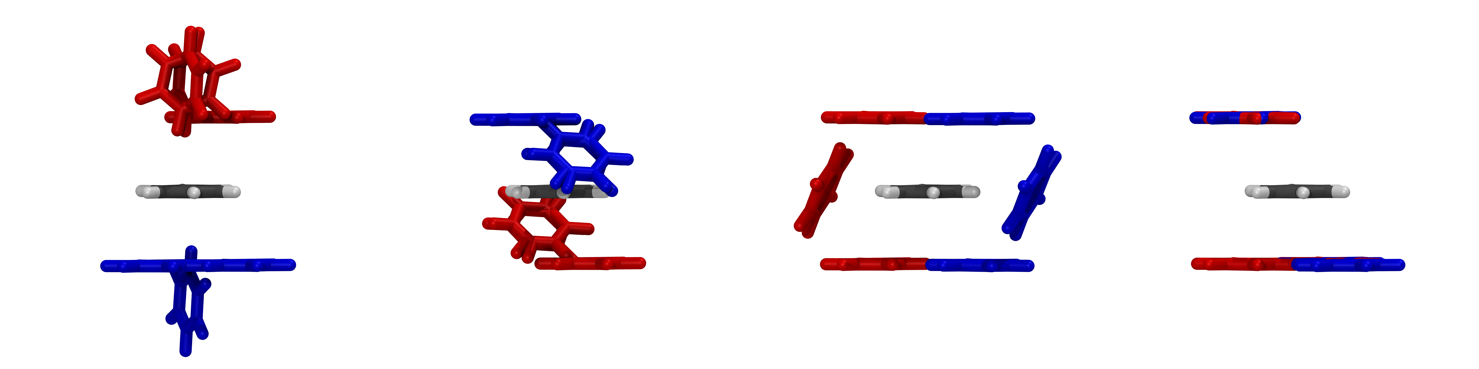
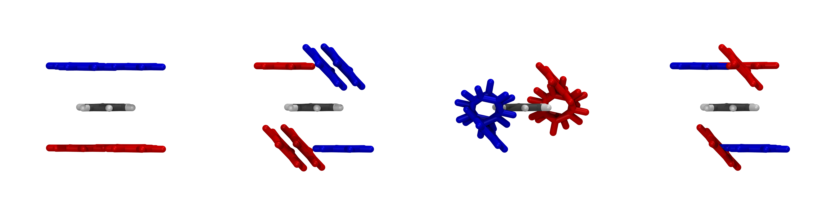
cart_50_7_7_11
DFT
[[-9, 9, 7], [-9, 9, 7], [-9, 9, 11]]
26 950 structures
FF
5
Notes:
37

Slide 13
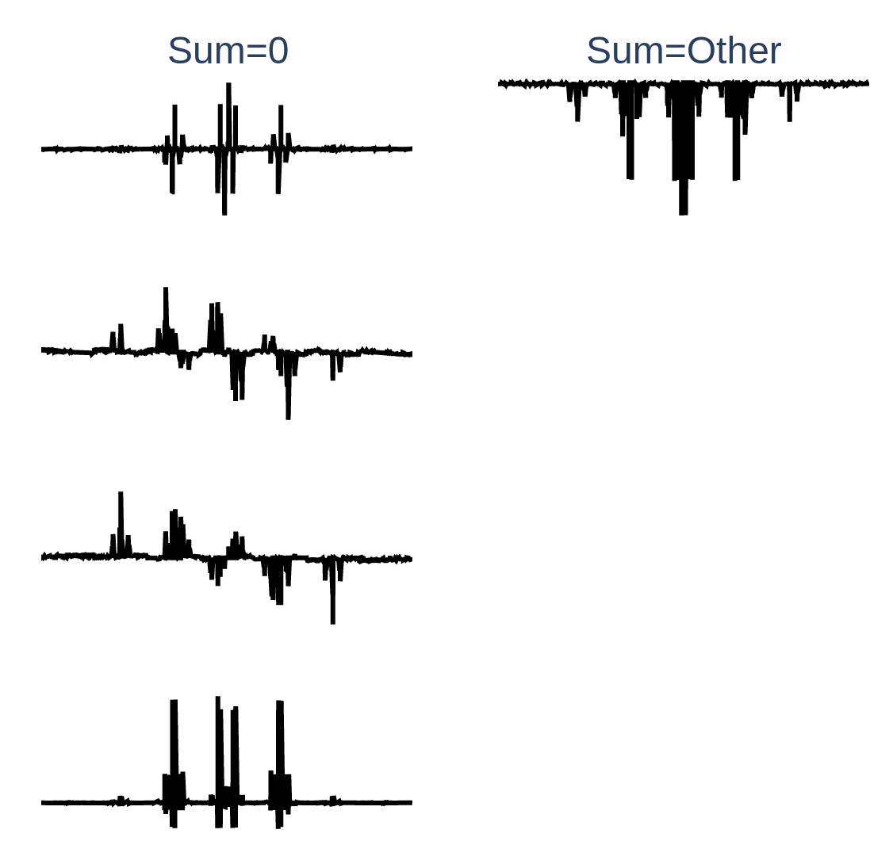
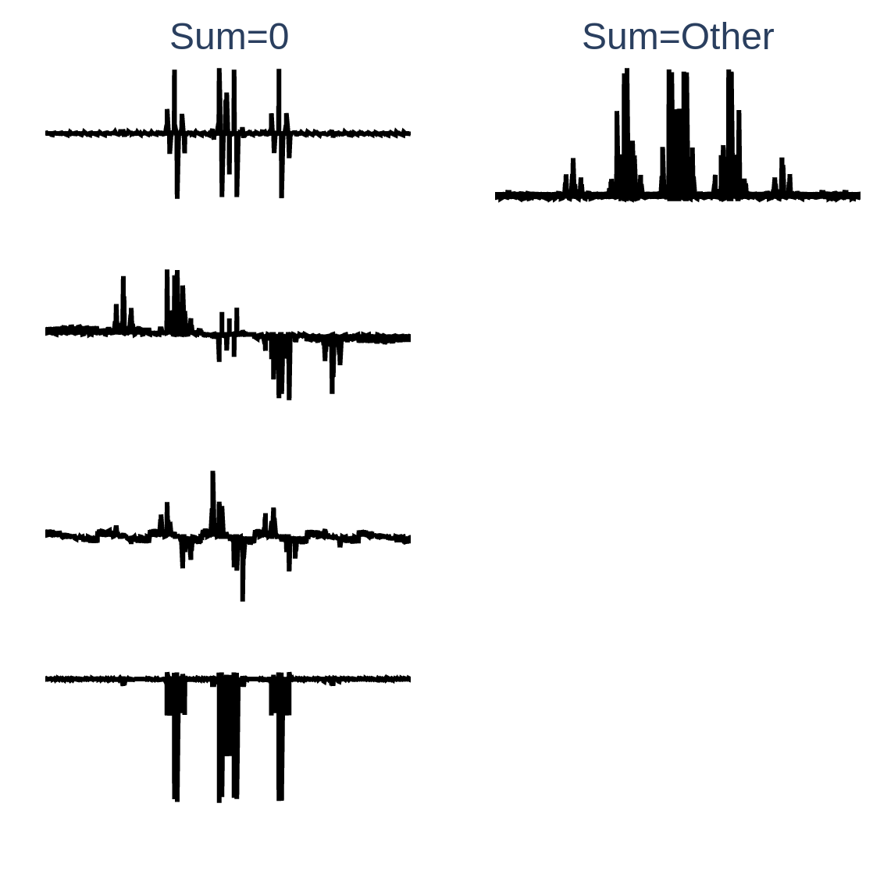
cart_50_7_7_11
[[-9, 9, 7], [-9, 9, 7], [-9, 9, 11]]
26 950 structures
DFT
FF
5
Notes:
37

Slide 14
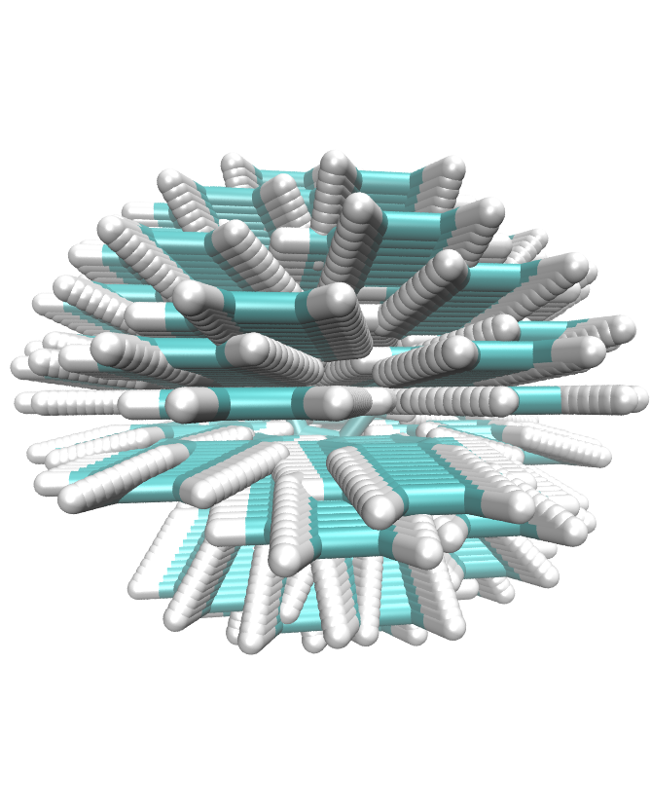
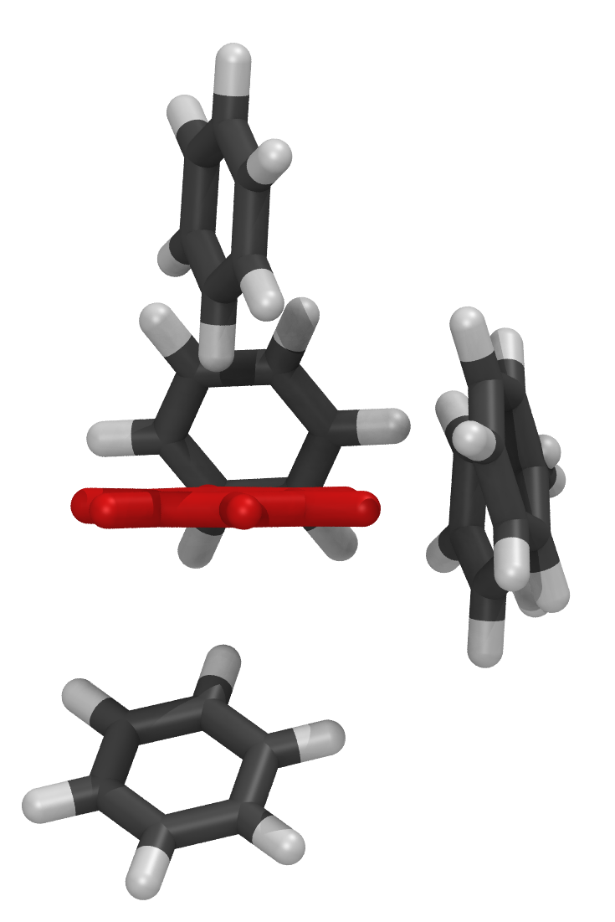
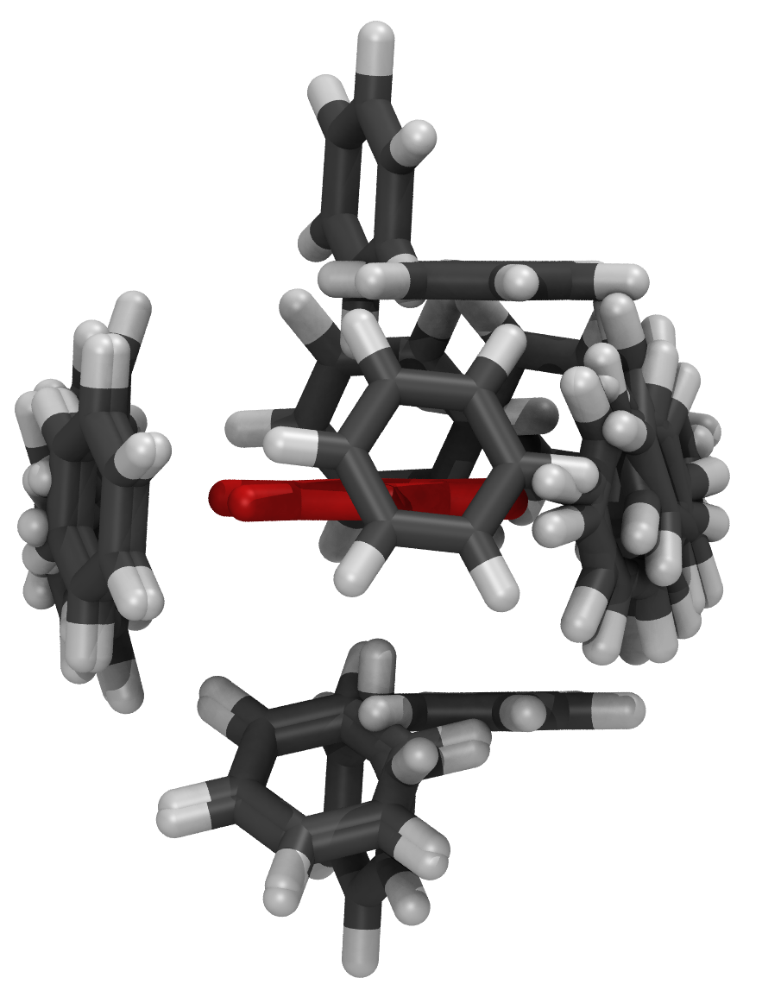
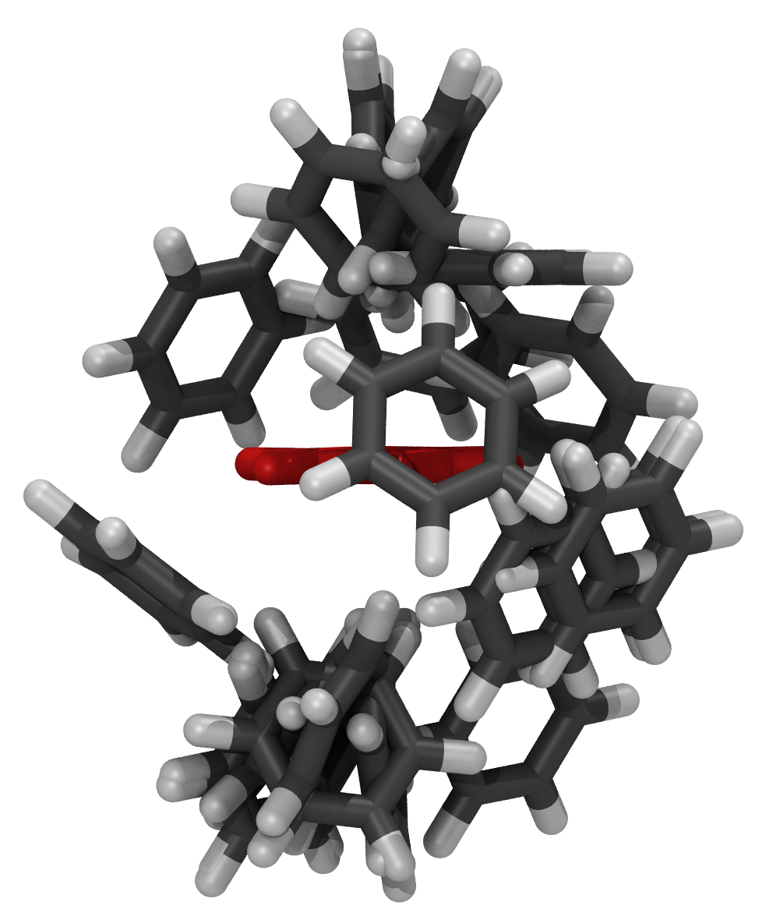
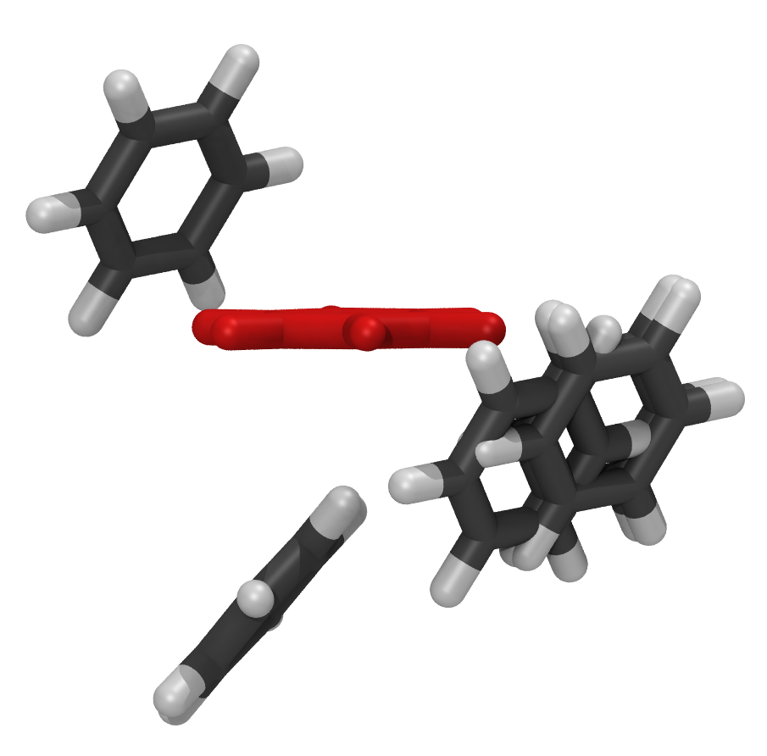
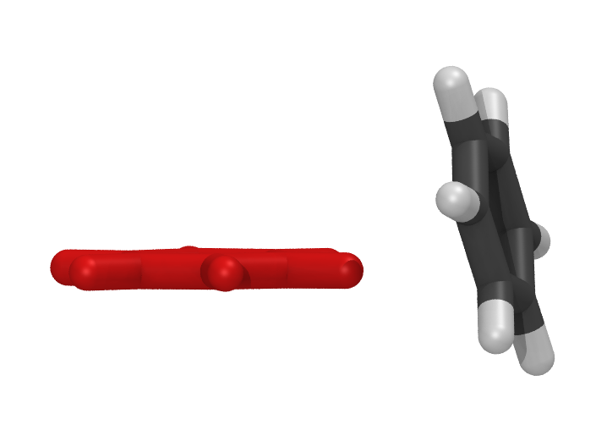
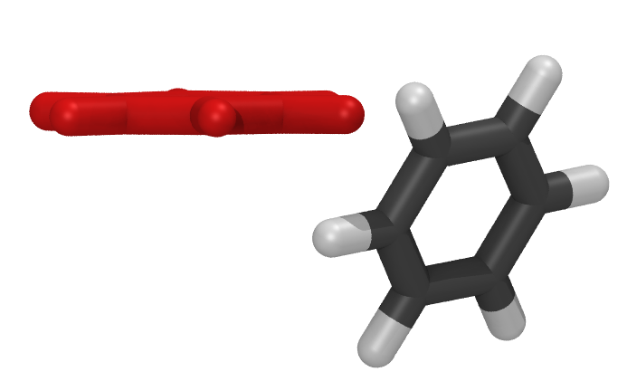
spherical_50_80_11
50, [80, [4, 6, 11]]
44 000 structures
DFT
FF
5
Notes:
37

Slide 15
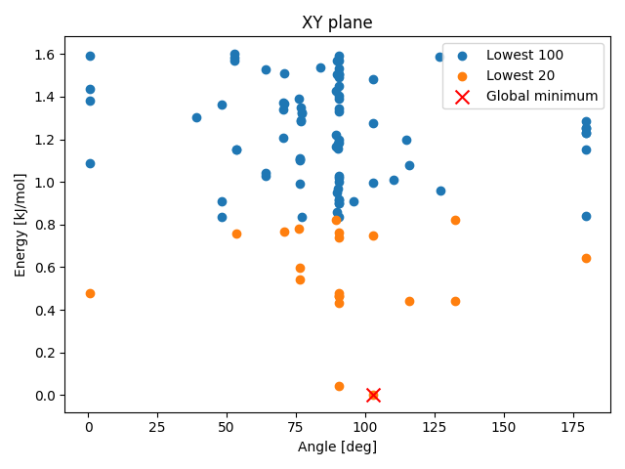
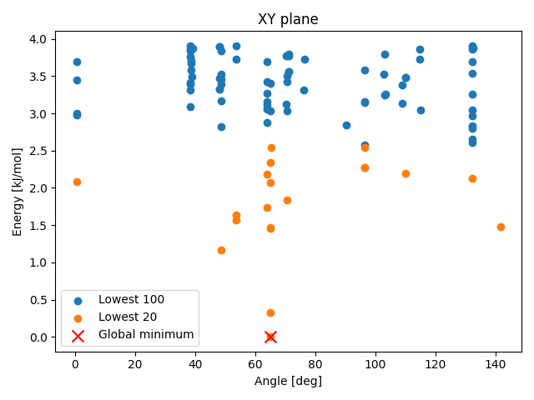
spherical_50_80_11
50, [80, [4, 6, 11]]
44 000 structures
DFT
FF
5
Notes:
37

Slide 16
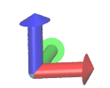
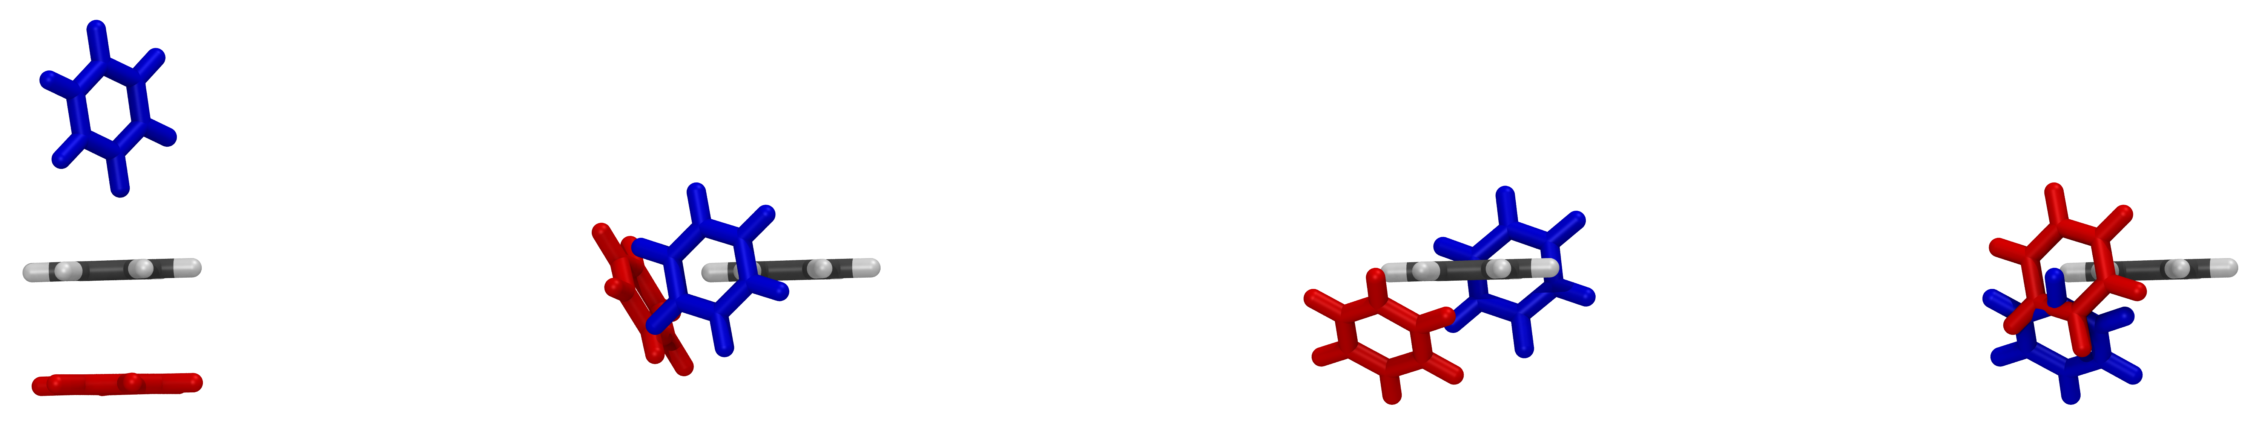
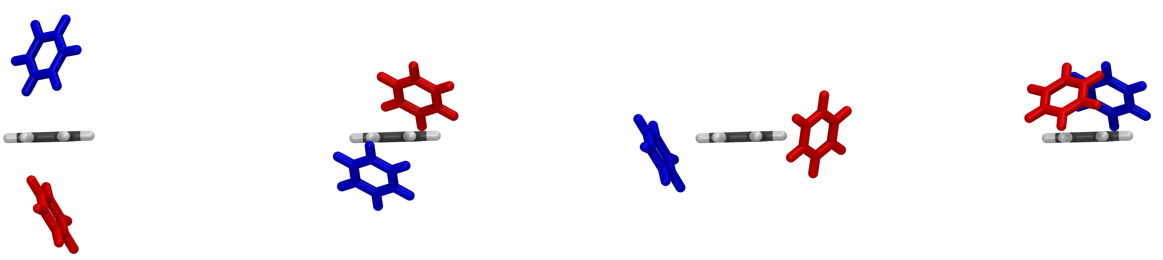
spherical_50_80_11
50, [80, [4, 6, 11]]
44 000 structures
DFT
FF
5
Notes:
37

Slide 17


spherical_50_80_11
50, [80, [4, 6, 11]]
44 000 structures
DFT
FF
5
Notes:
37

Slide 18


Hexafluorobenzene
5
C. J. Pace, J. Gao, Acc. Chem. Res. 2013, 46, 907-915.

Slide 19







cart_50_7_7_11
[[-9, 9, 7], [-9, 9, 7], [-9, 9, 11]]
26 950 structures
DFT
FF
5
Notes:
37

Slide 20


cart_50_7_7_11
[[-9, 9, 7], [-9, 9, 7], [-9, 9, 11]]
26 950 structures
DFT
FF
5
Notes:
37

Slide 21


cart_50_7_7_11
[[-9, 9, 7], [-9, 9, 7], [-9, 9, 11]]
26 950 structures
DFT
FF
5
Notes:
37

Slide 22

Benzene + Hexafluorobenzene
5
C. J. Pace, J. Gao, Acc. Chem. Res. 2013, 46, 907-915.

Slide 23








cart_100_1_1_100
[ [0,0,1], [0,0,1], [2, 12, 100] ]
10 000 structures
DFT
FF
5
Notes:
37

Slide 24


cart_100_1_1_100
[ [0,0,1], [0,0,1], [2, 12, 100] ]
10 000 structures
DFT
FF
5
Notes:
37

Slide 25


cart_100_1_1_100
[ [0,0,1], [0,0,1], [2, 12, 100] ]
10 000 structures
DFT
FF
5
Notes:
37

Slide 26



cart_100_1_1_100
[ [0,0,1], [0,0,1], [2, 12, 100] ]
10 000 structures
DFT
FF
5
Notes:
37

Slide 27
Conclusion
Conformer search works well
Small grids also good, but no eigenvectors
27

Slide 28



Outlook
A. Gupta, T. Stait-Gardner, W.S. Price, Adsorption 2021, 27, 503–533.
Until now MolGri has only isotropic diffusion
How hard is this approximation?
analytical binding rates kon
Compare analytical solution, HOOMD and MolGri
HOOMD: Brownian dynamics for rigid bodies
Use patchy particles (C60 Fullerenes)
Use rod- and disc-lilke molecules
https://en.wikipedia.org/wiki/Fullerene
G. Doppelbauer et al., Soft Matter 2012,8, 7768-7772.
28

Slide 29
Thank you for listening!

Slide 32






cart_50_7_7_11
[[-9, 9, 7], [-9, 9, 7], [-9, 9, 11]]
26 950 structures
DFT
FF
28
Notes:
37

Slide 33


cart_50_7_7_11
[[-9, 9, 7], [-9, 9, 7], [-9, 9, 11]]
26 950 structures
DFT
FF
28
Notes:
37

Slide 34


cart_50_7_7_11
[[-9, 9, 7], [-9, 9, 7], [-9, 9, 11]]
26 950 structures
DFT
FF
28
Notes:
37

Slide 35


cart_50_7_7_11
[[-9, 9, 7], [-9, 9, 7], [-9, 9, 11]]
26 950 structures
DFT
FF
28
Notes:
<number>

Slide 36


cart_50_7_7_11
[[-9, 9, 7], [-9, 9, 7], [-9, 9, 11]]
26 950 structures
DFT
FF
28
Notes:
<number>

Slide 37


Outlook
HYDROPRO
A. Gupta, T. Stait-Gardner, W.S. Price, Adsorption 2021, 27, 503–533.
Anisotropic diffusion
Before: diffusion constant D
Goal: Find diffusion tensor (trans + rot)
Implement into MolGri
→ get better rates
B. Carrasco, J. García de la Torre, Biophysical Journal 1999, 76, 3044-3057.
37

