Slide 1
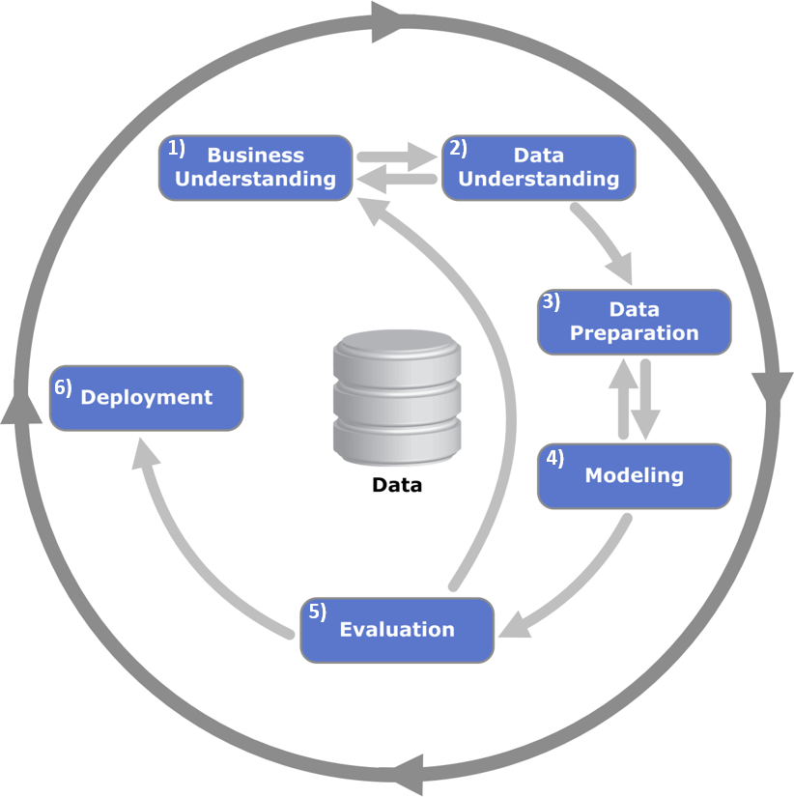
CRISP-DM
Cross Industry Standard Process for Data Mining
Wirth, R., & Hipp, J. (2000). CRISP-DM: Towards a standard process model for data mining. Proceedings of the 4th International Conference on the Practical Applications of Knowledge Discovery and Data Mining, 29–39.

