Slide 1

GIT Basics And Usage
Introduction
Architecture
Basic Workflows
GIT + Eclipse
Branching + Merging
Useful Commands, Further Gadgets
Discussion

Slide 2
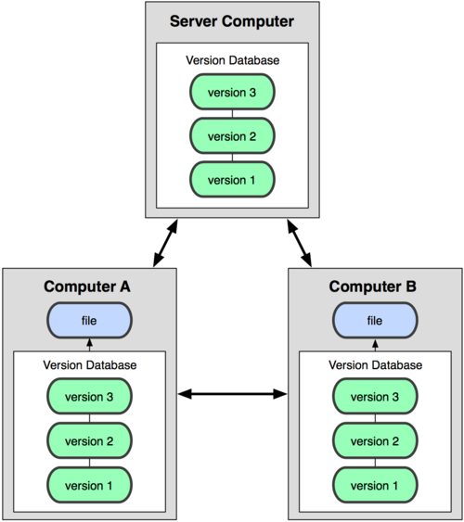

GIT
distributed version control system
svn checkout <url>: get the latest version of a repository git clone <url>: get everything, the complete history
working offline is simple, of incredible speed
no single point of failure
supports much more workflows than traditional vcs
all metadata in one directory (usualy .git), not one meta-directory in each directory
simple, consistent, powerful model
use lightweight branches; creating and undoing changes, merging: all is simple and cheap
takes definitively some time to become familiar with
for beginners sometimes irriatating
affine to the command line :-), overwhelming number of parameter for commands (but good help)

Slide 3
References
Scott Chacon: Pro Git http://git-scm.com/book/de HTML + PDF book available online. Complete reference to (almost) all aspects of GIT
John Wiegley: Git from the bottom up (Dec 2009) http://newartisans.com/2008/04/git-from-the-bottom-up/ a lot is taken from that source.
http://www.kernel.org/pub/software/scm/git/docs/everyday.html explains the usage of GIT by example for different development styles(
A lot of Git cheat sheets are available online
git help <command> is a valuable resource: explanation and examples
http://nvie.com/posts/a-successful-git-branching-model/ describes a realistic and complete development model for enterprise software based on GIT, compact and good
http://stackoverflow.com has a discussion about almost all aspects of using GIT, use Google, ask your question and you get an answer, probably from stackoverflow

Slide 4
Well Known: CVS/SVN
idea: sequence of deltas of a file
c1
Δ
c2
Δ
c3
Δ
file1:
c1
Δ
c2
Δ
c3
Δ
file2:
c1
Δ
c2
Δ
c3
Δ
file3:
branches: a complex other construct
ΣΔ
ΣΔ
ΣΔ
ΣΔ
ΣΔ
ΣΔ
ΣΔ
ΣΔ
ΣΔ
ΣΔ

Slide 5
The Idea Behind GIT: File System Snapshots Everything Is Immutable
commit
tree
tree
blob
blob
tree
blob
commit
commit
tree
tree
blob
blob
tree
blob
tree
tree
blob
tree
blob
commit
tree
tree
blob
blob
tree
blob
blob
commit
tree
tree
blob
blob
tree
blob
time

Slide 6
GIT File Workflow
Unstaged
Staged
Committed
git add
git commit
… edit …
$ mkdir repo; cd repo
$ git init
$ gvim explain.txt
$ git add ex*
$ git commit -m "added explain"
$ gvim explain.txt # next change
$ git add ex*
$ git commit -m "typos removed"
$ git log --oneline
$ git diff HEAD HEAD~ -- exp*

Slide 7
File Content Is Stored In Blobs
file content is stored in blobs
blobs are the leaves of the (file system like) tree
blobs store no meta-data. That‘s the responsibility of a tree
blobs are immutable
the name of a blob is the SHA-1 hash of (its size concatenated with) its content
blobs with the same content have the same name – everywhere in the world
files with identical content stored in different trees refer to one blob only
GIT uses content based adressing
$ mkdir gitRepo; cd gitRepo
$ git init
$ echo "Creasy" > names
$ git hash-object –w names
ffef955277e4ad7972740fe9c1fe1fff60e60a27
$ git cat-file –t ffef95
blob
$ git cat-file blob ffef95
Creasy

Slide 8
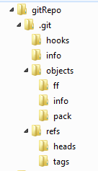
The Structure Of A GIT Repository
the working tree
its repository
content based store (name: SHA-1 hashes of the content,
e.g. blobs)
file "names" is here
names for commits (wait some minutes)
$ find .git -type f -and -regex '.*/objects/../.*'
.git/objects/ff/ef955277e4ad7972740fe9c1fe1fff60e60a27

Slide 9
Directories Are Stored In Trees
blobs have only content (+ their SHA-1 hash name)
structure and naming is represented in a tree
a tree assembles (sub-) trees and blobs
a tree object is immutable and its name is the SHA-1 hash of its content
trees are created from the files actually in the index ("staged files")
repo
$ mkdir descr; cd descr
$ echo "repository for cavy names" > README; cd ..
$ git hash-object -w descr/README
af0ceb86afde8b261a20c32a2d9f82a7e2352bd0
$ find .git -type f -and -regex '.*/objects/../.*'
.git/objects/af/0ceb86afde8b261a20c32a2d9f82a7e2352bd0
.git/objects/ff/ef955277e4ad7972740fe9c1fe1fff60e60a27
$ git ls-files –stage # outputs nothing
$ git add . # adds all
$ git ls-files –stage # warning: LF CRLF problems --- ignore
100644 af0ceb86afde8b261a20c32a2d9f82a7e2352bd0 0 descr/README
100644 ffef955277e4ad7972740fe9c1fe1fff60e60a27 0 names
descr
names
(ffef …)
README
(af0c …)

Slide 10
Directories Are Stored In Trees (continued)
$ git write-tree
3cd53c9c80254073be17b2bcf06edb4ac4a85803
$ find .git -type f -and -regex '.*/objects/../.*'
.git/objects/3c/d53c9c80254073be17b2bcf06edb4ac4a85803 # tree
.git/objects/50/ae7f1e28fd1ecf40bfc55c2e92410a49063fed # tree
.git/objects/af/0ceb86afde8b261a20c32a2d9f82a7e2352bd0 # blob
.git/objects/ff/ef955277e4ad7972740fe9c1fe1fff60e60a27 # blob
$ git ls-tree 3cd5
040000 tree 50ae7f1e28fd1ecf40bfc55c2e92410a49063fed descr
100644 blob ffef955277e4ad7972740fe9c1fe1fff60e60a27 names
$ git ls-tree 50ae
100644 blob 9190600164fe4b0818d230f825efb7bf0bcac269 README
repo
(3cd5 …)
descr
(50ae …)
names
(ffef …)
Trees are shared based on their SHA-1 hashes
README
(af0c …)

Slide 11
Commits Store The History Of Changes
commit
tree
tree
blob
blob
tree
blob
commit
commit
tree
tree
blob
blob
tree
blob
tree
tree
blob
tree
blob
commit
tree
tree
blob
blob
tree
blob
blob
commit
tree
tree
blob
blob
tree
blob
A commit is related to other commits
by a parent relation.
This creates an acyclic graph (a kind of
abstract time, an event structure)
time

Slide 12
Creating A Commit
a commit says,
who committed
when
what tree (the index!)
why
from what commit(-s) the change was derived (the immediate past, the parent(s))
each commit represents the whole history of previous changes (following its parents)
$ git commit-tree -m "the first name" 3cd5 # 5 objects are stored
3cdb74ef7a0a2b847d21d46c251bbb5c71b19ef9
$ git cat-file –t 3cdb
commit
$ git cat-file commit 3cdb
tree 3cd53c9c80254073be17b2bcf06edb4ac4a85803
author Reinhard Budde <reinhard.budde@iais.fraunhofer.de> 1360330438 +0100
committer Reinhard Budde <reinhard.budde@iais.fraunhofer.de> 1360330438 +0100
the first name

Slide 13
A Second Commit
$ echo "Pid" >> names; echo "Mucky" >> names
$ git add names
$ git ls-files --stage
100644 af0ceb86afde8b261a20c32a2d9f82a7e2352bd0 0 descr/README
100644 fd867e53ec91b9b48204214e4d67740a505aea2f 0 names # neuer SHA-1 hash!!
$ git write-tree
1be52efc1e1daed1c706b60588400487db083fe4
$ git commit-tree -m "2 further names"
-p 3cdb74ef7a0a2b847d21d46c251bbb5c71b19ef9 1be52
4335220dd169d637b3299363033307f3ef31fc1d
$ git cat-file commit 433522
tree 1be52efc1e1daed1c706b60588400487db083fe4
parent 3cdb74ef7a0a2b847d21d46c251bbb5c71b19ef9
author Reinhard Budde <reinhard.budde@iais.fraunhofer.de> 1360334547 +0100
committer Reinhard Budde <reinhard.budde@iais.fraunhofer.de> 1360334547 +0100
2 further names

Slide 14
Branches
you have 1-n branches (~~ lines of development) in your repository (below: c4, c7, c8)
a branch has a name. That name refers to a SHA-1 hash of a commit
this commit is the most recent commit of this branch, the head of that branch
a commit contains the whole history
… NOTHING ELSE …
adding a new branch branch1 (low level) to a repository:
echo "4335220dd169d637b3299363033307f3ef31fc1d" > .git/refs/heads/aNewBranch
by convention you should have the branch master:
echo "4335220dd169d637b3299363033307f3ef31fc1d" > .git/refs/heads/master
the head of the branch actually checked out in your working tree is referenced symbolically by HEAD (a top-level file in .git):
$ cat .git/HEAD
ref: refs/heads/master
the file HEAD is created by git init and changed by checking out another branch:
$ git checkout topic
Switched to branch topic'
$ cat .git/HEAD
ref: refs/heads/topic
c2
c3
c4
master
c1
c5
c6
c7
development
c8
experimental

Slide 15
Fom Plumbing To Porcelain
working with a repository using low level commands gives insight into GIT, but is boring
low-level commands: plumbing
user-level commands: porcelain
working with porcelain commands:
$ git log --oneline # show the commits
$ git branch experimental # create a branch forking from the current HEAD
$ git checkout experimental # goto that branch
… edit …
$ git add . # add everything to the next commit (be careful!)
$ git commit -m "a good comment is required here"
$ git checkout development # goto another branch
… edit …
$ git commit -a –m "..." # -a add everything to this commit what has changed
…
… workflows coming soon …

Slide 16
GIT Terminology 1
Recursive definitions …
working tree:
a directory to which a repository is associated with (usually the sub dir .git).
repository:
a collection of commits. It defines HEAD.
It contains branches and tags, which give names to commits.
commit:
a snapshot of the working tree at some point in time. The commit called HEAD, when a commit is made, becomes the commit‘s parent. This creates the history of a commit.
HEAD:
the commit the working tree refers to at this moment

Slide 17
GIT Terminology 2
Further definitions …
branch:
a name for a reference to a commit. The parents define the history of the branch: a „branch of development“.
tag:
a name for a commit. Always names the same commit.
master:
by convention the name of a branch, the mainline of development.
In no way special.
index:
often called „staging area“. GIT commits changes not directly from the working
tree, but from the index. Files changed have to be added to the index before they
can be committed.

Slide 18
… Workflows …

Slide 19
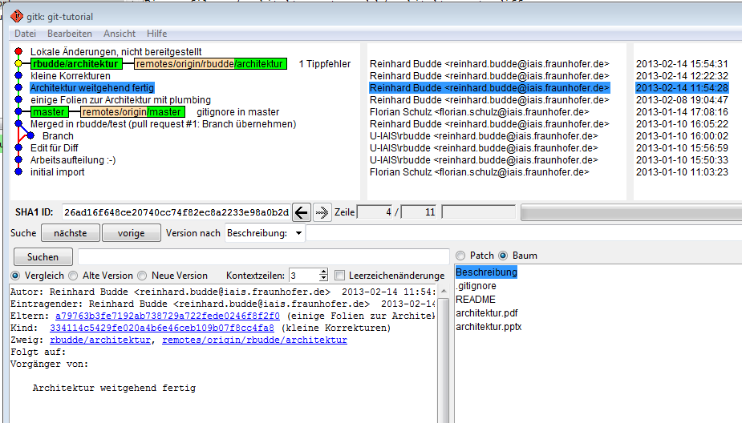
A Branch In gitk (git gui)

Slide 20
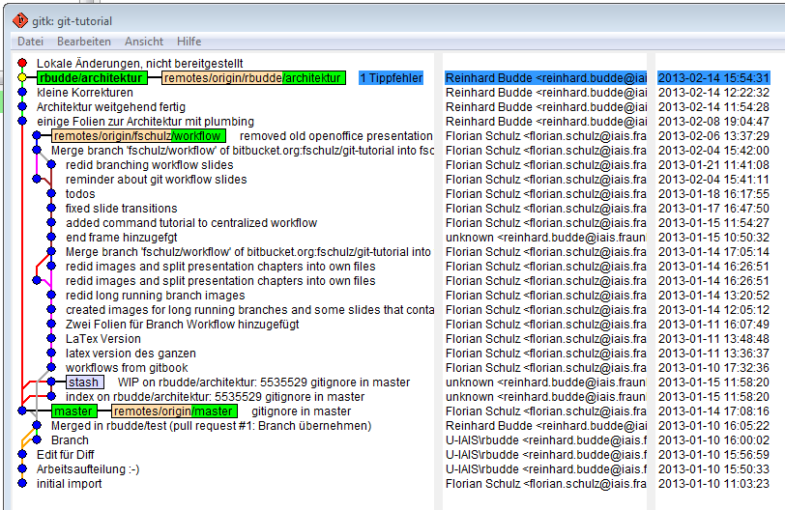
All Branches In gitk (git gui)
usually you have to filter out commits to control the amount of information.
use "Ansicht bearbeiten" (F4).
note some strange wordings, e.g. checkout is translated to "Umstellen …" or commit "abzeichnen"

Slide 21
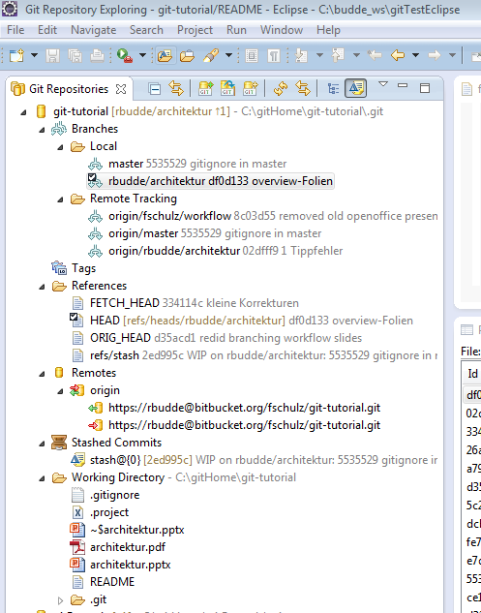
GIT And Eclipse (exploring)
the GIT exploring perspective shows
local and remote branches
tags, references (HEADs) and remote repositories
stashed commits
You may
create and delete branches
checkout branches
push and pull branches
merge and rebase
You may even browse the local repository .git
Add a GIT-based project
either bei cloning from a URL
or if a local repo exists: import… from the menu
select project from GIT
select the local repo
add the repo
import it

Slide 22
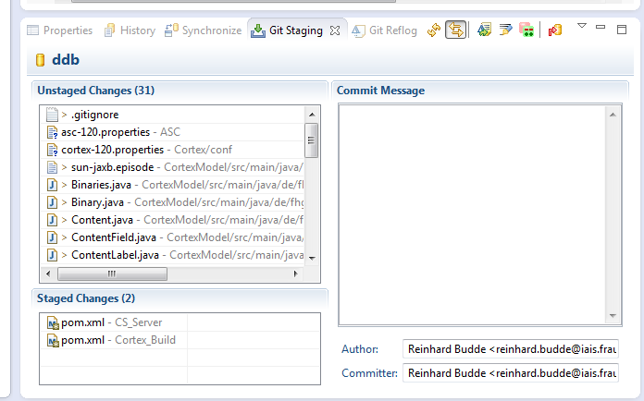
GIT And Eclipse (staging)
the GIT staging view
shows the staged and unstaged changes from the working tree,
you may stage, unstage by drag'n'drop,
replace by HEAD version and the view
allows to edit a commit message and commit the changes
commit

Slide 23
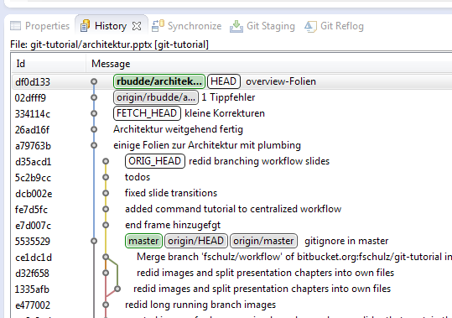
GIT And Eclipse (history)
the history view shows
the commit history of a selected resource (as a graph), but also
the commit history of a project or a repository
Select a resource,
drag it to the view and
use the menu buttons
to change the scope of the view

Slide 24
1. Solving A Merge Conflict With Eclipse: Create A Conflict
$ git branch forConflict # create branch, but stay in master!
$ cat names
Creasy
Pid
Mucky
Greta
$ echo "Garzavog" >> names
$ git commit -a -m "add Garzavog"
$ git checkout forConflict
$ echo "Minscha" >> names
$ git commit -a -m "add Minscha"

Slide 25
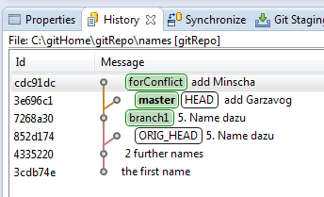
2. Solving A Merge Conflict With Eclipse: Merge Into Master
$ git checkout master
$ git merge forConflict
Auto-merging names
CONFLICT (content): Merge conflict in names
Automatic merge failed; fix conflicts and then commit the result.
… merge can be started from Eclipse GIT repository exploring view, too …

Slide 26
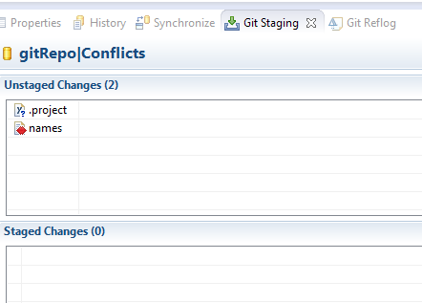
3. Solve A Merge Conflict With Eclipse: Start Merge Tool
in the GIT staging view the conflicting files is marked red
select one of the files
from the context menu start the merge tool
!!! select merge mode Use HEAD of conflicting files , click OK !!!

Slide 27
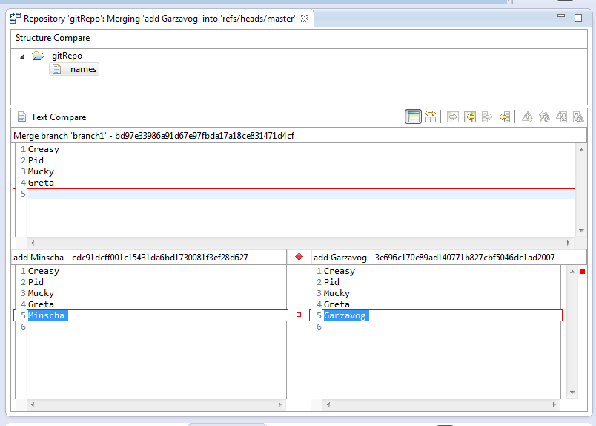
4. Solve A Merge Conflict With Eclipse: 3-Way Compare
choose 2- or 3-way diff - we suggest 3 way
solve the conflict, save the file
3-way

Slide 28
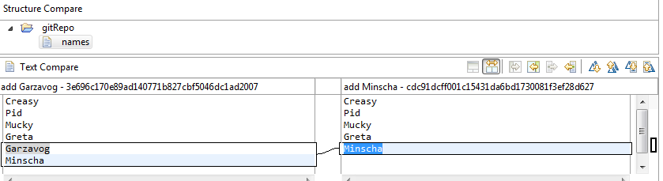
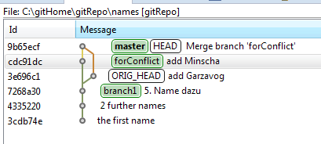
4. Solve A Merge Conflict With Eclipse: Use 2-Way Compare
2-way
in the staging view, move the file to staged and commit it
this will finish the merge, as the history view shows …
adding and commiting from the command line is ok, of course

Slide 29
Configuration
don't use environment variables
configuration files
global (~/.gitconfig)
system (<git-install-dir>/etc/gitconfig)
otherwise (<working-dir>/.git/config)
configuration in eclipse (don't forget this!):
set the installation directory of GIT in the configuration tab
use git config or edit the config files as text files to configure git
the user conf file (called the global file) defines user specific data, at least: [user]
email = reinhard.budde@iais.fraunhofer.de
name = Reinhard Budde
the system conf file defines general data, at least [core]: [core] symlinks = false autocrlf = true filemode = false [http]
sslverify = false
[alias]
b = branch
co = checkout
lo = log --oneline

Slide 30
Reverting / Undoing Changes --- Be careful
the best choice:
checkout a previous commit (e.g. git checkout 124fbc… / HEAD~6)
create a branch starting from there
these commands leave the working tree unchanged:
git reset HEAD delete changes staged in the index
git reset --soft HEAD~ ignore the last commit; backup to the parent of HEAD
this commands resets the working tree (BE VERY CAREFUL):
git reset --hard HEAD~ backup to the parent of HEAD; set the working tree to that commit
if the index is clean, the following commands are equivalent:
git reset --hard HEAD~2
git reset --soft HEAD~2 git reset --hard
git checkout -b twoCommitsBack HEAD~2
why don't you use the last command?

Slide 31
Reflog And Stash
the reflog stores all your changes in the form of commits:
for 30 days (you can configure that)
independant from branches, push, pulls, reset
you may inspect it using git reflog [<commit>]
or use the Eclipse view to browse
names are HEAD@{0} …
the stash stores the working tree and the index as a new commit:
git stash names are stash@{0} …
git stash apply applies the stash and keeps it; git stash pop applies and removes
typical use:
# ... hack hack hack ...
$ git stash
$ edit emergency fix
$ git commit -a -m "Fix in a hurry"
$ git stash pop
# ... continue hacking ...

Slide 32
Rewriting The History
never rewrite the histoy when somebody has seen it (i.e. after a push …)
there are three relevant cases:
rewrite the last commit when committing the next one (amend) git commit --amend # you may edit the last commit message
replace a sequence of commits by a single one git rebase -i HEAD~5 # combine the last 5 commits in interactive mode
rebase a branch based on another branch $ git checkout topic # edit, commit, … , now integrate the work of others $ git checkout master $ git pull $ git checkout topic $ git rebase master # rebase on master to minimize conflicts later
never rewrite the histoy when somebody has seen it (i.e. after a push …)

Slide 33
Understanding Commits => Mastering Version Control (1)
Names of commits …
Name | Meaning
branchname | refers to the most recent commit of that branch (.git/refs/heads/branchname)
tagname | refers to the a commit, never changed (.git/refs/tags/tagname)
HEAD | the currently checked out commit
ffef955277e4ad… ffef9552 ffef | a commit, full name is the 40 char SHA-1 hash
name^ | the parent of the commit
name^2 | the second parent (e.g. a merge commit)
name~10 | the 10th parent (name~1 == name^, name~3 == name^^^)
name:path | file of the tree of the commit
name^{tree} | the tree of the commit

Slide 34
Understanding Commits => Mastering Version Control (2)
Names of commit ranges …
Name | Meaning
name1..name2 | all commits from name2 back to name1, but excluding name1
name1…name2 | all commits referenced by name2 OR name1, but not by both
master.. | short for: master..HEAD; show changes made to the current branch
..master | short for: HEAD..master; useful after fetch: what occured after laster rebase/merge
--since="2 weeks ago" | all commits since a date
--until="2 weeks ago" | all commits up to a date
--grep="pattern" | all commits whose message match the pattern
--committer="pattern" | all commits whose committer name match the pattern
--author="pattern" | all commits whose author name match the pattern (for local repos as above, if patches are mailed, author + committer differ)
--no-merges | all commits that have only one parent
git log deploy-2012-12-14..HEAD -–since="10 days ago" -–grep="jira-" -–no-merges

Slide 35
Useful Commands When Exploring A Repository
Command | Meaning
git log HEAD~7.. --oneline / git log -7 --oneline | the last 7 commits in short notation
git log --graph --oneline | … as a graph
- | -
git blame <file> | show who changed which line and at what commit
git show <branch>:<file> | show a file from another branch ( > export_file saves it into a file)
git diff [-- <file>] | changes you made in the working tree relative to the index (staging area)
git diff --cached [<commit>] [-- <file>] | diff index (staging area) and the given commit (if missing: the last one)

Slide 36
Useful Commands When Working With A Repository
Command | Meaning
git checkout HEAD~3 | replace the whole working tree by the state three commits ago
git checkout -- <file> | replace a file from the working tree by the HEAD-version
git reset -- <file> | unstage a file (remove from index), working tree version unchanged
git rm --cached <file> | remove a file from the index, it remains in the working tree
git rm -f <file> | remove a file from the index and the working tree
- | -
git merge <branch> | merge <branch> into the branch actually checked out
git merge --abort | abort a merge if conflicts have been detected when running git merge <branch>
- | -
git add -u [<filepattern>] | add modified files to the staging area (… but not the untracked ones)
git add -A [<filepattern>] | add all modified and all new files to the staging area
- | -
… | …

Slide 37
Useful Commands When Working With Remote Repositories
Command | Meaning
git clone <uri> | clone a remote. --depth <n> to create a shallow clone of n revisions
- | -
git remote -v / -av | show the URI's of remote tracked repositories / with HEAD-commits
git branch -vv | show local branches and the remotes they are tracking
- | -
git config --global push.default simple | enforce that you can only push to remote branches of the same name
git branch name origin/name | get remote branch. Advice: use the same name locally
- | -
git fetch | update your local copy of remote branches. Doesn't change working copy or any of your local branches. Can be done everytime without any harm
git pull | make your reporsitory up-to-date. Essentially: git fetch; git merge. Note: the merge refers only to the branch actually checked-out, of course.
git push | push the committed changes of the branch checked out to the remote branch the local branch is tracking
- | -
git diff <localB> <remote>/<remoteB> | compare local to remote branch. Note: don't forget to call git fetch before

Slide 38
Questions - Discussions

Slide 39
GIT For A Standalone Developer (1)
A standalone individual developer does not exchange patches with other people, and works alone in a single repository, using the following commands.
git-init(1) to create a new repository.
git-show-branch(1) to see where you are.
git-log(1) to see what happened.
git-checkout(1) and git-branch(1) to switch branches.
git-add(1) to manage the index file.
git-diff(1) and git-status(1) to see what you are in the middle of doing.
git-commit(1) to advance the current branch.
git-reset(1) and git-checkout(1) (with pathname parameters) to undo changes.
git-merge(1) to merge between local branches.
git-rebase(1) to maintain topic branches.
git-tag(1) to mark known point.

Slide 40
GIT For A Standalone Developer (2)
Start indivdual development
$ tar zxf frotz.tar.gz; cd frotz; git init
$ git add . # add everything under the current directory.
$ git commit -m "import of frotz source tree."
$ git tag v2.43 # make a lightweight, unannotated tag.
Create a topic branch and develop.
$ git branch alsa-audio # create a new topic branch.
$ git checkout alsa-audio # checkout (abbr: git checkout -b alsa-audio)
$ edit/compile/test
$ git diff HEAD # to see what changes you are committing.
$ git commit -a -m "first changes"
$ edit/compile/test
$ git reset --soft HEAD^ # take last commit back, keep what is in the working tree.
$ edit/compile/test
$ git diff ORIG_HEAD # view the changes since the premature commit we took back.
$ git commit -a -c ORIG_HEAD # redo the commit undone, use message you originally wrote.
$ git checkout master # switch to the master branch.
$ git merge alsa-audio # merge a topic branch into your master branch.
$ git log --since='3 days ago' # review commit logs
$ git log v2.43.. curses/ # view changes that touch the curses directory, since v2.43 tag.

