Slide 1
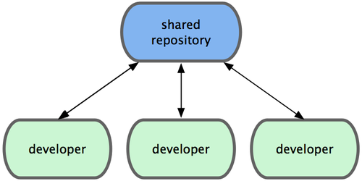
Zentralisierter Workflow

Slide 2
Zentralisierter Workflow
Bekannt aus SVN

Slide 3
Zentralisierter Workflow
Bekannt aus SVN
Git verhindert überschreiben von Daten

Slide 4
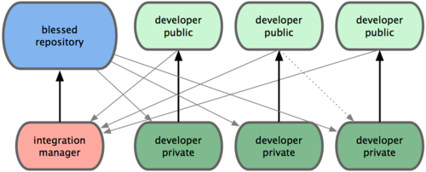
Integration-Manager Workflow

Slide 5
Integration-Manager Workflow
The project maintainer pushes to their public repository.

Slide 6
Integration-Manager Workflow
The project maintainer pushes to their public repository.
A contributor clones that repository and makes changes.

Slide 7
Integration-Manager Workflow
The project maintainer pushes to their public repository.
A contributor clones that repository and makes changes.
The contributor pushes to their own public copy.

Slide 8
Integration-Manager Workflow
The project maintainer pushes to their public repository.
A contributor clones that repository and makes changes.
The contributor pushes to their own public copy.
The contributor sends the maintainer a pull request asking them to pull changes.

Slide 9
Integration-Manager Workflow
The project maintainer pushes to their public repository.
A contributor clones that repository and makes changes.
The contributor pushes to their own public copy.
The contributor sends the maintainer an e-mail asking them to pull changes.
The maintainer adds the contributor’s repo as a remote and merges locally.

Slide 10
Integration-Manager Workflow
The project maintainer pushes to their public repository.
A contributor clones that repository and makes changes.
The contributor pushes to their own public copy.
The contributor sends the maintainer an e-mail asking them to pull changes.
The maintainer adds the contributor’s repo as a remote and merges locally.
The maintainer pushes merged changes to the main repository.

Slide 11
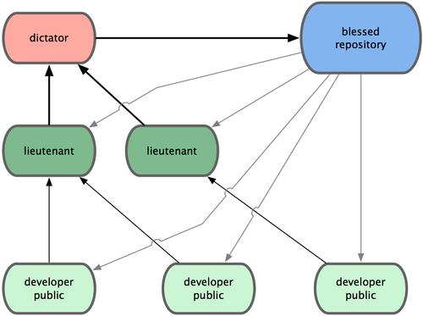
Integration-Manager Workflow

Slide 12
Integration-Manager Workflow
Regular developers work on their topic branch and rebase their work on top of master. The master branch is that of the dictator.

Slide 13
Integration-Manager Workflow
Regular developers work on their topic branch and rebase their work on top of master. The master branch is that of the dictator.
Lieutenants merge the developers’ topic branches into their master branch.

Slide 14
Integration-Manager Workflow
Regular developers work on their topic branch and rebase their work on top of master. The master branch is that of the dictator.
Lieutenants merge the developers’ topic branches into their master branch.
The dictator merges the lieutenants’ master branches into the dictator’s master branch.

Slide 15
Integration-Manager Workflow
Regular developers work on their topic branch and rebase their work on top of master. The master branch is that of the dictator.
Lieutenants merge the developers’ topic branches into their master branch.
The dictator merges the lieutenants’ master branches into the dictator’s master branch.
The dictator pushes their master to the reference repository so the other developers can rebase on it.

