Slide 1
GIT
Introduction
Architecture
Basic Workflows
Useful commands
Discussion

Slide 2
References
John Wiegley: Git from the bottom up a lot is taken from that source. PDF available online.
Scott Chacon: Pro Git PDF book available online. Complete reference to (almost) all aspects of GIT
A lot of Git cheat sheets are available online

Slide 3
GIT Advantages
all metadata in one directory (usualy .git), not one meta-directory in each directory
simple, consistent, powerful model
fast, robust
supports much more workflows than traditional vcs (CVS, SVN)

Slide 4
Well Known: CVS/SVN
idea: sequence of deltas of a file
c1
Δ
c2
Δ
c3
Δ
file1:
c1
Δ
c2
Δ
c3
Δ
file2:
c1
Δ
c2
Δ
c3
Δ
file3:
branches: a complex other construct
ΣΔ
ΣΔ
ΣΔ
ΣΔ
ΣΔ
ΣΔ
ΣΔ
ΣΔ
ΣΔ
ΣΔ

Slide 5
The Idea Behind GIT: File System Snapshots Everything Is Immutable
commit
tree
tree
blob
blob
tree
blob
commit
commit
tree
tree
blob
blob
tree
blob
tree
tree
blob
tree
blob
commit
tree
tree
blob
blob
tree
blob
blob
commit
tree
tree
blob
blob
tree
blob
time

Slide 6
GIT Terminology 1
Recursive definitions …
working tree:
a directory to which a repository is associated with (usually the sub dir .git).
repository:
a collection of commits. It defines HEAD.
It contains branches and tags, which give names to commits.
commit:
a snapshot of the working tree at some point in time. The commit called HEAD, when the commit was made, becomes the commit‘s parent. Thism defines the history of this commit.
HEAD:
the commit the working tree refers to at this moment

Slide 7
GIT Terminology 2
Further definitions …
branch:
a name for a reference to a commit. The parents define the history of the branch: a „branch of development“.
tag:
a name for a commit. Thus always names the same commit.
master:
by convention the name of a branch, in which the mainline of development is done.
In no way special.
index:
often called „staging area“. GIT commits changes not directly from the working
tree, but from the index. Files changed have to be added to the index before they
can be committed.

Slide 8
GIT File Workflow
Unstaged
Staged
Committed
git add
git commit
git commit

Slide 9
File Content Is Stored In Blobs
file content is stored in blobs
blobs are the leaves of the (file system like) tree
blobs store no meta-data. That‘s the responsibility of a tree
blobs are immutable
the name of a blob is the SHA-1 hash of (its size concatenated with) its content
blobs with the same content have the same name – everywhere in the world
files with identical content stored in different trees refer to one blob only
GIT uses content based adressing
$ mkdir gitRepo; cd gitRepo
$ git init
$ echo "Creasy" > names
$ git hash-object –w names
ffef955277e4ad7972740fe9c1fe1fff60e60a27
$ git cat-file –t ffef95
blob
$ git cat-file blob ffef95
Creasy

Slide 10
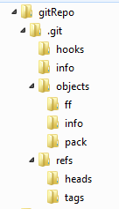
The Structure Of A GIT Repository
the working tree
its repository
content based store (name: SHA-1 hashes of the content,
e.g. blobs)
file "names" is here
names for commits (wait some minutes)
$ find .git -type f -and -regex '.*/objects/../.*'
.git/objects/ff/ef955277e4ad7972740fe9c1fe1fff60e60a27

Slide 11
Directories Are Stored In Trees
blobs have only content (+ their SHA-1 hash name)
structure and naming is represented in a tree
a tree assembles (sub-) trees and blobs
a tree object is immutable and its name is the SHA-1 hash of its content (like blobs)
trees are created from the files actually in the index ("staged files")
$ mkdir descr; cd descr
$ echo "repository for cavy names" > README; cd ..
$ git hash-object -w descr/README
af0ceb86afde8b261a20c32a2d9f82a7e2352bd0
$ find .git -type f -and -regex '.*/objects/../.*'
.git/objects/af/0ceb86afde8b261a20c32a2d9f82a7e2352bd0
.git/objects/ff/ef955277e4ad7972740fe9c1fe1fff60e60a27
$ git ls-files –stage # outputs nothing
$ git add . # adds all
$ git ls-files –stage # warning: LF CRLF problems --- ignore
100644 af0ceb86afde8b261a20c32a2d9f82a7e2352bd0 0 descr/README
100644 ffef955277e4ad7972740fe9c1fe1fff60e60a27 0 names

Slide 12
Directories Are Stored In Trees (continued)
$ git write-tree
3cd53c9c80254073be17b2bcf06edb4ac4a85803
$ find .git -type f -and -regex '.*/objects/../.*'
.git/objects/3c/d53c9c80254073be17b2bcf06edb4ac4a85803 # tree
.git/objects/50/ae7f1e28fd1ecf40bfc55c2e92410a49063fed # tree
.git/objects/af/0ceb86afde8b261a20c32a2d9f82a7e2352bd0 # blob
.git/objects/ff/ef955277e4ad7972740fe9c1fe1fff60e60a27 # blob
$ git ls-tree 3cd5
040000 tree 50ae7f1e28fd1ecf40bfc55c2e92410a49063fed descr
100644 blob ffef955277e4ad7972740fe9c1fe1fff60e60a27 names
$ git ls-tree 50ae
100644 blob 9190600164fe4b0818d230f825efb7bf0bcac269 README
Trees are shared based on their SHA-1 hashes
The same tree/blob structure (+ 1 commit object) would have been created by:
git commit –a –m "initial commit" # commit coming soon :-)

Slide 13
Commits Store The History Of Changes
commit
tree
tree
blob
blob
tree
blob
commit
commit
tree
tree
blob
blob
tree
blob
tree
tree
blob
tree
blob
commit
tree
tree
blob
blob
tree
blob
blob
commit
tree
tree
blob
blob
tree
blob
A commit is related to other commits
by a parent relation.
This creates an acyclic graph (a kind of
abstract time, an event structure)
time

Slide 14
Creating A Commit
a commit says,
who committed
when
what tree and
why and
from what commit(-s) the change was derived (the immediate past, the parent(s))
each commit represents the whole history of previous changes (follow its parents
$ git commit-tree -m "the first name" 3cd5 # afterwards 5 objects are stored
3cdb74ef7a0a2b847d21d46c251bbb5c71b19ef9
$ git cat-file –t 3cdb
commit
$ git cat-file commit 3cdb
tree 3cd53c9c80254073be17b2bcf06edb4ac4a85803
author Reinhard Budde <reinhard.budde@iais.fraunhofer.de> 1360330438 +0100
committer Reinhard Budde <reinhard.budde@iais.fraunhofer.de> 1360330438 +0100
the first name

Slide 15
A Second Commit
$ echo "Pid" >> names
$ echo "Mucky" >> names
$ git add names
$ git ls-files --stage
100644 af0ceb86afde8b261a20c32a2d9f82a7e2352bd0 0 descr/README
100644 fd867e53ec91b9b48204214e4d67740a505aea2f 0 names # neuer SHA-1 hash!!
$ git write-tree
1be52efc1e1daed1c706b60588400487db083fe4
$ git commit-tree -m "2 further names"
-p 3cdb74ef7a0a2b847d21d46c251bbb5c71b19ef9 1be52
4335220dd169d637b3299363033307f3ef31fc1d
$ git cat-file commit 433522
tree 1be52efc1e1daed1c706b60588400487db083fe4
parent 3cdb74ef7a0a2b847d21d46c251bbb5c71b19ef9
author Reinhard Budde <reinhard.budde@iais.fraunhofer.de> 1360334547 +0100
committer Reinhard Budde <reinhard.budde@iais.fraunhofer.de> 1360334547 +0100
2 further names

Slide 16
A Bigger Picture
you have 1-n branches (~~ lines of development) in your repository
a branch has a name. That name refers to a SHA-1 hash of a commit (see below)
this commit is the most recent commit of this branch, the head of that branch
this commit contains the whole history of this branch
NOTHING ELSE
adding a new branch (low level) to a repository:
echo "4335220dd169d637b3299363033307f3ef31fc1d" > .git/refs/heads/branch1
by convention you should have the branch master:
echo "4335220dd169d637b3299363033307f3ef31fc1d" > .git/refs/heads/master
the head of the branch actually checked out in your working tree is referenced symbolically by HEAD (a top-level file in .git):
$ cat .git/HEAD
ref: refs/heads/master
this content has been created by git init and is changed by checking out another branch:
git checkout branch1
$ git checkout branch1
Switched to branch 'branch1'
$ cat .git/HEAD
ref: refs/heads/branch1

Slide 17
Fom Plumbing To Porcelain
working with a repository using low level commands gives insight into GIT, but is boring
low-level commands: plumbing
user-level commands: porcelain
working with porcelain commands:
$ git add …
$ git status
$ git branch –v
$ git log
$ git log --oneline
$ git checkout …
$ git commit –m "…"
… more later …

Slide 18
Don't forget: if you understand commits, you master version control
Names of commits …
Name | Meaning
branchname | refers to the most recent commit of that branch (.git/refs/heads/branchname)
tagname | refers to the a commit, never changed (.git/refs/tags/tagname)
HEAD | the currently checked out commit
ffef955277e4ad… ffef9552 ffef | a commit, full name is the 40 char SHA-1 hash
name^ | the parent of the commit
name^2 | the second parent (e.g. a merge commit)
name~10 | the 10th parent (name~1 == name^, name~3 == name^^^)
name:path | file of the tree of the commit
name^{tree} | the tree of the commit

Slide 19
Don't forget: if you understand commits, you master version control
Names of commit ranges …
Name | Meaning
name1..name2 | all commits from name2 back to name1, but excluding name1
name1…name2 | all commits referenced by name2 OR name1, but not by both
master.. | short for: master..HEAD; show changes made to the current branch
..master | short for: HEAD..master; useful after fetch: what occured after laster rebase/merge
--since="2 weeks ago" | all commits since a date
--until="2 weeks ago" | all commits up to a date
--grep="pattern" | all commits whose message match the pattern
--committer="pattern" | all commits whose committer name match the pattern
--author="pattern" | all commits whose author name match the pattern (for local repos as above, if patches are mailed, author + committer differ)
--no-merges | all commits that have only one parent
git log deploy-2012-12-14..HEAD -–since="10 days ago" -–grep="jira-3212" -–no-merges

Slide 20
------------------------------------------------------------------

Slide 21
Useful Commands For Achieving A Good Overview
Command | Meaning
git remote -v | show the remote tracked repositories
git branch -vv [-a] | show all local branches and the remote branches, they are connected to
git config --global push.default simple | enforce that you can only push to remote branches of the same name
git branch name origin/name | get remote branch name. Advice: use the same name locally
git log HEAD~7.. --oneline | the last 7 (8???) commits in short notation
git log --graph --oneline | show as a graph
git status [-s] | working tree status [-s short format, but easy to read]
all examples use the command line interpreter git bash
git gui is nice, too. See next slides.
egit in eclipse is fully compatible with command line git. See next slides.

Slide 22
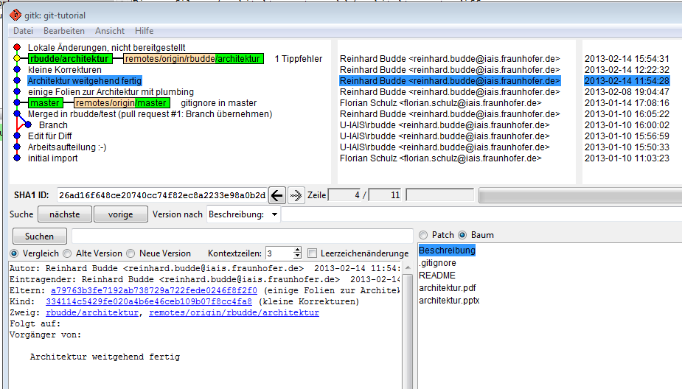
A Branch In gitk (git gui)

Slide 23
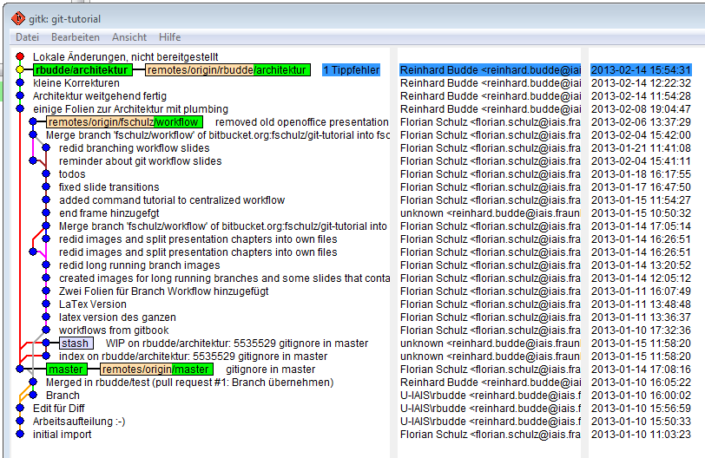
All Branches In gitk (git gui)
usually you have to filter out commits to control the amount of information.
use "Ansicht bearbeiten" (F4).
note some strange wordings, e.g. checkout is translated to "Umstellen …" or commit "abzeichnen"

Slide 24
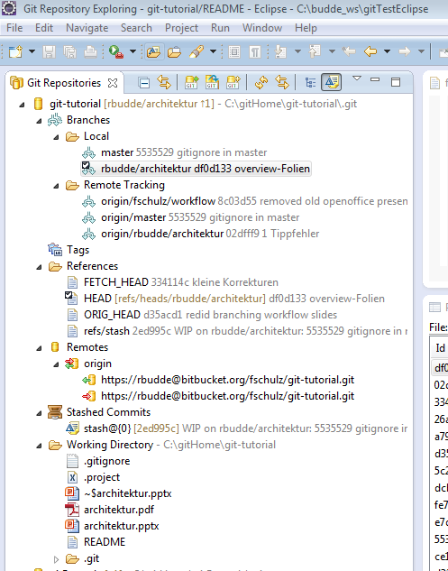
GIT And Eclipse
the GIT exploring perspective shows
local and remote branches
tags, references (HEADs) and remote repositories
stashed commits
You may
create and delete branches
checkout branches
push and pull branches
merge and rebase
You may even browse the local repository .git

Slide 25
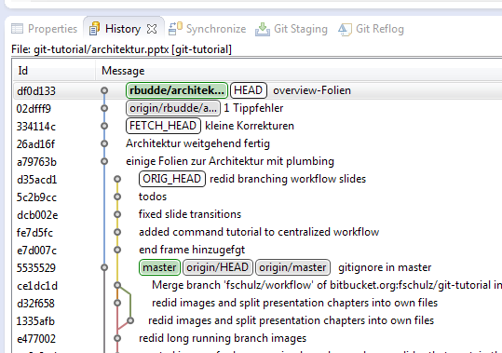
GIT And Eclipse
the GIT staging view
shows the staged and unstaged changes from the working tree and
allows to edit a commit message and commit changed
the history view shows
the commit history of a selected resource (as a graph), but also
the commit history of a project or a repository
Select a resource,
drag it to the view and
use the menu buttons
to change the scope of the view

Slide 26
Solving A Merge Conflict With Eclipse -1-
create an Eclipse project from gitRepo -- now we use the cavy-repository again
import…
select project from GIT
select local repo
add the repo
import as general project
create a conflict :-)
$ git branch forConflict
$ cat names
Creasy
Pid
Mucky
Greta
$ echo "Garzavog" >> names
$ git commit -a -m "add Garzavog"
$ git checkout forConflict
$ echo "Minscha" >> names
$ git commit -a -m "add Minscha"

Slide 27
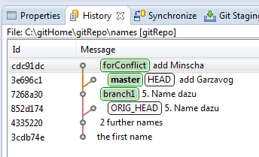
Solving A Merge Conflict With Eclipse -2-
3. merge into master the branch forConflict
$ git checkout master
$ git merge forConflict
Auto-merging names
CONFLICT (content): Merge conflict in names
Automatic merge failed; fix conflicts and then commit the result.

Slide 28
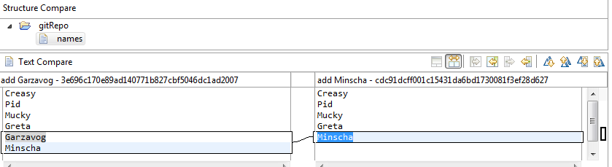
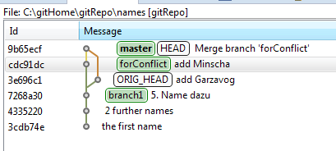
Solving A Merge Conflict With Eclipse -3-
4. switch to eclipse
in the GIT staging view the conflict is marked red
from the context menu start the merge tool
!!! select merge mode Use HEAD of conflicting files , click OK !!!
solve the conflict, save the file
in the staging view, move the file to staged and commit it
this will finish the merge, as the history view shows …

Slide 29
------------------------------------------------------------------

Slide 30
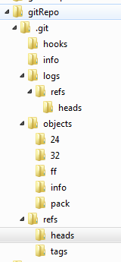
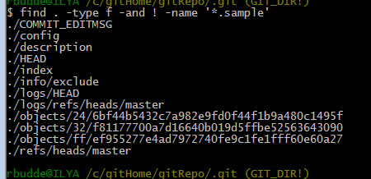
The Structure Of A GIT Repository
the working tree
its repository
content based store (name: SHA-1 hashes of the content,
e.g. blobs)
file content of "names" is found here
names for commits (wait some minutes)
configuration
the commit checked out
working tree image (added files!)
the objects stored
the last commit of the branch "master"

Slide 31
The Structure Of A GIT Repository
the working tree
its repository
content based store (name: SHA-1 hashes of the content,
e.g. blobs)
file "names" is here
names for commits (wait some minutes)
--- cd to .git and then:
$ find . -type f -and -regex './objects/../.*'
./objects/24/6bf44b5432c7a982e9fd0f44f1b9a480c1495f # hash is 246bf……
./objects/25/ae680dccc76c1e67ceb52886cdcabaf94186b1
./objects/32/f81177700a7d16640b019d5ffbe52563643090
./objects/48/33b56499eae2332773f2fce8784861dcb91e69
./objects/8f/38871a7d5599bdd54d8ec6ccd733afa94b0a16
./objects/91/90600164fe4b0818d230f825efb7bf0bcac269
./objects/ff/ef955277e4ad7972740fe9c1fe1fff60e60a27

Slide 32
File Content Is Stored In Blobs
file content is stored in blobs
blobs are the leaves of the (file system like) tree
blobs store no meta-data. That‘s the responsibility of a tree
blobs are immutable
the name of a blob is the SHA-1 hash of (its size concatenated with) its content
blobs with the same content have the same name – everywhere in the world
files with identical content stored in different trees refer to one blob only
GIT uses content based adressing
$ mkdir gitRepo; cd gitRepo
$ git init
$ echo "Creasy" > names
$ git hash-object names
ffef955277e4ad7972740fe9c1fe1fff60e60a27
$ git add names
$ git commit –m "first of 6 names"
$ git cat-file –t ffef95
blob
$ git cat-file blob ffef95
Creasy

