Slide 1
Mirror Room
Computer Graphics Term Project
한우진 조
2015170830 손승우
2015410067 정여진
2015170313 한 빈

Slide 2
Contents
Scene
Process
Ray Tracing
Data Structure
Code
References

Slide 3

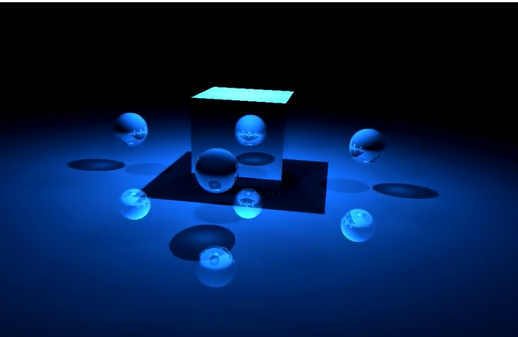
Scene - Goal

Slide 4
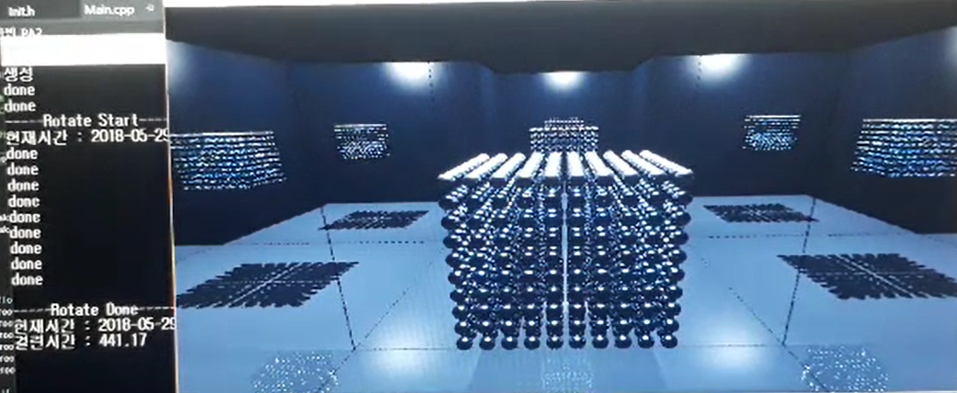
Final Scene

Slide 5


Process
Sphere
Ray Tracing
Polygon
Ray Tracing
일반 Mesh Data
변환하여 Ray tracing
Octree로
최적화
Triangle
Ray Tracing
Reflection을 통한 거울 구현
거울의 방 Scene 구현
성능분석

Slide 6
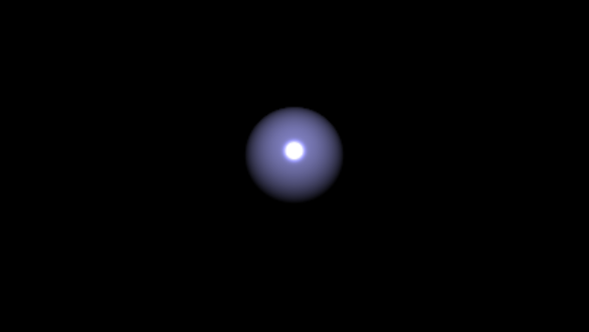
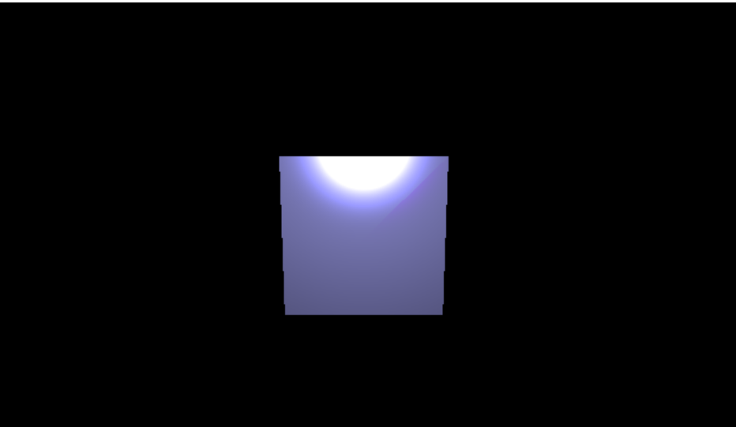

Simple Ray Tracing

Slide 7
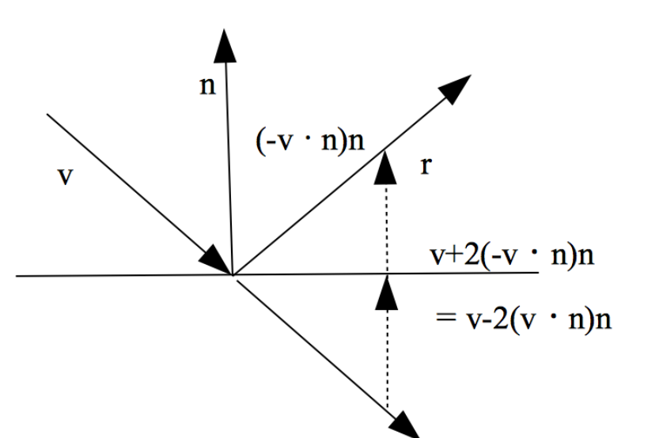
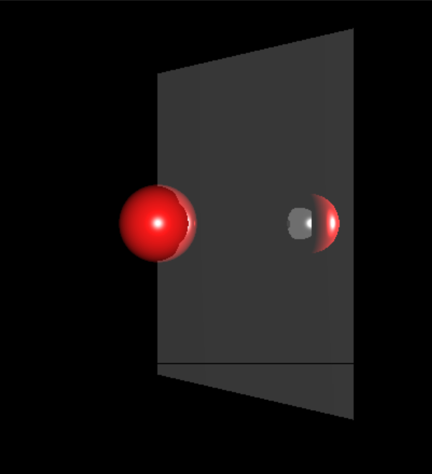

Reflection & Simple Mirror

Slide 8
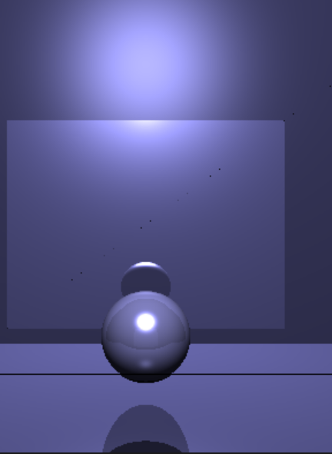
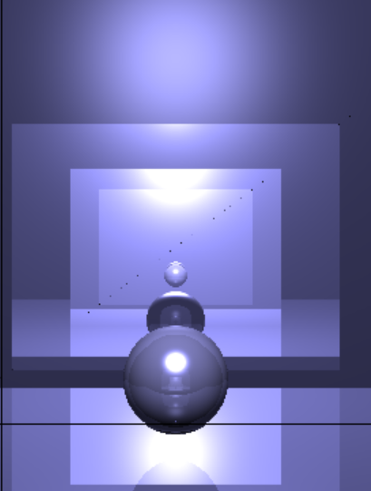
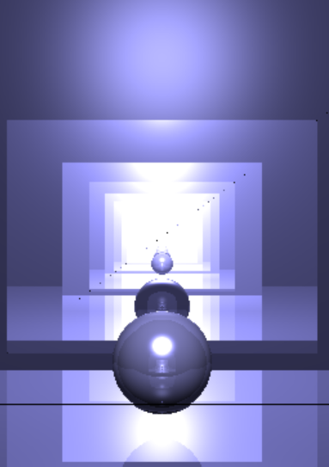
Reflection & Simple Mirror
Depth 1
Depth 3
Depth 10

Slide 9
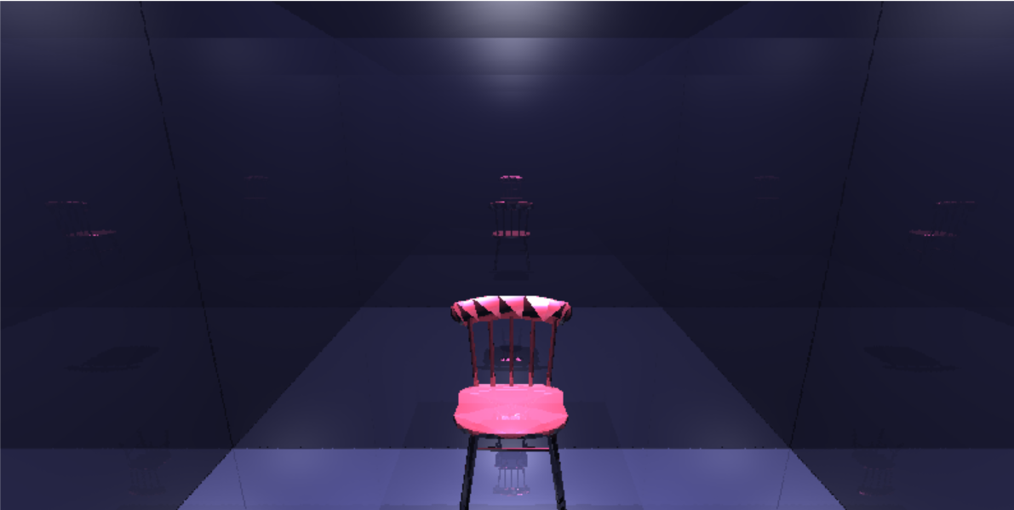
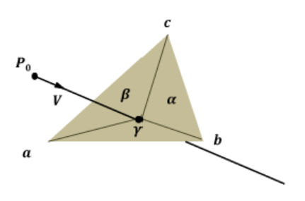
Mesh Data & Ray tracing

Slide 10
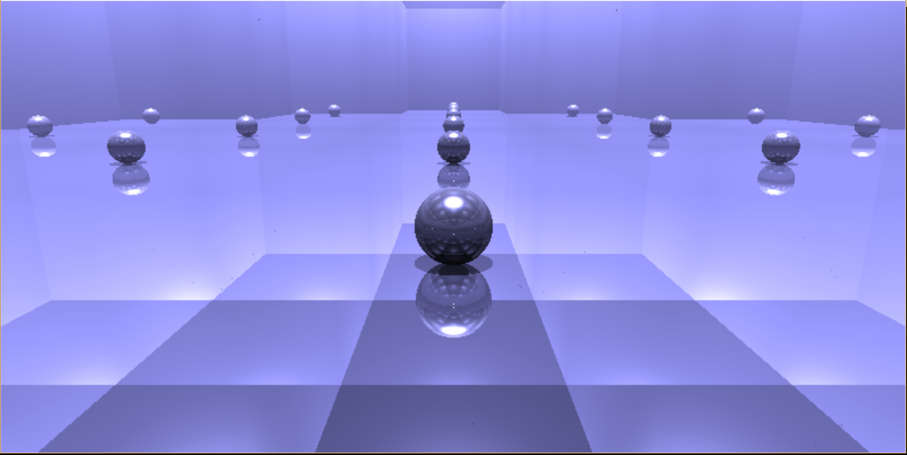
Mirror Room

Slide 11
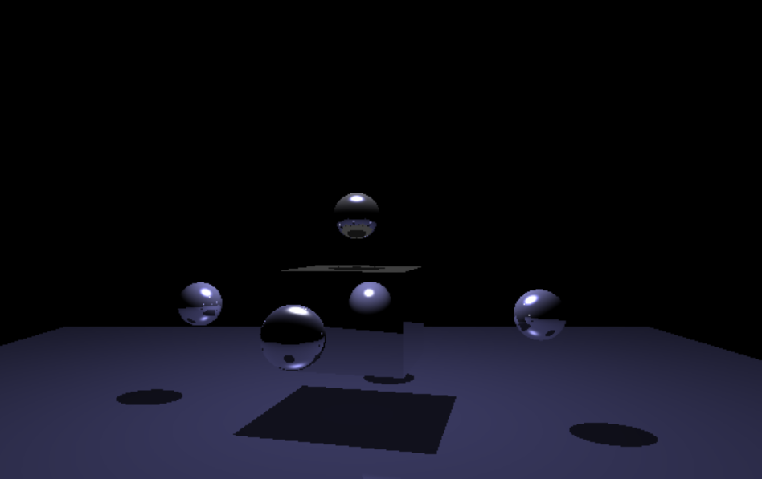
Mirror Room

Slide 12
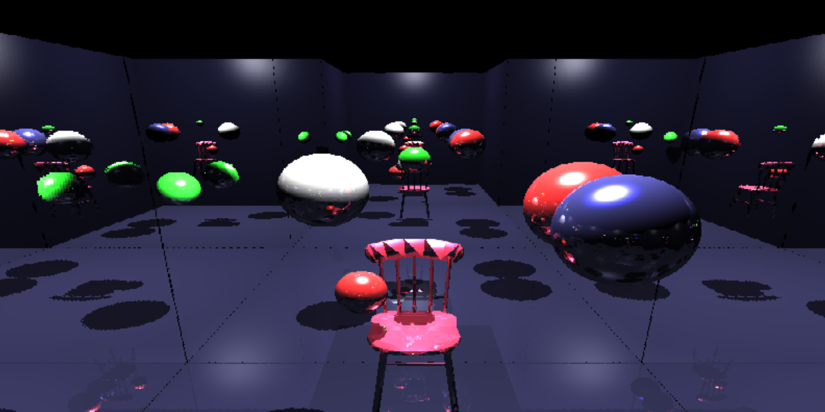
Mirror Room

Slide 13
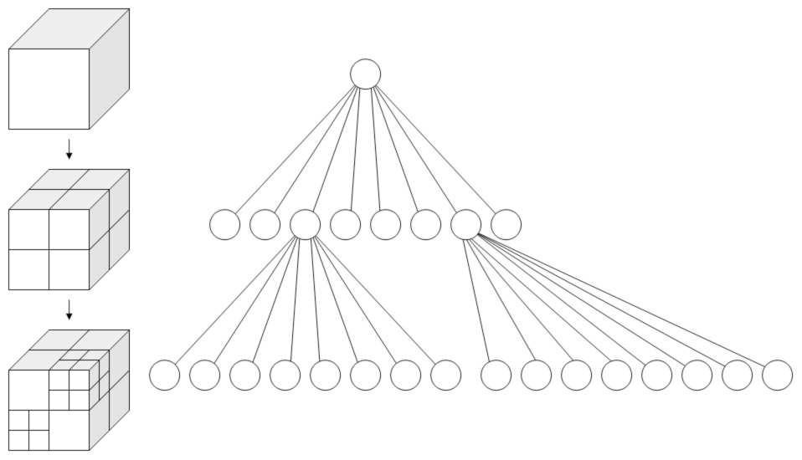
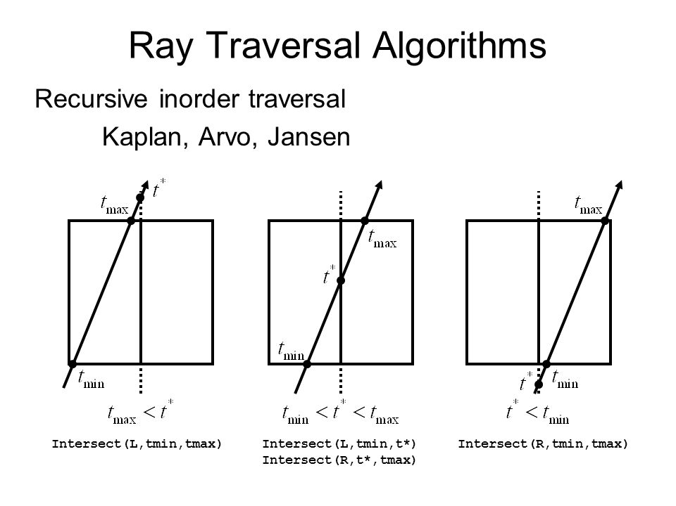
Data Structure-Octree

Slide 14
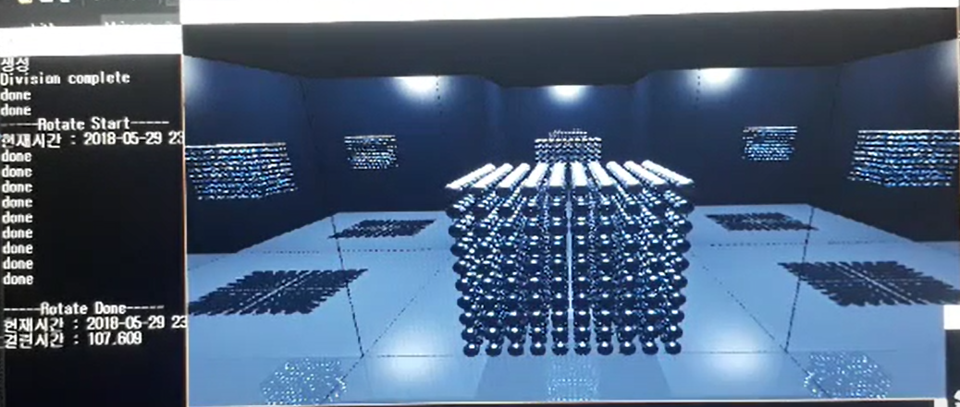
Performance Analysis
With Octree
Without Octree

Slide 15
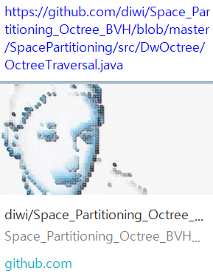
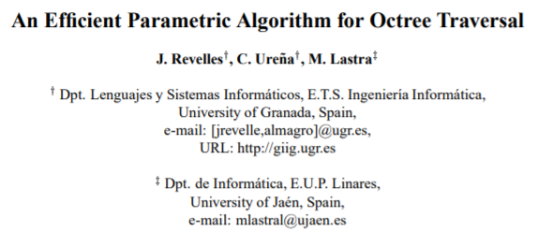
References

Slide 16
Thank you!!

