Slide 1
Machine Learning + Computer Vision
using Python
with Tensorflow
Week 5. Chapter 6 (Hanbin Son)

Slide 2

Contents
Clustering Images
Hierarchical Clustering
Spectral Clustering

Slide 3
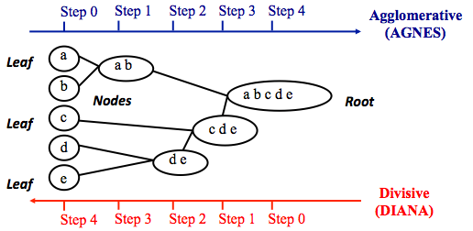
Hierarchical Clustering
Hierarchical Clustering Algorithm
Agglomerative approach (bottom up approach)
Begin with each individual objects and merge the two closest objects
The process is iterated until all objects are aggregated into a single group
Divisive approach (top down approach)
Start with assumption that all objects are group into a single group and then we split the group into two recursively until each group consists of a single group

Slide 4
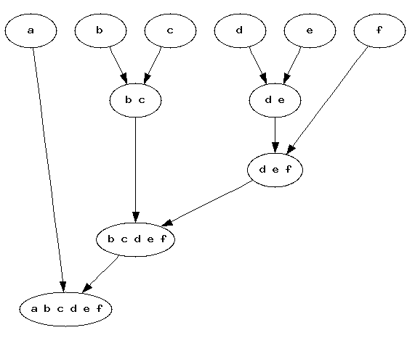
Hierarchical Clustering
Hierarchical Clustering Algorithm
모든 노드를 Cluster로 정의한다.
2개의 Cluster를 고를 수 있는 모든 경우의 수에서 데이터간의 거리(L1 or L2 distance)를 측정하여 가장 작은 거리가 나온 노드 2개를 선정한다.
2개의 Cluster를 하나의 Cluster로 합치고 합친 노드의 정보, 2개 노드 값의 평균, 2 노드 사이의 거리 정보를 기록한다.
2-3 과정을 Cluster가 1개 남을 때까지 반복 시행한다

Slide 5
Hierarchical Clustering
def hcluster(features, distfcn = L2dist): """ Cluster the rows of features using hierarchical clustering. """ # cache of distance calculations distances = {} # initialize with each row as a cluster node = [ClusterLeafNode(array(f), id=i) for i, f in enumerate(features)] while len(node) > 1: closest = float('Inf') # loop thro # # # ugh every pair looking for the smallest distance for ni, nj in combinations(node, 2): if (ni, nj) not in distances: distances[ni, nj] = distfcn(ni.vec, nj.vec) d = distances[ni, nj] if d < closest: closest = d lowestpair = (ni, nj) ni, nj = lowestpair # average the two clusters new_vec = (ni.vec + nj.vec) / 2.0 # create new node new_node = ClusterNode(new_vec, left=ni, right=nj, distance=closest) node.remove(ni) node.remove(nj) node.append(new_node) return node[0]
모든 개별 데이터를 Cluster로 정의
Cluster가 하나 남을 때까지 반복
Cluster 안에서 모든 2개의 조합 경우의 수를 찾아 반복문 시행
가장 짧은 거리를 갖는 2개의 Cluster를 선정
2개의 Cluster를 하나의 새로운 Cluster로 합침

Slide 6
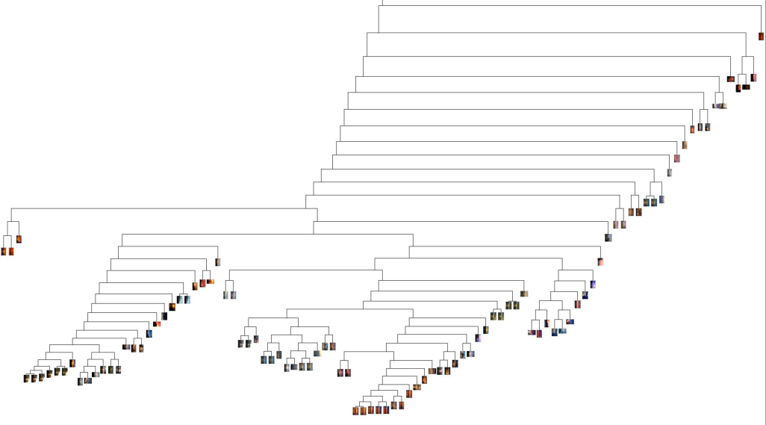
Hierarchical Clustering
from PIL import Image from numpy import * import os import hcluster # create a list of images path = './sunsets/' imlist = [os.path.join(path, f) for f in os.listdir(path) if f.endswith('.jpg')] # extract feature vector (8 bins per color channel) features = zeros([len(imlist), 512]) for i, f in enumerate(imlist): im = array(Image.open(f)) # multi-dimensional histogram h, edges = histogramdd(im.reshape(-1, 3), 8, normed=True, range=[(0, 255), (0, 255), (0, 255)]) features[i] = h.flatten() tree = hcluster.hcluster(features) hcluster.draw_dendrogram(tree, imlist, filename='sunset.pdf')
지정한 폴더에서 Image파일 이름 불러오기
Image파일 로드
Image histogram 생성하여 1차원 배열로 변환
Hierarchical Clustering 시행
Clustering Tree 시각화

Slide 7
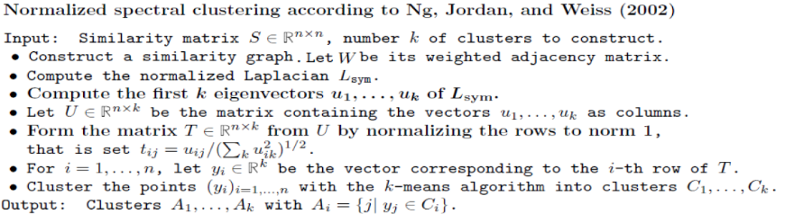
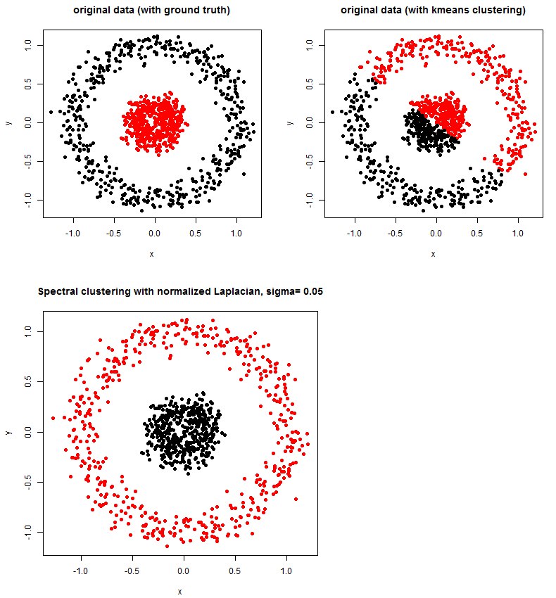
Spectral Clustering
Spectral Clustering Algorithm

Slide 8
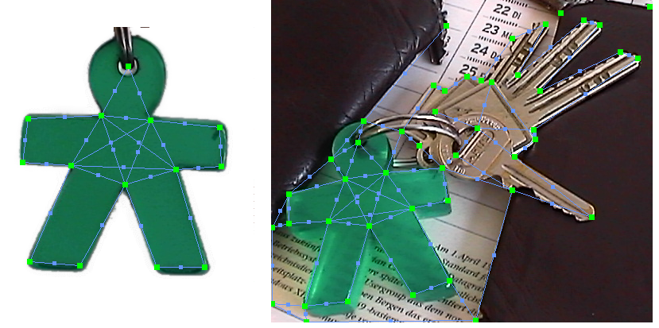
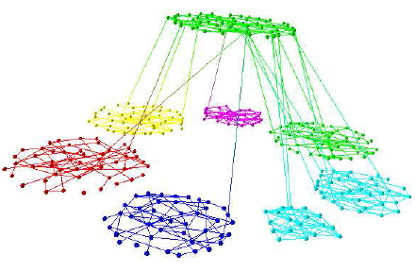
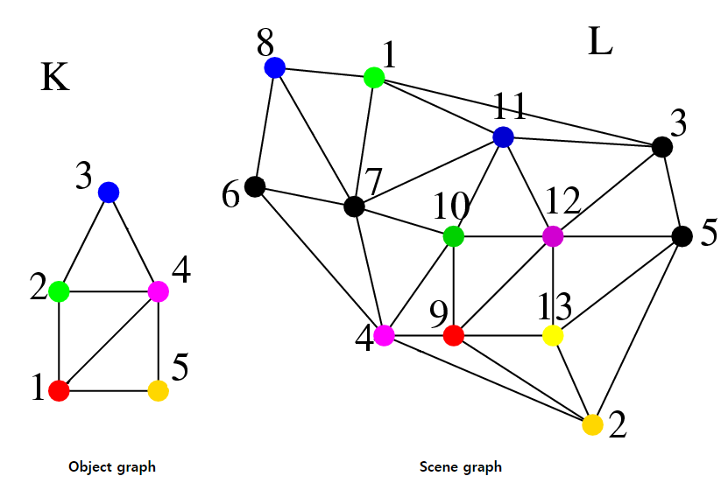
Spectral Clustering
Graph Theory
A graph is an abstract representation of a set of objects, where several pairs of the objects are connected by links.
Graph matching
Clustering

Slide 9
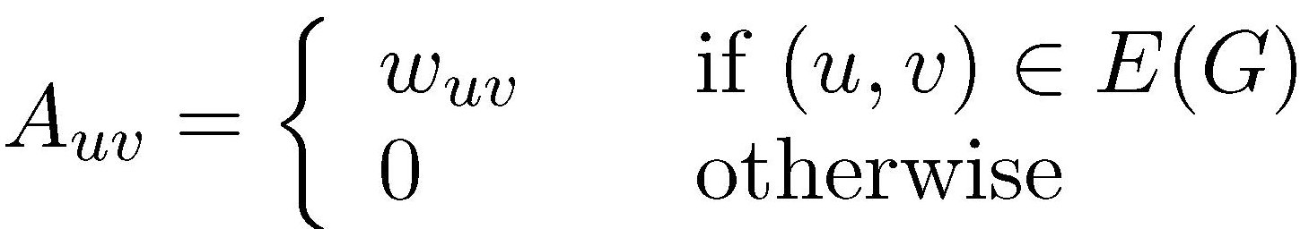
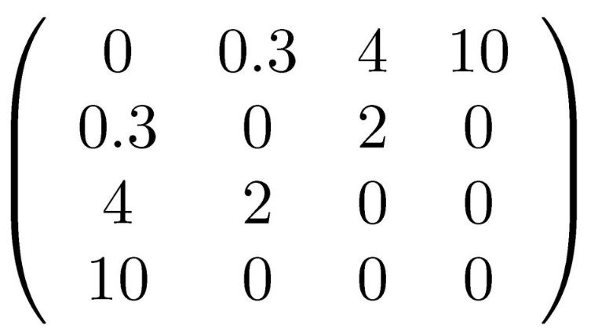
Spectral Clustering
Graph Theory
The Adjacency Matrix
10
4
1
0.3
4
A=
2
3
2

Slide 10
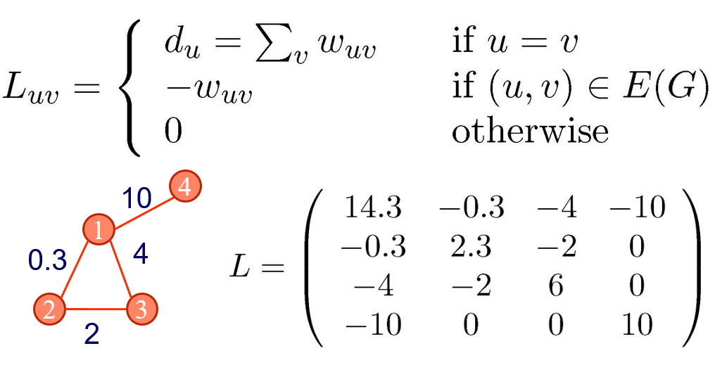
Spectral Clustering
Graph Theory
The Weighted Laplacian Matrix

Slide 11
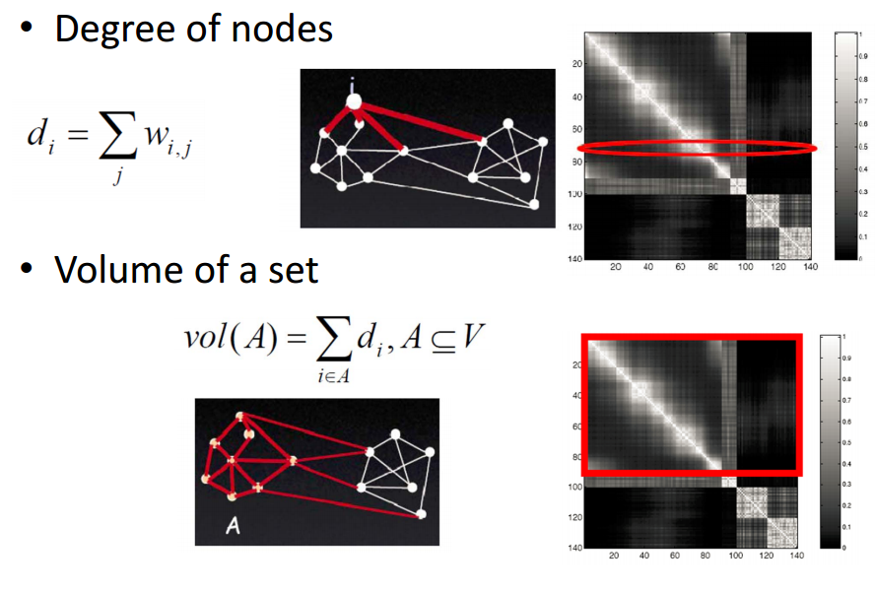
Spectral Clustering
Spectral Graph Theory
The Weighted Laplacian Matrix

Slide 12
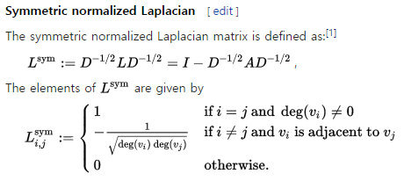
Spectral Clustering
Spectral Graph Theory
The Symmetric normalized Laplacian Matrix

Slide 13
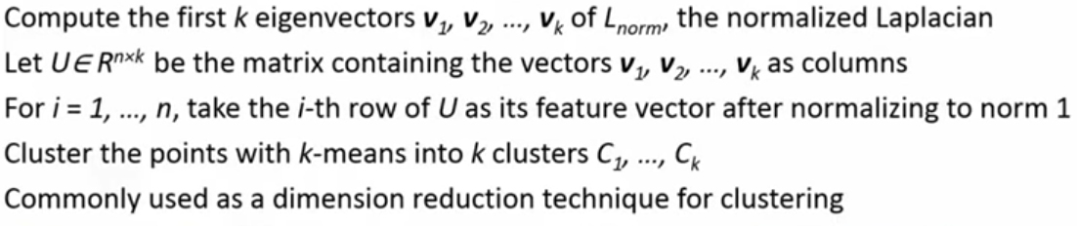
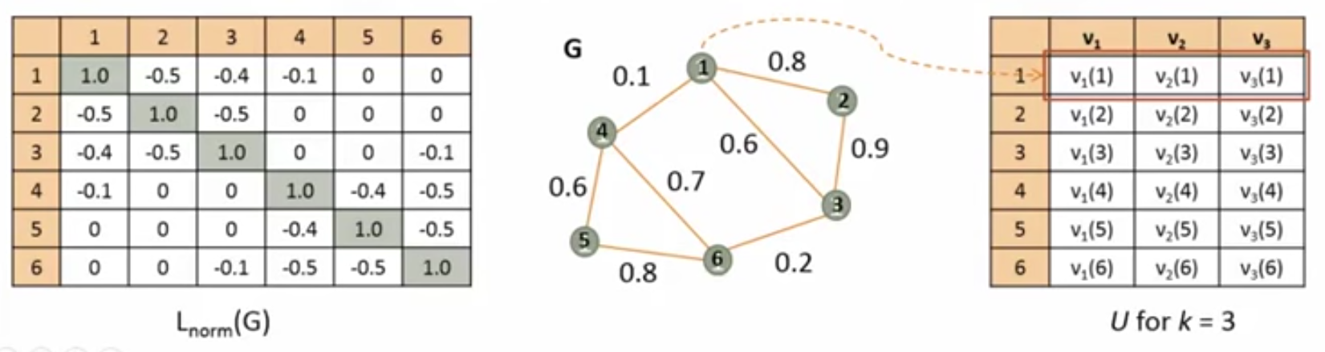
Spectral Clustering
Ng-Jordan-Weiss(NJW) Algorithm (2002)

Slide 14
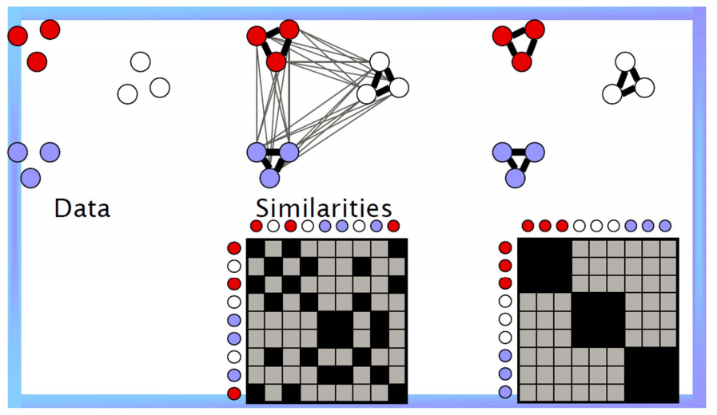
Spectral Clustering
Ng-Jordan-Weiss(NJW) Algorithm (2002)

Slide 15
Spectral Clustering
Python Example Code analysis
n = len(projected) # compute distance matrix S = array([[ sqrt(sum((projected[i]-projected[j]) ** 2)) for i in range(n) ] for j in range(n)], 'f') # create Laplacian matrix rowsum = sum(S, axis=0) D = diag(1 / sqrt(rowsum)) I = identity(n) L = I - dot(D, dot(S, D)) # compute eigenvectors of L U, sigma, V = linalg.svd(L) k = 5 # create feature vector from k first eigenvectors # by stacking eigenvectors as columns features = array(V[:k]).T # k-means features = whiten(features) centroids, distortion = kmeans(features, k) code, distance = vq(features, centroids) # plot clusters gray() for c in range(k): ind = where(code==c)[0] figure() for i in range(minimum(len(ind), 39)): im = Image.open(imlist[ind[i]]).convert('L') subplot(4, 10, i+1) imshow(im) axis('equal') axis('off') show()
PCA로 차원을 낮춘 Data array
Adjacency matrix 생성
Laplacian matrix 생성
Laplacian matrix를 SVD로 분리하여 Eigenvector 얻음
Eigenvector를 Feature로 하여 K-means 알고리즘 수행
Cluster 별로 Visualize 수행

Slide 16
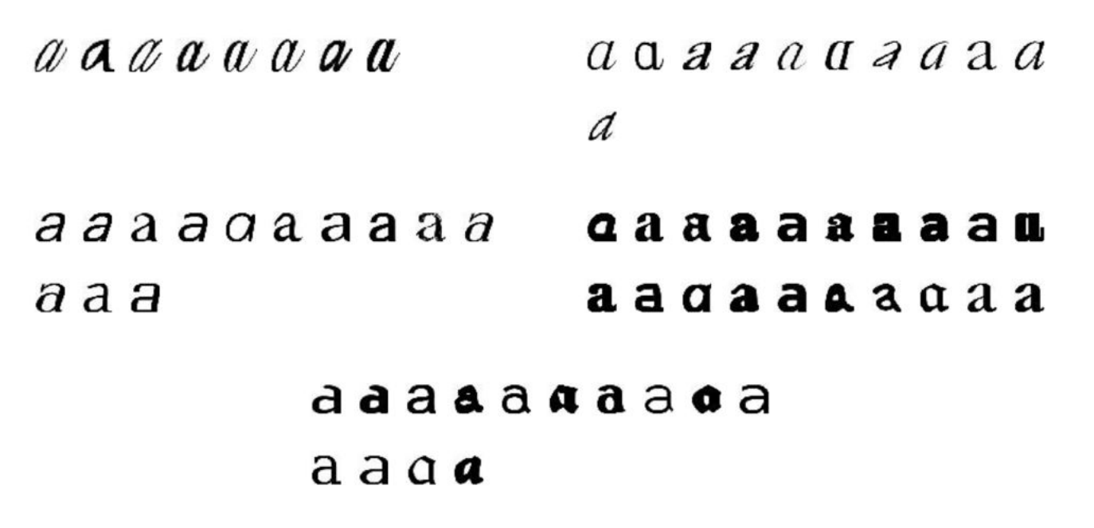
Spectral Clustering
Python Example Result

Slide 17
Q & A
Thank you

