Slide 3
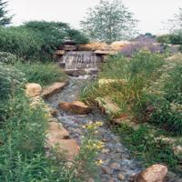
System diagram
Dictionary
Indexed database
Patches extraction
Alto-learned feature selection algorithm
Nearest Neighbor Retrieval
Response reactivation scoring
Reentrant Process

Slide 4
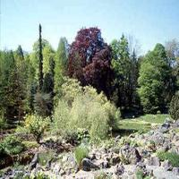

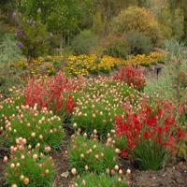
Dictionary Indexing
Dictionary
Patches extraction
Alto-learned feature selection algorithm
Indexed database
Response reactivation scoring
Reentrant Process

Slide 6
Dictionary
Indexed database
Preprocessing & Patches extraction
Inhibitive Feature Selection Algorithm
Nearest Neighbor Retrieval
Synaptic Plasticity Reactivation Scoring
Retrieved
Images
Hash Value Generation

