Slide 1
Tooth Registration
Surface-based Registration
Point cloud-based Registration
Result and Analysis
02/25/2022
Bionics Lab
Hanbyeol Yoon

Slide 2
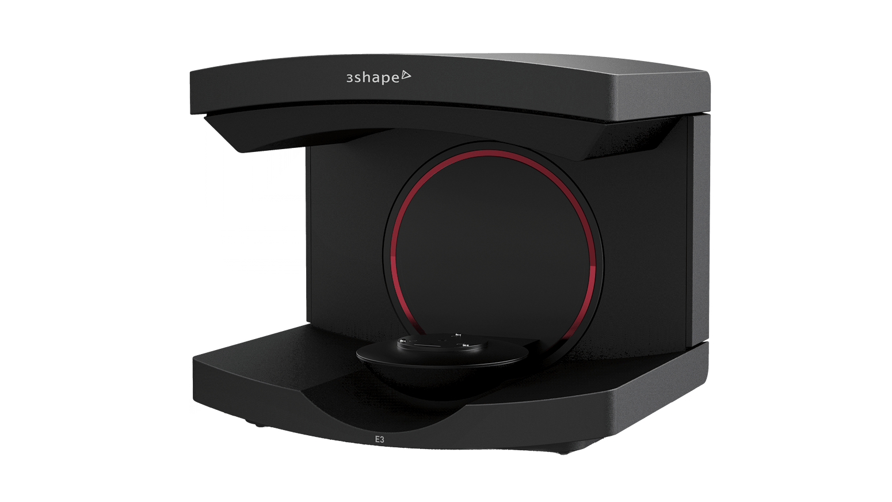
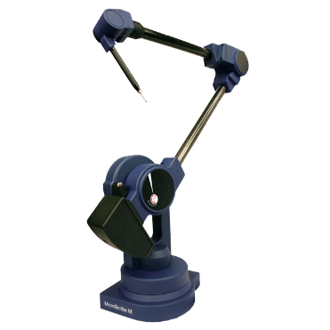
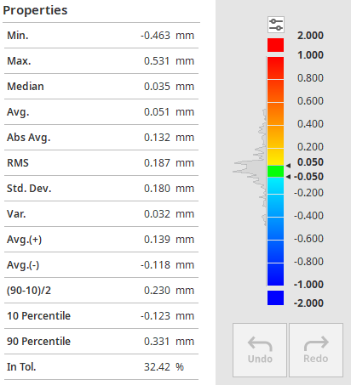
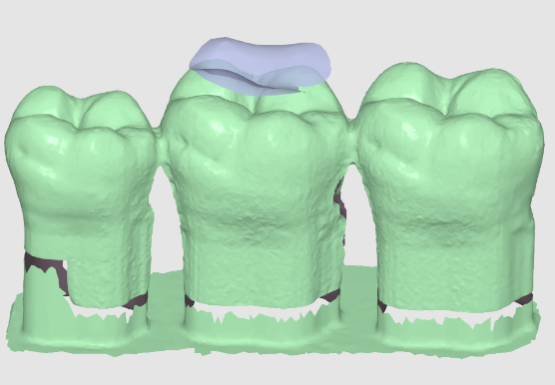
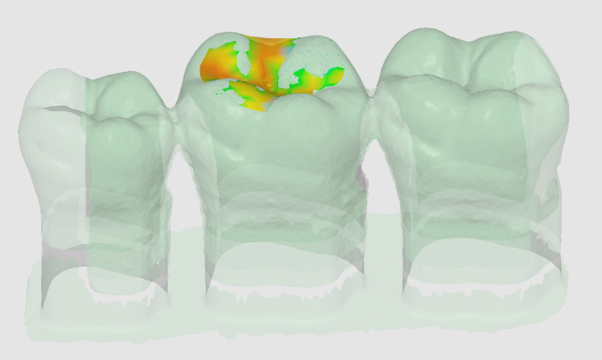
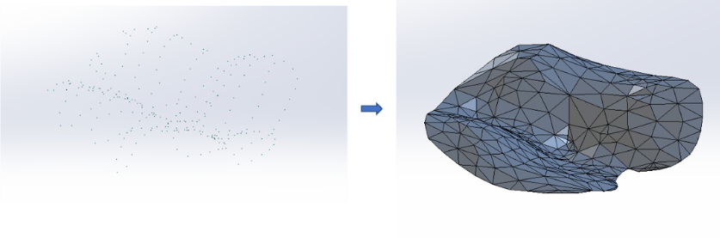
1. Surface-based Registration (Previous Method)
Procedure - Scan the tooth with 3D scanner → scan.stl - Measure multiple points on the tooth with CMM - Generate surface with the multiple points through inter/extrapolation¹ → measure.stl - Align the two models / Compute the transformation matrix / Analyze the distance error
Limitation - CMM measurement noise - Human error when measuring multiple points with CMM - inter/extrapolation error of the generated surface - lack of correspondences for alignment²
To-do - Measure the small number of points of the unique shape (e.g. valley of tooth) - Take the various types of noise into account - Estimate not only the transformation matrix but also correspondences
3D Scanner
CMM
XYZ points
Surface¹
Alignment²
Analysis Visualization
Analysis Statistics

Slide 3
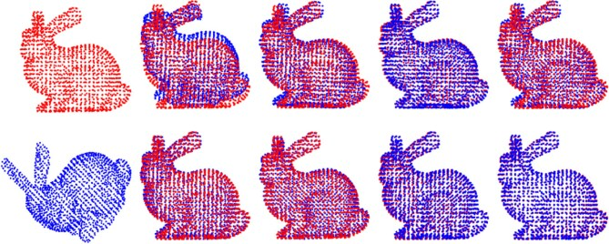
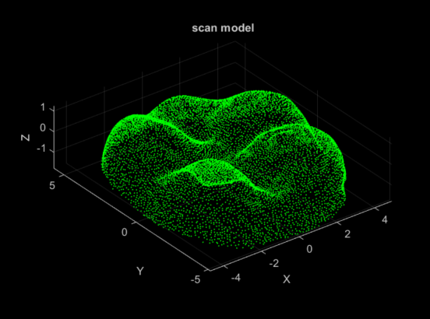
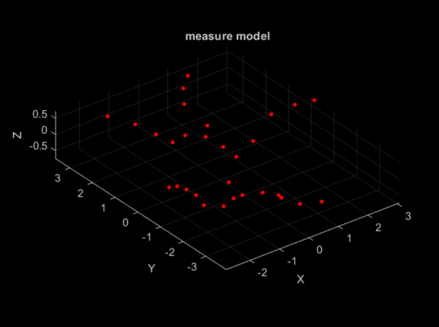
2. Point cloud-based Registration
Overview of Point-set Registration¹ - Correspondence-based Registration : Outlier-free registration, Robust registration, … - Simultaneous Pose and Correspondence Registration : Iterative Closest Point (ICP), Coherent Point Drift (CPD), Normal Distribution Transformation (NDT),...
NDT for our application - Rigid-body transformation - Correspondence registration - Probability-based registration : the noise of measurement may have normal distribution
Procedure - Convert 3D scan model to point clouds - Measure points only on the valley of the tooth with CMM - Point cloud-based registration (NDT) - Compute the transformation matrix / Analyze the distance error
Limitation - The results are dependent on initial guess of correspondences
Example of Point-set Registration
Point Clouds of Scan/Measure Model

Slide 4
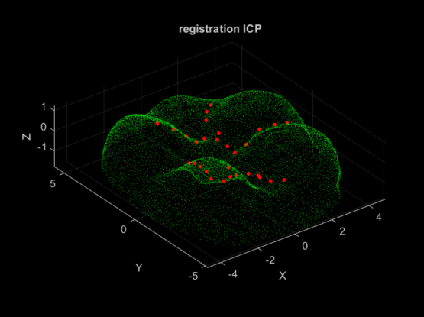
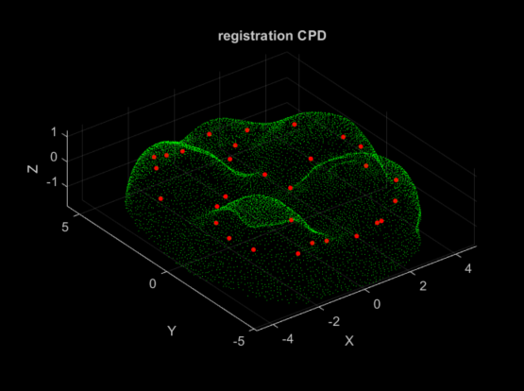
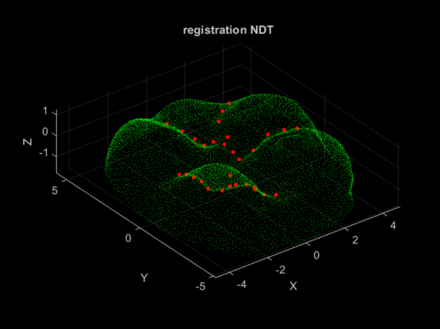
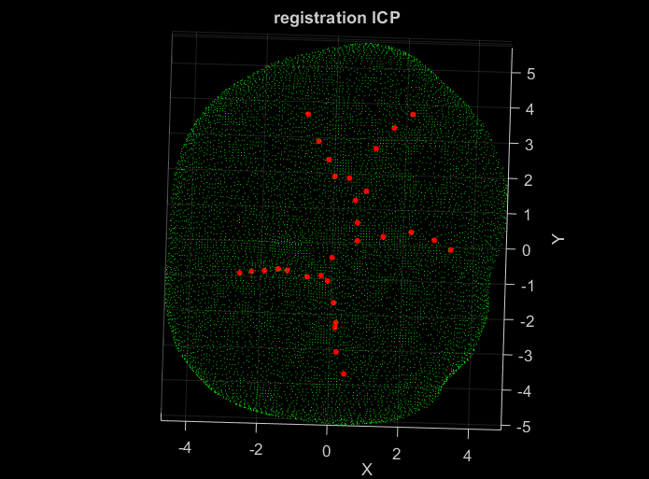
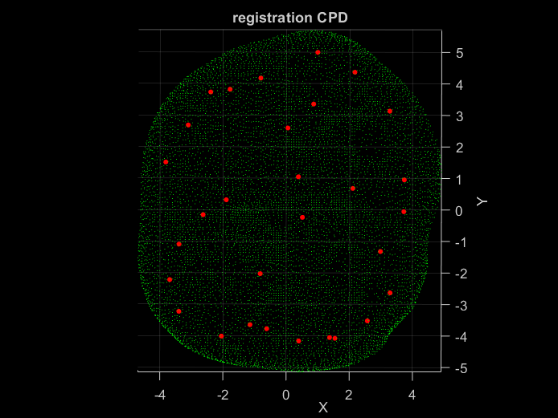
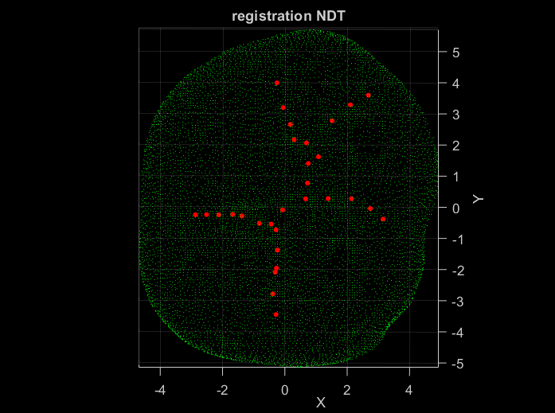
3. Result & Analysis
 | ICP | CPD | NDT
Probabilistic | X (Deterministic) | O | O
Rigid Transformation | O | X (Non-rigid) | O
Correspondence Estimation | O | O | O
Figure
RMSE (mm) | 0.3398 | 0.1085 | 0.0679

