Slide 1

APPLICATIONS OF
MATLAB IN ENGINEERING
Yan-Fu Kuo
Dept. of Bio-industrial Mechatronics Engineering
National Taiwan University
Today:
Fall 2015
•
•
•
Introduction
MATLAB as calculator
Array operation

Slide 2
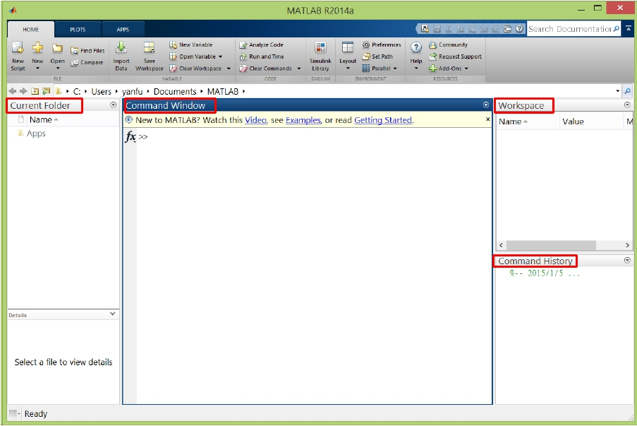
Applications of MATLAB in Engineering
Ready to Launch?
Y.-F. Kuo
2

Slide 3
Applications of MATLAB in Engineering
Y.-F. Kuo
3
MATLAB Programming Modes
- Command line (in command window)
- Scripts (.m files)

Slide 4
Applications of MATLAB in Engineering
Y.-F. Kuo
4
MATLAB asACalculator
• Operators: +
-
*
/
^
• Result is computed, and displayed as ans
• Precedence rules:
• Left-to-right within a precedence group
• Precedence groups are (highest first):
1. Parenthesis ()
2. Power (^)
3. Multiplication and division (*, /)
4. Addition and subtraction (+, -)

Slide 5
Y.-F. Kuo
5
Applications of MATLAB in Engineering
Exercise
• Calculate:
1+2+3+4 3
• cos
5
• sin
𝜋 + ln(tan 1 )
• 23.5×1.7
• 𝑒sin 10
• Your best friend – on-line help

Slide 6
Applications of MATLAB in Engineering
Y.-F. Kuo
6
Elementary Math Functions
• Function list:
http://www.mathworks.com/help/matlab/functionlist.html
• Arithmetic
• Trigonometry
• Exponents and Logarithms
• Complex Numbers
• Cartesian Coordinate System Conversion

Slide 7
Applications of MATLAB in Engineering
Y.-F. Kuo
7
Embedding Functions
• Functions may be embedded into other functions,
sin(cos(pi))
cos(pi)
sin(ans)
• Many lines of code can be condensed into one
single command
=

Slide 8
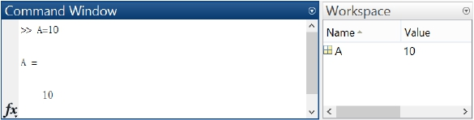
Applications of MATLAB in Engineering
Y.-F. Kuo
8
Variables
• Variables do NOT need to be declared before assignment
• A single “equal” sign (=) is the assignment operator:
>> LHS = RHS
>> A = 10
1.
2.
Upper case/lower case make difference?
Can variable names can begin with a number?

Slide 9
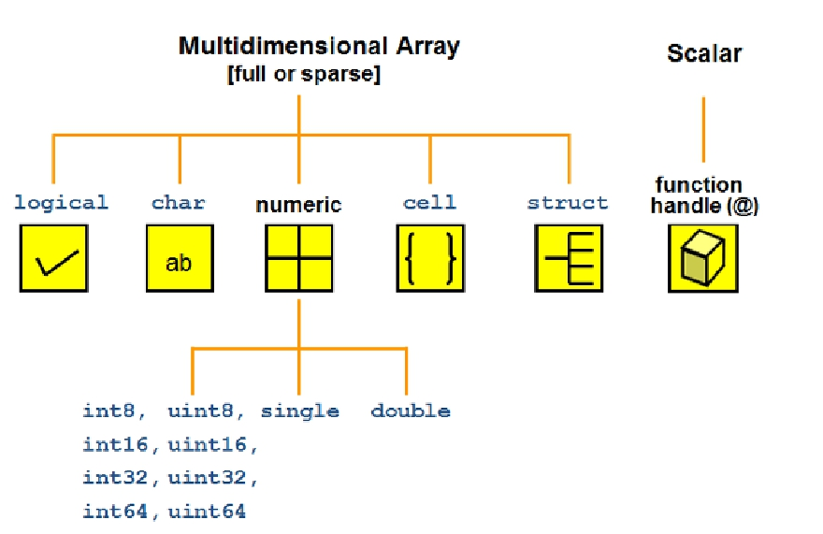
Applications of MATLAB in Engineering
Y.-F. Kuo
9
Numeric Variable (Data) Type

Slide 10
Applications of MATLAB in Engineering
Y.-F. Kuo
10
Special Variables and Constants
• ans
• i,j: complex number
• Inf: ∞
• eps: 2.2204e-016
• NaN: not a number
• pi: π
• To list keywords:
>> iskeyword
• What’s the answer from
MATLAB after typing?
>> x = 1/0
>> x = log(0)
>> x = inf/inf

Slide 11
Applications of MATLAB in Engineering
Y.-F. Kuo
11
MATLAB Calling Priority
High
Variable
Built-in function
Subfunction
Private function:
• MEX-file
• P-file
• M-file
cos='This string.';
cos(8)
clear cos
cos(8)
Low

Slide 12
Applications of MATLAB in Engineering
Y.-F. Kuo
12
Numeric Display “Format”
>> format long
Style
Result
Example
short
long
Short, fixed-decimal format with 4 digits after the 3.1416
decimal point.
Long, fixed-decimal format with 15 digits after the 3.141592653589793
decimal point fordouble values, and 7 digits after
the decimal point for single values.
shortE
longE
Short scientific notation with 4 digits after the
decimal point.
Long scientific notation with 15 digits after the
3.1416e+00
3.141592653589793
decimal point fordouble values, and 7 digits after e+00
the decimal point for single values.
bank
hex
rat
Currency format with 2 digits after the decimal
point.
Hexadecimal representation of a binary double-
precision number.
Ratio of small integers.
3.14
400921fb54442d18
355/113

Slide 13
Applications of MATLAB in Engineering
Exercise
• Calculate:
Y.-F. Kuo
13
3
13
4
14
5
15
+
+
=
1. 232/273
2. 233/273
3. 131/275
4. 132/2730
a. 0.84981384981682
b. 0.84981484981683
c. 0.84981584981684
d. 0.84981684981685

Slide 14
Applications of MATLAB in Engineering
Y.-F. Kuo
14
Command Line Terminal
• Observe the difference between
>> a = 10
>> b = 10;
• ; at the end of a command suppresses output to
the terminal
• ↑ display previous commands

Slide 15
Applications of MATLAB in Engineering
Y.-F. Kuo
15
Some Useful Functions
• clc: clear command window display
• clear: remove all variables in the workspace
• who: variables in the workspace
• whos: variable information of the workspace

Slide 16
Applications of MATLAB in Engineering
Y.-F. Kuo
16
Array (Vector and Matrix)
• Row vector:
>> a = [1 2 3 4]
• Column vector:
>> b = [1; 2; 3; 4]
• Try:
>> a*b
>> b*a
• Key in the following matrix in MATLAB:
1
𝐴 = 5
21 6
17 9
31
2
7

Slide 17
Applications of MATLAB in Engineering
Y.-F. Kuo
17
Array Indexing
• Select a certain subset of elements inside a matrix
1
𝐴 = 5
21 6
17 9
31
2
7
• What’s the answer from MATLAB after typing?
>>
>>
>>
>>
>>
A(8)
A([1 3 5])
A([1 3; 1 3])
A(3,2)
A([1 3], [1 3])

Slide 18
Applications of MATLAB in Engineering
Y.-F. Kuo
18
Replacing Entries
• Change the following elements in the matrix:
1
𝐴 = 5
31
21
17
2
6
9
7
1
5
31
76
17
0
6
9
7
1
5
31
0
0
0
0
0
7

Slide 19
Applications of MATLAB in Engineering
Y.-F. Kuo
19
Colon Operator
• Want to create a long array: A = [1 2 3 … 100]
• Creates vectors or arrays, and specify for iterations
• Syntax: j:k
⇒ [j, j+1, j+2,..., j+m]
j:i:k ⇒ [j, j+i, j+2i, ..., j+m*i]
• What’s the answer from MATLAB after typing?
>>
>>
>>
>>
B =
B =
B =
str
1:5
1:2:5
[1:5; 2:3:15; -2:0.5:0]
= 'a':2:'z'

Slide 20
Applications of MATLAB in Engineering
Y.-F. Kuo
20
Indexing Using Colon Operator
1
𝐴 = 5
31
0 0
0 0
0 7
1 0
5 0
0
0
• How do we delete a row or a column of A?
• Exercise: try the expression
>> A(3,:)
>> A(3,:) = []

Slide 21
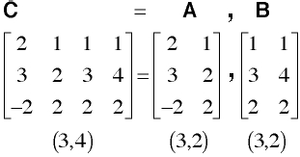
Applications of MATLAB in Engineering
Y.-F. Kuo
21
Array Concatenation
• Arrays can be formed through concatenation as
long as the rectangular shape is preserved
• Create matrices A, B, C, and D and concatenate
them into F:
12 34 | 99 99
5678
-2-101
A
C
D
B
F =

Slide 22
Applications of MATLAB in Engineering
Array Manipulation
Y.-F. Kuo
22
1
2 3
3
3
3
𝐴 = 4
9
5 4
8 7
𝐵 = 2
1
4
3
9
1
𝑎 = 2
• Operators on array: +
-
*
/
^ .
'
• Type the following command and observe the results:
>> x1=A+a
>> x2=A/a
>> x3=A./a
>> x4=A^a
>> x5=A.^a
>> C=A'
>> y1=A+B
>> y2=A*B
>> y3=A.*B
>> y4=A/B
>> y5=A./B

Slide 23
Applications of MATLAB in Engineering
Array Manipulation
Y.-F. Kuo
23
Symbol
+
-
+
-
*
.*
./
.\
.^
Operation
Scalar-array addition
Scalar-array subtraction
Array addition
Array subtraction
Matrix multiplication
Array multiplication
Array right division
Array left division
Array exponentiation
Form
A+b
A–b
A+B
A-B
A*B
A.*B
A./B
A.\B
A.^B
Examples
[6,3]+2=[8,5]
[8,3]-5=[3,-2]
[6,5]+[4,8]=[10,13]
[6,5]-[4,8]=[2,-3]
[3,5]*[4,8]’=52
[3,5].*[4,8]=[12,40]
[2,5]./[4,8]=[2/4,5/8]
[2,5].\[4,8]=[4/2,8/5]
[3,5].^[2,4]=[3^2,5^4]

Slide 24
Applications of MATLAB in Engineering
Y.-F. Kuo
24
Some Special Matrix
• eye(n): n×n identity matrix
• zeros(n1,n2): n1×n2 zero matrix
• ones(n1,n2): n1×n2 matrix with every entry as 1
• diag(): diagonal matrix

Slide 25
Applications of MATLAB in Engineering
Y.-F. Kuo
25
Some Matrix Related Functions
1
2
3
𝐴 = 0
5 6
7
0
9
• Type the following command and observe the
results:
>> max(A)
>> max(max((A))
>> min(A)
>> sum(A)
>> mean(A)
>> sort(A)
>> sortrows(A)
>> size(A)
>> length(A)
>> find(A)

Slide 26

Applications of MATLAB in Engineering
End of Class
Y.-F. Kuo
26

