Slide 1

APPLICATIONS OF
MATLAB IN ENGINEERING
Yan-Fu Kuo
Dept. of Bio-industrial Mechatronics Engineering
National Taiwan University
Today:
Fall 2015
•
•
•
Script writing
Structured programming
User-defined function

Slide 2
Applications of MATLAB in Engineering
Y.-F. Kuo
2
MATLAB Script
• A file containing a series of MATLAB commands
• Pretty much like a C/C++ program
• Scripts need to be saved to a <file>.m file
before they can be run

Slide 3
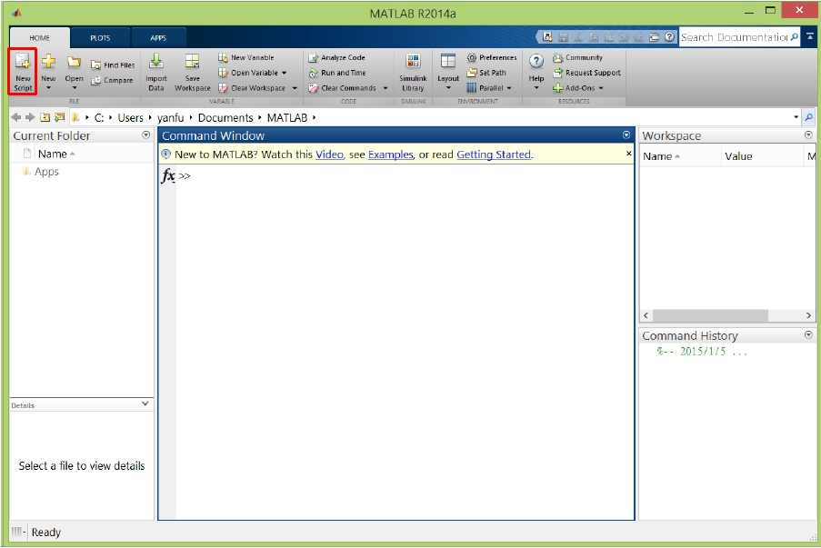
Applications of MATLAB in Engineering
Y.-F. Kuo
3
StartAScript (.m) File

Slide 4
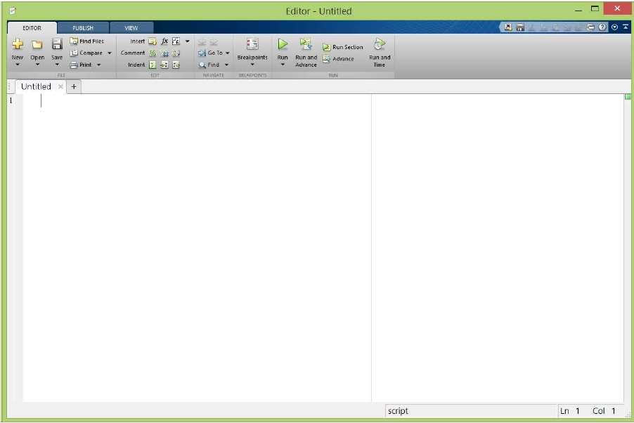
Applications of MATLAB in Engineering
Y.-F. Kuo
4
Script Editor
for i=1:10
x=linspace(0,10,101);
plot(x,sin(x+i));
print(gcf,'-deps',strcat('plot',num2str(i),'.ps'));
end

Slide 5
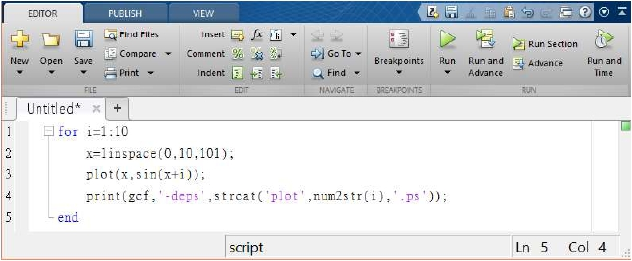
Applications of MATLAB in Engineering
Y.-F. Kuo
5
Script Flow
• Typically scripts run from the first line to the last
• Structured programming techniques (subroutine, loop,
condition, etc) are applied to make the program looks
neat

Slide 6
Applications of MATLAB in Engineering
Flow Control
Y.-F. Kuo
6
if, elseif, else
for
switch, case,
otherwise
try, catch
while
break
continue
end
pause
return
Execute statements if condition is true
Execute statements specified number of times
Execute one of several groups of statements
Execute statements and catch resulting errors
Repeat execution of statements while condition is true
Terminate execution of for or while loop
Pass control to next iteration of for or while loop
Terminate block of code, or indicate last array index
Halt execution temporarily
Return control to invoking function

Slide 7
Applications of MATLAB in Engineering
Y.-F. Kuo
7
Relational (Logical) Operators
Operator
<
<=
>
>=
==
~=
&&
||
Meaning
Less than
Less than or equal to
Greater than
Greater than or equal to
Equal to
Not equal to
And
Or

Slide 8
Applications of MATLAB in Engineering
if elseif else
Y.-F. Kuo
8
if condition1
statement1
elseif condition2
statement2
else
if rem(a, 2) == 0
disp('a is even')
else
disp('a is odd')
end
statement3
end
• “elseif” and “else” are optional

Slide 9
Applications of MATLAB in Engineering
switch
Y.-F. Kuo
9
switch expression
case value1
statement1
case value2
statement2
.
.
otherwise
statement
end
switch input_num
case -1
disp('negative 1');
case 0
disp('zero');
case 1
disp('positive 1');
otherwise
disp('other value');
end

Slide 10
Applications of MATLAB in Engineering
while
while expression
Y.-F. Kuo
n = 1;
10
statement
while prod(1:n) < 1e100
n = n + 1;
end
end

Slide 11
Applications of MATLAB in Engineering
Y.-F. Kuo
11
Exercise
• Use while loop to calculate the summation of the
series 1+2+3+…+999

Slide 12
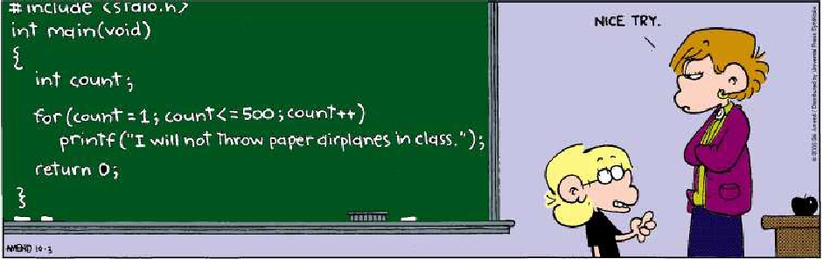
Applications of MATLAB in Engineering
for
Y.-F. Kuo
12
for variable=start : increment : end
commands
end
for n=1:10
a(n)=2^n;
end
disp(a)

Slide 13
Applications of MATLAB in Engineering
Y.-F. Kuo
13
Pre-allocating Space to Variables
• In the previous example, we do not pre-allocate
space to vector a rather than letting MATLAB resize it
on every iteration
• Which method is faster?
A | B
tic forii=1:2000 forjj=1:2000 A(ii,jj)=ii+jj; end end toc | tic A=zeros(2000,2000); forii=1:size(A,1) forjj=1:size(A,2) A(ii,jj)=ii+jj; end end toc

Slide 14
Applications of MATLAB in Engineering
Y.-F. Kuo
14
Exercise
• Use structured programming to:
1. Find the entries in matrix 𝐴 that are negative
2. Store these entries’ position in a matrix B
3. Change the values of these entries to zero
0
−1
4
𝐴 =
9
−14 25
−34
49
64

Slide 15
Applications of MATLAB in Engineering
Y.-F. Kuo
15
break
• Terminates the execution of for or while loops
x = 2; k = 0; error = inf;
error_threshold = 1e-32;
while error > error_threshold
if k > 100
break
end
x = x - sin(x)/cos(x);
error = abs(x - pi);
k = k + 1;
end
• Used in iteration where convergence is not guaranteed

Slide 16
Applications of MATLAB in Engineering
Y.-F. Kuo
16
Tips for Script Writing
• At the beginning of your script, use command
• clear all to remove previous variables
• close all to close all figures
• Use semicolon ; at the end of commands to inhibit
unwanted output
• Use ellipsis ... to make scripts more readable:
A = [1 2 3 4 5 6; ...
6 5 4 3 2 1];
• Press Ctrl+C to terminate the script before
conclusion

Slide 17
Applications of MATLAB in Engineering
Y.-F. Kuo
17
Scripts vs. Functions
• Scripts and functions are both .m files that
contain MATLAB commands
• Functions are written when we need to perform
routines
Scripts | Functions
•Noinputarguments •Nooutputarguments •Operateondatainthe globalworkspace | •Yesinputarguments •Yesoutputarguments •Operateondatainthe localworkspace

Slide 18
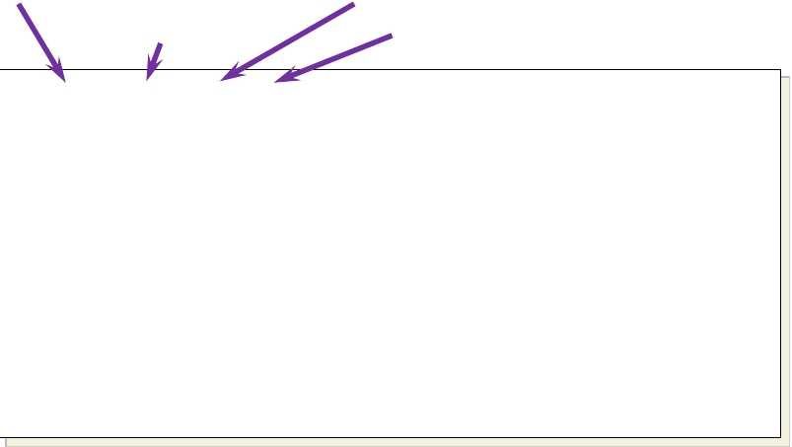
Applications of MATLAB in Engineering
Y.-F. Kuo
18
Content of MATLAB Built-in Functions
>> edit(which('mean.m'))
Keyword: function
Function Name (same as file name .m)
Output Argument(s)
function y = mean(x)
Input Argument(s)
%MEAN
Average or mean value.
% S = MEAN(X) is the mean value of the elements in X
% if X is a vector. For matrices, S is a row
% vector containing the mean value of each column.
…
if nargin==2 && ischar(dim)
flag = dim;
elseif nargin < 3
flag = 'default';
end
…
Online
Help
MATLAB
Code

Slide 19
Applications of MATLAB in Engineering
Y.-F. Kuo
19
Some Observations
• Keyword: function
• Function name matches the file name
• Directory: MATLAB needs to find the function
• Input and output variables are optional
• Local variables: dim and flag cannot be
accessed

Slide 20
Applications of MATLAB in Engineering
Y.-F. Kuo
20
User Define Functions
• Write a function that calculate the displacement of
free falling for given initial displacement 𝑥0, initial
velocity 𝑣0, and duration of falling 𝑡:
1
𝑥 = 𝑥0 + 𝑣0𝑡 + 𝑔𝑡2
2
function x = freebody(x0,v0,t)
% calculation of free falling
% x0: initial displacement in m
% v0: initial velocity in m/sec
% t: the elapsed time in sec
% x: the depth of falling in m
x = x0 + v0.*t + 1/2*9.8*t.*t;

Slide 21
Applications of MATLAB in Engineering
Y.-F. Kuo
21
Functions with Multiple Inputs and Outputs
• The acceleration of a particle and the force acting
on it are as follows:
𝑣2 − 𝑣1
𝑡2 − 𝑡1
𝑎 =
𝐹 = 𝑚𝑎
function [a F] = acc(v2,v1,t2,t1,m)
a = (v2-v1)./(t2-t1);
F = m.*a;
[Acc Force] = acc(20,10,5,4,1)

Slide 22
Applications of MATLAB in Engineering
Y.-F. Kuo
22
Exercise
• Write a function that asks for a temperature in
degrees Fahrenheit
• Compute the equivalent temperature in degrees
Celsius
• Show the converted temperature in degrees
Celsius
• The script should keep running until no number is
provided to convert
• You may want to use these functions:
input, isempty, break, disp, num2str

Slide 23
Applications of MATLAB in Engineering
Y.-F. Kuo
23
Function Default Variables
inputname
mfilename
nargin
nargout
varargin
varargout
Variable name of function input
File name of currently running function
Number of function input arguments
Number of function output arguments
Variable length input argument list
Variable length output argument list
function [volume]=pillar(Do,Di,height)
if nargin==2,
height=1;
end
volume=abs(Do.^2-Di.^2).*height*pi/4;

Slide 24
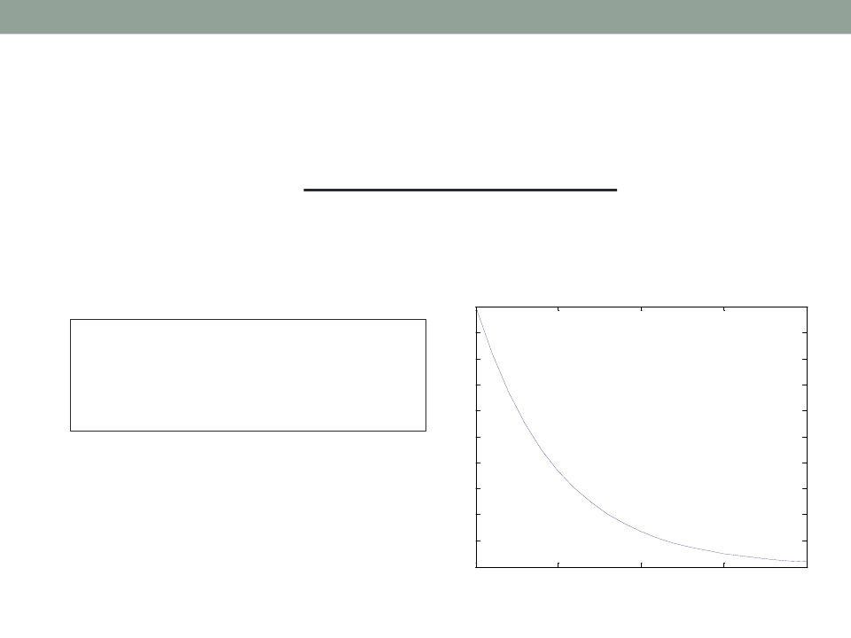
Applications of MATLAB in Engineering
Y.-F. Kuo
24
Function Handles
• A way to create anonymous functions, i.e., one
line expression functions that do not have to be
defined in .m files
1
f = @(x) exp(-2*x);
x = 0:0.1:2;
plot(x, f(x));
0.9
0.8
0.7
0.6
0.5
0.4
0.3
0.2
0.1
0
0
0.5
1
1.5
2

Slide 25

Applications of MATLAB in Engineering
End of Class
Y.-F. Kuo
25

