Slide 1

APPLICATIONS OF
MATLAB IN ENGINEERING
Yan-Fu Kuo
Dept. of Bio-industrial Mechatronics Engineering
National Taiwan University
Today:
Fall 2015
•
•
Variables: string, structure, cell
Data access

Slide 2
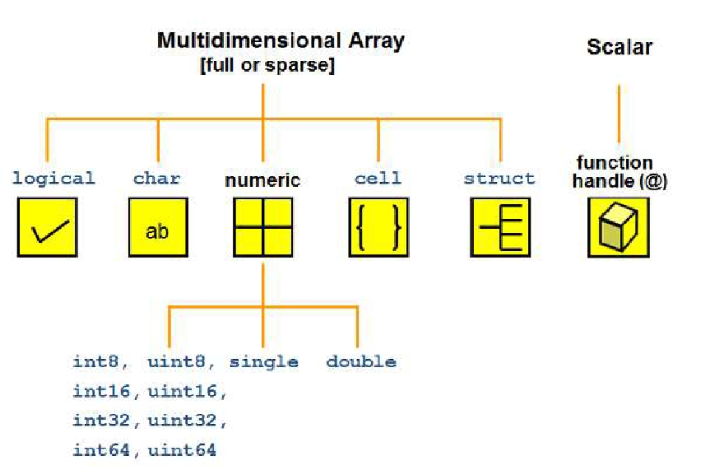
Applications of MATLAB in Engineering
Y.-F. Kuo
2
MATLAB Data (Variables) Types

Slide 3
Applications of MATLAB in Engineering
Y.-F. Kuo
3
Variable (Data) Type Conversion
double()
single()
int8()
int16()
int32()
int64()
uint8()
uint16()
uint32()
uint64()
Convert to double precision
Convert to single precision
Convert to 8-bit signed integer
Convert to 16-bit signed integer
Convert to 32-bit signed integer
Convert to 64-bit signed integer
Convert to 8-bit unsigned integer
Convert to 16-bit unsigned integer
Convert to 32-bit unsigned integer
Convert to 64-bit unsigned integer

Slide 4
Applications of MATLAB in Engineering
Y.-F. Kuo
4
Character (char)
• A character is represented in ASCII using a
numeric code between 0 to 255
• Create a character or a string by putting them into
a pair of apostrophe:
s1 = 'h'
whos
uint16(s1)
s2 = 'H'
whos
uint16(s2)

Slide 5
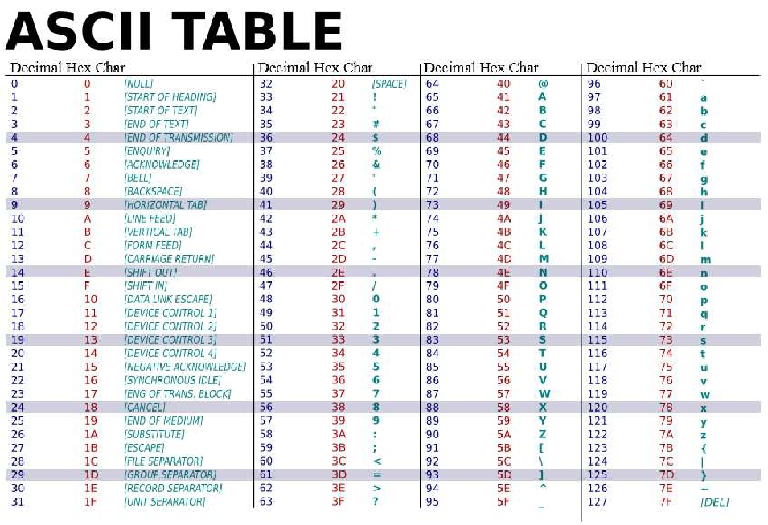
Applications of MATLAB in Engineering
Y.-F. Kuo
5

Slide 6
Applications of MATLAB in Engineering
Y.-F. Kuo
6
String
• An array collects characters:
s1 = 'Example';
s2 = 'String';
• String concatenation:
s3 = [s1 s2];
s4 = [s1; s2];

Slide 7
Applications of MATLAB in Engineering
Y.-F. Kuo
7
Logical Operations andAssignments
• Many numerical and logical operators can be
applied to strings
str = 'aardvark';
'a' == str
• Try this:
str(str == 'a') = 'Z'
• What if we want to compare the entire string with
another?

Slide 8
Applications of MATLAB in Engineering
Y.-F. Kuo
8
Exercise
• Write a script that inverts any given string
s1='I like the letter E'
s2='E rettel eht ekil I'

Slide 9
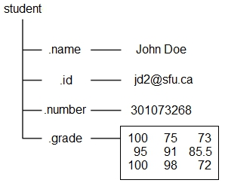
Applications of MATLAB in Engineering
Y.-F. Kuo
9
Structure
• A method of storing heterogeneous data
• Structures contain arrays called fields
• Student assignment grades:
student.name = 'John Doe';
student.id = 'jdo2@sfu.ca';
student.number = 301073268;
student.grade = [100, 75, 73; ...
95, 91, 85.5; ...
100, 98, 72];
student

Slide 10
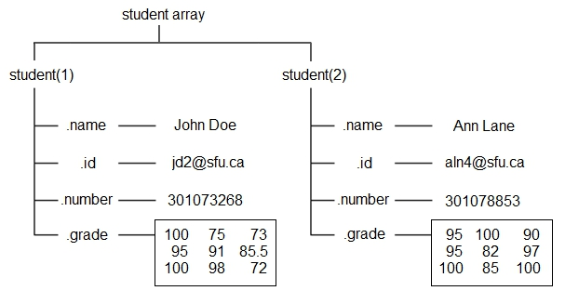
Applications of MATLAB in Engineering
Y.-F. Kuo
10
Adding Information toAStructure
student(2).name = 'Ann Lane';
student(2).id = 'aln4@sfu.ca';
student(2).number = 301078853;
student(2).grade = [95 100 90; 95 82 97; 100 85 100];
• Retrieve the 3rd grade for Ann Lane

Slide 11
Applications of MATLAB in Engineering
Y.-F. Kuo
11
Structure Functions
cell2struct Convert cell array to structure array
fieldnames
getfield
isfield
isstruct
Field names of structure, or public fields of object
Field of structure array
Determine whether input is structure array field
Determine whether input is structure array
orderfields Order fields of structure array
rmfield
setfield
struct
Remove fields from structure
Assign values to structure array field
Create structure array
struct2cell Convert structure to cell array
structfun
Apply function to each field of scalar structure
• Try:
fieldnames(student)
rmfield(student,'id')

Slide 12
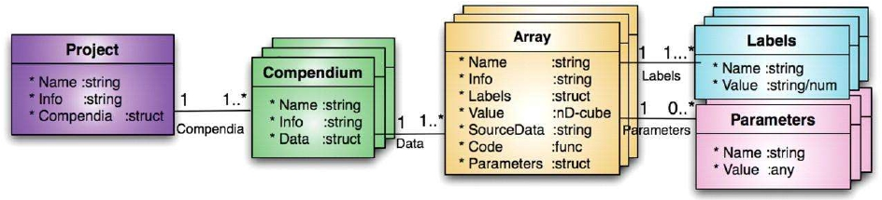
Applications of MATLAB in Engineering
Y.-F. Kuo
12
Nesting Structures
A = struct('data', [3 4 7; 8 0 1], 'nest', ...
struct('testnum', 'Test 1', ...
'xdata', [4 2 8],'ydata', [7 1 6]));
A(2).data = [9 3 2; 7 6 5];
A(2).nest.testnum = 'Test 2';
A(2).nest.xdata = [3 4 2];
A(2).nest.ydata = [5 0 9];
A.nest

Slide 13
Applications of MATLAB in Engineering
Y.-F. Kuo
13
CellArray
• Another method of storing heterogeneous data
• Similar to matrix but each entry contains different
type of data
• Declared using { }
A(1,1)={[1 4 3; 0 5 8; 7 2 9]};
A(1,2)={'Anne Smith'};
A(2,1)={3+7i};
A(2,2)={-pi:pi:pi};
A
A{1,1}=[1 4 3; 0 5 8; 7 2 9];
A{1,2}='Anne Smith';
A{2,1}=3+7i;
A{2,2}=-pi:pi:pi;
A
143 058 729 | 'AnneSmith'
3+7i | −𝜋0𝜋

Slide 14
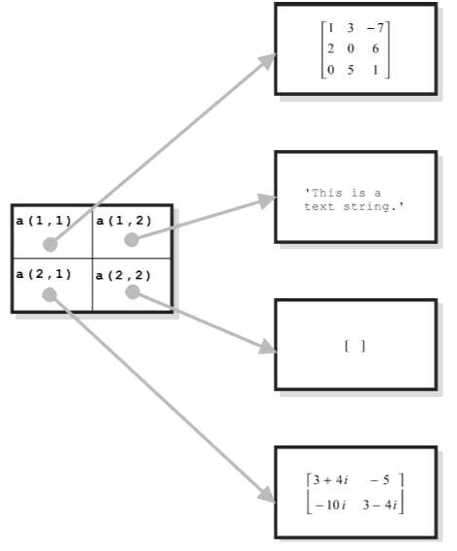
Applications of MATLAB in Engineering
Y.-F. Kuo
14
How Does MATLAB Do It?
• Each entry in a
cell array holds a
pointer to a data
structure
• Different cells of
the same cell
array can point to
different types of
data structures

Slide 15
Applications of MATLAB in Engineering
Y.-F. Kuo
15
Exercise
• Create a cell array B that has the following
structure
'Thisisthefirstcell' (String) | [5+j*64+j*5] (1x2complex numberarray)
123 456 789 (3x3integerarray) | {'Tim','Chris'} (1X2stringarray)

Slide 16
Applications of MATLAB in Engineering
Y.-F. Kuo
16
Accessing CellArray
• Curly braces, { }, are used to access the “content”
of cell arrays
• What are the differences between C and D?
C = A{1,1}
D = A(1,1)
• How do I get this number?
143 058 729 | 'AnneSmith'
3+7i | −𝜋0𝜋

Slide 17
Applications of MATLAB in Engineering
CellArray Functions
Y.-F. Kuo
17
cell
cell2mat
cell2struct
celldisp
cellfun
cellplot
cellstr
iscell
mat2cell
num2cell
struct2cell
Create cell array
Convert cell array to numeric array
Convert cell array to structure array
Cell array contents
Apply function to each cell in cell array
Graphically display structure of cell array
Create cell array of strings from character array
Determine whether input is cell array
Convert array to cell array with different sized cells
Convert array to cell array with consistently sized cells
Convert structure to cell array

Slide 18
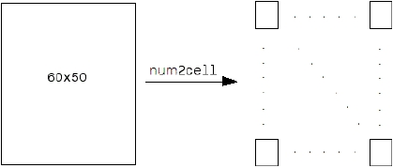
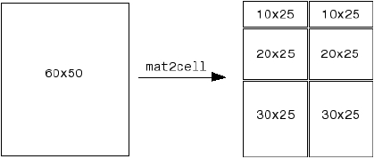
Applications of MATLAB in Engineering
Y.-F. Kuo
18
num2cell() and mat2cell()
• Transform a matrix into a cell variable
a = magic(3)
b = num2cell(a)
c = mat2cell(a, [1 1 1], 3)
num2cell
mat2cell

Slide 19
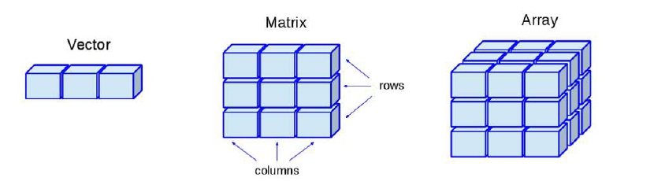
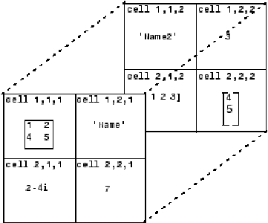
Applications of MATLAB in Engineering
Y.-F. Kuo
19
MultidimensionalArray
A{1,1,1}
A{1,2,1}
A{2,1,1}
A{2,1,1}
A{1,1,2}
A{1,2,2}
A{2,1,2}
A{2,2,2}
=
=
=
=
=
=
=
=
[1 2;4 5];
'Name';
2-4i;
7;
'Name2';
3;
0:1:3;
[4 5]';

Slide 20
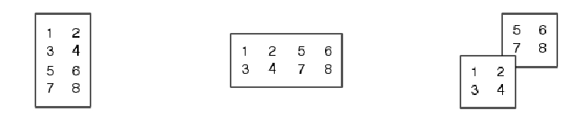
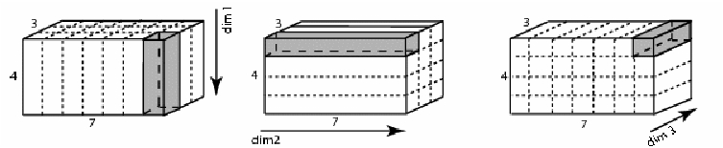
Applications of MATLAB in Engineering
Y.-F. Kuo
20
cat()
• Array concatenation
A=[1 2;3 4]; B=[5 6;7 8];
C=cat(1,A,B)
C=cat(2,A,B)
C=cat(3,A,B)

Slide 21

Applications of MATLAB in Engineering
Y.-F. Kuo
21
MultidimensionalArray
A{1,1} = [1 2;4 5];
A{1,2} = 'Name';
A{2,1} = 2-4i;
A{2,2} = 7;
B{1,1} = 'Name2';
B{1,2} = 3;
B{2,1} = 0:1:3;
B{2,2} = [4 5]';
C = cat(3, A, B)

Slide 22
Applications of MATLAB in Engineering
Y.-F. Kuo
22
reshape()
• Returns a new array with assigned rows and columns
A = {'James Bond', [1 2;3 4;5 6]; pi, magic(5)}
C = reshape(A,1,4)
• Create a matrix B from the matrix A below using reshape:
A = [1:3; 4:6];
1 5
𝐵 = 4 3
2 6
1
4
2 3
5 6
𝐴 =

Slide 23
Applications of MATLAB in Engineering
Y.-F. Kuo
23
Checking VariableAnd Variable Status
isinteger
islogical
isnan
isnumeric
isprime
isreal
iscell
ischar
isempty
isequal
isfloat
isglobal
ishandle
isinf
Determine if input is integer array
Determine if input is logical array
Detect an element that isnot a number (NaN)
Determine if input is numeric array
Detect prime elements of array
Determine if all array elements are real numbers
Determine if input is cell array
Determine if input is character array
Determine if input is empty array
Determine if arrays are numerically equal
Determine if input is floating-point array
Determine if input is global variable
Detect valid graphics object handles
Detect infinite elements of array

Slide 24
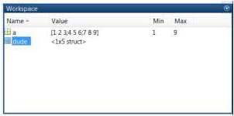
Applications of MATLAB in Engineering
FileAccess
File
System
• Supported file formats:
Y.-F. Kuo
Work
Space
24
Import Export
Function Function
File Content
Extension
Description
MATLAB
MAT
Saved MATLAB workspace
load
save
formatted data
Text
Space delimited numbers
load
save
Spreadsheet
XLS, XLSX
xlsread xlswrite

Slide 25
Applications of MATLAB in Engineering
Y.-F. Kuo
25
save() and load()
• Save (all) workspace data to a file:
clear; a = magic(4);
save mydata1.mat
save mydata2.mat -ascii
• Load data stored in a file:
load('mydata1.mat')
load('mydata2.mat','-ascii')
• How does one save a specific variable?

Slide 26
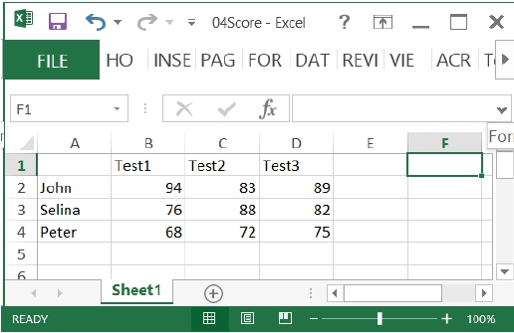
Applications of MATLAB in Engineering
Y.-F. Kuo
26
Excel File Reading: xlsread()
• Read from Excel spreadsheet
Score = xlsread('04Score.xlsx')
Score = xlsread('04Score.xlsx', 'B2:D4')

Slide 27
Applications of MATLAB in Engineering
Y.-F. Kuo
27
Excel File Writing: xlswrite()
• Calculate the means and write into Excel
spreadsheet
M = mean(Score')';
xlswrite('04Score.xlsx', M, 1, 'E2:E4');
xlswrite('04Score.xlsx', {'Mean'}, 1, 'E1');
• Calculate the standard deviations and write them
into column F

Slide 28

Applications of MATLAB in Engineering
Y.-F. Kuo
28
Getting Text in Excel Spreadsheet
• Getting both the text and numbers
[Score Header] = xlsread('04Score.xlsx')
• How do we write both the text and number into an
Excel file?

Slide 29

Applications of MATLAB in Engineering
Y.-F. Kuo
29
Low-level File Input/Output
• Read and write file at the
byte or character level
• A file has an ID fid
• Location in the file is
specified by a pointer that
can be moved around
Pointer
John
1995
12
5
12.3
3.24
fid
Tom
Jean
1995
1996
12
3
7
2
2.3
10.2
2.0
0

Slide 30

Applications of MATLAB in Engineering
Y.-F. Kuo
30
Low-level File I/O Functions
Function
fopen
fclose
fscanf
fprintf
feof
Description
Open file, or obtain information about open files
Close one or all open files
Read data from text file
Write data to text file
Test for end-of-file
• Open and close a file:
fid = fopen('[filename]', '[permission]');
'r'
'r+'
'w'
status = fclose(fid);
'w+'
'a'
'a+'

Slide 31
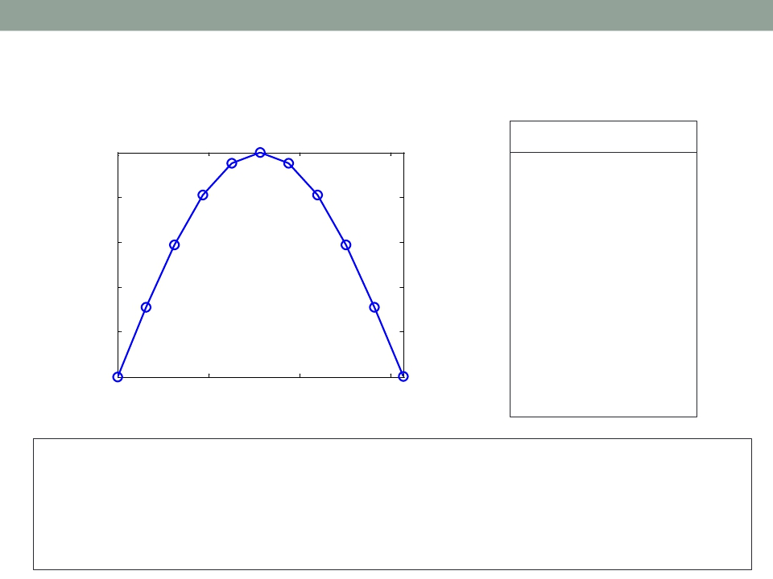
Applications of MATLAB in Engineering
Y.-F. Kuo
31
Writing Sine Values intoAFile
x
0.000
0.314
0.628
0.942
1.257
1.571
1.885
2.199
2.513
y
0.0000
0.3090
0.5878
0.8090
0.9511
1.0000
0.9511
0.8090
0.5878
1
0.8
0.6
0.4
0.2
0
0
2.827
3.142
0.3090
0.0000
1
2
3
x = 0:pi/10:pi; y = sin(x); fid = fopen('sinx.txt','w');
for i=1:11
fprintf(fid,'%5.3f %8.4f\n', x(i), y(i));
end
fclose(fid);
type sinx.txt

Slide 32



Applications of MATLAB in Engineering
Y.-F. Kuo
32
Read and Write through Formatted I/O
• Read: A = fscanf(fid, format, size);
Data
read
Format
specifier
Data to
write
Amount of
data to read
• Write: fprintf(fid, format, x, y,...);
• Format specifier: %-12.5e
width and precision
Specifier Description
%c Single character
%d Decimal notation (signed)
%e Exponential notation
%f Fixed-point notation
%g The more compact of %e or %f
%o
%s
%u
%x
Octal notation (unsigned)
String of characters
Decimal notation (unsigned)
Hexadecimal notation

Slide 33
Applications of MATLAB in Engineering
Y.-F. Kuo
33
Reading from Files
• Check if it is the end of file: feof(fid)
• 04asciiData.txt:
John
Tom
Jean
1995
1995
1996
12
12
3
5
7
2
12.3
2.3
10.2
3.24
2.0
0
fid = fopen('04asciiData.txt','r'); i = 1;
while ~feof(fid)
name(i,:) = fscanf(fid,'%5c',1);
year(i)
no1(i)
no2(i)
no3(i)
no4(i)
i=i+1;
end
fclose(fid);
= fscanf(fid,'%d',1);
= fscanf(fid,'%d',1);
= fscanf(fid,'%d',1);
= fscanf(fid,'%g',1);
= fscanf(fid,'%g\n');

Slide 34

Applications of MATLAB in Engineering
End of Class
Y.-F. Kuo
34

