Slide 1
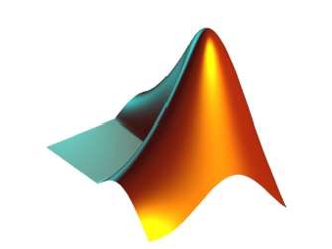
APPLICATIONS OF
MATLAB IN ENGINEERING
Yan-Fu Kuo
Dept. of Bio-industrial Mechatronics Engineering
National Taiwan University
Today:
Fall 2015
•
•
Basic plotting
Graphical object properties

Slide 2
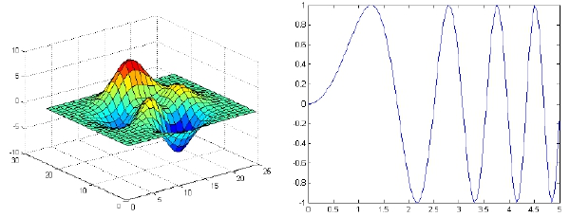
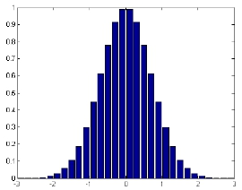
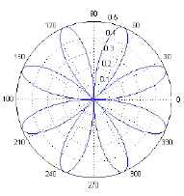
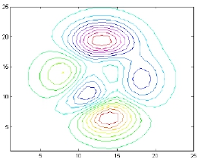
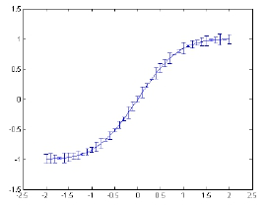
Applications of MATLAB in Engineering
Y.-F. Kuo
2
Basics
• MATLAB has a powerful plotting engine that can generate
a wide variety of plots

Slide 3
Applications of MATLAB in Engineering
Y.-F. Kuo
3
Plot from “Data”
• MATLAB does not understand functions
𝑓(𝑡) = sin(2𝜋𝑡)
• Strategies:
1. Generate the numeric values of a function over a
specific range
2. Display the data “points” in a graphical way

Slide 4
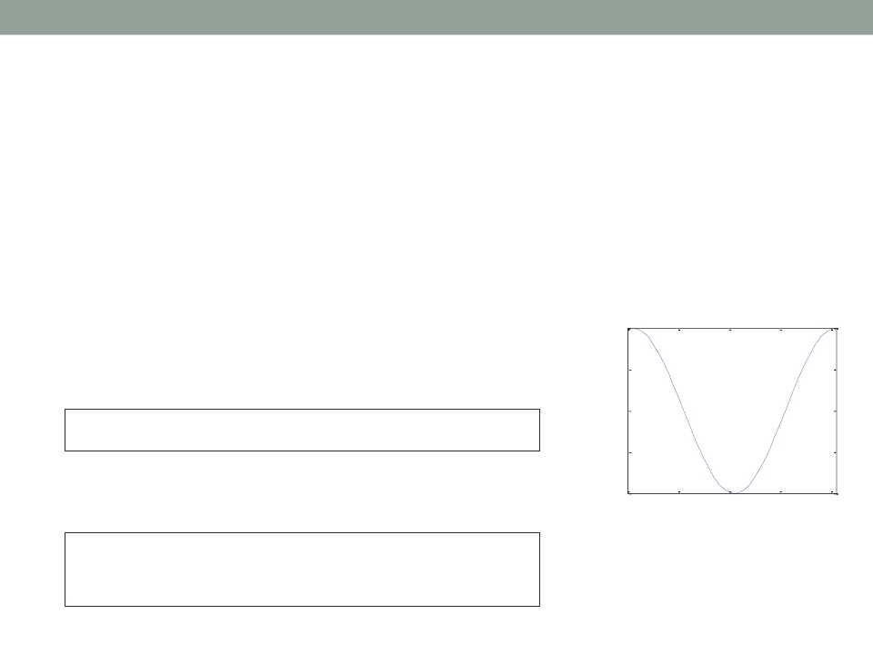
Applications of MATLAB in Engineering
Y.-F. Kuo
4
plot()
• plot(x,y) plots each
vector pairs (x,y)
• plot(y) plots each vector pairs (x,y),
where x=[1…n], n=length(y)
• Example:
plot(cos(0:pi/20:2*pi));
1
0.5
0
-0.5
• What do you see after this script?
-1
0
10
20
30
40
plot(cos(0:pi/20:2*pi));
plot(sin(0:pi/20:2*pi));

Slide 5
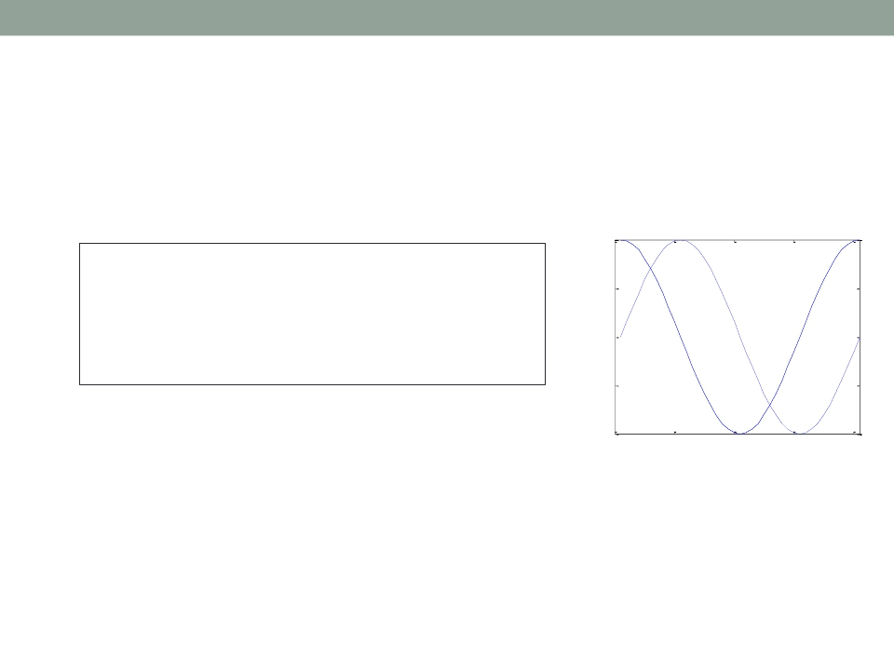
Applications of MATLAB in Engineering
Y.-F. Kuo
5
hold on/off
• Use hold on to have both plots in one figure
1
hold on
plot(cos(0:pi/20:2*pi));
plot(sin(0:pi/20:2*pi));
0.5
0
hold off
-0.5
-1
0
10
20
30
40

Slide 6
Applications of MATLAB in Engineering
Y.-F. Kuo
6
Plot Style
• plot(x,y,'str') plots each vector pairs (x,y)
using the format defined in str (check linespec)
Datamarkers | Linetypes | Colors
Dot(.). Asterisk(*)* Cross(×)X Circle(○)o Plussign(+)+ Square(□)s Diamond(◇)d Five-pointedstar(☆)p Triangle(down∇)v Triangle(upΔ)^ Triangle(left)< Triangle(right)> hexagramH | Solidline- Dashedline-- Dash-dottedline-. Dottedline: | Blackk Blueb Cyanc Greeng Magentam Redr Whitew Yellowy

Slide 7
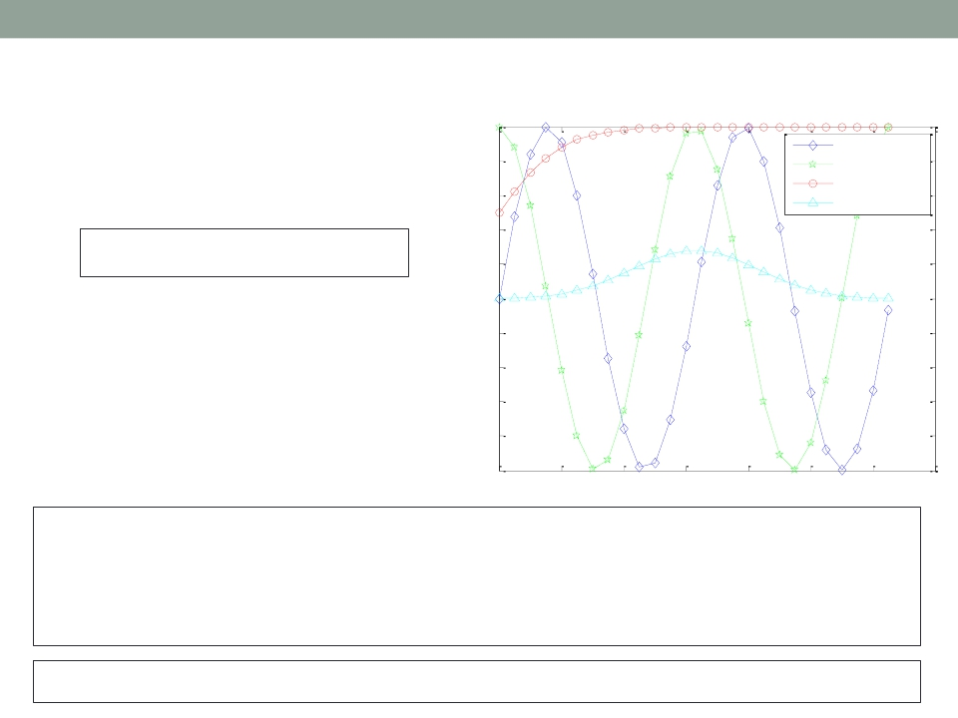
Applications of MATLAB in Engineering
legend()
Y.-F. Kuo
7
1
0.8
sin(x)
cos(x)
• Add legend to graph
legend('L1',...)
• Position adjustment
Sigmoid
Gauss function
0.6
0.4
0.2
0
-0.2
-0.4
-0.6
-0.8
-1
0
2
4
6
8
10
12
14
x=0:0.5:4*pi;
y=sin(x); h=cos(x); w=1./(1+exp(-x));
g=(1/(2*pi*2)^0.5).*exp((-1.*(x-2*pi).^2)./(2*2^2));
plot(x,y,'bd-',x,h,'gp:',x,w,'ro-',x,g,'c^-');
legend('sin(x)','cos(x)','Sigmoid','Gauss function');

Slide 8
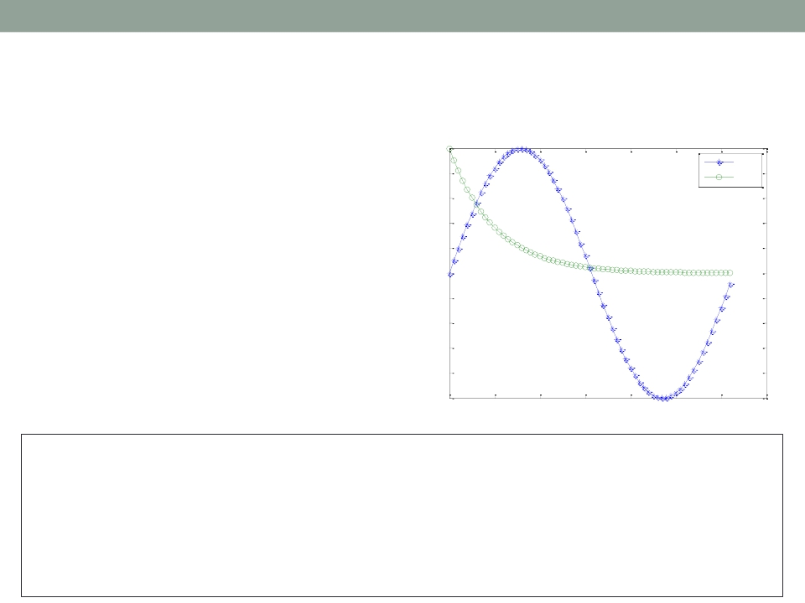
Applications of MATLAB in Engineering
Y.-F. Kuo
8
title() and ?label()
Function Plots of sin(t) and e-x
• title()
• xlabel()
• ylabel()
• zlabel()
1
0.8
0.6
0.4
0.2
0
-0.2
-0.4
-0.6
-0.8
sin(t)
e-x
values of sin(t) and e -x
-1
0
1
2
3
4
5
6
7
t = 0 to 2π
x = 0:0.1:2*pi; y1 = sin(x); y2 = exp(-x);
plot(x, y1, '--*', x, y2, ':o');
xlabel('t = 0 to 2\pi');
ylabel('values of sin(t) and e^{-x}')
title('Function Plots of sin(t) and e^{-x}');
legend('sin(t)','e^{-x}');

Slide 9
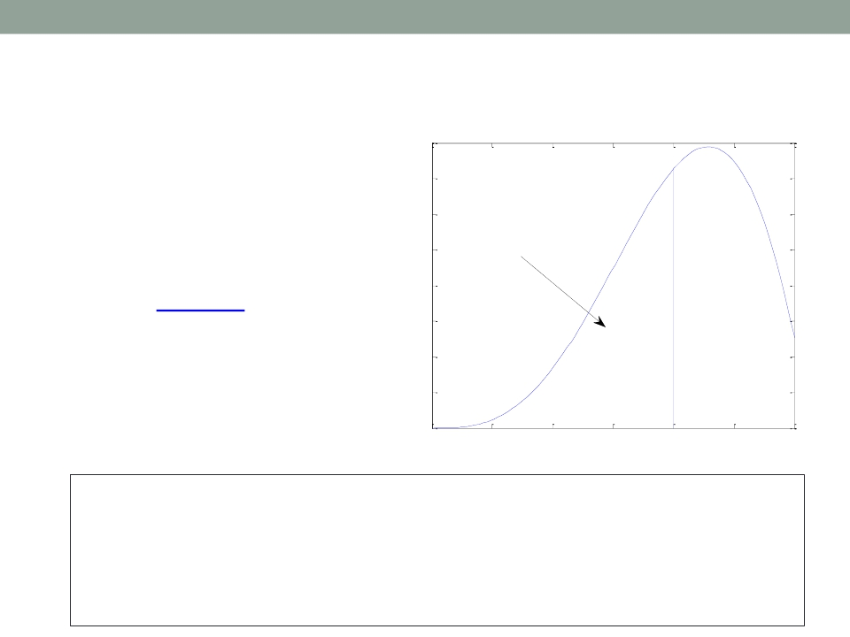
Applications of MATLAB in Engineering
Y.-F. Kuo
9
text() and annotation()
4
• Text with
3.5
mathematical
expression
3
2.5
Z
2
x2 sin(x)dx
0
using LaTex
2
1.5
1
0.5
0
0
0.5
1
1.5
2
2.5
3
x = linspace(0,3); y = x.^2.*sin(x); plot(x,y);
line([2,2],[0,2^2*sin(2)]);
str = '$$ \int_{0}^{2} x^2\sin(x) dx $$';
text(0.25,2.5,str,'Interpreter','latex');
annotation('arrow','X',[0.32,0.5],'Y',[0.6,0.4]);

Slide 10
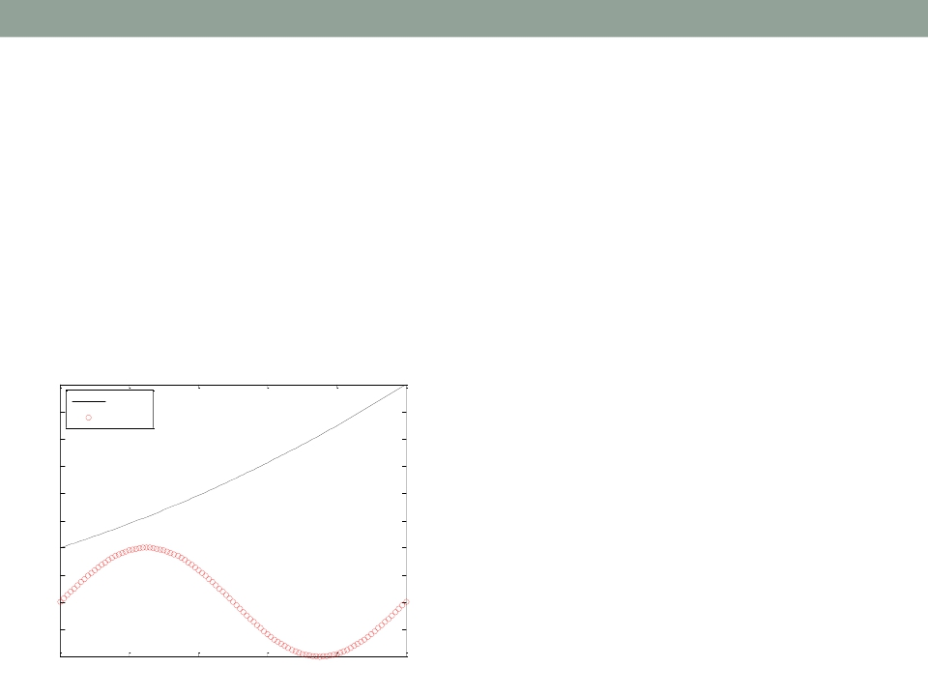
Applications of MATLAB in Engineering
Y.-F. Kuo
10
Exercise
• Plot 𝑓 as a black line and 𝑔 as a series of red
circles for the range t = 1 to 2 in one figure
𝑓 = 𝑡2 and 𝑔 = sin(2𝜋𝑡)
• Label each axis, and add title and legend
Mini Assignment #1
4
t2
sin(2π t)
3.5
3
2.5
2
1.5
1
0.5
0
-0.5
f(t)
-1
1
1.2
1.4
1.6
1.8
2
Time (ms)

Slide 11
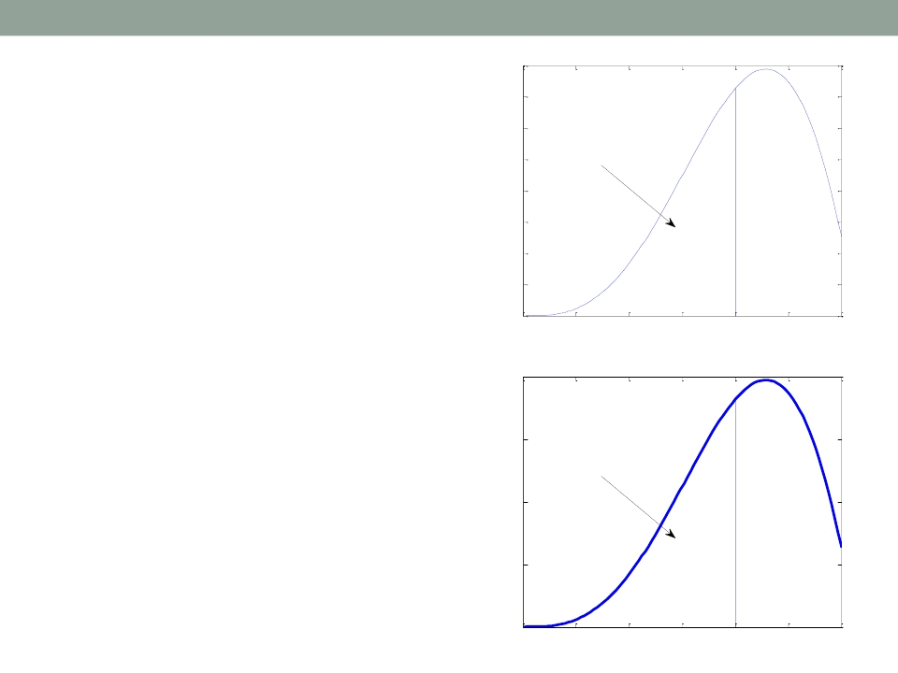
Applications of MATLAB in Engineering
FigureAdjustment
Y.-F. Kuo
4
3.5
3
11
Z
2
x2 sin(x)dx
• Several properties:
2.5
2
0
• Font
• Font size
1.5
1
0.5
• Line width
0
0
0.5
1
1.5
2
2.5
3
• Axis limit
4
• Tick position
• Tick label
3
2
Z
2
x2sin(x)dx
0
• But how?
1
0
0
0.5
1
1.5
2
2.5
3

Slide 12
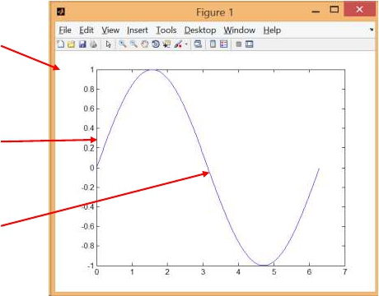
Applications of MATLAB in Engineering
Y.-F. Kuo
12
Graphical Objects
• A figure is composed of many objects
Hierarchy
Figure
Figure
object
Axes
Axes
object
Line
object
Line
Text
Surface
…
x = linspace(0, 2*pi, 1000);
y = sin(x);
plot(x,y);
set(gcf, 'Color', [1 1 1]);

Slide 13
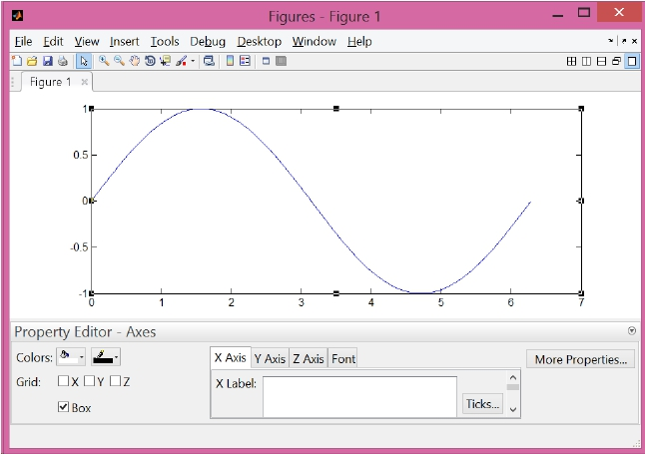
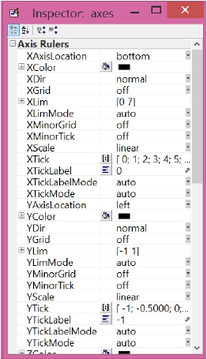
Applications of MATLAB in Engineering
Y.-F. Kuo
13
Figure Properties
• http://www.mathworks.com/help/matlab/ref/figure-properties.html

Slide 14
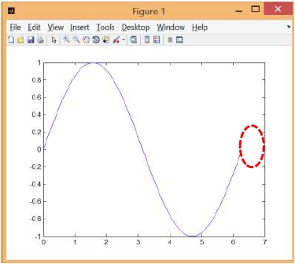
Applications of MATLAB in Engineering
Y.-F. Kuo
14
Modifying Properties ofAn Object
• Strategy:
1. Identify the “handle” of an object
2. Fetch or modify the object’s properties
• For example, to change the
limits of the x-axis:
1. Find the handle of the x-axis
2. Modify the limits

Slide 15
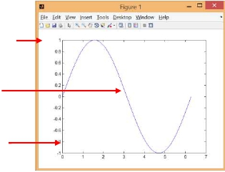
Applications of MATLAB in Engineering
Y.-F. Kuo
15
1. Identifying the Handle ofAn Object
• Upon creation:
h = plot(x,y);
• Utility functions:
gcf Figure
Line
gca Axes
Function
gca
gcf
Purpose
Return the handle of the “current” axes
Return the handle of the “current” figure
allchild Find all children of specified objects
ancestor Find ancestor of graphics object
delete
findall
Delete an object
Find all graphics objects

Slide 16
Applications of MATLAB in Engineering
Y.-F. Kuo
16
Fetching or Modifying Properties
• To fetch properties, use
get()
• To modify properties, use
set()

Slide 17
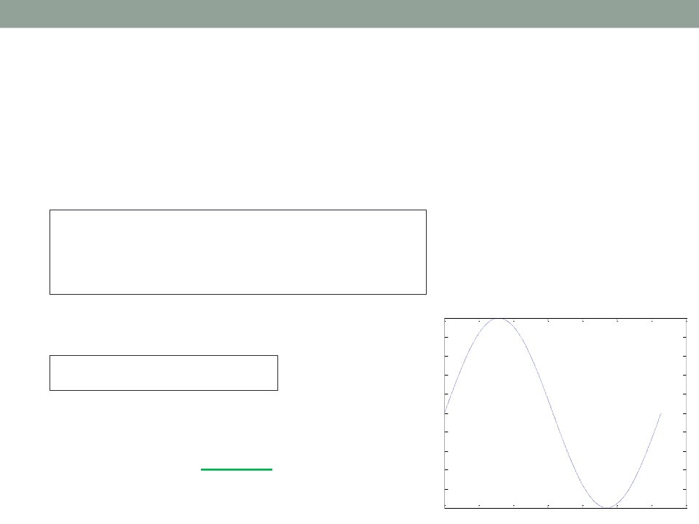
Applications of MATLAB in Engineering
Y.-F. Kuo
17
Getting Object Properties
• Getting properties of a graphical object: get()
• What do you see after running?
x = linspace(0, 2*pi, 1000);
y = sin(x); h = plot(x,y);
get(h)
• What do you see?
get(gca)
• Where do we modify the
limits of the x-axis?
1
0.8
0.6
0.4
0.2
0
-0.2
-0.4
-0.6
-0.8
-1
0
1
2
3
4
5
6
7

Slide 18
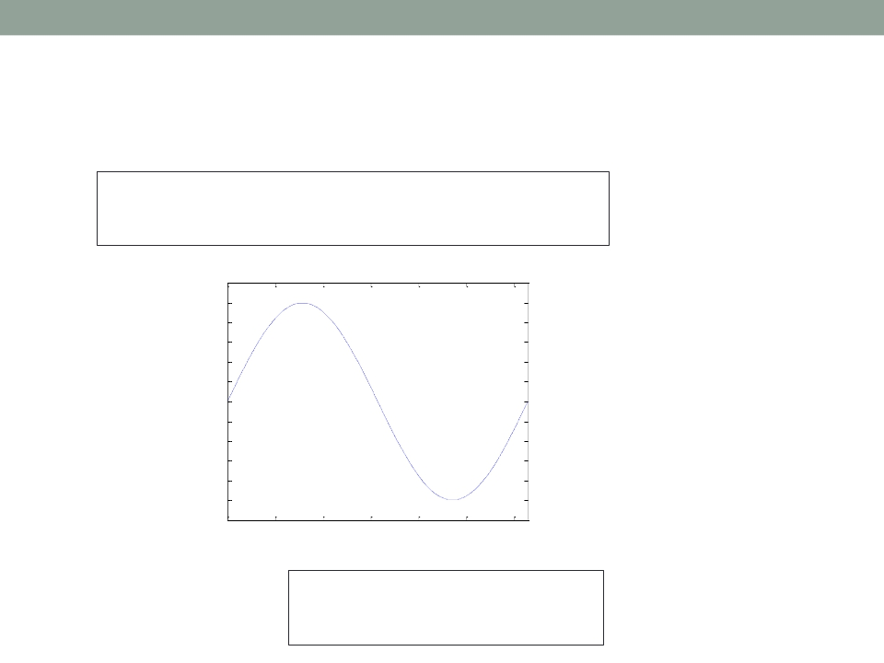
Applications of MATLAB in Engineering
Y.-F. Kuo
18
SettingAxes Limits
set(gca, 'XLim', [0, 2*pi]);
set(gca, 'YLim', [-1.2, 1.2]);
1
0.8
0.6
0.4
0.2
0
-0.2
-0.4
-0.6
-0.8
-1
0
1
2
3
4
5
6
• Alternative:
xlim([0, 2*pi]);
ylim([-1.2, 1.2]);

Slide 19
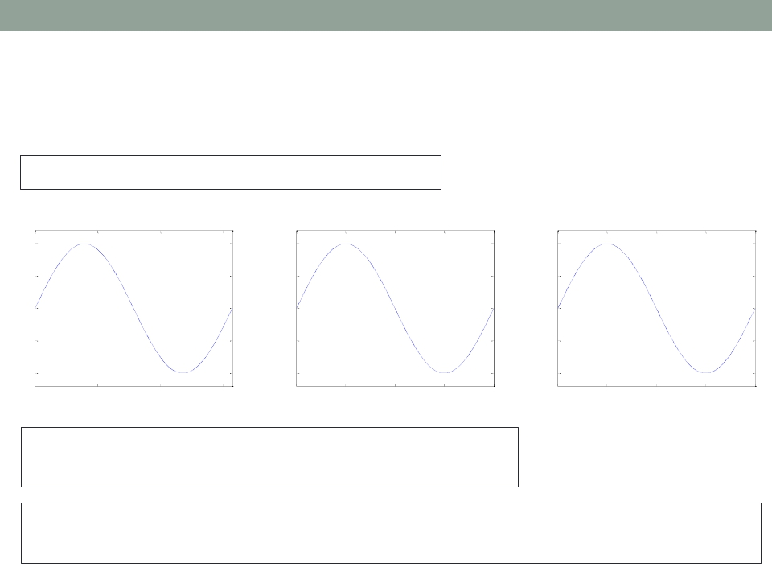
Applications of MATLAB in Engineering
Y.-F. Kuo
19
Setting Font and Tick ofAxes
set(gca, 'FontSize', 25);
1
0.5
0
-0.5
-1
1
0.5
0
-0.5
-1
1
0.5
0
−0.5
−1
0
2
4
6
0
90
180
270
360
0
π/2
π
3π/2
2π
set(gca, 'XTick', 0:pi/2:2*pi);
set(gca, 'XTickLabel', 0:90:360);
set(gca, 'FontName', 'symbol');
set(gca, 'XTickLabel', {'0', 'p/2', 'p', '3p/2', '2p'});

Slide 20
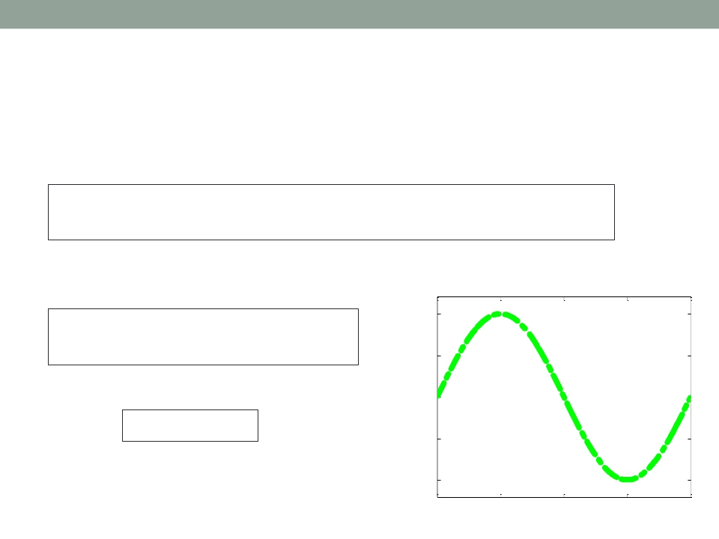
Applications of MATLAB in Engineering
Y.-F. Kuo
20
Line Specification
• Line style and width:
set(h, 'LineStyle', '-.',...
'LineWidth', 7.0, 'Color', 'g');
• Alternative:
plot(x,y, '-.g',...
'LineWidth', 7.0);
1
0.5
0
• Try:
delete(h);
−0.5
−1
0
π/2
π
3π/2
2π

Slide 21
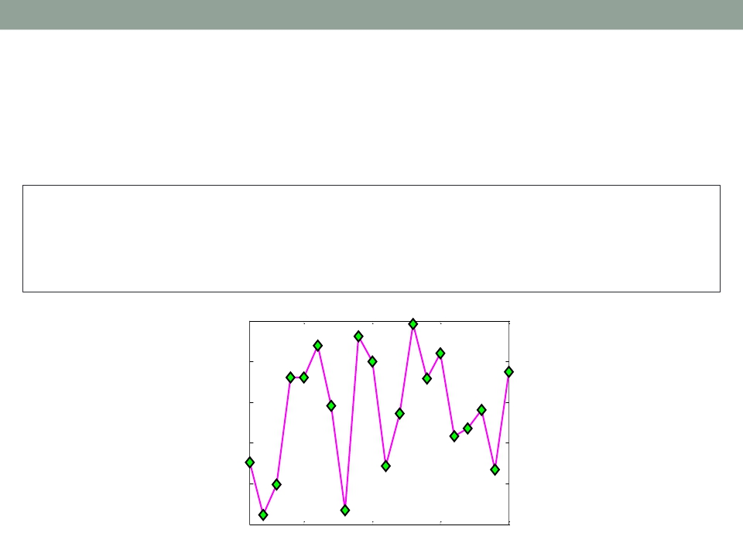
Applications of MATLAB in Engineering
Y.-F. Kuo
21
Marker Specification
• Face and edge colors of the markder
x=rand(20,1);
set(gca, 'FontSize', 18);
plot(x,'-md','LineWidth', 2, 'MarkerEdgeColor', 'k',...
'MarkerFaceColor', 'g', 'MarkerSize', 10);
xlim([1, 20]);
1
0.8
0.6
0.4
0.2
0
5
10
15
20

Slide 22
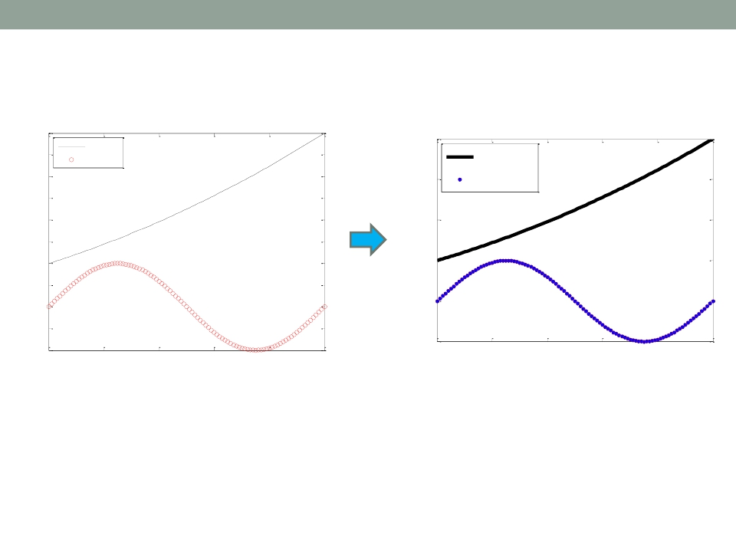
Applications of MATLAB in Engineering
Exercise
Y.-F. Kuo
22
Mini Assignment #1
Mini Assignment #1
4
3.5
4
t2
sin(2π t)
t2
3
2.5
2
1.5
1
0.5
0
-0.5
3
2
1
0
sin(2π t)
f(t)
f(t)
-1
1
-1
1
1.2
1.4
1.6
1.8
2
1.2
1.4
1.6
1.8
2
Time (ms)
Time (ms)

Slide 23
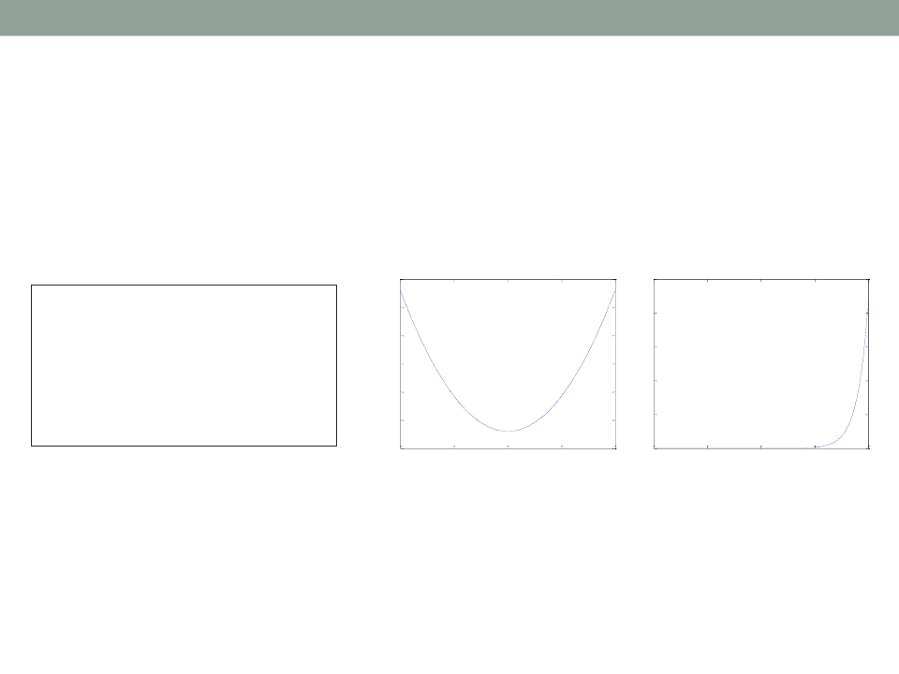
Applications of MATLAB in Engineering
Y.-F. Kuo
23
Multiple Figures
• Create a figure window by calling figure
Figure 1
Figure 2
100
2.5
x 10
4
x = -10:0.1:10;
y1 = x.^2 - 8;
y2 = exp(x);
figure, plot(x,y1);
figure, plot(x,y2);
80
60
40
20
0
2
1.5
1
0.5
-20
-10
-5
0
5
10
0
-10
-5
0
5
10
• Be careful when using the gcf handle where
there exists multiple figures

Slide 24
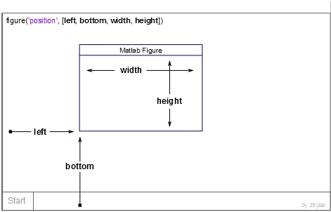
Applications of MATLAB in Engineering
Y.-F. Kuo
24
Figure Position and Size
figure('Position', [left, bottom, width, height]);

Slide 25
Applications of MATLAB in Engineering
Y.-F. Kuo
25
Several Plots in One Figure
• Several small plots “in a figure”
subplot(m, n,1);
n
1
4
2
5
3
6
m

Slide 26
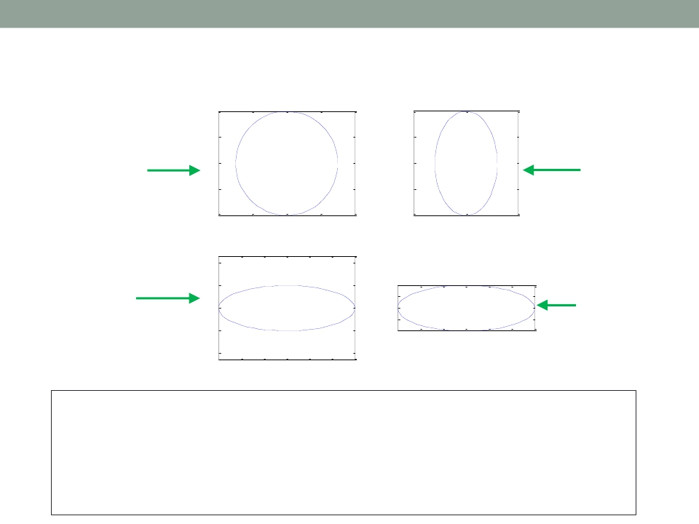
Applications of MATLAB in Engineering
subplot()
1
0.5
Y.-F. Kuo
1
0.5
26
axis
normal
axis
square
0
-0.5
0
-0.5
-1
-4
-2
0
2
4
-1
-5
0
5
2
axis
equal
axis
square
tight
1
0
-1
0.5
0
-0.5
-2
-1
0
1
2
3
-2
-2
-1
0
1
2
3
t = 0:0.1:2*pi; x
subplot(2, 2, 1);
subplot(2, 2, 2);
subplot(2, 2, 3);
subplot(2, 2, 4);
= 3*cos(t);
plot(x, y);
plot(x, y);
plot(x, y);
plot(x, y);
y = sin(t);
axis normal
axis square
axis equal
axis equal tight

Slide 27
Applications of MATLAB in Engineering
Y.-F. Kuo
27
Control of Grid, Box, andAxis
grid on/off
box on/off
axis on/off
axis normal
axis square
axis equal
axis equal tight
axis image
axis ij
axis xy
Make the grid visible or invisible
Make the box visible or invisible
Make the axes visible or invisible
Automatically adjust the aspect ratio of the axes
and the relative scaling of the data units
Make the current axes region square
Set the aspect ratio so that the data units are the
same in every direction
Set the axis limits to the range of the data
Let the plot box fits tightly around the data
Place the origin of the coordinate system in the
upper left corner
Place the origin in the lower left corner

Slide 28
Applications of MATLAB in Engineering
Y.-F. Kuo
28
Saving Figures into Files
saveas(gcf,'<filename>','<formattype>');
Option
'jpeg'
'png'
'tiff'
'bmpmono'
'bmp'
'bmp256'
Option
'pdf'
'eps'
'epsc'
'meta'
'svg'
'ps'
'psc'
Bitmap Image Format
JPEG 24-bit
PNG 24-bit
TIFF 24-bit (compressed)
BMP Monochrome
BMP 24-bit
BMP 8-bit (256 color, uses a fixed colormap)
Vector Graphics Format
Full page Portable Document Format (PDF) color
Encapsulated PostScript (EPS) Level 3 black and white
Encapsulated PostScript (EPS) Level 3 color
Enhanced Metafile (Windows only)
SVG (scalable vector graphics)
Full-page PostScript (PS) Level 3 black and white
Full-page PostScript (PS) Level 3 color
To control size and resolution, use print instead:
http://www.mathworks.com/help/matlab/ref/print.html#input_argument_formattype

Slide 29

Applications of MATLAB in Engineering
End of Class
Y.-F. Kuo
29

