Slide 1
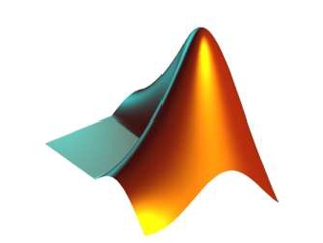
APPLICATIONS OF
MATLAB IN ENGINEERING
Yan-Fu Kuo
Dept. of Bio-industrial Mechatronics Engineering
National Taiwan University
Today:
Fall 2015
•
•
•
Advanced 2D plots
Color space
3D plots

Slide 2
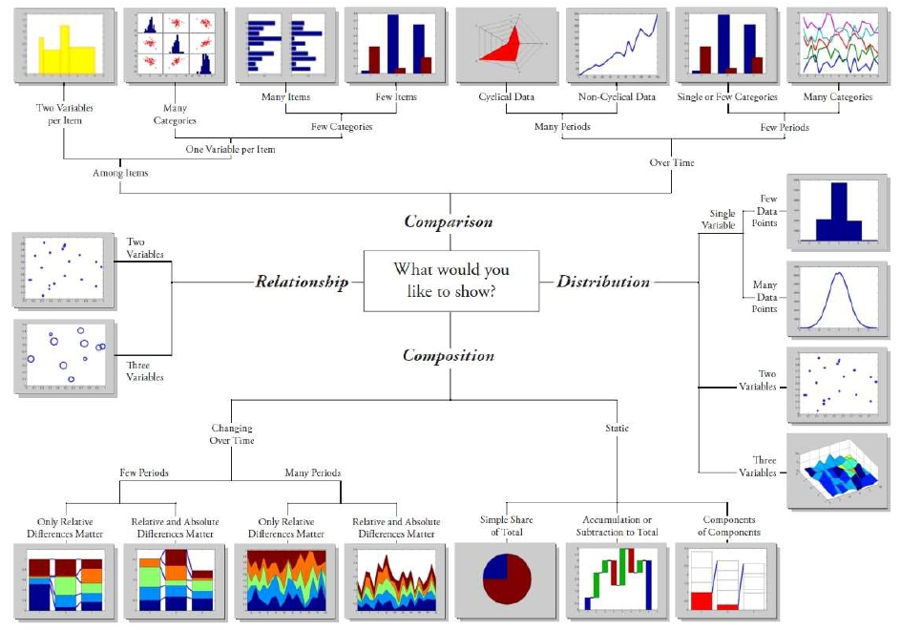
Applications of MATLAB in Engineering
Y.-F. Kuo
2

Slide 3
Applications of MATLAB in Engineering
Special Plots
Y.-F. Kuo
3
Function
loglog
semilogx
semilogy
plotyy
Function
hist
bar
pie
polar
Description
Graph with logarithmic scales for both axes
Graph with a logarithmic scale for the x-axis and a
linear scale for the y-axis
Graph with a logarithmic scale for the y-axis and a
linear scale for the x-axis
Graph with y-tick labels on the left and right side
Description
Histogram plot
Bar graph
Pie chart
Polar coordinate plot

Slide 4
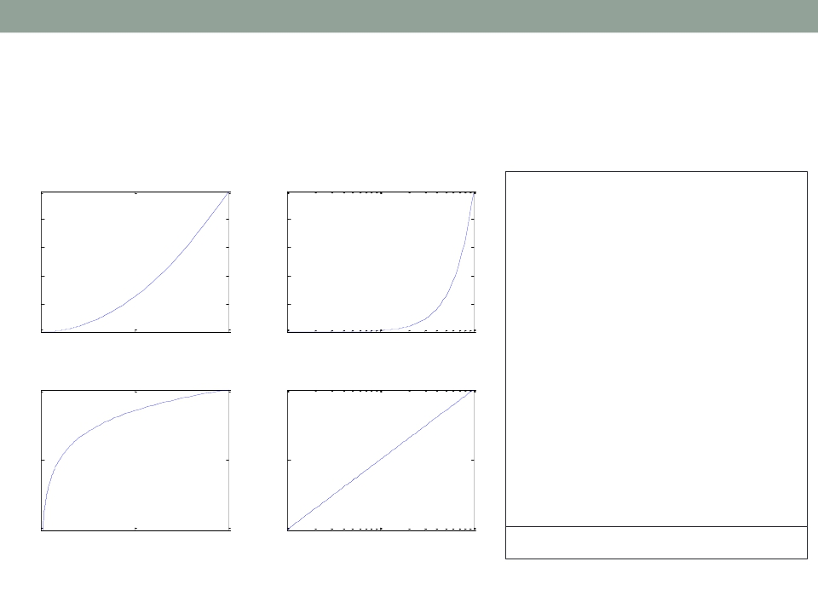
Applications of MATLAB in Engineering
Logarithm Plots
Y.-F. Kuo
4
Plot
Semilogx
x = logspace(-1,1,100);
y = x.^2;
subplot(2,2,1);
plot(x,y);
title('Plot');
subplot(2,2,2);
100
80
60
40
20
100
80
60
40
20
0
0
10
semilogx(x,y);
title('Semilogx');
0
5
10
-1
10
0
10
1
2
Semilogy
2
Loglog
subplot(2,2,3);
semilogy(x,y);
10
10
title('Semilogy');
10
0
10
0
subplot(2,2,4);
loglog(x, y);
title('Loglog');
10
-2
10
-2
10
0
5
10
-1
0
1
set(gca,'XGrid','on');
10
10

Slide 5
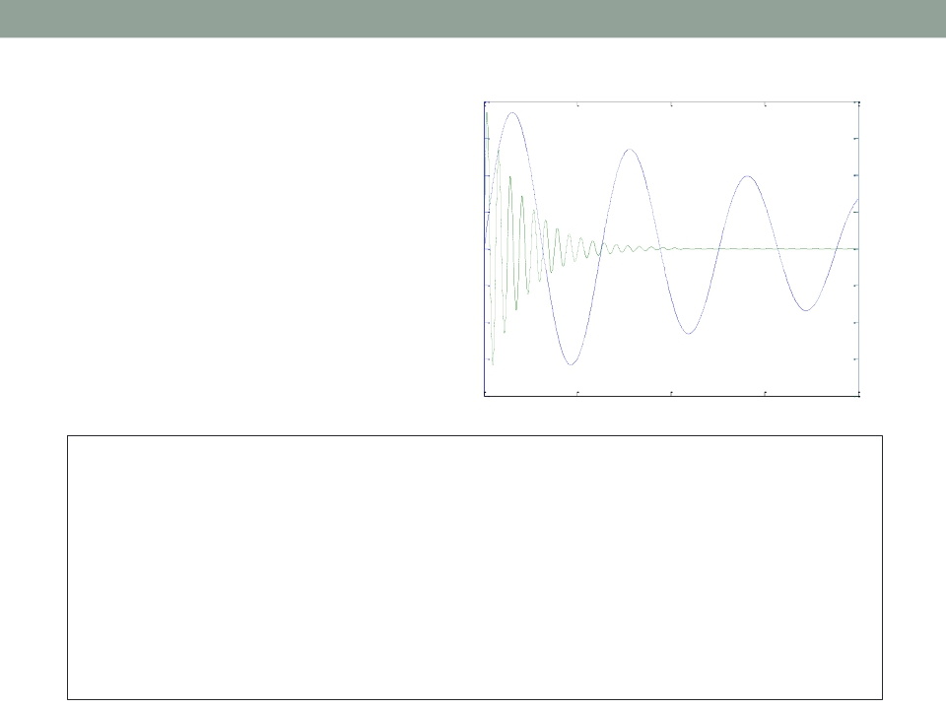
Applications of MATLAB in Engineering
Y.-F. Kuo
5
plotyy()
Labeling plotyy
200
150
100
50
0
-50
-100
-150
0.8
0.6
0.4
0.2
0
-0.2
-0.4
-0.6
Left Y-axis
Right Y-axis
-200
0
5
10
15
-0.8
20
x = 0:0.01:20;
y1 = 200*exp(-0.05*x).*sin(x);
y2 = 0.8*exp(-0.5*x).*sin(10*x);
[AX,H1,H2] = plotyy(x,y1,x,y2);
set(get(AX(1),'Ylabel'),'String','Left Y-axis')
set(get(AX(2),'Ylabel'),'String','Right Y-axis')
title('Labeling plotyy');
set(H1,'LineStyle','--'); set(H2,'LineStyle',':');

Slide 6
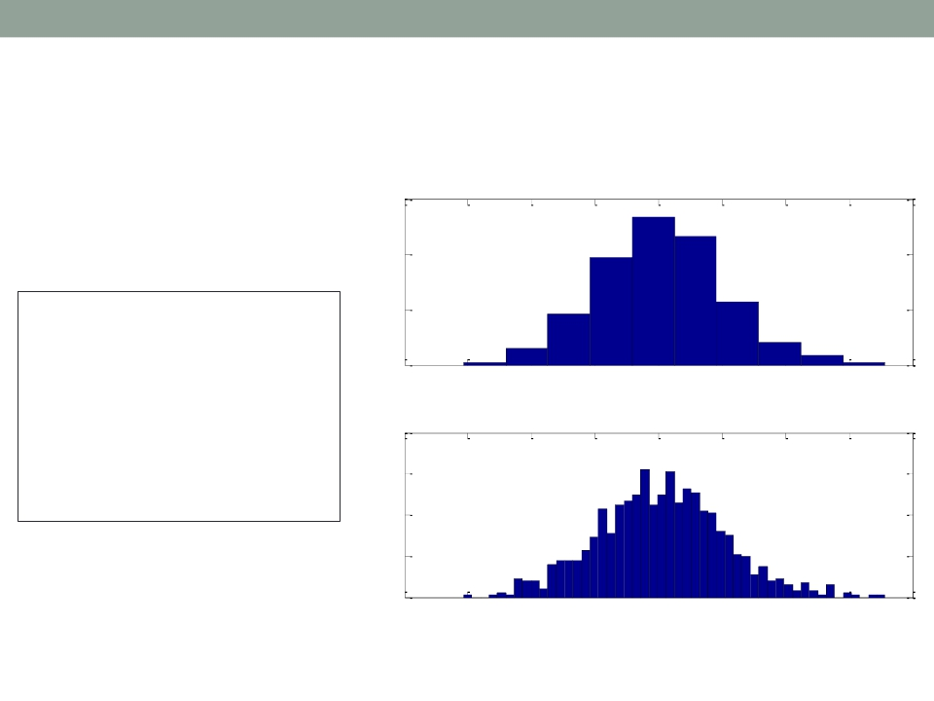
Applications of MATLAB in Engineering
Y.-F. Kuo
6
Histogram
Bins = 10
300
200
y = randn(1,1000);
subplot(2,1,1);
100
hist(y,10);
0
-4
-3
-2
-1
0
1
2
3
4
title('Bins = 10');
subplot(2,1,2);
hist(y,50);
title('Bins = 50');
Bins = 50
80
60
40
20
0
-4
-3
-2
-1
0
1
2
3
4

Slide 7
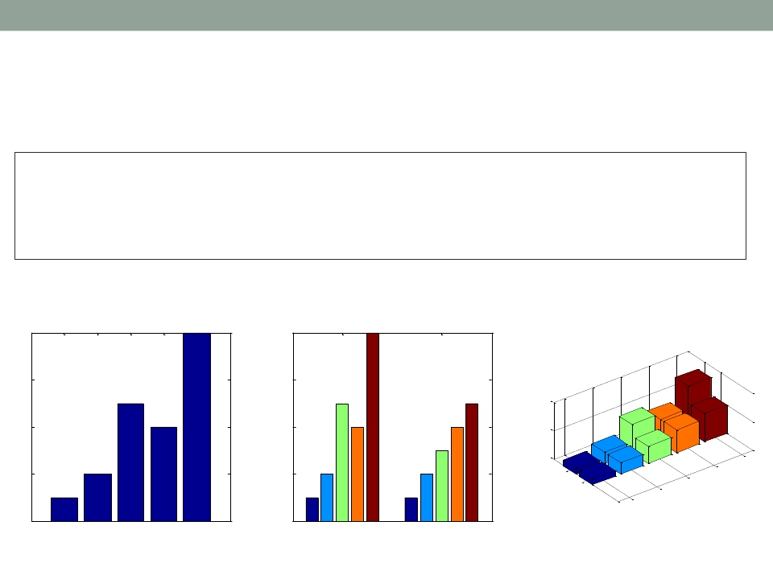
Applications of MATLAB in Engineering
Bar Charts
x = [1 2 5 4 8];
y = [x;1:5];
Y.-F. Kuo
7
subplot(1,3,1); bar(x); title('A bargraph of vector x');
subplot(1,3,2); bar(y); title('A bargraph of vector y');
subplot(1,3,3); bar3(y); title('A 3D bargraph');
A bargraph of vector x
A bargraph of vector y
8
6
4
8
6
4
A 3D bargraph
10
5
0
5
2
0
2
0
1
4
2
2
3
1
1
2
3
4
5
1
2

Slide 8
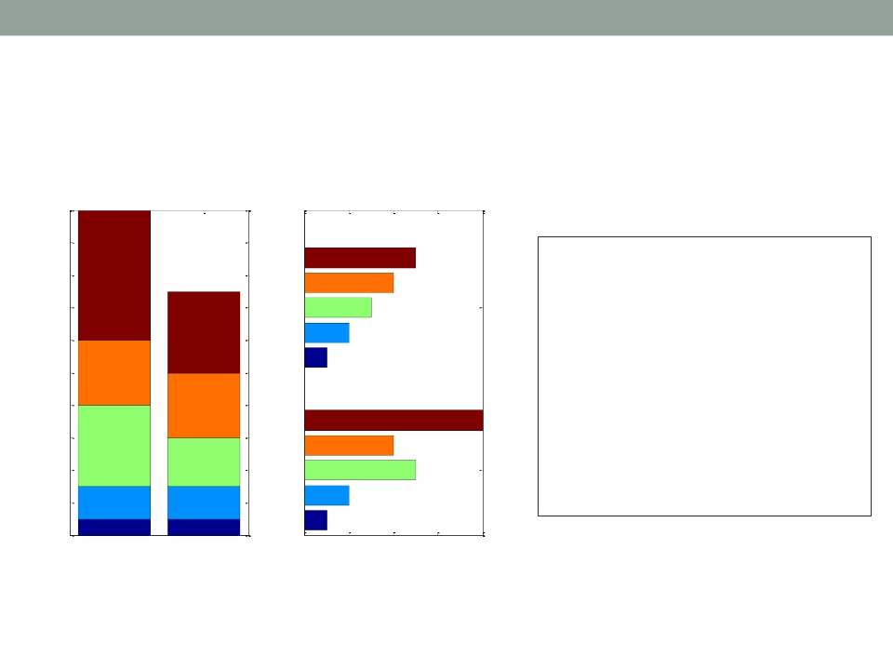
Applications of MATLAB in Engineering
Y.-F. Kuo
8
Stacked and Horizontal Bar Charts
Stacked
Horizontal
20
18
16
x = [1 2 5 4 8];
y = [x;1:5];
14
12
10
8
6
4
2
2
1
subplot(1,2,1);
bar(y,'stacked');
title('Stacked');
subplot(1,2,2);
barh(y);
title('Horizontal');
0
1
2
0
2
4
6
8
• Exercise: stack the horizontal bar chart

Slide 9
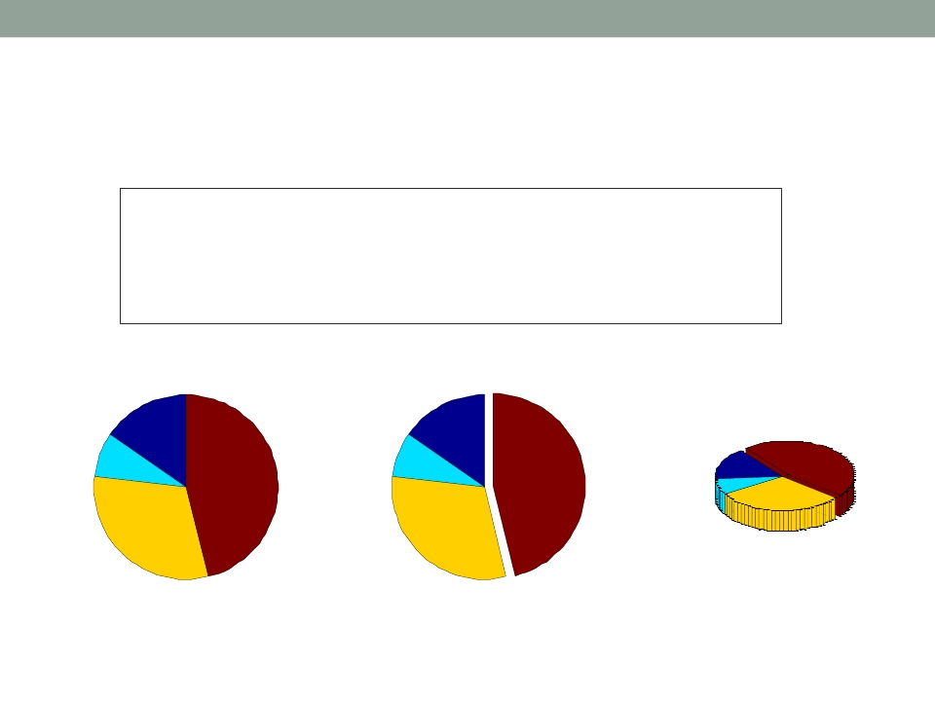
Applications of MATLAB in Engineering
Y.-F. Kuo
9
Pie Charts
a = [10 5 20 30];
subplot(1,3,1); pie(a);
subplot(1,3,2); pie(a, [0,0,0,1]);
subplot(1,3,3); pie3(a, [0,0,0,1]);
15%
15%
8%
8%
46%
46%
15%
8%
46%
31%
31%
31%
• Exercise: separate all the pieces in the pie chart

Slide 10
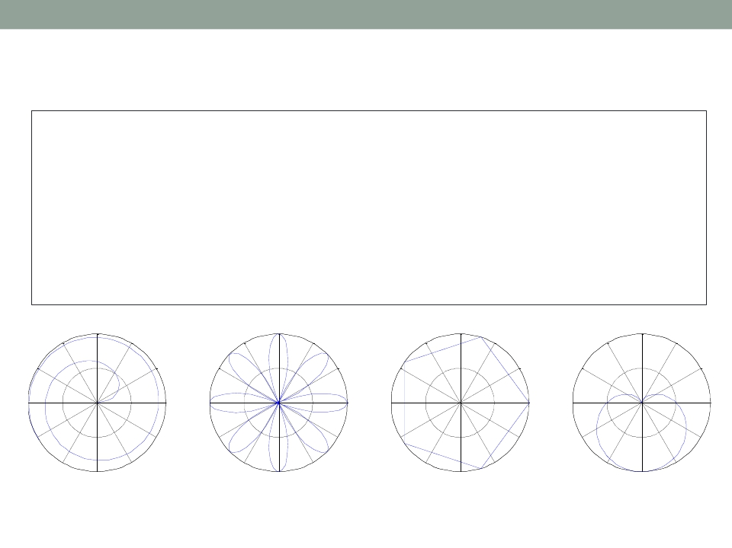
Applications of MATLAB in Engineering
Y.-F. Kuo
10
Polar Chart
x = 1:100; theta = x/10; r = log10(x);
subplot(1,4,1); polar(theta,r);
theta = linspace(0, 2*pi); r = cos(4*theta);
subplot(1,4,2); polar(theta, r);
theta = linspace(0, 2*pi, 6); r = ones(1,length(theta));
subplot(1,4,3); polar(theta,r);
theta = linspace(0, 2*pi); r = 1-sin(theta);
subplot(1,4,4); polar(theta , r);
120
90 2
1
60
120
90 1
0.5
60
120
90 1
0.5
60
120
90 2
1
60
150
30
150
30
150
30
150
30
180
210
0
330
180
210
0
330
180
210
0
330
180
210
0
330
240
270
300
240
270
300
240
270
300
240
270
300
• Exercise: plot a hexagon on a polar chart

Slide 11
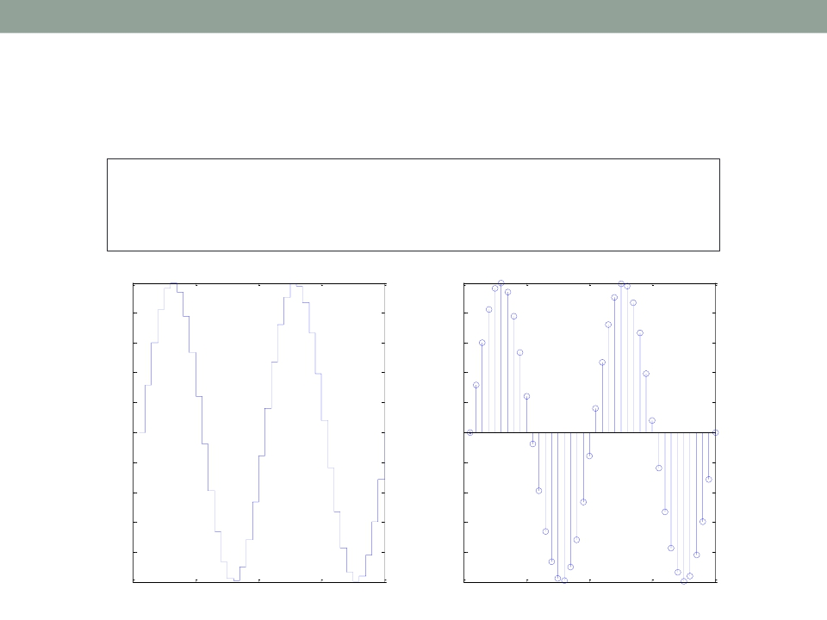
Applications of MATLAB in Engineering
Y.-F. Kuo
11
Stairs and Stem Charts
x = linspace(0, 4*pi, 40); y = sin(x);
subplot(1,2,1); stairs(y);
subplot(1,2,2); stem(y);
1
0.8
0.6
0.4
0.2
0
-0.2
-0.4
-0.6
-0.8
1
0.8
0.6
0.4
0.2
0
-0.2
-0.4
-0.6
-0.8
-1
0
10
20
30
40
-1
0
10
20
30
40

Slide 12
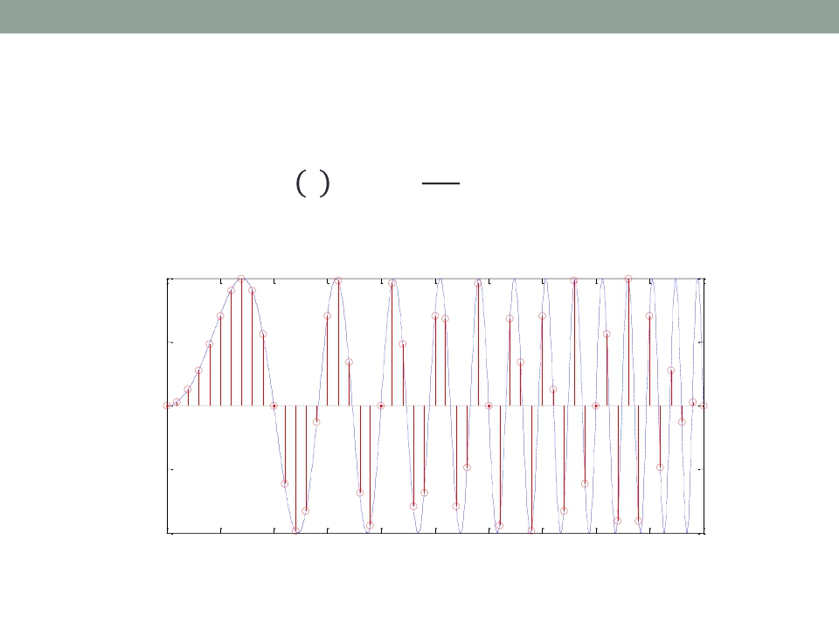
Applications of MATLAB in Engineering
Exercise
Y.-F. Kuo
12
𝜋𝑡2
sin(
4
• Plot a function: 𝑓 𝑡 =
)
• Add the points sampled at 5 Hz using stem()
1
0.5
0
-0.5
-1
0
1
2
3
4
5
6
7
8
9
10

Slide 13
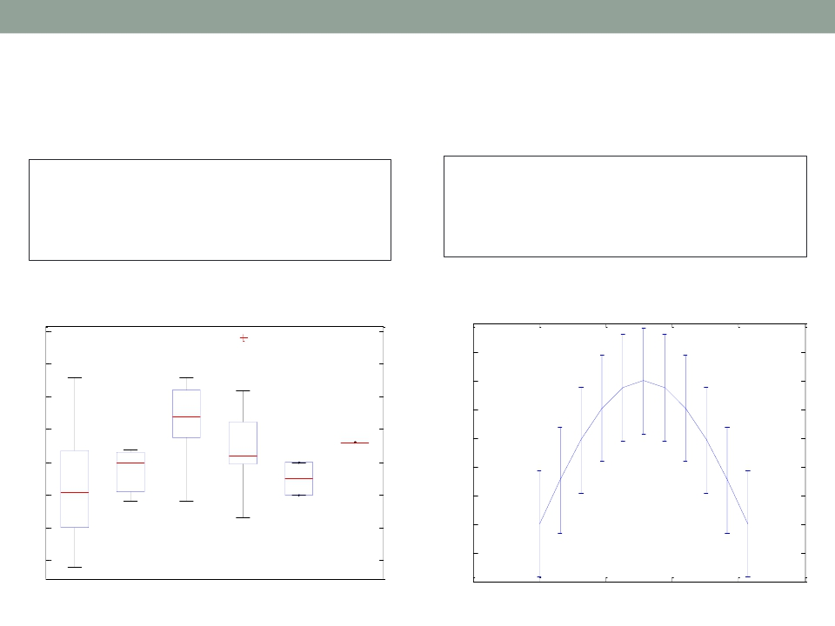
Applications of MATLAB in Engineering
Y.-F. Kuo
13
Boxplot and Error Bar
load carsmall
boxplot(MPG, Origin);
45
x=0:pi/10:pi; y=sin(x);
e=std(y)*ones(size(x));
errorbar(x,y,e)
1.4
1.2
40
1
35
0.8
30
25
20
15
10
0.6
0.4
0.2
0
-0.2
USA
France
Japan
Germany
Sweden
Italy
-0.4
-1
0
1
2
3
4

Slide 14
Applications of MATLAB in Engineering
Y.-F. Kuo
14
fill()
• Stop sign
t =(1:2:15)'*pi/8; x = sin(t); y = cos(t);
fill(x,y,'r'); axis square off;
text(0,0,'STOP','Color', 'w', 'FontSize', 80, ...
'FontWeight','bold', 'HorizontalAlignment', 'center');
STOP

Slide 15
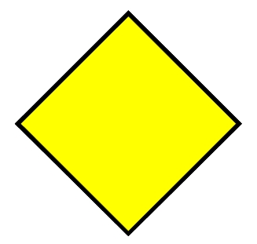
Applications of MATLAB in Engineering
Exercise
• Plot a wait sign
Y.-F. Kuo
WAIT
15

Slide 16
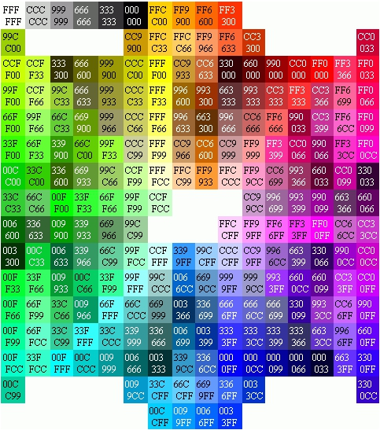
Applications of MATLAB in Engineering
Color Space
• [R G B]
• 0 is minimum
• 1 is maximum
• 8-bit equivalence:
Y.-F. Kuo
16
[0 0 0]
[0 255 0]
[255 255 255]
[0 0 255]
[75 75 75]
[255 0 0]

Slide 17
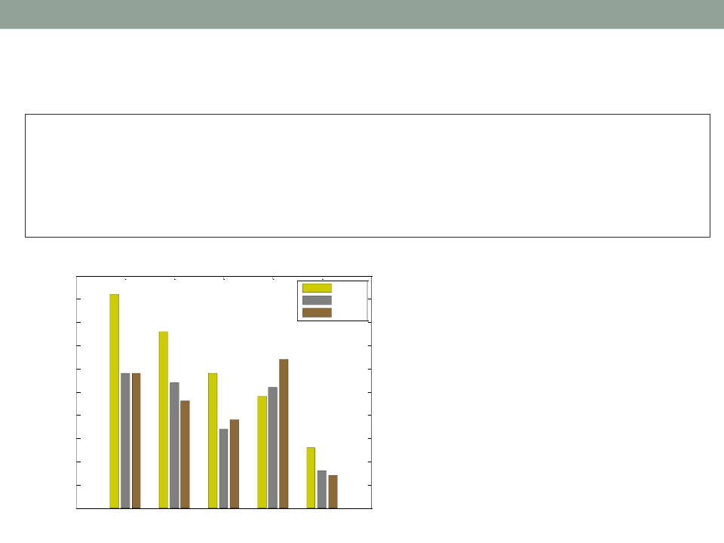
Applications of MATLAB in Engineering
Y.-F. Kuo
17
Exercise
G = [46 38 29 24 13]; S = [29 27 17 26 8];
B = [29 23 19 32 7]; h = bar(1:5, [G' S' B']);
title('Medal count for top 5 countries in 2012 Olympics');
ylabel('Number of medals');
xlabel('Country');
legend('Gold', 'Silver', 'Bronze')
Medal count for top five countries in 2012 Olympics
50
Gold
45
Silver
Bronze
40
35
30
25
20
15
10
5
Number of medals
0
USA
CHN
GBR
RUS
KOR
Country

Slide 18
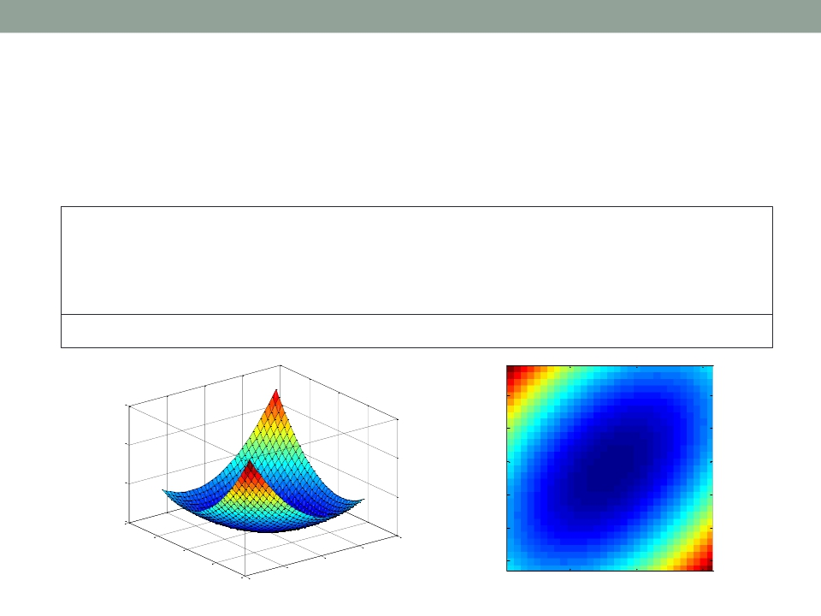
Applications of MATLAB in Engineering
Y.-F. Kuo
18
Visualizing Data asAn Image: imagesc()
• Display values of a matrix as an “image”
[x, y] = meshgrid(-3:.2:3,-3:.2:3);
z = x.^2 + x.*y + y.^2;
set(gca,'FontSize', 16);
surf( x, y, z); box on;
zlabel('z');
xlim([-4 4]);
xlabel('x');
ylim([-4 4]);
ylabel('y');
imagesc(z);
30
axis square;
xlabel('x');
5
ylabel('y');
10
20
15
10
20
z
y
0
4
25
2
2
4
0
y
0
30
-2
-2
10
20
30
-4 -4
x
x

Slide 19
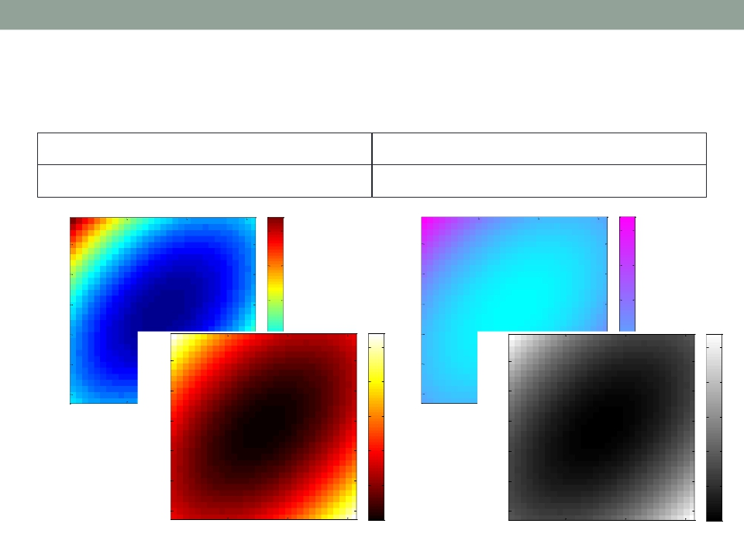
Applications of MATLAB in Engineering
Y.-F. Kuo
19
Color Bar and Scheme
colorbar; | colormap(cool);
colormap(hot); | colormap(gray);
25
25
5
5
10
15
20
20
15
10
10
15
20
20
15
10
y
y
25
25
25
5
5
25
5
5
30
10
15
20
15
30
10
15 x
20
15
10
20
30
0
10
20
30
0
y
x
y
20
25
10
5
20
25
10
5
30
0
30
10
20
30
10
20
30
0
x
x

Slide 20
Applications of MATLAB in Engineering
Built-in Colormaps
Y.-F. Kuo
20
Color Scale
• Use built-in color
maps:
colormap([Name])
• A color map is a
matrix of 256X3
a = colormap(prism)
• Use a customized
color map:
a = ones(256,3);
colormap(a);
Name
parula
jet
hsv
hot
cool
spring
summer
autumn
winter
gray
bone
copper
pink
lines
colorcube
prism

Slide 21

Applications of MATLAB in Engineering
Y.-F. Kuo
21
Exercise
• Create a custom green color map such that the
output of the script below looks like:
0.5
14
x = [1:10; 3:12; 5:14];
imagesc(x);
colorbar;
map = zeros(256,3);
map(:,2) = (0:255)/255;
colormap(map);
1
1.5
2
12
10
8
6
2.5
4
3
2
3.5
2
4
6
8
10

Slide 22
Applications of MATLAB in Engineering
3D Plots
Y.-F. Kuo
22
Function
plot3
surf
surfc
surface
meshc
contour
contourf
Description
3-D line plot
3-D shaded surface plot
Contour plot under a 3-D shaded surface plot
Create surface object
Plot a contour graph under mesh graph
Contour plot of matrix
Filled 2-D contour plot

Slide 23
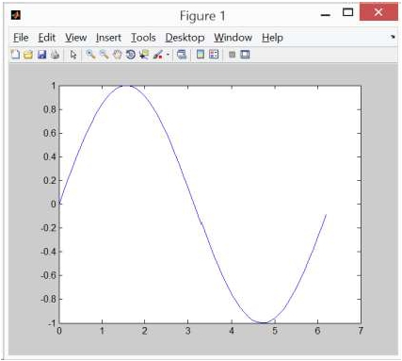
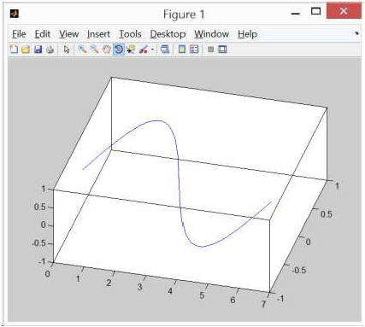
Applications of MATLAB in Engineering
2D vs. 3D
x=0:0.1:2*pi;
plot(x,sin(x));
Y.-F. Kuo
23

Slide 24
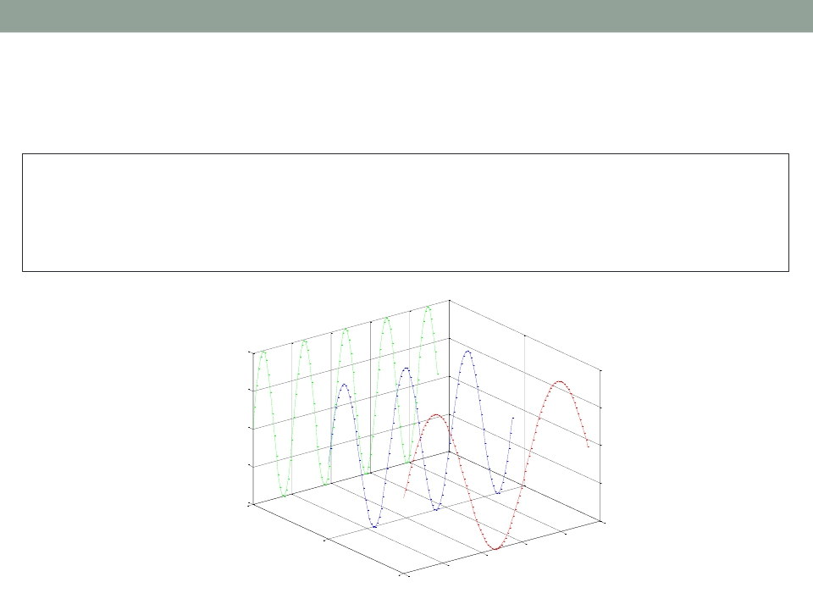
Applications of MATLAB in Engineering
Y.-F. Kuo
24
plot3()
x=0:0.1:3*pi; z1=sin(x); z2=sin(2.*x); z3=sin(3.*x);
y1=zeros(size(x)); y3=ones(size(x)); y2=y3./2;
plot3(x,y1,z1,'r',x,y2,z2,'b',x,y3,z3,'g');
grid on;
xlabel('x-axis');
ylabel('y-axis');
zlabel('z-axis');
1
0.5
0
-0.5
-1
1
10
z-axis
0.5
6
8
2
4
y-axis
0
0
x-axis

Slide 25
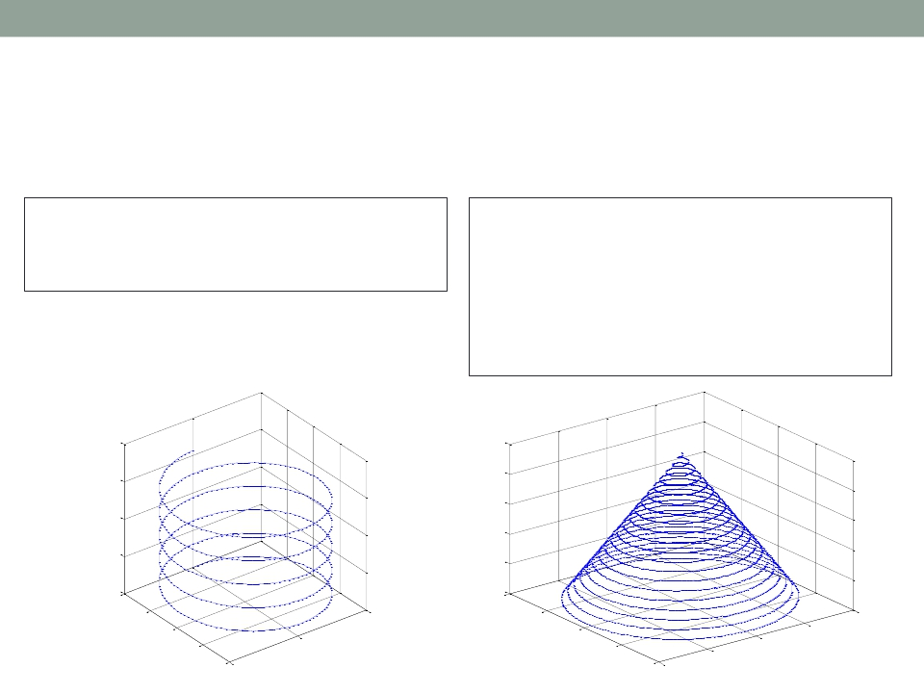
Applications of MATLAB in Engineering
More 3D Line Plots
Y.-F. Kuo
25
t = 0:pi/50:10*pi;
plot3(sin(t),cos(t),t)
grid on; axis square;
turns = 40*pi;
t = linspace(0,turns,4000);
x = cos(t).*(turns-t)./turns;
y = sin(t).*(turns-t)./turns;
z = t./turns;
plot3(x,y,z);
grid on;
40
30
1
0.8
0.6
20
0.4
10
0
1
0.2
0
1
0.5
1
0.5
1
0
0
0
0
0.5
-0.5
-0.5
-0.5
-1
-1
-1
-1

Slide 26
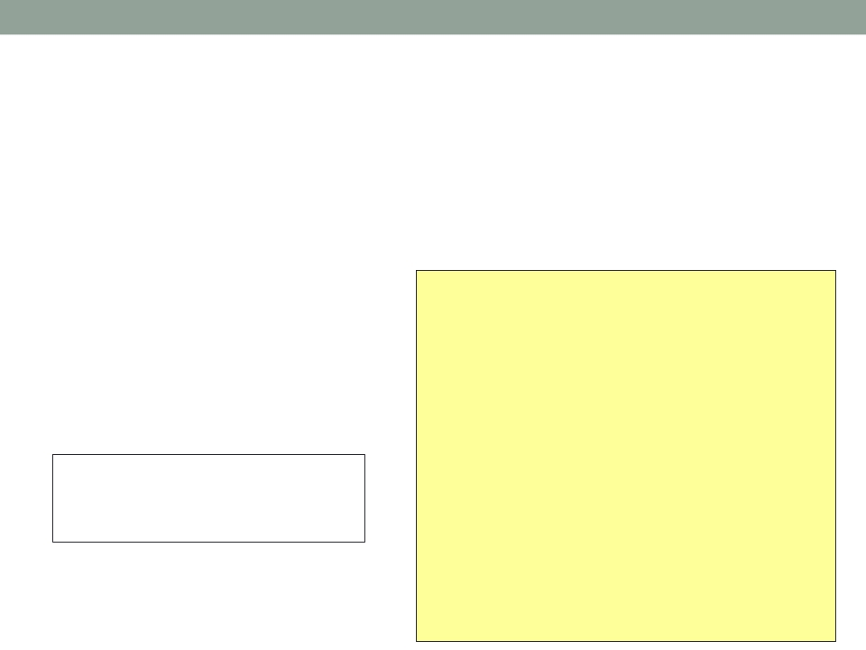
Applications of MATLAB in Engineering
Y.-F. Kuo
26
Principles for 3D Surface Plots
• Usually for plotting functions: 𝑧 = 𝑓(𝑥,𝑦)
• Need to provide MATLAB a set of (𝑥,𝑦,𝑧) points
• Use meshgrid to
X =
create matrices
X and Y for a given
range
-2
-2
-2
-2
-2
-1
-1
-1
-1
-1
0
0
0
0
0
1
1
1
1
1
2
2
2
2
2
0.4
0.2
0
x = -2:1:2;
Y =
y = -2:1:2;
[X,Y] = meshgrid(x,y)
-0.2
-0.4
4
-2
-1
-2
-1
-2
-1
-2
-1
-2
-1
2
0
1
0
-21
0
1
0
1
0
2
1
4
0
0
-2
2
2
-4
-4
2
2
2

Slide 27
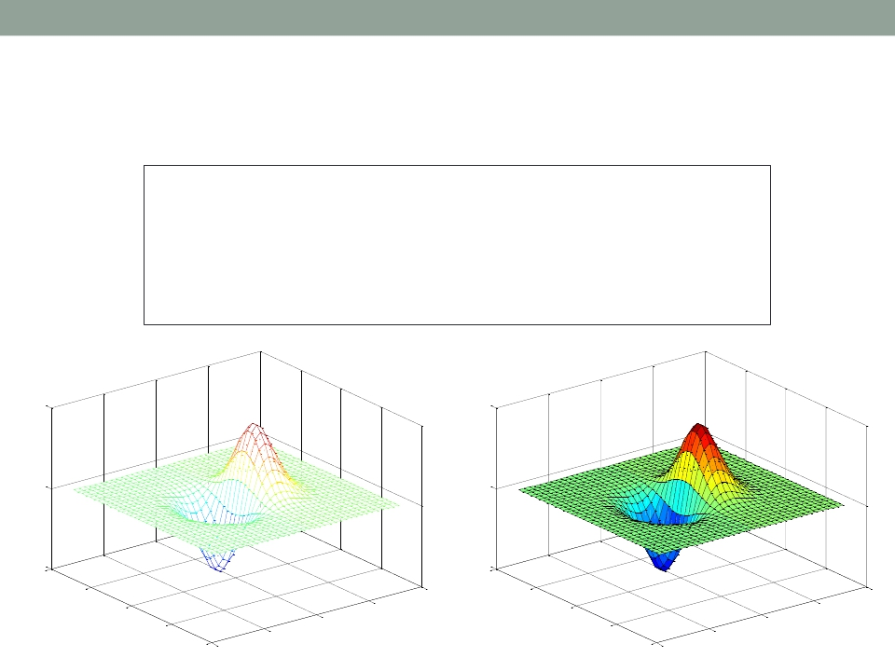
Applications of MATLAB in Engineering
Y.-F. Kuo
27
Surface Plots: mesh() and surf()
x = -3.5:0.2:3.5;
y = -3.5:0.2:3.5;
[X,Y] = meshgrid(x,y);
Z = X.*exp(-X.^2-Y.^2);
subplot(1,2,1); mesh(X,Y,Z);
subplot(1,2,2); surf(X,Y,Z);
0.5
0
-0.5
4
0.5
0
-0.5
4
2
4
2
4
0
2
0
2
-2
0
-2
0
-4
-2
-4
-2
-4
-4

Slide 28
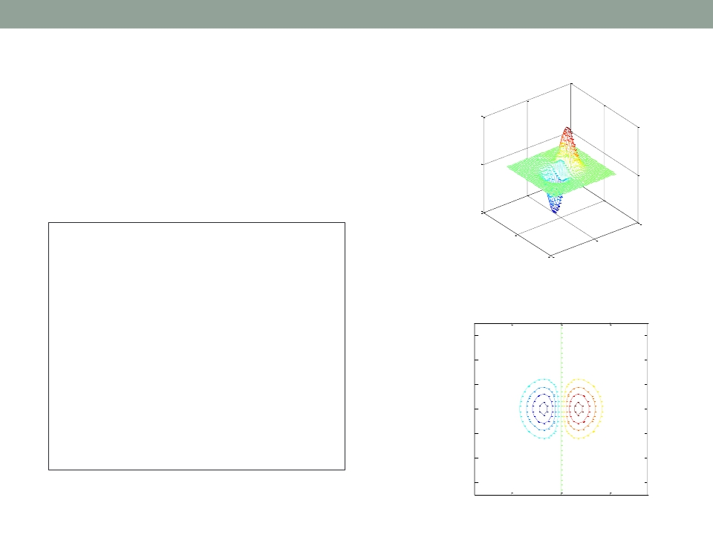
Applications of MATLAB in Engineering
Y.-F. Kuo
28
contour()
0.5
• Projection of equal heights
of 3D plot onto a 2D plane
0
-0.5
5
x = -3.5:0.2:3.5;
y = -3.5:0.2:3.5;
5
0
0
-5 -5
[X,Y] = meshgrid(x,y);
Z = X.*exp(-X.^2-Y.^2);
subplot(2,1,1);
mesh(X,Y,Z);
axis square;
subplot(2,1,2);
contour(X,Y,Z);
axis square;
3
2
1
0
-1
-2
-3
-2
0
2

Slide 29
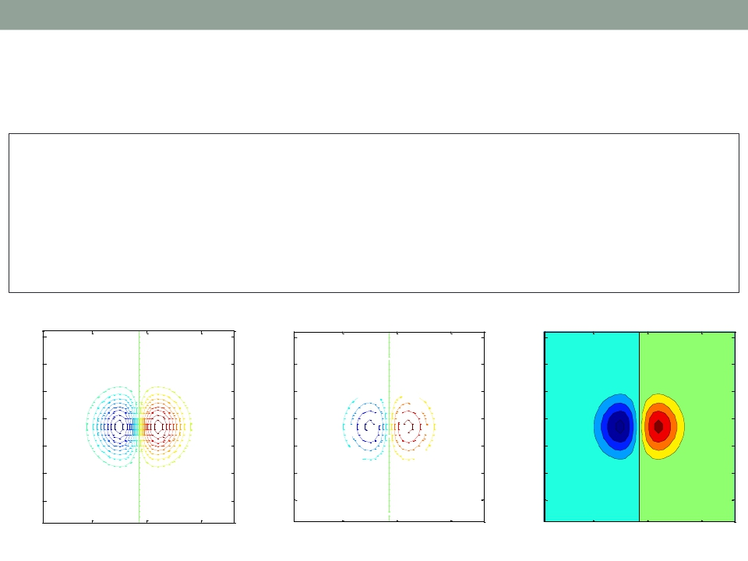
Applications of MATLAB in Engineering
Y.-F. Kuo
29
Various Contour Plots
x = -3.5:0.2:3.5;
y = -3.5:0.2:3.5;
[X,Y] = meshgrid(x,y);
Z = X.*exp(-X.^2-Y.^2);
subplot(1,3,1); contour(Z,[-.45:.05:.45]);
subplot(1,3,2); [C,h] = contour(Z);
axis square;
clabel(C,h);
axis square;
subplot(1,3,3);
35
30
contourf(Z);
35
30
axis square;
35
30
0
25
20
15
10
5
25
20
15
10
5
-0.1
0.1
25
20
15
10
5
-0.3
0.3
0.2
-0. 2 - .
0 4
0.4
0.2
- .
0
0
0.1
1
0
10
20
30
10
20
30
10
20
30

Slide 30
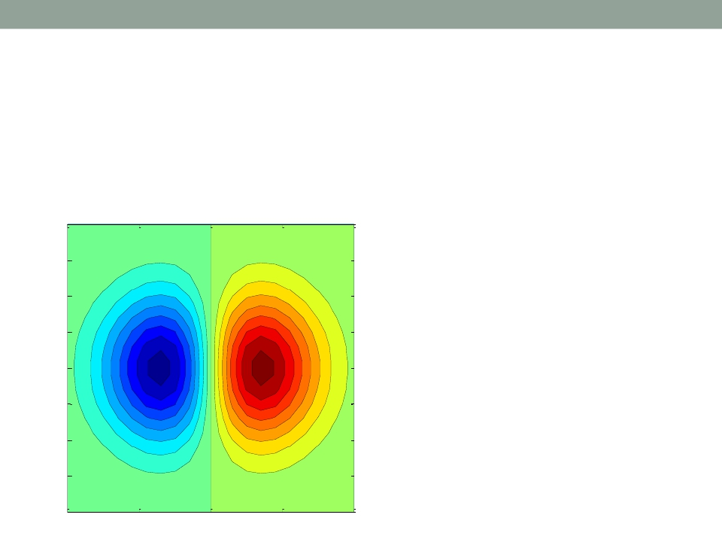
Applications of MATLAB in Engineering
Y.-F. Kuo
30
Exercise
• Combine the contour techniques to generate a
figure as shown below
2
1.5
1
0
1
0.5
0
-0.5
05
-0. .15
0 1 .1
-0 -0-0.25
0.2. 5
0 0
.
.2
.
-0
-0
-0.05
5
0.25
5
.3
00.0
- 5
5
0. 3
0 3
-0.1
.
0.2 0.3
4
0 4
.
.
0.1
- .
-0
0 2
0.1
5
5
- .1
0
-0.2
.
15
0.
15
0.2
-1
-0
-0.05
0.05
-1.5
-2
-2
-1
0
1
2

Slide 31
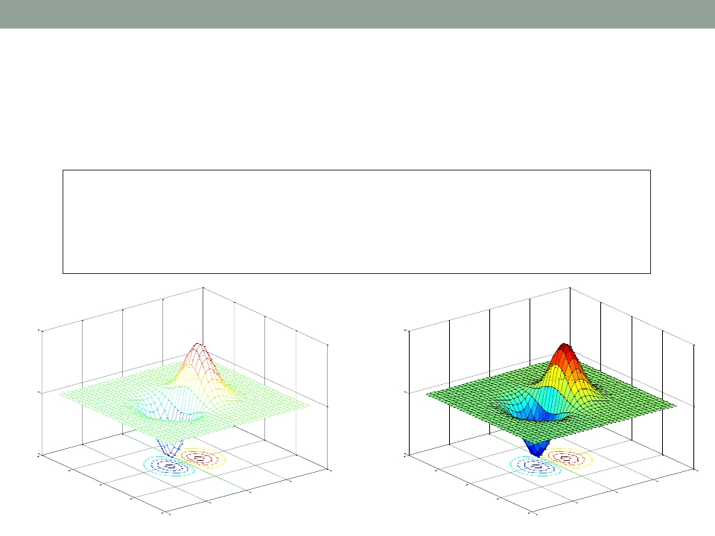
Applications of MATLAB in Engineering
Y.-F. Kuo
31
meshc() and surfc()
• Combination of surface/mesh and contours
x = -3.5:0.2:3.5;
y = -3.5:0.2:3.5;
[X,Y] = meshgrid(x,y);
Z = X.*exp(-X.^2-Y.^2);
subplot(1,2,1);
subplot(1,2,2);
meshc(X,Y,Z);
surfc(X,Y,Z);
0.5
0
-0.5
4
0.5
0
-0.5
4
2
4
2
4
0
2
0
2
-2
-2
0
-2
-2
0
-4
-4
-4
-4

Slide 32
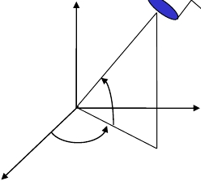
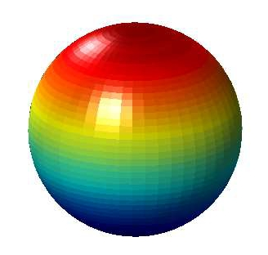
Applications of MATLAB in Engineering
ViewAngle: view()
• Vary the view angle
Y.-F. Kuo
32
z
Elevation
view(-45,20);
in the script below
sphere(50);
shading flat;
light('Position',[1 3 2]);
light('Position',[-3 -1 3]);
material shiny;
axis vis3d off;
set(gcf,'Color',[1 1 1]);
view(-45,20);
x
Azimuth
-y

Slide 33
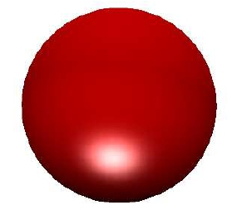
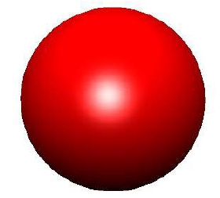
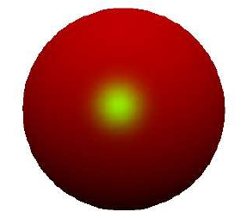
Applications of MATLAB in Engineering
Y.-F. Kuo
33
Light: light()
[X, Y, Z] = sphere(64); h = surf(X, Y, Z);
axis square vis3d off;
reds = zeros(256, 3); reds(:, 1) = (0:256.-1)/255;
colormap(reds);
shading interp; lighting phong;
set(h, 'AmbientStrength', 0.75, 'DiffuseStrength', 0.5);
L1 = light('Position', [-1, -1, -1]);
set(L1, 'Position', [-1, -1, 1]);
set(L1, 'Color', 'g');

Slide 34
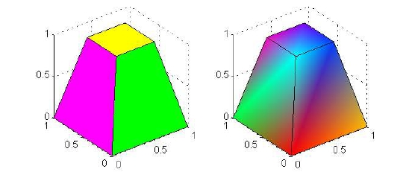
Applications of MATLAB in Engineering
Y.-F. Kuo
34
patch()
• A graphical object containing polygons
v = [0 0 0; 1 0 0 ; 1 1 0; 0 1 0; 0.25 0.25 1; ...
0.75 0.25 1; 0.75 0.75 1; 0.25 0.75 1];
f = [1 2 3 4; 5 6 7 8; 1 2 6 5; 2 3 7 6; 3 4 8 7; 4 1 5 8];
subplot(1,2,1);
patch('Vertices', v, 'Faces', f, ...
'FaceVertexCData', hsv(6), 'FaceColor', 'flat');
view(3); axis square tight; grid on;
subplot(1,2,2); patch('Vertices', v, 'Faces', f, ...
'FaceVertexCData', hsv(8), 'FaceColor', 'interp');
view(3); axis square tight; grid on;

Slide 35
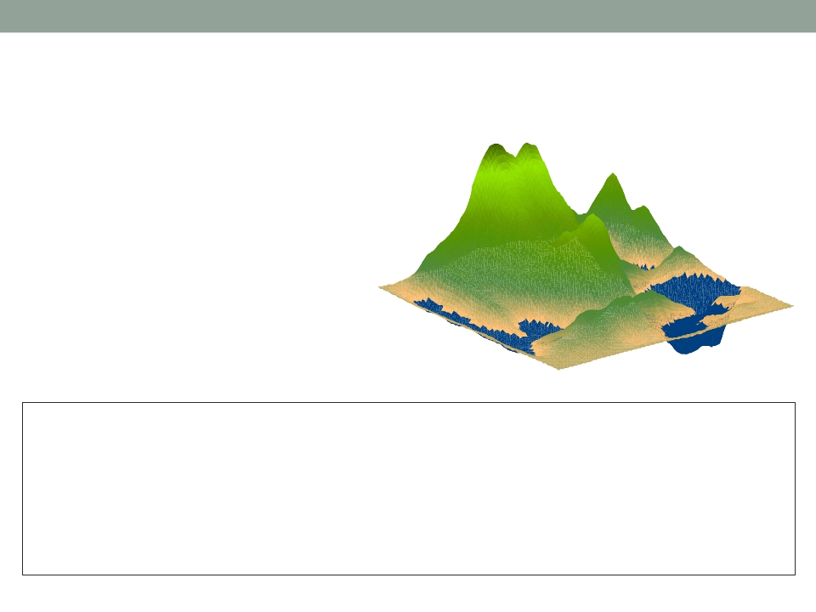
Applications of MATLAB in Engineering
Y.-F. Kuo
35
Exercise
• MATLAB plots can be
very professional!
load cape
X=conv2(ones(9,9)/81,cumsum(cumsum(randn(100,100)),2));
surf(X,'EdgeColor','none','EdgeLighting','Phong',...
'FaceColor','interp');
colormap(map); caxis([-10,300]);
grid off; axis off;

Slide 36

Applications of MATLAB in Engineering
End of Class
Y.-F. Kuo
36

