Slide 1
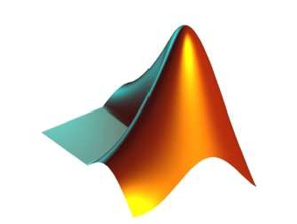
APPLICATIONS OF
MATLAB IN ENGINEERING
Yan-Fu Kuo
Dept. of Bio-industrial Mechatronics Engineering
National Taiwan University
Today:
Fall 2015
•
Graphical user interface

Slide 2
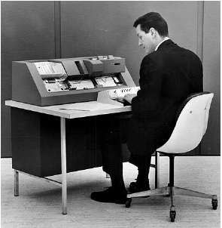
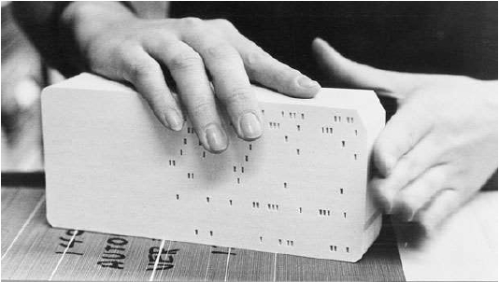
Applications of MATLAB in Engineering
Y.-F. Kuo
2
User Interface
• User interface (UI) is a method of interaction
between a person and a computer
• 1970s

Slide 3
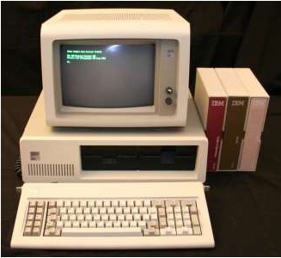
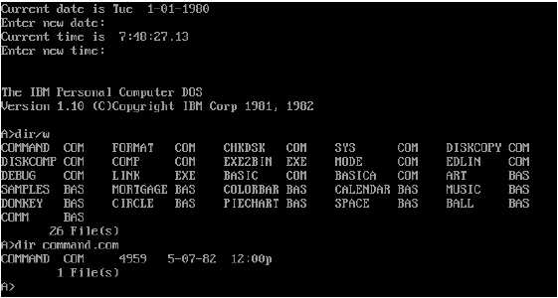
Applications of MATLAB in Engineering
Y.-F. Kuo
3
User Interface
• User interface (UI) is a method of interaction
between a person and a computer
• 1980s

Slide 4
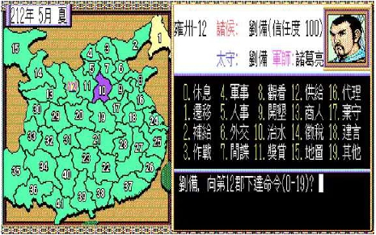
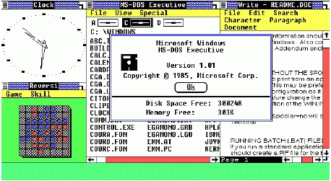
Applications of MATLAB in Engineering
Y.-F. Kuo
4
User Interface
• User interface (UI) is a method of interaction
between a person and a computer
• 1990s

Slide 5
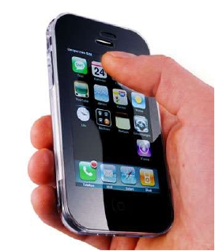

Applications of MATLAB in Engineering
Y.-F. Kuo
5
User Interface
• User interface (UI) is a method of interaction
between a person and a computer
• 2000s

Slide 6
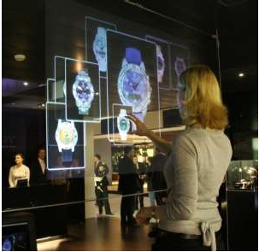

Applications of MATLAB in Engineering
Y.-F. Kuo
6
User Interface
• User interface (UI) is a method of interaction
between a person and a computer
• Future!

Slide 7
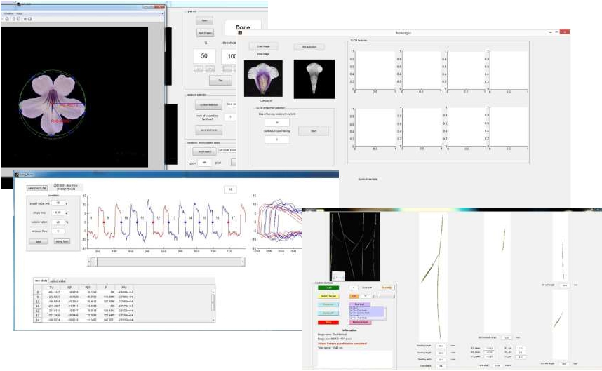
Applications of MATLAB in Engineering
Y.-F. Kuo
7
MATLAB GUI Programs

Slide 8
Applications of MATLAB in Engineering
Y.-F. Kuo
8
StartAGUI Program
• Set your “current folder” where you want to store
the GUI program
• Use GUIDE (graphical user interface design
environment) to create a MATLAB GUI
interactively by typing in guide command
window

Slide 9
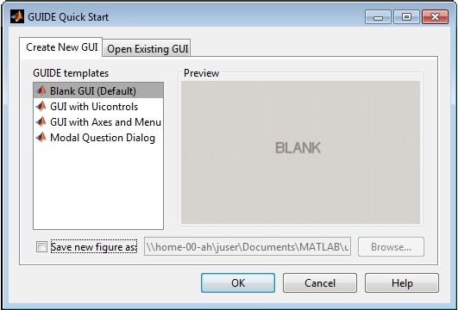
Applications of MATLAB in Engineering
Y.-F. Kuo
9
GUIDE Quick Start
• Double click “Blank GUI (Default)”

Slide 10
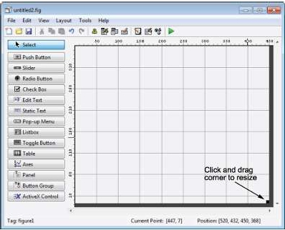
Applications of MATLAB in Engineering
Y.-F. Kuo
10
GUI Figure
• Display the names of the GUI components
• Select File > Preferences > GUIDE
• Check “Show names in component palette”
• Set GUI figure size

Slide 11
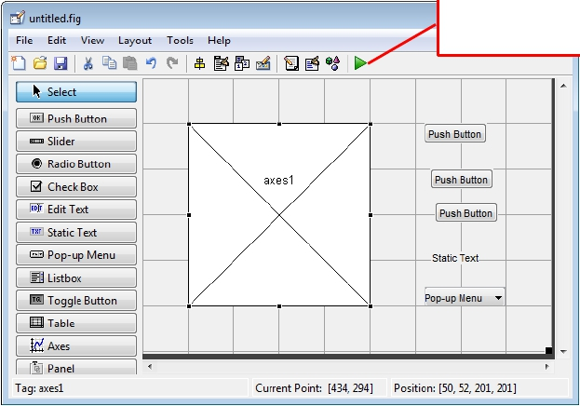
Applications of MATLAB in Engineering
Add Components
• 3 push buttons
• A static text area
Y.-F. Kuo
• A pop-up menu
• An axes
Click and see
what happens
11

Slide 12
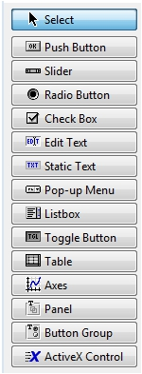
Applications of MATLAB in Engineering
Y.-F. Kuo
12
Available Objects/Components
Component
Push Button
Slider
Radio Button
Check Box
Edit Text
Static Text
Pop-Up Menu
List Box
Toggle Button
Table
Axes
Description
Push buttons generate an action when clicked.
Sliders accept numeric input within a specified range by enabling
the user to move a sliding bar.
Radio buttons are similar to check boxes, but radio buttons are
typically mutually exclusive within a group of related radio
buttons.
Check boxes can generate an action when checked and indicate
their state as checked or not checked.
Edit text components are fields that enable users to enter or
modify text strings. Use edit text when you want text as input.
Static text controls display lines of text.
Pop-up menus open to display a list of choices when users click
the arrow.
List boxes display a list of items and enable users to select one
or more items.
Toggle buttons generate an action and indicate whether they are
turned on or off.
Use the table button to create a table component.
Axes enable your GUI to display graphics such as graphs and
images.

Slide 13
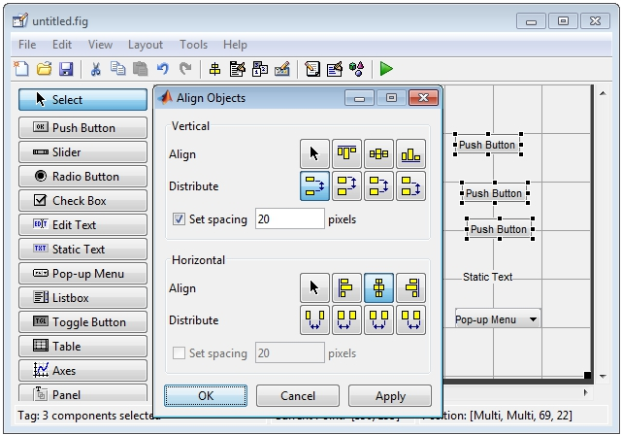
Applications of MATLAB in Engineering
Y.-F. Kuo
13
Align the Components
• Select Tools > Align Objects

Slide 14
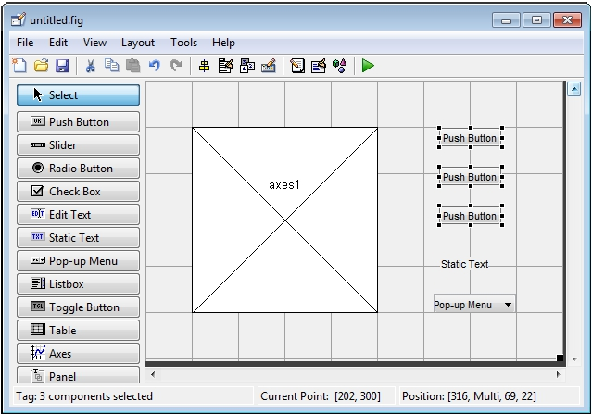
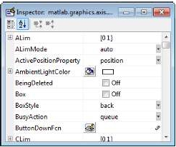
Applications of MATLAB in Engineering
Y.-F. Kuo
14
Label the Push Buttons
• Select View > Property Inspector

Slide 15
Applications of MATLAB in Engineering
Y.-F. Kuo
15
GUI Script Structure
function varargout = untitled(varargin)
% UNTITLED MATLAB code for untitled.fig
…
% Begin initialization code - DO NOT EDIT
…
% --- Executes just before untitled is made visible.
function untitled_OpeningFcn(hObject, eventdata, handles, varargin)
…
% --- Outputs from this function are returned to the command line.
function varargout = untitled_OutputFcn(hObject, eventdata, handles)
…
% --- Executes on button press in pushbutton1.
function pushbutton1_Callback(hObject, eventdata, handles)
…
% --- Executes on button press in pushbutton2.
function pushbutton2_Callback(hObject, eventdata, handles)
…
% --- Executes on button press in pushbutton3.
function pushbutton3_Callback(hObject, eventdata, handles)
…
% --- Executes on selection change in popupmenu1.
function popupmenu1_Callback(hObject, eventdata, handles)
…
% --- Executes during object creation, after setting all properties.
function popupmenu1_CreateFcn(hObject, eventdata, handles)
…

Slide 16
Applications of MATLAB in Engineering
Y.-F. Kuo
16
function untitled_OpeningFcn
function untitled_OpeningFcn(hObject, eventdata, handles, varargin)
% This function has no output args, see OutputFcn.
% hObject
% eventdata
handle to figure
reserved - to be defined in a future version of MATLAB
% handles structure with handles and user data (see GUIDATA)
% varargin
command line arguments to untitled (see VARARGIN)
% Choose default command line output for untitled
handles.output = hObject;
% Update handles structure
guidata(hObject, handles.membrane=membrane;
[x,y] = meshgrid(-8:.5:8);
r = sqrt(x.^2+y.^2) + eps;
sinc = sin(r)./r;
handles.sinc = sinc;
handles.current_data = handles.peaks;
surf(handles.current_data)
handles);

Slide 17
Applications of MATLAB in Engineering
Y.-F. Kuo
17
Callbck ofAn Object
function pushbutton1_Callback(hObject, eventdata, handles)
% hObject
% eventdata
handle to pushbutton1 (see GCBO)
reserved - to be defined in a future version of MATLAB
% handles structure with handles and user data (see GUIDATA)
handles.peaks=peaks(35);
handles.membrane=membrane;
[x,y] = meshgrid(-8:.5:8);
r = sqrt(x.^2+y.^2) + eps;
sinc = sin(r)./r;
handles.sinc = sinc;
handles.current_data = handles.peaks;
surf(handles.current_data)

Slide 18
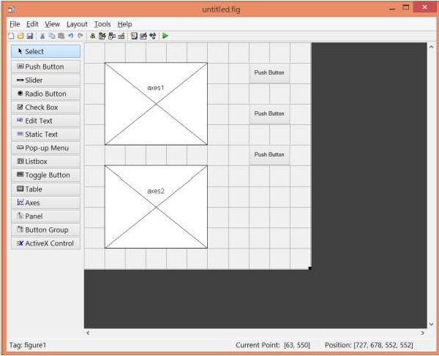
Applications of MATLAB in Engineering
Y.-F. Kuo
18
What If We Have Two axes?
• Which axes the figure will show on?

Slide 19
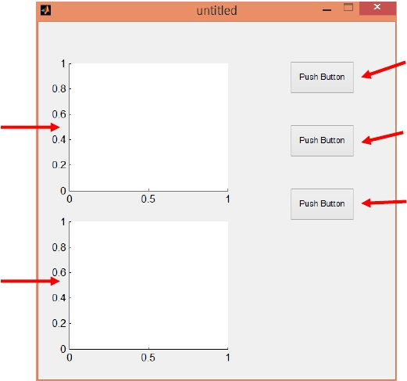
Applications of MATLAB in Engineering
Y.-F. Kuo
19
handles – information of the GUI objects
handles.pushbutton1
handles.axes1
handles.pushbutton2
handles.pushbutton3
handles.axes2

Slide 20
Applications of MATLAB in Engineering
Y.-F. Kuo
20
Set the axes for Plotting
• Modify the script to
handles.peaks=peaks(35);
handles.membrane=membrane;
[x,y] = meshgrid(-8:.5:8); r = sqrt(x.^2+y.^2) + eps;
sinc = sin(r)./r; handles.sinc = sinc;
handles.current_data = handles.peaks;
surf(handles.axes1, handles.current_data);
or
handles.peaks=peaks(35);
handles.membrane=membrane;
[x,y] = meshgrid(-8:.5:8); r = sqrt(x.^2+y.^2) + eps;
sinc = sin(r)./r; handles.sinc = sinc;
handles.current_data = handles.peaks;
axes(handles.axes1); surf(handles.current_data);

Slide 21
Applications of MATLAB in Engineering
Y.-F. Kuo
21
Review – set() and get()
• get() acquires properties
• set() sets properties
• Example:
a = get(handles.slider1, 'Value');
set(handles.text2, 'String', 'TEST');

Slide 22
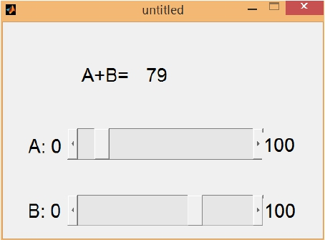
Applications of MATLAB in Engineering
Y.-F. Kuo
22
Practice
• Write a GUI program
• It contains 2 sliders each of which is associated
with a variable with value ranged from 0 to 100
• Display the summation of the slider variables as
an integer
• You may need these
functions:
• get()
• set()
• int16()
• num2str()

Slide 23
Applications of MATLAB in Engineering
Y.-F. Kuo
23
Handles to Store Variables
• handles is also used to pass variables from one
GUI object to another
• Store variable a into handles
handles.myData = a;
guidata(hObject, handles);
• Retrieve variable a from handles
a = handles.myData;

Slide 24

Applications of MATLAB in Engineering
End of Class
Y.-F. Kuo
24

