Slide 1
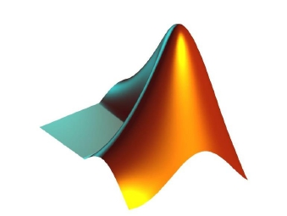
APPLICATIONS OF
MATLAB IN ENGINEERING
Yan-Fu Kuo
Dept. of Bio-industrial Mechatronics Engineering
National Taiwan University
Today:
Fall 2015
•
•
Polynomial differentiation and integration
Numerical differentiation and integration

Slide 2
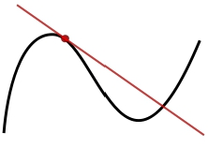
Applications of MATLAB in Engineering
Y.-F. Kuo
2
Differentiation
• The derivative of a function 𝑓(𝑥) is written as
𝑓′(𝑥) or
𝑑𝑓(𝑥)
𝑑𝑥
• The rate of the change in the function 𝑓(𝑥) with
respect to 𝑥
• Geometrically, 𝑓′(𝑥0) represents
the coefficient of the line tangent
to the curve in the point 𝑥0

Slide 3
Applications of MATLAB in Engineering
Y.-F. Kuo
3
Polynomial Differentiation
• Polynomials are often used in numerical
calculations
• For a polynomial
𝑓 𝑥 = 𝑎𝑛𝑥𝑛 + 𝑎𝑛−1𝑥𝑛−1 + ⋯+ 𝑎1𝑥 + 𝑎0,
the derivative is
𝑓′ 𝑥 = 𝑎𝑛𝑛𝑥𝑛−1 + 𝑎𝑛−1(𝑛 − 1)𝑥𝑛−2 + ⋯+ 𝑎1
• How do we calculate this using MATLAB?

Slide 4
Applications of MATLAB in Engineering
Y.-F. Kuo
4
Representing Polynomials in MATLAB
• Polynomials were represented as row vectors
• For example, consider the equation
𝑓 𝑥 = 𝑥3 − 2𝑥 − 5
• To enter this polynomial into MATLAB, use
p = [1 0 -2 -5];

Slide 5
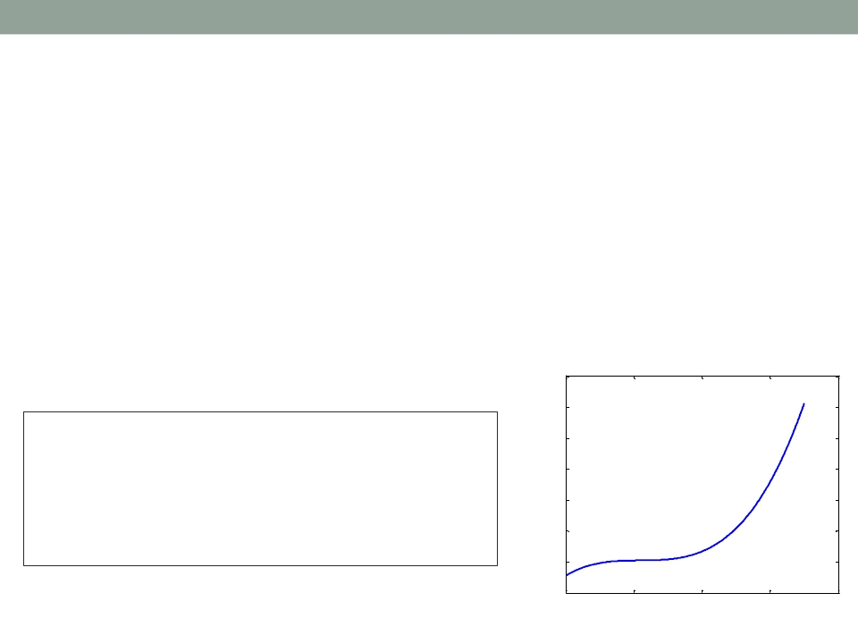
Applications of MATLAB in Engineering
Y.-F. Kuo
5
Values of Polynomials: polyval()
• Plot the polynomial
9𝑥3 – 5𝑥2 + 3𝑥 + 7
for −2 ≤ 𝑥 ≤ 5
1200
1000
a = [9,-5,3,7];
x = -2:0.01:5;
800
f = polyval(a,x);
plot(x,f,'LineWidth', 2);
xlabel('x'); ylabel('f(x)');
set(gca, 'FontSize', 14)
f(x)
600
400
200
0
-200
-2
0
2
4
6
x

Slide 6
Applications of MATLAB in Engineering
Y.-F. Kuo
6
Polynomial Differentiation: polyder()
• Given 𝑓(𝑥) = 5𝑥4 − 2𝑥2 + 1
1. What is the derivative of the function 𝑓′(𝑥)?
2. What is the derivative of the function value of
𝑓′(7)?
p=[5 0 -2 0 1];
polyder(p)
polyval(polyder(p),7)

Slide 7
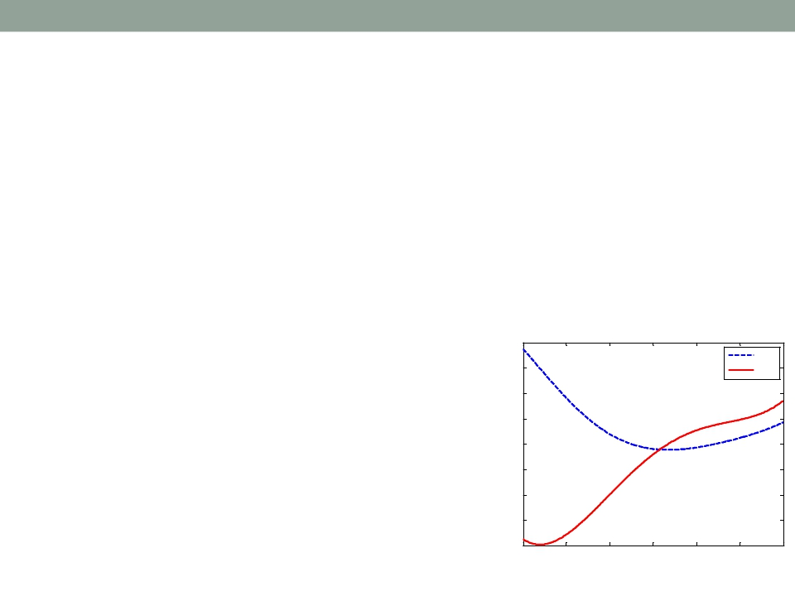
Applications of MATLAB in Engineering
Y.-F. Kuo
7
Exercise
• Plot the polynomial
𝑓(𝑥) = (5𝑥3 − 7𝑥2 + 5𝑥 + 10)(4𝑥2 + 12𝑥 − 3)
and its derivative for −2 ≤ 𝑥 ≤ 1
• Hint: conv()
800
f(x)
600
400
200
0
-200
-400
-600
f'(x)
-800
-2
-1.5
-1
-0.5
0
0.5
1
x

Slide 8
Applications of MATLAB in Engineering
Y.-F. Kuo
8
Polynomial Integration
• For a polynomial
𝑓 𝑥 = 𝑎𝑛𝑥𝑛 + 𝑎𝑛−1𝑥𝑛−1 + ⋯+ 𝑎1𝑥 + 𝑎0,
the integration is
1
𝑛 + 1
1
𝑛
𝑓 𝑥 =
𝑎𝑛𝑥
𝑛+1
+ 𝑎𝑛−1𝑥𝑛 + ⋯+ 𝑎0𝑥 + 𝑘
• How do we calculate this using MATLAB?

Slide 9
Applications of MATLAB in Engineering
Y.-F. Kuo
9
Polynomial Integration: polyint()
• Given 𝑓(𝑥) = 5𝑥4 − 2𝑥2 + 1
1. What is the integral of the function
𝑓(𝑥) with
a constant of 3?
2. What is the derivative of the function value of
𝑓(7)?
p=[5 0 -2 0 1];
polyint(p, 3)
polyval(polyint(p, 3),7)

Slide 10
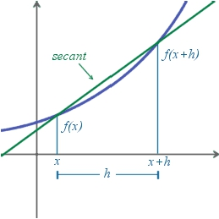
Applications of MATLAB in Engineering
Y.-F. Kuo
10
Numerical Differentiation
• The simplest method:
finite difference approximation
• Calculating a secant line in the
vicinity of 𝑥0
𝑓′ 𝑥0 =
lim
ℎ→0
𝑓 𝑥0+ℎ −𝑓 𝑥0
ℎ
,
where ℎ represents a small
change in 𝑥

Slide 11
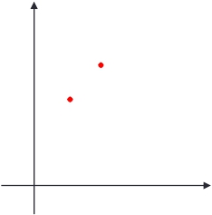
Applications of MATLAB in Engineering
Y.-F. Kuo
11
Differences: diff()
• diff() calculates the differences between
adjacent elements of a vector
x = [1 2
5
2
1];
diff(x)
• Exercise: obtain the slope of a line between 2
points (1,5) and (2,7)
(2,7)
(1,5)
x = [1 2]; y = [5 7];
slope = diff(y)./diff(x)

Slide 12
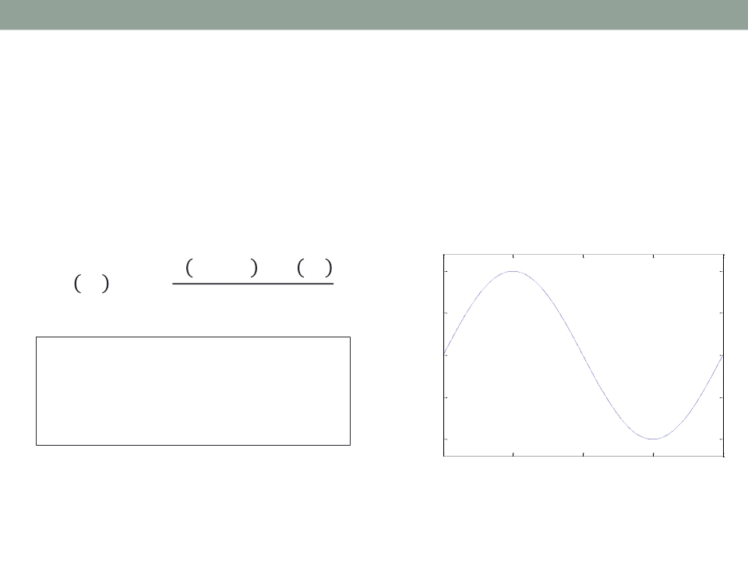
Applications of MATLAB in Engineering
Y.-F. Kuo
12
Numerical Differentiation Using diff()
• Given 𝑓(𝑥) = sin(𝑥), find 𝑓′(𝑥0) at 𝑥0 = 𝜋/2
using ℎ = 0.1
sin(x)
𝑓 𝑥0 + ℎ − 𝑓 𝑥0
ℎ
1
0.5
𝑓′ 𝑥0
= lim
ℎ→0
x0 = pi/2; h = 0.1;
x = [x0 x0+h];
y = [sin(x0) sin(x0+h)];
m = diff(y)./diff(x)
0
−0.5
−1
0
π/2
π
3π/2
2π
• How does ℎ affect accuracy?

Slide 13
Applications of MATLAB in Engineering
Y.-F. Kuo
13
Exercise
• Given 𝑓(𝑥) = sin(𝑥), write a script to find the error
of 𝑓′(𝑥0) at 𝑥0 = 𝜋/2 using various ℎ
ℎ
0.1
0.01
0.001
0.0001
0.00001
0.000001
0.0000001
Error of 𝑓′(𝑥0)

Slide 14
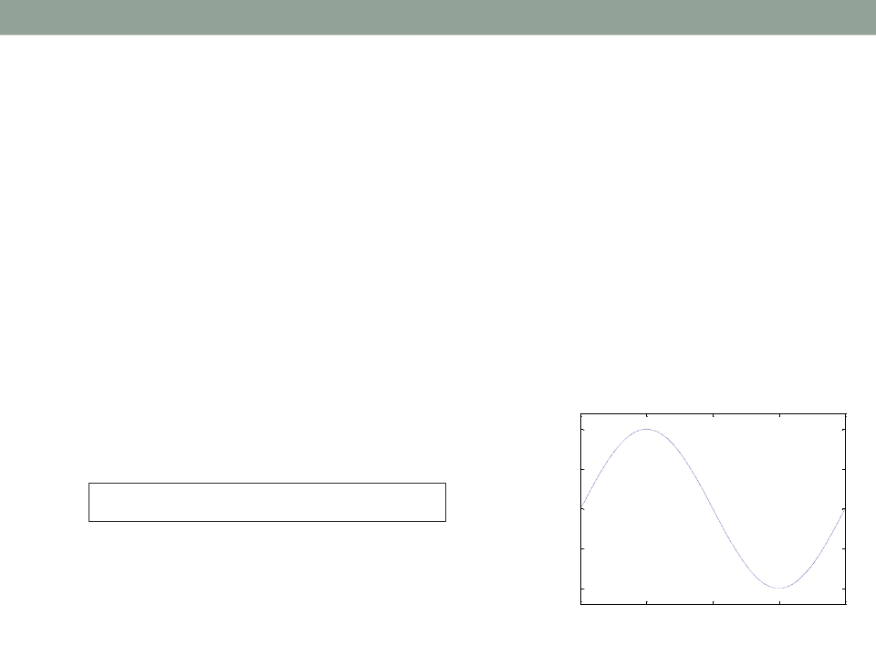
Applications of MATLAB in Engineering
Y.-F. Kuo
14
How to Find the 𝑓′ overAn Interval [0,2𝜋]?
• In the previous example, 𝑥0 = 𝜋/2
• Strategy:
1.
2.
Create an array in the interval [0,2𝜋]
The step is the ℎ
3.
Calculate the 𝑓′ at these points
sin(x)
• For example,
1
0.5
h = 0.5;
x = 0:h:2*pi;
0
−0.5
−1
0
π/2
π
3π/2
2π

Slide 15
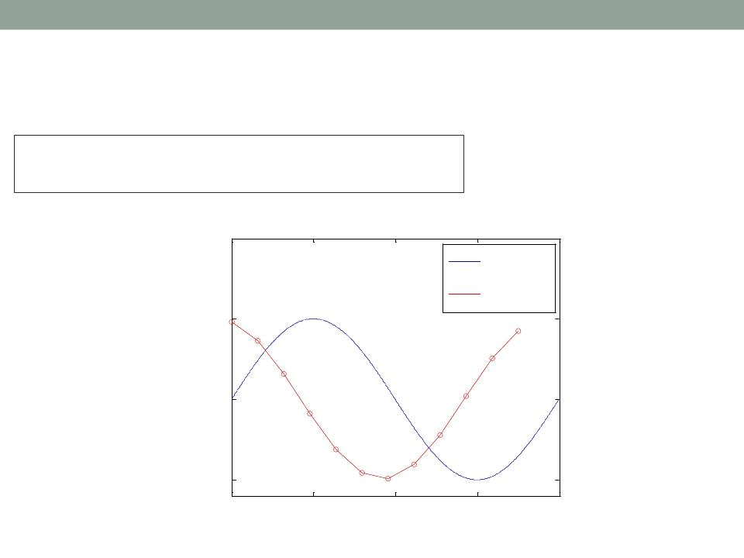
Applications of MATLAB in Engineering
Y.-F. Kuo
15
Find sin′(𝑥) over 𝑥 = [0,2𝜋]
h = 0.5;
x = 0:h:2*pi;
y = sin(x); m = diff(y)./diff(x);
2
hold on; plot(0:.01:2*pi,sin(0:.01:2*pi));
plot(x(1:end-1), m, '--or'); hold off sin'(x)
set(gca, 'XLim',1 [0, 2*pi]);
set(gca, 'YLim', [-1.2, 2]);
set(gca, 'FontSize', 25);
set(gca, 'FontName', 'symbol');
set(gca, 'XTick', 0:pi/2:2*pi);
set(gca, 'XTickLabel', {'0', 'p/2', 'p', '3p/2', '2p'});
h = legend('sin(x)',strcat('sin','''','(x)'));
set(h,'FontName', 'Times New Roman'); box on;
;
0

Slide 16
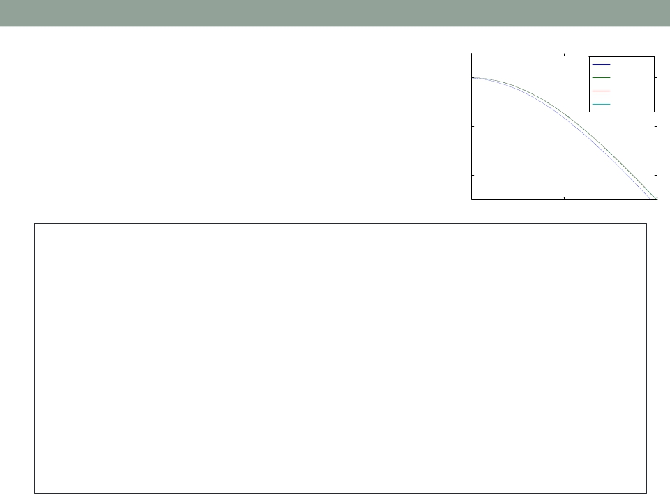
Applications of MATLAB in Engineering
Y.-F. Kuo
16
1.2
Various Step Size
• The derivatives of 𝑓(𝑥) = sin(𝑥)
calculated using various ℎ values
h=0.1
h=0.01
h=0.001
h=0.0001
1
0.8
0.6
0.4
0.2
0
0
π/4
π/2
g = colormap(lines);
hold on;
for i=1:4
x = 0:power(10, -i):pi;
y = sin(x); m = diff(y)./diff(x);
plot(x(1:end-1), m, 'Color', g(i,:));
end
hold off;
set(gca, 'XLim', [0, pi/2]);
set(gca, 'YLim', [0, 1.2]);
set(gca, 'FontSize', 18);
set(gca, 'FontName', 'symbol');
set(gca, 'XTick', 0:pi/4:pi/2);
set(gca, 'XTickLabel', {'0', 'p/4', 'p/2'});
h = legend('h=0.1','h=0.01','h=0.001','h=0.0001');
set(h,'FontName', 'Times New Roman'); box on;

Slide 17
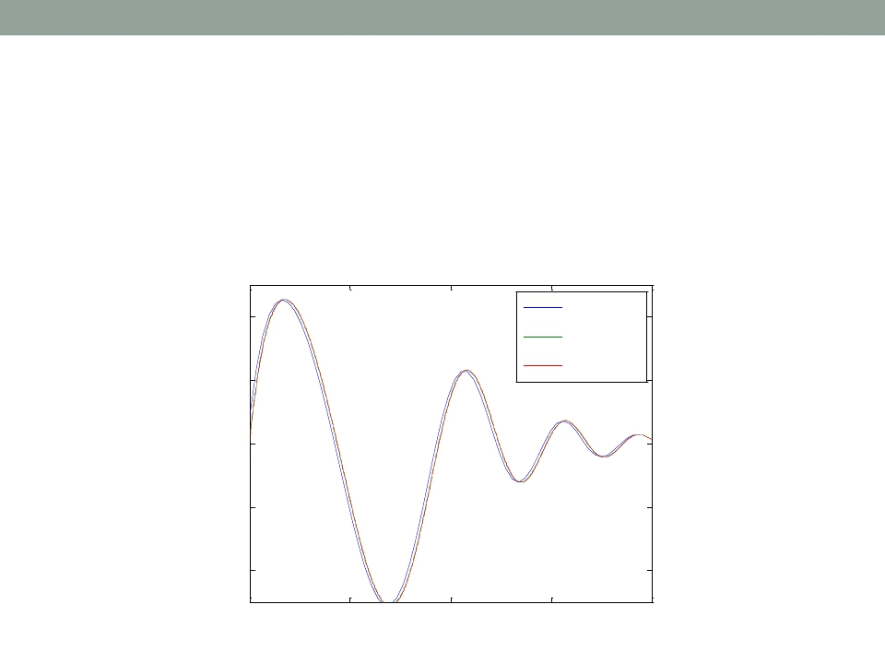
Applications of MATLAB in Engineering
Y.-F. Kuo
17
Exercise
• Given 𝑓(𝑥) = 𝑒−𝑥sin(𝑥2/2), plot the approximate
derivatives 𝑓′ of ℎ = 0.1, 0.01, and 0.001
0.2
0.1
0
−0.1
−0.2
h=0.1
h=0.01
h=0.001
0
π/2
π
3π/2
2π

Slide 18
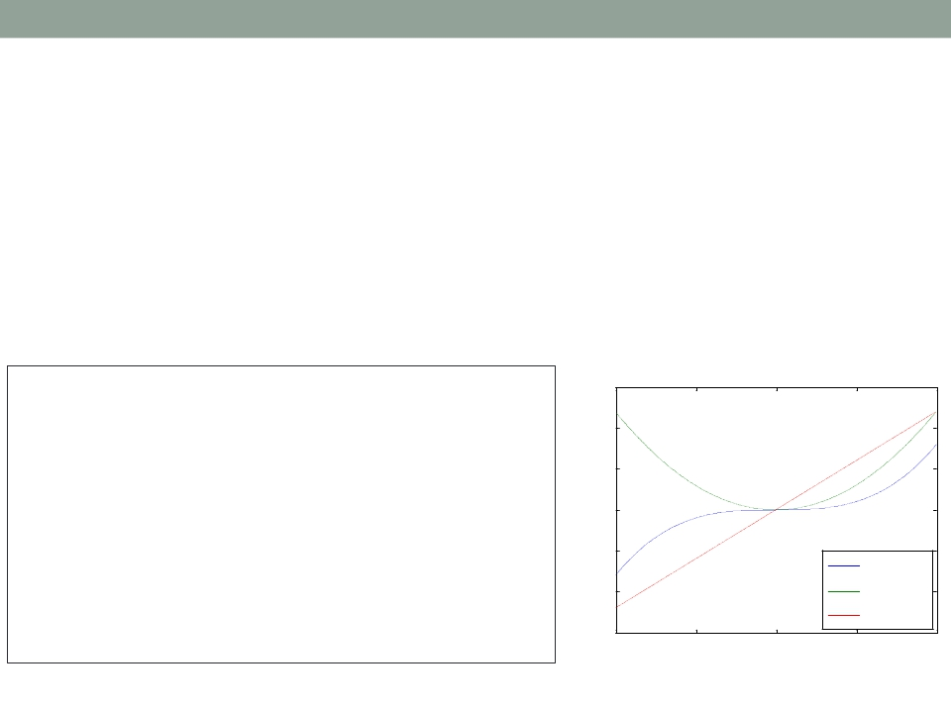
Applications of MATLAB in Engineering
Y.-F. Kuo
18
Second and Third Derivatives
• The second derivative 𝑓′′ and third derivative 𝑓′′′
can be obtained using similar approaches
• Given 𝑓(𝑥) = 𝑥3, plot 𝑓′ and 𝑓′ for −2 ≤ 𝑥 ≤ 2
x = -2:0.005:2;
y = x.^3;
15
m = diff(y)./diff(x);
m2 = diff(m)./diff(x(1:end-1));
plot(x,y,x(1:end-1),m,x(1:end-2),m2);
xlabel('x', 'FontSize', 18);
10
5
0
y
ylabel('y', 'FontSize', 18);
legend('f(x) =
x^3','f''(x)','f''''(x)', 4);
set(gca, 'FontSize', 18);
-5
-10
-15
-2
f(x) = x3
f'(x)
f''(x)
-1
0
1
2
x

Slide 19
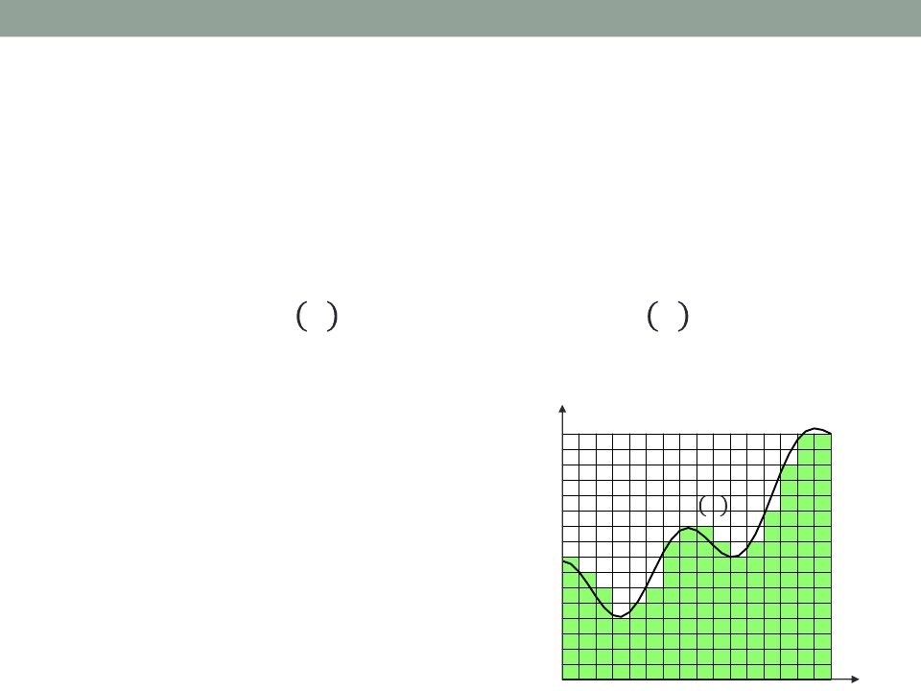
Applications of MATLAB in Engineering
Y.-F. Kuo
19
Numerical Integration
• Calculating the numerical value of a definite
integral
𝑏
𝑎
𝑛
𝑖=0
𝑏
𝑎
𝑠 =
𝑓 𝑥 𝑑(𝑥) ≈
𝑓(𝑥𝑖)
𝐿𝑖 𝑥 𝑑𝑥
• Quadrature method –
approximating the
integral by using a
𝑓 𝑥
finite set of points
𝑠

Slide 20
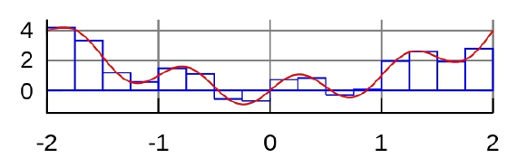
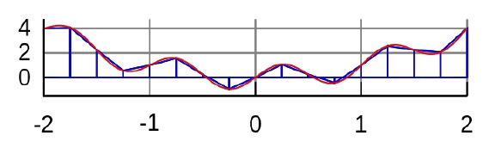
Applications of MATLAB in Engineering
Y.-F. Kuo
20
Numerical Quadrature Rules
•
Basic quadrature rules:
1.
2.
Midpoint rule (zeroth-order approximation)
Trapezoid rule (first-order approximation)

Slide 21


Applications of MATLAB in Engineering
Midpoint Rule
Y.-F. Kuo
21
𝑥3
𝑥0
𝑛−1
𝑖=0
𝑓 𝑥 𝑑𝑥 ≈ ℎ𝑓 0 + ℎ𝑓 1 + ℎ𝑓 2 = ℎ
𝑓 𝑖
𝑥1 + 𝑥2
2
𝑓 1 = 𝑓
𝑥0 + 𝑥1
2
𝑥2 + 𝑥3
2
𝑓 0 = 𝑓
𝑓 2 = 𝑓
𝑥3
𝑥0
𝑥1
𝑥2
ℎ
ℎ
ℎ

Slide 22
Applications of MATLAB in Engineering
Y.-F. Kuo
22
Midpoint Rule Using sum()
•Example:
2
0
𝐴 =
4𝑥3 𝑑𝑥 = 𝑥4|2 0 = 2
4
− 0
4
= 16
h = 0.05; x = 0:h:2;
midpoint = (x(1:end-1)+x(2:end))./2;
y = 4*midpoint.^3;
s = sum(h*y)
•How accurate is it?
•How to improve the accuracy?

Slide 23


Applications of MATLAB in Engineering
Trapezoid Rule
Y.-F. Kuo
23
𝑥3
𝑥0
𝑓 0 + 𝑓 1
2
𝑓 1 + 𝑓 2
2
𝑓 2 + 𝑓 3
2
𝑓 𝑥 𝑑𝑥 ≈ ℎ
+ℎ
+ℎ
𝑓 𝑥1 + 𝑓 𝑥2
2
𝑓 1 =
𝑓 𝑥0 + 𝑓 𝑥1
2
𝑓 𝑥2 + 𝑓 𝑥3
2
𝑓 0 =
𝑓 2 =
𝑥3
𝑥0
𝑥1
𝑥2
ℎ
ℎ
ℎ

Slide 24
Applications of MATLAB in Engineering
Y.-F. Kuo
24
Trapezoid Rule Using trapz()
•Example:
2
0
𝐴 =
4𝑥3 𝑑𝑥 = 𝑥4|2 0 = 2
4
− 0
4
= 16
h = 0.05; x = 0:h:2; y = 4*x.^3;
s = h*trapz(y)
• How accurate is it?
• Alternative:
h = 0.05; x = 0:h:2; y = 4*x.^3;
trapezoid = (y(1:end-1)+y(2:end))/2;
s = h*sum(trapezoid)

Slide 25
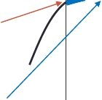

Applications of MATLAB in Engineering
Y.-F. Kuo
25
1
3
𝑥2
𝑥0
𝑓0
ℎ
3
𝑓 𝑥 𝑑𝑥 ≈
𝑓 0 + 4𝑓 1 + 𝑓 2
𝑓1
𝑓2
Parabolic
curve
𝑥0
𝑥1 𝑥2
ℎ
ℎ

Slide 26
Applications of MATLAB in Engineering
Simpson’s Rule
•Example:
Y.-F. Kuo
26
2
0
𝐴 =
4𝑥3 𝑑𝑥 = 𝑥4|2 0 = 2
4
− 0
4
= 16
h = 0.05; x = 0:h:2; y = 4*x.^3;
s = h/3*(y(1)+2*sum(y(3:2:end-2))+...
4*sum(y(2:2:end))+y(end))
• How accurate is it?

Slide 27
Applications of MATLAB in Engineering
Comparison
Y.-F. Kuo
27
Name
Degree
Formula
𝑏
𝑎
(𝑛/2)−1
𝑖=0
Midpoint Rule
0
𝑓 𝑥 𝑑𝑥 =2ℎ
𝑓 𝑥2𝑖+1
𝑏
𝑎
ℎ
2
𝑛−1
𝑖=1
Trapezoid Rule
1
𝑓 𝑥 𝑑𝑥 =
𝑓 𝑎 + 2
𝑓(𝑥𝑖) + 𝑓(𝑏)
𝑏
𝑎
ℎ
3
𝑛 2 −1
𝑖=1
𝑛/2
𝑖=1
Simpson’s Rule
2
𝑓 𝑥 𝑑𝑥 =
𝑓 𝑎 + 2
𝑓 𝑥2𝑖 + 4
𝑓(𝑥2𝑖−1) + 𝑓(𝑏)
Midpoint rule
Trapezoid rule
Simpson’s rule

Slide 28
Applications of MATLAB in Engineering
Y.-F. Kuo
28
Review of Function Handles (@)
• A handle is “a pointer to a function”
• Can be used to pass functions to other functions
• Example:
Pass a function f(x)=sin(x)
to a user-defined function: g(f,…)
f=sin(x)
g(@f,…)

Slide 29
Applications of MATLAB in Engineering
Y.-F. Kuo
29
Function Handles (@) Example
• The input of the following function xy_plot is a
math function:
function [y] = xy_plot(input,x)
% xy_plot receives the handle of a function
% and plots that function of x
y = input(x); plot(x,y,'r--');
xlabel('x');
ylabel('function(x)');
end
• Try: xy_plot(@sin,0:0.01:2*pi);
xy_plot(@cos,0:0.01:2*pi);
xy_plot(@exp,0:0.01:2*pi);

Slide 30
Applications of MATLAB in Engineering
Y.-F. Kuo
30
Numerical Integration: integral()
• Numerical integration on a function from using
global adaptive quadrature and default error
tolerances
2
0
1
𝑥3−2𝑥−5
𝑑𝑥
• Example:
y = @(x) 1./(x.^3-2*x-5);
integral(y,0,2)

Slide 31
Applications of MATLAB in Engineering
Y.-F. Kuo
31
Double and Triple Integrals
𝜋
0
• Example 𝑓 𝑥,𝑦 =
2𝜋
𝜋
(𝑦
∙ sin 𝑥 + 𝑥 ∙ cos(𝑦))𝑑𝑥𝑑𝑦
f = @(x,y) y.*sin(x)+x.*cos(y);
integral2(f,pi,2*pi,0,pi)
1
−1
1
0
• Example: 𝑓 𝑥,𝑦 =
𝜋
0
(𝑦
∙ sin 𝑥 + 𝑧 ∙ cos(𝑦))𝑑𝑥𝑑𝑦𝑑𝑧
f = @(x,y,z) y.*sin(x)+z.*cos(y);
integral3(f,0,pi,0,1,-1,1)

Slide 32

Applications of MATLAB in Engineering
End of Class
Y.-F. Kuo
32

