Slide 1
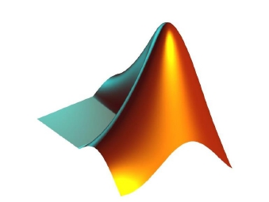
APPLICATIONS OF
MATLAB IN ENGINEERING
Yan-Fu Kuo
Dept. of Bio-industrial Mechatronics Engineering
National Taiwan University
Today:
Fall 2015
•
•
•
Symbolic approach
Numeric root solvers
Recursive functions

Slide 2
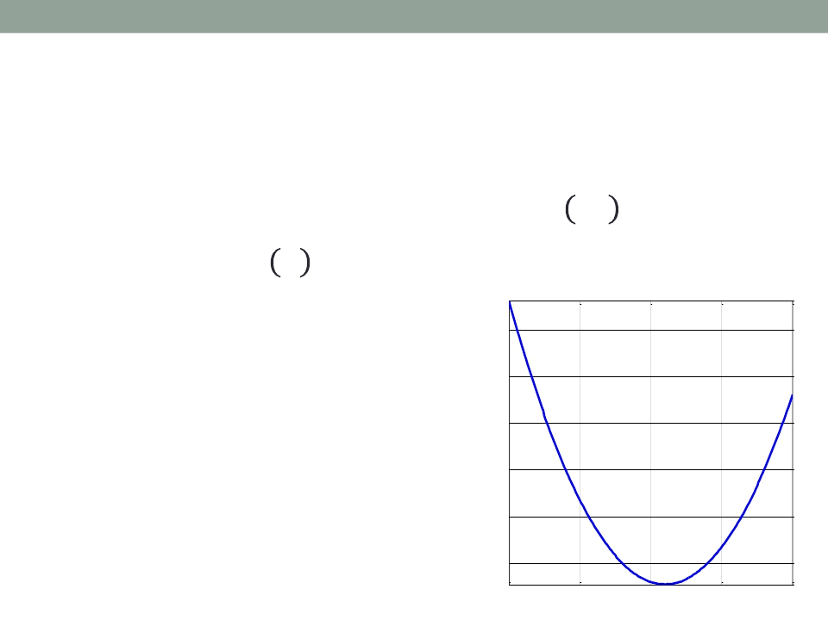
Applications of MATLAB in Engineering
Y.-F. Kuo
2
Problem Statement
• Suppose you have a mathematical function 𝑓(𝑥)
and you want to find 𝑥0 such that 𝑓 𝑥0 = 0, e.g.
𝑓 𝑥 = 𝑥2 − 2𝑥 − 8 = 0
• How do you solve the
100
problem using MATLAB?
80
• Analytical Solutions
60
• Graphical Illustration
40
• Numerical Solutions
20
0
f(x)
-10
-5
0
5
10
x

Slide 3
Applications of MATLAB in Engineering
Y.-F. Kuo
3
Symbolic Root FindingApproach
• Performing mathematics on symbols, NOT numbers
• The symbols math are performed using “symbolic
variables”
• Use sym or syms to create symbolic variables
syms x
x + x + x
(x + x + x)/4
• Define: 𝑦 = 𝑥2 − 2𝑥 − 8
x=sym('x');
x + x + x
(x + x + x)/4

Slide 4
Applications of MATLAB in Engineering
Y.-F. Kuo
4
Symbolic Root Finding: solve()
• Function solve finds roots for equations
𝑦 = 𝑥 ∙ sin(𝑥) − 𝑥 = 0
syms x
solve('x*sin(x)-x', x)
syms x
y = x*sin(x)-x;
solve(y, x)
• Find the roots for:
cos(𝑥)2 − sin(𝑥)2 = 0
and cos(𝑥)2 + sin(𝑥)2 = 0

Slide 5
Applications of MATLAB in Engineering
Y.-F. Kuo
5
Solving Multiple Equations
• Solve this equation using symbolic approach:
𝑥 − 2𝑦 = 5
𝑥 + 𝑦 = 6
syms x y
eq1 = x - 2*y - 5;
eq2 = x + y - 6;
A = solve(eq1,eq2,x,y)

Slide 6
Applications of MATLAB in Engineering
Y.-F. Kuo
6
Solving Equations Expressed in Symbols
• What if we are given a function expressed in
symbols?
𝑎𝑥2 − 𝑏 = 0
syms x a b
solve('a*x^2-b')
• 𝑥 is always the first choice to be solved
• What if one wants to express 𝑏 in terms of 𝑎 and 𝑥?
syms x a b
solve('a*x^2-b', 'b')

Slide 7
Applications of MATLAB in Engineering
Y.-F. Kuo
7
Exercise
• Solve this equation for 𝑥 using symbolic approach
𝑥 − 𝑎
2
+ 𝑦 − 𝑏
2
= 𝑟2
• Find the matrix inverse using symbolic approach
𝑎
𝑐
𝑏
𝑑

Slide 8
Applications of MATLAB in Engineering
Y.-F. Kuo
8
Symbolic Differentiation: diff()
• Calculate the derivative of a symbolic function:
𝑦 = 4𝑥5
syms x
y = 4*x^5;
yprime = diff(y)
• Exercise:
𝑥2
− 𝑥 + 3
𝑒
𝑑𝑓
𝑑𝑥
𝑓 𝑥 =
,
=?
𝑥3
𝑥2 + 𝑥𝑦 − 1
𝑦3 + 𝑥 + 3
𝜕𝑓
𝜕𝑥
𝑔 𝑥 =
,
=?

Slide 9
Applications of MATLAB in Engineering
Y.-F. Kuo
9
Symbolic Integration:
• Calculate the integral of a symbolic function:
𝑧 =
𝑦𝑑𝑥 =
𝑥2𝑒𝑥𝑑𝑥,
𝑧(0) = 0
syms x; y = x^2*exp(x);
z = int(y); z = z-subs(z, x, 0)
• Exercise:
10
0
𝑥2 − 𝑥 + 1
𝑥 + 3
𝑑𝑥

Slide 10
Applications of MATLAB in Engineering
Y.-F. Kuo
10
Symbolic vs. Numeric
Advantages
Disadvantages
Symbolic • Analytical solutions • Sometimes can't be solved
• Lets you intuit things about • Can be overly complicated
solution form
Numeric
• Always get a solution
• Can make solutions
accurate
• Easy to code
• Hard to extract a deeper
understanding

Slide 11
Applications of MATLAB in Engineering
Y.-F. Kuo
11
Review of Function Handles (@)
• A handle is a pointer to a function
• Can be used to pass functions to other functions
• For example, the input of the following function is
another function:
function [y] = xy_plot(input,x)
% xy_plot receives the handle of a function and plots that
% function of x
y = input(x); plot(x,y,'r--');
xlabel('x');
ylabel('function(x)');
end
• Try: xy_plot(@sin,0:0.01:2*pi);

Slide 12
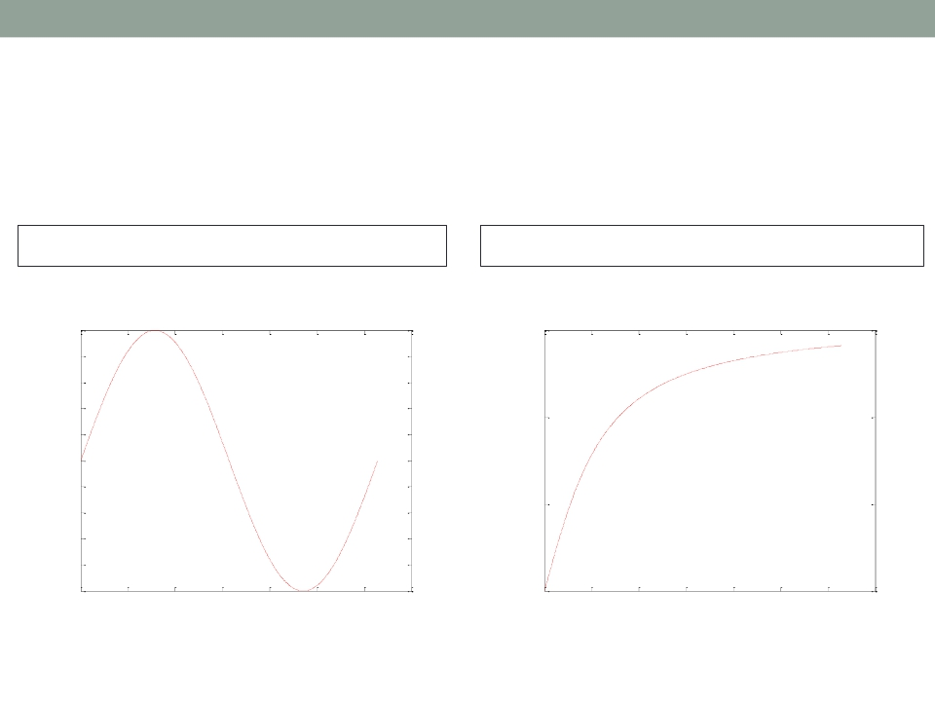
Applications of MATLAB in Engineering
Y.-F. Kuo
12
Using Function Handles
xy_plot(@sin,0:0.01:2*pi);
1
0.8
0.6
0.4
0.2
0
-0.2
-0.4
-0.6
-0.8
xy_plot(@atan,0:0.01:2*pi);
1.5
1
0.5
function(x)
function(x)
-1
0
1
2
3
4
5
6
7
0
0
1
2
3
4
5
6
7
x
x

Slide 13

Applications of MATLAB in Engineering
Y.-F. Kuo
13
fsolve()
• A numeric root solver
• For example, solve this equation:
𝑓 𝑥 = 1.2𝑥 + 0.3 + 𝑥 ∙ sin(𝑥)
f2 = @(x) (1.2*x+0.3+x*sin(x));
fsolve(f2,0)
A function handle
Initial guess

Slide 14
Applications of MATLAB in Engineering
Y.-F. Kuo
14
Exercise
• Find the root for this equation :
2𝑥 − 𝑦 − 𝑒−𝑥
−𝑥 + 2𝑦 − 𝑒−𝑦
𝑓 𝑥,𝑦 =
using initial value 𝑥,𝑦 = (−5,−5)

Slide 15
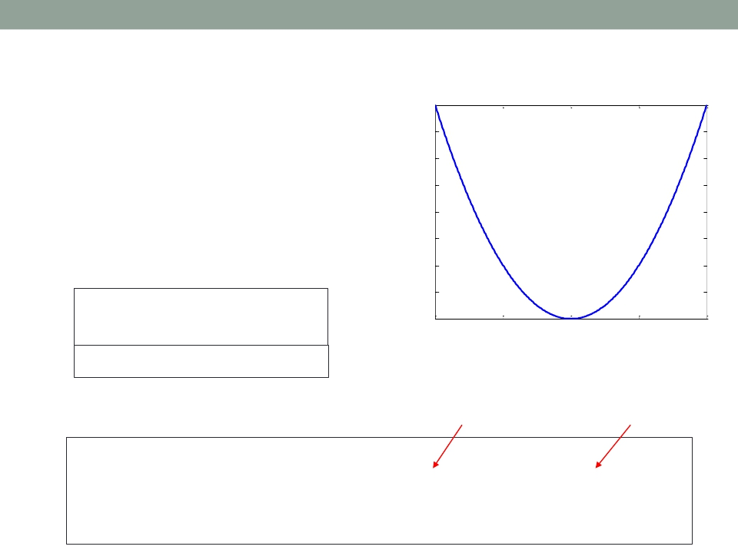
15
Applications of MATLAB in Engineering
fzero()
• Anther numeric root solver
• Find the zero if and only if
the function crosses the
x-axis
f=@(x)x.^2
Y.-F. Kuo
4
3.5
3
2.5
2
1.5
1
0.5
fzero(f,0.1)
0
-2
-1
0
1
2
fsolve(f,0)
• Options:
Number of iterations
Tolerance
f=@(x)x.^2
options=optimset('MaxIter',1e3,'TolFun',1e-10);
fsolve(f,0.1,options)
fzero(f,0.1,options)

Slide 16
Applications of MATLAB in Engineering
Y.-F. Kuo
16
Finding Roots of Polynomials: roots()
• Find the roots of this polynomial:
𝑓(𝑥) = 𝑥5 − 3.5𝑥4 + 2.75𝑥3 + 2.125𝑥2 − 3.875𝑥 + 1.25
roots([1 -3.5 2.75 2.125 -3.875 1.25])
• roots only works for polynomials
• Find the roots of the polynomial:
𝑓 𝑥 = 𝑥3 − 6𝑥2 − 12𝑥 + 81

Slide 17
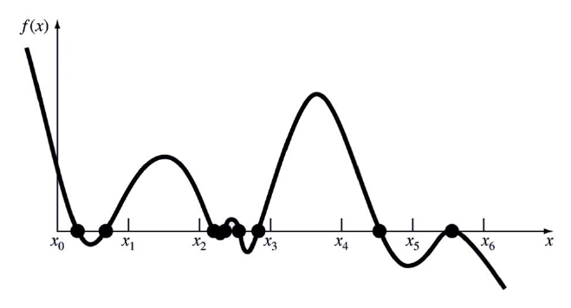
Applications of MATLAB in Engineering
Y.-F. Kuo
17
How Do These Solvers Find the Roots?
• Now we are going to introduce more details of
some numeric methods

Slide 18
Applications of MATLAB in Engineering
Y.-F. Kuo
18
Numeric Root Finding Methods
• Two major types:
• Bracketing methods (e.g., bisection method)
Start with an interval that contains the root
• Open methods (e.g., Newton-Raphson method)
Start with one or more initial guess points
• Roots are found iteratively until some criteria are
satisfied:
• Accuracy
• Number of iteration

Slide 19
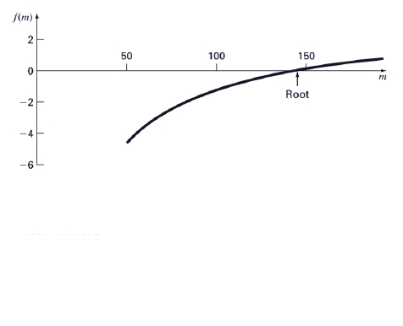
Applications of MATLAB in Engineering
Y.-F. Kuo
19
Bisection Method (Bracketing)
Assumptions:
• 𝑓(𝑥) continuous on [𝑙,𝑢]
• 𝑓(𝑙) ∙ 𝑓(𝑢) < 0
Algorithm:
Loop
1. 𝑟 = (𝑙 + 𝑢)/2
2. If 𝑓(𝑟) ∙ 𝑓(𝑢) < 0 then new interval [𝑟,𝑢]
If 𝑓(𝑙) ∙ 𝑓(𝑟) < 0
End
then new interval [𝑙,𝑟]

Slide 20

Applications of MATLAB in Engineering
Y.-F. Kuo
20
BisectionAlgorithm Flowchart
Start:
Given 𝑙,𝑢
Calculate 𝑓(𝑙) 𝑓(𝑢)
Calculate
𝑟 =
𝑙+𝑢
2
𝑓(𝑟)
no
yes
(𝑢 − 𝑙) < 𝜀
Stop
yes
𝑙 = 𝑟
no
𝑢 = 𝑟
𝑓(𝑟) ∙ 𝑓(𝑢) < 0

Slide 21
Applications of MATLAB in Engineering
Y.-F. Kuo
21
Newton-Raphson Method (Open)
Assumption:
• 𝑓(𝑥) continuous
f(x)
y
• 𝑓′(𝑥) known
f(x0 0)
f(x1 1)
Algorithm:
x2 2
Loop
x
f(x2 2)
x1 1
x0 0
𝑥𝑛+1 = 𝑥𝑛 −
End
𝑓 𝑥𝑛
𝑓′ 𝑥𝑛

Slide 22

Applications of MATLAB in Engineering
Y.-F. Kuo
22
Newton-RaphsonAlgorithm Flowchart
Start:
Given 𝑥0
Calculate 𝑓(𝑥0), 𝑛 = 0
no
Calculate
𝑓 𝑥𝑛
𝑓 𝑥𝑛
𝑛 = 𝑛 + 1
yes
𝑥𝑛+1 = 𝑥𝑛 − ′
𝑓(𝑥0) < 𝜀
Stop

Slide 23
Applications of MATLAB in Engineering
Y.-F. Kuo
23
Bisection vs. Newton-Raphson
Bisection
Newton
•
•
•
•
•
•
•
Reliable
No knowledge of derivative is needed
Slow
One function evaluation per iteration
Needs an interval [a,b] containing the root, f(a)·f(b)<0
Fast but may diverge
Needs derivative and an initial guess x0, f’(x0) is
nonzero

Slide 24
Applications of MATLAB in Engineering
Y.-F. Kuo
24
Recursive Functions
• Functions that call themselves
• Example, factorial of an integer n
𝑛! = 1 × 2 × 3 × ⋯× 𝑛
• A factorial can be defined in terms of another
factorial:
𝑛! = 𝑛 × (𝑛 − 1)!
= 𝑛 × (𝑛 − 1) × (𝑛 − 2)!
= 𝑛 × (𝑛 − 1) × (𝑛 − 2) × (𝑛 − 3)!
= 𝑛 × 𝑛 − 1 × 𝑛 − 2 × ⋯

Slide 25
Applications of MATLAB in Engineering
Y.-F. Kuo
25
Factorial Recursive Function
• The function includes a recursive case and a base
case
• The function stops when it reaches the base case
function output = fact(n)
% fact recursively finds n!
if n==1
output = 1;
else
output = n * fact(n-1);
end
end
Base case
Recursive case

Slide 26

Applications of MATLAB in Engineering
End of Class
Y.-F. Kuo
26

