Slide 1

APPLICATIONS OF
MATLAB IN ENGINEERING
Yan-Fu Kuo
Dept. of Bio-industrial Mechatronics Engineering
National Taiwan University
Today:
Fall 2015
•
•
Linear equation
Linear system

Slide 2
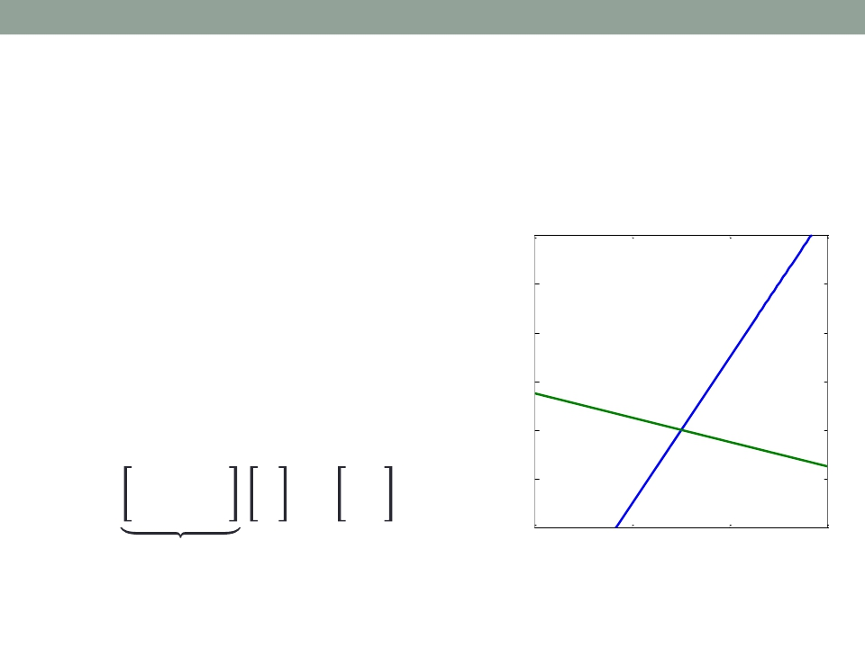
Applications of MATLAB in Engineering
Y.-F. Kuo
2
Linear Equation
• Suppose you are given linear equations:
x = linspace(0,6,100);
3𝑥 − 2𝑦 = 5
𝑥 + 4𝑦 = 11
• Matrix notation:
6
y1 5 = 3/2*x-5/2;
y2 = -1/4*x+11/4;
4
plot(x,y1,x,y2,...
3 'LineWidth',2);
xlim([0, 6]);
ylim([0, 6]);
set( gca, 'FontSize', 14);
2
3 −2 𝑥
𝑦
𝑨 𝒙
axis square;
1
0
0 2
5
11
𝒃
=
1
4
4
6

Slide 3
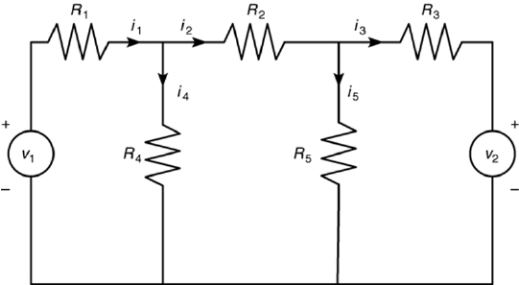
Applications of MATLAB in Engineering
Y.-F. Kuo
3
Why Matrix Form?
• An electrical network:
• 𝑉 1 = 𝑅1𝑖1 + 𝑅4𝑖4
• 𝑅4𝑖4 = 𝑅2𝑖2 + 𝑅5𝑖5
• 𝑅5𝑖5 = 𝑅3𝑖3 + 𝑉2
• 𝑖1 = 𝑖2 + 𝑖4
• 𝑖2 = 𝑖3 + 𝑖5
• Given the voltages 𝑉 1 and 𝑉2 and the resistances 𝑅1 …𝑅5
• Solve the currents 𝑖1 …𝑖5

Slide 4
Applications of MATLAB in Engineering
Y.-F. Kuo
4
Formulation for the Electrical Network
𝑅1
0
0
1
0
0
𝑅2
0
−1
1
0
0
−𝑅3
0
−1
𝑅4
−𝑅4
0
−1
0
0
𝑅5
𝑅5
0
−1
𝑖1 𝑉 1
𝑖2 0
𝑖3 = 𝑉2
𝑖4 0
𝑖5 0
=
𝑨
𝒙
𝒃
• Usually when solving linear equations:
1.
2.
𝑨 and 𝒃 are know
𝒙 is unknown

Slide 5
Applications of MATLAB in Engineering
Y.-F. Kuo
5
Solving Linear Equations
1. Successive elimination (through factorization)
2. Cramer’s method

Slide 6
Applications of MATLAB in Engineering
Gaussian Elimination
• Suppose given:
Y.-F. Kuo
6
𝑥 + 2𝑦 + 𝑧 = 2
1
2 1
2
2𝑥 + 6𝑦 + 𝑧 = 7
𝑥 + 𝑦 + 4𝑧 = 3
⇒ 2
1
6
1
1
4
7
3
1
1
2
2
1
−1
5
2
2
3
5
2
2
2
−1
1
−1
3
2
3
1
⇒
⇒

Slide 7
Applications of MATLAB in Engineering
Y.-F. Kuo
7
Gaussian Elimination – rref()
𝑥 + 2𝑦 + 𝑧 = 2
1
2 1
2
2𝑥 + 6𝑦 + 𝑧 = 7
𝑥 + 𝑦 + 4𝑧 = 3
⇒
2
1
6 1
1 4
7
3
A = [1 2 1;2 6 1;1 1 4];
b = [2; 7; 3];
R = rref([A b])

Slide 8
Applications of MATLAB in Engineering
Y.-F. Kuo
8
LU Factorization
• Suppose we want to solve: 𝑨𝒙 = 𝒃, where 𝑨 ∈ ℜ𝑚×𝑚
• Decompose 𝑨 into 2 triangular matrices: 𝑨 = 𝑳−1𝑼
• The problem become: 𝑨𝒙 = 𝒃
⇒
𝑳−1𝑼𝒙 = 𝒃
𝒚
• Strategies:
1.
2.
Solve 𝑳−1𝒚 = 𝒃 to obtain 𝒚
Then solve 𝑼𝒙 = 𝒚

Slide 9
Applications of MATLAB in Engineering
Y.-F. Kuo
9
Lower and Upper Triangular Matrices
1
• Lower triangular matrix 𝑳 = ⋮
⋮
⋮
• Upper triangular matrix 𝑼 = 0
0
0
⋱
⋯
⋯
⋱
0
0
0 ∈ ℜ𝑚×𝑚
1
⋮
⋮ ∈ ℜ𝑚×𝑚
⋮

Slide 10
Applications of MATLAB in Engineering
Y.-F. Kuo
10
How to Obtain 𝑳 and 𝑼?
• The matrices 𝑳 and 𝑼 are obtained by using a
serious of left-multiplication, i.e.,
𝑳𝑚 …𝑳2𝑳1𝑨 = 𝑼
𝑳

Slide 11
Applications of MATLAB in Engineering
Y.-F. Kuo
11
LU Factorization Example
1
• For example: 𝑨 = 2
4
1
3
6
1
5
8
1
0
0 1
1
1
1
1
1
𝑳1𝑨 = −2 1
−4 0
0 2
1 4
3
6
5 = 0
8 0
1
2
3
4
1
0
0 1
1
1
1
1
1
𝑳2(𝑳1𝑨) = 0
1
0 0
1
3 = 0
1
3 = 𝑼
0 −2 1 0
2
4
0
0 −2

Slide 12
Applications of MATLAB in Engineering
Y.-F. Kuo
12
LU Factorization – lu()
1 1
𝑨 = 2 3
4 6
1
5
8
2
𝒃 = 7
3
A = [1 1 1;2 3 5;4 6 8];
[L, U, P] = lu(A);
𝑳−1𝒚 = 𝒃
𝑼𝒙 = 𝒚
inv(L)
U
• Solving:
1
0
0
2
4
6
8
−.25 1
0 𝒚 = 7
0 −.5
−1 𝒙 = 𝒚
−.5
0
1
3
0
0
1

Slide 13
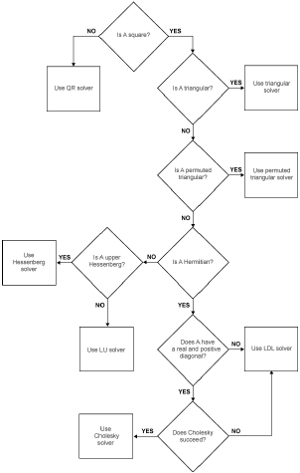
Applications of MATLAB in Engineering
Y.-F. Kuo
13
Matrix Left Division: \ or mldivide()
• Solving systems of linear equations 𝑨𝒙 = 𝒃 using
factorization methods:
𝑥 + 2𝑦 + 𝑧 = 2
2𝑥 + 6𝑦 + 𝑧 = 7
𝑥 + 𝑦 + 4𝑧 = 3
A = [1 2 1;2 6 1;1 1 4];
b = [2; 7; 3];
x = A\b
http://www.mathworks.com/help/matlab/ref/
mldivide.html?searchHighlight=mldivide

Slide 14
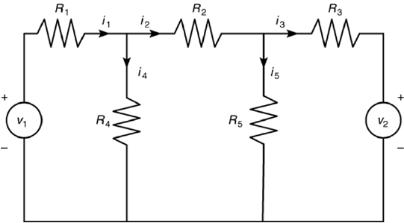
Applications of MATLAB in Engineering
Y.-F. Kuo
14
Exercise
• 𝑉 1 = 𝑅1𝑖1 + 𝑅4𝑖4
• 𝑅4𝑖4 = 𝑅2𝑖2 + 𝑅5𝑖5
• 𝑅5𝑖5 = 𝑅3𝑖3 + 𝑉2
• 𝑖1 = 𝑖2 + 𝑖4
• 𝑖2 = 𝑖3 + 𝑖5
• Write a function to solve 𝑖1 …𝑖5 for given 𝑉 1, 𝑉2, and 𝑅1 …𝑅5

Slide 15
Applications of MATLAB in Engineering
Y.-F. Kuo
15
Matrix Decomposition Functions
qr
ldl
ilu
lu
chol
gsvd
svd
Orthogonal-triangular decomposition
Block LDL' factorization for Hermitian indefinite matrices
Sparse incomplete LU factorization
LU matrix factorization
Cholesky factorization
Generalized singular value decomposition
Singular value decomposition

Slide 16
Applications of MATLAB in Engineering
Y.-F. Kuo
16
Cramer’s (Inverse) Method
• Given the problem:
3 −2 𝑥
𝑦
5
11
=
1
4
𝑨
𝒙
𝒃
• Suppose there exists the 𝑨−1 ∈ ℜ𝑚×𝑚 such that
𝑨𝑨−1 = 𝑨−1𝑨 = 𝑰
• The variable 𝒙 is: 𝒙 = 𝑨−1𝒃

Slide 17
Applications of MATLAB in Engineering
Y.-F. Kuo
17
Inverse Matrix
• For a matrix 𝑨, the inverse is defined as:
−1
1
det 𝑨
1
det(𝑨) −𝑐
−1
𝑎
𝑐
𝑏
𝑑
𝑑
−𝑏
𝑎
𝑨
=
=
𝑎𝑑𝑗(𝑨) =
where det 𝑨 is the determinant:
det 𝑨 = 𝑎𝑑 − 𝑏𝑐
• Properties: 𝑨 = (𝑨−1)−1, (𝑘𝑨)−1= 𝑘−1𝑨−1

Slide 18
Applications of MATLAB in Engineering
Y.-F. Kuo
18
Solving Equations Using Cramer’s Method
• Given equation:
𝑥 + 2𝑦 + 𝑧 = 2
1
2 1
2
2𝑥 + 6𝑦 + 𝑧 = 7
⇒
2
6 1 𝒙 = 7
𝑥 + 𝑦 + 4𝑧 = 3
1
1 4
3
• 𝒙 = 𝑨−1𝒃
A = [1 2 1;2 6 1;1 1 4];
b = [2; 7; 3];
x = inv(A)*b

Slide 19
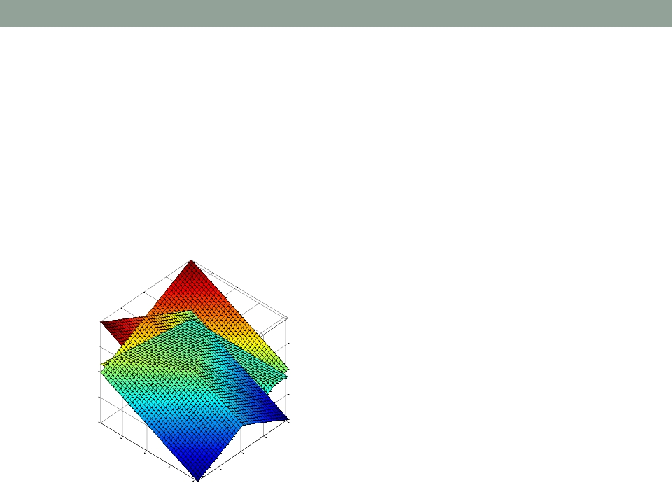
Applications of MATLAB in Engineering
Y.-F. Kuo
19
Exercise
𝑥 + 𝑦 + 𝑧 = 0
• Plot the planes in 3D:
𝑥 − 𝑦 + 𝑧 = 0
𝑥 + 3𝑧 = 0
20
10
0
-10
-20
40
10
30
20
20
30
10
40

Slide 20
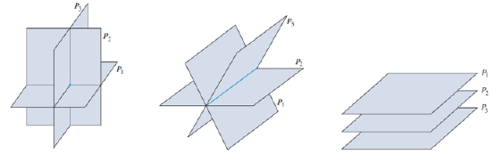
Applications of MATLAB in Engineering
Y.-F. Kuo
20
Singular
• The inverse matrix does not exist
1
9
1
2
4
8
3
3
6
7
2
4
8
6
8
𝑨 = 2
A = [ 1 2 3 4; 2 4 6 8; ...
9 8 7 6; 1 3 2 8];
inv(A)
det(A)

Slide 21
Applications of MATLAB in Engineering
Y.-F. Kuo
21
Problem with Cramer’s Method
• The determinant is zero if the equations are
singular, i.e., det(A)=0
• The accuracy is low when the determinant is very
close to zero, i.e., det(A)~0
• Recall that
1
det 𝑨
𝑨−1
=
𝑎𝑑𝑗(𝑨)

Slide 22
Applications of MATLAB in Engineering
Y.-F. Kuo
22
Functions to Check Matrix Condition
cond
rank
Matrix condition number
Matrix rank
𝑨 =
1 2
2 4.0001
9
8
𝑩 =
1 2
2 5
9 8
3
6
7
3
6
7
• 𝑨𝒙 = 𝒃
• Check the change in 𝒙 if 𝑨 changes by a “small” amount
𝛿𝑨:
||𝛿𝒙||
||𝒙||
||𝛿𝑨||
||𝑨||
< 𝜅(𝑨)
,
where 𝜅(𝑨) is the condition number of 𝑨
• A smaller 𝜅(𝑨) indicate a well-conditioned matrix
A = [ 1 2 3; 2 4.0001 6; 9 8 7];
cond(A)
B = [ 1 2 3; 2 5 6; 9 8 7];
cond(B)

Slide 23
Applications of MATLAB in Engineering
Y.-F. Kuo
23
Linear System
• Suppose you are given linear equations:
2 ∙ 2 − 12 ∙ 4 = 𝑥
1 ∙ 2 − 5 ∙ 4 = 𝑦
• Matrix notation:
3𝑥 − 2𝑦 = 5
𝑥 + 4𝑦 = 11
<Linear equation>
2 𝑥 𝑥
−2 𝑥 5
4 𝑦 = 11
3 −12 2 5
1 −5 4 𝑦 = 𝑦
3
1
4 1
𝑨
𝒃
𝒚
𝑨
𝒙
𝒃
• Note the difference between the two formulation

Slide 24
Applications of MATLAB in Engineering
Y.-F. Kuo
24
Eigenvalues and Eigenvectors
• For a system 𝑨 ∈ ℜ𝑚×𝑚, matrix multiplication
𝒚 = 𝑨𝒃 is complicated
• Want to find vector(s) 𝒗𝑖 ∈ ℜ𝑚 such that
𝑨𝒗𝑖 = 𝜆𝑖𝒗𝑖,
• Then we decompose 𝒃 =
where 𝜆𝑖 ∈ ℜ
𝛼𝑖𝒗𝑖 , 𝛼𝑖 ∈ ℜ
• The multiplication becomes:
𝑨𝒃 =
𝛼𝑖𝑨𝒗𝑖 =
𝛼𝑖𝜆𝑖𝒗𝑖

Slide 25
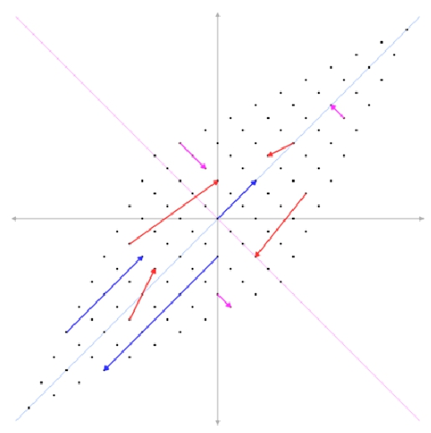
Applications of MATLAB in Engineering
Y.-F. Kuo
25
Interpretation of Eigenvalues and Eigenvectors
𝒚 = 𝑨𝒃
2
1
1
2
𝑨 =
−0.71
0.71
0.71
0.71
𝜆1 = 1, 𝒗1 =
𝜆2 = 3, 𝒗2 =

Slide 26
Applications of MATLAB in Engineering
Y.-F. Kuo
26
Solving Eigenvalues and Eigenvectors
2
1
−12 2
−5 4
• For given 𝑨𝒃 =
0.97
0.24
0.95
0.32
𝜆1𝒗1 = −1
,
𝜆2𝒗2 = −2
𝒃 = 𝛼1𝒗1 + 𝛼2𝒗2 = −41.2𝒗1 + 44.3𝒗2
𝑨𝒃 = 𝑨 𝛼1𝒗1 + 𝛼2𝒗2
= 𝛼1𝑨𝒗1 + 𝛼2𝑨𝒗2 = 𝛼1𝜆1𝒗1 + 𝛼2𝜆2𝒗2
0.97
0.24
0.95
0.32
= −41.2 −1
+ (44.3)(−2)

Slide 27
Applications of MATLAB in Engineering
Y.-F. Kuo
27
eig()
• Find the eigenvalues and eigenvectors:
2
1
−12
−5
𝑨 =
[v,d]=eig([2 -12;1 -5])

Slide 28
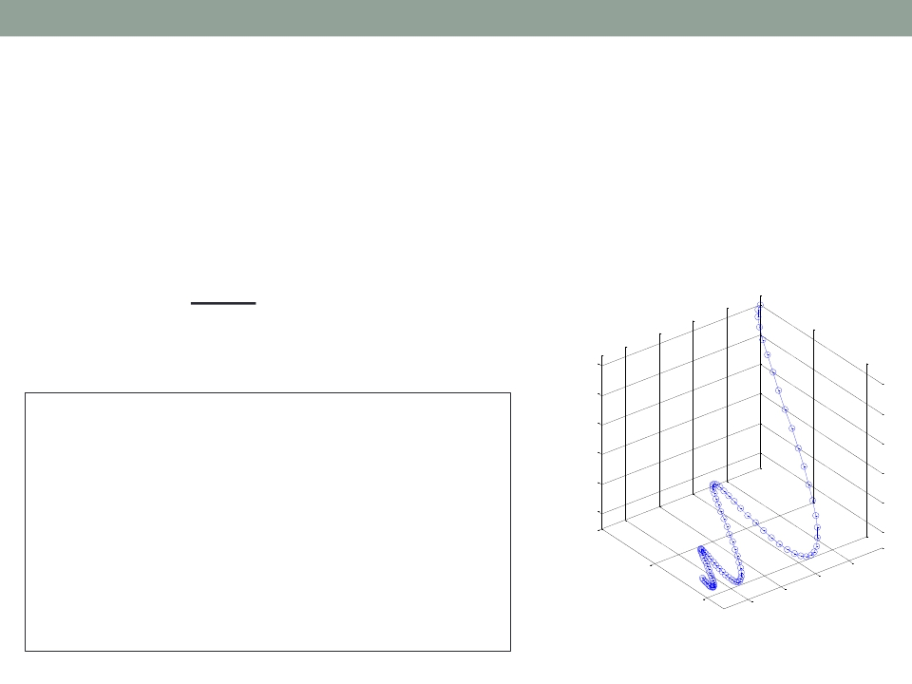
Applications of MATLAB in Engineering
Y.-F. Kuo
28
Matrix Exponential: expm()
• A typical linear time-invariant system is usually
formulated as
𝒚 =
𝑑𝒙(𝑡)
𝑑𝑡
= 𝒙 = 𝑨𝒙
1
0.8
A = [0 -6 -1; 6 2 -16; -5 20 -10];
x0 = [1 1 1]'; X = [];
for t = 0:.01:1
X = [X expm(t*A)*x0];
end
plot3(X(1,:),X(2,:),X(3,:),'-o');
0.6
0.4
0.2
0
1
x3
xlabel('x_1'); ylabel('x_2');
zlabel('x_3'); grid on;
axis tight square;
0.5
x2
0.8
0.4
0.6
0
0.2
x1

Slide 29

Applications of MATLAB in Engineering
End of Class
Y.-F. Kuo
29

