Slide 1

APPLICATIONS OF
MATLAB IN ENGINEERING
Yan-Fu Kuo
Dept. of Bio-industrial Mechatronics Engineering
National Taiwan University
Today:
Fall 2015
•
Statistics

Slide 2

Applications of MATLAB in Engineering
Y.-F. Kuo
2
USAGasoline Prices from 1984 to 2004
Jan
Feb
Mar
Apr
May
Jun
Jul
Aug
Sep
Oct
Nov
Dec
1984
1985
1986
1987
1988
1989
1990
1991
1992
1993
1994
1995
1996
1997
1998
1999
2000
2001
2002
2003
1.216
1.148
1.194
0.862
0.933
0.918
1.042
1.247
1.073
1.117
1.043
1.129
1.129
1.261
1.131
0.972
1.301
1.472
1.139
1.473
1.209
1.131
1.12
0.905
0.913
0.926
1.037
1.143
1.054
1.108
1.051
1.12
1.124
1.255
1.082
0.955
1.369
1.484
1.13
1.641
1.21
1.159
0.981
0.912
0.904
0.94
1.023
1.082
1.058
1.098
1.045
1.115
1.162
1.235
1.041
0.991
1.541
1.447
1.241
1.748
1.227
1.205
0.888
0.934
0.93
1.065
1.044
1.104
1.079
1.112
1.064
1.14
1.251
1.231
1.052
1.177
1.506
1.564
1.407
1.659
1.236
1.231
0.923
0.941
0.955
1.119
1.061
1.156
1.136
1.129
1.08
1.2
1.323
1.226
1.092
1.178
1.498
1.729
1.421
1.542
1.229
1.241
0.955
0.958
0.955
1.114
1.088
1.16
1.179
1.13
1.106
1.226
1.299
1.229
1.094
1.148
1.617
1.64
1.404
1.514
1.212
1.242
0.89
0.971
0.967
1.092
1.084
1.127
1.174
1.109
1.136
1.195
1.272
1.205
1.079
1.189
1.593
1.482
1.412
1.524
1.196
1.229
0.843
0.995
0.987
1.057
1.19
1.14
1.158
1.097
1.182
1.164
1.24
1.253
1.052
1.255
1.51
1.427
1.423
1.628
1.203
1.216
0.86
0.99
0.974
1.029
1.294
1.143
1.158
1.085
1.177
1.148
1.234
1.277
1.033
1.28
1.582
1.531
1.422
1.728
1.209
1.204
0.831
0.976
0.957
1.027
1.378
1.122
1.154
1.127
1.152
1.127
1.227
1.242
1.042
1.274
1.559
1.362
1.449
1.603
1.207
1.207
0.821
0.976
0.949
0.999
1.377
1.134
1.159
1.113
1.163
1.101
1.25
1.213
1.028
1.264
1.555
1.263
1.448
1.535
1.193
1.208
0.823
0.961
0.93
0.98
1.354
1.123
1.136
1.07
1.143
1.101
1.26
1.177
0.986
1.298
1.489
1.131
1.394
1.494

Slide 3
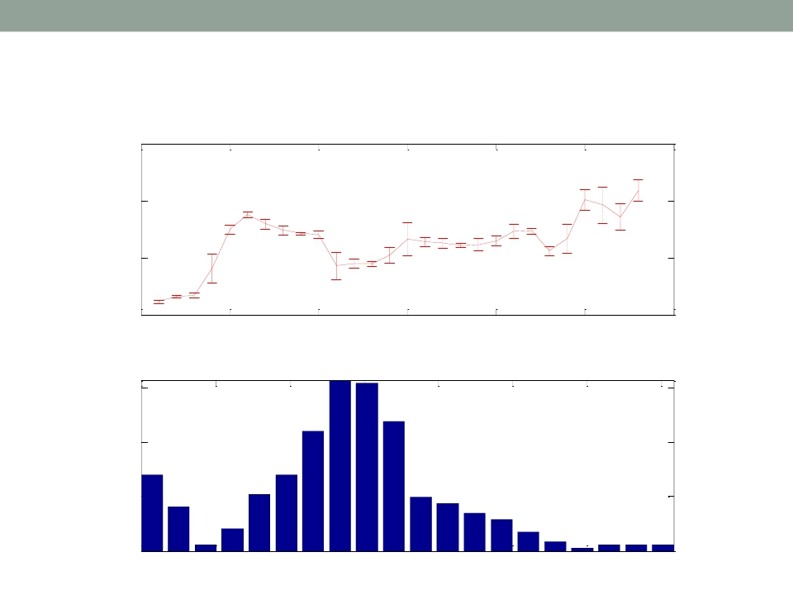
Applications of MATLAB in Engineering
Y.-F. Kuo
3
USAGasoline Prices from 1984 to 2004
Gas Price
2
1.5
1
$/Gallon
0.5
1975
1980
1985
1990
1995
2000
2005
Year
Monthly Price Distribution
0.15
0.1
0.05
Fraction
0
0.6
0.8
1
1.2
1.4
1.6
1.8
2
$/Gallon

Slide 4
Applications of MATLAB in Engineering
Y.-F. Kuo
4
Statistics
• The science of “data”
• Involving the collection, analysis, interpretation,
presentation, and organization of data

Slide 5
Applications of MATLAB in Engineering
Y.-F. Kuo
5
Main Statistical Methodologies
Statistics
Descriptive
Statistics
Numerical and graphical
methods to look for
patterns, to summarize the
information in a data set
Inferential
Statistics

Slide 6
Y.-F. Kuo
6
Applications of MATLAB in Engineering
Summary Measures
Summary
Measures
Quartile
Central Tendency
Variation
Mean
Median
Mode
Range
Variance
Standard
Deviation

Slide 7
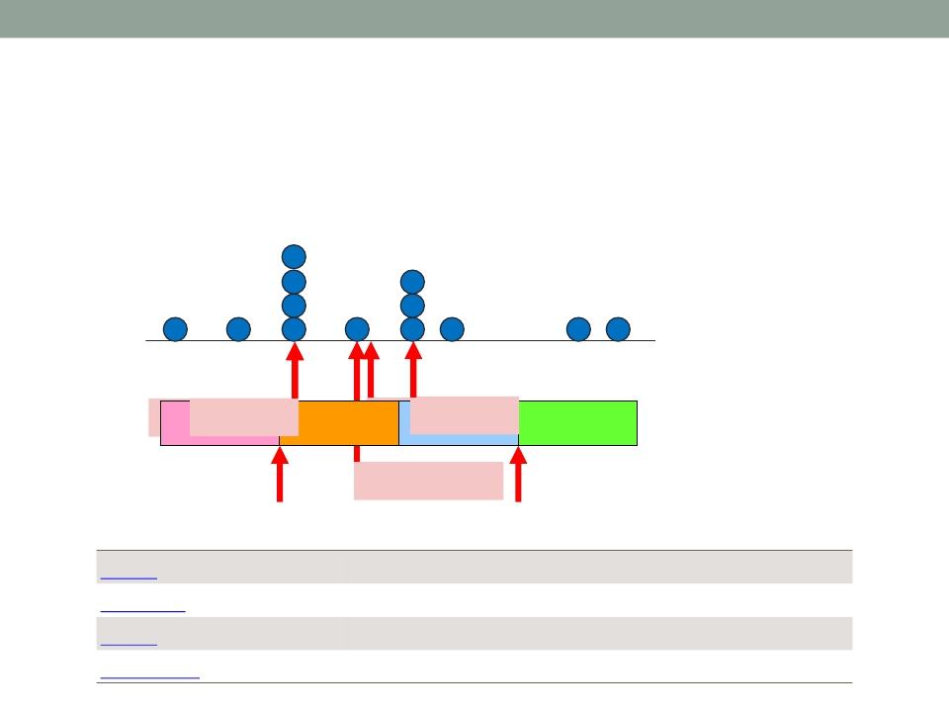
Applications of MATLAB in Engineering
Y.-F. Kuo
7
Mean, Median, Mode, and Quartile
• Suppose we have samples:
1 2 3 4 5 6 7 8 9 10 11 12 13 14
𝑞
25% Mean 𝑞3 25%
Mode 1 =5 5
9
25%
==7.31
Median = 7
25%
𝑞1
𝑞3
Average or mean value of array
Median value of array
Most frequent values in array
Percentiles of a data set
mean
median
mode
prctile

Slide 8
Applications of MATLAB in Engineering
Y.-F. Kuo
8
Range and Interquartile Range
• Suppose we have samples:
1 2 3 4 5 6 7 8 9 10 11 12 13 14
𝑞1 = 5
𝑞3 = 9
Range = 13
Interquartile Range = 4
max
min
Largest elements in array
Smallest elements in array

Slide 9
Applications of MATLAB in Engineering
Y.-F. Kuo
9
Variance and Standard Deviation
• Suppose we have samples:
1 2 3 4 5 6 7 8 9 10 11 12 13 14
(𝑥𝑖−𝑥)2
𝑛−1
• Variance: 𝑠 =
= 14.3974
(𝑥𝑖−𝑥)2
𝑛−1
• Standard deviation: 𝑠 =
= 3.7944
std
var
Standard deviation
Variance

Slide 10
Applications of MATLAB in Engineering
Y.-F. Kuo
10
Exercise
• Find the following properties of the variable x4
1. Mean, median, mode, and quartile
2. Range and interquartile range
3. Variance and standard deviation
load stockreturns;
x4 = stocks(:,4);

Slide 11
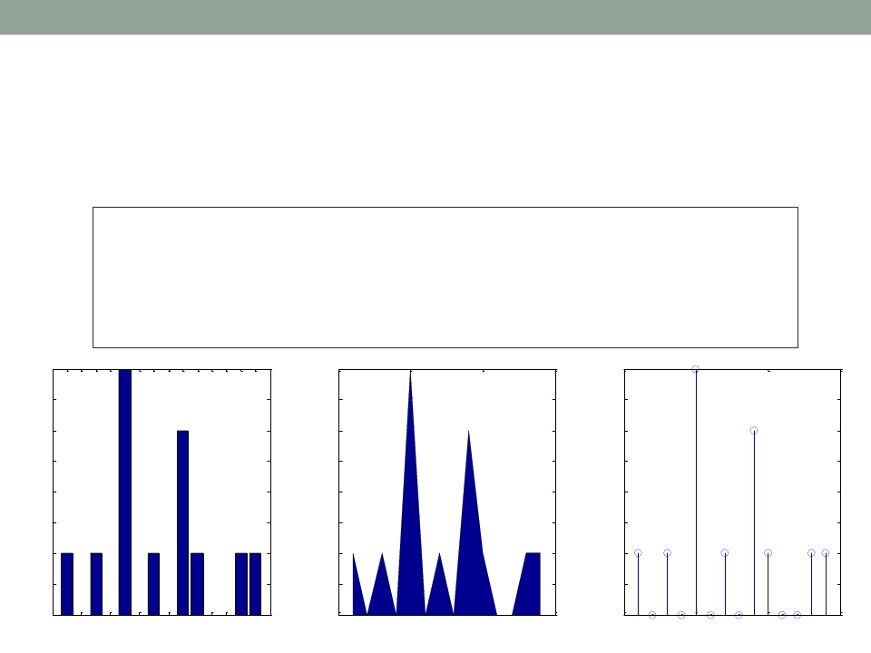
Applications of MATLAB in Engineering
Y.-F. Kuo
11
FiguresAreAlways More Powerful
• Suppose we have samples:
x = 1:14;
freqy = [1 0 1 0
4 0 1 0 3 1 0 0 1 1];
subplot(1,3,1);
subplot(1,3,2);
bar(x,freqy);
area(x,freqy);
xlim([0 15]);
xlim([0 15]);
subplot(1,3,3);6
stem(x,freqy); xlim([0 15]);
2 4 5
7 13 14 8 9 10 11 12
4
3.5
3
2.5
2
1.5
1
0.5
4
3.5
3
2.5
2
1.5
1
0.5
4
3.5
3
2.5
2
1.5
1
0.5
0
1 2 3 4 5 6 7 8 91011121314
0
0
5
10
15
0
0
5
10
15

Slide 12
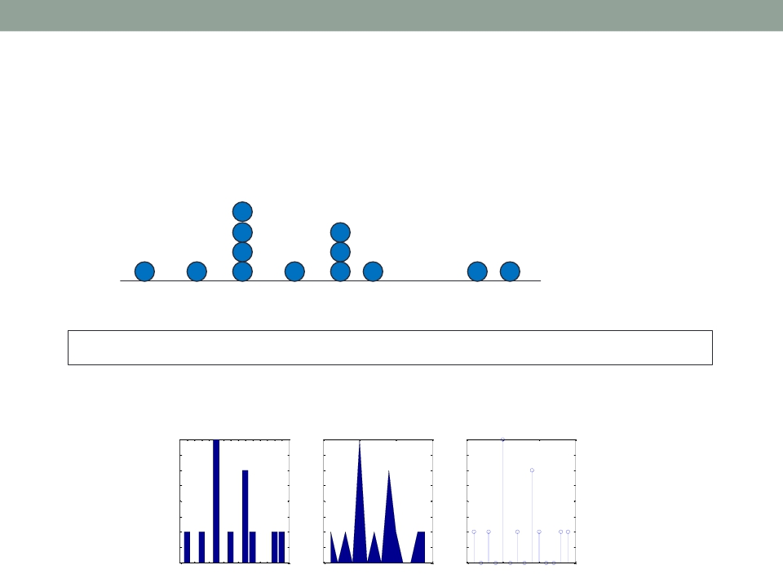
Applications of MATLAB in Engineering
Y.-F. Kuo
12
Exercise
• Suppose we are given the samples:
1 2 3 4 5 6 7 8 9 10 11 12 13 14
x = [1 3 5 5 5 5 7 9 9 9 10 13 14];
• Plot the histograms:
4
3.5
3
2.5
2
1.5
1
0.5
4
3.5
3
2.5
2
1.5
1
0.5
4
3.5
3
2.5
2
1.5
1
0.5
0
1 2 3 4 5 6 7 8 91011121314
0
0
5
10
15
0
0
5
10
15

Slide 13
Applications of MATLAB in Engineering
Y.-F. Kuo
13
Boxplot
• Suppose we are given the samples:
1 2 3 4 5 6 7 8 9 10 11 12 13 14
25%
25%
25%
25%
𝑚𝑖𝑛
𝑞1
𝑞1
𝑞3
𝑚𝑎𝑥

Slide 14
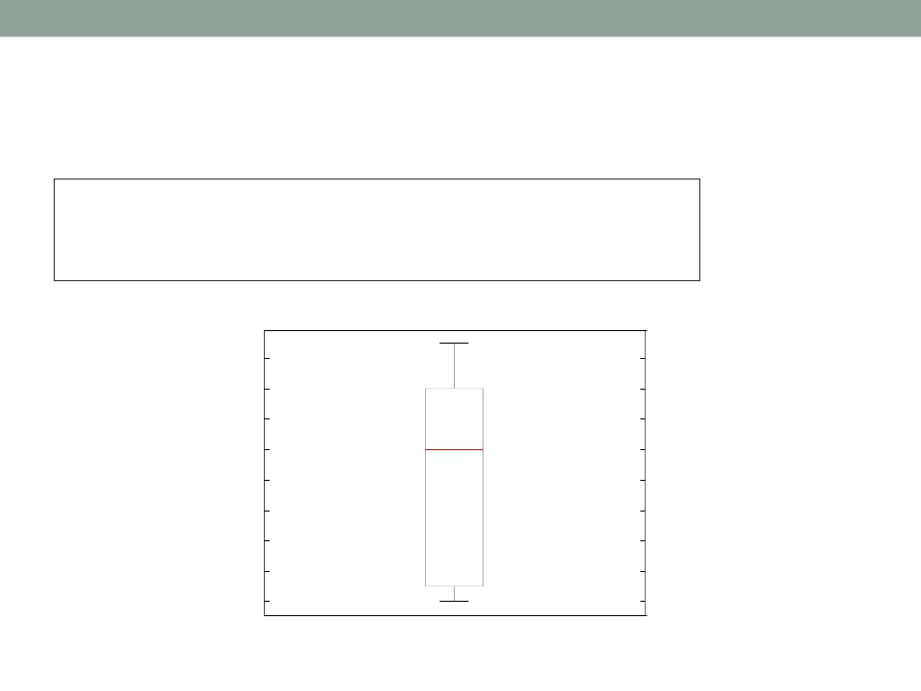
Applications of MATLAB in Engineering
Y.-F. Kuo
14
Boxplot Example
marks = [80 81 81 84 88 92 92 94 96 97];
boxplot(marks)
prctile(marks, [25 50 75])
96
94
92
90
88
86
84
82
80
1

Slide 15
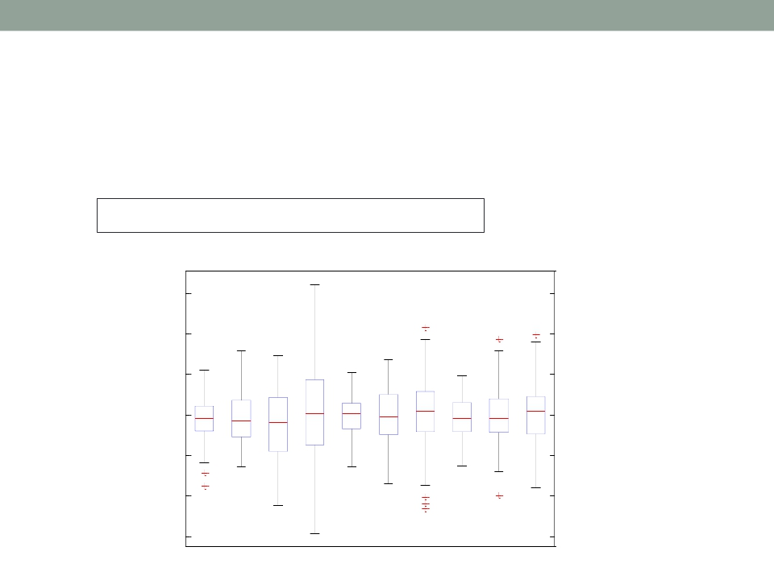
Applications of MATLAB in Engineering
Y.-F. Kuo
15
Exercise
• Plot the boxplot of the variable stocks
load stockreturns;
6
4
2
0
-2
-4
-6
1
2
3
4
5
6
7
8
9
10

Slide 16
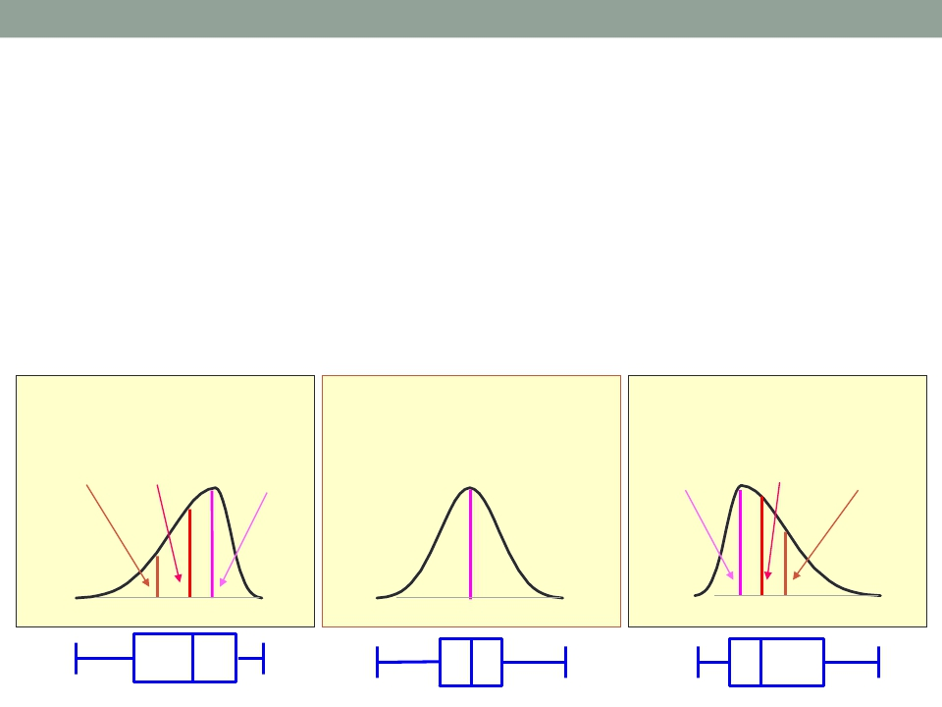
Applications of MATLAB in Engineering
Y.-F. Kuo
16
Skewness
• A measure of distribution skewness
• Left-skewed: skewness < 0
• Right-skewed: skewness > 0
Left-Skewed
Mean < Median < Mode
Symmetric
Mean = Median =Mode
Right-Skewed
Mode < Median < Mean

Slide 17
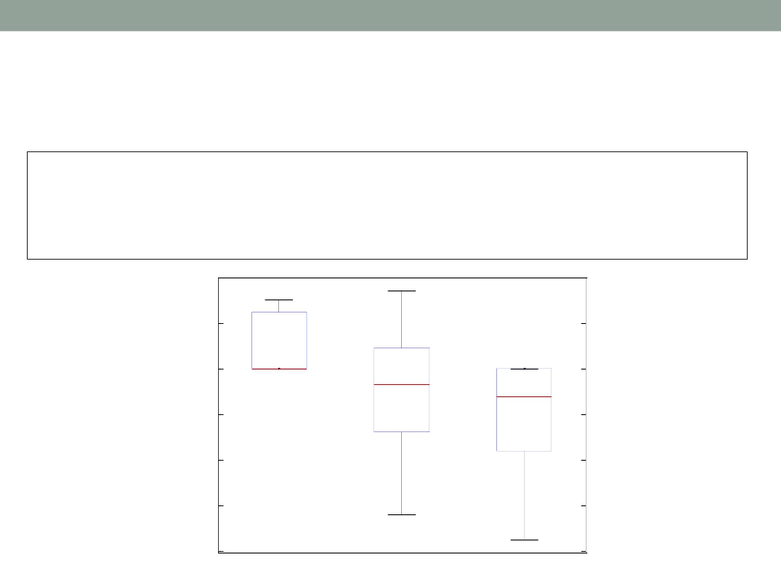
Applications of MATLAB in Engineering
Y.-F. Kuo
17
Skewness: skewness()
X = randn([10 3])*3;
X(X(:,1)<0, 1) = 0; X(X(:,3)>0, 3) = 0;
boxplot(X, {'Right-skewed', 'Symmetric', 'Left-skewed'});
y = skewness(X)
2
0
-2
-4
-6
-8
Right-skewed
Symmetric
Left-skewed

Slide 18
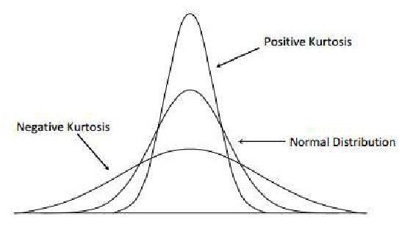
Applications of MATLAB in Engineering
Y.-F. Kuo
18
Kurtosis
• A measure of distribution flatness
• A kurtosis of a normal distribution is zero
• Positive Kurtosis: more acute peak
• Negative Kurtosis: more flat peak

Slide 19
Applications of MATLAB in Engineering
Y.-F. Kuo
19
Exercise
• Find the skewness and kurtosis for each column
of the variable stocks
load stockreturns;

Slide 20
Applications of MATLAB in Engineering
Y.-F. Kuo
20
Main Statistical Methodologies
Statistics
Descriptive
Statistics
Inferential
Statistics
Methods to make
estimates, decisions, and
predictions using sample
data

Slide 21
Applications of MATLAB in Engineering
Y.-F. Kuo
21
Statistical Hypothesis Testing
• A method of making decisions using data
• Example: Am I going to get grade A in this class?
• Typical hypothesis:
• 𝐻0: 𝜃 = 𝜃0
• 𝐻0: 𝜃 ≥ 𝜃0
• 𝐻0: 𝜃 ≤ 𝜃0
𝑣.𝑠.
𝑣.𝑠.
𝑣.𝑠.
𝐻1 :𝜃 ≠ 𝜃0
𝐻1 :𝜃 < 𝜃0
𝐻1 :𝜃 > 𝜃0
where 𝐻0 is null hypothesis, and 𝐻1 is alternative
hypothesis

Slide 22
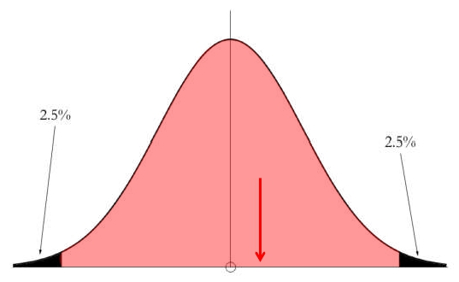
Applications of MATLAB in Engineering
Y.-F. Kuo
22
Hypothesis Testing Procedure
• Determine a probability, say 0.95, for the hypothesis test
• Find the 95% “confidence Interval” of the 𝐻0
• Check if your score falls into the interval
93.7
92

Slide 23
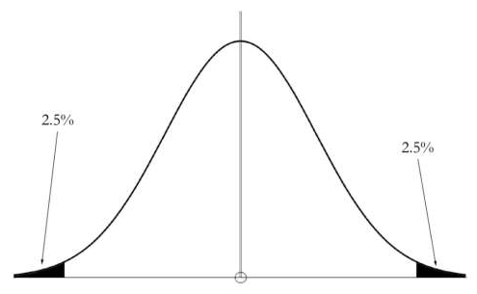
Applications of MATLAB in Engineering
Y.-F. Kuo
23
Terminology in Hypothesis Testing
• Determine a probability, say 0.95, for the hypothesis test
• Find the 95% “confidence Interval” of the 𝐻0
• Check if your score falls into the interval
• Terminology:
• Confidence interval
• Confidence level (1 − 𝛼)
• Significance level 𝛼
• p-value

Slide 24
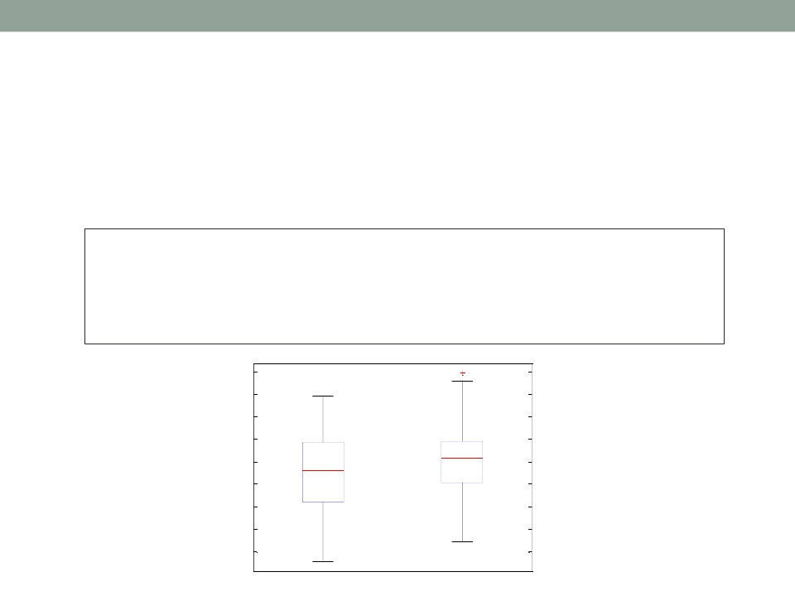
Applications of MATLAB in Engineering
Y.-F. Kuo
24
t-test Example
• Are means of the two stock returns (#3 and #10)
the same?
load stockreturns;
x1 = stocks(:,3); x2 = stocks(:,10);
boxplot([x1, x2], {'3', '10'});
[h,p] = ttest2(x1, x2)
4
3
2
1
0
-1
-2
-3
-4
3
10

Slide 25
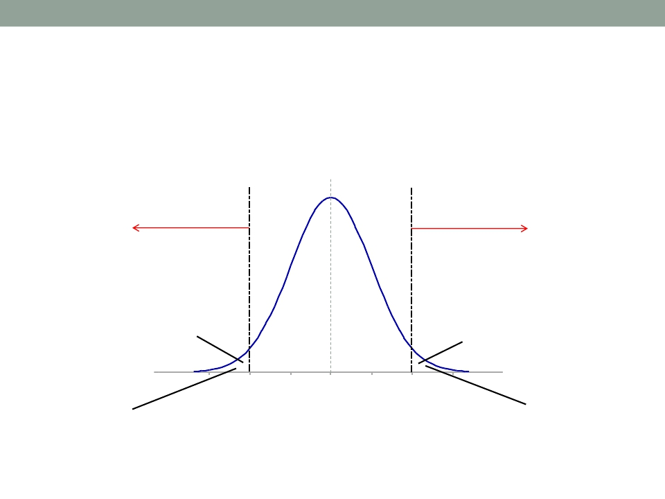
Applications of MATLAB in Engineering
Y.-F. Kuo
25
Two-tailed Significance Test
• Using a 5% significance level
µ
Reject 𝐻0
Reject 𝐻0
2.5%
Lower critical
region
95%
2.5%
Upper critical
region

Slide 26
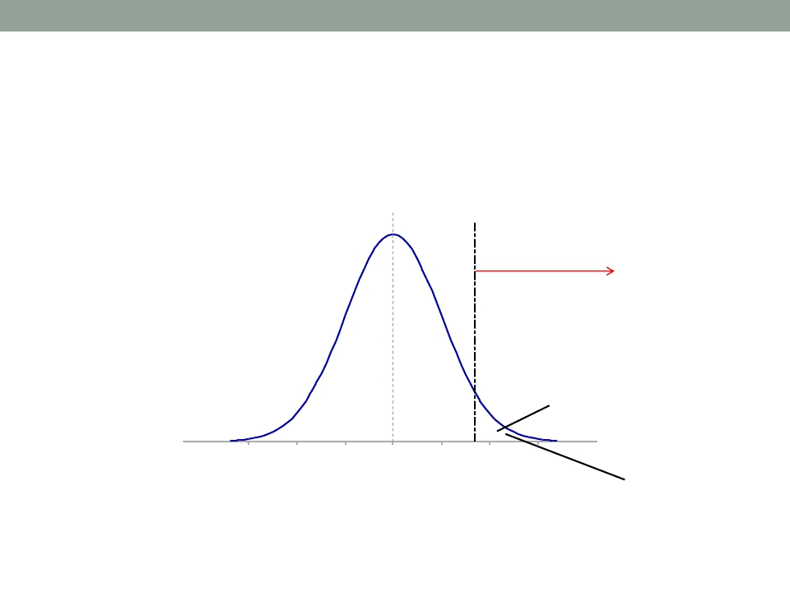
Applications of MATLAB in Engineering
Y.-F. Kuo
26
One-tailed Significance Test
• Using a 5% significance level
µ
Reject 𝐻0
95%
5%
Upper critical
region

Slide 27
Applications of MATLAB in Engineering
Y.-F. Kuo
27
Common Hypothesis Tests
More than
two groups
Paired data
Unpaired data
Parametric
• z-test
• t-test
• two-sample t-
test
• Analysis of
variance
(ANOVA)
Non-parametric • Sign test
• Wilcoxon
signed-rank
test
• Wilcoxon
rank-sum test
ranksum()
signrank()
ttest()
ttest2()
ztest()
Wilcoxon rank sum test
Wilcoxon signed rank test
One-sample and paired-sample t-test
Two-sample t-test
z-test

Slide 28

Applications of MATLAB in Engineering
End of Class
Y.-F. Kuo
28

