Slide 1
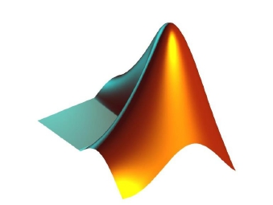
APPLICATIONS OF
MATLAB IN ENGINEERING
Yan-Fu Kuo
Dept. of Bio-industrial Mechatronics Engineering
National Taiwan University
Today:
Fall 2015
•
•
•
Polynomial curve fitting
Multiple regression
Interpolation

Slide 2
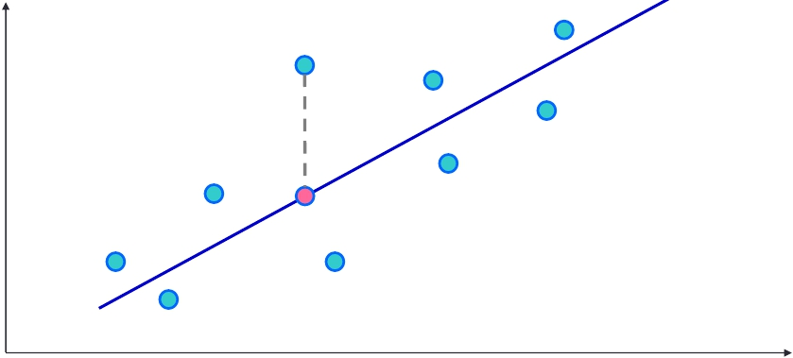
Applications of MATLAB in Engineering
Y.-F. Kuo
2
Simple Linear Regression
• A bunch of data points (𝑥𝑖,𝑦𝑖) are collected
• Assume 𝑥 and 𝑦 are linearly correlated
𝑦
(𝑥𝑖,𝑦𝑖)
𝑦𝑖 = 𝛽0 + 𝛽1𝑥𝑖
𝜖𝑖
(𝑥𝑖,𝑦𝑖)
𝑥

Slide 3
Applications of MATLAB in Engineering
Y.-F. Kuo
3
Linear Regression Formulation
• Define sum of squared errors (𝑆𝑆𝐸):
𝑆𝑆𝐸 =
𝜖𝑖2 =
(𝑦𝑖 − 𝑦𝑖)2
𝑖
𝑖
• Given that the regression model: 𝑦𝑖 = 𝛽0 + 𝛽1𝑥𝑖,
𝑆𝑆𝐸 =
(𝑦𝑖 − 𝛽0 − 𝛽1𝑥𝑖)2
𝑖
• What variables are known and what are
unknown?
• How do we obtain the optimal parameters?

Slide 4
Applications of MATLAB in Engineering
Y.-F. Kuo
4
Solving Least-squares Problem
• 𝑆𝑆𝐸 is minimized when its gradient with respect to
each parameter is equal to zero:
𝜕 𝑖𝜖𝑖2
= −2
= −2
𝑦𝑖 − 𝛽0 − 𝛽1𝑥𝑖 = 0
𝑦𝑖 − 𝛽0 − 𝛽1𝑥𝑖 𝑥𝑖 = 0
𝜕𝛽0
𝑖
𝜕 𝑖𝜖𝑖2
𝜕𝛽1
𝑖

Slide 5
Applications of MATLAB in Engineering
Y.-F. Kuo
5
Least-squares Solution
• Suppose there exists 𝑁 data points:
𝑁
𝑖=1
𝑁
𝑖=1
𝑦𝑖 = 𝛽0 ∙ 𝑁 + 𝛽1
𝑥𝑖
𝑁
𝑖=1
𝑁
𝑖=1
𝑁
𝑖=1
𝑦𝑖𝑥𝑖 = 𝛽0
𝑥𝑖 + 𝛽1
𝑥𝑖2
𝑦𝑖
𝑦𝑖𝑥𝑖
𝑁
𝑥𝑖
𝑥𝑖
𝑥𝑖2
𝛽0
𝛽1
⇒
=

Slide 6
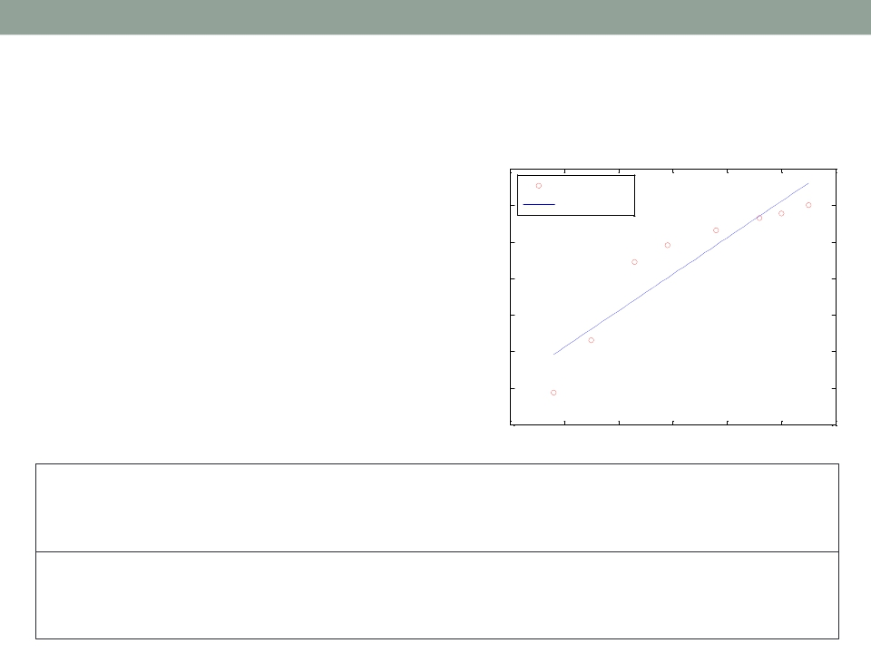
Applications of MATLAB in Engineering
Y.-F. Kuo
6
Polynomial Curve Fitting: polyfit()
• Curve fitting for
polynomials of
different orders
15
10
5
0
-5
-10
-15
data points
best-fit
-20
-2
-1
0
1
2
3
4
x =[-1.2 -0.5 0.3 0.9 1.8 2.6 3.0 3.5];
y =[-15.6 -8.5 2.2 4.5 6.6 8.2 8.9 10.0];
fit = polyfit(x,y,1);
xfit = [x(1):0.1:x(end)];
plot(x,y,'ro',xfit,yfit);
yfit = fit(1)*xfit + fit(2);
set(gca,'FontSize',14);
legend(2,'data points','best-fit');

Slide 7
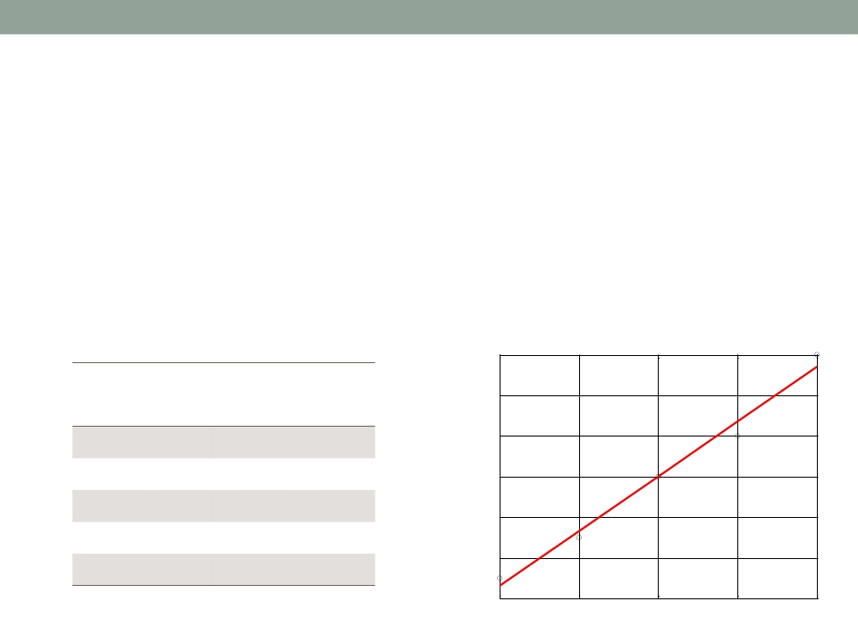
Applications of MATLAB in Engineering
Y.-F. Kuo
7
Exercise
• Given the table below:
1. Find the 𝛽0 and 𝛽1 of the regression line
2. Plot the figure
Calibration of TC
0.08
TC Output Temperature
(mV) (oC)
0.07
0.025
0.035
0.050
0.060
0.080
20
30
40
50
60
0.06
0.05
0.04
0.03
TC output (mV)
0.02
20
30
40
50
60
Temperature (oC)

Slide 8
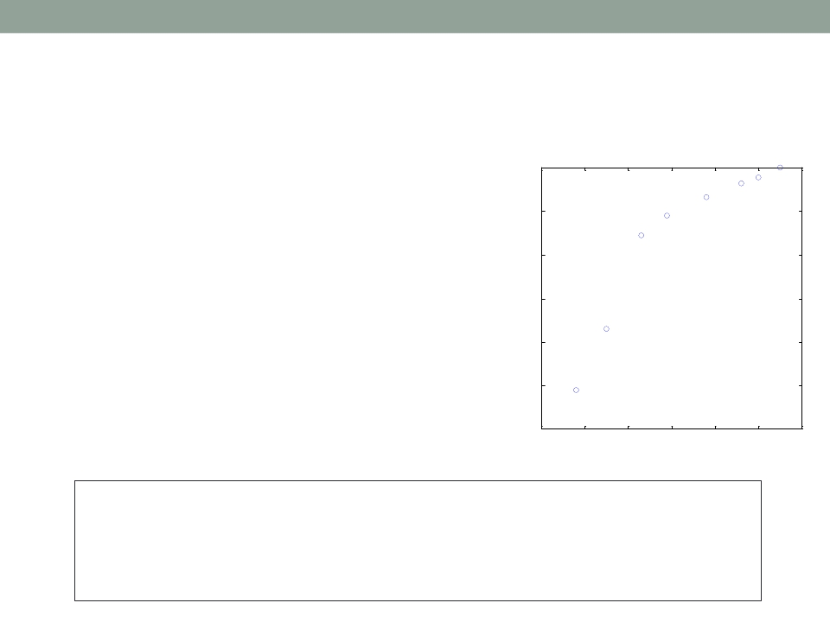
Applications of MATLAB in Engineering
Y.-F. Kuo
8
Are 𝑥 and 𝑦 Linearly Correlated?
• If not, the line may not well
describe their relationship
• Check the linearity by using
• scatter(): scatterplot
10
5
0
-5
-10
• corrcoef(): correlation
coefficient, −1 ≤ 𝑟 ≤ 1
-15
-20
-2
-1
0
1
2
3
4
x =[-1.2 -0.5 0.3 0.9 1.8 2.6 3.0 3.5];
y =[-15.6 -8.5 2.2 4.5 6.6 8.2 8.9 10.0];
scatter(x,y);
corrcoef(x,y)
box on; axis square;

Slide 9
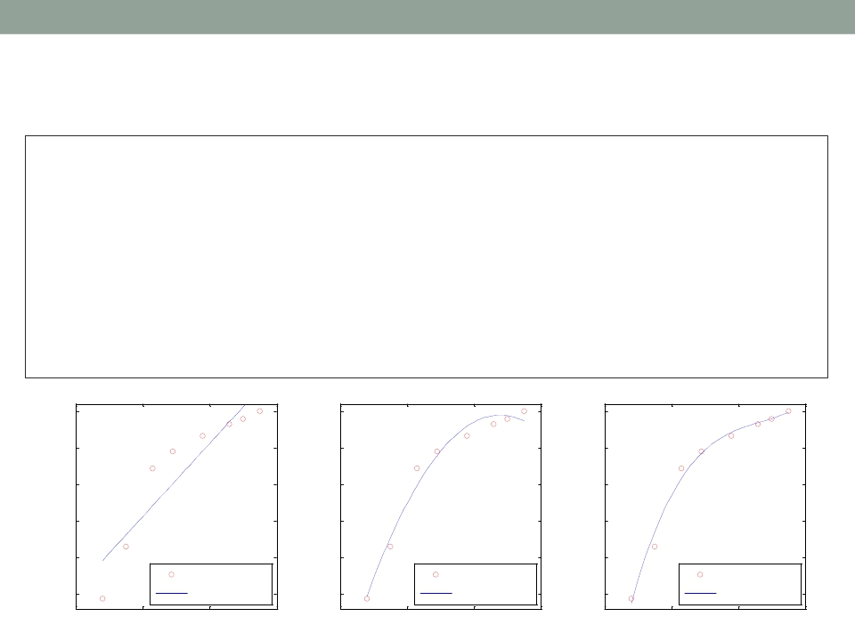
Applications of MATLAB in Engineering
Y.-F. Kuo
9
Higher Order Polynomials
x =[-1.2 -0.5 0.3 0.9 1.8 2.6 3.0 3.5];
y =[-15.6 -8.5 2.2 4.5 6.6 8.2 8.9 10.0];
figure('Position', [50 50 1500 400]);
for i=1:3
subplot(1,3,i); p = polyfit(x,y,i);
xfit = x(1):0.1:x(end);
yfit = polyval(p,xfit);
plot(x,y,'ro',xfit,yfit);
set(gca,'FontSize',14);
ylim([-17, 11]); legend(4,'Data points','Fitted curve');
end
10
5
0
-5
-10
10
5
0
-5
-10
10
5
0
-5
-10
Data points
Data points
Data points
-15
Fitted curve
-15
Fitted curve
-15
Fitted curve
-2
0
2
4
-2
0
2
4
-2
0
2
4

Slide 10
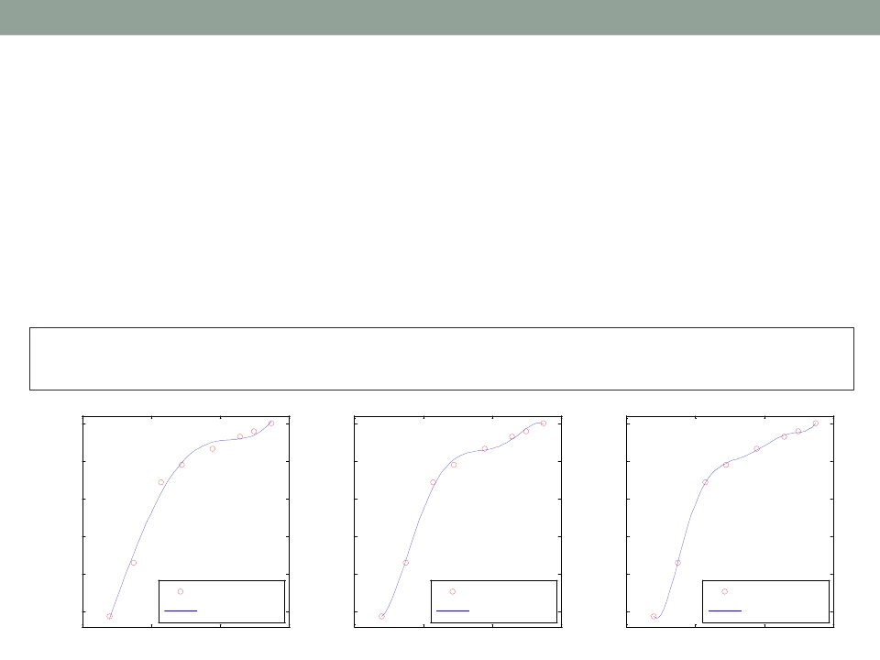
Applications of MATLAB in Engineering
Y.-F. Kuo
10
Exercise
• Find the 4th, 5th, and 6th-order polynomials
• Is it better to use higher order polynomials?
• What if using 7th-order polynomials?
x =[-1.2 -0.5 0.3 0.9 1.8 2.6 3.0 3.5];
y =[-15.6 -8.5 2.2 4.5 6.6 8.2 8.9 10.0];
10
5
0
-5
-10
10
5
0
-5
-10
10
5
0
-5
-10
Data points
Data points
Data points
-15
Fitted curve
-15
Fitted curve
-15
Fitted curve
-2
0
2
4
-2
0
2
4
-2
0
2
4

Slide 11
Applications of MATLAB in Engineering
Y.-F. Kuo
11
What If There Exists More Variables?
• Equations associated with more than one
explanatory variables:
𝑦 = 𝛽0 + 𝛽1𝑥1 + 𝛽2𝑥2
• Multiple linear regression: regress()
• Note: the function gives you more statistics (e.g.,
𝑅2) of the regression model

Slide 12
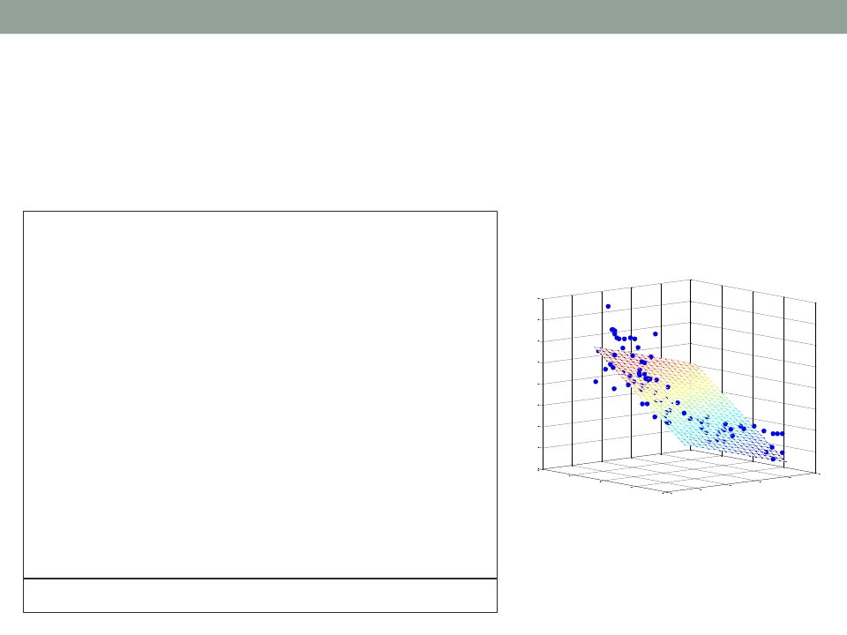
Applications of MATLAB in Engineering
Y.-F. Kuo
12
Multiple Linear Regression: regress()
• How to obtain the coefficient of determination 𝑅2?
load carsmall;
y = MPG;
x1 = Weight; x2 = Horsepower;
X = [ones(length(x1),1) x1 x2];
b = regress(y,X);
x1fit = min(x1):100:max(x1);
x2fit = min(x2):10:max(x2);
[X1FIT,X2FIT]=meshgrid(x1fit,x2fit);
YFIT=b(1)+b(2)*X1FIT+b(3)*X2FIT;
45
40
35
30
25
20
15
MPG
scatter3(x1,x2,y,'filled'); hold on;
mesh(X1FIT,X2FIT,YFIT); hold off;
xlabel('Weight');
ylabel('Horsepower');
10
5
1000
2000
3000
4000
Weight
150
Horsepower
200
250
5000
0
50
100
zlabel('MPG'); view(50,10);
[b,bint,r,rint,stats]=regress(y,X);

Slide 13
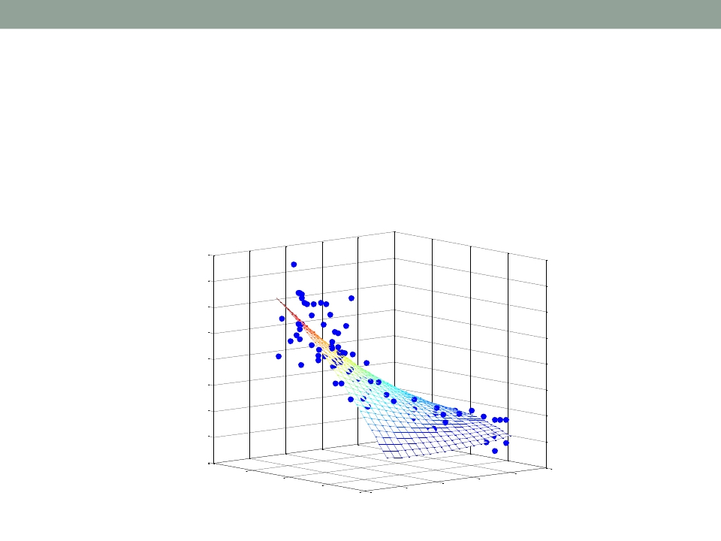
Applications of MATLAB in Engineering
Y.-F. Kuo
13
Exercise
• Fit the data using the formulation:
𝑦 = 𝛽0 + 𝛽1𝑥1 + 𝛽2𝑥2 + 𝛽3𝑥12 + 𝛽4𝑥22 + 𝛽5𝑥1𝑥2
45
40
35
30
25
20
15
10
MPG
5
1000
2000
3000
150
200
250
4000
5000
0
50
100
Weight
Horsepower

Slide 14
Applications of MATLAB in Engineering
Y.-F. Kuo
14
What If the EquationsAre NOT Linear?
• What are linear equations?
𝑦 = 𝛽0 + 𝛽1𝑥 + 𝛽2𝑥2 + 𝛽3𝑥12 + 𝛽4𝑥22 + 𝛽5𝑥1𝑥2
𝑦 = 𝛽0 + 𝛽1𝑥 + 𝛽2𝑥2
𝑦 = 𝛼1𝑒𝛽1𝑥
ln 𝑦 = ln𝛼1 + 𝛽1𝑥
1.
2.
3.
4.
𝑦 =
𝛼3
𝑥
𝛽3+𝑥
5.
• How do we do curve fitting using nonlinear
equations?

Slide 15
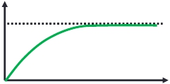
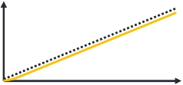
Applications of MATLAB in Engineering
Y.-F. Kuo
15
DC Motor System Identification
• For a typical DC motor, the velocity 𝑣 𝑡 and
displacement 𝑠 𝑡 profiles of a step responses of are
v(t)
vf
s(t)
0
Time (t)
Time (t)
• The displacement 𝑠 𝑡 profile is:
𝛼𝑒−𝛽𝑡
𝛽
𝑠 𝑡 = 𝛼𝑡 +
+ 𝛾,
where 𝛽 is the time constant

Slide 16
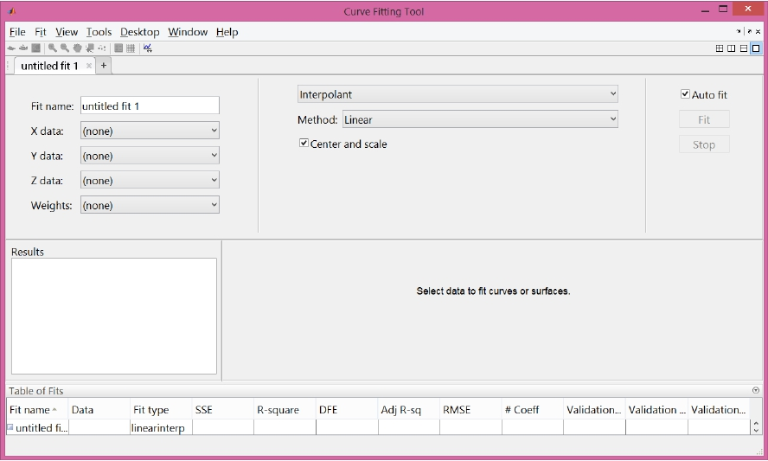
Applications of MATLAB in Engineering
Y.-F. Kuo
16
Curve Fitting Toolbox: cftool()

Slide 17
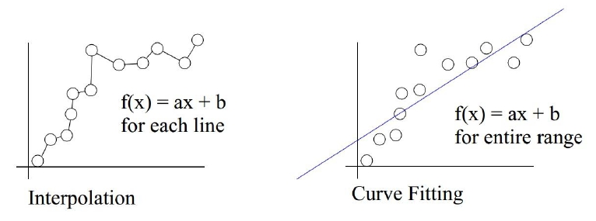
Applications of MATLAB in Engineering
Y.-F. Kuo
17
Interpolation vs Regression
• Interpolation
• The process of finding
an approximation of a
function
• The fit does traverse all
known points
• Regression
• The process of finding a
curve of best fit
• The fit generally does
not pass through the
data points

Slide 18
Applications of MATLAB in Engineering
Y.-F. Kuo
18
Common InterpolationApproaches
• Piecewise linear interpolation
• Piecewise cubic polynomial interpolation
• Cubic spline interpolation
interp1()
pchip()
spline()
mkpp()
1-D data interpolation (table lookup)
Piecewise Cubic Hermite Interpolating Polynomial
Cubic spline data interpolation
Make piecewise polynomial

Slide 19
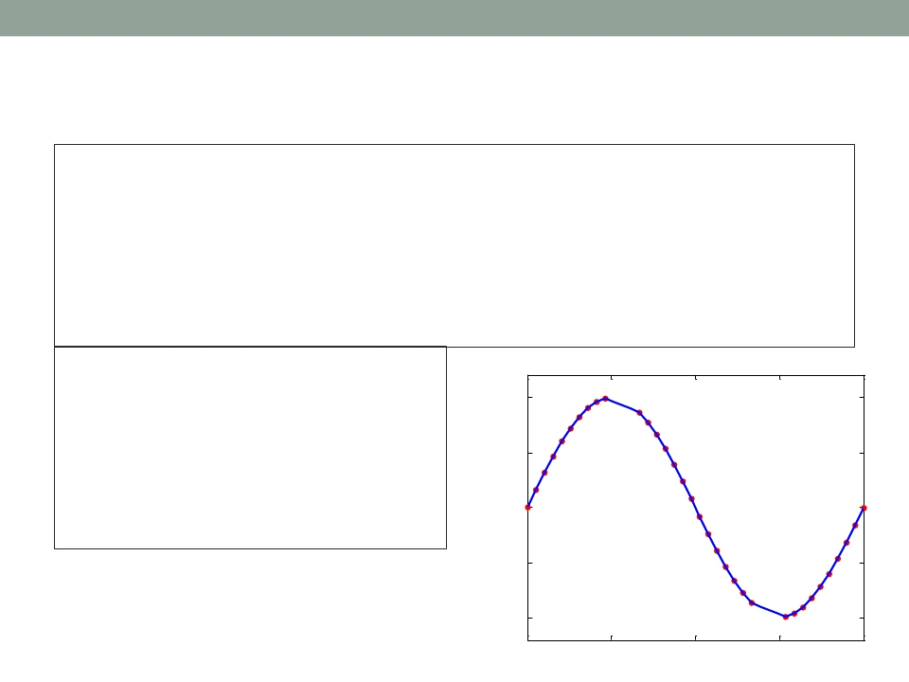
Applications of MATLAB in Engineering
Y.-F. Kuo
19
Linear Interpolation: interp1()
x = linspace(0, 2*pi, 40);
x_m([11:13, 28:30]) = NaN;
x_m = x;
y_m = sin(x_m);
plot(x_m, y_m,'ro', 'MarkerFaceColor', 'r');
xlim([0, 2*pi]); ylim([-1.2, 1.2]); box on;
set(gca, 'FontName', 'symbol', 'FontSize', 16);
set(gca, 'XTick', 0:pi/2:2*pi);
set(gca, 'XTickLabel', {'0', 'p/2', 'p', '3p/2', '2p'});
m_i = ~isnan(x_m);
y_i = interp1(x_m(m_i), ...
y_m(m_i), x);
hold on;
plot(x,y_i,'-b', ...
'LineWidth', 2);
hold off;
1
0.5
0
−0.5
−1
0
π/2
π
3π/2
2π

Slide 20
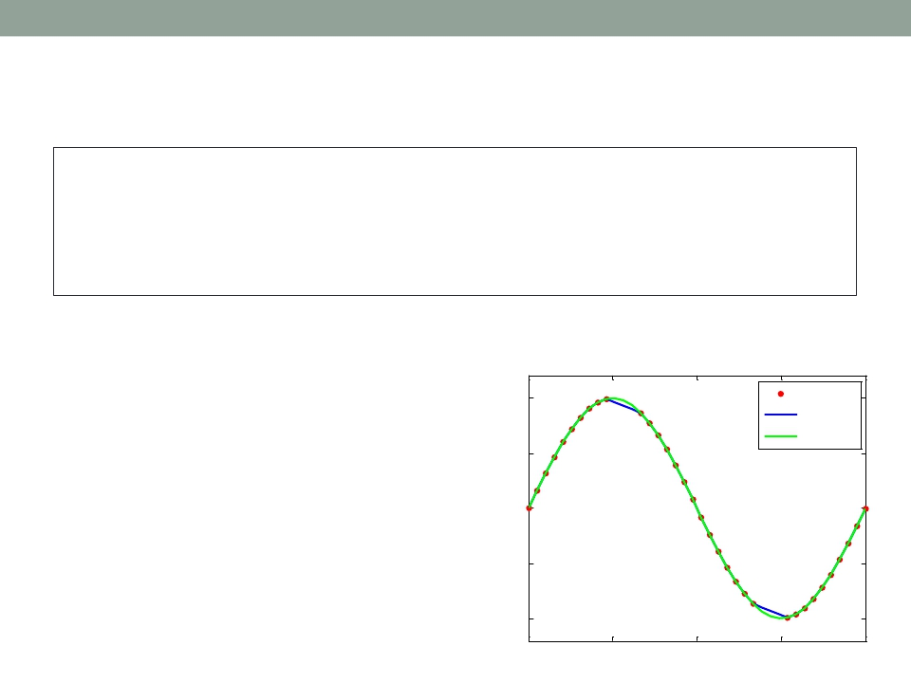
Applications of MATLAB in Engineering
Y.-F. Kuo
20
Spline Interpolation: spline()
m_i = ~isnan(x_m);
y_i = spline(x_m(m_i), y_m(m_i), x);
hold off;
hold on; plot(x,y_i,'-g', 'LineWidth', 2);
h = legend('Original', 'Linear', 'Spline');
set(h,'FontName', 'Times New Roman');
1
0.5
0
−0.5
−1
Original
Linear
Spline
0
π/2
π
3π/2
2π

Slide 21
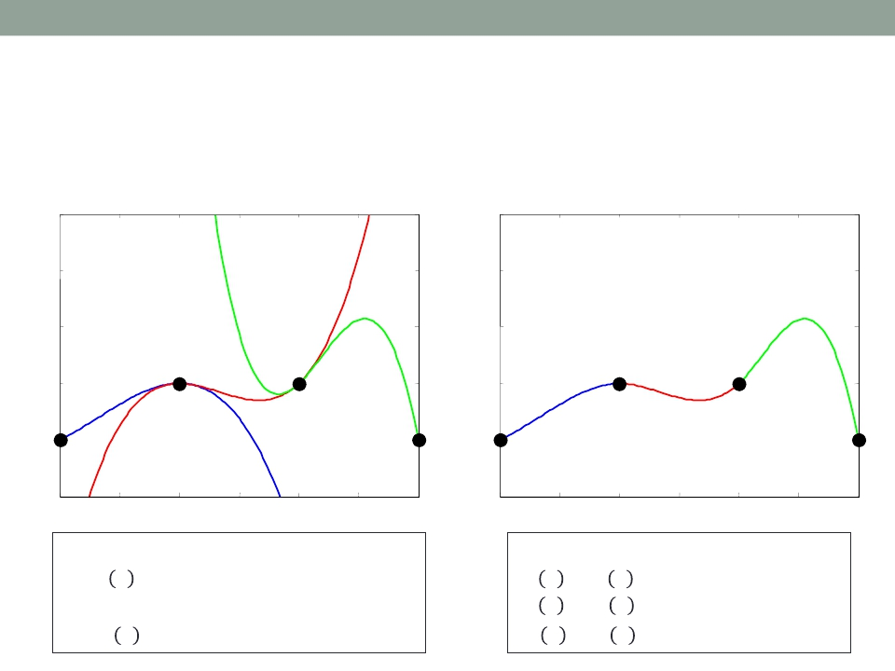
Applications of MATLAB in Engineering
Y.-F. Kuo
21
WhatAre Splines?
• Piecewise polynomial functions
4
3
2
1
0
4
3
2
1
0
-1
0
0.5
1
1.5
2
2.5
3
-1
0
0.5
1
1.5
2
2.5
3
Three separate functions:
One function, 𝑠(𝑥), where:
𝑓 𝑥 = −𝑥3 + 𝑥2 + 𝑥
𝑔(𝑥) = 2𝑥3 − 8𝑥2 + 10𝑥 − 3
ℎ 𝑥 = −7𝑥3 + 46𝑥2 − 98𝑥 + 69
𝑠 𝑥 = 𝑓 𝑥
𝑠 𝑥 = 𝑔 𝑥
𝑠 𝑥 = ℎ 𝑥
𝑓𝑜𝑟 0 ≤ 𝑥 ≤ 1
𝑓𝑜𝑟 1 ≤ 𝑥 ≤ 2
𝑓𝑜𝑟 2 ≤ 𝑥 ≤ 3

Slide 22
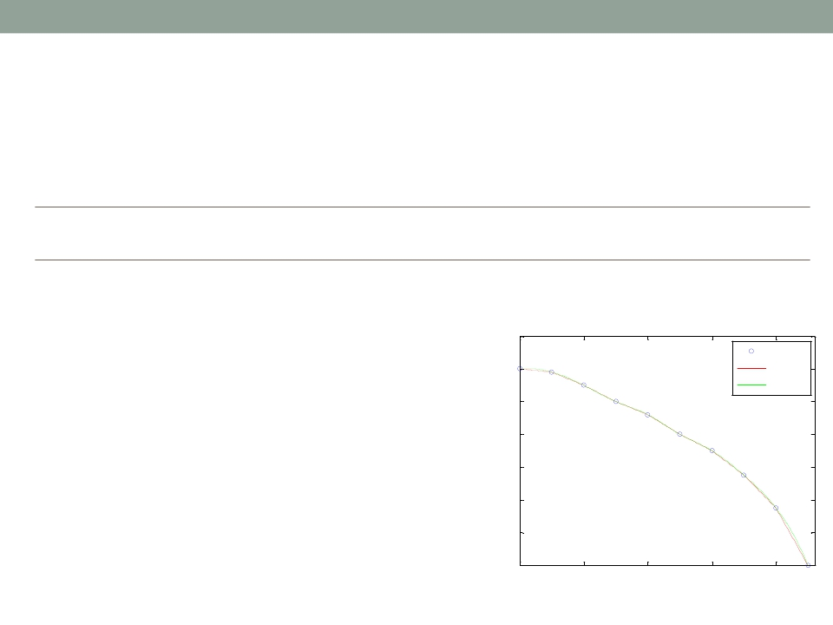
Applications of MATLAB in Engineering
Y.-F. Kuo
22
Exercise
• Fit the data using linear lines and cubic splines
x (ft)
y (ft)
0
1.2
0.25
1.18
0.5
1.1
0.75
1
1.0
0.92
1.25
0.8
1.5
0.7
1.75
0.55
2.0
0.35
2.25
0
Data & Fit Model
1.4
Data
1.2
Linear
Spline
1
0.8
0.6
0.4
0.2
y(ft)
0
0
0.5
1
1.5
2
x(ft)

Slide 23
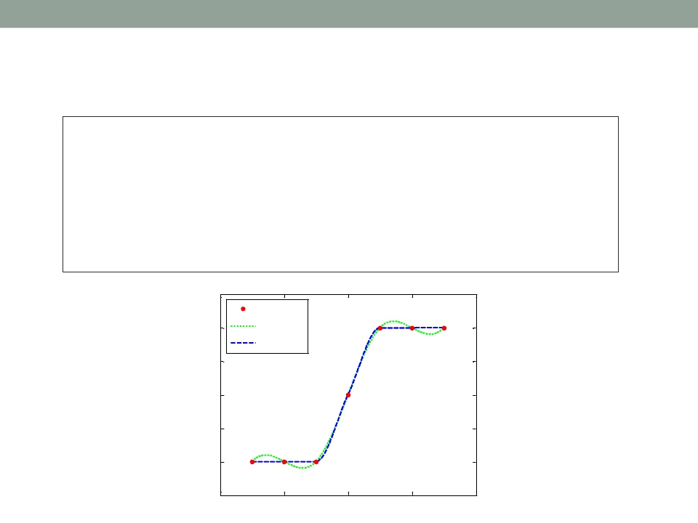
Applications of MATLAB in Engineering
Y.-F. Kuo
23
Cubic Spline vs. Hermite Polynomial
x = -3:3;
y = [-1 -1 -1 0 1 1 1]; t = -3:.01:3;
s = spline(x,y,t);
p = pchip(x,y,t);
hold on; plot(t,s,':g', 'LineWidth', 2);
plot(t,p,'--b', 'LineWidth', 2);
plot(x,y,'ro', 'MarkerFaceColor', 'r');
hold off; box on; set(gca, 'FontSize', 16);
h = legend(2,'Original', 'Spline', 'Hermite');
1.5
Original
1
Spline
Hermite
0.5
0
-0.5
-1
-1.5
-4
-2
0
2
4

Slide 24
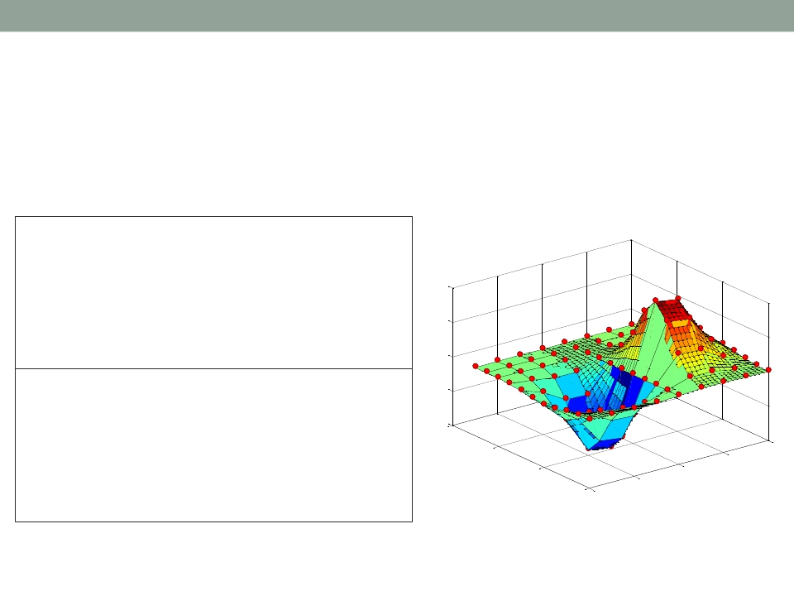
Applications of MATLAB in Engineering
Y.-F. Kuo
24
2D Interpolation: interp2()
xx = -2:.5:2;
yy = -2:.5:3;
[X,Y] = meshgrid(xx,yy);
Z = X.*exp(-X.^2-Y.^2);
0.4
surf(X,Y,Z);
hold on;
plot3(X,Y,Z+0.01,'ok',...
'MarkerFaceColor','r')
0.2
0
xx_i = -2:.1:2;
yy_i = -2:.1:3;
-0.2
[X_i,Y_i] = meshgrid(xx_i,yy_i);
Z_i = interp2(xx,yy,Z,X_i,Y_i);
-0.4
4
surf(X_i,Y_i,Z_i);
hold on;
2
1
2
plot3(X,Y,Z+0.01,'ok',...
'MarkerFaceColor','r')
0
0
-2
-1
-2

Slide 25
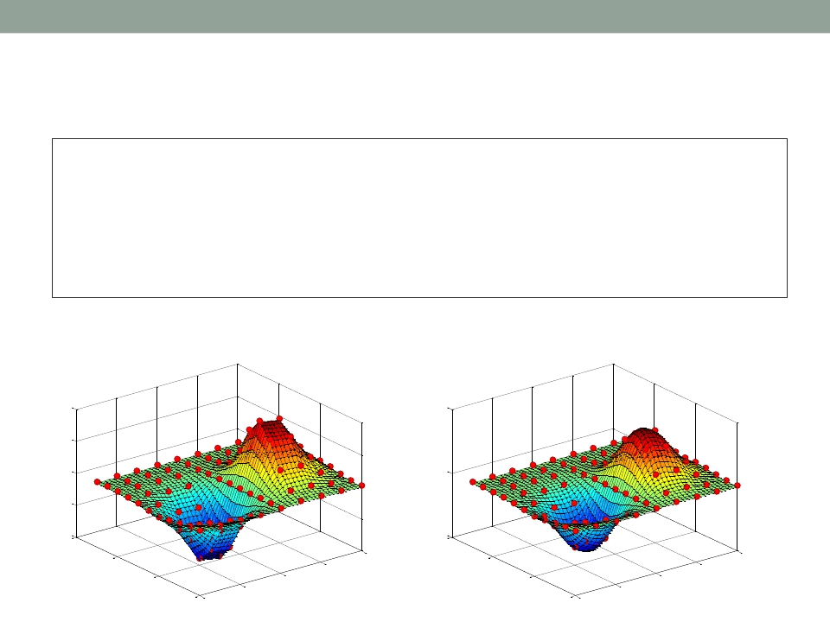
Applications of MATLAB in Engineering
Y.-F. Kuo
25
2D Interpolation Using Spline
xx = -2:.5:2;
yy = -2:.5:3;
[X,Y] = meshgrid(xx,yy);
Z = X.*exp(-X.^2-Y.^2);
xx_i = -2:.1:2;
yy_i = -2:.1:3;
[X_i,Y_i] = meshgrid(xx_i,yy_i);
Z_c = interp2(xx,yy,Z,X_i,Y_i,'cubic');
surf(X_i,Y_i,Z_c);
hold on;
plot3(X,Y,Z+0.01,'ok', 'MarkerFaceColor','r'); hold off;
Linear
Spline
0.4
0.2
0
-0.2
-0.4
4
0.5
0
-0.5
4
2
1
2
2
1
2
0
0
0
0
-2
-2
-1
-2
-2
-1

Slide 26

Applications of MATLAB in Engineering
End of Class
Y.-F. Kuo
26

