Slide 1
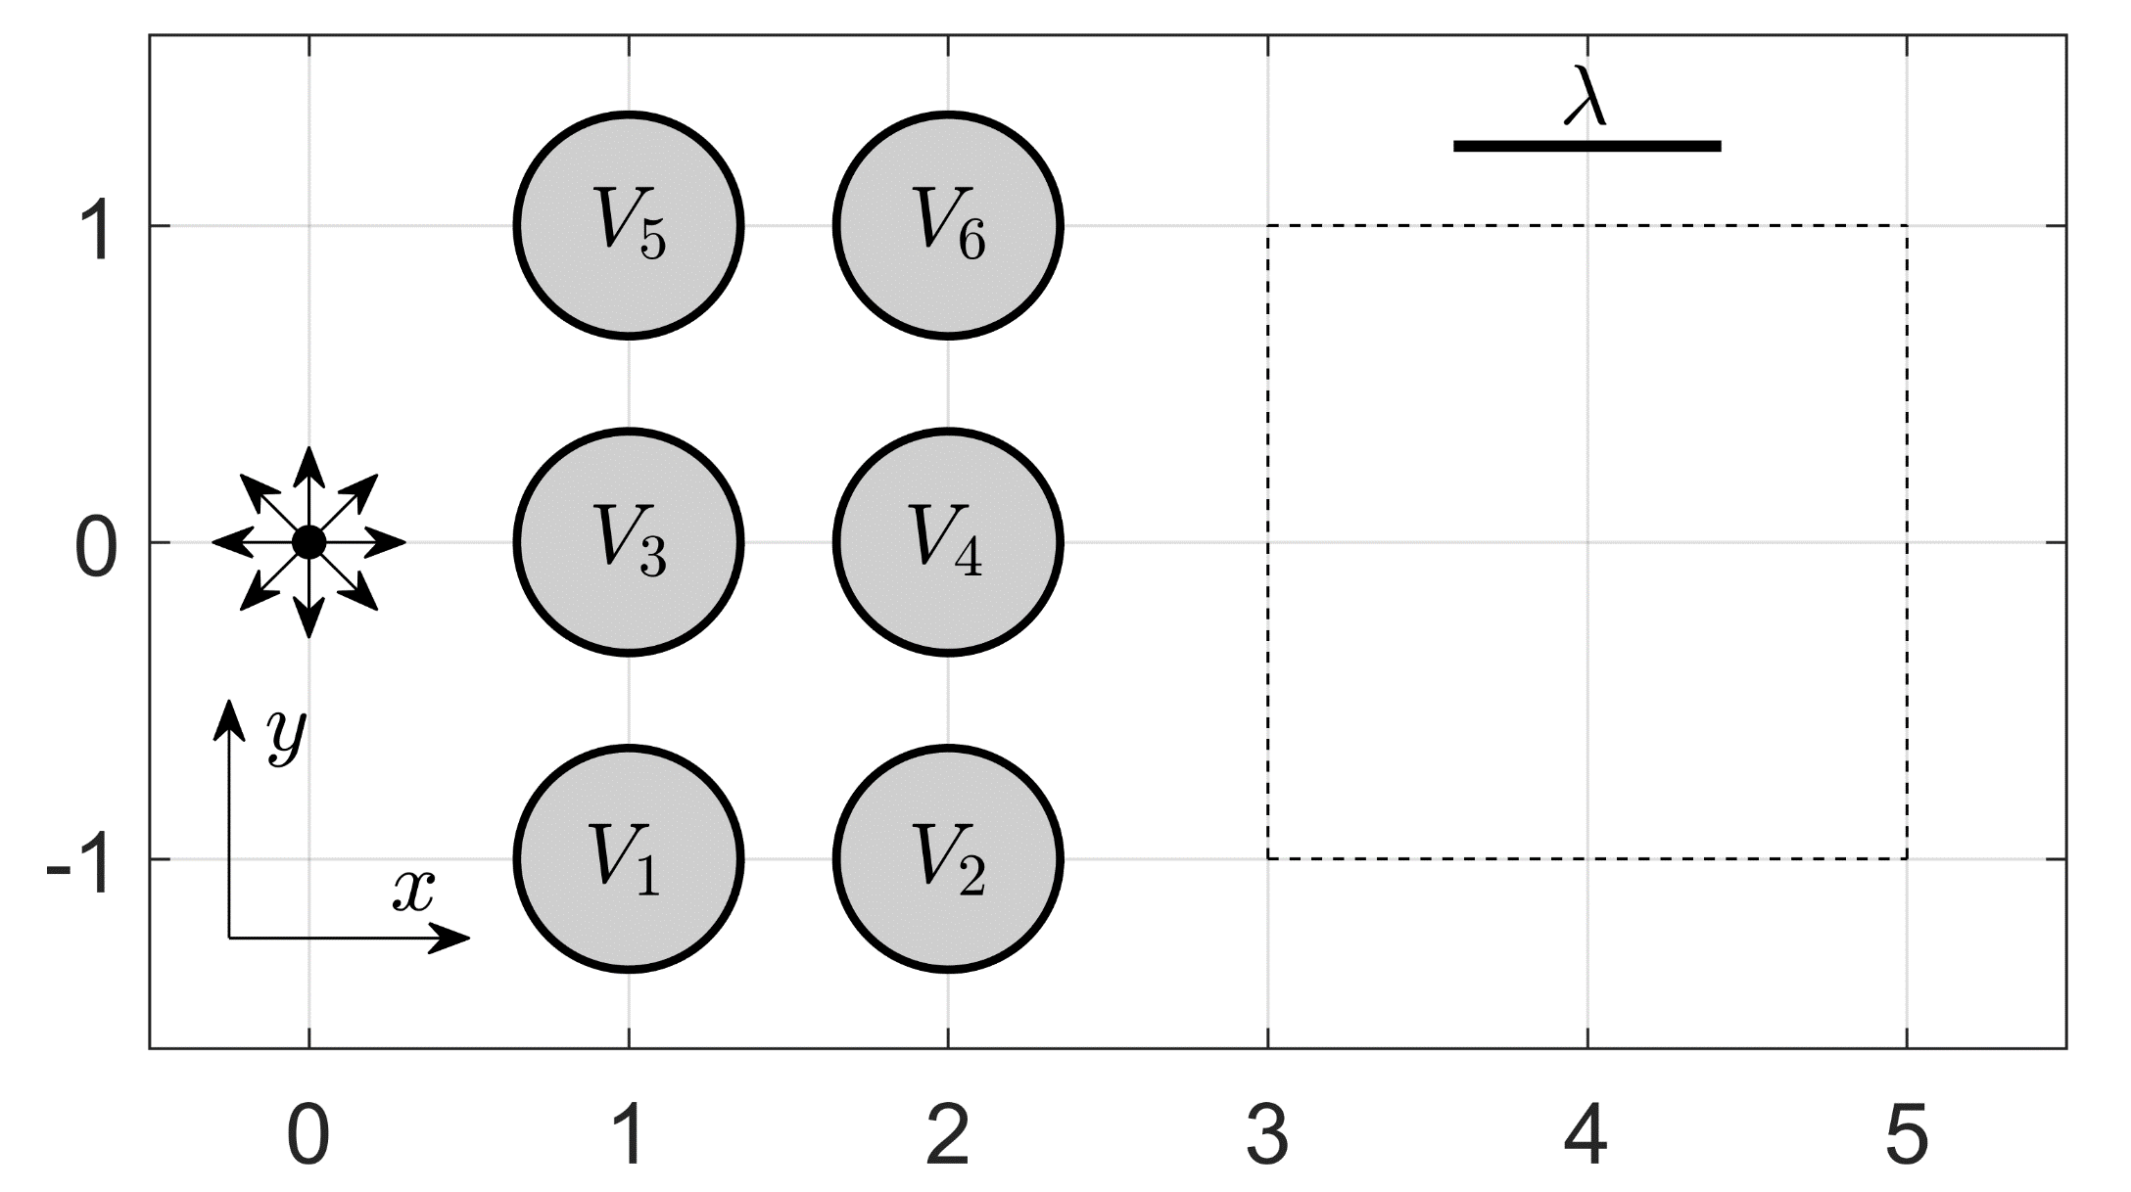


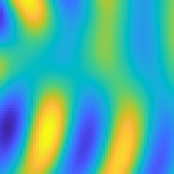









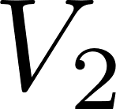
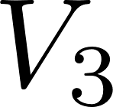
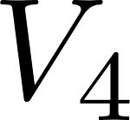
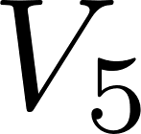
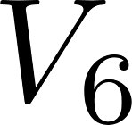
(a)
(b)
MLP
(64, 64, 8)
Up Sampling 1
Up Sampling 2
Conv
Conv+BN+ReLU
Residual
(32, 32, 16)
(16, 16, 32)
(8, 8, 64)
(1,1,512)
(1,1,7)
(4, 4, 128)

