Slide 1
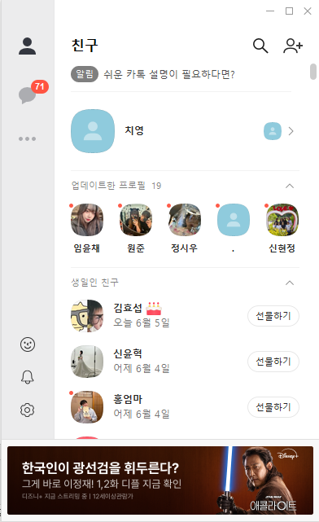
Friend(index.html)
Width: 500px
Height: 810px
lnb
on
myprofile
gnb
friendprofile1
screen
Overflow:scroll
friendprofile2
Index.html, Chatlist.html
More.html 에서 공통적으로
사용되는 lnb, gnb, banner
클래스를 mainframe 으로 사용
banner
icon

Slide 2
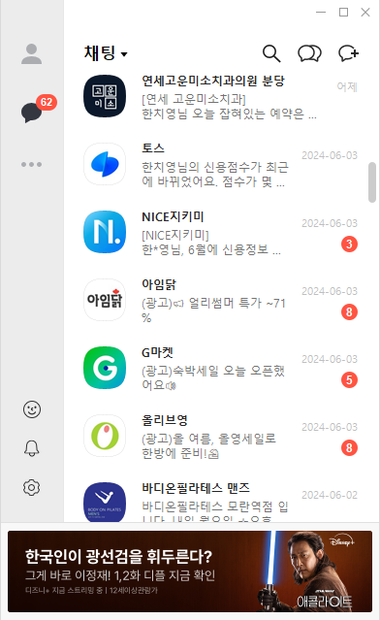
chatlist.html
Width: 500px
Height: 810px
lnb
on
talk1
gnb
talk2
screen
Overflow:scroll
talk3
talk4
banner
icon

Slide 3
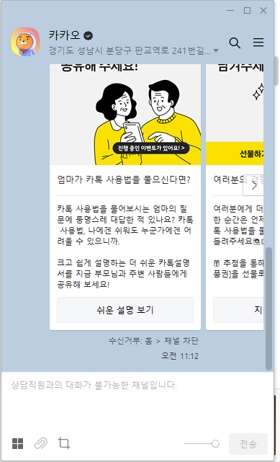
talk(1, 2, 3, 4).html
Width: 500px
Height: 810px
lnb
user
chat
board
talk
icon

Slide 4
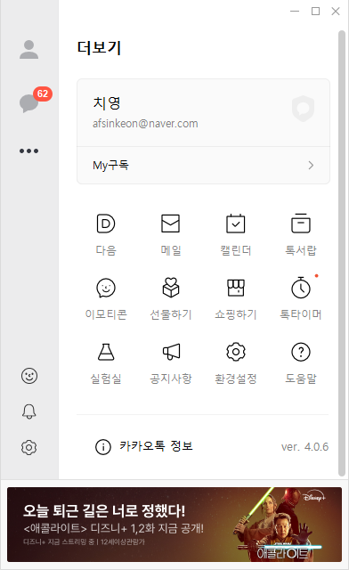
more.html
Width: 500px
Height: 810px
lnb
on
user
gnb
screen
notice
Overflow:scroll
imoticon
info
banner
icon

Slide 5
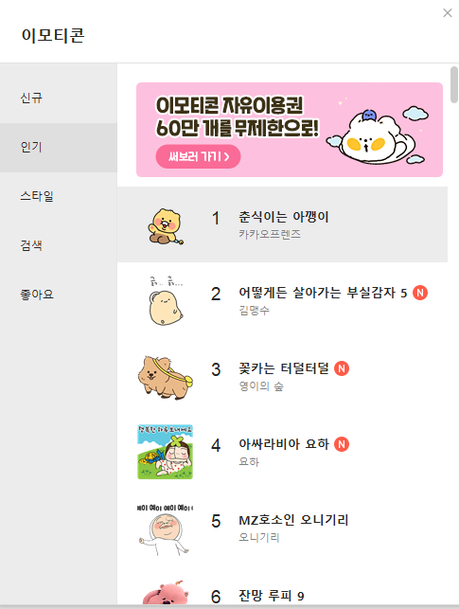
imoticon.html
Width: 500px
Height: 810px
imoRank1
imoRank2
imoRank3
menu
rank
imoRank4
Imoticon.html, update.html
에서 공통적으로 사용되는
Header, menu 클래스를
subframe 으로 사용
imoRank5
imoRank6
icon

Slide 6
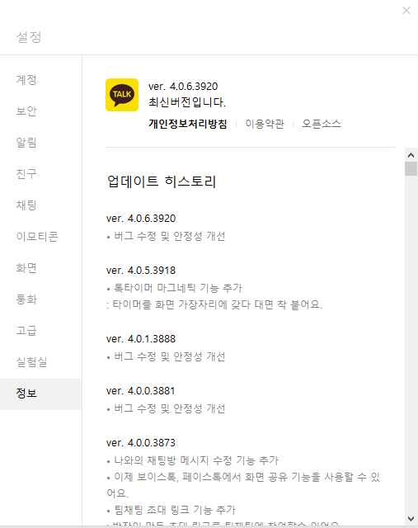
update.html
Width: 500px
Height: 810px
version
menu
history
icon

Slide 7
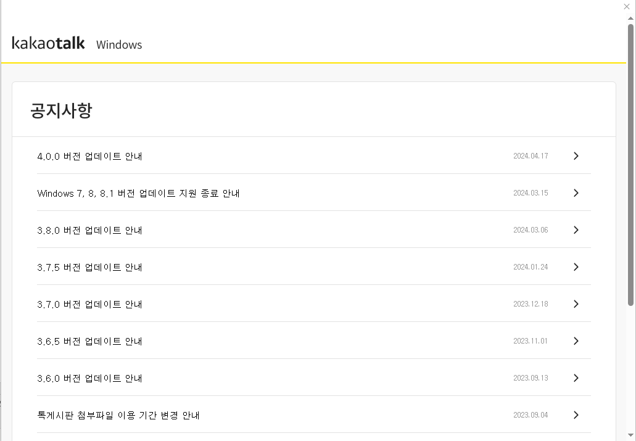
notice.html
Width: 500px
Height: 810px
notice
icon

