Slide 1

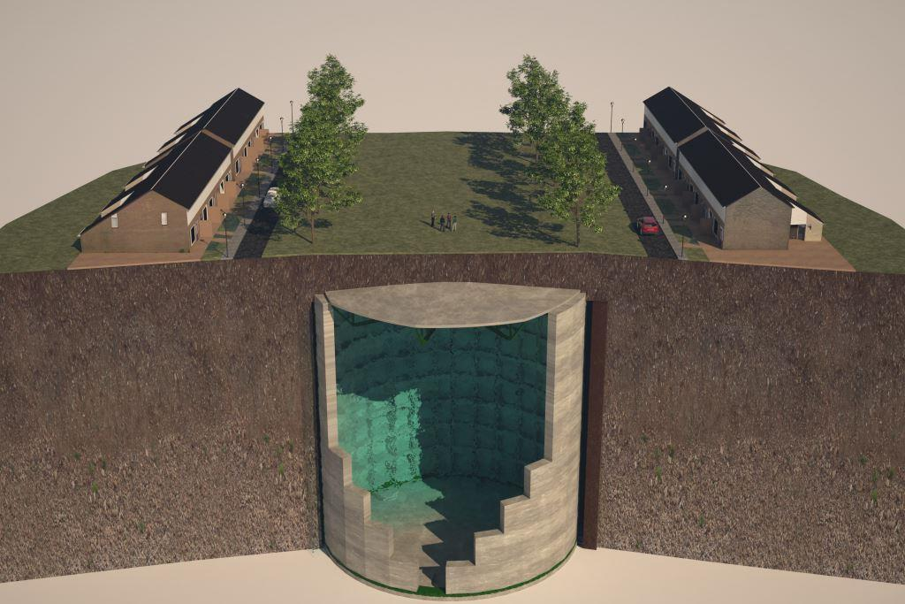
Ecovat
Team Members:
Ehsaan Al Assad 594688
Abdulhadi Bakhash 602016
Aliya
karl
Supervisor:
MES Big Data & Small Data M BDSD
Arnhem, June 2019

Slide 2
Content
1. INTRODUCTION
2. What is Ecovat ?
3. Gathering the Data
4. Data Preparation
5. Preparing the Data
6. Implementing the ML model (NN)
7. Results
8. Questions

Slide 3
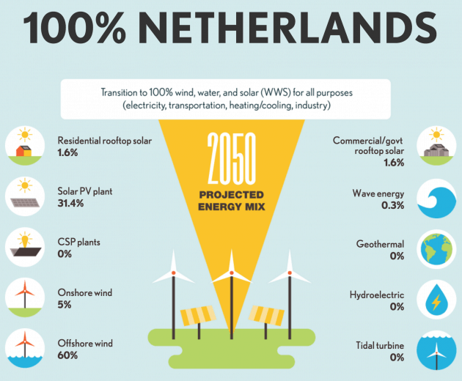
INTRODUCTION

Slide 4
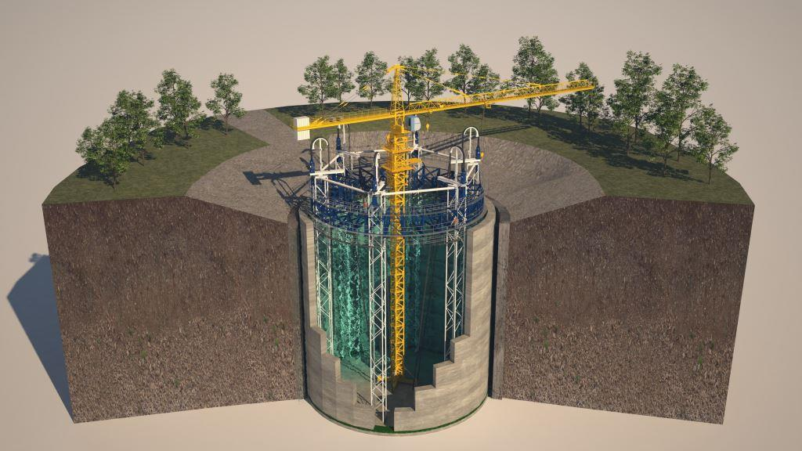
What is Ecovat ?

Slide 5
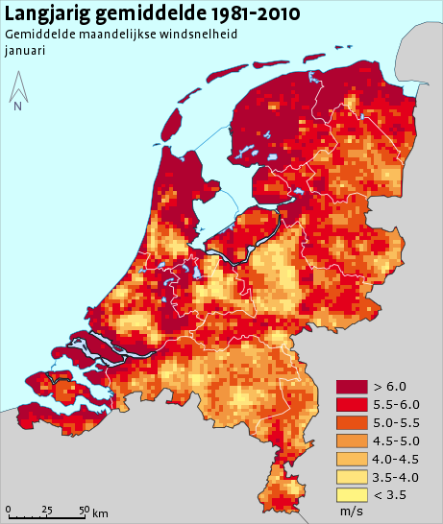
Gathering the Data
HAN
Heat pomp
central heating boiler
KNMI ()
-average wind speed
-Temperature
-Duration of the sunshine
-sum of the precipitation

Slide 6
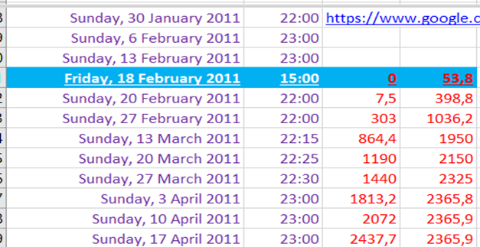
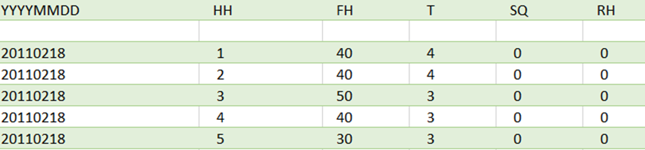
Data Preparation:
Data collection and preparation are the foundation for trusted ML models.
Once the data is collected, it’s time to assess the condition of it, including looking for trends, outliers, exceptions, incorrect, inconsistent, missing, or skewed information.
Because we have data from two different sources additional task should be implemented, such as: Find the optimal intersection or even the applicable one between the two datasets.
First we Determine the starting and the ending date of the measurements and the measurements intervals.
Data Consumption data set | KNMI Data set

Slide 7
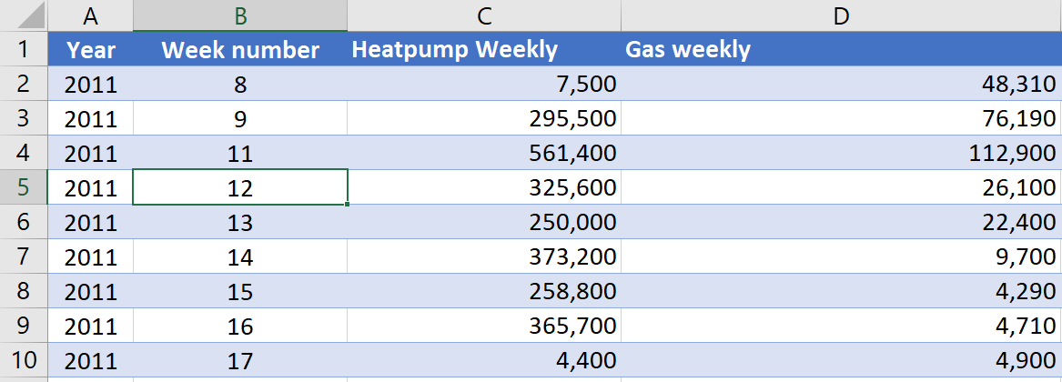
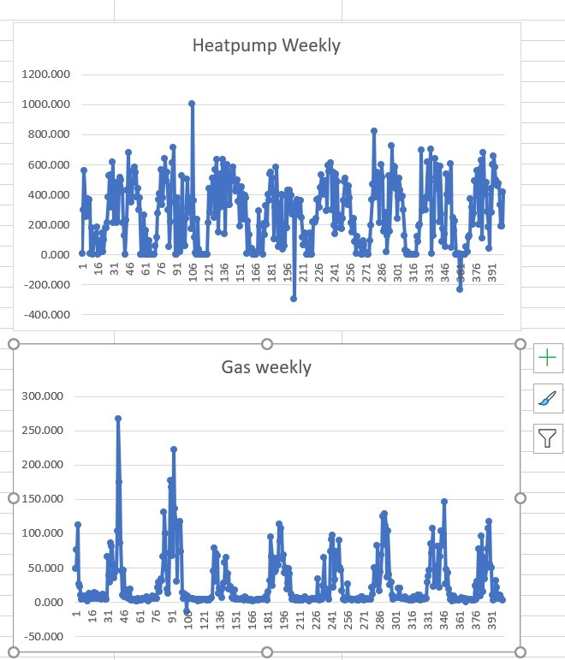
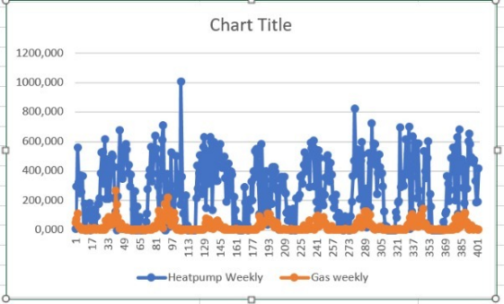
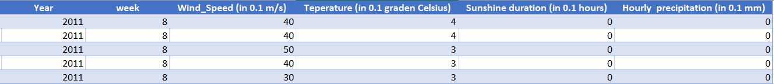
The Energy consumption interval measurements were not equal,
but a weekly interval will be so most convenience. But still in the
dataset there are some missing weeks and intersecting intervals,
so a lot of manual correction was done.
To prepare the KNMI dataset and fit it to the energy consumption dataset:
We change the unit in windspeed and temperature columns
We calculated the average and the sum on weekly bases for our four chosen columns.
We omitted manually all the weeks that have no equivalent in the energy consumption table and correct all the intersecting intervals, either by emitting or by adding them to the right week number.
We plotted the resulted dataset and omitted all the outliers’ values manually.

Slide 8
We combine the two tables together and created extra columns, such as total energy “Total energy” to get the following final table:
Now our data is ready for the ML model.

