Slide 1
Adjustment of Data preparation
%Normalization and Scaling [data_table_norm, mu, sigma]=zscore(data_table);
% get the last 4 columns content and put them in a matrix which represents the input x = data_table_norm(:, 6:11); no_samples = size(x, 1);
% get the y’s y = data_table_norm(:, 3:5);

Slide 2
Change of error metrics
Original code was for binary classification problem.
We have a prediction problem.
New error metrics e.g.
mae (mean absolute error)
mare (mean absolute relative error)
mape (mean absolute percentage error)

Slide 3
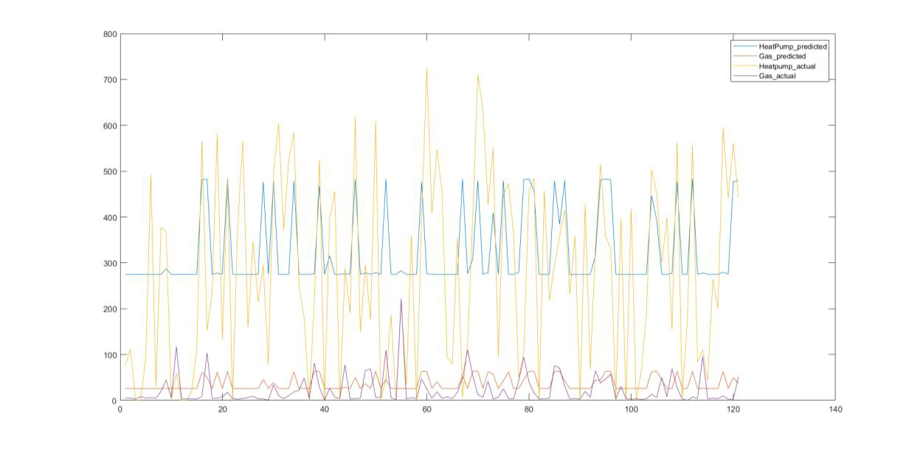
Results
NN output vs expected values – 50 hidden neurons

Slide 4
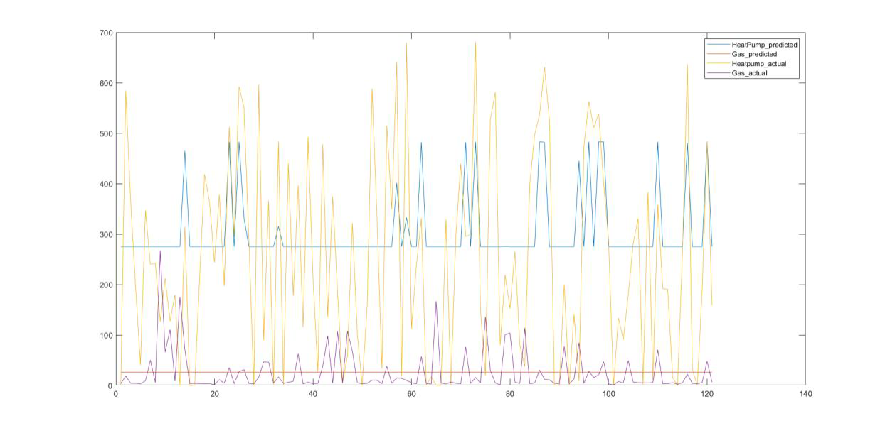
Results
NN output vs expected values - 150 hidden neurons

Slide 5
Conclustions
Heating demand cannot be predicted from this weather data with this type of prediction algorithm
Possible improvement on NN: use more hidden layers
Possible improvement on dataset:
Daily values
Bigger house with several households to mitigate effects of varying daily routines
Gather actual heat consumption data individually for hot water demand and heating

Slide 6
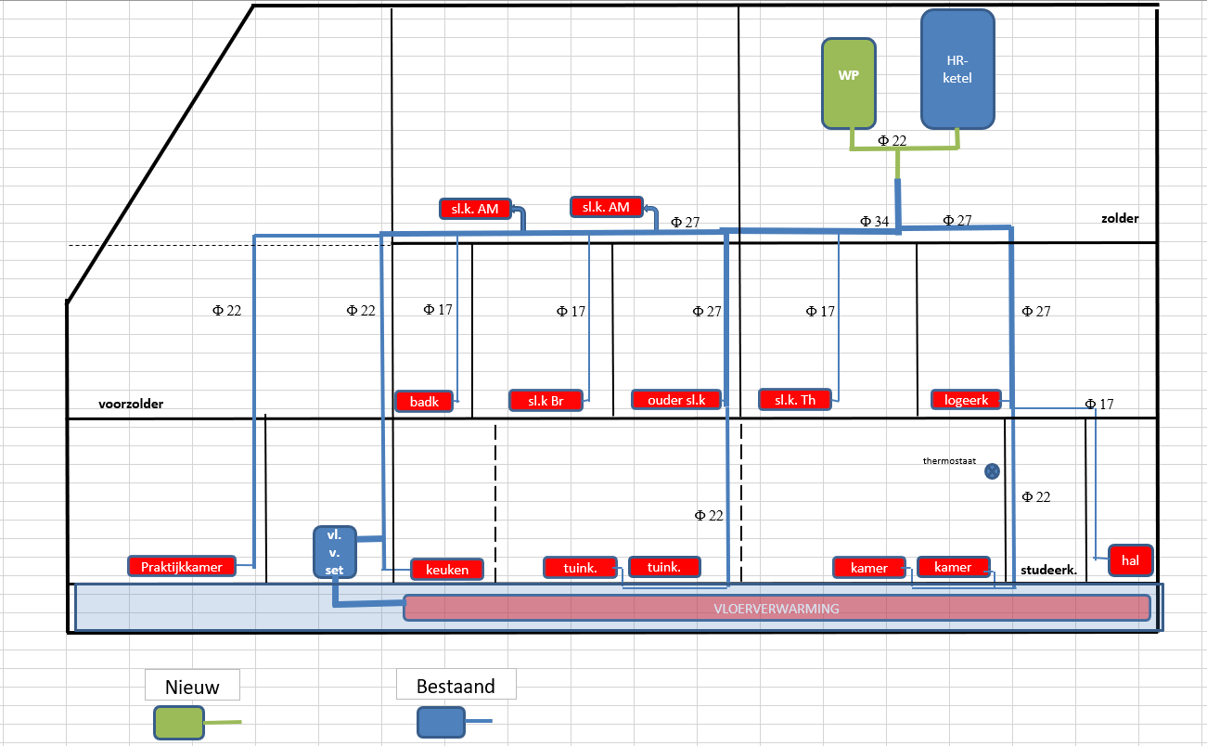
Origin of dataset

Slide 7
