Slide 1
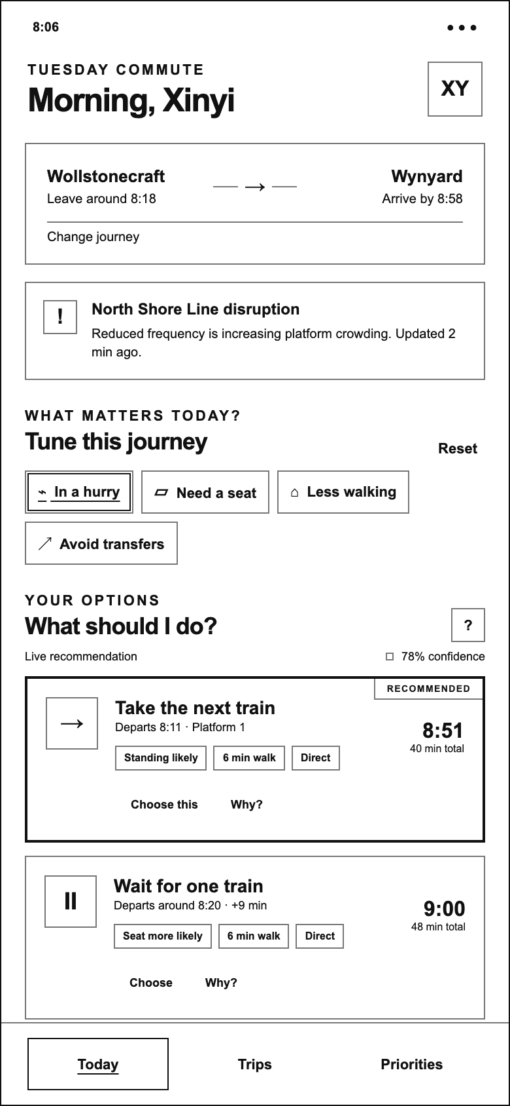
WAYWISE / LOW-FIDELITY WIREFRAMES
Today / Journey overview
PURPOSE
Understand the current journey before choosing a service.
KEY ELEMENTS
Origin and destination; service alert; journey-specific priorities; recommendation confidence.
INTERACTION
Select a priority or scroll to compare Take, Wait and Switch.
PROTOTYPE SCOPE
All service conditions and confidence values are fictional.
390 × 844 portrait viewport · white canvas / outline-only UI
01 / 17
Notes:
Understand the current journey before choosing a service.
Origin and destination; service alert; journey-specific priorities; recommendation confidence.
Select a priority or scroll to compare Take, Wait and Switch.
Scope: All service conditions and confidence values are fictional.
Source: existing Waywise mid-fidelity demo. Wireframe translation created 2026-09-30, not evidence of an earlier design iteration.
Live prototype: https://hancyhxy.github.io/waywise-aid-demo/low-fi/

Slide 2
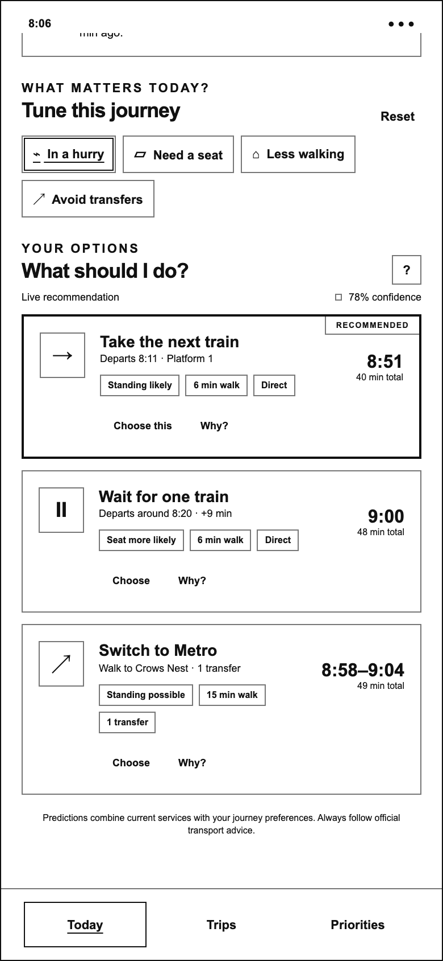
WAYWISE / LOW-FIDELITY WIREFRAMES
Today / Compare options
PURPOSE
Compare the consequences of taking, waiting or switching.
KEY ELEMENTS
Arrival time; total duration; seating or boarding likelihood; walking; transfers.
INTERACTION
Choose an option, or open Why? to inspect its rationale.
PROTOTYPE SCOPE
Outlined recommendation reflects the demo ranking, not live routing.
390 × 844 portrait viewport · white canvas / outline-only UI
02 / 17
Notes:
Compare the consequences of taking, waiting or switching.
Arrival time; total duration; seating or boarding likelihood; walking; transfers.
Choose an option, or open Why? to inspect its rationale.
Scope: Outlined recommendation reflects the demo ranking, not live routing.
Source: existing Waywise mid-fidelity demo. Wireframe translation created 2026-09-30, not evidence of an earlier design iteration.
Live prototype: https://hancyhxy.github.io/waywise-aid-demo/low-fi/

Slide 3
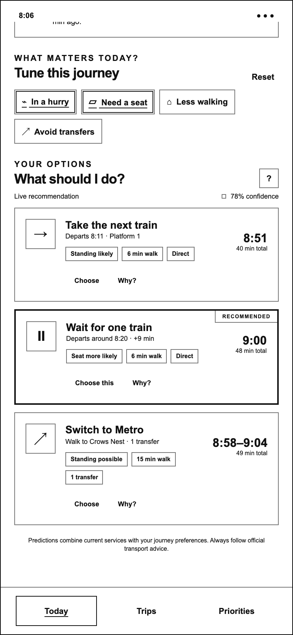
WAYWISE / LOW-FIDELITY WIREFRAMES
Today / Need a seat
PURPOSE
Make comfort part of the current decision.
KEY ELEMENTS
The selected priority has an outlined, underlined state. The recommended route can change.
INTERACTION
Toggle Need a seat; compare the updated recommendation.
PROTOTYPE SCOPE
Journey chips affect demo ranking; preference sliders do not.
390 × 844 portrait viewport · white canvas / outline-only UI
03 / 17
Notes:
Make comfort part of the current decision.
The selected priority has an outlined, underlined state. The recommended route can change.
Toggle Need a seat; compare the updated recommendation.
Scope: Journey chips affect demo ranking; preference sliders do not.
Source: existing Waywise mid-fidelity demo. Wireframe translation created 2026-09-30, not evidence of an earlier design iteration.
Live prototype: https://hancyhxy.github.io/waywise-aid-demo/low-fi/

Slide 4
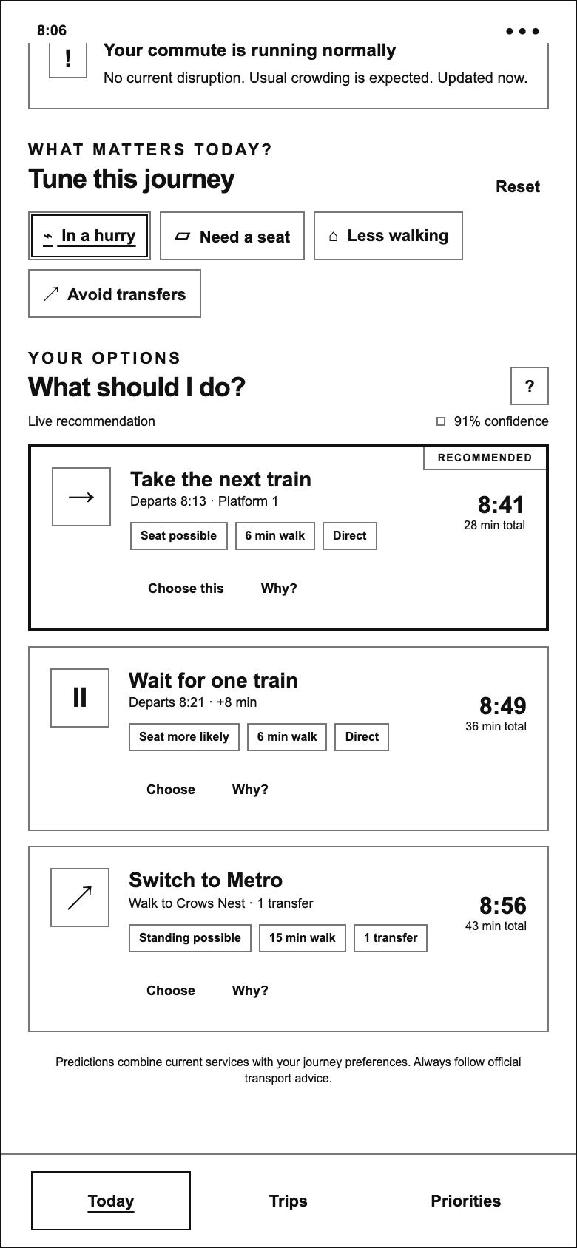
WAYWISE / LOW-FIDELITY WIREFRAMES
Today / Normal service
PURPOSE
Compare options when the usual service is running normally.
KEY ELEMENTS
Normal-service scenario; 91% demo confidence; direct and alternative routes.
INTERACTION
Compare the next train with waiting or switching.
PROTOTYPE SCOPE
A scenario variation of Today, not a separate navigation page.
390 × 844 portrait viewport · white canvas / outline-only UI
04 / 17
Notes:
Compare options when the usual service is running normally.
Normal-service scenario; 91% demo confidence; direct and alternative routes.
Compare the next train with waiting or switching.
Scope: A scenario variation of Today, not a separate navigation page.
Source: existing Waywise mid-fidelity demo. Wireframe translation created 2026-09-30, not evidence of an earlier design iteration.
Live prototype: https://hancyhxy.github.io/waywise-aid-demo/low-fi/

Slide 5
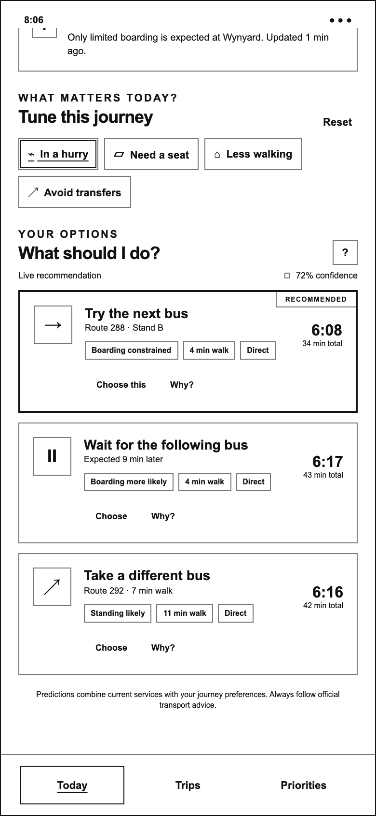
WAYWISE / LOW-FIDELITY WIREFRAMES
Today / Full bus
PURPOSE
Make boarding uncertainty visible before committing.
KEY ELEMENTS
Capacity scenario; boarding constraints; next bus, following bus and alternative bus.
INTERACTION
Compare the risk of waiting with the extra walking of switching.
PROTOTYPE SCOPE
Boarding likelihood is illustrative rather than a capacity prediction.
390 × 844 portrait viewport · white canvas / outline-only UI
05 / 17
Notes:
Make boarding uncertainty visible before committing.
Capacity scenario; boarding constraints; next bus, following bus and alternative bus.
Compare the risk of waiting with the extra walking of switching.
Scope: Boarding likelihood is illustrative rather than a capacity prediction.
Source: existing Waywise mid-fidelity demo. Wireframe translation created 2026-09-30, not evidence of an earlier design iteration.
Live prototype: https://hancyhxy.github.io/waywise-aid-demo/low-fi/

Slide 6
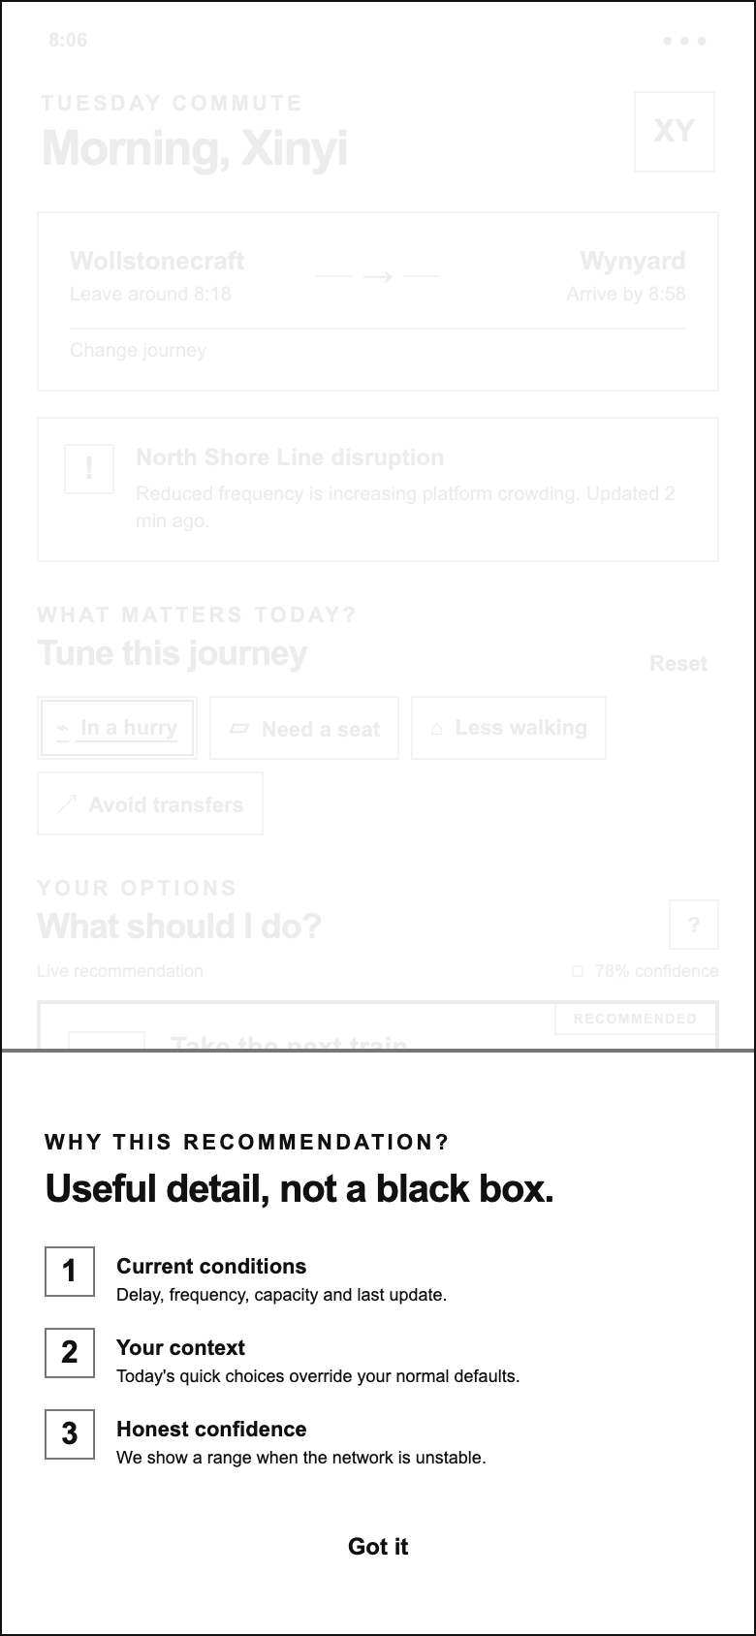
WAYWISE / LOW-FIDELITY WIREFRAMES
Explanation / How it works
PURPOSE
Explain the basis of the recommendation.
KEY ELEMENTS
Current conditions; journey context; confidence and uncertainty.
INTERACTION
Close the sheet using the handle, Got it, backdrop or Escape.
PROTOTYPE SCOPE
Explanatory overlay from the existing demo.
390 × 844 portrait viewport · white canvas / outline-only UI
06 / 17
Notes:
Explain the basis of the recommendation.
Current conditions; journey context; confidence and uncertainty.
Close the sheet using the handle, Got it, backdrop or Escape.
Scope: Explanatory overlay from the existing demo.
Source: existing Waywise mid-fidelity demo. Wireframe translation created 2026-09-30, not evidence of an earlier design iteration.
Live prototype: https://hancyhxy.github.io/waywise-aid-demo/low-fi/

Slide 7
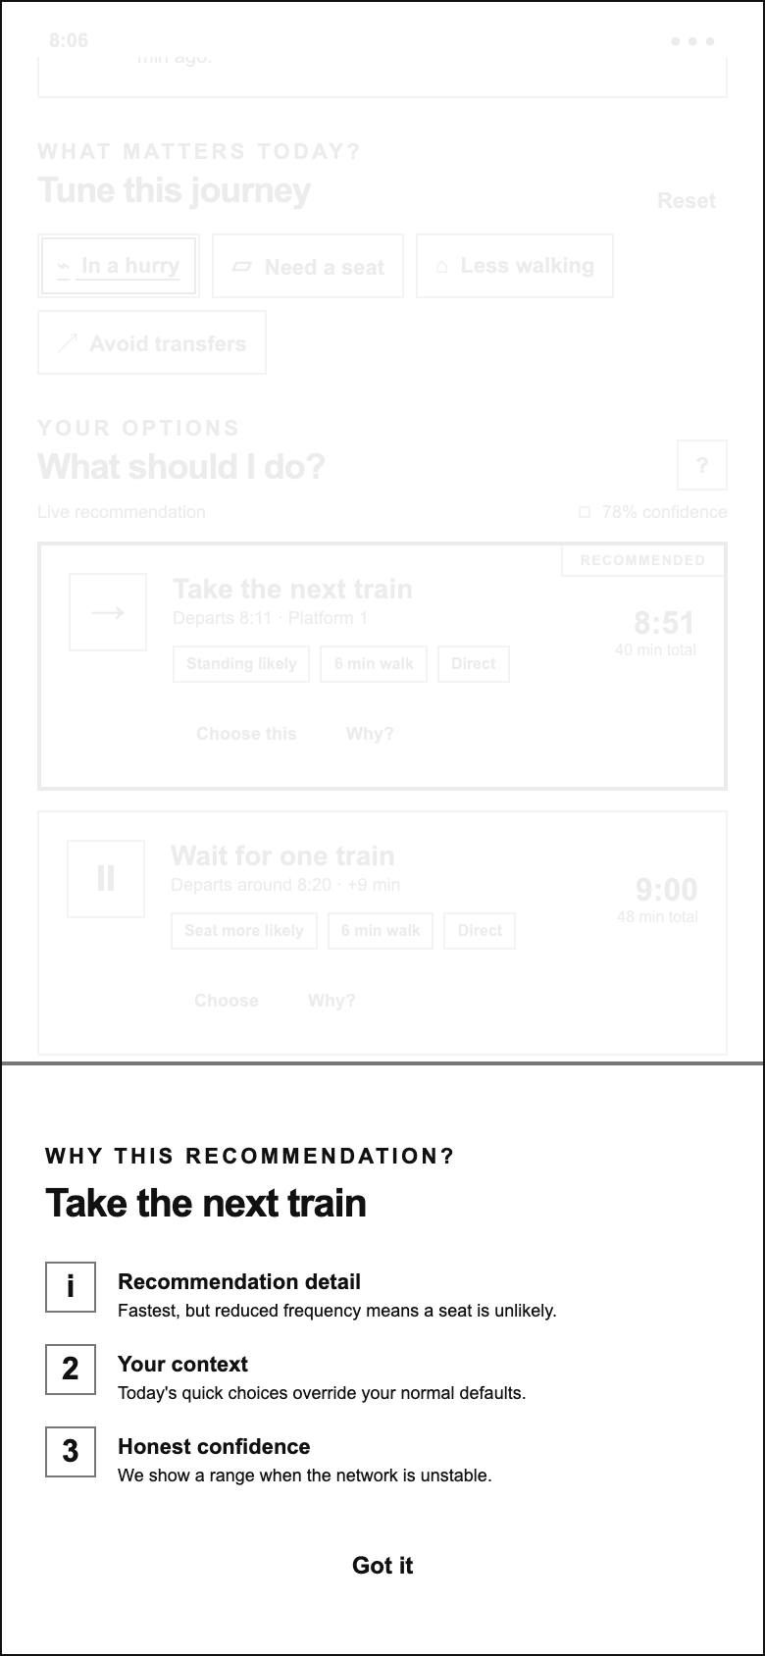
WAYWISE / LOW-FIDELITY WIREFRAMES
Explanation / Take
PURPOSE
Explain why taking the next train may suit this journey.
KEY ELEMENTS
Route-specific rationale alongside context and confidence explanations.
INTERACTION
Read the trade-off, then return to the option list.
PROTOTYPE SCOPE
In this scenario: fastest, but a seat is unlikely.
390 × 844 portrait viewport · white canvas / outline-only UI
07 / 17
Notes:
Explain why taking the next train may suit this journey.
Route-specific rationale alongside context and confidence explanations.
Read the trade-off, then return to the option list.
Scope: In this scenario: fastest, but a seat is unlikely.
Source: existing Waywise mid-fidelity demo. Wireframe translation created 2026-09-30, not evidence of an earlier design iteration.
Live prototype: https://hancyhxy.github.io/waywise-aid-demo/low-fi/

Slide 8
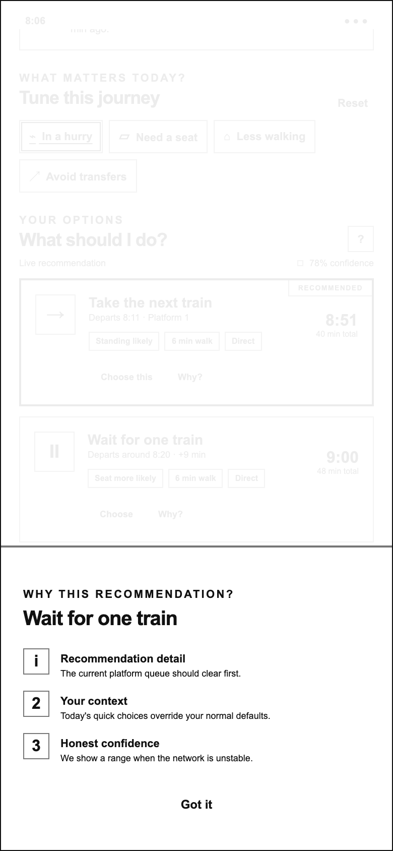
WAYWISE / LOW-FIDELITY WIREFRAMES
Explanation / Wait
PURPOSE
Explain the potential benefit of waiting.
KEY ELEMENTS
Queue-clearing rationale and the effect of current context.
INTERACTION
Return to the list to compare or choose the waiting option.
PROTOTYPE SCOPE
The queue-clearing statement is fictional demo content.
390 × 844 portrait viewport · white canvas / outline-only UI
08 / 17
Notes:
Explain the potential benefit of waiting.
Queue-clearing rationale and the effect of current context.
Return to the list to compare or choose the waiting option.
Scope: The queue-clearing statement is fictional demo content.
Source: existing Waywise mid-fidelity demo. Wireframe translation created 2026-09-30, not evidence of an earlier design iteration.
Live prototype: https://hancyhxy.github.io/waywise-aid-demo/low-fi/

Slide 9
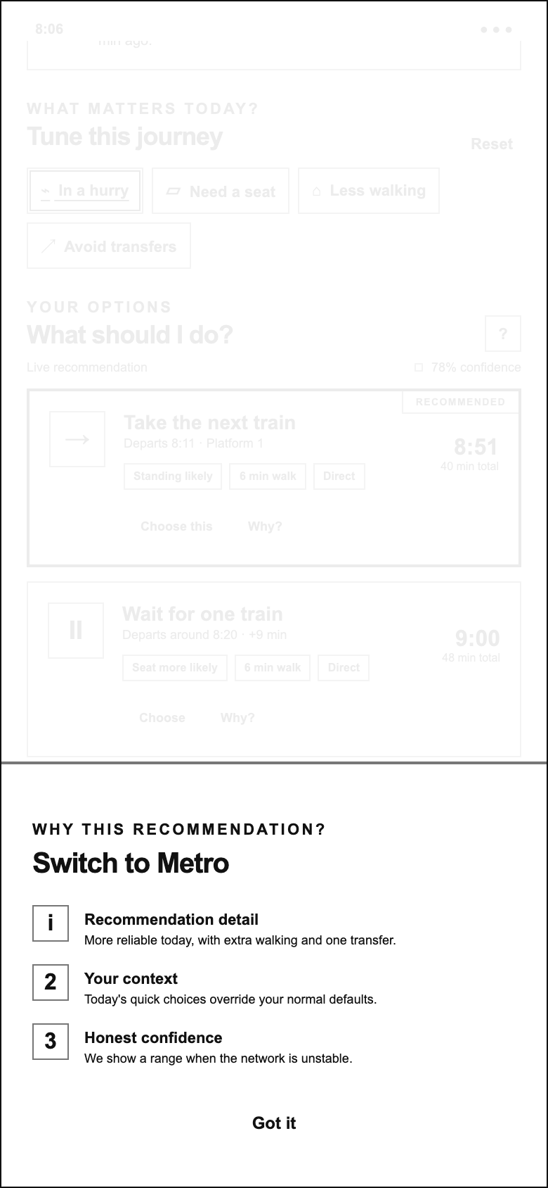
WAYWISE / LOW-FIDELITY WIREFRAMES
Explanation / Switch
PURPOSE
Explain the trade-off in changing routes.
KEY ELEMENTS
Reliability benefit; extra walking; one transfer.
INTERACTION
Return to the options and make a decision.
PROTOTYPE SCOPE
No map or navigation flow exists in the source prototype.
390 × 844 portrait viewport · white canvas / outline-only UI
09 / 17
Notes:
Explain the trade-off in changing routes.
Reliability benefit; extra walking; one transfer.
Return to the options and make a decision.
Scope: No map or navigation flow exists in the source prototype.
Source: existing Waywise mid-fidelity demo. Wireframe translation created 2026-09-30, not evidence of an earlier design iteration.
Live prototype: https://hancyhxy.github.io/waywise-aid-demo/low-fi/

Slide 10
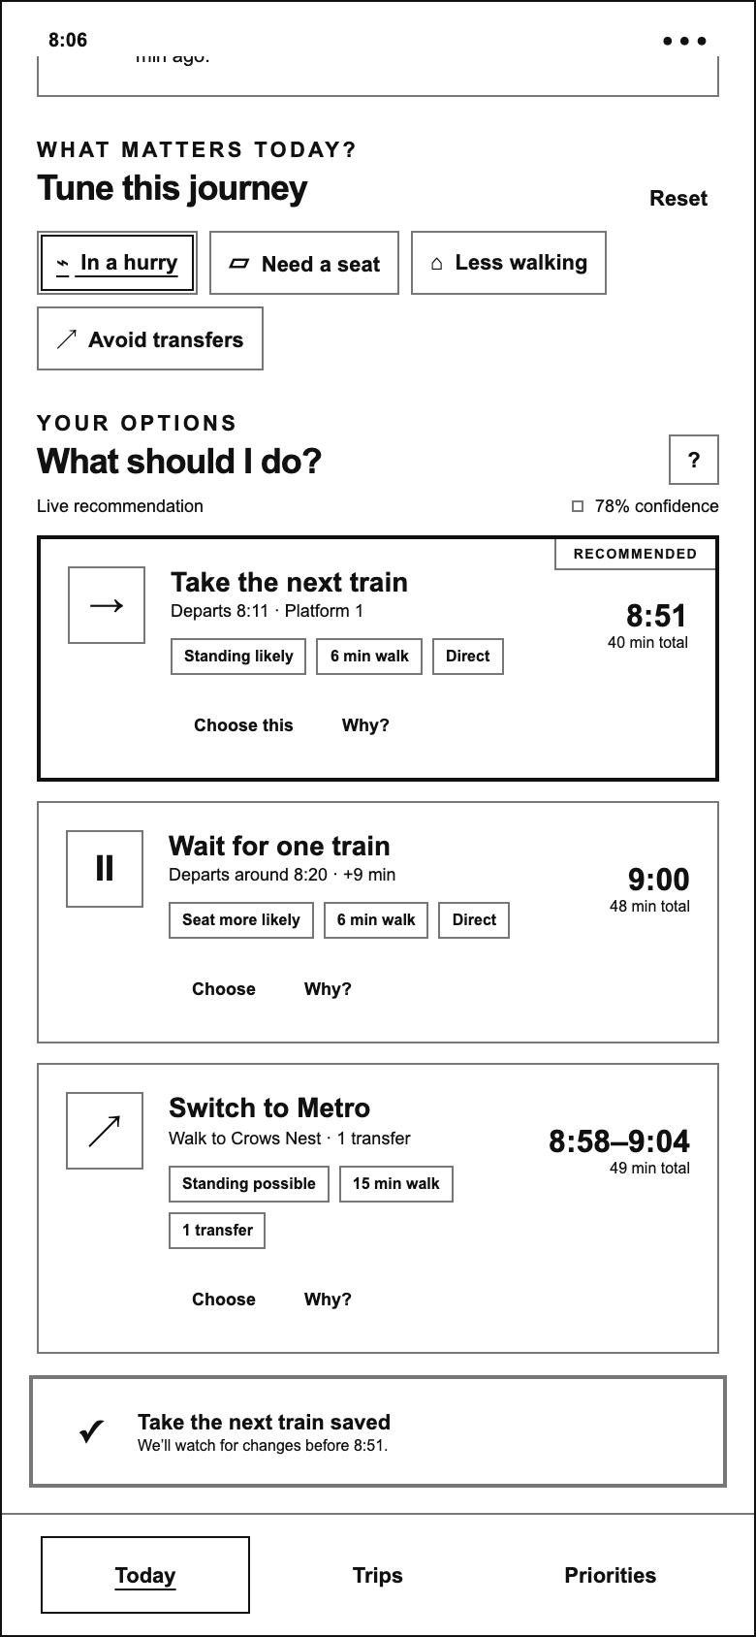
WAYWISE / LOW-FIDELITY WIREFRAMES
Feedback / Decision saved
PURPOSE
Acknowledge the selected commute option.
KEY ELEMENTS
A short confirmation with the chosen action and arrival reference.
INTERACTION
Continue reviewing the journey after the message dismisses.
PROTOTYPE SCOPE
Session-only feedback: no persistent saving or real monitoring.
390 × 844 portrait viewport · white canvas / outline-only UI
10 / 17
Notes:
Acknowledge the selected commute option.
A short confirmation with the chosen action and arrival reference.
Continue reviewing the journey after the message dismisses.
Scope: Session-only feedback: no persistent saving or real monitoring.
Source: existing Waywise mid-fidelity demo. Wireframe translation created 2026-09-30, not evidence of an earlier design iteration.
Live prototype: https://hancyhxy.github.io/waywise-aid-demo/low-fi/

Slide 11
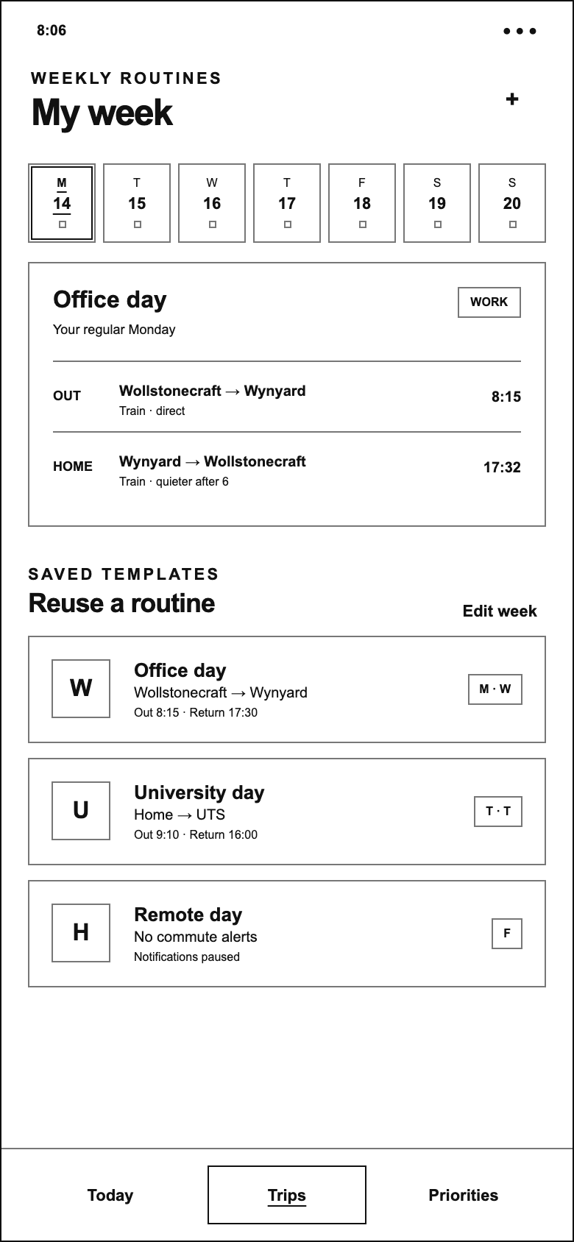
WAYWISE / LOW-FIDELITY WIREFRAMES
My week / Office day
PURPOSE
View a weekly routine and its outbound and return journeys.
KEY ELEMENTS
Seven-day selector; office-day journey pair; saved routine templates.
INTERACTION
Choose another day; use Today to return to route comparison.
PROTOTYPE SCOPE
Change journey opens this screen; it does not apply a saved route.
390 × 844 portrait viewport · white canvas / outline-only UI
11 / 17
Notes:
View a weekly routine and its outbound and return journeys.
Seven-day selector; office-day journey pair; saved routine templates.
Choose another day; use Today to return to route comparison.
Scope: Change journey opens this screen; it does not apply a saved route.
Source: existing Waywise mid-fidelity demo. Wireframe translation created 2026-09-30, not evidence of an earlier design iteration.
Live prototype: https://hancyhxy.github.io/waywise-aid-demo/low-fi/

Slide 12
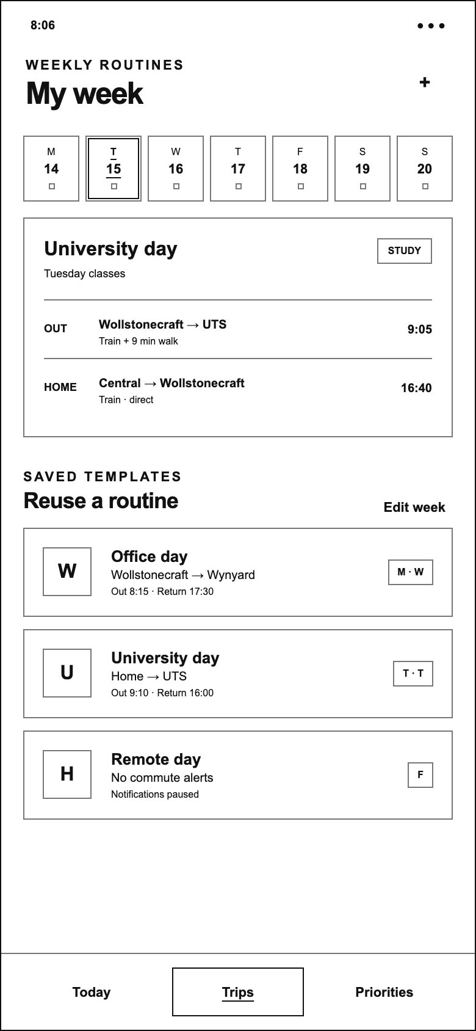
WAYWISE / LOW-FIDELITY WIREFRAMES
My week / University day
PURPOSE
Support different destinations and schedules across the week.
KEY ELEMENTS
University-day outbound and return journeys; scheduled times.
INTERACTION
Select another weekday to inspect its routine.
PROTOTYPE SCOPE
Wednesday repeats office; Thursday uses later university times.
390 × 844 portrait viewport · white canvas / outline-only UI
12 / 17
Notes:
Support different destinations and schedules across the week.
University-day outbound and return journeys; scheduled times.
Select another weekday to inspect its routine.
Scope: Wednesday repeats office; Thursday uses later university times.
Source: existing Waywise mid-fidelity demo. Wireframe translation created 2026-09-30, not evidence of an earlier design iteration.
Live prototype: https://hancyhxy.github.io/waywise-aid-demo/low-fi/

Slide 13
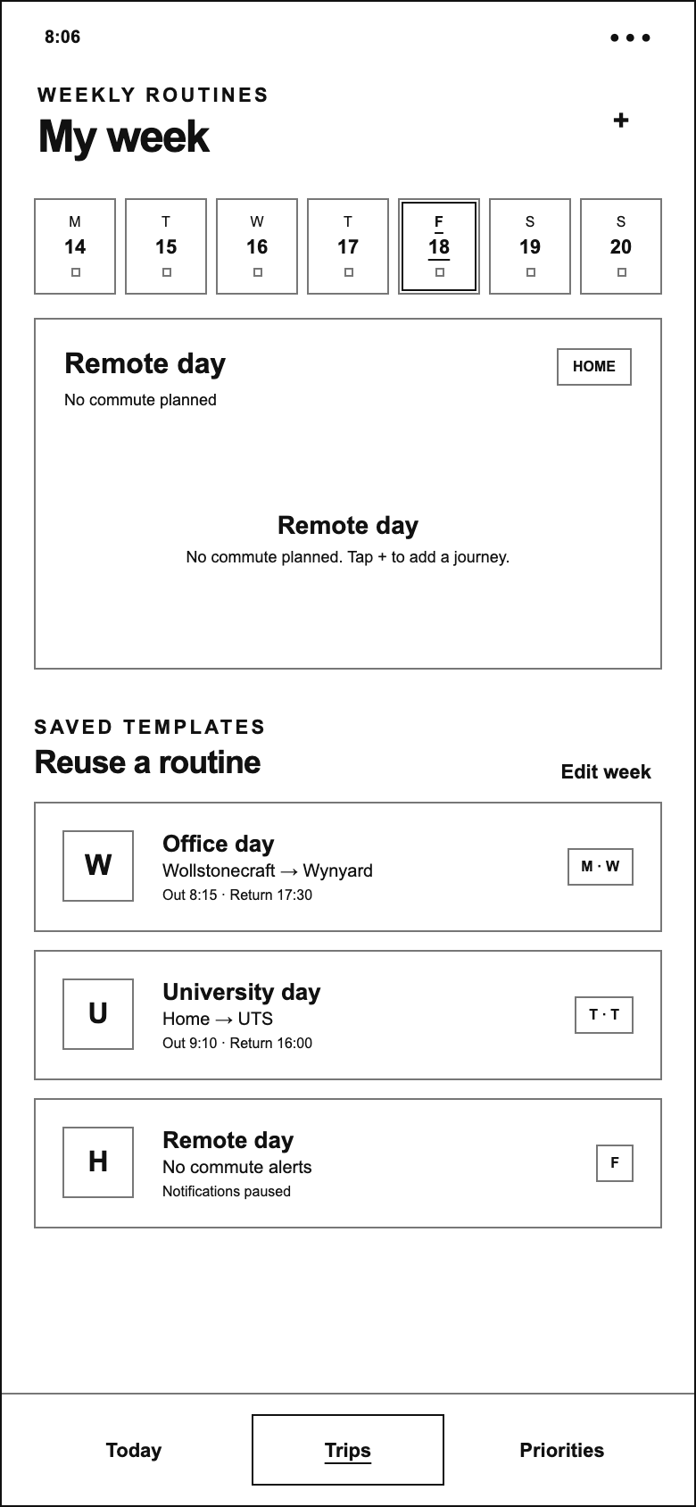
WAYWISE / LOW-FIDELITY WIREFRAMES
My week / Remote day
PURPOSE
Represent a day without a commute.
KEY ELEMENTS
Remote-day label; no-commute state; reusable routine templates.
INTERACTION
Use + to see the routine-editor placeholder.
PROTOTYPE SCOPE
Notification pausing is descriptive only in this demo.
390 × 844 portrait viewport · white canvas / outline-only UI
13 / 17
Notes:
Represent a day without a commute.
Remote-day label; no-commute state; reusable routine templates.
Use + to see the routine-editor placeholder.
Scope: Notification pausing is descriptive only in this demo.
Source: existing Waywise mid-fidelity demo. Wireframe translation created 2026-09-30, not evidence of an earlier design iteration.
Live prototype: https://hancyhxy.github.io/waywise-aid-demo/low-fi/

Slide 14
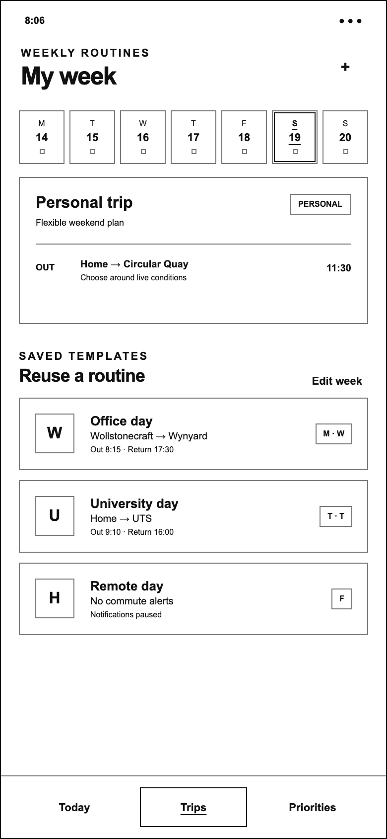
WAYWISE / LOW-FIDELITY WIREFRAMES
My week / Personal trip
PURPOSE
Show a flexible weekend journey.
KEY ELEMENTS
One outbound journey; personal-trip category; departure time.
INTERACTION
Switch days or return to Today.
PROTOTYPE SCOPE
A single-leg routine is retained from the source prototype.
390 × 844 portrait viewport · white canvas / outline-only UI
14 / 17
Notes:
Show a flexible weekend journey.
One outbound journey; personal-trip category; departure time.
Switch days or return to Today.
Scope: A single-leg routine is retained from the source prototype.
Source: existing Waywise mid-fidelity demo. Wireframe translation created 2026-09-30, not evidence of an earlier design iteration.
Live prototype: https://hancyhxy.github.io/waywise-aid-demo/low-fi/

Slide 15
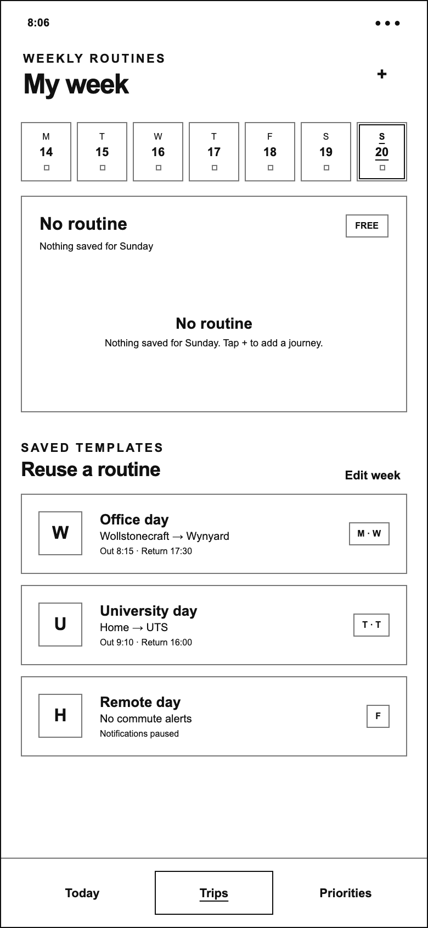
WAYWISE / LOW-FIDELITY WIREFRAMES
My week / No routine
PURPOSE
Show the empty state for an unscheduled day.
KEY ELEMENTS
No saved Sunday journey; guidance to add one.
INTERACTION
Use + to inspect the available editor feedback.
PROTOTYPE SCOPE
The prototype does not implement a complete create/edit form.
390 × 844 portrait viewport · white canvas / outline-only UI
15 / 17
Notes:
Show the empty state for an unscheduled day.
No saved Sunday journey; guidance to add one.
Use + to inspect the available editor feedback.
Scope: The prototype does not implement a complete create/edit form.
Source: existing Waywise mid-fidelity demo. Wireframe translation created 2026-09-30, not evidence of an earlier design iteration.
Live prototype: https://hancyhxy.github.io/waywise-aid-demo/low-fi/

Slide 16
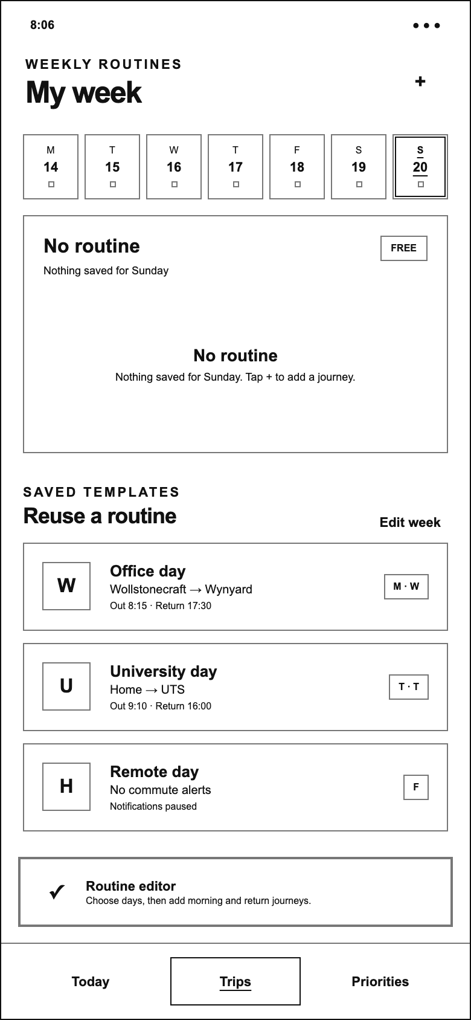
WAYWISE / LOW-FIDELITY WIREFRAMES
Feedback / Routine editor
PURPOSE
Indicate the intended next step for adding a routine.
KEY ELEMENTS
Placeholder feedback describes choosing days and adding journey legs.
INTERACTION
Dismisses automatically; Edit week triggers the same feedback.
PROTOTYPE SCOPE
This is a placeholder, not a working routine editor.
390 × 844 portrait viewport · white canvas / outline-only UI
16 / 17
Notes:
Indicate the intended next step for adding a routine.
Placeholder feedback describes choosing days and adding journey legs.
Dismisses automatically; Edit week triggers the same feedback.
Scope: This is a placeholder, not a working routine editor.
Source: existing Waywise mid-fidelity demo. Wireframe translation created 2026-09-30, not evidence of an earlier design iteration.
Live prototype: https://hancyhxy.github.io/waywise-aid-demo/low-fi/

Slide 17
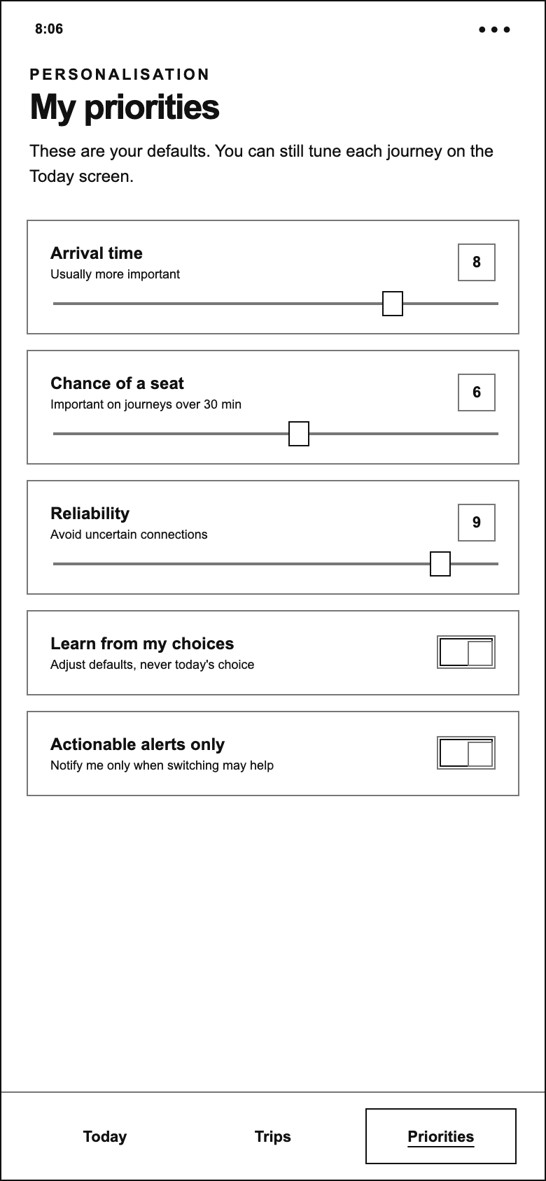
WAYWISE / LOW-FIDELITY WIREFRAMES
Priorities / Default preferences
PURPOSE
Express default priorities separately from today’s context.
KEY ELEMENTS
Arrival time, seat chance and reliability sliders; learning and alert toggles.
INTERACTION
Move a slider or switch a toggle to see its visible state.
PROTOTYPE SCOPE
Controls are visual-only and do not persist or affect route ranking.
390 × 844 portrait viewport · white canvas / outline-only UI
17 / 17
Notes:
Express default priorities separately from today’s context.
Arrival time, seat chance and reliability sliders; learning and alert toggles.
Move a slider or switch a toggle to see its visible state.
Scope: Controls are visual-only and do not persist or affect route ranking.
Source: existing Waywise mid-fidelity demo. Wireframe translation created 2026-09-30, not evidence of an earlier design iteration.
Live prototype: https://hancyhxy.github.io/waywise-aid-demo/low-fi/

