Slide 1
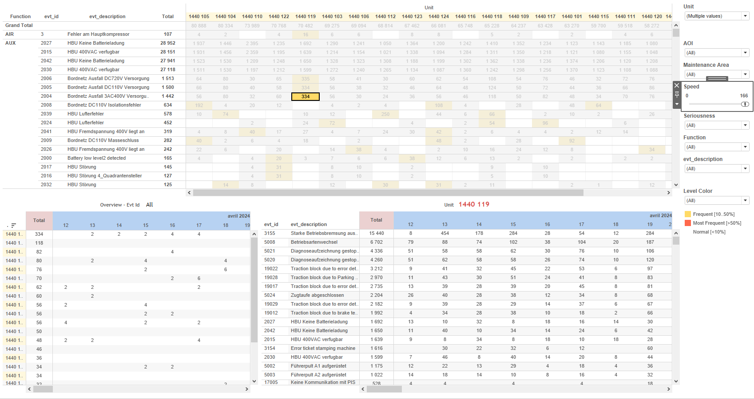
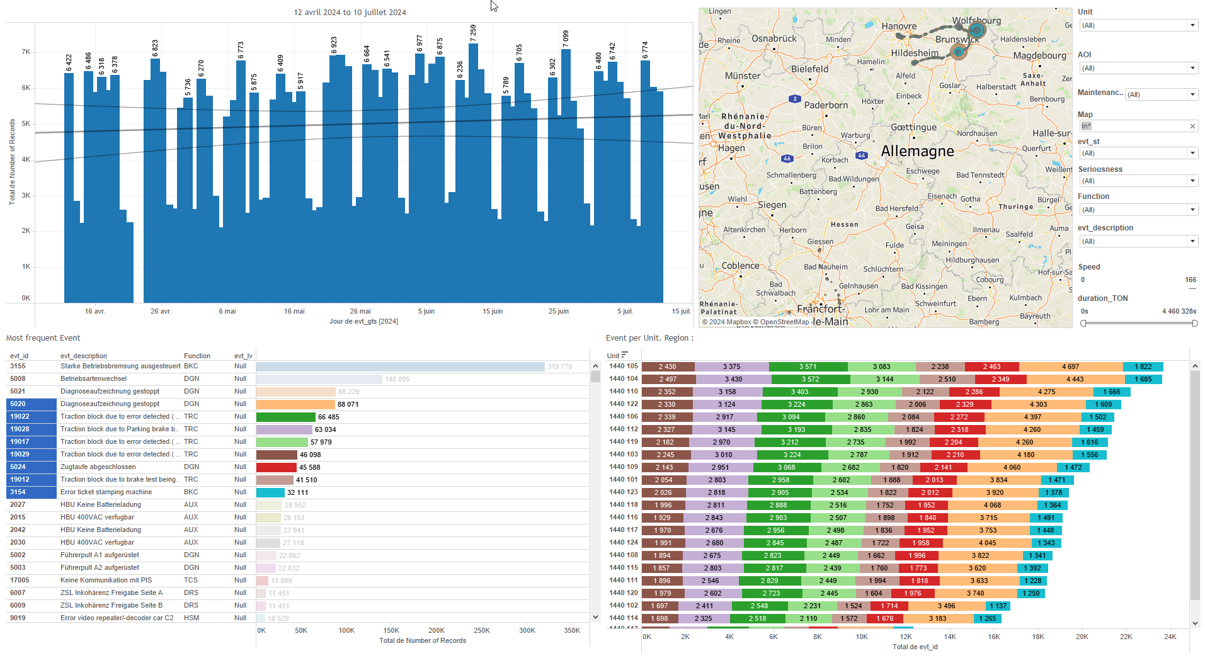
DATA VISUALIZATION REPORT SHEET
HealthHub
Analog
Standard
Event Analysis
Represented By
timestamp Variable In Motion Speed Unit Name Gap value Delta median_value
GENERAL DESCRIPTION
The DashBoard provides a comprehensive analysis of fleet performance and behavior through various visualizations. Users can explore data trends, relationships, and gaps using interactive plots, enabling detailed data exploration and informed decision-making.
MAIN CHARACTERISTICS | Description
Project | Any project
Domain | Statistics, Operational Data
Type of report | Data Exploration - Train Event Data with Contextual Variables
Report's Objective | To provide a comprehensive analysis of fleet performance and behavior through various visualizations. To enable detailed data exploration and informed decision-making. To explore data trends, relationships, and gaps using interactive plots.

Slide 2
Constitution du rapport 1/1
DashBoard Dashboard
The DashBoard provides a comprehensive analysis of fleet performance and behavior through various visualizations. Users can explore data trends, relationships, and gaps using interactive plots, enabling detailed data exploration and informed decision-making.
Position | Exemple de question | Description
bottom left | What is the gap from the median for units in motion? | This visualization displays the gap analysis using the 'Gap' variable on the x-axis and 'Unit' variable on the y-axis. The size of the points is also determined by the 'Gap' variable.
top right | What is the relationship between timestamp and value in the Time View plot? | This line plot visualizes the timestamp against the value. The x-axis represents the timestamp, and the y-axis represents the value. The data is filled with the Variable.
bottom right | What is the behavior of the Delta variable in the dataset? | This area plot visualizes the relationship between Delta (x-axis) and Delta (y-axis). The fill axis represents Variable, which categorizes the data points.
top | What is the average speed (km/h) of the object in motion over time? | This visualization represents the Speed over time. The x-axis displays the timestamp, while the y-axis shows the Speed in real values.
Principaux Filtres/Paramètres
Filtrage par | Description
In Motion | Filtering events based on whether the speed exceeds 5 units, resulting in a boolean output indicating if the entity is 'In Motion'.
timestamp | Filtering by relative dates in datetime format, applicable to workbooks.
Variable | Filtering applicable to workbooks.
timestamp | Filtering applicable to workbooks.
Temperature | Filtering applicable to workbooks based on the temperature data.
timestamp | Filtering by day based on datetime values

Slide 3
Liste des variables
GENERAL DESCRIPTION
La liste des variables ci-dessous est necessaire pour la constitution du rapport. Pour le projet [Projet] leur equivalence doit être fournie avec la plage de Valeur associée en cas de demande de rapport.
Variable | Description
Delta | Delta measures the deviation from a reference value. It is recorded continuously as operational data.
DeltaRef | DeltaRef measures the difference from a reference point in train operations. It is used in various dashboards for performance analysis.
Ecart | Ecart represents the deviation from the median value of a dataset. It is used in various dashboards to analyze train performance data.
Name | This variable represents the name of a component or event in the train's operational data. It is used in various dashboards to filter and plot relevant data.
Ordering | Ordering is an integer variable used in the Histogram dashboard to track order-related data. It is recorded as context data for an event.
Speed | Speed indicates how fast the train is moving. It is recorded continuously as operational data.
Unit | This variable identifies different parts of a train. It is used in various operational and event-related dashboards.
Variable | This variable is used to track operational data for various train components. It is primarily used in dashboards to monitor performance metrics.
median_value | This variable represents the median value of a dataset. It is used in various dashboards to show central tendency.
timestamp | This variable records the date and time of events or operational data. It is crucial for time-based analysis and tracking in dashboards.
value | This variable is recorded continuously as operational data. It is used in various dashboards for different analyses, including speed and temperature monitoring.
NOTE
Les illustrations fournissent un aperçu des représentations graphiques et ne préjugent pas des données pouvant être contenues dans le rapport. En effet, les données peuvent évoluer au cours du projet et dépendent entièrement de celui-ci.
Toute reproduction ou distribution non autorisée de ce rapport est interdite. Les informations contenues dans ce document sont confidentielles et destinées uniquement aux parties mentionnées. L'utilisation ou la divulgation non autorisée de ces informations est passible de poursuites judiciaires. Les représentations graphiques sont fournies à titre indicatif et ne sauraient engager la responsabilité de l'émetteur quant à l'exhaustivité ou l'exactitude des données présentées. Les données sont sujettes à des modifications au fil du projet et doivent être interprétées dans ce contexte.

