Slide 1
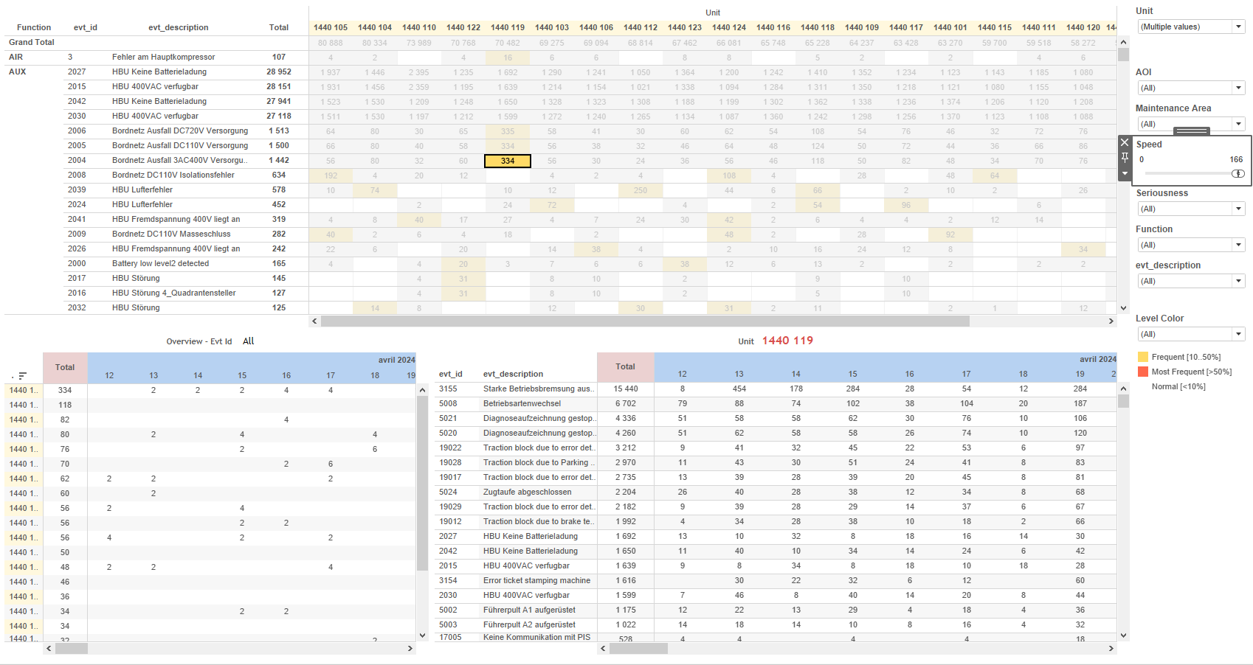
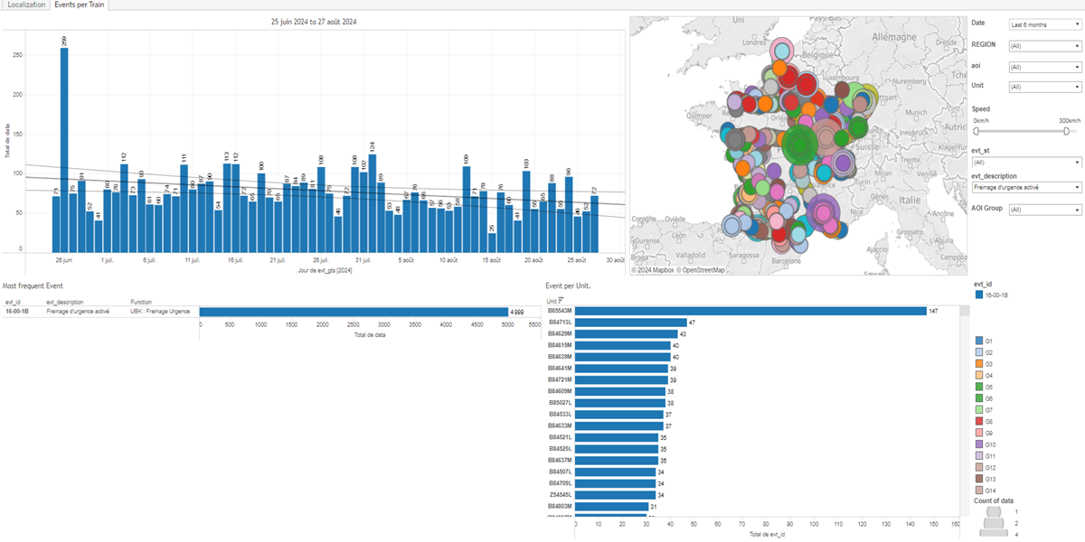
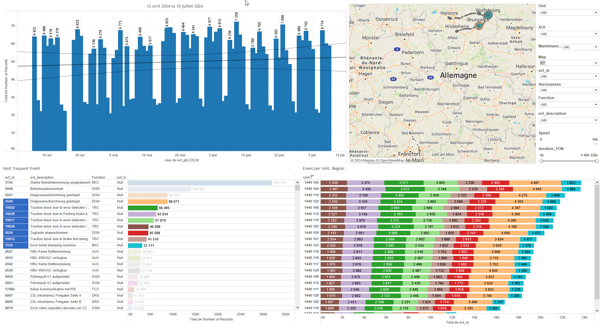
DATA VISUALIZATION REPORT SHEET
HealthHub
Brakes_eb_sb
Standard
Event Analysis
Represented By
AOI Group evt_gts aoi Unit Function evt_spd aoi_ref evt_gps_lat evt_st
GENERAL DESCRIPTION
This report offers a detailed examination of train events, providing insights through multiple visualizations including tables, bar charts, and GPS maps. It allows users to filter data by event type, time, and location to understand event distribution and frequency. The report also explores the geographical distribution and density of events based on GPS coordinates and AOI Group.
MAIN CHARACTERISTICS | Description
Project | Any project
Domain | Event, Exploration
Type of report | Data Exploration - Train Event Data with Contextual Variables
Report's Objective | Provide a comprehensive overview of train-related events. Enable detailed exploration through various visualizations such as tables, bar charts, and GPS maps. Facilitate in-depth analysis of spatial relationships and trends.

Slide 2
Constitution du rapport 1/2
Events per Train Dashboard
The 'Events per Train' dashboard provides a comprehensive overview of train-related events, enabling detailed exploration through various visualizations such as tables, bar charts, and GPS maps. Users can filter data by event type, time, and location to gain insights into event distribution and frequency.
Position | Exemple de question | Description
top left | What are the events per train per day? | This plot visualizes the number of events per train over a day. The x-axis represents time (evt_gts), while the y-axis represents the event data.
bottom left | What is the most frequent event in the dataset? | This plot displays the distribution of 'Function' categories across different 'data (Extract.data)_5E2A4E7065DE4CF89DED893D1476C0B5' values, with each cell colored and valued by 'evt_id'.
bottom right | What are the events per unit and their associated details? | This plot visualizes the number of events per train unit. The x-axis represents the event IDs (evt_id), while the y-axis shows the unit count (Unit). The fill axis uses event IDs (evt_id) for color and value representation.
top right | What are the events per train based on GPS coordinates and AOI Group? | This visualization displays GPS coordinates with circles representing events per train. The x-axis represents 'evt_gps_lon' (longitude) and the y-axis represents 'evt_gps_lat' (latitude). The color fill is based on the 'AOI Group'.
Principaux Filtres/Paramètres
Filtrage par | Description
aoi | Filtering all or part of the project's 'AOI' (Area Of Interest)
evt_gts | Filtering by date and time based on the provided source data.

Slide 3
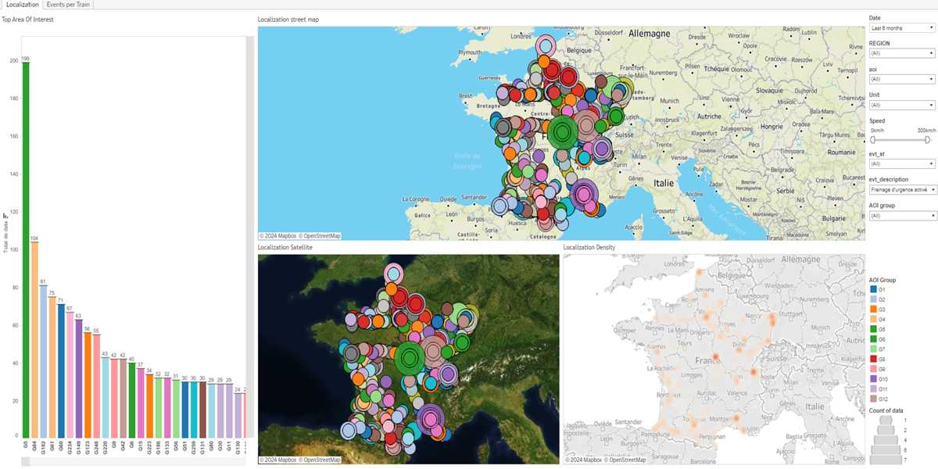
Constitution du rapport 2/2
Localization Dashboard
The 'Localization' dashboard provides a comprehensive overview of the geographical distribution and density of events based on GPS coordinates and AOI Group. It allows for detailed data exploration through various visualizations including maps, tables, and heatmaps, facilitating an in-depth analysis of spatial relationships and trends.
Position | Exemple de question | Description
top | What is the localization of events based on GPS coordinates and AOI group? | This plot visualizes the geographical coordinates with longitude on the x-axis and latitude on the y-axis. The AOI Group is used to color-code the regions.
left | What is the top area of interest based on the calculated AOI Group and Speed variables? | This plot displays the AOI Group categorized by data (Extract.data)_5E2A4E7065DE4CF89DED893D1476C0B5. Each cell is colored and valued based on the AOI Group.
bottom left | What is the relationship between the AOI Group and the geographic coordinates (latitude and longitude) of the events? | This plot visualizes the geographical distribution using longitude (evt_gps_lon) and latitude (evt_gps_lat) with color coding based on AOI Group.
bottom right | What is the distribution of localization density based on AOI Group and GPS coordinates? | This heatmap visualizes the relationship between longitude (evt_gps_lon) and latitude (evt_gps_lat) with data values represented by color intensity. The data is sourced from 'data (Extract.data)_5E2A4E7065DE4CF89DED893D1476C0B5'.
Principaux Filtres/Paramètres
Filtrage par | Description
evt_gts | Filtering events by datetime from the source [data].
AOI Group | Filtering all or part of the project's 'AOI' (Area Of Interest)
evt_gts | Filtering events by datetime. Source: [data]. Used: False. Filter caption: Date.
AOI Group | Filtering all or part of the project's 'AOI' (Area Of Interest)
evt_gts | Filtering events by datetime from the source data.
AOI Group | Filtering all or part of the project's 'AOI' (Area Of Interest)

Slide 4
Liste des variables
GENERAL DESCRIPTION
La liste des variables ci-dessous est necessaire pour la constitution du rapport. Pour le projet [Projet] leur equivalence doit être fournie avec la plage de Valeur associée en cas de demande de rapport.
Variable | Description
Function | The function describes the purpose of a specific train-related variable. It is used across multiple dashboards for different analyses.
REGION | The region variable helps in identifying different areas of interest within the train network. It is used extensively in various dashboards to filter and plot data.
Unit | This variable identifies a specific part of a train. It is used across various dashboards for event and operational data analysis.
aoi | AOI is a variable representing the Area of Interest in train operations. It is used in multiple dashboards to analyze event localization and speed.
aoi_ref | The variable is used to identify areas of interest within train data. It is crucial for event localization and operational analysis.
evt_description | This variable provides descriptions for events recorded in the system. It is used to label and categorize events for better analysis.
evt_gps_lat | This variable represents the latitude coordinate recorded during an event. It is used to plot the location of events on a map.
evt_gps_lon | This variable represents the longitude from the GPS data of an event. It is used in various dashboards to map the location of events.
evt_gts | This variable captures the timestamp of an event. It is crucial for analyzing event timelines and trends.
evt_id | This variable is used to identify specific events in the system. It is recorded as context data for various event-related dashboards.
evt_spd | This variable represents the speed of the train during an event. It is recorded as context data for various dashboards.
NOTE
Les illustrations fournissent un aperçu des représentations graphiques et ne préjugent pas des données pouvant être contenues dans le rapport. En effet, les données peuvent évoluer au cours du projet et dépendent entièrement de celui-ci.
Toute reproduction ou distribution non autorisée de ce rapport est interdite. Les informations contenues dans ce document sont confidentielles et destinées uniquement aux parties mentionnées. L'utilisation ou la divulgation non autorisée de ces informations est passible de poursuites judiciaires. Les représentations graphiques sont fournies à titre indicatif et ne sauraient engager la responsabilité de l'émetteur quant à l'exhaustivité ou l'exactitude des données présentées. Les données sont sujettes à des modifications au fil du projet et doivent être interprétées dans ce contexte.

