Slide 1
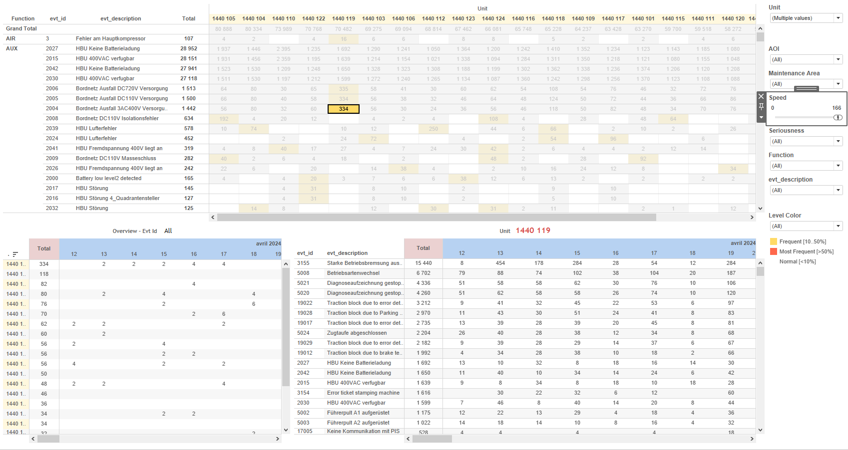
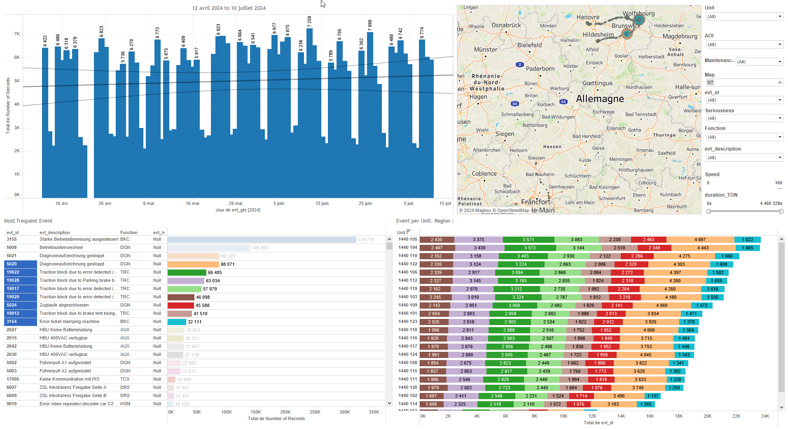
DATA VISUALIZATION REPORT SHEET
HealthHub
Burst_detection
Standard
Event Analysis
Represented By
evt_id Date evt_gts Unit Cnt evt_description aoi Hour Value idx
GENERAL DESCRIPTION
The 'Bursts' dashboard provides a comprehensive analysis of event data across different units and time periods. It allows users to explore trends, distributions, and contexts of bursts through various visualizations such as tables, line charts, and polygon charts, facilitating detailed data exploration and interaction between different plots.
MAIN CHARACTERISTICS | Description
Project | Any project
Domain | Event,Operational Data
Type of report | Data Exploration - Train Event Data with Contextual Variables
Report's Objective | Provide a comprehensive analysis of event data across different units and time periods. Explore trends, distributions, and contexts of bursts through various visualizations. Facilitate detailed data exploration and interaction between different plots.

Slide 2
Constitution du rapport 1/1
Bursts Dashboard
The 'Bursts' dashboard provides a comprehensive analysis of event data across different units and time periods. It allows users to explore trends, distributions, and contexts of bursts through various visualizations such as tables, line charts, and polygon charts, facilitating detailed data exploration and interaction between different plots.
Position | Exemple de question | Description
top left | What are the event details, including unit, event ID, and description, represented in a bar chart? | This table visualizes the distribution of evt_id across different Units. Each cell is color-coded based on the evt_id value, providing a clear and readable representation of the data.
top | What is the trend of bursts over time? | This plot shows the Date on the x-axis and evt_id on the y-axis. Each cell is colored and valued based on evt_id.
center | What is the trend of bursts over time? | This visualization shows the distribution of data over different hours of the day, using 'Date' on the x-axis and 'Hour' on the y-axis. The 'Cnt' variable is used to display the count in each cell.
bottom left | What is the context of bursts over time? | This line chart displays the 'Value' over time, with 'evt_gts' on the x-axis and 'Value' on the y-axis. The 'variable' is used for color coding each data point.
Principaux Filtres/Paramètres
Filtrage par | Description

Slide 3
Liste des variables
GENERAL DESCRIPTION
La liste des variables ci-dessous est necessaire pour la constitution du rapport. Pour le projet [Projet] leur equivalence doit être fournie avec la plage de Valeur associée en cas de demande de rapport.
Variable | Description
Cnt | The variable represents the count of events detected in the system. It is used in various burst detection dashboards to track trends over time.
NbEvt | This variable represents the number of events recorded. It is used in burst detection analysis.
Time | This variable represents the time at which events occur. It is recorded continuously as operational data.
Unit | This variable identifies parts of a train and is recorded continuously as operational data.
aoi | Area of Interest (AOI) is used to identify specific parts of the train. It is recorded as context data during events.
evt_description | Description of events captured in the system. Used in various dashboards for analyzing operational incidents.
evt_gts | The event timestamp is used to track and log specific occurrences in the system. It is crucial for identifying and analyzing events over time.
evt_gts_end | This variable represents the end timestamp of a ground test sequence. It is used in the Bursts dashboard to calculate the duration of events.
evt_gts_start | This variable records the start time of an event in the system. It is used in burst detection analysis.
evt_id | This variable is an identifier for specific events recorded on trains. It is used in various dashboards to track and analyze these events.
idx | The variable 'idx' is an integer used to identify events in various dashboards. It is crucial for tracking and analyzing event data.
NOTE
Les illustrations fournissent un aperçu des représentations graphiques et ne préjugent pas des données pouvant être contenues dans le rapport. En effet, les données peuvent évoluer au cours du projet et dépendent entièrement de celui-ci.
Toute reproduction ou distribution non autorisée de ce rapport est interdite. Les informations contenues dans ce document sont confidentielles et destinées uniquement aux parties mentionnées. L'utilisation ou la divulgation non autorisée de ces informations est passible de poursuites judiciaires. Les représentations graphiques sont fournies à titre indicatif et ne sauraient engager la responsabilité de l'émetteur quant à l'exhaustivité ou l'exactitude des données présentées. Les données sont sujettes à des modifications au fil du projet et doivent être interprétées dans ce contexte.

