Slide 1
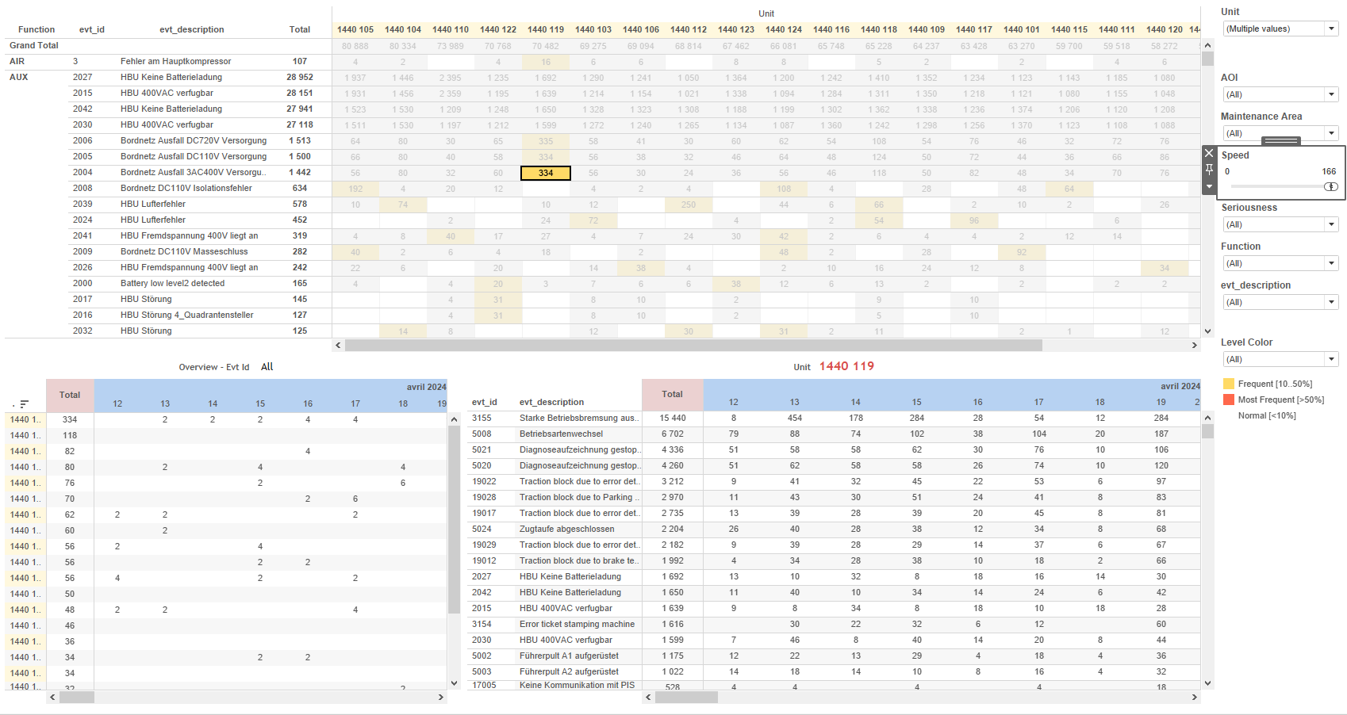
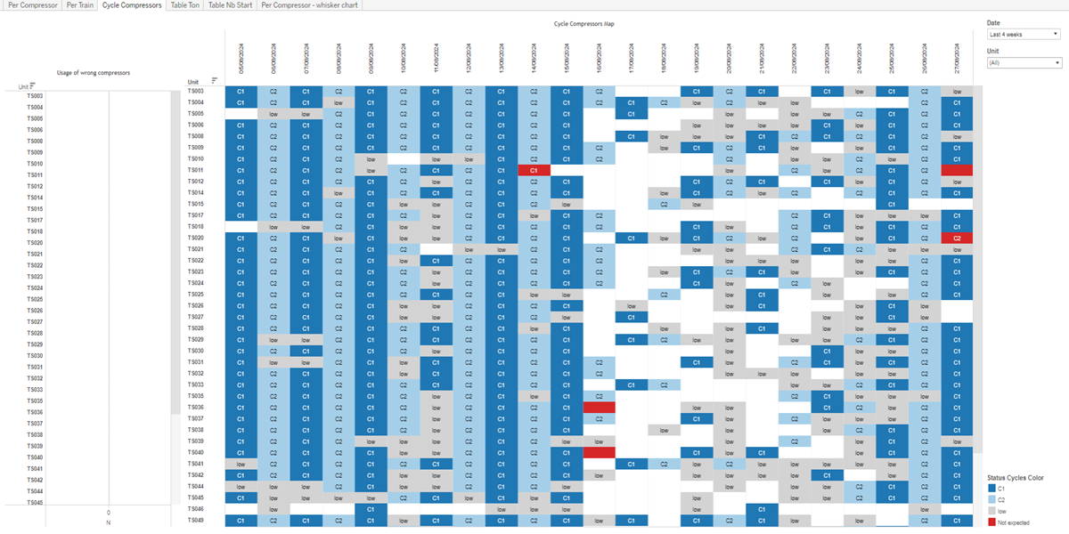
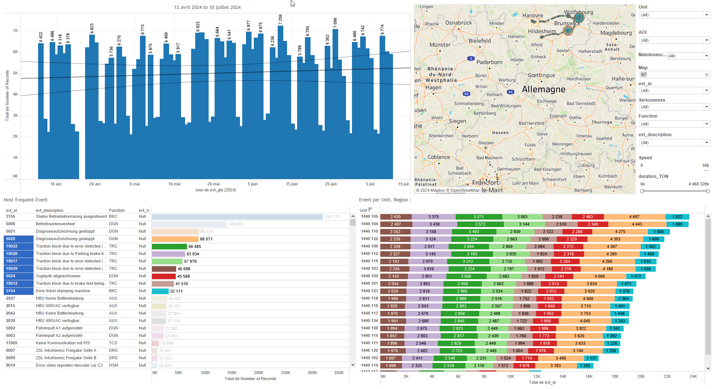
DATA VISUALIZATION REPORT SHEET
HealthHub
Compressors_Alert
Standard
Event Analysis
Represented By
CompExpected Date Unit day Compressors Today Ton Time On Duty_Cycle St
GENERAL DESCRIPTION
The report provides a comprehensive overview of compressor and train performance metrics, with detailed data exploration through interactive visualizations. It includes analysis of status cycles, operational metrics, and cumulative starts, allowing for in-depth insights into efficiency and performance trends over time.
MAIN CHARACTERISTICS | Description
Project | Any project
Domain | Statistics,Exploration
Type of report | Data Exploration - Operational Time Series (OPDAT)
Report's Objective | Provide insights into the status cycles of compressors over time. Analyze compressor performance including rank order based on operational metrics. Explore trends over time and interact with various visualizations to gain insights into compressor efficiency and performance. Provide a comprehensive view of train performance metrics including rank order based on Time On, Cycle, or Duty Cycle. Facilitate detailed exploration of cumulative starts and expected values through interactive tables.

Slide 2
Constitution du rapport 1/5
Cycle Compressors Dashboard
The 'Cycle Compressors' dashboard provides insights into the status cycles of compressors over time and their impact on cycle performance. It allows for detailed exploration of unit data and distribution across different values, with interactive visualizations that highlight the relationship between unit, date, and status cycles color.
Position | Exemple de question | Description
top | What is the relationship between the unit and date variables in the Cycle Compressors Map, considering the status cycles color and calculation values? | This visualization represents the 'Unit' data over time ('Date') using a bar chart. Each bar is colored based on the 'Status Cycles Color', which is determined by a formula. The chart provides insights into the status cycles of compressors over the given dates.
bottom | What is the impact of using the wrong compressors on the cycle? | This plot displays the distribution of Unit across different N values, with each cell filled based on CompExpected.
Principaux Filtres/Paramètres
Filtrage par | Description

Slide 3
Constitution du rapport 2/5
Per Compressor Dashboard
The 'Per Compressor' dashboard provides an in-depth analysis of compressor performance, including rank order based on operational metrics, detailed 'Time On' data, and distribution of compressors by tonnage. It allows users to filter data by unit and expected value, explore trends over time, and interact with various visualizations to gain insights into compressor efficiency and performance.
Position | Exemple de question | Description
top | What is the rank order based on the sum of Time On, number of starts, and Duty Cycle for compressors? | This visualization displays the expected compressor performance categorized by unit and expected value. The x-axis represents the tonnage, while the y-axis categorizes compressors. Each cell is filled based on the expected compressor performance.
bottom | What is the median duty cycle and ton trend over time for the compressors? | This visualization shows the 'Time On' for each day. The 'Time On' is calculated as the sum of 'Ton' divided by 3600, and it is categorized by 'CompExpected'.
bottom right | What is the distribution of compressors expected today, and how is it represented in terms of tonnage? | This plot displays data using circles to represent values in tons.
Principaux Filtres/Paramètres
Filtrage par | Description

Slide 4
Constitution du rapport 3/5
Per Train Dashboard
The 'Per Train' dashboard provides a comprehensive view of train performance metrics, including rank order based on Time On, Cycle, or Duty Cycle, and detailed duty cycle data for each day. It allows for detailed data exploration through interactive tables that highlight relationships between variables and provide insights based on CompExpected.
Position | Exemple de question | Description
top | What is the rank order based on Time On, Cycle, or Duty Cycle? | This visualization displays the relationship between DiffDuty_Cycle and Unit, with CompExpected used for color and value of each cell. The x-axis represents DiffDuty_Cycle, while the y-axis represents Unit, a categorical variable. The plot is automatically determined to be a table.
bottom | What are the details of the duty cycle for today based on the provided variables and calculations? | This plot visualizes the 'Time On' for each 'day'. The 'CompExpected' variable is used to fill the color and value of each cell.
Principaux Filtres/Paramètres
Filtrage par | Description

Slide 5
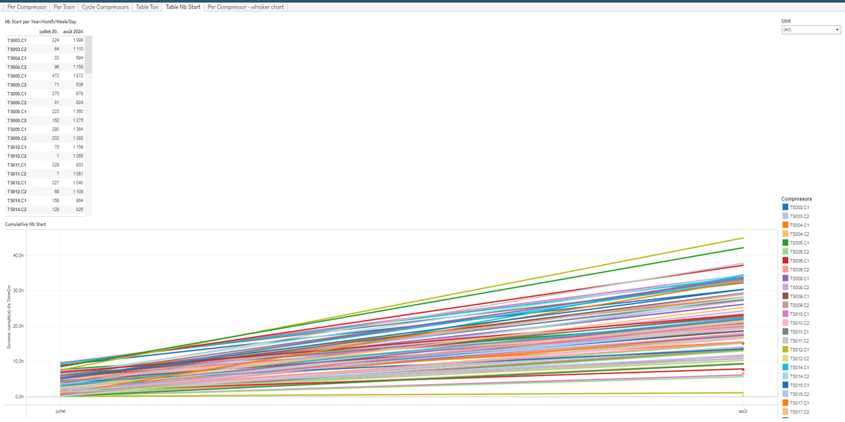
Constitution du rapport 4/5
Table Nb Start Dashboard
The 'Table Nb Start' dashboard provides an in-depth analysis of compressor performance over time. It allows users to filter data by date and compressor unit, facilitating detailed exploration of cumulative starts and expected values through interactive tables.
Position | Exemple de question | Description
bottom | How does the cumulative number of starts vary over time, considering different units and expected compressor values? | This visualization shows the time spent on various compressors over different dates. The data is represented in a table format with each cell color-coded based on the compressor and its expected value.
top | What are the expected compressor starts per unit on different dates? | This table visualizes the data for Compressors over time. The x-axis represents Date, while the y-axis shows Compressors categorized by the formula STR([Unit])+'.'+[CompExpected]. The text axis is represented by St.
Principaux Filtres/Paramètres
Filtrage par | Description

Slide 6
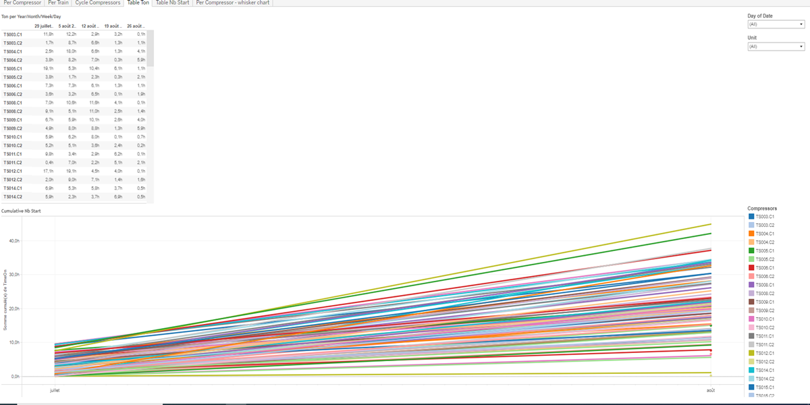
Constitution du rapport 5/5
Table Ton Dashboard
The 'Table Ton' dashboard provides a comprehensive analysis of compressor usage over time. It allows users to explore trends in compressor activity and cumulative starts, with interactive tables that highlight key metrics based on date and compressor unit.
Position | Exemple de question | Description
top | What is the trend of Ton per Year/Month/Week/Day based on the given variables? | This table visualizes the relationship between Date and Compressors. Each cell is color-coded and represents the value derived from the formula STR([Unit])+'.'+[CompExpected].
bottom | What is the cumulative number of starts over time for different compressors? | This visualization displays the total time on compressors in hours, categorized by date. Each cell is color-coded based on the compressor unit and expected compressor.
Principaux Filtres/Paramètres
Filtrage par | Description

Slide 7
Liste des variables
GENERAL DESCRIPTION
La liste des variables ci-dessous est necessaire pour la constitution du rapport. Pour le projet [Projet] leur equivalence doit être fournie avec la plage de Valeur associée en cas de demande de rapport.
Variable | Description
CompExpected | This variable indicates the expected state of the compressor. It is used to compare with actual states for monitoring purposes.
Date | This variable represents the date and time of events. It is crucial for temporal analysis in various dashboards.
DiffDuty_Cycle | This variable measures the difference in duty cycles of compressors. It is used to track compressor performance across trains.
DiffNbStart | The variable measures the difference in the number of starts between two points in time. It is used to monitor the operational status of train compressors.
DiffTon | Difference in tons between expected and actual compressor performance. It is used in the context of ranking and operational analysis.
Duty_Cycle | This variable represents the duty cycle of the compressors. It is used to measure the operational efficiency of the compressors in the train system.
N | This variable represents a real number recorded as operational data. It is used in multiple dashboards for various calculations.
NbStartC1 | Number of starts for compressor C1. Recorded as operational data.
NbStartC2 | This variable represents the number of starts for the second compressor. It is recorded as operational data and used in multiple dashboards.
NbStartC3 | This variable tracks the number of times a compressor starts. It is recorded as operational data.
NbStartC4 | This variable counts the number of compressor starts. It is recorded continuously as operational data.
NOTE
Les illustrations fournissent un aperçu des représentations graphiques et ne préjugent pas des données pouvant être contenues dans le rapport. En effet, les données peuvent évoluer au cours du projet et dépendent entièrement de celui-ci.
Toute reproduction ou distribution non autorisée de ce rapport est interdite. Les informations contenues dans ce document sont confidentielles et destinées uniquement aux parties mentionnées. L'utilisation ou la divulgation non autorisée de ces informations est passible de poursuites judiciaires. Les représentations graphiques sont fournies à titre indicatif et ne sauraient engager la responsabilité de l'émetteur quant à l'exhaustivité ou l'exactitude des données présentées. Les données sont sujettes à des modifications au fil du projet et doivent être interprétées dans ce contexte.

