Slide 1
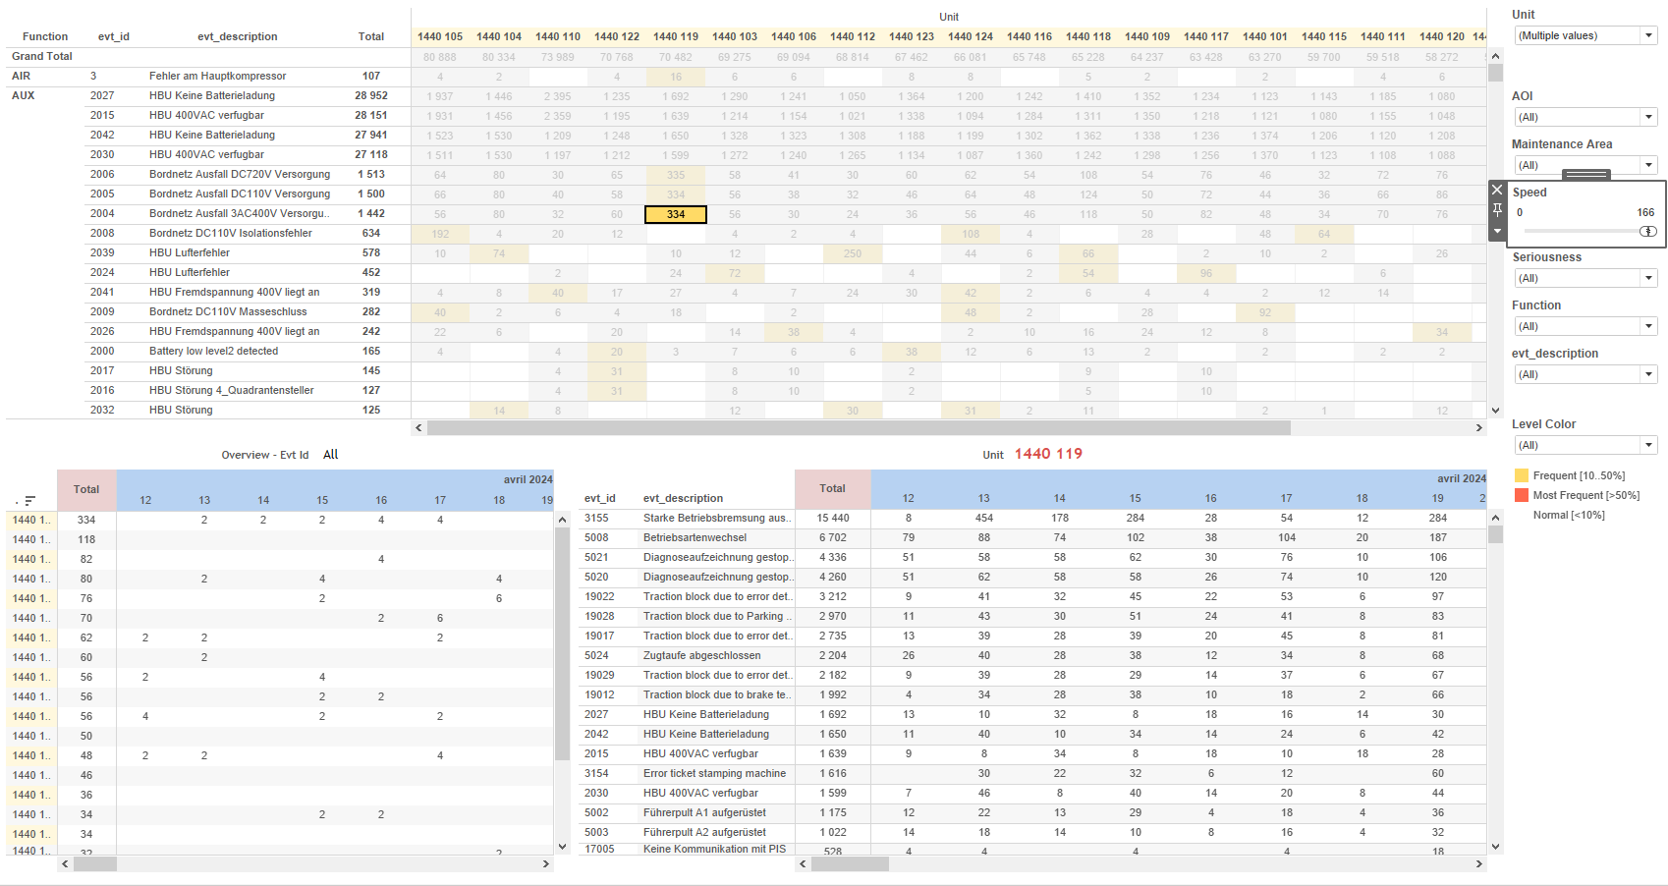
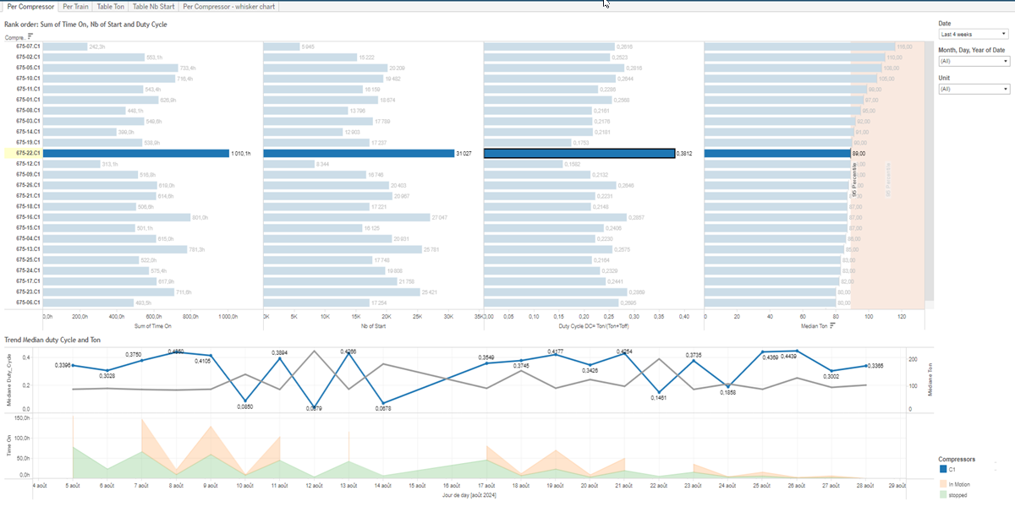
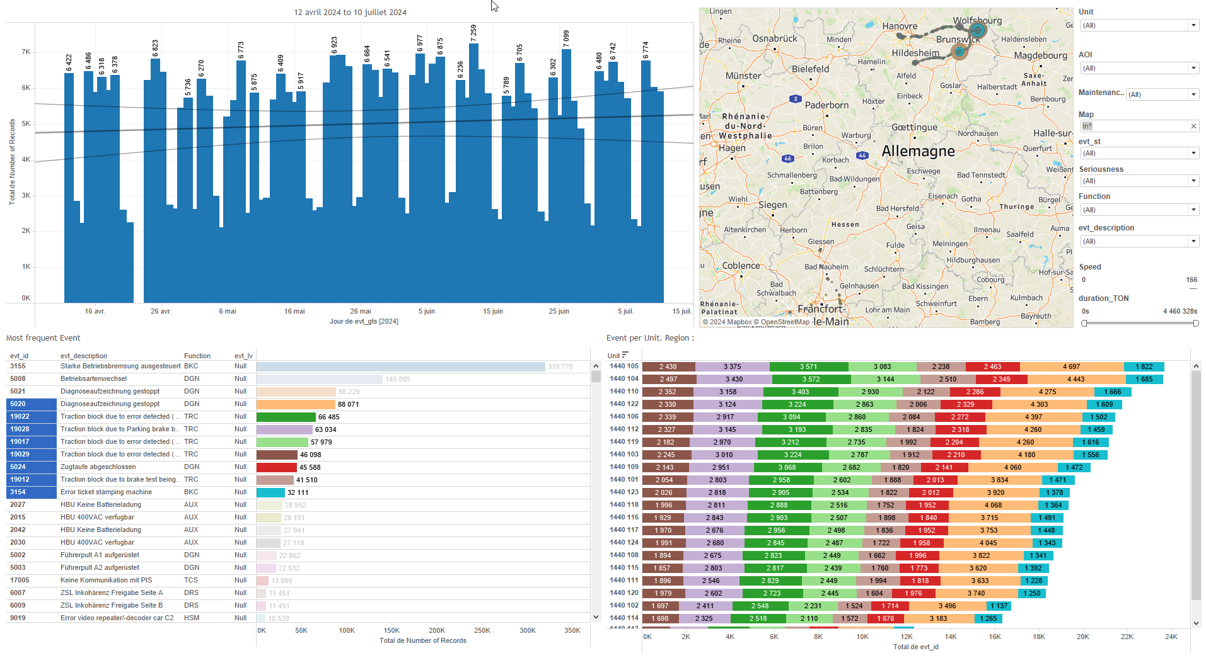
DATA VISUALIZATION REPORT SHEET
HealthHub
Compressors_Alert_NoSeq
Standard
Event Analysis
Represented By
CompExpected Date Compressors day Unit Ton Time On Today Duty_Cycle St
GENERAL DESCRIPTION
This report provides a comprehensive overview of compressor performance and duty cycles, showcasing detailed trends, rank orders, and distributions. It allows users to explore data in depth through interactive tables and graphs, enabling detailed data exploration and interaction between various visualizations.
MAIN CHARACTERISTICS | Description
Project | Any project
Domain | Statistics,Exploration
Type of report | Data Exploration - Operational Time Series (OPDAT)
Report's Objective | Provide comprehensive analysis of compressor performance and duty cycles. Enable detailed data exploration and interaction between various visualizations. Showcase the rank order of time on, cycle, or duty cycle. Facilitate in-depth analysis and comparison of compressor starts over time.

Slide 2
Constitution du rapport 1/4
Per Compressor Dashboard
The 'Per Compressor' dashboard provides a comprehensive analysis of compressor performance and duty cycles. It allows users to explore detailed trends, rank orders, and distributions, facilitating in-depth data exploration and interaction between various visualizations.
Position | Exemple de question | Description
top | What is the rank order based on the sum of Time On, number of Starts, and Duty Cycle? | This visualization shows the distribution of compressors based on their expected performance and duty cycle. The x-axis represents the Ton, while the y-axis categorizes the compressors. The color fill represents the expected performance of each compressor.
bottom left | What is the trend of the median duty cycle and Ton over time? | This visualization shows the time on for each day, color-coded by the expected compressor. The time on is calculated as the sum of ton-hours divided by 3600.
bottom right | What is the expected compressor performance on a given day based on the unit and other variables? | This visualization displays the distribution of 'Ton' values using a Circle chart. The y-axis represents 'Ton' which is a real number.
Principaux Filtres/Paramètres
Filtrage par | Description

Slide 3
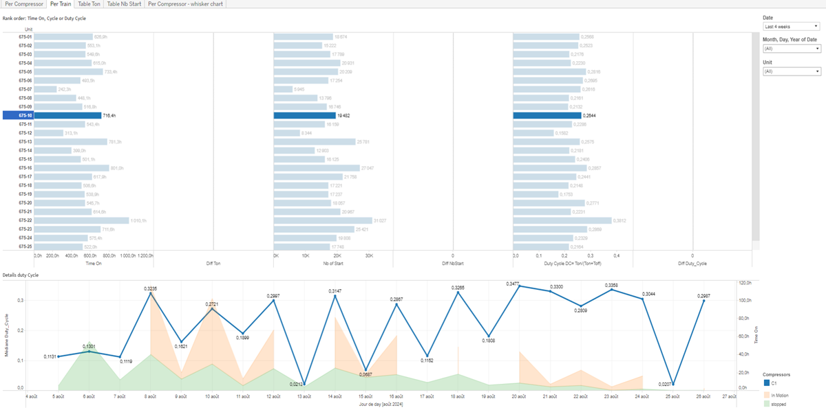
Constitution du rapport 2/4
Per Train Dashboard
The 'Per Train' dashboard provides a comprehensive analysis of train performance by showcasing the rank order of time on, cycle, or duty cycle, and detailing the expected completion status over time. It allows for detailed data exploration through interactive tables and graphs, enabling users to filter and drill down into specific metrics.
Position | Exemple de question | Description
top | What is the rank order of Time On, Cycle, or Duty Cycle? | This visualization shows the distribution of CompExpected across different Units, with DiffDuty_Cycle on the x-axis and Duty_Cycle providing additional context.
bottom | What is the duty cycle details based on the given variables and their formulas? | This visualization shows the time on (in hours) for each day, colored by the expected completion status.
Principaux Filtres/Paramètres
Filtrage par | Description

Slide 4
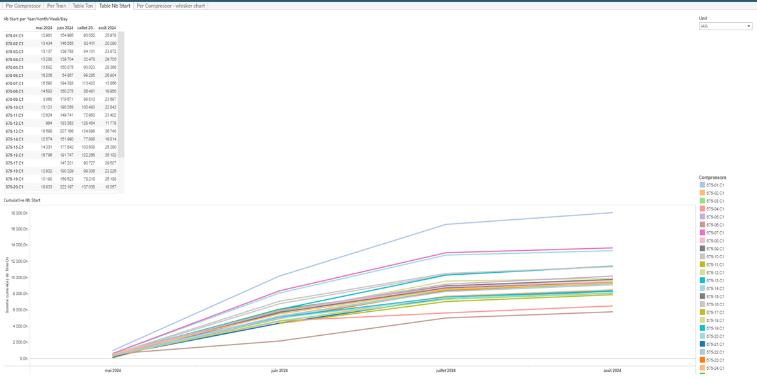
Constitution du rapport 3/4
Table Nb Start Dashboard
The 'Table Nb Start' dashboard provides a comprehensive overview of compressor starts over time, allowing users to filter data by dates and compressors. It enables detailed exploration through interactive tables that display cumulative starts and starts per time period, facilitating in-depth analysis and comparison.
Position | Exemple de question | Description
bottom | What is the cumulative number of starts for compressors over time? | This visualization displays the 'TimeOn' calculation in hours (Ton/3600) over different dates. The cells are filled with 'Compressors' information derived from the formula STR([Unit])+'.'+[CompExpected].
top | What is the number of starts per Year/Month/Week/Day for each unit and compressor? | This table displays data with Date on the x-axis and Compressors on the y-axis. Each cell is colored and valued based on the 'St' variable.
Principaux Filtres/Paramètres
Filtrage par | Description

Slide 5
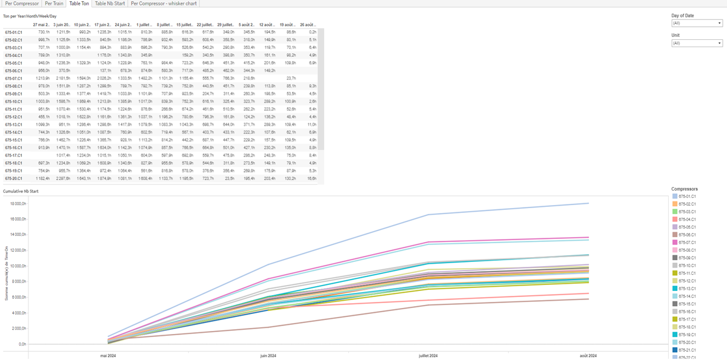
Constitution du rapport 4/4
Table Ton Dashboard
The 'Table Ton' dashboard provides insights into the relationship between Date and Compressors usage over different time periods and the cumulative number of starts for compressors. It allows users to explore data in detail through interactive tables that summarize key metrics and trends.
Position | Exemple de question | Description
top | How does the compressor usage and time on correlate over different time periods (Year/Month/Week/Day)? | This table shows the relationship between Date and Compressors. The color and value of each cell represent the summarized information based on the provided formula.
bottom | What is the cumulative number of starts for the compressors over time? | This visualization shows the relationship between Date and TimeOn. Each cell is filled with Compressors, calculated as STR([Unit])+'.'+[CompExpected].
Principaux Filtres/Paramètres
Filtrage par | Description

Slide 6
Liste des variables
GENERAL DESCRIPTION
La liste des variables ci-dessous est necessaire pour la constitution du rapport. Pour le projet [Projet] leur equivalence doit être fournie avec la plage de Valeur associée en cas de demande de rapport.
Variable | Description
CompExpected | This variable indicates the expected state of the compressor. It is used in various plots to show compressor performance.
Date | This variable records the date and time of events. It is used in various dashboards for tracking and analysis.
DiffDuty_Cycle | This variable represents the difference in duty cycle of compressors over time. It is used to monitor compressor performance and efficiency.
DiffNbStart | The difference in the number of starts is recorded as operational data. It helps in analyzing the performance of train compressors.
DiffTon | The difference in tons recorded by compressors over a specific period. Used to monitor compressor performance.
Duty_Cycle | Duty Cycle measures the operational load of compressors. It is used to rank and trend compressor performance.
NbStartC2 | This variable counts the number of compressor starts. It is used in various operational dashboards to monitor compressor performance.
NbStartC3 | The variable represents the number of starts for a specific compressor in the train. It is used to monitor compressor performance and operational status.
NbStartC4 | Number of compressor starts recorded for operational analysis. Helps monitor compressor performance over time.
Speed | Speed indicates how fast the train is moving. It is recorded continuously as operational data.
St | The variable measures the number of starts for compressors in various contexts. It is used in multiple dashboards to track compressor performance and operational metrics.
NOTE
Les illustrations fournissent un aperçu des représentations graphiques et ne préjugent pas des données pouvant être contenues dans le rapport. En effet, les données peuvent évoluer au cours du projet et dépendent entièrement de celui-ci.
Toute reproduction ou distribution non autorisée de ce rapport est interdite. Les informations contenues dans ce document sont confidentielles et destinées uniquement aux parties mentionnées. L'utilisation ou la divulgation non autorisée de ces informations est passible de poursuites judiciaires. Les représentations graphiques sont fournies à titre indicatif et ne sauraient engager la responsabilité de l'émetteur quant à l'exhaustivité ou l'exactitude des données présentées. Les données sont sujettes à des modifications au fil du projet et doivent être interprétées dans ce contexte.

