Slide 1
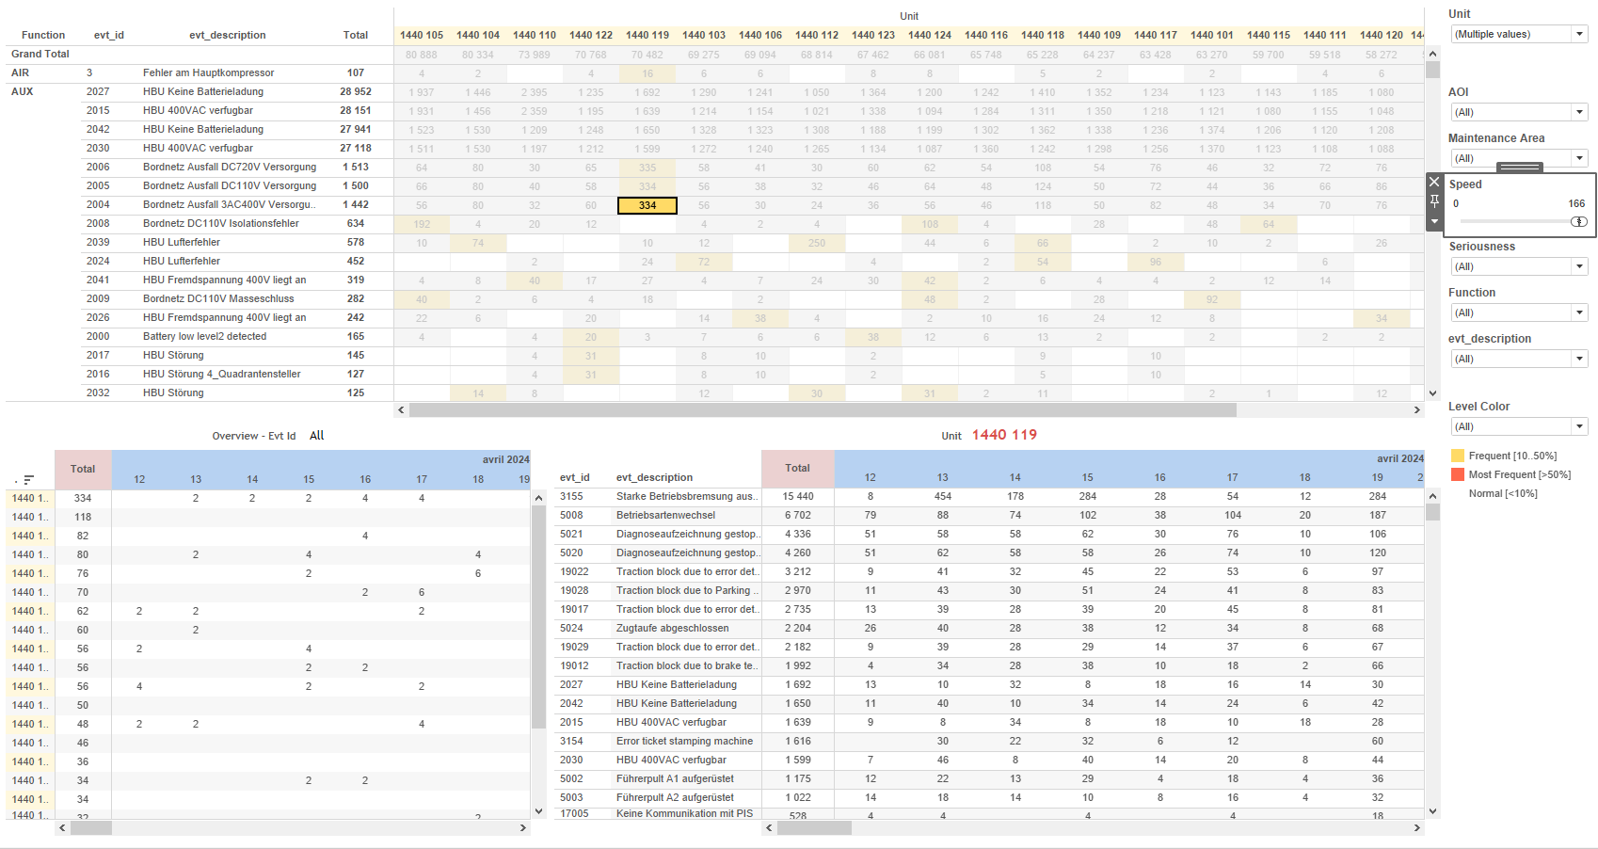
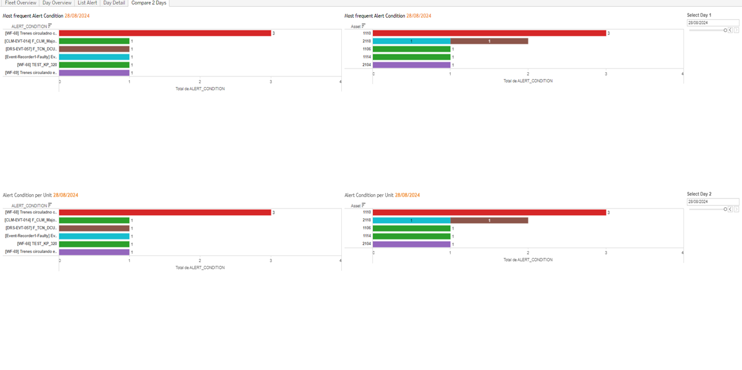
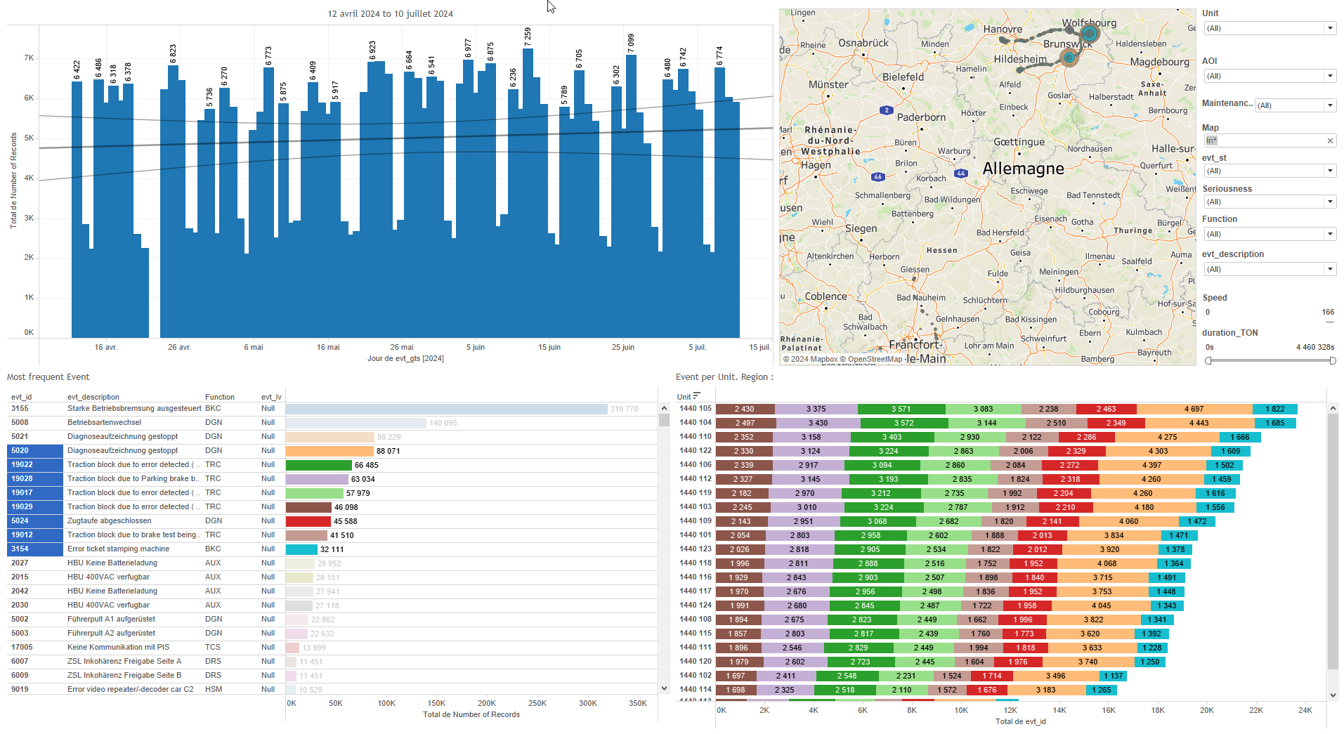
DATA VISUALIZATION REPORT SHEET
HealthHub
Daily_Alert_Condition
Standard
Event Analysis
Represented By
ALERT_CONDITION id Asset Timestamp Timestamp Day Day Selected Occurence Date Period Days History Day Previous Occurence
GENERAL DESCRIPTION
This report provides comprehensive data visualizations and exploration capabilities for train equipment. It includes dashboards for comparing alert conditions across two days, detailed analysis of alert distributions per unit, fleet operations overview, and historical comments related to assets. The report aims to facilitate in-depth data analysis and interaction between different visualizations to identify patterns and anomalies.
MAIN CHARACTERISTICS | Description
Project | Any project
Domain | Event,Operational Data
Type of report | Data Exploration - Train Event Data with Contextual Variables
Report's Objective | Provide a detailed comparison of alert conditions across two days. Facilitate exploration of alert distributions per unit over a day. Analyze fleet operations and alert conditions over the last 100 days. Offer a historical overview of comments related to assets.

Slide 2
Constitution du rapport 1/5
Compare 2 Days Dashboard
The 'Compare 2 Days' dashboard allows users to explore the relationship between ALERT_CONDITION and Asset across two days. It provides detailed tables that categorize alert conditions by asset and unit, facilitating easy comparison and in-depth data analysis.
Position | Exemple de question | Description
top right | What is the most frequent alert condition for the selected day, categorized by asset? | This plot visualizes the relationship between ALERT_CONDITION and Asset. ALERT_CONDITION is used to color and value each cell.
bottom right | What is the alert condition per unit for the given timestamp and asset? | This plot shows the relationship between ALERT_CONDITION and Asset. Each cell is colored and valued based on ALERT_CONDITION.
top left | What is the most frequent alert condition for the selected day? | This table visualization shows the ALERT_CONDITION for Day vs Day Before. The color and value of each cell represent the ALERT_CONDITION.
bottom left | What is the alert condition per unit on Day 2 compared to the previous day? | This plot visualizes the ALERT_CONDITION data, comparing values from one day to the day before. Each cell in the table is colored based on the ALERT_CONDITION values.
Principaux Filtres/Paramètres
Filtrage par | Description
Day Selected | Filtering applicable to workbooks by selecting a specific day.
Day Selected | Filtering applicable to workbooks. Filtering by date selected. The filter is used to select a specific day based on the input data. This is particularly useful for time-based analyses and reports.
Day Selected | Filtering by the selected day, using date datatype and specific formula provided.
Day Previous | Filtering applicable to workbooks.

Slide 3
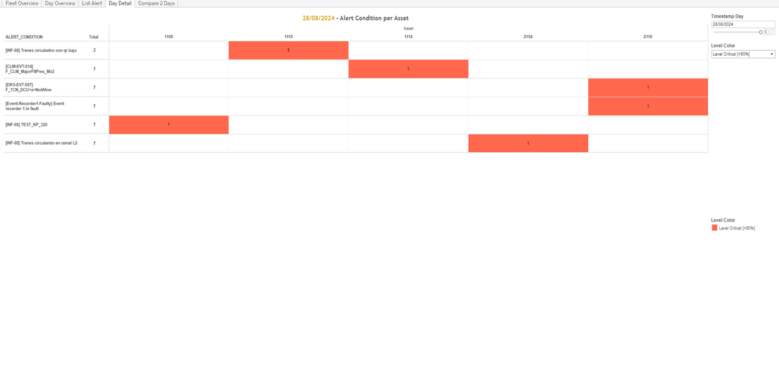
Constitution du rapport 2/5
Day Detail Dashboard
The 'Day Detail' dashboard provides an in-depth look at the distribution of alerts per unit over the course of a day. It allows users to filter data by asset and alert level, facilitating detailed exploration and interaction between different graphs to identify patterns and anomalies.
Position | Exemple de question | Description
center | What is the distribution of alert conditions per unit over the day? | This plot shows the distribution of alerts per unit categorized by asset. The y-axis represents the total number of alerts, and the fill color indicates the alert level based on the percentage of records.
Principaux Filtres/Paramètres
Filtrage par | Description

Slide 4
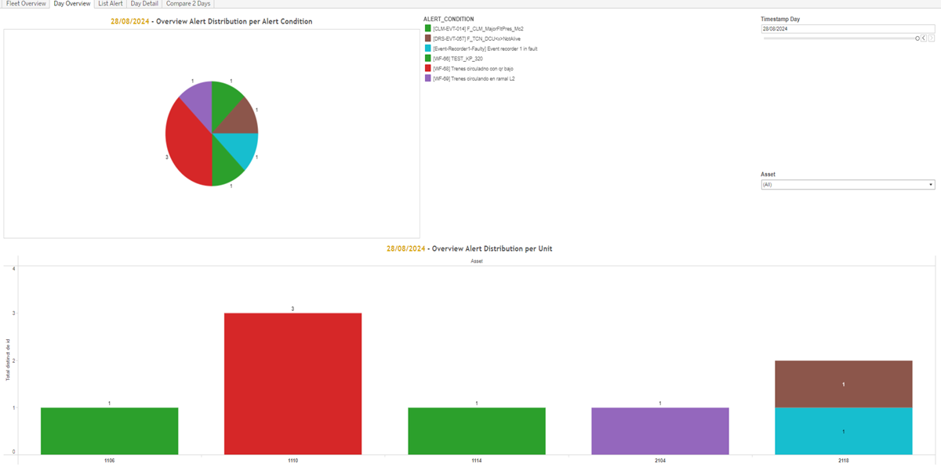
Constitution du rapport 3/5
Day Overview Dashboard
The 'Day Overview' dashboard provides a comprehensive analysis of alert distributions. It allows users to explore alert conditions through a pie chart and examine alert distributions per unit using a detailed table, facilitating detailed data exploration and interaction between visualizations.
Position | Exemple de question | Description
top | What is the distribution of alerts per alert condition? | This pie chart visualizes the distribution of alert conditions. Each slice represents a different alert condition, categorized by the ALERT_CONDITION variable.
bottom | What is the distribution of alerts per unit for the day? | This visualization shows the distribution of alerts per unit. The x-axis represents the Asset, while the y-axis shows the id. The fill axis uses ALERT_CONDITION to color and value each cell.
Principaux Filtres/Paramètres
Filtrage par | Description

Slide 5
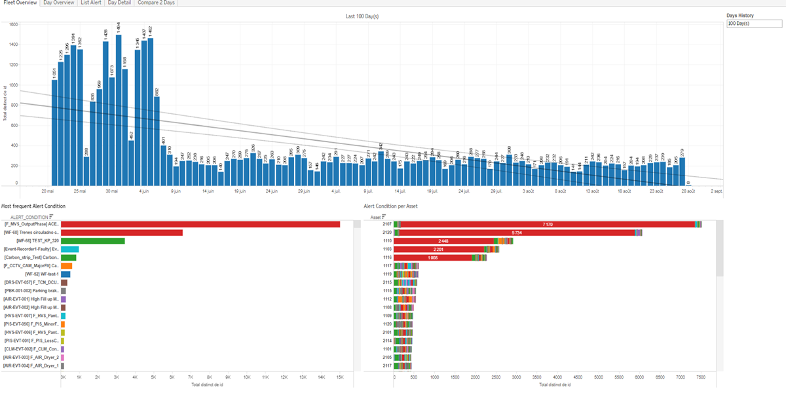
Constitution du rapport 4/5
Fleet Overview Dashboard
The 'Fleet Overview' dashboard provides a comprehensive view of fleet operations over the last 100 days. It includes a bar chart for ID distribution over days, a table for alert conditions per asset, and a table for alert condition statuses, allowing detailed data exploration and interaction between visualizations.
Position | Exemple de question | Description
top | What is the distribution of IDs over Timestamp Days for the last 100 days? | This visualization displays a bar chart where the x-axis represents the 'Timestamp Day' and the y-axis represents the 'id'. Since 'id' is an integer, the plot is a bar chart.
bottom left | What is the alert condition per asset over a specified period? | This visualization displays the Asset data from the dataset, categorized by id. Each cell is filled based on the ALERT_CONDITION variable.
bottom right | What is the most frequent Alert Condition in the fleet overview? | This visualization displays the alert condition status for each fleet unit. The x-axis represents the unique identifier for each unit, while the y-axis shows the alert condition status.
Principaux Filtres/Paramètres
Filtrage par | Description

Slide 6
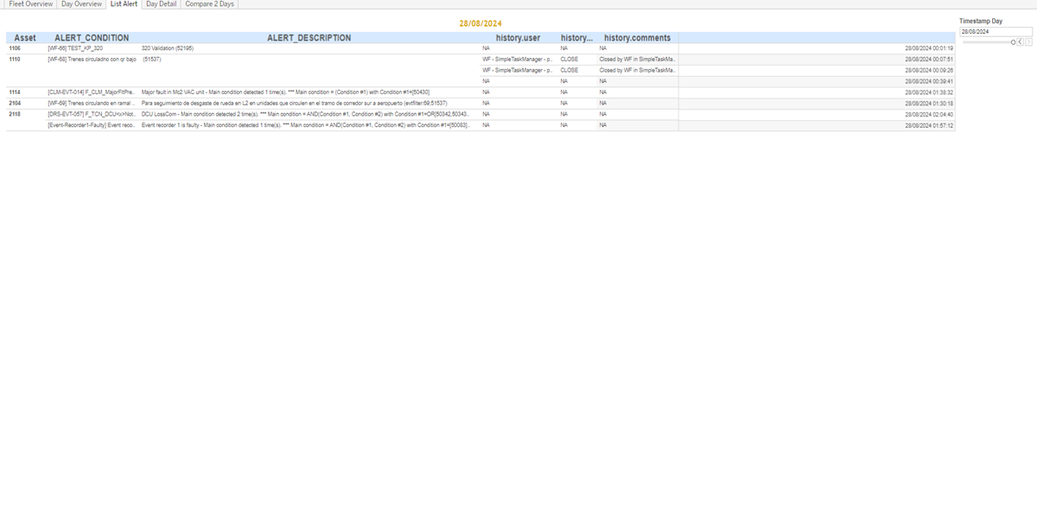
Constitution du rapport 5/5
List Alert Dashboard
The 'List Alert' dashboard provides an overview of historical comments related to assets, categorized by timestamp. It allows users to explore alert conditions and descriptions, facilitating detailed data analysis through textual representations.
Position | Exemple de question | Description
center | What is the alert condition and description for the asset, and what are the historical comments and timestamps related to it? | This plot displays historical comments over time. The x-axis represents the timestamp of each comment, while the y-axis categorizes the comments. This is a textual representation of the data.
Principaux Filtres/Paramètres
Filtrage par | Description

Slide 7
Liste des variables
GENERAL DESCRIPTION
La liste des variables ci-dessous est necessaire pour la constitution du rapport. Pour le projet [Projet] leur equivalence doit être fournie avec la plage de Valeur associée en cas de demande de rapport.
Variable | Description
ALERT_CONDITION | This variable represents the condition that triggers an alert. It is used frequently in various dashboards to analyze alert patterns.
ALERT_DESCRIPTION | This variable describes the type of alert condition occurring in the train. It is used in various dashboards to track and analyze alert events.
Asset | Asset represents a unique identifier for a part of a train. It is used to track operational data and alert conditions.
Timestamp | The timestamp records the exact moment an event occurs. It is used in various dashboards to track and compare events over time.
history.comments | This variable contains comments related to historical events. It is used for context in various dashboards.
history.ts | This variable represents the timestamp of historical events recorded in the system. It is used to track and analyze the timing of various alerts and conditions.
history.type | This variable categorizes the type of history events recorded. It is used in alert condition plots.
history.user | The user associated with historical events. Recorded as context data for operational analysis.
id | The variable is an identifier for a part of a train and is recorded as operational data.
NOTE
Les illustrations fournissent un aperçu des représentations graphiques et ne préjugent pas des données pouvant être contenues dans le rapport. En effet, les données peuvent évoluer au cours du projet et dépendent entièrement de celui-ci.
Toute reproduction ou distribution non autorisée de ce rapport est interdite. Les informations contenues dans ce document sont confidentielles et destinées uniquement aux parties mentionnées. L'utilisation ou la divulgation non autorisée de ces informations est passible de poursuites judiciaires. Les représentations graphiques sont fournies à titre indicatif et ne sauraient engager la responsabilité de l'émetteur quant à l'exhaustivité ou l'exactitude des données présentées. Les données sont sujettes à des modifications au fil du projet et doivent être interprétées dans ce contexte.

