Slide 1
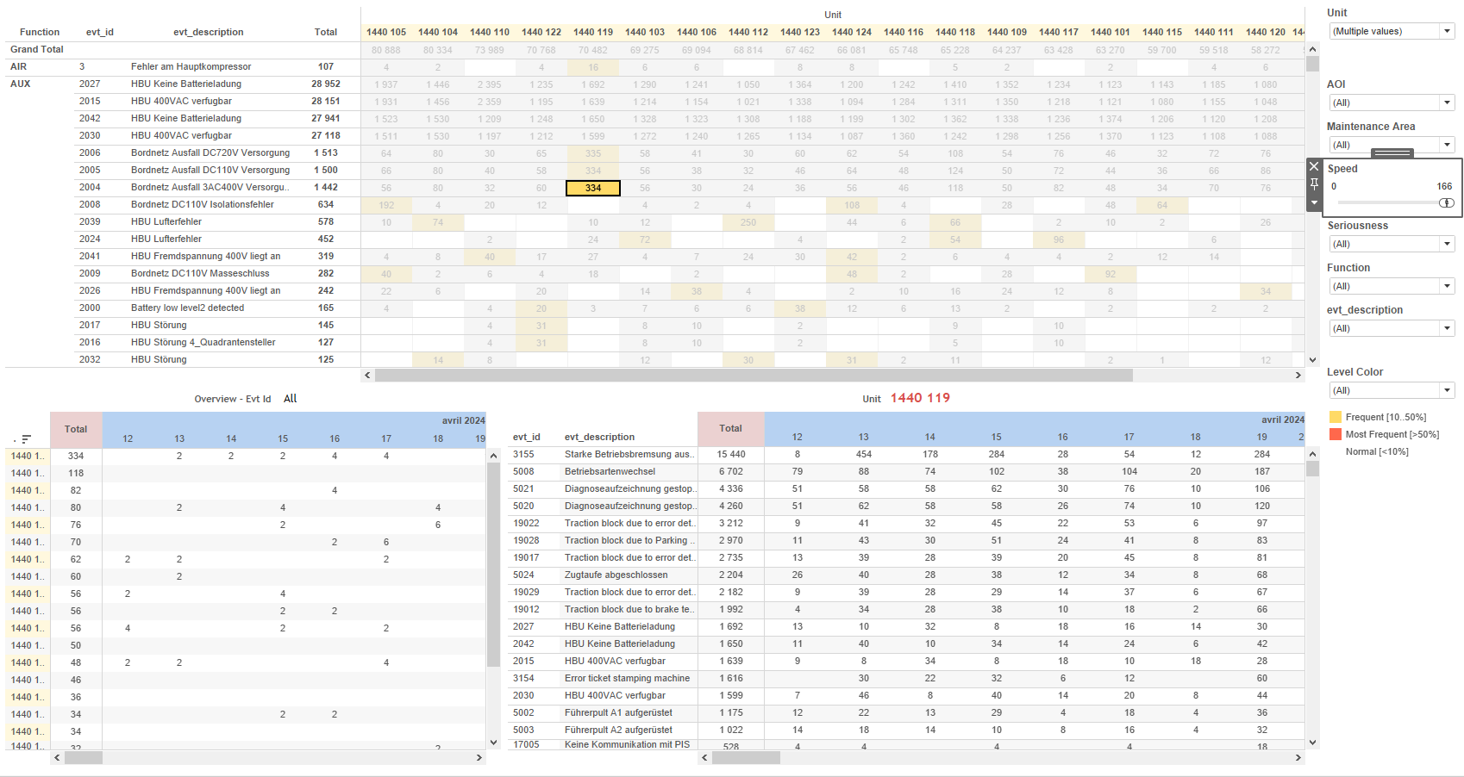
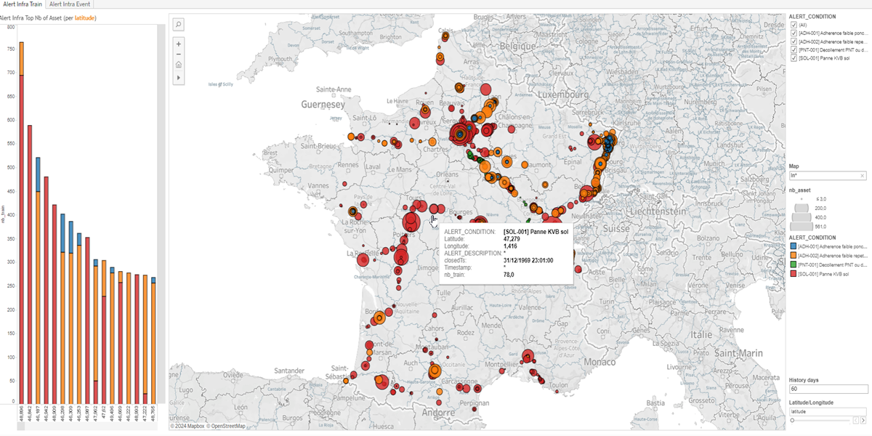
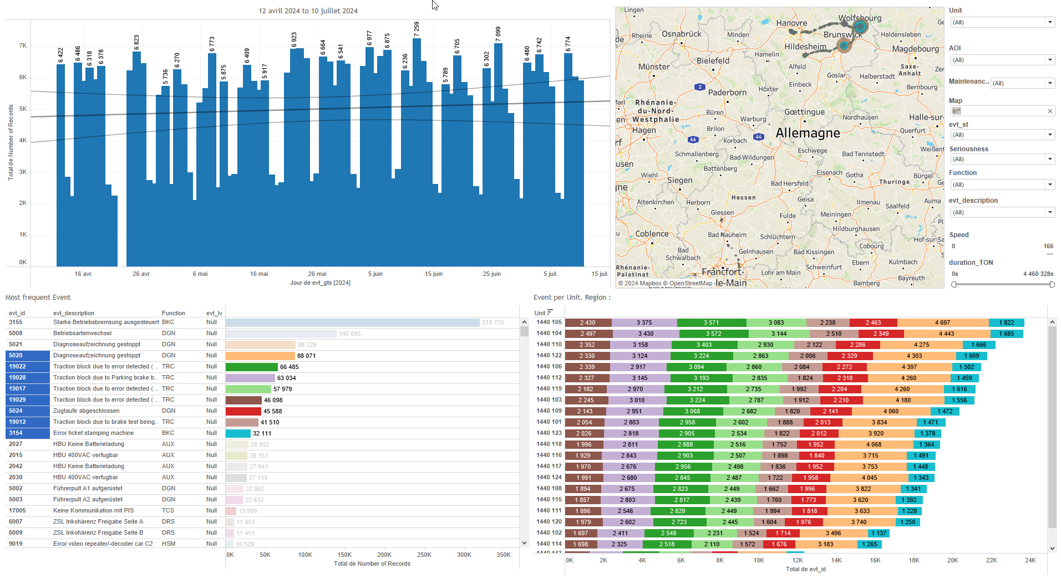
DATA VISUALIZATION REPORT SHEET
HealthHub
Daily_Alert_Condition_Infra
Standard
Event Analysis
Represented By
ALERT_CONDITION Variable Longitude Latitude t1 History days Round nb_evt closedTs longitude
GENERAL DESCRIPTION
The 'Daily_Alert_Condition_Infra' report provides a comprehensive overview of train alert conditions by visualizing their geographical distribution and detailed alert counts. Users can filter data based on latitude and longitude, explore detailed alert conditions, and interact with graphs to identify top assets with alerts over the past 60 days.
MAIN CHARACTERISTICS | Description
Project | Any project
Domain | Statistics, Exploration
Type of report | Data Exploration - Train Event Data with Contextual Variables
Report's Objective | Provide a comprehensive overview of train alert conditions. Visualize geographical distribution and detailed alert counts. Enable users to filter data based on latitude and longitude. Allow exploration of detailed alert conditions. Identify top assets with alerts over the past 60 days.

Slide 2
Constitution du rapport 1/2
Alert Infra Train Dashboard
The 'Alert Infra Train' dashboard provides a comprehensive overview of train alert conditions by visualizing their geographical distribution and detailed alert counts. Users can filter data based on latitude and longitude, explore detailed alert conditions, and interact with graphs to identify top assets with alerts over the past 60 days.
Position | Exemple de question | Description
right | What are the latitude and longitude values based on the given conditions? | This plot visualizes the relationship between Longitude and Latitude, with color indicating different alert conditions. The size of the markers represents the number of trains.
left | What are the top assets in terms of number of alerts based on latitude or longitude over the past 60 days? | This visualization displays the number of trains (nb_train) with conditions (ALERT_CONDITION) based on the specified calculation for the x-axis variable. The x-axis variable is determined by a formula that checks the 'latitude' parameter.
Principaux Filtres/Paramètres
Filtrage par | Description

Slide 3
Constitution du rapport 2/2
Alert Intra Event Dashboard
The 'Alert Intra Event' dashboard provides a comprehensive overview of geographical locations and the number of events under alert conditions, enabling detailed exploration and categorization of events based on latitude or longitude over the past 60 days.
Position | Exemple de question | Description
right | What are the geographical locations (latitude and longitude) of the events and how many events (nb_evt) occurred under the alert condition? | Description of a worksheet in a report. A worksheet contains charts (plots) and addresses a specific question.
left | What is the top number of events for Alert Infra based on latitude or longitude over the past 60 days? | This visualization shows the number of events (nb_evt) categorized by ALERT_CONDITION. The x-axis represents Variable, which is calculated based on the selected parameter (latitude).
Principaux Filtres/Paramètres
Filtrage par | Description

Slide 4
Liste des variables
GENERAL DESCRIPTION
La liste des variables ci-dessous est necessaire pour la constitution du rapport. Pour le projet [Projet] leur equivalence doit être fournie avec la plage de Valeur associée en cas de demande de rapport.
Variable | Description
ALERT_CONDITION | Indicates the condition that triggers an alert in the system. Used in various dashboards to monitor and plot alert-related events.
ALERT_DESCRIPTION | This variable provides a description of alerts. It is used in various dashboards to display alert details.
Map | The map shows the geographical location of events on the train. It helps in visualizing where specific alerts or conditions occur.
Timestamp | This variable records the date and time of events. It is used across multiple dashboards to timestamp various operational data.
closedTs | This variable records the timestamp when an event is closed. It is used for tracking the closure times of various alerts.
latitude | Latitude represents the geographical location of a train. It is recorded as operational data.
longitude | This variable represents the geographical longitude of a train. It is recorded continuously as operational data.
nb_evt | Number of events recorded for a specific condition in the train's operational data.
nb_train | This variable represents the number of trains. It is used to monitor train operations in the dashboard.
NOTE
Les illustrations fournissent un aperçu des représentations graphiques et ne préjugent pas des données pouvant être contenues dans le rapport. En effet, les données peuvent évoluer au cours du projet et dépendent entièrement de celui-ci.
Toute reproduction ou distribution non autorisée de ce rapport est interdite. Les informations contenues dans ce document sont confidentielles et destinées uniquement aux parties mentionnées. L'utilisation ou la divulgation non autorisée de ces informations est passible de poursuites judiciaires. Les représentations graphiques sont fournies à titre indicatif et ne sauraient engager la responsabilité de l'émetteur quant à l'exhaustivité ou l'exactitude des données présentées. Les données sont sujettes à des modifications au fil du projet et doivent être interprétées dans ce contexte.

