Slide 1
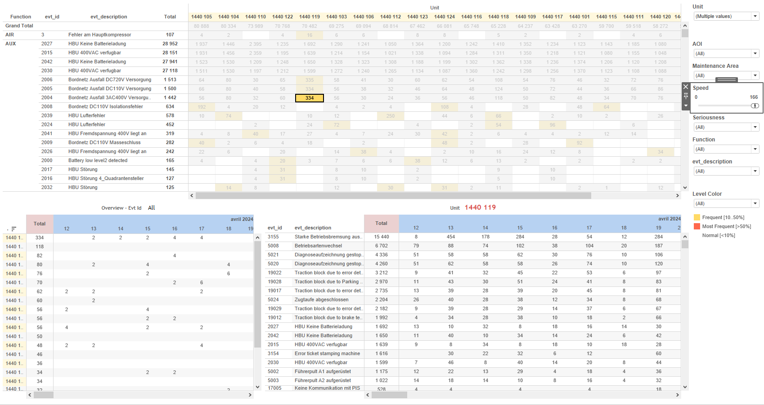
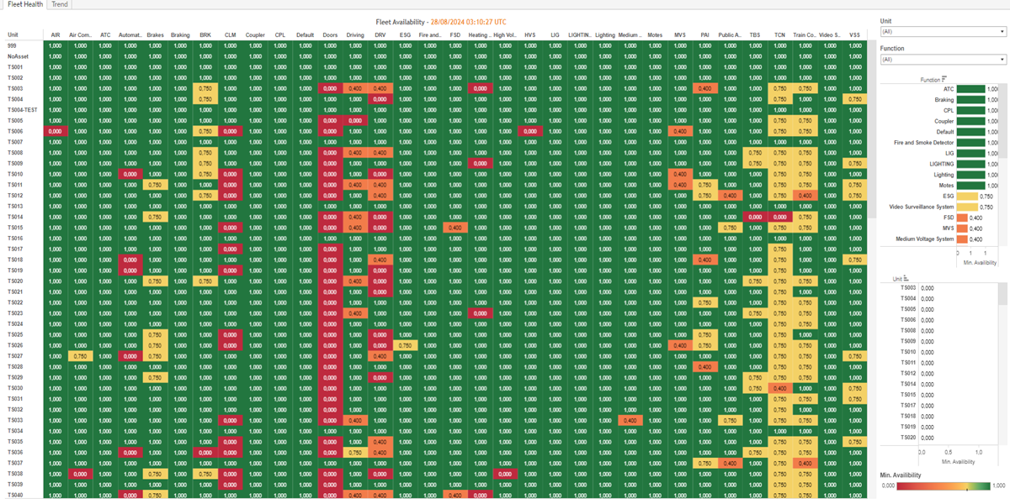
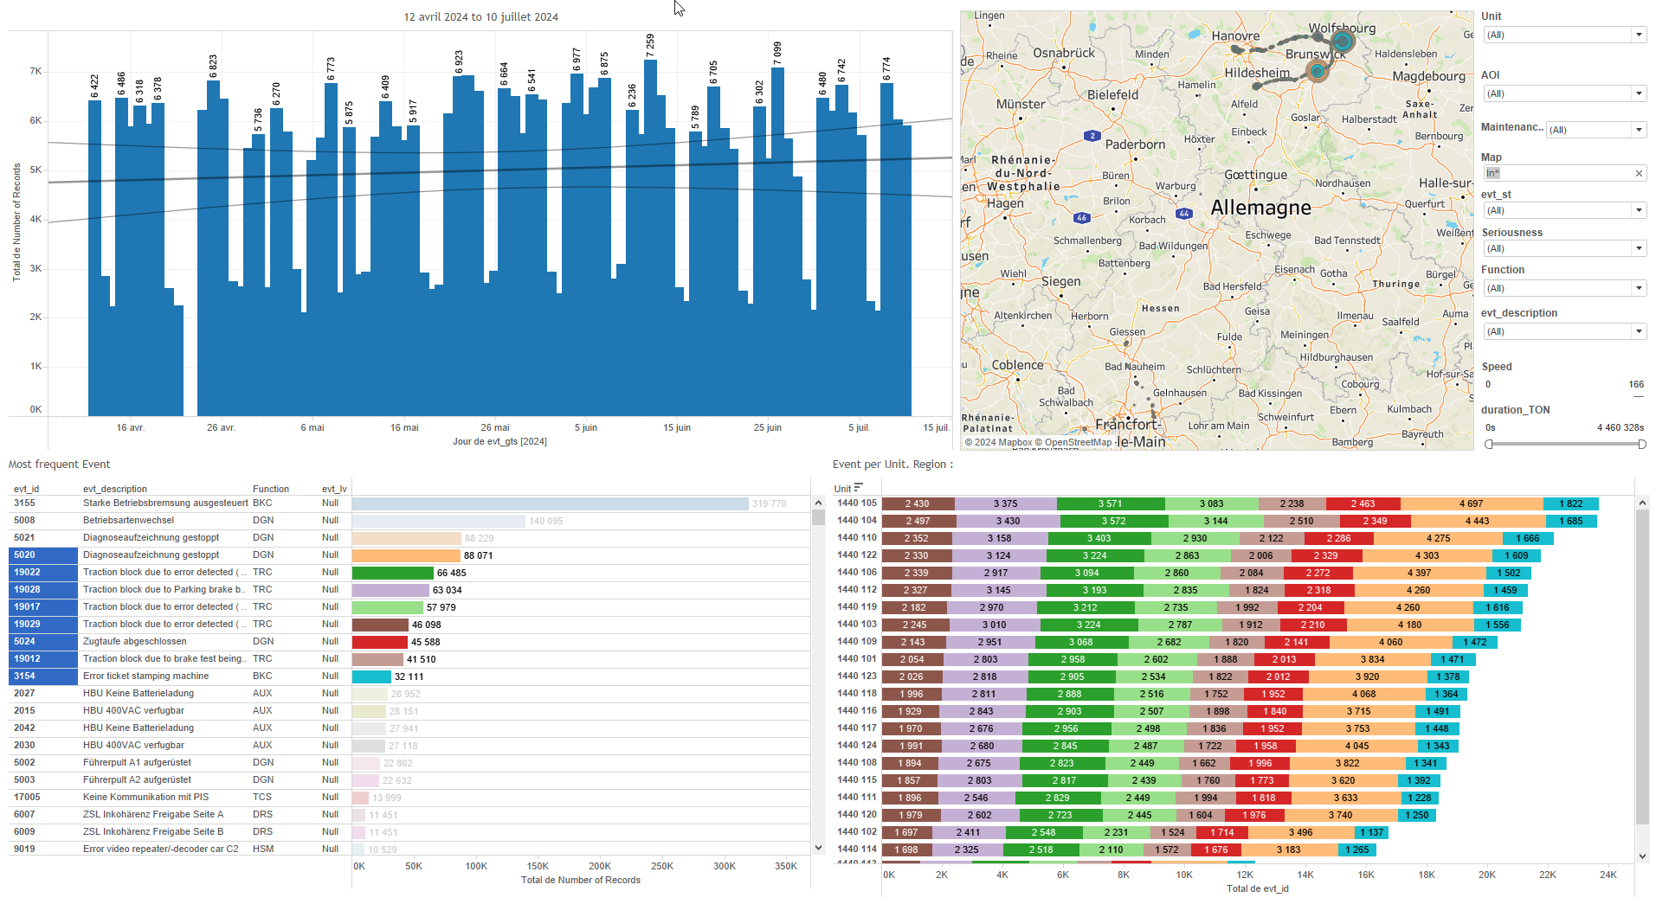
DATA VISUALIZATION REPORT SHEET
HealthHub
Daily_Health_Card
Standard
Event Analysis
Represented By
Availibility Function Unit one Date Status Date
GENERAL DESCRIPTION
The 'Daily Health Card' report offers an in-depth look at the availability status and trends of various functions and units within the fleet. It includes detailed visualizations such as tables and area plots that allow for interactive exploration of the data, highlighting key relationships and trends over time.
MAIN CHARACTERISTICS | Description
Project | Any project
Domain | Operational Data
Type of report | Data Exploration - Operational Time Series (OPDAT)
Report's Objective | Provide a comprehensive overview of the availability status of different functions and units within the fleet. Visualize the availability trend over time. Allow users to explore detailed relationships between functions and availability. Present unit-specific availability data through interactive and color-coded tables.

Slide 2
Constitution du rapport 1/2
Fleet Health Dashboard
The 'Fleet Health' dashboard provides a comprehensive overview of the availability status of different functions and units within the fleet. It allows users to explore detailed relationships between functions and availability, as well as unit-specific availability data, through interactive and color-coded tables.
Position | Exemple de question | Description
top | What is the availability status of the fleet based on various functions and units? | This table displays the availability of different functions across various units. Each cell is color-coded based on the availability values.
bottom right | What is the relationship between Function and Availibility as depicted in the chart? | This plot visualizes the Function data against Availibility. The x-axis represents the Availibility (real values) and the y-axis represents the Function (categorical data). Each cell is colored and valued based on the Availibility data.
bottom left | What is the relationship between Unit and Availibility in the context of the given data? | This visualization displays the availability of units. The x-axis represents the availability in real numbers, while the y-axis categorizes the units. Each cell in the table is colored and valued based on the availability data.
Principaux Filtres/Paramètres
Filtrage par | Description

Slide 3
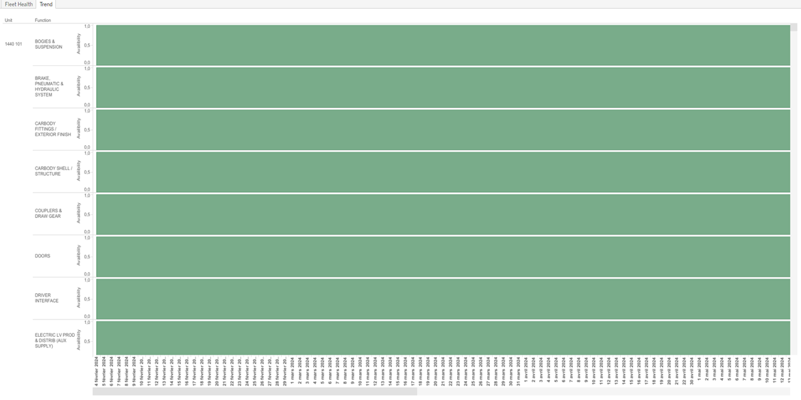
Constitution du rapport 2/2
Trend Dashboard
The 'Trend' dashboard primarily aims to visualize the availability trend over time. It includes an area plot that filters data by date and availability percentage, allowing for detailed exploration of how availability changes over time.
Position | Exemple de question | Description
center | What is the availability trend over time? | This area plot shows the availability data over a period of time. The x-axis represents the dates, while the y-axis indicates the availability percentage.
Principaux Filtres/Paramètres
Filtrage par | Description

Slide 4
Liste des variables
GENERAL DESCRIPTION
La liste des variables ci-dessous est necessaire pour la constitution du rapport. Pour le projet [Projet] leur equivalence doit être fournie avec la plage de Valeur associée en cas de demande de rapport.
Variable | Description
Availibility | Availability measures the operational uptime of train units. It is recorded as continuous operational data.
Date | This variable records the date and time of an event. It is used across multiple dashboards for temporal analysis.
Function | This variable represents a specific function or operation within the train system. It is used across various dashboards to track and analyze train functionalities.
Status Date | This variable records the date when the status was last updated. It is used in fleet health dashboards to track availability over time.
Unit | This variable identifies parts of a train. It is used in various contexts such as availability and function analysis.
NOTE
Les illustrations fournissent un aperçu des représentations graphiques et ne préjugent pas des données pouvant être contenues dans le rapport. En effet, les données peuvent évoluer au cours du projet et dépendent entièrement de celui-ci.
Toute reproduction ou distribution non autorisée de ce rapport est interdite. Les informations contenues dans ce document sont confidentielles et destinées uniquement aux parties mentionnées. L'utilisation ou la divulgation non autorisée de ces informations est passible de poursuites judiciaires. Les représentations graphiques sont fournies à titre indicatif et ne sauraient engager la responsabilité de l'émetteur quant à l'exhaustivité ou l'exactitude des données présentées. Les données sont sujettes à des modifications au fil du projet et doivent être interprétées dans ce contexte.

