Slide 1
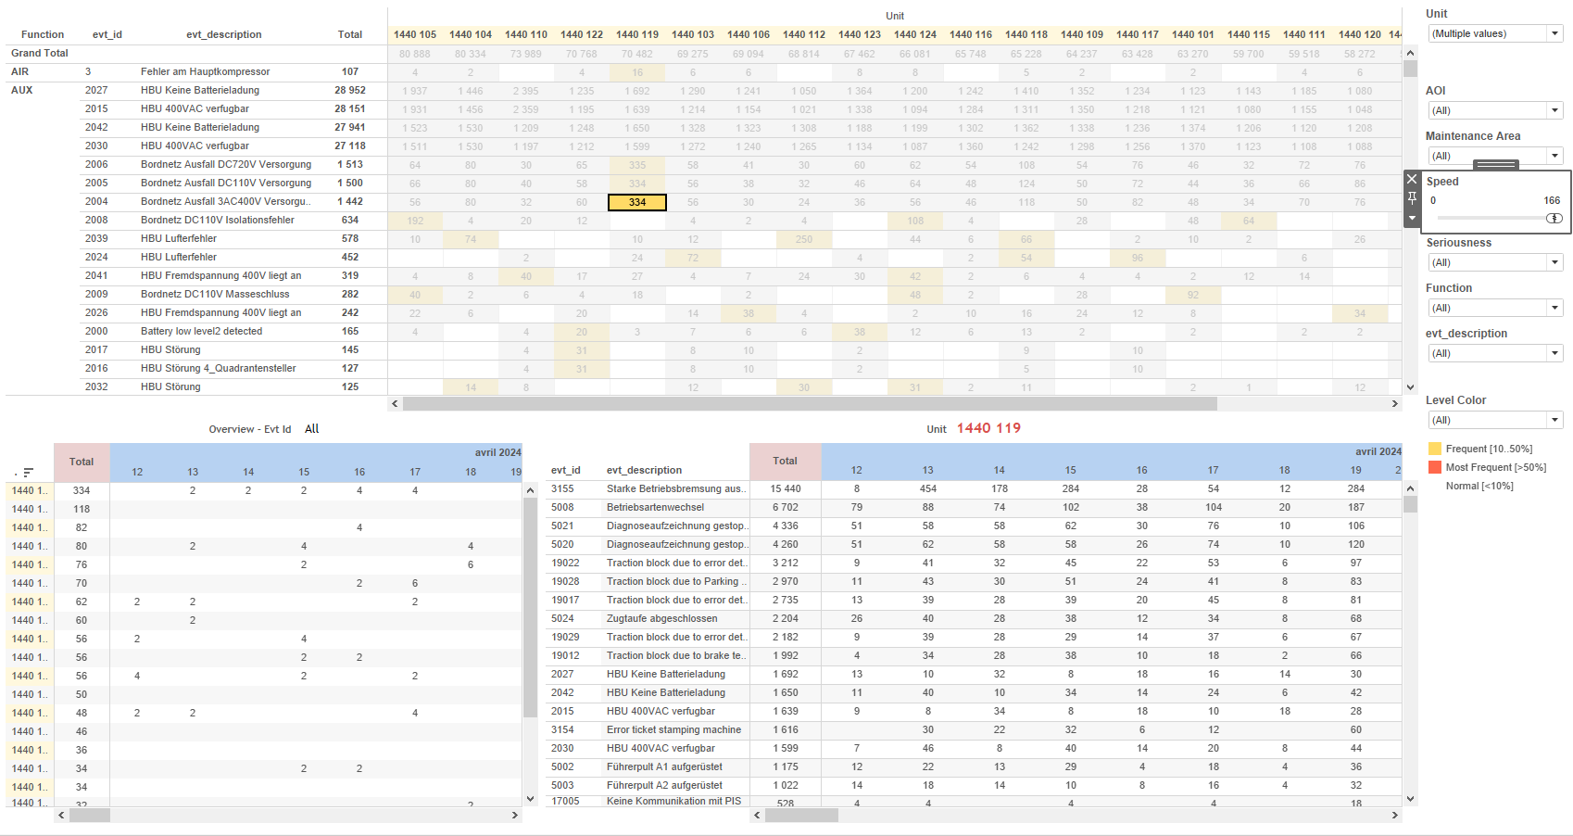
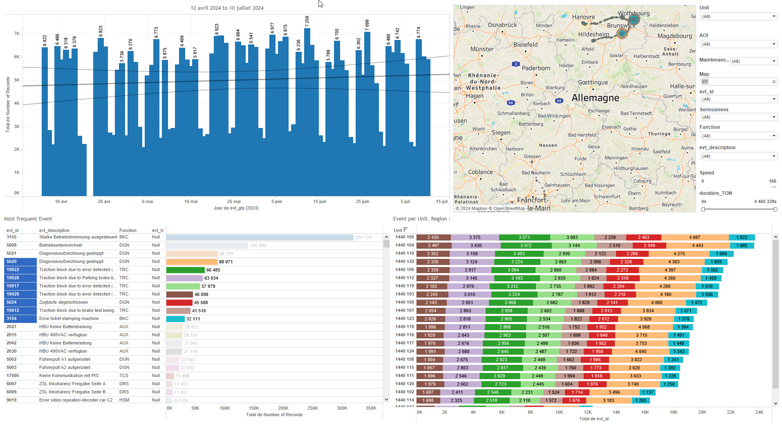
DATA VISUALIZATION REPORT SHEET
HealthHub
Data_Flow
Standard
Event Analysis
Represented By
flow_type timestamp Unit N delay
GENERAL DESCRIPTION
The DataFlow and Delay dashboards offer comprehensive insights into session history, flow types, and delay metrics over time. These dashboards provide interactive visualizations including vertical bar, text, and line charts, enabling detailed data exploration and analysis. The DataFlow dashboard focuses on session counts and flow type distributions, while the Delay dashboard emphasizes delay history and distribution, categorized by flow type and unit.
MAIN CHARACTERISTICS | Description
Project | Any project
Domain | Statistics,Exploration
Type of report | Data Exploration - Operational Time Series (OPDAT)
Report's Objective | Provide a detailed overview of session history and flow types over time. Enable users to analyze session counts, flow type distributions, and relationships between flow types and other variables. Facilitate detailed data exploration and comparison of delay metrics over time, categorized by flow type and unit.

Slide 2
Constitution du rapport 1/2
DataFlow Dashboard
The DataFlow dashboard provides an overview of session history and flow types over time, allowing for detailed data exploration through various chart types. Users can interact with vertical bar, text, and line charts to analyze session counts, flow type distributions, and relationships between flow types and other variables.
Position | Exemple de question | Description
top | What is the flow type distribution over time? | This plot displays a bar chart representing the number of sessions over time. The fill color of each bar indicates the type of flow.
bottom | What is the relationship between flow_type and N in the given text data? | This plot visualizes the flow_type categorized by N. It is displayed as a text chart due to the string datatype of flow_type.
bottom left | What is the number of sessions per flow type over time? | This line plot visualizes the number of sessions over time. The x-axis represents the timestamp, while the y-axis shows the number of sessions (N). The flow type is used to fill the plot.
bottom right | What is the number of sessions per unit over time? | This line chart visualizes the timestamp on the x-axis and the integer values of N on the y-axis. The fill variable, Unit, is used for additional categorization.
Principaux Filtres/Paramètres
Filtrage par | Description
flow_type | Filtering applicable to workbooks.
timestamp | Filtering applicable to workbooks. This filter is based on the datetime data type and is used to filter data by date and time.

Slide 3
Constitution du rapport 2/2
Delay Dashboard
The 'Delay' dashboard provides a comprehensive analysis of delay metrics over time, categorized by flow type and unit. It allows users to explore delay history and distribution through interactive vertical bar and line plots, facilitating detailed data exploration and comparison.
Position | Exemple de question | Description
top | What is the delay history over time categorized by flow type? | This plot shows the delay history over time. The x-axis represents the timestamp, and the y-axis represents the delay. Each cell is filled based on the flow type.
bottom | What is the delay distribution across different flow types? | Description of a worksheet in a report. A worksheet contains charts (plots) and addresses a specific question.
bottom left | What is the delay per flow type over time? | This line plot visualizes the delay over time, categorized by flow_type.
bottom right | What is the delay per unit over time? | This line plot visualizes the delay over time, with timestamps on the x-axis and delay values on the y-axis. The color and value of each cell are determined by the Unit variable.
Principaux Filtres/Paramètres
Filtrage par | Description
timestamp | Filtering by the hour of the timestamp in datetime format.
timestamp | Filtering by timestamp in the context of datetime, specifically filtering by hours.

Slide 4
Liste des variables
GENERAL DESCRIPTION
La liste des variables ci-dessous est necessaire pour la constitution du rapport. Pour le projet [Projet] leur equivalence doit être fournie avec la plage de Valeur associée en cas de demande de rapport.
Variable | Description
N | This variable represents the number of sessions recorded. It is used in various dashboards to track operational data.
Unit | This variable represents a specific part of a train. It is used in various dashboards to track operational data.
delay | This variable records the delay times of train units. It is crucial for monitoring operational efficiency.
flow_type | This variable categorizes the type of flow in the system. It is crucial for analyzing different operational patterns.
timestamp | The timestamp indicates the precise time an event occurred. It is crucial for tracking and analyzing operational data.
NOTE
Les illustrations fournissent un aperçu des représentations graphiques et ne préjugent pas des données pouvant être contenues dans le rapport. En effet, les données peuvent évoluer au cours du projet et dépendent entièrement de celui-ci.
Toute reproduction ou distribution non autorisée de ce rapport est interdite. Les informations contenues dans ce document sont confidentielles et destinées uniquement aux parties mentionnées. L'utilisation ou la divulgation non autorisée de ces informations est passible de poursuites judiciaires. Les représentations graphiques sont fournies à titre indicatif et ne sauraient engager la responsabilité de l'émetteur quant à l'exhaustivité ou l'exactitude des données présentées. Les données sont sujettes à des modifications au fil du projet et doivent être interprétées dans ce contexte.

