Slide 1
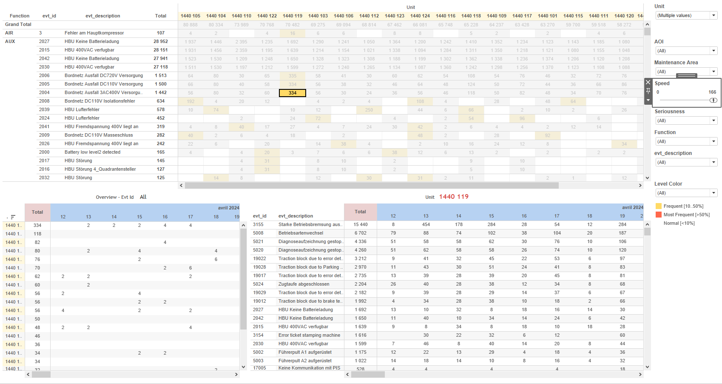
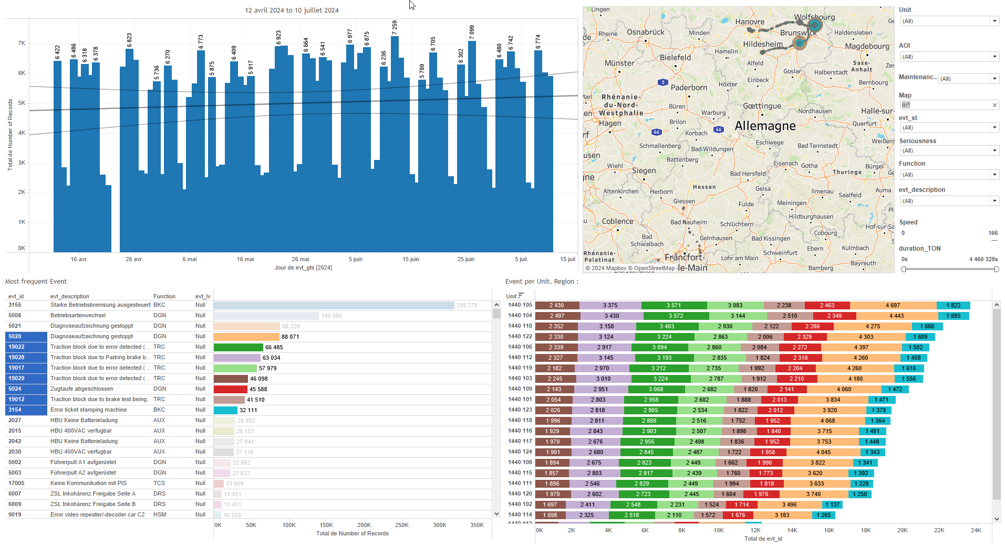
DATA VISUALIZATION REPORT SHEET
HealthHub
Data_Flow_UIC559
Standard
Event Analysis
Represented By
file error one Unit flow_type Date Week LocalDate Color Error Year
GENERAL DESCRIPTION
The KPI dashboard provides a comprehensive overview of error rates, file distributions, and their relationships with timestamps and units. It allows for detailed data exploration through various visualizations, including tables and circle plots, enabling users to identify patterns and trends effectively.
MAIN CHARACTERISTICS | Description
Project | Any project
Domain | Exploration
Type of report | Key Performance Indicator (KPI) - Operational Time Series (OPDAT)
Report's Objective | Provide a comprehensive overview of error rates, file distributions, and their relationships with timestamps and units. Enable detailed data exploration through various visualizations, including tables and circle plots. Identify patterns and trends effectively.

Slide 2
Constitution du rapport 1/1
KPI Dashboard
The KPI dashboard provides a comprehensive overview of error rates, file distributions, and their relationships with timestamps and units. It allows for detailed data exploration through various visualizations, including tables and circle plots, enabling users to identify patterns and trends effectively.
Position | Exemple de question | Description
bottom right | What is the error rate based on file data and other variables? | This visualization displays a table where each cell's color represents the result of the formula 'IF SUM(error) > 0 THEN 1 ELSE 0 END'. The 'file' variable is displayed on the y-axis.
bottom | What is the relationship between file, timestamp, and flow_type in the given data? | This visualization shows the distribution of 'file' values over time. Each circle represents a different 'flow_type' for the given 'file' at a specific 'timestamp'.
top right | What are the units and errors associated with the given data over time? | This table displays the relationship between error and Unit, where each cell is colored and valued based on the fill variable.
top left | What is the distribution of file types and their associated color errors? | Description of a worksheet in a report. A worksheet contains charts (plots) and addresses a specific question.
Principaux Filtres/Paramètres
Filtrage par | Description

Slide 3
Liste des variables
GENERAL DESCRIPTION
La liste des variables ci-dessous est necessaire pour la constitution du rapport. Pour le projet [Projet] leur equivalence doit être fournie avec la plage de Valeur associée en cas de demande de rapport.
Variable | Description
LocalDate | This variable represents the local date in the dataset. It is used to track events and operations over time.
Unit | Unit is an identifier for a part of a train. It is used in various dashboards for operational data analysis.
error | This variable represents errors recorded in train operations. It is used in various dashboards to indicate performance issues.
file | This variable is recorded as context data for events. It is used in multiple KPIs for analysis.
flow_type | This variable represents the type of flow in train operations. It is used in various key performance indicators.
timestamp | This variable records the date and time of events. It is used in multiple dashboards for tracking and analysis.
NOTE
Les illustrations fournissent un aperçu des représentations graphiques et ne préjugent pas des données pouvant être contenues dans le rapport. En effet, les données peuvent évoluer au cours du projet et dépendent entièrement de celui-ci.
Toute reproduction ou distribution non autorisée de ce rapport est interdite. Les informations contenues dans ce document sont confidentielles et destinées uniquement aux parties mentionnées. L'utilisation ou la divulgation non autorisée de ces informations est passible de poursuites judiciaires. Les représentations graphiques sont fournies à titre indicatif et ne sauraient engager la responsabilité de l'émetteur quant à l'exhaustivité ou l'exactitude des données présentées. Les données sont sujettes à des modifications au fil du projet et doivent être interprétées dans ce contexte.

