Slide 1
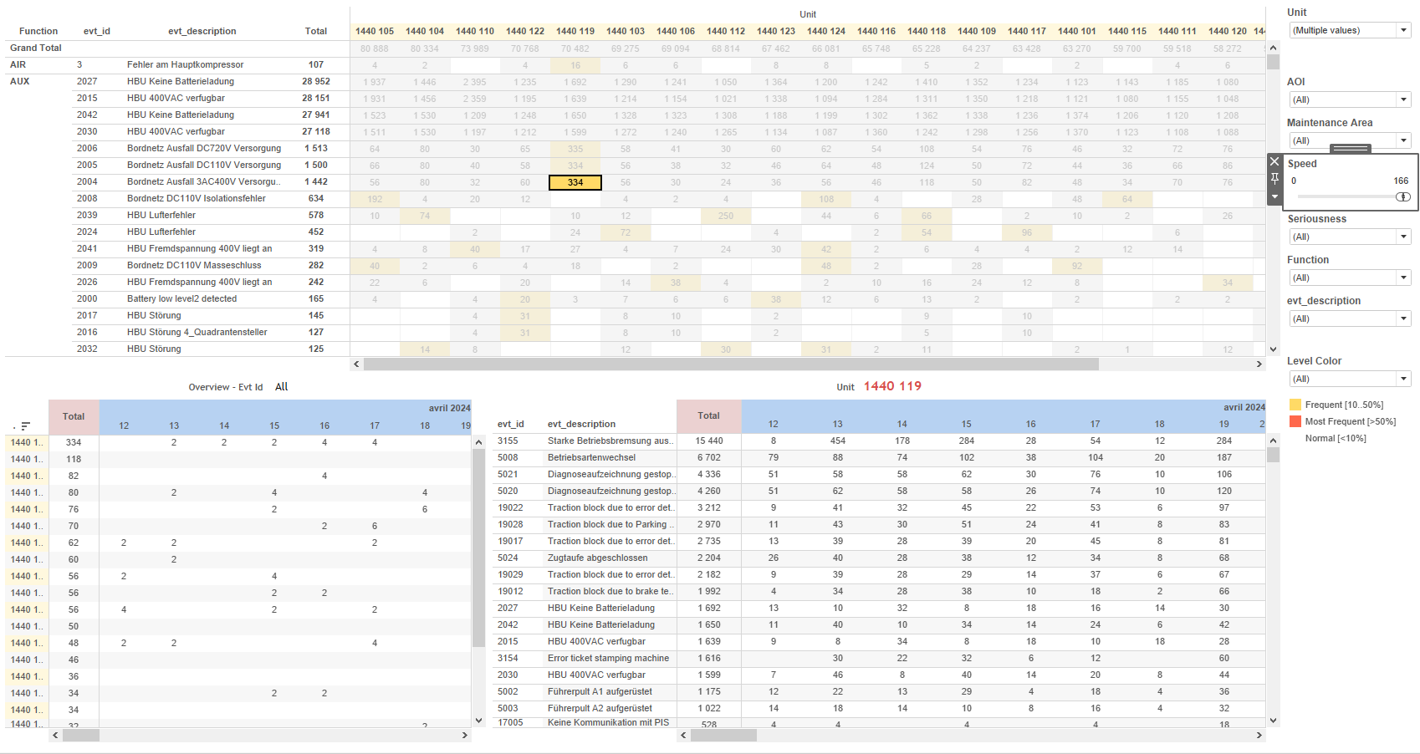
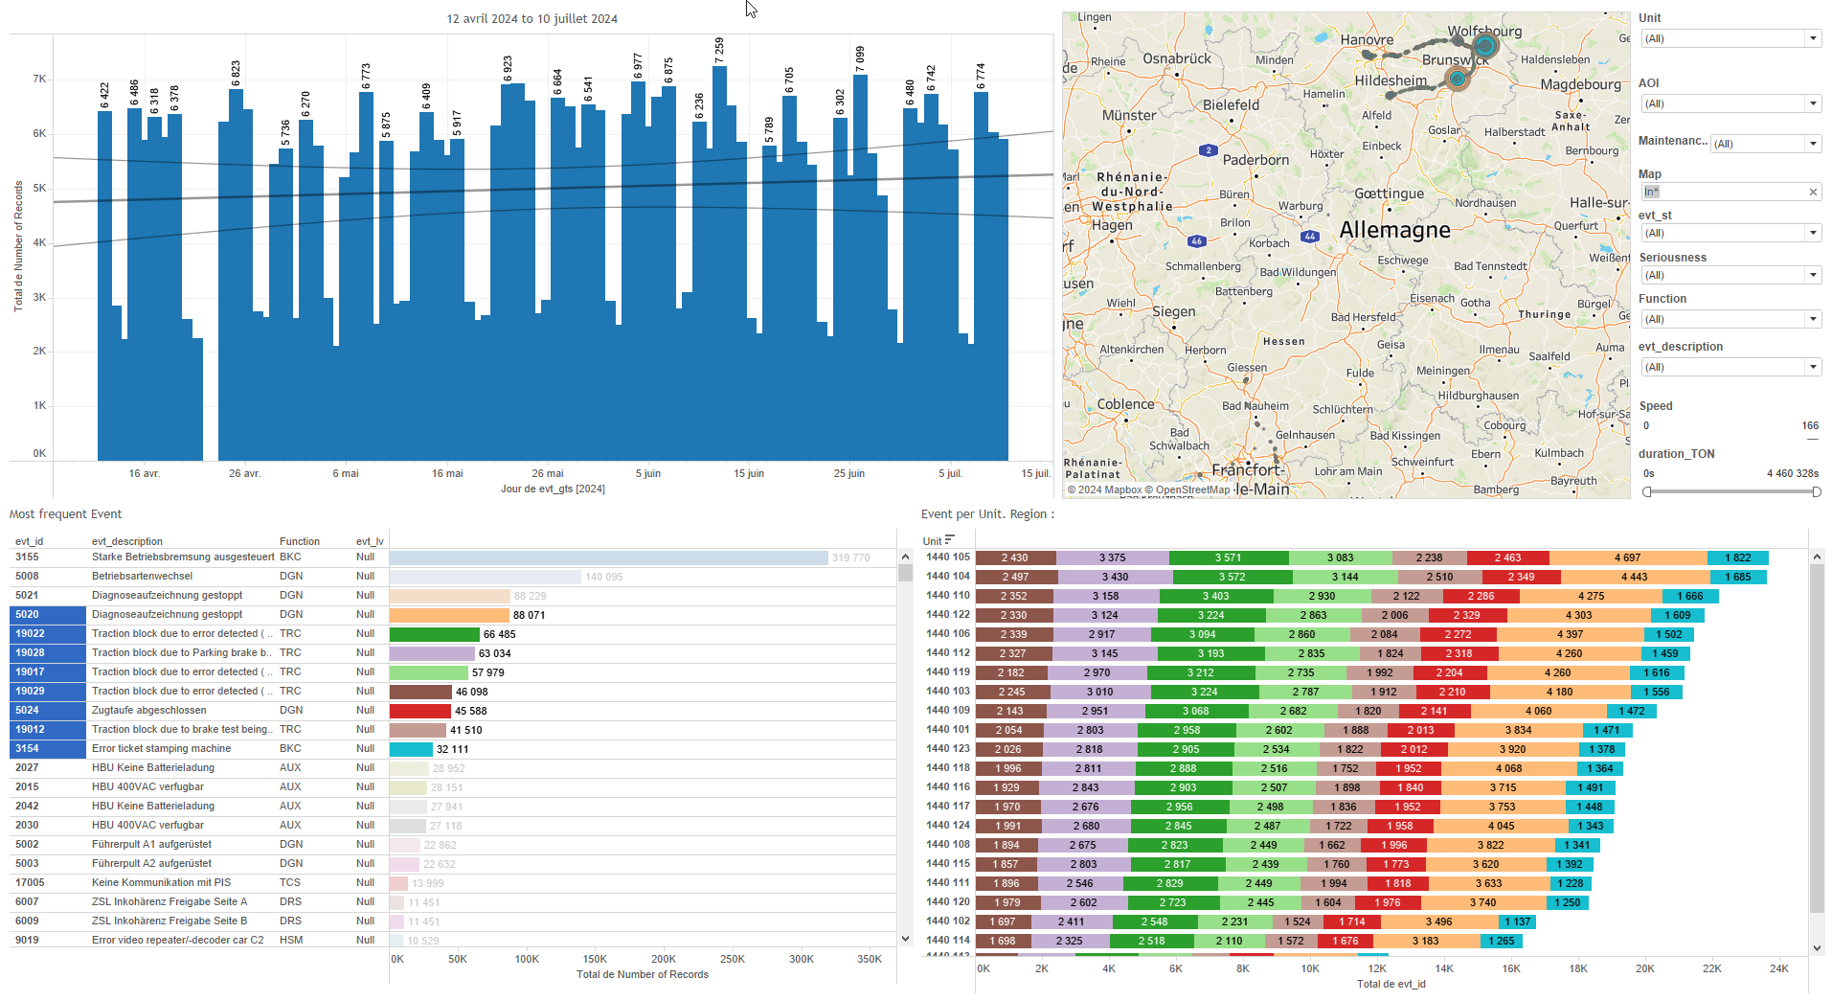
DATA VISUALIZATION REPORT SHEET
HealthHub
Distribution_Analysis
Standard
Event Analysis
Represented By
Hours LocalDate value (bin) SubFleet Unit diff variable value Bin value
GENERAL DESCRIPTION
This report provides data visualization and exploration about Train equipments. It includes detailed analyses of value distributions over time, total hours by SubFleet, and the relationship between LocalDate and Unit for vehicle operation hours.
MAIN CHARACTERISTICS | Description
Project | Any project
Domain | Operational Data
Type of report | Data Exploration - Operational Time Series (OPDAT)
Report's Objective | Provide an in-depth analysis of value distributions over time. Facilitate detailed insights into hourly distributions and range comparisons. Offer a comprehensive overview of the total hours by SubFleet. Visualize the relationship between LocalDate and Unit for vehicle operation hours.

Slide 2
Constitution du rapport 1/3
Distribution Dashboard
The 'Distribution' dashboard provides an in-depth analysis of value distributions over time. It allows users to explore data through interactive bar charts and tables, facilitating detailed insights into hourly distributions and range comparisons.
Position | Exemple de question | Description
bottom left | What is the distribution of values over time and how do they relate to hours and specific bins? | This bar chart visualizes the distribution of values in bins. The x-axis represents the binned values, and the y-axis represents the hours calculated from the difference divided by 3600.
top left | What is the distribution range of days for the given data? | This plot displays the distribution of hours calculated from the difference in LocalDate, binned by value.
top right | What is the distribution range of the total values in the bar chart? | This visualization displays the distribution range of total hours. The y-axis represents the hours calculated as [diff]/3600, and the fill axis uses integer values from the 'value (bin)' variable.
Principaux Filtres/Paramètres
Filtrage par | Description
LocalDate | Filtering by date using datetime datatype. This filter is used to specify a date range or a specific date for data analysis.

Slide 3
Constitution du rapport 2/3
SubFleet Dashboard
The 'SubFleet' dashboard provides a comprehensive overview of the total hours by SubFleet, calculated using the difference in seconds. It allows for detailed data exploration by categorizing data by SubFleet and positioning the information centrally for easy access and interaction.
Position | Exemple de question | Description
center | What is the total hours calculated from the difference in seconds for each SubFleet? | This table displays the total hours by SubFleet. The x-axis represents the hours calculated using the formula '[diff]/3600', and the y-axis categorizes the data by SubFleet.
Principaux Filtres/Paramètres
Filtrage par | Description

Slide 4
Constitution du rapport 3/3
Tables Dashboard
The 'Tables' dashboard visualizes the relationship between LocalDate and Unit, showing how many hours each vehicle operates per day. It uses a table format with color-coded cells to facilitate detailed data exploration.
Position | Exemple de question | Description
center | How many hours does each vehicle operate per day? | This visualization shows the relationship between LocalDate and Unit, where Hours are calculated using the formula '[diff]/3600'. The data is presented in a table format, with colors representing different values for each cell.
Principaux Filtres/Paramètres
Filtrage par | Description
LocalDate | Filtering applicable to workbooks based on datetime values. Example: Filtering by date ranges or specific dates.

Slide 5
Liste des variables
GENERAL DESCRIPTION
La liste des variables ci-dessous est necessaire pour la constitution du rapport. Pour le projet [Projet] leur equivalence doit être fournie avec la plage de Valeur associée en cas de demande de rapport.
Variable | Description
LocalDate | LocalDate is used to record the date of events and operations in the dashboards. It helps in tracking and analyzing time-based data.
SubFleet | This variable categorizes trains into smaller groups for analysis. It is used in various operational and performance dashboards.
Unit | Unit is an identifier for parts of a train. It is used extensively in various operational and event data dashboards.
diff | This variable represents the difference in recorded data. It is used to calculate operational hours in various dashboards.
value | This variable represents a continuous operational data point recorded for analysis. It is used in various dashboards for monitoring train performance.
variable | This variable is used in various analyses including burst detection and distribution analysis. It provides operational data for different dashboards.
NOTE
Les illustrations fournissent un aperçu des représentations graphiques et ne préjugent pas des données pouvant être contenues dans le rapport. En effet, les données peuvent évoluer au cours du projet et dépendent entièrement de celui-ci.
Toute reproduction ou distribution non autorisée de ce rapport est interdite. Les informations contenues dans ce document sont confidentielles et destinées uniquement aux parties mentionnées. L'utilisation ou la divulgation non autorisée de ces informations est passible de poursuites judiciaires. Les représentations graphiques sont fournies à titre indicatif et ne sauraient engager la responsabilité de l'émetteur quant à l'exhaustivité ou l'exactitude des données présentées. Les données sont sujettes à des modifications au fil du projet et doivent être interprétées dans ce contexte.

