Slide 1
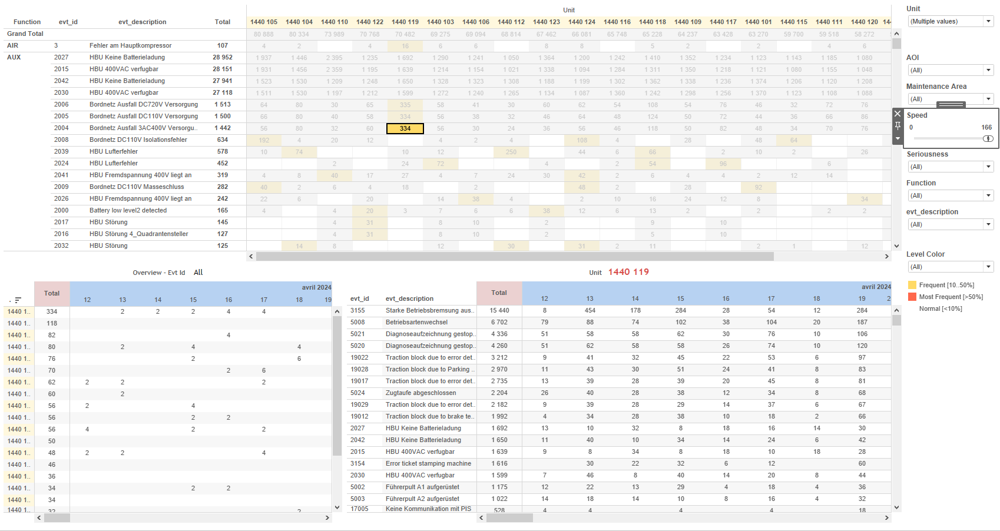
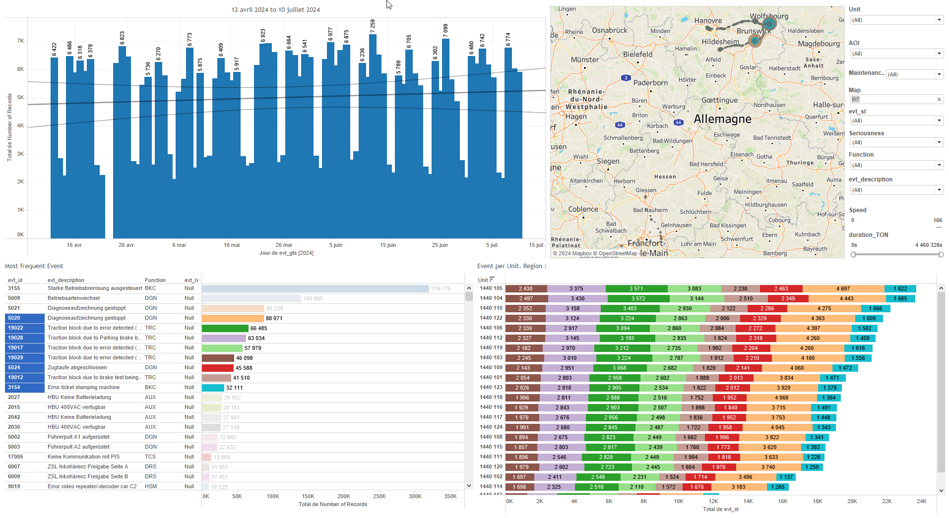
DATA VISUALIZATION REPORT SHEET
HealthHub
Energy_Fleet
Standard
Event Analysis
Represented By
Level 0 timestamp Level 2 Value Level 1 Service value Motion Unit
GENERAL DESCRIPTION
The 'Overview' dashboard provides a comprehensive analysis of mileage, value, and balance trends over time using various visualizations such as tables, area plots, and pie charts. It allows for detailed data exploration through level-based color coding and timestamp-based filtering, enabling users to interact with and understand the distribution and balance of values across different categories.
MAIN CHARACTERISTICS | Description
Project | Any project
Domain | Operational Data, Exploration
Type of report | Data Exploration - Operational Time Series (OPDAT)
Report's Objective | Provide a comprehensive analysis of mileage, value, and balance trends over time. Enable detailed data exploration through level-based color coding and timestamp-based filtering. Visualize data using tables, area plots, and pie charts for better understanding of distribution and balance of values.

Slide 2
Constitution du rapport 1/1
Overview Dashboard
The 'Overview' dashboard provides a comprehensive analysis of mileage, value, and balance trends over time using various visualizations such as tables, area plots, and pie charts. It allows for detailed data exploration through level-based color coding and timestamp-based filtering, enabling users to interact with and understand the distribution and balance of values across different categories.
Position | Exemple de question | Description
top left | What is the balance trend shown in the bar chart, considering the variables Level 0, Level 2, Mileage, and timestamp? | This plot displays the timestamp against Mileage with Level 0 used for color coding each cell. It visualizes the mileage data over time.
bottom left | What are the details of the day based on various levels and values? | This area plot visualizes the Value over time, where the x-axis represents the timestamp and the y-axis represents the calculated Value. The fill axis variable is Level 0, which is used to color the areas based on different levels.
top right | What is the balance of the given values based on the specified conditions and levels? | This visualization represents the 'Value' across different 'Level 2' categories. Each cell is colored based on 'Level 0' values.
bottom right | What is the distribution of values and positions across different levels in the dataset? | This pie chart visualizes data categorized by 'Level 0' and calculated values from 'Calculation_1062005113316786179'.
Principaux Filtres/Paramètres
Filtrage par | Description
Level 0 | Filtering all or part of the project's 'AOI' (Area Of Interest)
Level 2 | Filtering applicable to workbooks.
timestamp | Filtering applicable to workbooks. Filtering events by timestamp, which is a datetime value.
Level 1 | Filtering applicable to workbooks.

Slide 3
Liste des variables
GENERAL DESCRIPTION
La liste des variables ci-dessous est necessaire pour la constitution du rapport. Pour le projet [Projet] leur equivalence doit être fournie avec la plage de Valeur associée en cas de demande de rapport.
Variable | Description
Level 0 | Level 0 indicates the type of operation or event related to train units. It helps in categorizing data for analysis.
Level 1 | This variable categorizes data at the first level. It is used to filter and plot various operational metrics.
Level 2 | Level 2 is a categorical variable used in multiple plots and filters. It helps in segmenting data for better visualization and analysis.
Mileage | Mileage is the total distance covered by the train. It is used to monitor train usage and performance.
Motion | This variable indicates whether the train is in motion. It is used in various operational plots to analyze train activity.
Service | Service is a variable used to denote the type of service operation for the train. It is recorded as context data in various dashboards.
Unit | Unit refers to an identifier for a part of a train. It is used extensively across various dashboards for operational and event data.
timestamp | The timestamp variable records the date and time of events. It is used in various operational and context data plots.
value | This variable represents a real-time operational metric recorded for trains. It is used across multiple dashboards for various analyses.
NOTE
Les illustrations fournissent un aperçu des représentations graphiques et ne préjugent pas des données pouvant être contenues dans le rapport. En effet, les données peuvent évoluer au cours du projet et dépendent entièrement de celui-ci.
Toute reproduction ou distribution non autorisée de ce rapport est interdite. Les informations contenues dans ce document sont confidentielles et destinées uniquement aux parties mentionnées. L'utilisation ou la divulgation non autorisée de ces informations est passible de poursuites judiciaires. Les représentations graphiques sont fournies à titre indicatif et ne sauraient engager la responsabilité de l'émetteur quant à l'exhaustivité ou l'exactitude des données présentées. Les données sont sujettes à des modifications au fil du projet et doivent être interprétées dans ce contexte.

