Slide 1
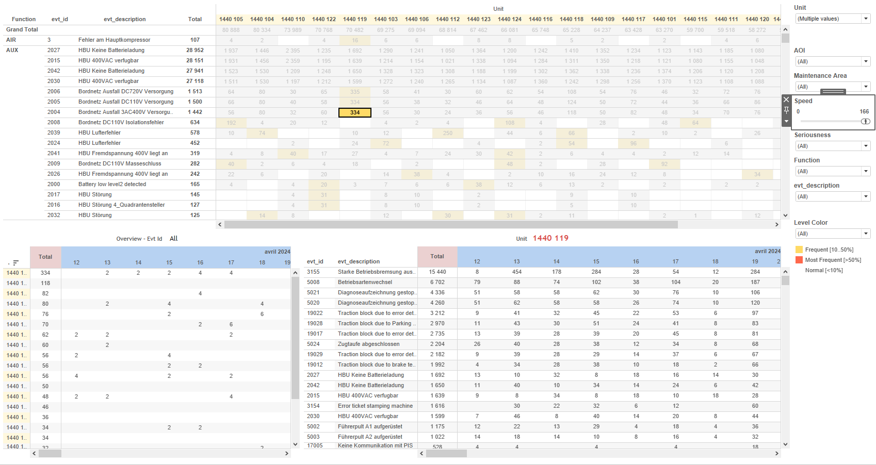
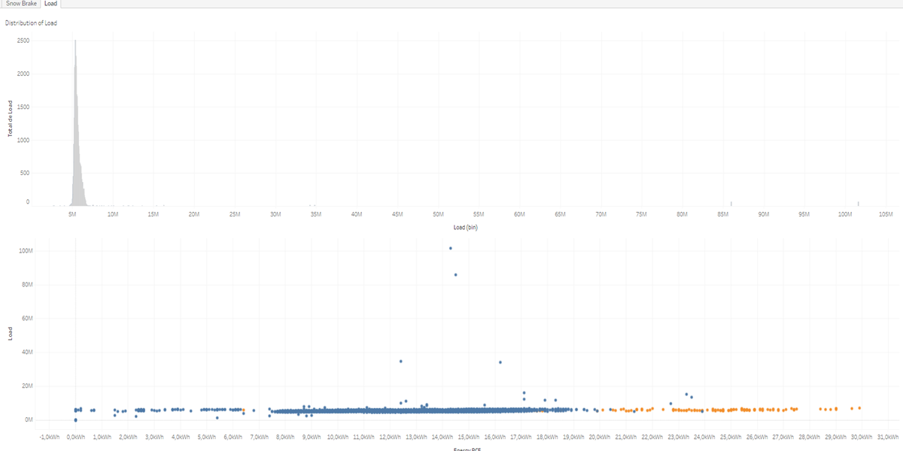
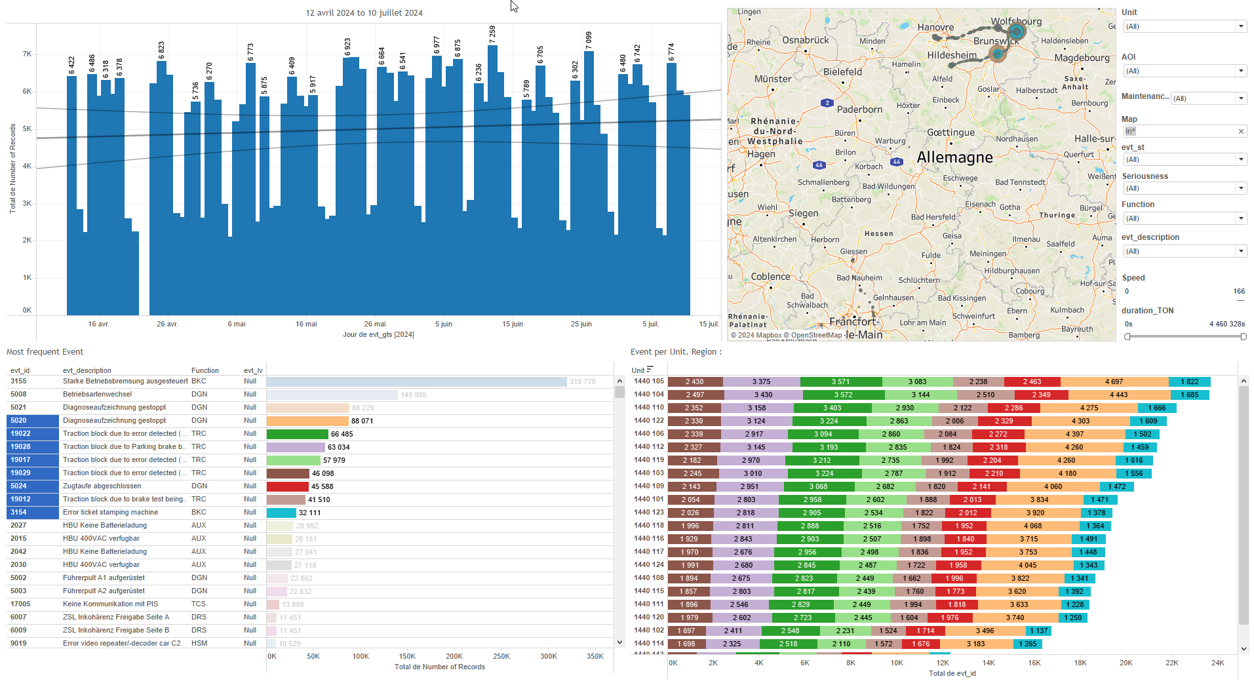
DATA VISUALIZATION REPORT SHEET
HealthHub
Energy_Fleet_Snow_Brake
Standard
Event Analysis
Represented By
SnowBrakeActivated Energy PCE Timestamp Unit SBfullyActivatedInSection Full Snow Brake Activated in the Section PCE2_IEnergyCons Section PCE1_IEnergyCons idx
GENERAL DESCRIPTION
This report provides a comprehensive analysis of energy consumption and Snow Brake activation over time. It includes various visualizations such as circle plots, bar charts, and tables, enabling users to understand the relationship between energy usage and Snow Brake activation, and to identify patterns and trends. The report is designed for detailed data exploration and offers insights into how these variables interact with snow brake activation and load binning.
MAIN CHARACTERISTICS | Description
Project | Any project
Domain | Exploration,Statistics
Type of report | Data Exploration - Operational Time Series (OPDAT)
Report's Objective | Provide insights into energy consumption and load distribution. Analyze the relationship between energy usage and Snow Brake activation. Identify patterns and trends in energy consumption over time. Visualize the distribution of load based on various conditions.

Slide 2
Constitution du rapport 1/2
Load Dashboard
The Load dashboard provides insights into energy consumption (Energy PCE) and load distribution, allowing for detailed exploration of how these variables interact with snow brake activation and load binning.
Position | Exemple de question | Description
bottom | How does the energy consumption (Energy PCE) vary with the load and snow brake activation? | This plot visualizes the relationship between Energy PCE and Load, with the fill color representing SnowBrakeActivated. The data is plotted in a circular format, providing a clear view of the distribution and correlation between these variables.
top | What is the distribution of load based on the given variables and conditions? | This plot visualizes the relationship between Load (bin) and Load. Load (bin) is binned from the Load variable.
Principaux Filtres/Paramètres
Filtrage par | Description

Slide 3
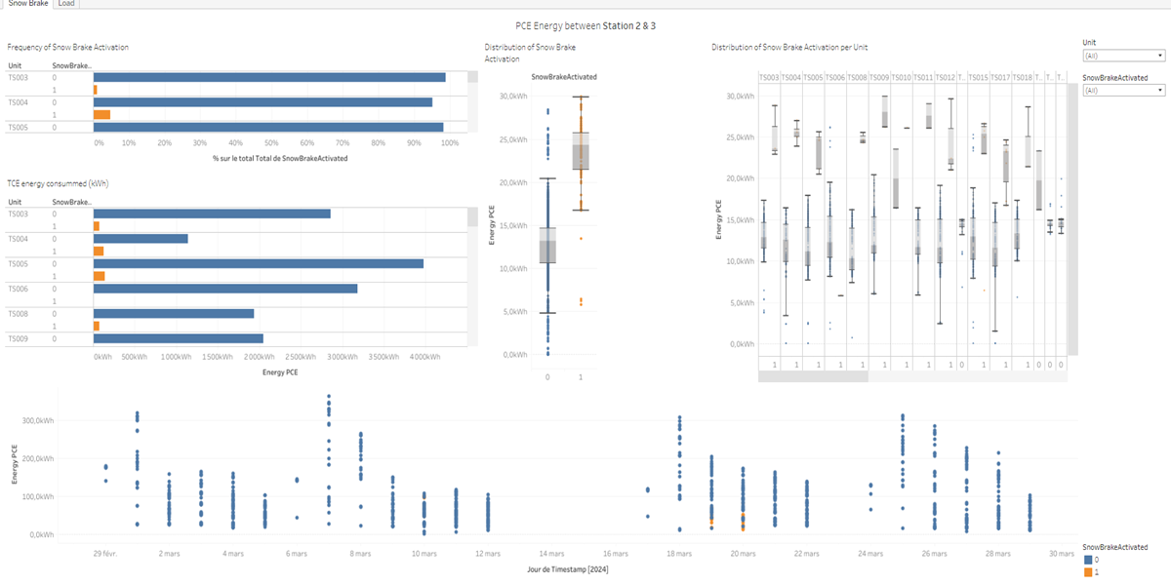
Constitution du rapport 2/2
Snow Brake Dashboard
The 'Snow Brake' dashboard provides a comprehensive analysis of energy consumption and Snow Brake activation over time. It allows for detailed data exploration through various visualizations, including circle plots, bar charts, and tables, enabling users to understand the relationship between energy usage and Snow Brake activation, and to identify patterns and trends.
Position | Exemple de question | Description
bottom | How does the energy consumption of PCE1 and PCE2 vary over time, and what is the state of the Snow Brake activation? | This plot visualizes the energy consumption (Energy PCE) over time, with each point representing the energy consumed at a specific timestamp. The color of each point indicates whether the Snow Brake was activated.
top left | What is the frequency of snow brake activation in different sections? | This plot visualizes the SnowBrakeActivated data using a bar chart. The x-axis represents qk, and the y-axis shows the SnowBrakeActivated values.
bottom right | What is the distribution of snow brake activation per unit? | This Circle plot visualizes the relationship between SnowBrakeActivated and Energy PCE. The x-axis represents the SnowBrakeActivated variable, while the y-axis represents the Energy PCE, calculated using the formula [PCE1_IEnergyCons]+[PCE2_IEnergyCons].
top right | What is the total energy consumed (kWh) by PCE devices? | This visualization displays the relationship between Energy PCE and SnowBrakeActivated. The plot uses color to fill each cell based on the value of SnowBrakeActivated.
Principaux Filtres/Paramètres
Filtrage par | Description

Slide 4
Liste des variables
GENERAL DESCRIPTION
La liste des variables ci-dessous est necessaire pour la constitution du rapport. Pour le projet [Projet] leur equivalence doit être fournie avec la plage de Valeur associée en cas de demande de rapport.
Variable | Description
Load | Load is the measure of the weight or force exerted by the train. It is recorded continuously as operational data.
PCE1_IEnergyCons | This variable represents the energy consumption of a train part. It is used in various energy and snow brake related analyses.
PCE2_IEnergyCons | This variable measures the energy consumption of a specific part of the train. It is used to monitor and analyze energy efficiency.
SBfullyActivatedInSection | This variable indicates whether the snow brake is fully activated in a section. It is used in various dashboards to analyze snow brake performance.
SnowBrakeActivated | This variable indicates whether the snow brake was activated. It is used in various energy and operational dashboards.
Timestamp | The timestamp records the exact time an event occurs or data is captured. It is crucial for synchronizing and analyzing operational data in train systems.
Unit | This variable identifies parts of a train. It is used extensively in various operational and event-based dashboards.
idx | Index variable used to uniquely identify each event or data point in the dashboards. It is an integer value recorded continuously.
NOTE
Les illustrations fournissent un aperçu des représentations graphiques et ne préjugent pas des données pouvant être contenues dans le rapport. En effet, les données peuvent évoluer au cours du projet et dépendent entièrement de celui-ci.
Toute reproduction ou distribution non autorisée de ce rapport est interdite. Les informations contenues dans ce document sont confidentielles et destinées uniquement aux parties mentionnées. L'utilisation ou la divulgation non autorisée de ces informations est passible de poursuites judiciaires. Les représentations graphiques sont fournies à titre indicatif et ne sauraient engager la responsabilité de l'émetteur quant à l'exhaustivité ou l'exactitude des données présentées. Les données sont sujettes à des modifications au fil du projet et doivent être interprétées dans ce contexte.

