Slide 1
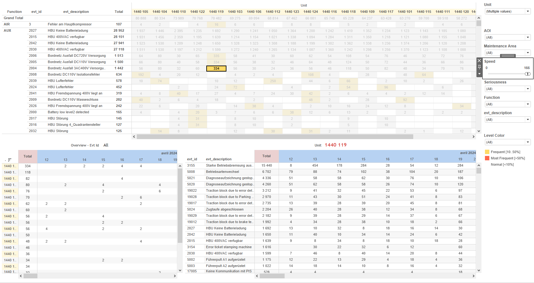
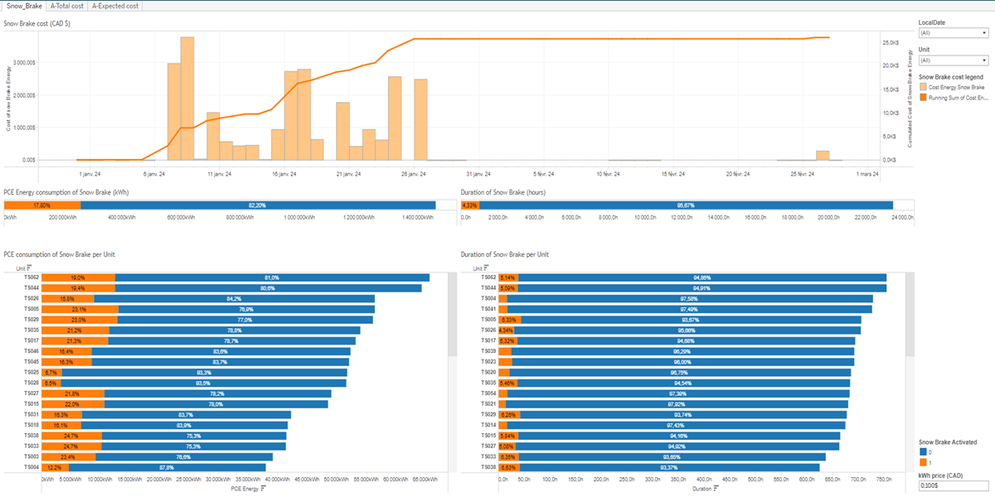
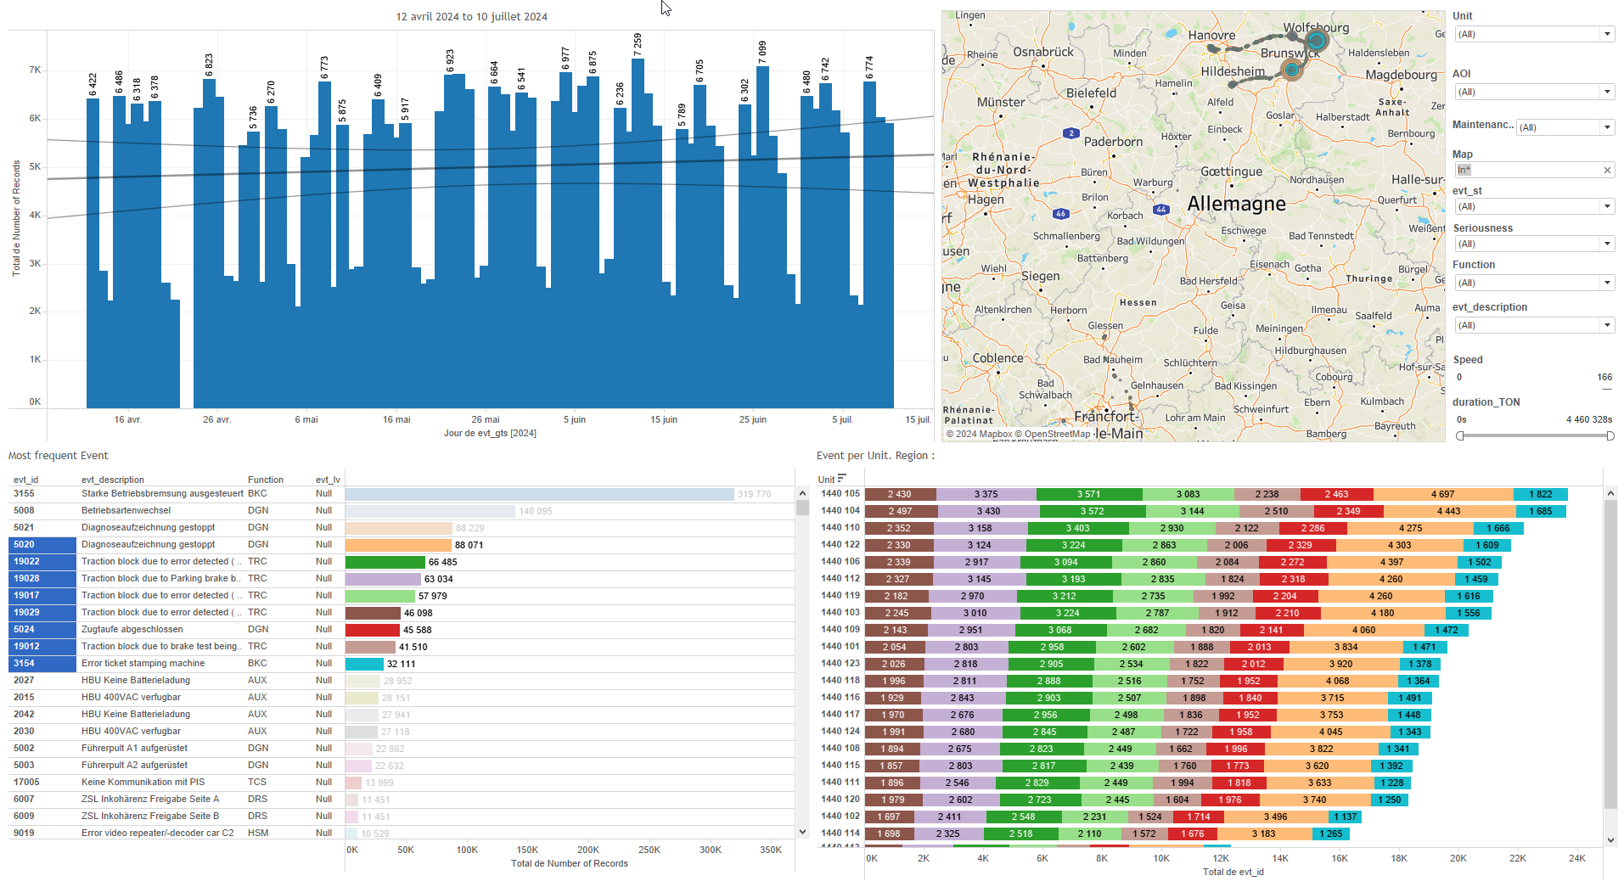
DATA VISUALIZATION REPORT SHEET
HealthHub
Energy_Fleet_Snow_Brake_KPI
Standard
Event Analysis
Represented By
Snow Brake Activated Unit PCE Energy LocalDate SnowBrakeActivated Cost Energy Snow Brake PCE2_IEnergyCons Duration PCE1_IEnergyCons kWh price
GENERAL DESCRIPTION
The 'Snow_Brake' dashboard provides an in-depth analysis of energy consumption, fleet analysis, duration, and cost trends related to the Snow Brake system. It allows users to explore detailed data through various visualizations, including tables and bar charts, with interactive features for filtering and comparing data.
MAIN CHARACTERISTICS | Description
Project | Any project
Domain | Exploration
Type of report | Data Exploration - Operational Time Series (OPDAT)
Report's Objective | Analyze energy consumption of the Snow Brake system. Explore fleet analysis data related to Snow Brake. Investigate duration trends of Snow Brake activation. Evaluate cost trends associated with Snow Brake energy consumption.

Slide 2
Constitution du rapport 1/1
Snow_Brake Dashboard
The 'Snow_Brake' dashboard provides an in-depth analysis of energy consumption, fleet analysis, duration, and cost trends related to the Snow Brake system. It allows users to explore detailed data through various visualizations, including tables and bar charts, with interactive features for filtering and comparing data.
Position | Exemple de question | Description
bottom left | What is the PCE consumption of Snow Brake per Unit? | This visualization displays the energy consumption (PCE Energy) with units categorized. The Snow Brake Activated status is used to fill the color and value of each cell.
top left | What is the energy consumption of the Snow Brake in kWh? | This visualization displays the PCE Energy consumption calculated from PCE1 and PCE2. The fill color represents the Snow Brake Activation status.
bottom right | What is the duration of snow brake activation per unit? | This plot shows the duration of various units. The x-axis represents the duration in hours, calculated as [Time]/3600, while the y-axis categorizes the units. The color fill represents the 'Snow Brake Activated' status, using the formula IFNULL([SnowBrakeActivated],0).
top right | How long does the snow brake activation last in hours? | This visualization displays the duration of fleet time in hours, with the Snow Brake Activated status used to fill each cell. The x-axis represents the duration, and the fill axis shows the Snow Brake Activated status.
Principaux Filtres/Paramètres
Filtrage par | Description

Slide 3
Liste des variables
GENERAL DESCRIPTION
La liste des variables ci-dessous est necessaire pour la constitution du rapport. Pour le projet [Projet] leur equivalence doit être fournie avec la plage de Valeur associée en cas de demande de rapport.
Variable | Description
LocalDate | This variable represents the local date when the data was recorded. It is used in various dashboards for time-based analysis.
PCE1_IEnergyCons | This variable represents the energy consumption of the primary PCE component in the Snow Brake system. It is recorded as operational data (opdat) and used to analyze energy trends and costs.
PCE2_IEnergyCons | This variable represents the energy consumption of the PCE2 system. It is recorded continuously as operational data.
SnowBrakeActivated | Indicates whether the snow brake is activated. This data is crucial for monitoring energy consumption and costs associated with the snow brake.
Time | The variable 'Time' is recorded continuously as operational data. It is used to measure the duration of events such as the Snow Brake activation per unit.
Unit | This variable identifies parts of a train. It is used in various dashboards to track operational and event data.
NOTE
Les illustrations fournissent un aperçu des représentations graphiques et ne préjugent pas des données pouvant être contenues dans le rapport. En effet, les données peuvent évoluer au cours du projet et dépendent entièrement de celui-ci.
Toute reproduction ou distribution non autorisée de ce rapport est interdite. Les informations contenues dans ce document sont confidentielles et destinées uniquement aux parties mentionnées. L'utilisation ou la divulgation non autorisée de ces informations est passible de poursuites judiciaires. Les représentations graphiques sont fournies à titre indicatif et ne sauraient engager la responsabilité de l'émetteur quant à l'exhaustivité ou l'exactitude des données présentées. Les données sont sujettes à des modifications au fil du projet et doivent être interprétées dans ce contexte.

