Slide 1
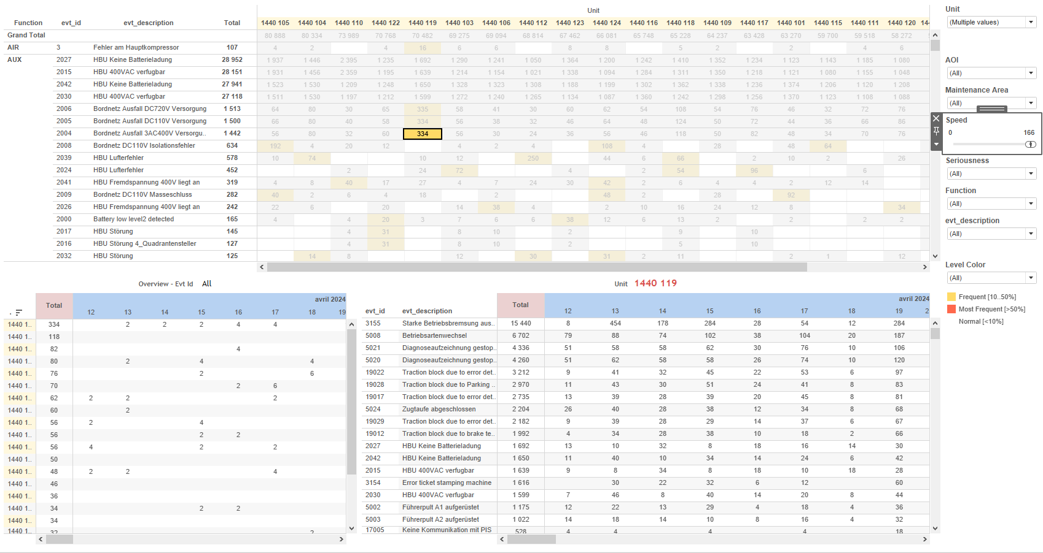
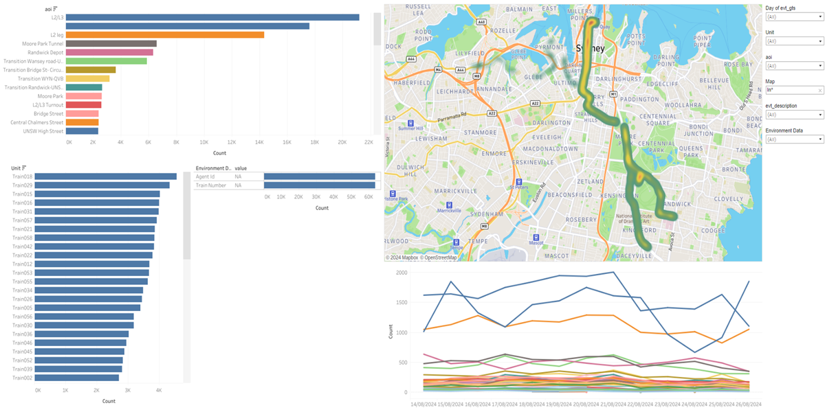
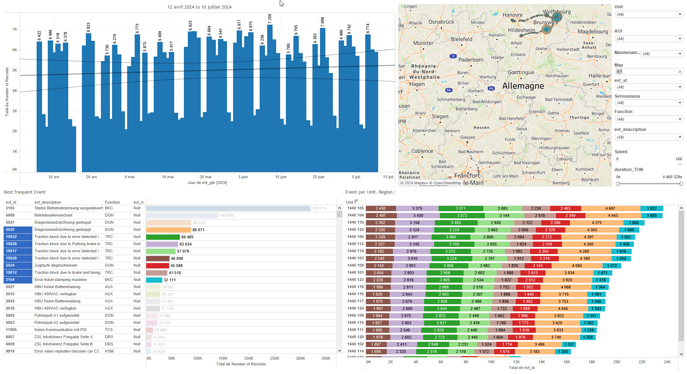
DATA VISUALIZATION REPORT SHEET
HealthHub
Event_HeatMap
Standard
Event Analysis
Represented By
aoi value Unit idx evt_gts evt_description Environment Data evt_id evt_gps_lat evt_gps_lon
GENERAL DESCRIPTION
The 'Location' dashboard offers an in-depth visualization of the area of interest (aoi) and its interaction with various environmental factors over time. It includes interactive tables, heatmaps, and line plots to facilitate detailed data exploration, allowing users to discern trends, distributions, and correlations within the dataset.
MAIN CHARACTERISTICS | Description
Project | Any project
Domain | Event,Operational Data
Type of report | Data Exploration - Train Event Data with Contextual Variables
Report's Objective | Provide comprehensive visualization of the area of interest (aoi) and its relationship with various environmental factors over time. Enable detailed data exploration through interactive tables, heatmaps, and line plots. Understand trends, distributions, and correlations within the dataset.

Slide 2
Constitution du rapport 1/1
Location Dashboard
The 'Location' dashboard provides a comprehensive visualization of the area of interest (aoi) and its relationship with various environmental factors over time. It allows for detailed data exploration through interactive tables, heatmaps, and line plots, enabling users to understand trends, distributions, and correlations within the dataset.
Position | Exemple de question | Description
top left | What is the impact of different environments on the area of interest (aoi) over time? | This plot visualizes the 'aoi' data categorized by 'idx'. The color and value of each cell are determined by the 'aoi' variable.
bottom left | What is the relationship between the Unit and the idx in the given dataset? | This plot displays the Unit distribution across different idx values. The x-axis represents the idx, while the y-axis shows the Unit. Since the y-axis is categorical, the plot is represented as a table with color-coded cells based on the fill variable.
top right | How does the geographical distribution of events look on the map? | This heatmap visualizes the geographical distribution of events using longitude (evt_gps_lon) and latitude (evt_gps_lat) coordinates. The intensity of the heatmap indicates the concentration of events in different locations.
bottom right | What are the environmental data values over time? | This visualization displays the relationship between value and value. Both axes represent real number data, providing insights into their correlation.
Principaux Filtres/Paramètres
Filtrage par | Description

Slide 3
Liste des variables
GENERAL DESCRIPTION
La liste des variables ci-dessous est necessaire pour la constitution du rapport. Pour le projet [Projet] leur equivalence doit être fournie avec la plage de Valeur associée en cas de demande de rapport.
Variable | Description
Environment Data | This variable captures environmental conditions relevant to train operations. It is used across multiple dashboards for analysis.
Map | This variable represents the geographical location data of the train. It is used in various dashboards to plot the train's position.
Unit | This variable identifies different parts of a train. It is recorded as context data for various events.
aoi | AOI represents an area of interest on the train. It is used in various dashboards to monitor specific sections.
evt_description | This variable records event descriptions for different train events. It is used across multiple dashboards for various analyses.
evt_gps_lat | The latitude of the train's GPS location is recorded during events. It helps in mapping the train's position accurately.
evt_gps_lon | This variable represents the GPS longitude of an event. It is used to plot locations on a map.
evt_gts | The variable records the timestamp of events in the train's operational data. It is crucial for event tracking and analysis.
evt_id | This variable represents the unique identifier for events recorded on the train. It is used extensively across various dashboards to track and analyze event data.
idx | This variable represents an index used in various operational contexts. It is recorded continuously as operational data.
value | This variable is used for various operational analyses including energy and HVAC systems. It is recorded continuously and can be plotted in different dashboards.
NOTE
Les illustrations fournissent un aperçu des représentations graphiques et ne préjugent pas des données pouvant être contenues dans le rapport. En effet, les données peuvent évoluer au cours du projet et dépendent entièrement de celui-ci.
Toute reproduction ou distribution non autorisée de ce rapport est interdite. Les informations contenues dans ce document sont confidentielles et destinées uniquement aux parties mentionnées. L'utilisation ou la divulgation non autorisée de ces informations est passible de poursuites judiciaires. Les représentations graphiques sont fournies à titre indicatif et ne sauraient engager la responsabilité de l'émetteur quant à l'exhaustivité ou l'exactitude des données présentées. Les données sont sujettes à des modifications au fil du projet et doivent être interprétées dans ce contexte.

