Slide 1
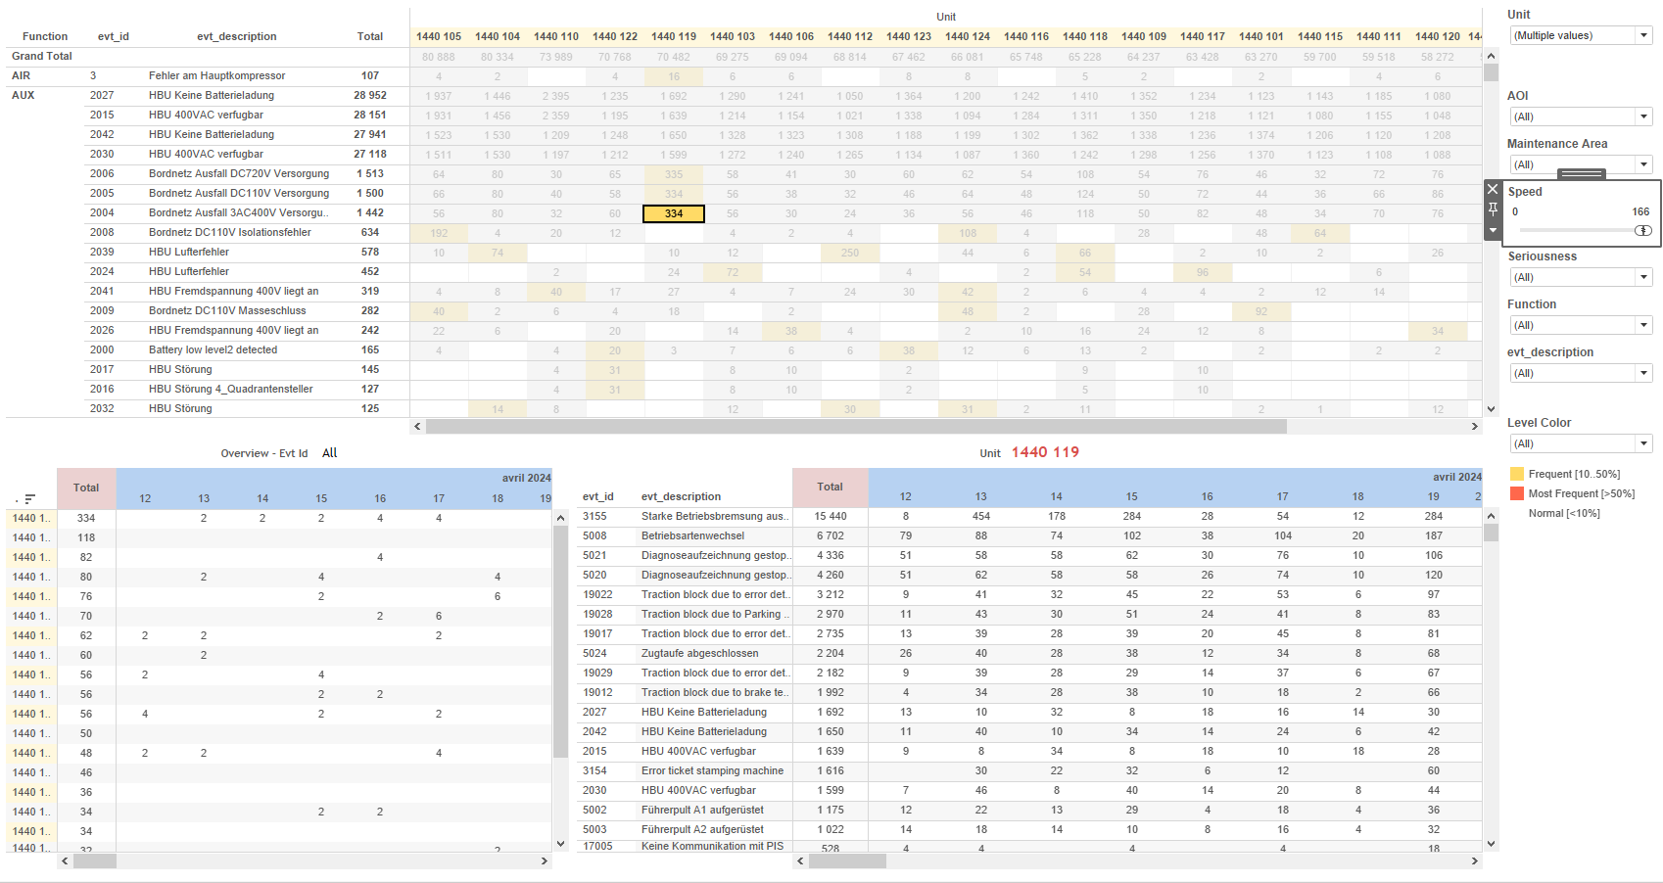
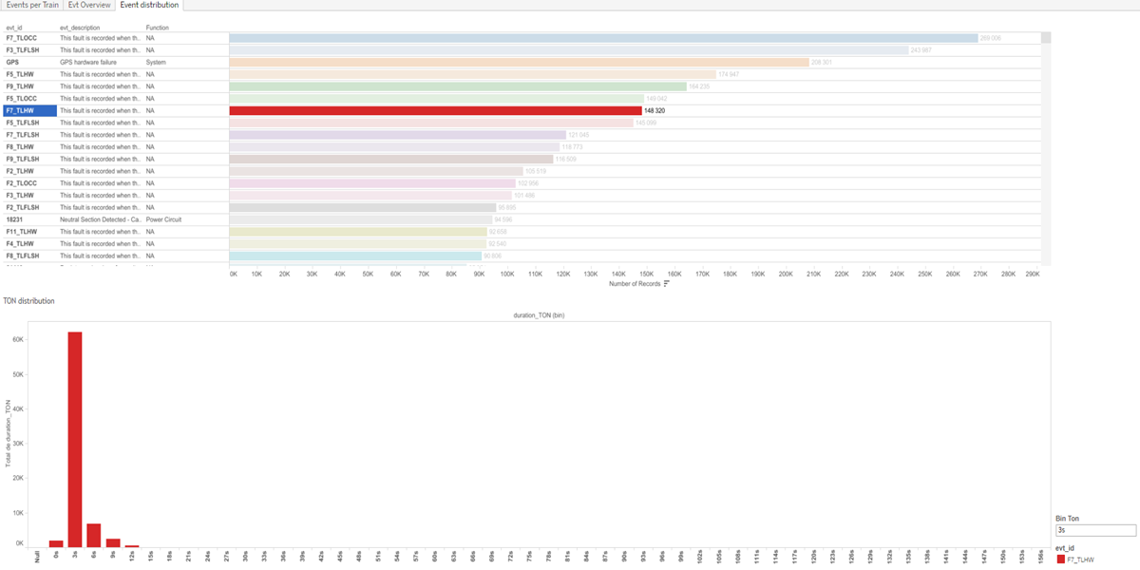
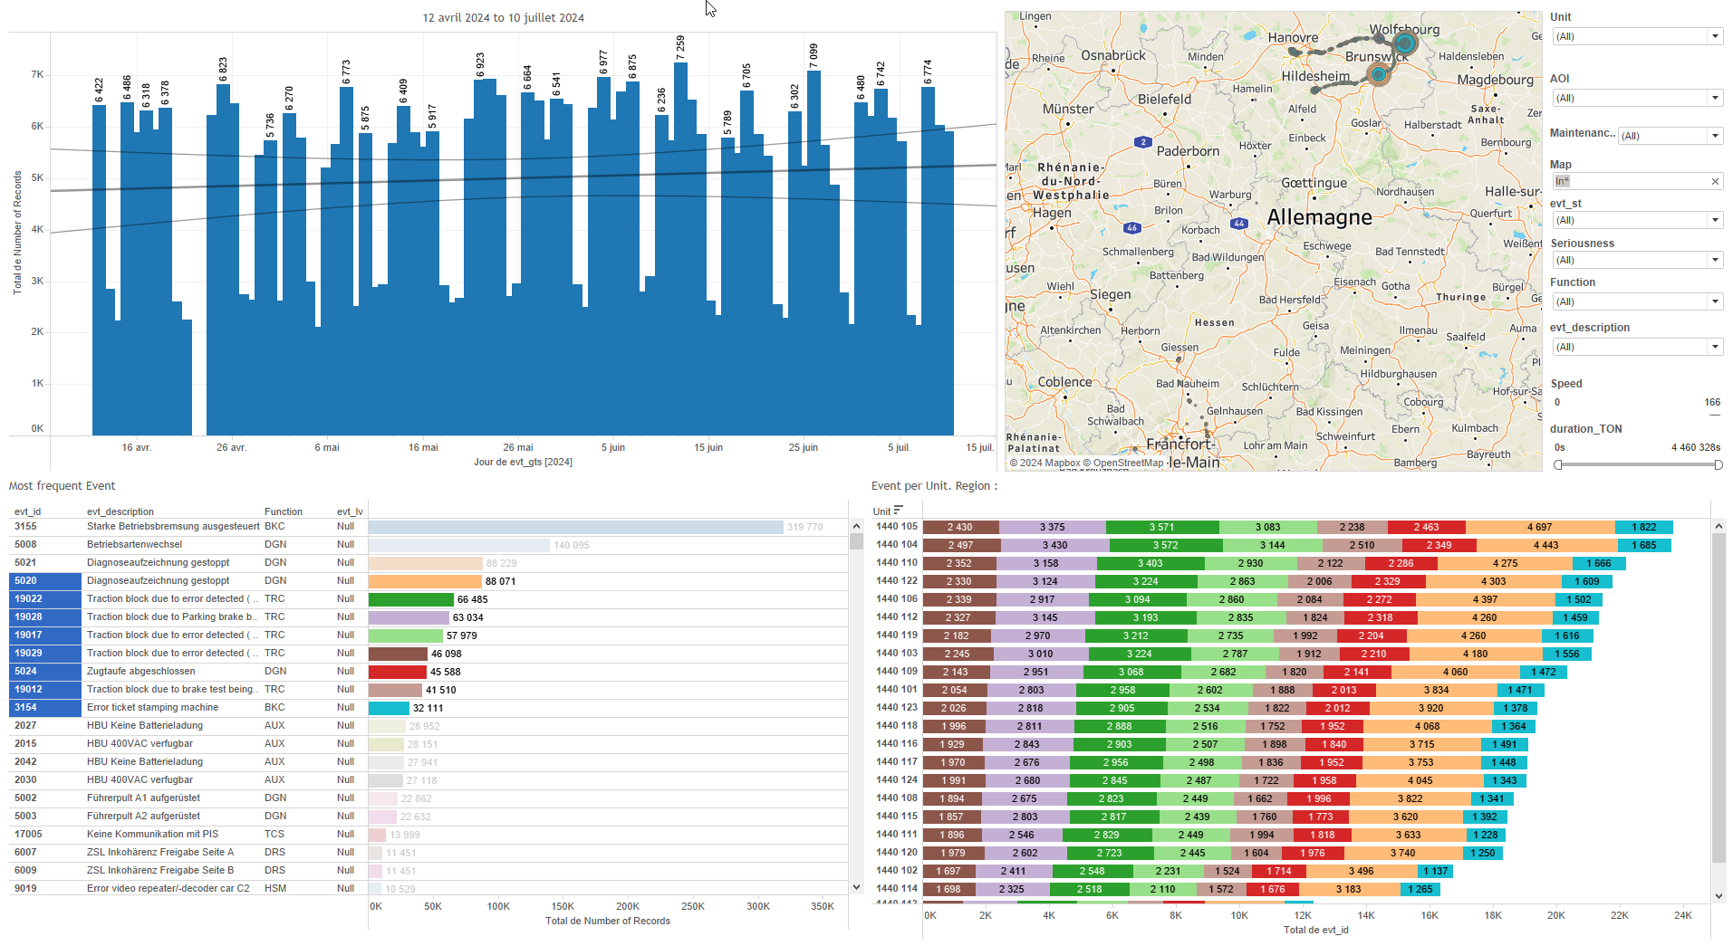
DATA VISUALIZATION REPORT SHEET
HealthHub
Evt_14days
Standard
Event Analysis
Represented By
evt_id Number of Records evt_lv Speed aoi Function duration_TON evt_description Maintenance Area evt_st
GENERAL DESCRIPTION
This report provides comprehensive data visualization and exploration of train event data. It includes detailed analyses of event durations, event data per train unit, and overall event distribution across different units and areas of interest. The report aims to enhance data clarity and understanding through interactive tables and visualizations.
MAIN CHARACTERISTICS | Description
Project | Any project
Domain | Event, Exploration
Type of report | Data Exploration - Train Event Data with Contextual Variables
Report's Objective | Provide an in-depth analysis of event durations and functions by the number of records. Enable detailed exploration of event data per train unit through various visualizations. Visualize the distribution, frequency, and timestamps of recorded events to identify patterns and trends.

Slide 2
Constitution du rapport 1/3
Event distribution Dashboard
The 'Event distribution' dashboard provides an in-depth analysis of event durations and functions by the number of records. It allows users to filter and explore detailed event data through interactive tables, enhancing data clarity and understanding.
Position | Exemple de question | Description
bottom | What is the distribution of TON based on the given parameters? | This plot visualizes the duration_TON (bin) against duration_TON. The evt_id is used for coloring the cells, making it easier to distinguish different events.
top | What is the function and number of records for each event ID? | This table visualizes the function of events categorized by the number of records. Each cell is filled with the event ID for clarity.
Principaux Filtres/Paramètres
Filtrage par | Description

Slide 3
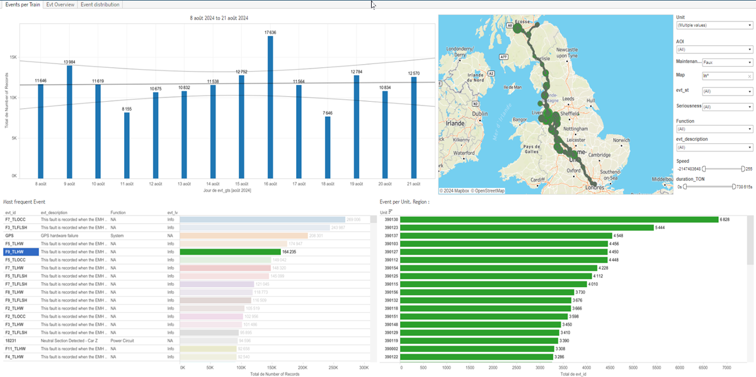
Constitution du rapport 2/3
Events per Train Dashboard
The 'Events per Train' dashboard provides a comprehensive overview of event data per train unit, allowing for detailed exploration through various visualizations including bar charts, tables, and GPS maps. Users can filter data by event timestamps, event IDs, and GPS coordinates to identify patterns and relationships in train event data.
Position | Exemple de question | Description
top left | What is the speed distribution of events per train per day? | This bar chart displays the number of records (Number of Records) against the event timestamps (evt_gts).
bottom left | What is the most frequent event based on the provided data? | This visualization shows the number of records against evt_lv, with evt_id used for color and value of each cell. The x-axis represents the Number of Records, and the y-axis represents evt_lv.
bottom right | What is the relationship between the event speed and the maintenance area for each unit? | This plot shows the distribution of events per train unit, categorized by event ID and unit. Each cell color represents the event ID.
top right | What are the GPS coordinates and IDs of events recorded by the train? | This visualization shows the distribution of events per train using GPS coordinates. The x-axis represents the longitude (evt_gps_lon) and the y-axis represents the latitude (evt_gps_lat). Each circle is filled based on the event ID (evt_id).
Principaux Filtres/Paramètres
Filtrage par | Description
Speed | Filtering by speed
aoi | Filtering all or part of the project's 'AOI' (Area Of Interest)
evt_lv | Filtering the severity of events
Maintenance Area | Filtering maintenance-related depot areas

Slide 4
Constitution du rapport 3/3
Evt Overview Dashboard
The 'Evt Overview' dashboard provides a comprehensive analysis of event data across different units and areas of interest. It allows for detailed data exploration by visualizing the distribution, frequency, and timestamps of recorded events, enabling users to identify patterns and trends effectively.
Position | Exemple de question | Description
top | What is the distribution of event seriousness across different units and areas of interest? | This plot visualizes the total count of events by unit. Each cell is colored based on the frequency of the records, with 'Most Frequent [>50%]', 'Frequent [10..50%]', and 'Normal [<10%]' categories.
bottom left | What is the speed and unit over time in the given dataset? | This visualization shows the number of records per unit over time, categorized by evt_gts.
bottom right | What are the recorded events and their corresponding timestamps? | This visualization shows the evt_gts over time along with the evt_description. Each record is counted and displayed as Number of Records.
Principaux Filtres/Paramètres
Filtrage par | Description
evt_lv | Filtering the severity of events
aoi | Filtering all or part of the project's 'AOI' (Area Of Interest)
Speed | Filtering by speed

Slide 5
Liste des variables
GENERAL DESCRIPTION
La liste des variables ci-dessous est necessaire pour la constitution du rapport. Pour le projet [Projet] leur equivalence doit être fournie avec la plage de Valeur associée en cas de demande de rapport.
Variable | Description
Function | This variable is used to describe a function related to train operations. It is utilized in various dashboards for monitoring and analysis.
Map | The map shows the location of events recorded on the train. It is used in various dashboards to visualize the geographical distribution of these events.
Unit | This variable represents a specific part of a train. It is used in both event context data and continuous operational data.
aoi | AOI is used to identify technical areas of interest in train events. It is often used in dashboards to filter and plot data related to specific train units.
duration_TON | The variable duration_TON measures the duration of an event in minutes. It is used to analyze the distribution and frequency of events across different time periods.
evt_description | This variable provides a description of events recorded in the system. It is used across multiple dashboards for various analyses.
evt_gps_lat | This variable records the latitude of the train during an event. It helps in mapping the location of incidents.
evt_gps_lon | This variable represents the longitude recorded during an event. It is used for mapping train locations.
evt_gts | This variable records the timestamp of an event. It is crucial for tracking the sequence of occurrences.
evt_id | This variable is used to uniquely identify events in the system. It is crucial for tracking and analyzing event data.
evt_lv | This variable represents the seriousness of an event. It is used in various dashboards to filter and plot event data.
NOTE
Les illustrations fournissent un aperçu des représentations graphiques et ne préjugent pas des données pouvant être contenues dans le rapport. En effet, les données peuvent évoluer au cours du projet et dépendent entièrement de celui-ci.
Toute reproduction ou distribution non autorisée de ce rapport est interdite. Les informations contenues dans ce document sont confidentielles et destinées uniquement aux parties mentionnées. L'utilisation ou la divulgation non autorisée de ces informations est passible de poursuites judiciaires. Les représentations graphiques sont fournies à titre indicatif et ne sauraient engager la responsabilité de l'émetteur quant à l'exhaustivité ou l'exactitude des données présentées. Les données sont sujettes à des modifications au fil du projet et doivent être interprétées dans ce contexte.

