Slide 1
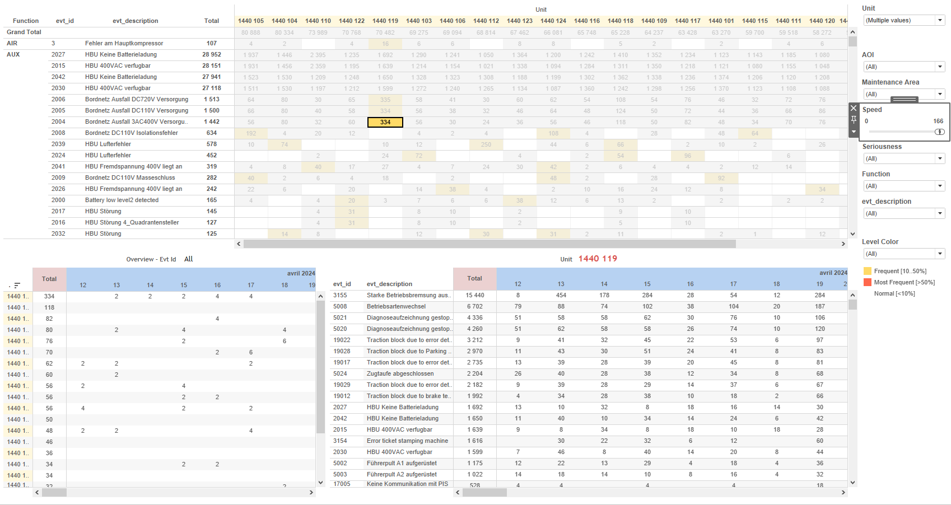
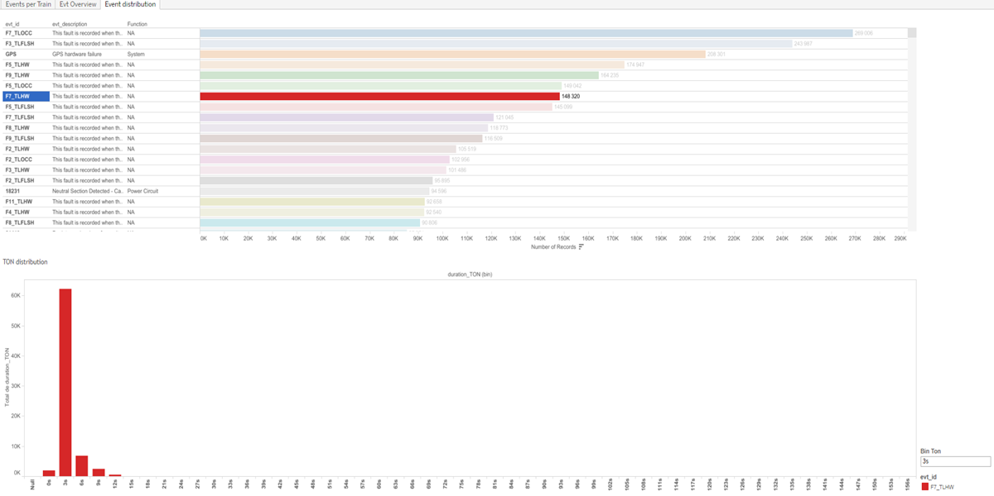
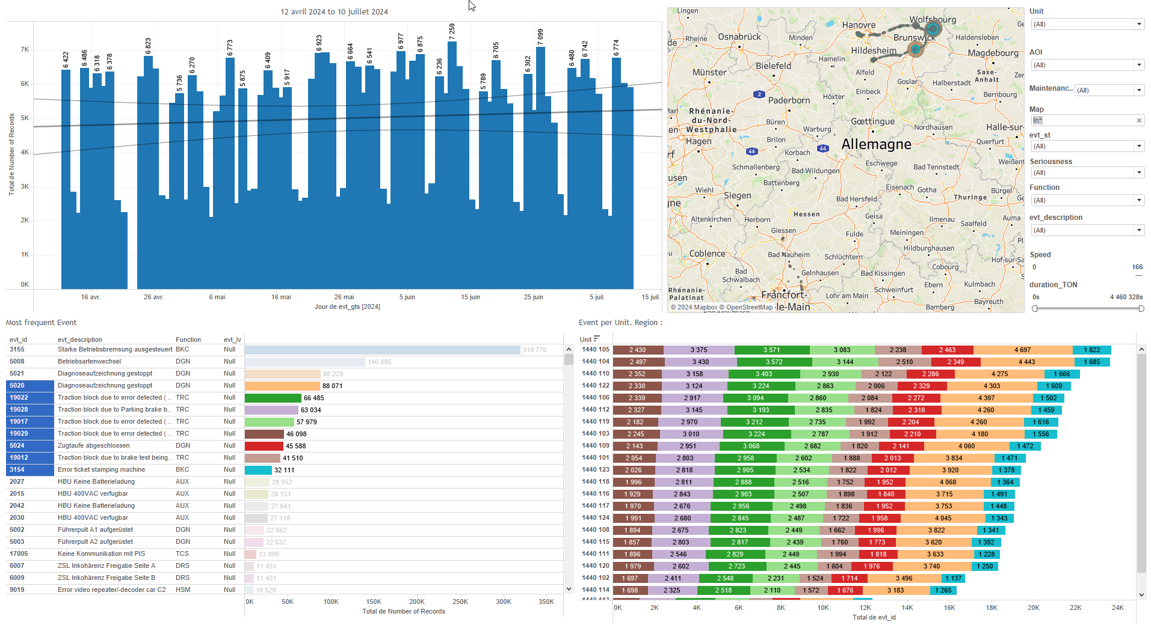
DATA VISUALIZATION REPORT SHEET
HealthHub
Evt_30days
Standard
Event Analysis
Represented By
evt_id Number of Records evt_lv Speed aoi evt_description Function Maintenance Area duration_TON evt_spd
GENERAL DESCRIPTION
This report provides a comprehensive overview of train event data, including analysis of event distribution, speed, frequency, severity, and geographical distribution. It allows for detailed data exploration through interactive tables and visualizations, enabling users to filter and analyze data based on various criteria.
MAIN CHARACTERISTICS | Description
Project | Any project
Domain | Event, Exploration
Type of report | Data Exploration - Train Event Data with Contextual Variables
Report's Objective | Provide a comprehensive analysis of event data. Enable users to explore the distribution of duration_TON and understand the function of records based on evt_id. Allow detailed data exploration through interactive tables and GPS maps. Facilitate understanding of event seriousness levels and timestamps.

Slide 2
Constitution du rapport 1/3
Event distribution Dashboard
The 'Event distribution' dashboard provides a comprehensive analysis of event data. It allows users to explore the distribution of duration_TON and understand the function of records based on evt_id, facilitating detailed data exploration through interactive tables.
Position | Exemple de question | Description
bottom | What is the distribution of TON based on the provided data and variables? | This plot visualizes the duration_TON data. The x-axis represents binned duration_TON values, while the y-axis shows the real duration_TON values. The fill axis is categorized by evt_id.
top | What is the function of the records based on the evt_id in the dataset? | This table visualizes the Function against the Number of Records, with each cell colored and valued based on the evt_id.
Principaux Filtres/Paramètres
Filtrage par | Description

Slide 3
Constitution du rapport 2/3
Events per Train Dashboard
The 'Events per Train' dashboard provides a comprehensive overview of train event data, including daily event speed, event frequency and severity, events per unit, and geographical distribution. It allows for detailed data exploration through interactive tables and a GPS map, enabling users to filter and analyze data based on various criteria.
Position | Exemple de question | Description
top left | What is the speed of the events per train on a daily basis? | This plot shows the number of records over time, with evt_gts on the x-axis and Number of Records on the y-axis. Each cell is colored and valued based on the fill variable.
bottom left | What is the most frequent event recorded, and how serious are these events? | This plot shows the Number of Records against evt_lv, with evt_id used for coloring each cell. Since evt_lv is a real number and evt_id is a string, the plot is most likely a table.
bottom right | What is the event per unit in the specified region? | This visualization displays the number of events per train unit, categorized by the event ID and unit.
top right | What are the GPS coordinates and IDs of events occurring per train, and how are they distributed on the map? | This visualization shows the geographical distribution of events based on GPS coordinates. The longitude is represented on the x-axis (evt_gps_lon) and the latitude on the y-axis (evt_gps_lat). Each circle represents an event identified by evt_id.
Principaux Filtres/Paramètres
Filtrage par | Description
Speed | Filtering by speed
AOI | Filtering all or part of the project's 'AOI' (Area Of Interest)
evt_lv | Filtering the severity of events
Maintenance Area | Filtering maintenance-related depot areas

Slide 4
Constitution du rapport 3/3
Evt Overview Dashboard
The 'Evt Overview' dashboard provides a comprehensive analysis of event data, focusing on speed distribution, event seriousness levels, and their timestamps. It allows for detailed exploration through interactive tables that categorize and visualize data based on frequency and time, facilitating a deep understanding of maintenance area events.
Position | Exemple de question | Description
top | What is the speed distribution and most frequent event seriousness levels in the maintenance area based on the given data? | This visualization displays the total count of events, categorized by Unit. The color of each cell represents the frequency level, ranging from 'Most Frequent' to 'Normal'.
bottom left | What is the speed of the events over time and how many records are there? | This plot displays the number of records (Number of Records) against event timestamps (evt_gts) and unit categories (Unit). Since the y-axis variable is categorical, this plot is most likely represented as a table where each cell is filled with color and value.
bottom right | What is the relationship between event descriptions and their timestamps in the dataset? | This plot displays evt_gts over time against evt_description, with the number of records as an integer value.
Principaux Filtres/Paramètres
Filtrage par | Description
evt_lv | Filtering the severity of events
aoi | Filtering all or part of the project's 'AOI' (Area Of Interest)
Speed | Filtering by speed

Slide 5
Liste des variables
GENERAL DESCRIPTION
La liste des variables ci-dessous est necessaire pour la constitution du rapport. Pour le projet [Projet] leur equivalence doit être fournie avec la plage de Valeur associée en cas de demande de rapport.
Variable | Description
Function | This variable is used to categorize different functions related to train events. It appears in multiple dashboards for operational analysis.
Map | The map variable is used to visualize train locations and event distributions. It is essential for understanding operational data in the context of specific events.
Unit | This variable identifies different parts of a train. It is recorded as context data for events.
aoi | The variable represents an area of interest, commonly used in maintenance and event detection. It helps identify specific sections of the train for detailed analysis.
duration_TON | This variable represents the duration of a specific train event. It is used in various operational dashboards for monitoring event distributions and occurrences.
evt_description | This variable describes events related to train operations. It is used in multiple dashboards for event analysis.
evt_gps_lat | This variable records the latitude from the GPS during an event. It helps in locating the train's position.
evt_gps_lon | This variable represents the longitude from the GPS data recorded during an event. It is used to map the location of the event on the dashboard.
evt_gts | This variable records the timestamp of an event. It is used across multiple dashboards for tracking event occurrences.
evt_id | This variable identifies specific events recorded in the system. It is used across multiple dashboards for event tracking and analysis.
evt_lv | This variable represents the seriousness of an event. It is recorded as context data for various event dashboards.
NOTE
Les illustrations fournissent un aperçu des représentations graphiques et ne préjugent pas des données pouvant être contenues dans le rapport. En effet, les données peuvent évoluer au cours du projet et dépendent entièrement de celui-ci.
Toute reproduction ou distribution non autorisée de ce rapport est interdite. Les informations contenues dans ce document sont confidentielles et destinées uniquement aux parties mentionnées. L'utilisation ou la divulgation non autorisée de ces informations est passible de poursuites judiciaires. Les représentations graphiques sont fournies à titre indicatif et ne sauraient engager la responsabilité de l'émetteur quant à l'exhaustivité ou l'exactitude des données présentées. Les données sont sujettes à des modifications au fil du projet et doivent être interprétées dans ce contexte.

