Slide 1
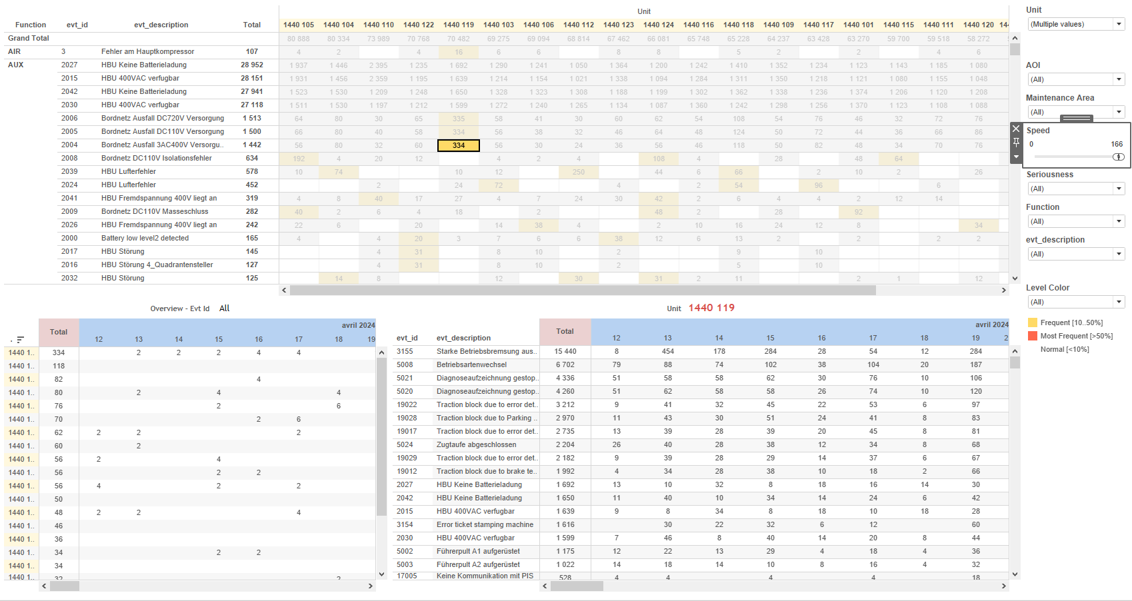
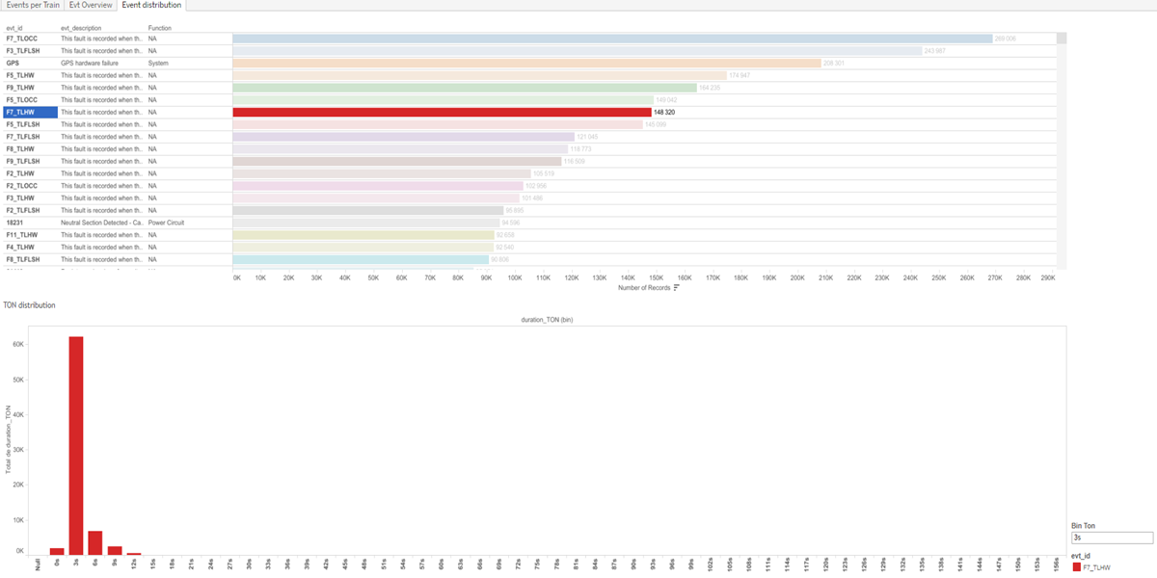
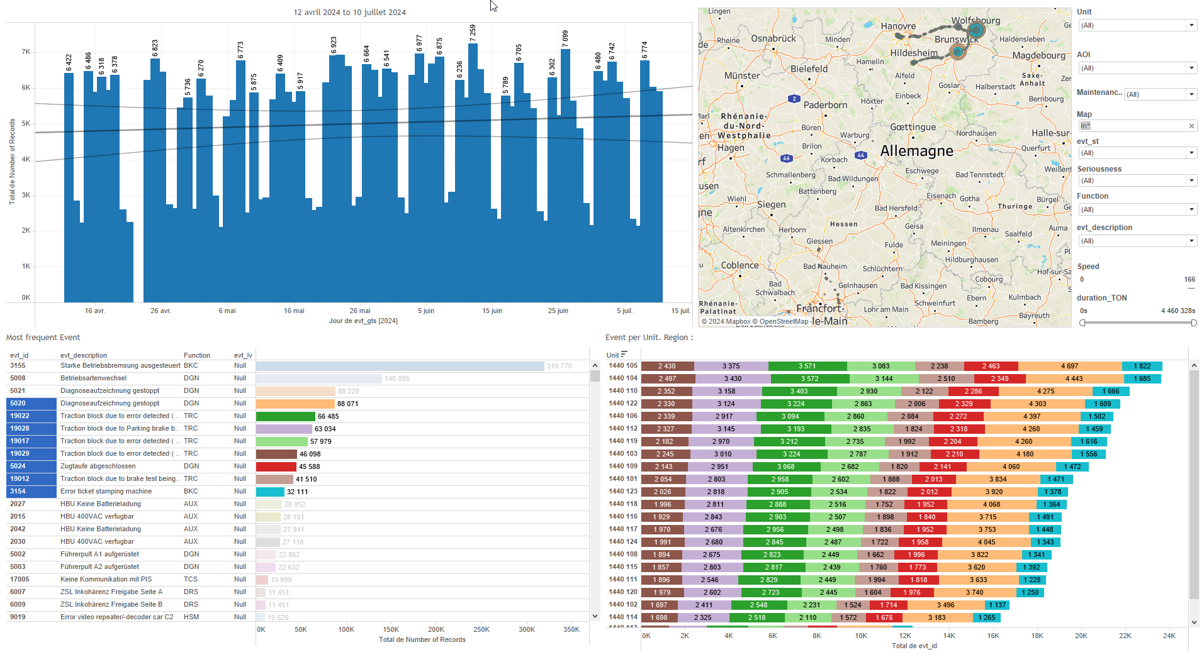
DATA VISUALIZATION REPORT SHEET
HealthHub
Evt_365days
Standard
Event Analysis
Represented By
evt_id Number of Records evt_lv aoi Speed Function evt_description Maintenance Area duration_TON evt_spd
GENERAL DESCRIPTION
The 'Evt_365days' report provides a comprehensive overview of train event data, allowing users to explore detailed data through interactive visualizations. It includes dashboards for event distribution, events per train, and an overview of events, facilitating data-driven insights and exploration.
MAIN CHARACTERISTICS | Description
Project | Any project
Domain | Event,Exploration
Type of report | Data Exploration - Train Event Data with Contextual Variables
Report's Objective | Provide a comprehensive analysis of event durations and record functions. Allow detailed exploration of event distributions and functions through interactive tables. Provide an overview of event data per train, including time-based records, event frequency, unit-specific events, and GPS coordinates. Identify the most frequent events, understand their seriousness levels, and explore the relationship between event descriptions and their timestamps.

Slide 2
Constitution du rapport 1/3
Event distribution Dashboard
The 'Event distribution' dashboard provides a comprehensive analysis of event durations and record functions. It allows for detailed exploration of event distributions and functions through interactive tables, facilitating data-driven insights.
Position | Exemple de question | Description
bottom | What is the distribution of duration_TON based on the provided variables and context? | This plot visualizes the distribution of duration_TON (bin) on the x-axis and duration_TON on the y-axis. The cells are filled with evt_id values, providing insights into the event distribution.
top | What is the function of the records identified by their evt_id in the dataset, and how many such records are there? | This table visualizes the distribution of the 'Number of Records' across different 'Function' categories. Each cell is colored based on the 'evt_id' variable, providing an intuitive view of the data.
Principaux Filtres/Paramètres
Filtrage par | Description

Slide 3
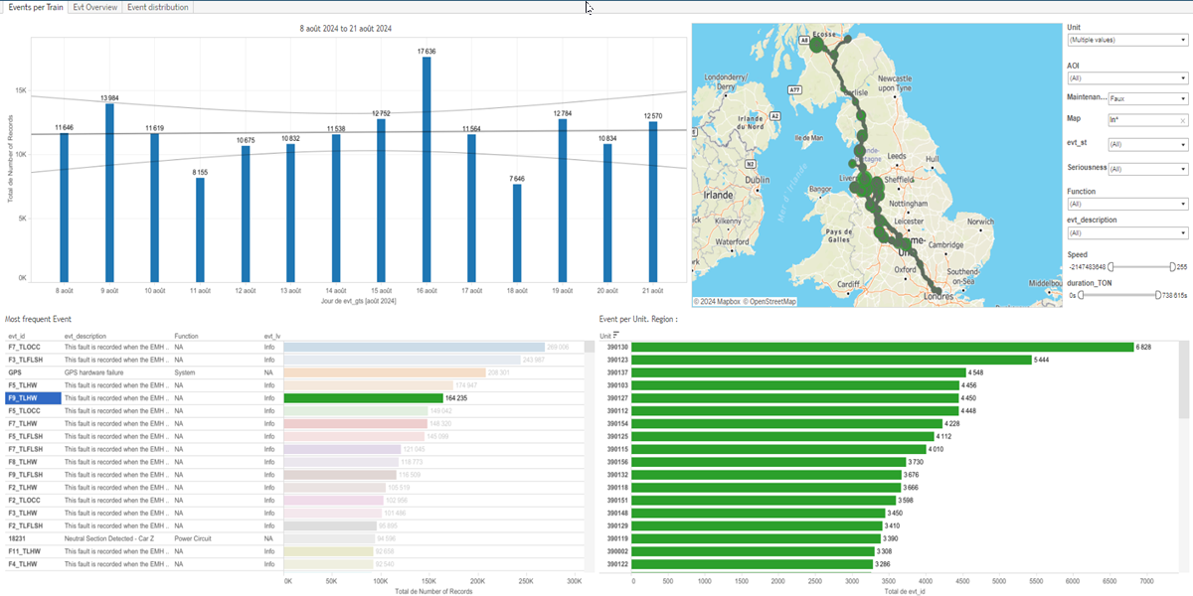
Constitution du rapport 2/3
Events per Train Dashboard
The 'Events per Train' dashboard provides a comprehensive overview of event data per train, including time-based records, event frequency, unit-specific events, and GPS coordinates. Users can explore detailed data through interactive visualizations, filtering by event ID and unit, with graphs that update dynamically based on user interactions.
Position | Exemple de question | Description
top left | What are the events per train per day as visualized in a bar chart? | This visualization shows the number of records over time, with evt_gts as the datetime axis and Number of Records as the integer value.
bottom left | What is the most frequent event recorded per train? | This plot visualizes the number of records for each event level, with color and value represented by event ID.
bottom right | What is the event distribution per unit in the specified region? | This plot displays the number of events per train unit, categorized by event ID and unit. The data is presented in a table format, with colors indicating different values for each cell.
top right | What are the GPS coordinates and IDs of events per train? | This visualization plots evt_gps_lon against evt_gps_lat with each point representing an event identified by evt_id. The size and color of each point are determined by evt_id.
Principaux Filtres/Paramètres
Filtrage par | Description
Speed | Filtering by speed
aoi | Filtering all or part of the project's 'AOI' (Area Of Interest)
evt_lv | Filtering the severity of events
Maintenance Area | Filtering maintenance-related depot areas

Slide 4
Constitution du rapport 3/3
Evt Overview Dashboard
The 'Evt Overview' dashboard provides a comprehensive analysis of event data across different units and categories. It allows users to identify the most frequent events, understand their seriousness levels, and explore the relationship between event descriptions and their timestamps, facilitating detailed data exploration and interaction between various plots.
Position | Exemple de question | Description
top | What are the most frequent events and their seriousness levels in different maintenance areas? | This plot visualizes the total count of events per unit. Each unit is represented on the x-axis, and the total count is shown on the y-axis. The fill color of each cell indicates the frequency category of the records: 'Most Frequent [>50%]', 'Frequent [10..50%]', or 'Normal [<10%]'.
bottom left | What is the speed of events over time and how many records are there? | This plot visualizes the event timestamps (evt_gts) against the unit categories. The number of records is displayed as text.
bottom right | What is the relationship between event descriptions and their timestamps, and how many records are present in the dataset? | This plot visualizes the event descriptions over time. The x-axis represents the event timestamps (evt_gts), while the y-axis shows the event descriptions (evt_description). The number of records is also displayed.
Principaux Filtres/Paramètres
Filtrage par | Description
evt_lv | Filtering the severity of events
aoi | Filtering all or part of the project's 'AOI' (Area Of Interest)
Speed | Filtering by speed

Slide 5
Liste des variables
GENERAL DESCRIPTION
La liste des variables ci-dessous est necessaire pour la constitution du rapport. Pour le projet [Projet] leur equivalence doit être fournie avec la plage de Valeur associée en cas de demande de rapport.
Variable | Description
Function | This variable represents a function related to train operations. It is used in various dashboards for analyzing events and operational data.
Map | This variable represents a geographical map used in event analysis. It helps visualize the distribution and location of events on the train network.
Unit | This variable identifies specific parts of a train. It is used across various dashboards to analyze operational data.
aoi | AOI refers to the Area of Interest within a train's operational context. It is used to filter and analyze events related to specific regions of the train.
duration_TON | Duration of train operation in TON mode.
evt_description | Describes the type of event that occurred, providing context for the recorded data. Useful for identifying and categorizing incidents in operational reports.
evt_gps_lat | The variable represents the latitude from the GPS data recorded during events. It helps in mapping the exact location of the train when an event occurs.
evt_gps_lon | This variable represents the longitude recorded during an event. It is used to map the train's location.
evt_gts | This variable represents the timestamp of an event recorded in the system. It is used in various dashboards for event tracking and analysis.
evt_id | This variable is used to identify specific events in various dashboards. It is crucial for tracking and analyzing train events.
evt_lv | This variable measures the level of an event. It is recorded as context data for events.
NOTE
Les illustrations fournissent un aperçu des représentations graphiques et ne préjugent pas des données pouvant être contenues dans le rapport. En effet, les données peuvent évoluer au cours du projet et dépendent entièrement de celui-ci.
Toute reproduction ou distribution non autorisée de ce rapport est interdite. Les informations contenues dans ce document sont confidentielles et destinées uniquement aux parties mentionnées. L'utilisation ou la divulgation non autorisée de ces informations est passible de poursuites judiciaires. Les représentations graphiques sont fournies à titre indicatif et ne sauraient engager la responsabilité de l'émetteur quant à l'exhaustivité ou l'exactitude des données présentées. Les données sont sujettes à des modifications au fil du projet et doivent être interprétées dans ce contexte.

