Slide 1
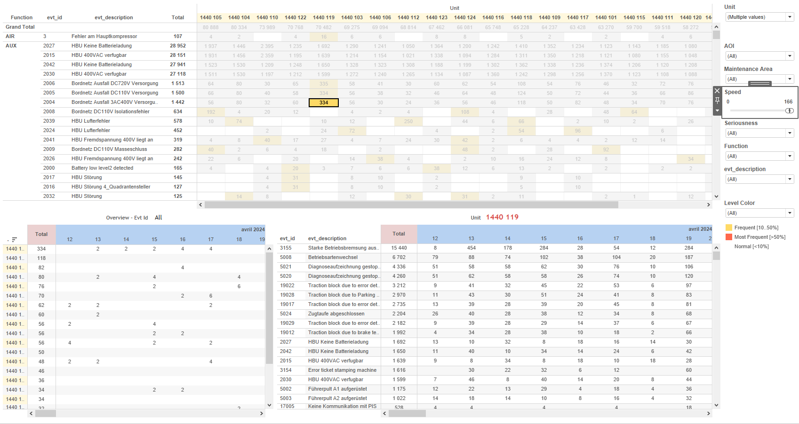
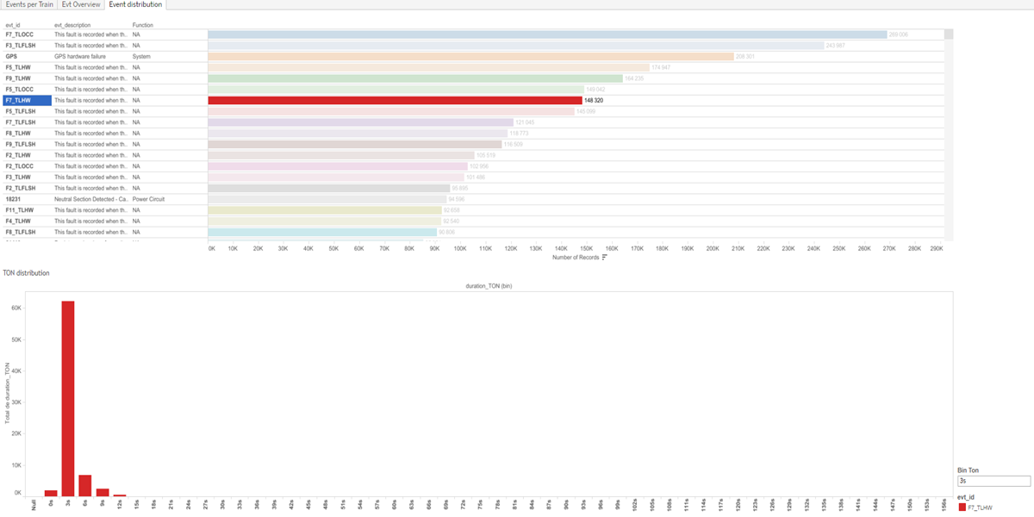
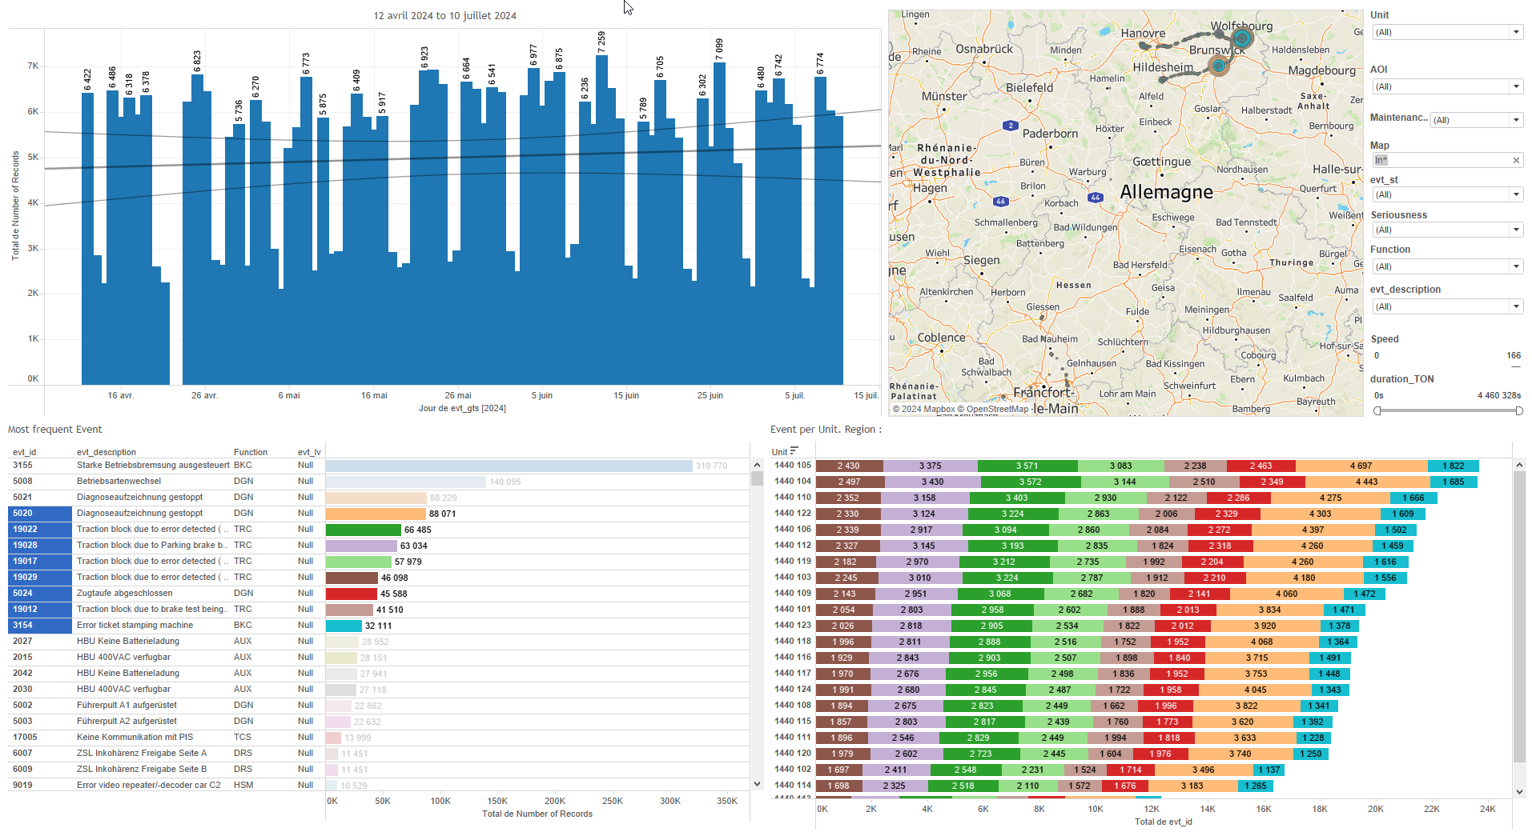
DATA VISUALIZATION REPORT SHEET
HealthHub
Evt_7days
Standard
Event Analysis
Represented By
evt_id Number of Records evt_lv aoi Speed Maintenance Area duration_TON Function evt_description evt_spd
GENERAL DESCRIPTION
The report provides a comprehensive overview of interesting features related to train events and fleet performance. It includes visualizations for event distribution, event records per train, and key metrics for fleet performance. The data is categorized by various parameters such as function, speed, unit, and GPS coordinates, allowing for detailed exploration and analysis.
MAIN CHARACTERISTICS | Description
Project | Any project
Domain | Event,Exploration
Type of report | Data Exploration - Train Event Data with Contextual Variables
Report's Objective | Provide a comprehensive analysis of event data by visualizing the distribution of duration_TON and categorizing records by function. Enable detailed exploration of event records per train, including their distribution over time, event types, and GPS locations. Facilitate an in-depth analysis of fleet performance by displaying key metrics and frequent occurrences based on speed, unit, and event data.

Slide 2
Constitution du rapport 1/3
Event distribution Dashboard
The 'Event distribution' dashboard provides a comprehensive analysis of event data by visualizing the distribution of duration_TON and categorizing records by function. It allows for detailed exploration of TON distribution and the number of records per function, facilitating a deeper understanding of event characteristics and trends.
Position | Exemple de question | Description
bottom | What is the distribution of TON based on various parameters and conditions? | This plot visualizes the distribution of duration_TON (bin) against duration_TON, categorized by evt_id.
top | What is the function and number of records associated with each event ID in the dataset? | This table displays the number of records categorized by function. Each cell is filled based on the event ID, providing a clear view of the distribution of records across different functions.
Principaux Filtres/Paramètres
Filtrage par | Description

Slide 3
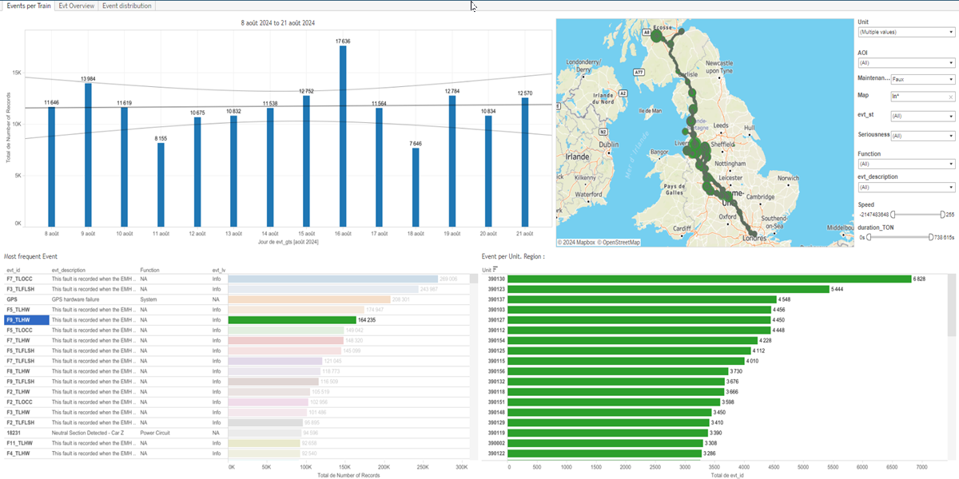
Constitution du rapport 2/3
Events per Train Dashboard
The 'Events per Train' dashboard provides an overview of event records per train, including their distribution over time, event types, and GPS locations. It enables detailed data exploration through various plots, allowing users to filter and interact with the data to identify trends and anomalies.
Position | Exemple de question | Description
top left | What are the events per train for each day as represented by speed and area of interest? | This plot displays the number of records over time. The x-axis represents the datetime of events (evt_gts), and the y-axis shows the number of records.
bottom left | What is the most frequent event in the dataset? | This visualization shows the Number of Records on the x-axis and evt_lv on the y-axis. The cells are filled based on evt_id.
bottom right | What is the distribution of events per unit in the specified region? | This visualization shows the distribution of events per train unit. The x-axis represents the event IDs (evt_id), and the y-axis represents the units (Unit). Each cell is colored and valued based on the event ID.
top right | What are the GPS coordinates and IDs of events plotted on a Circle chart? | A visualization showing the GPS longitude and latitude of events, with event IDs used for color and size.
Principaux Filtres/Paramètres
Filtrage par | Description
Speed | Filtering by speed
AOI | Filtering all or part of the project's 'AOI' (Area Of Interest)
evt_lv | Filtering the severity of events
Maintenance Area | Filtering maintenance-related depot areas

Slide 4
Constitution du rapport 3/3
Evt Overview Dashboard
The 'Evt Overview' dashboard provides a comprehensive view of fleet performance by displaying key metrics and frequent occurrences based on speed, unit, and event data. It allows users to explore detailed data through color-coded visualizations and interactions between graphs, facilitating an in-depth analysis of event descriptions and timestamps.
Position | Exemple de question | Description
top | What are the key metrics and frequent occurrences in the fleet's performance based on speed, unit, and event data? | This visualization shows the total count of events by unit, with color coding indicating the frequency of records. The y-axis represents the total count, and the fill axis provides color coding based on frequency levels.
bottom left | What is the speed of events over time? | This plot displays the number of records over time categorized by unit. Each cell is color-coded based on the unit.
bottom right | What is the relationship between event descriptions and timestamps in the dataset? | This plot visualizes the event descriptions over time, with the number of records displayed as text. The x-axis represents the event timestamps (evt_gts), and the y-axis represents the event descriptions (evt_description).
Principaux Filtres/Paramètres
Filtrage par | Description
evt_lv | Filtering the severity of events
aoi | Filtering all or part of the project's 'AOI' (Area Of Interest)
Speed | Filtering by speed

Slide 5
Liste des variables
GENERAL DESCRIPTION
La liste des variables ci-dessous est necessaire pour la constitution du rapport. Pour le projet [Projet] leur equivalence doit être fournie avec la plage de Valeur associée en cas de demande de rapport.
Variable | Description
Function | This variable represents a function or operation related to train events. It is used in various dashboards for monitoring and analysis.
Map | This variable represents the map used to visualize train event locations. It is used in various dashboards for operational insights.
Unit | This variable identifies specific parts of a train. It is used across multiple dashboards for event and operational data analysis.
aoi | AOI represents the area of interest and is used to identify technical areas. It is recorded as context data for events.
duration_TON | Duration TON measures the time a train spends in a specific operational state. It is recorded as continuous operational data.
evt_description | This variable describes the type of event that occurred. It is used in various dashboards for event tracking and analysis.
evt_gps_lat | This variable records the latitude of the train's GPS position during events. It helps in mapping the train's location.
evt_gps_lon | Longitude data from the GPS recorded during events. Used for location mapping in various dashboards.
evt_gts | This variable records the timestamp of an event occurrence. It is used across multiple dashboards for tracking event timelines.
evt_id | This variable identifies specific events related to train operations. It is used across multiple dashboards to filter and plot event data.
evt_lv | This variable measures the seriousness of an event. It is recorded as context data.
NOTE
Les illustrations fournissent un aperçu des représentations graphiques et ne préjugent pas des données pouvant être contenues dans le rapport. En effet, les données peuvent évoluer au cours du projet et dépendent entièrement de celui-ci.
Toute reproduction ou distribution non autorisée de ce rapport est interdite. Les informations contenues dans ce document sont confidentielles et destinées uniquement aux parties mentionnées. L'utilisation ou la divulgation non autorisée de ces informations est passible de poursuites judiciaires. Les représentations graphiques sont fournies à titre indicatif et ne sauraient engager la responsabilité de l'émetteur quant à l'exhaustivité ou l'exactitude des données présentées. Les données sont sujettes à des modifications au fil du projet et doivent être interprétées dans ce contexte.

