Slide 1
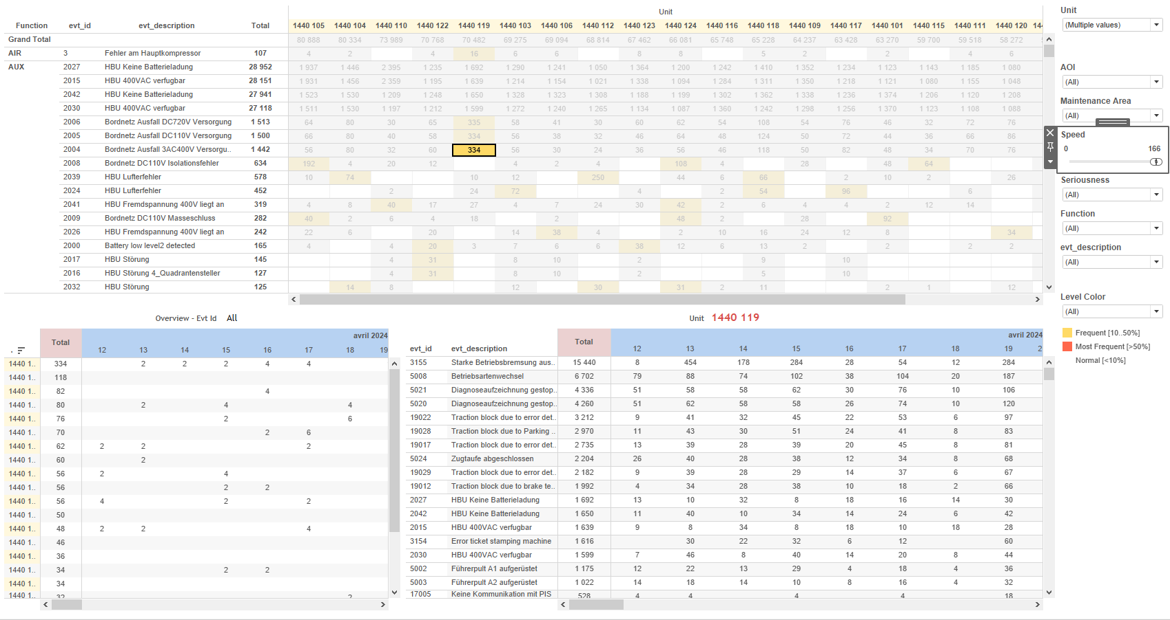
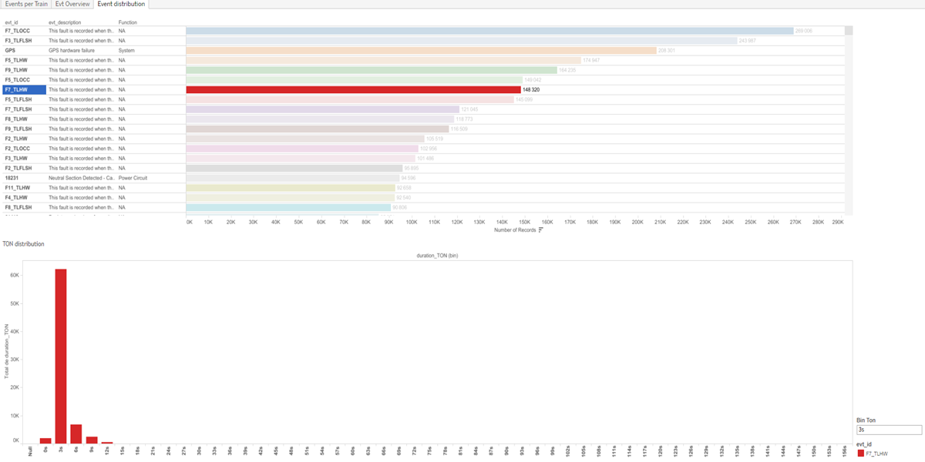
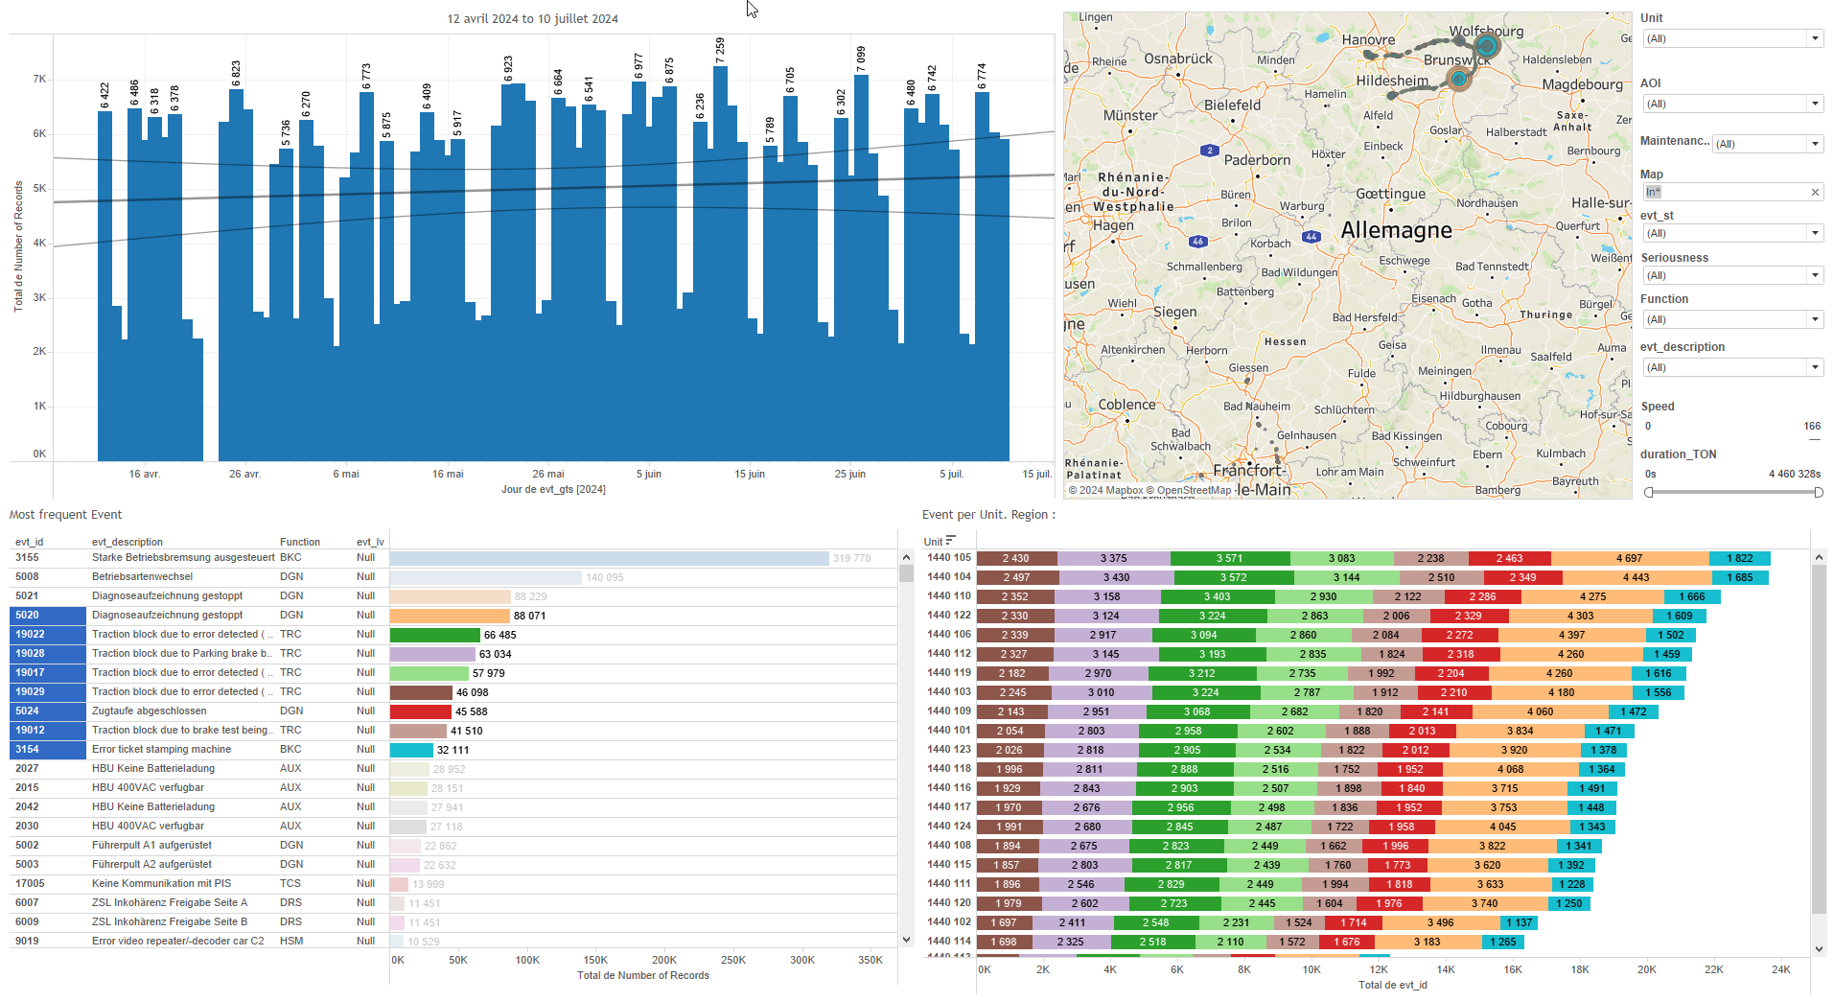
DATA VISUALIZATION REPORT SHEET
HealthHub
Evt_90days
Standard
Event Analysis
Represented By
evt_id evt_lv Number of Records aoi Speed evt_description Maintenance Area duration_TON Function evt_spd
GENERAL DESCRIPTION
This report provides a comprehensive overview of event data related to train equipment. It includes various visualizations such as bar charts, tables, and GPS maps to facilitate interaction between different data points, identify patterns and trends, and understand the relationships between different event metrics.
MAIN CHARACTERISTICS | Description
Project | Any project
Domain | Event,Exploration
Type of report | Data Exploration - Train Event Data with Contextual Variables
Report's Objective | Provide an in-depth analysis of event durations and functions. Facilitate detailed data exploration and understanding of the provided variables and formulas. Offer a comprehensive overview of train events by day, event type, unit, and GPS location. Enable users to filter data by unit and event type and explore relationships between different event metrics.

Slide 2
Constitution du rapport 1/3
Event distribution Dashboard
The 'Event distribution' dashboard provides an in-depth analysis of event durations and functions by displaying the distribution of duration_TON and categorizing functions by the number of records. It allows users to explore data through interactive tables, with color fills representing evt_id values, facilitating detailed data exploration and understanding of the provided variables and formulas.
Position | Exemple de question | Description
bottom | What is the distribution of TON based on the provided variables and formulas? | This visualization presents the distribution of duration_TON (bin) against duration_TON. The color fill represents evt_id.
top | What is the function of the records based on the given variables? | This table displays the Function categorized by the Number of Records. Each cell is filled with the evt_id values.
Principaux Filtres/Paramètres
Filtrage par | Description

Slide 3
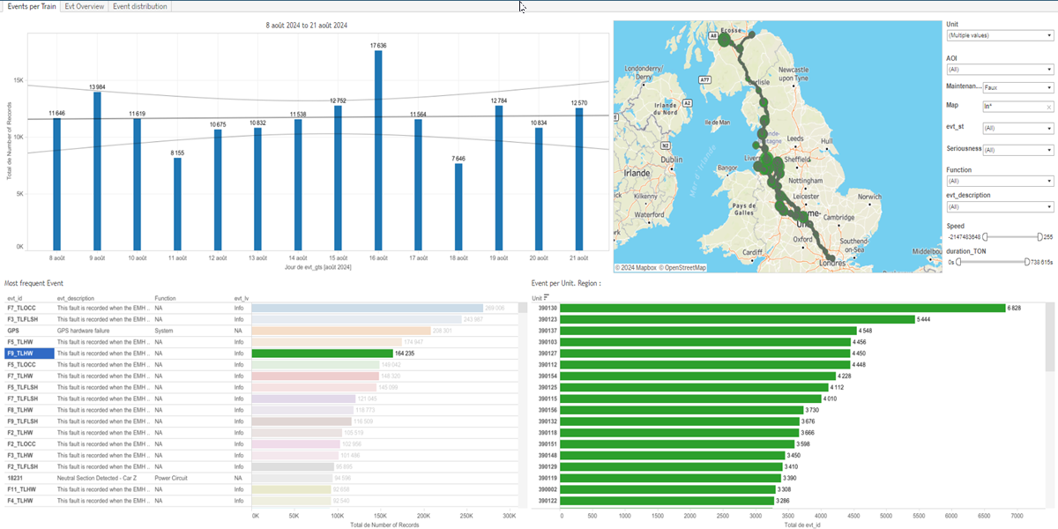
Constitution du rapport 2/3
Events per Train Dashboard
The 'Events per Train' dashboard provides a comprehensive overview of train events by day, event type, unit, and GPS location. It allows for detailed exploration through various visualizations, including bar charts, tables, and GPS maps, facilitating interaction between different data points to identify patterns and trends.
Position | Exemple de question | Description
top left | What are the events per train per day represented in a bar chart? | This visualization shows the number of records (Number of Records) per event timestamp (evt_gts).
bottom left | What is the most frequent event and its seriousness in the dataset? | A table visualization showing the Number of Records against evt_lv with evt_id used for cell color and value.
bottom right | What are the events per unit in the region? | This plot visualizes the events per train unit using categorical data for both axes. The 'evt_id' is represented on the x-axis, and 'Unit' is represented on the y-axis. Each cell is filled based on the 'evt_id' value.
top right | What are the events per train based on GPS data? | A visualization of GPS coordinates with evt_gps_lon on the x-axis and evt_gps_lat on the y-axis. The color and size of each circle represent evt_id.
Principaux Filtres/Paramètres
Filtrage par | Description
Speed | Filtering by speed
aoi | Filtering all or part of the project's 'AOI' (Area Of Interest)
evt_lv | Filtering the severity of events
Maintenance Area | Filtering maintenance-related depot areas

Slide 4
Constitution du rapport 3/3
Evt Overview Dashboard
The 'Evt Overview' dashboard provides a comprehensive view of event data, including frequency distribution across units, speed distribution over time, and detailed event descriptions with timestamps. It enables users to filter data by unit and event type, and interactively explore the relationships between different event metrics.
Position | Exemple de question | Description
top | What is the most frequent event level and its distribution across different units and areas of interest? | This visualization displays a bar chart where the x-axis represents 'Unit' and the y-axis represents the 'Total' count of events. The fill color of each cell is determined by the 'Level Color', categorized based on the frequency of records.
bottom left | What is the speed distribution over time? | This plot visualizes the 'Unit' data categorized by 'evt_gts'. The 'Number of Records' is displayed as the text axis.
bottom right | What are the details of the events based on their descriptions and timestamps? | This plot visualizes event descriptions over time, using the number of records as a metric.
Principaux Filtres/Paramètres
Filtrage par | Description
evt_lv | Filtering the severity of events
aoi | Filtering all or part of the project's 'AOI' (Area Of Interest)
Speed | Filtering by speed

Slide 5
Liste des variables
GENERAL DESCRIPTION
La liste des variables ci-dessous est necessaire pour la constitution du rapport. Pour le projet [Projet] leur equivalence doit être fournie avec la plage de Valeur associée en cas de demande de rapport.
Variable | Description
Function | This variable is used to categorize train events. It is recorded as context data for various operational dashboards.
Map | This variable is used in various dashboards to represent the geographical location of events. It is a context data variable, typically used in mapping and visualization.
Unit | This variable identifies different parts of a train. It is used in various dashboards to track and analyze operational data.
aoi | This variable represents the area of interest for maintenance. It is recorded as context data for events.
duration_TON | This variable represents the duration of a train's operational state. It is recorded continuously as operational data.
evt_description | Describes the event that occurred during train operation. Useful for understanding the context of specific incidents.
evt_gps_lat | This variable records the latitude of the train's GPS position during events. It is used in various dashboards to plot locations.
evt_gps_lon | This variable represents the longitude recorded during events. It is used to plot the location on maps.
evt_gts | This variable represents the timestamp for an event in the train's operation. It is used in multiple dashboards to track event occurrences.
evt_id | This variable is used to identify specific events related to train operations. It is crucial for tracking and analyzing operational data.
evt_lv | This variable indicates the seriousness of an event. It is used across multiple dashboards to filter and plot event data.
NOTE
Les illustrations fournissent un aperçu des représentations graphiques et ne préjugent pas des données pouvant être contenues dans le rapport. En effet, les données peuvent évoluer au cours du projet et dépendent entièrement de celui-ci.
Toute reproduction ou distribution non autorisée de ce rapport est interdite. Les informations contenues dans ce document sont confidentielles et destinées uniquement aux parties mentionnées. L'utilisation ou la divulgation non autorisée de ces informations est passible de poursuites judiciaires. Les représentations graphiques sont fournies à titre indicatif et ne sauraient engager la responsabilité de l'émetteur quant à l'exhaustivité ou l'exactitude des données présentées. Les données sont sujettes à des modifications au fil du projet et doivent être interprétées dans ce contexte.

